Slide 1
ONLINE SHOPPERS PURCHASING INTENTION
IE 7275: DATA MINING IN ENGINEERING
Prof. Srinivasan Radhakrishnan
(GROUP - 4)
Members: MALAVIKA KRISHNAN
DHRUV BHALALA

Slide 2
INTRODUCTION
Online e-commerce applications are becoming a primary vehicle for people to find, compare and ultimately purchase products.
Fundamental concept is to understand, characterize and model user long-term online purchasing intent for a long term e-commerce service.
Analysis and buildup over time is important because individuals spend large amount of time and resources on online shopping.

Slide 3
PROJECT OBJECTIVE
Building machine learning models to identify user behaviour patterns and determine the likelihood of purchase based on the given features for online purchase of customer data.

Slide 4
DATA DICTIONARY
Data Source: The data is collected from UCI Machine Learning Repository - maintained by Center of MAchine Learning and Intelligent Systems at the UCI.
Data Description:
Data set consists of 12330 number of records and 18 attributes.
It contains 10 numerical and 8 categorical attributes.
Data set was formed for different users in a 1-year long period to avoid specific tendencies to a special day, campaign or period.

Slide 5
Variable Description:
Page type and traffic characteristics
Administrative | Page used by account users and administrative users to add, edit, manage payment gateways of user accounts. | Integer
Administrative Duration | Total time spent on administrative page in user’s session. | Continuous/ Float
Informational | Page showing general user informations. | Integer
Informational Duration | Total time spent on informational page in user’s session. | Continuous/ Float
Product Related | Page type visited showing product related information | Integer
Product Related Duration | Total time spent on Product related page in user’s session. | Continuous/ Float

Slide 6
2.Google Analytics Metrics
Bounce Rates | Percentage of users who enter from a page and then leave. | Continuous/ Float
Exit Rates | Feature for a specific web page is calculated as for all page views to that page, the percentage of users leaving the site. | Continuous/ Float
Page Values | The average value for a page that the user visited before completing an e-commerce transaction. | Continuous/ Float
3. Time Characteristics
Special Day | Indicates the closeness of a site visiting time to a specific special day. | Continuous/ Float
Month | Month of the year. | Integer
Weekend | Boolean value indicating whether the date of visit is weekend/weekday. | Boolean/Binary

Slide 7
4.User Interface Systems
Operating System | Operating system(s) used by the user in the session. | Integer
Browser | Bowser(s) used by users in the session. | Integer
5. Geographic Characteristics
6. Target Variable
Region | Value indicating the region of the user. | Integer
Traffic type | Value indicating the type of user activity. | Integer
Visitor Type | Value indicating type of visitor whether returning, new, or other types. | Integer
Revenue | Value returns true if purchase occurred, else false. | Boolean/ Binary

Slide 8
EXPLORATORY DATA ANALYSIS
Our response variable is Revenue which is a binary variable.
Out of all sessions, around 15% sessions were positive cases ending with shopping.
Moreover, around three fourth out of all sessions’ revenue were generated on weekdays.

Slide 9
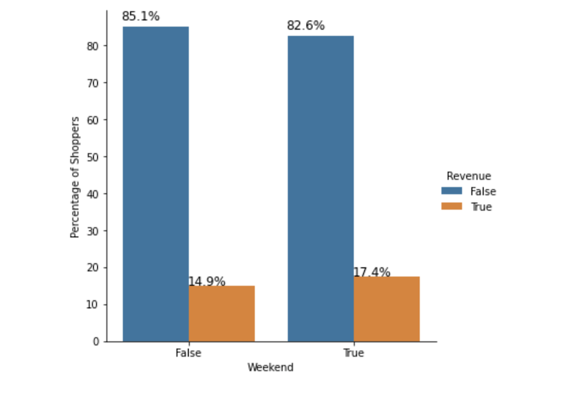
BAR PLOTS
Distribution of the percentage of customers who have shopped both on the weekdays and weekends.
The trend shows that customers who purchased during the weekdays contributed to a higher revenue than the customers who purchased during the weekend.
Fig 1: Percentage of shoppers on weekend/weekdays

Slide 10
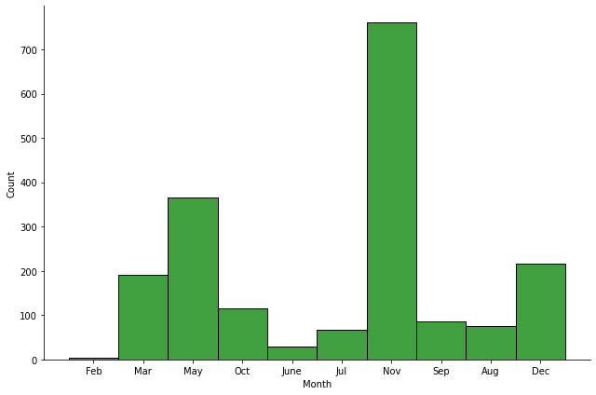
BAR PLOTS - Contd...
This graph depicts that the highest shopping sessions occurred in the month of November.
In May month, it is almost half of the graph's peak value.
In January, February and April almost no shopping sessions occurred.
Fig 2: Bar plot of months when shopping occured

Slide 11
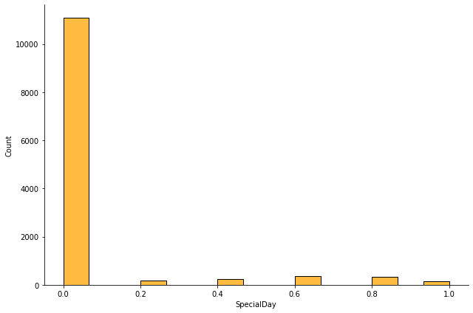
BAR PLOTS - Contd...
We have six categories in Special Day feature and they are in numerical values of 0.0, 0.2, 0.4, 0.6, 0.8, 1.0.
It can be seen from the bar plot that almost 50% of the records have value of zero.
This feature might not add any value in our model building.
Fig 3: Bar plot of SpecialDay

Slide 12
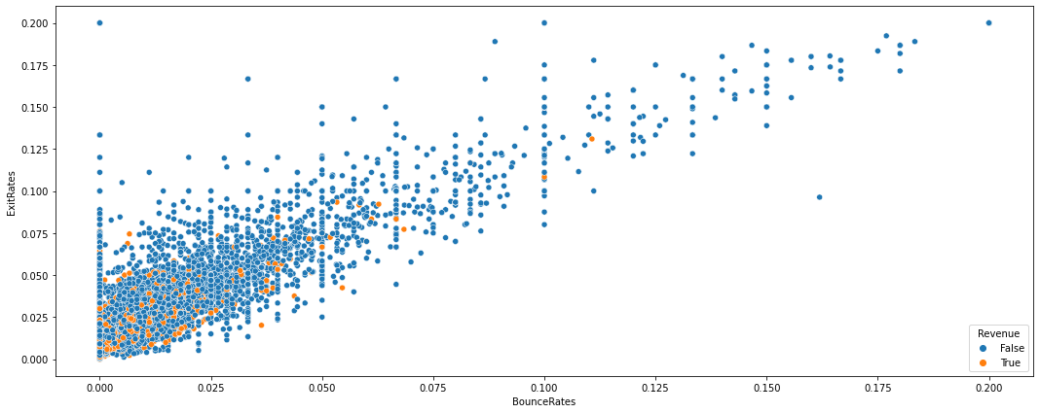
SCATTER PLOTS
Fig 4: Scatter plot between Bounce Rates and Exit Rates
Good linear relationship can be observed in the plot.
It also shows that revenue is mostly false and the true value for revenue is concentrated between 0-1. Moreover, it can be seen that higher the exit rates and bounce rates, higher the chances of revenue being false

Slide 13
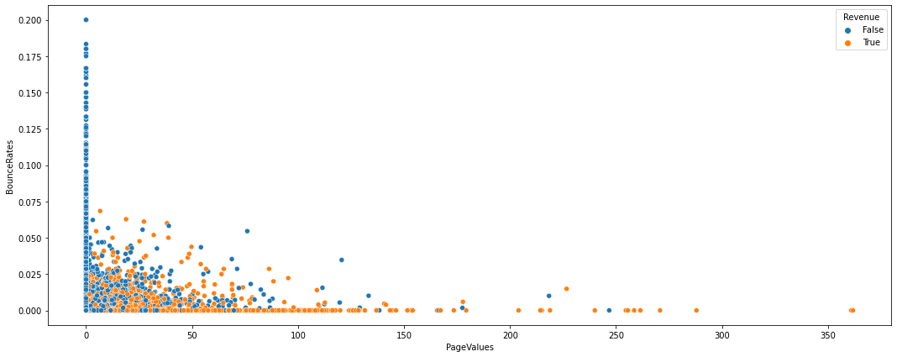
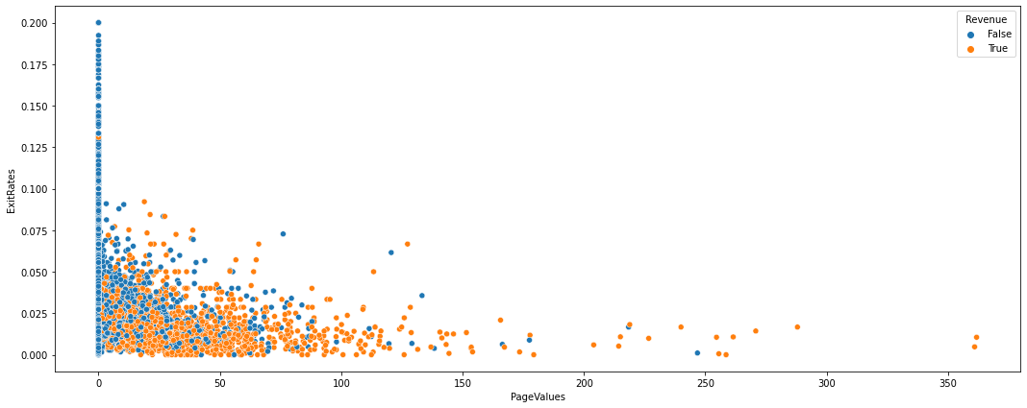
SCATTER PLOTS - Contd...
Fig 4: Scatter plot between Bounce Rates and Page Values
Fig 4: Scatter plot between Exit Rates and Page Values
The plot shows a non-linear relationship.
Concentrations of Bounce rates and Page values in certain areas.
Seems that all page values towards the extremes translate into revenue equals true and all the Bounce rates translate into revenue equals false.
This plot also shows a similar trend of strong nonlinear relationship.
If exit rates are between 0-1 and page values between 0-max, there is a high chance that revenue could be equal to true.

Slide 14
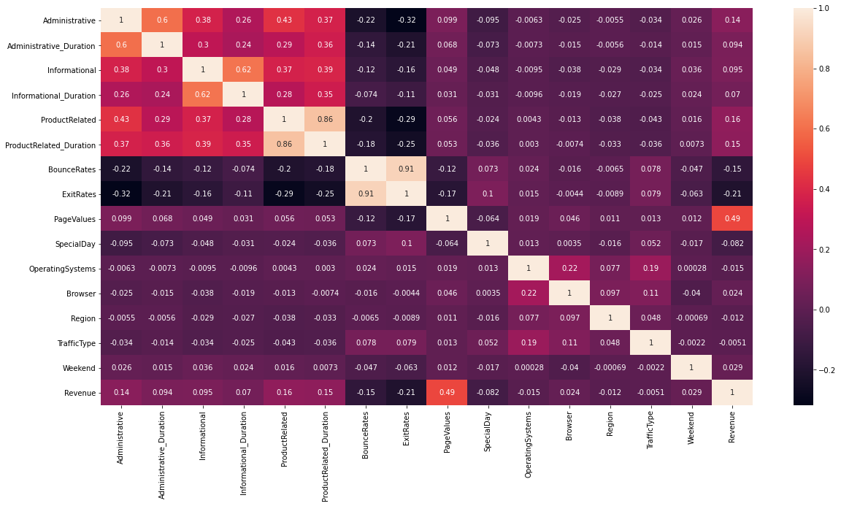
HEAT MAP
It can be seen from the heat map that ProductRelated and ProductRelated_Duration attributes are highly correlated.
So are the other two variables- BounceRates and ExitRates.
So we have dropped ProductRelated_Duration and ExitRates.
Fig 6: Heat Map to show correlation between variables

Slide 15
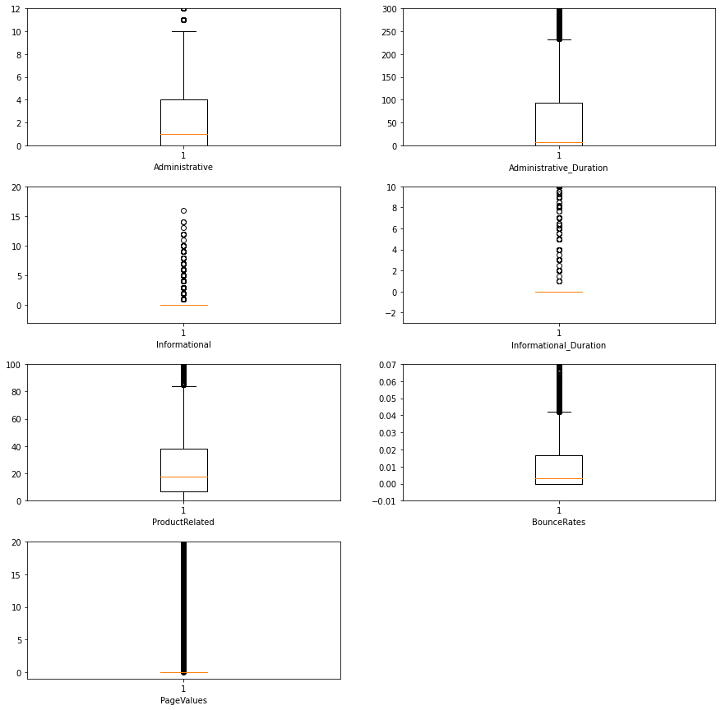
BOX PLOTS
From these plots, we can see that Administrative, Administrative_Duration, ProductRelated and BounceRates have left skewed distributions.
In all of this, we have a bunch of outliers, so we control the limit of the box plots.
` Fig 7: Box plots

Slide 16
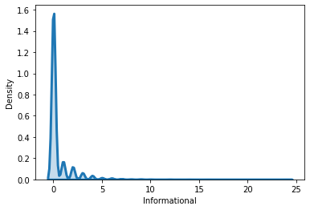
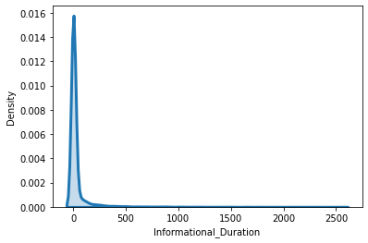
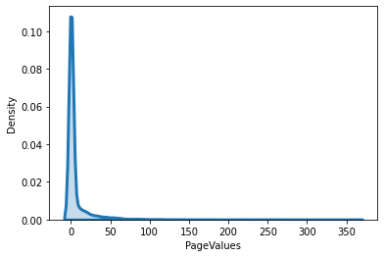
DENSITY PLOTS
In Informational, Informational_Duration and Pagevalues attributes, we cannot be able to see distribution from box plot.
Thus, we have density plot for all. They all have major values towards zero.
Fig 8: Density Plots

Slide 17
DATA PREPROCESSING
MISSING VALUE IMPUTATION
ONE HOT ENCODING
PCA
1.
3.
5.
2.
4.
OUTLIER DETECTION
FEATURE SCALING

Slide 18
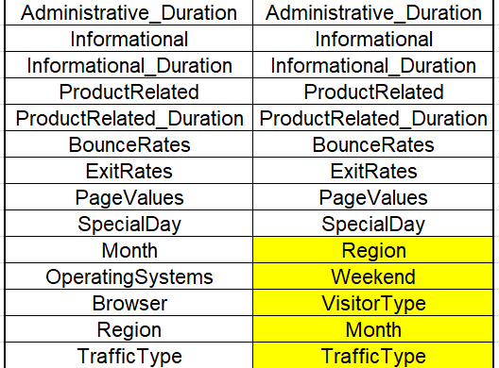
SUBSETTING PREDICTORS
ProductRelated_Duration & ExitRates are dropped predictors.
After kNN method and Logistic regression, we encountered that after the first 8 features, other features were not adding much value towards the accuracy part.

Slide 19
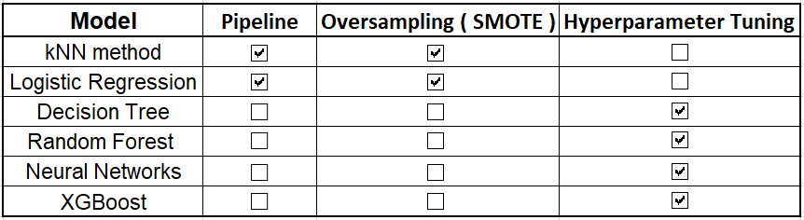
MODEL IMPLEMENTATION
Class of Interest ( Revenue ) is around 15 %.

Slide 20
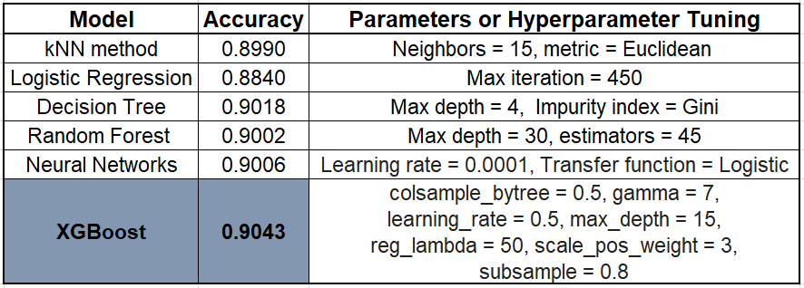
MODEL PERFORMANCE ANALYSIS
With all 15 predictors

Slide 21
CHALLENGES AND LIMITATIONS
The project was done based on the data having features belonging to only 12,330 online sessions.
The findings may not be applicable for different countries because of socio-cultural differences and may not be generalized for all e-commerce sites.
Dataset focuses on short-term user activity on whether a given user session will result in a purchase.
Cross-platform analysis of how user purchase varies over time is missing.
Contrasting the population of purchasing users with the population of non- purchasing users and understanding how the customer behavior changes over time from the norm was not possible in this scenario.

Slide 22
FINDINGS & RECOMMENDATIONS
From the EDA, the number of purchase in November and May is greater compared to others. We can therefore leverage this and obtain better turnouts by offering gift coupons , offers and special discounts to customers.
Bounce rates and exit rates depicts negative influence on customers behaviour. So we must be cautious on users with high exit rates or bounce rates.

Slide 23
REFERENCES
https://archive.ics.uci.edu/ml/datasets/Online+Shoppers+Purchasing+Intention+Dataset

Slide 24
THANK YOU!

