Slide 1
DIABETES HEALTH INDICATOR
MALAVIKA T

Slide 2
Introduction
As one of the most prevalent chronic diseases all over the world, diabetes, especially type 2 diabetes, affects the health of millions of people and puts an enormous financial burden on the economy.
We aimed to develop predictive models to identify risk factors for type 2 diabetes, which could help facilitate early diagnosis and intervention and reduce medical costs.

Slide 3
Data Overview
The dataset contains 254000 observations and 22 columns.
Class 1(0):- no diabetes(213703)
Class 2(1)- diabetes(39977)
The data used in this project has been downloaded from Kaggle (https://www.kaggle.com/alexteboul/diabetes-health-indicators-dataset).
Exploratory Data Analysis
What are the risk factors most predictive of diabetes risk?
What is the age of infection with diabetes?
What causes most genders to have diabetes?
Modeling :
Classify the people who have diabetes, prediabetes, or don't have diabetes.
The most important factors that refer to prediabetes?
The main factors that affect diabetes?

Slide 4
Methodology
The classification algorithms that has been used in this project:
Logistic Regression:
Logistic Regression (Random over Sampler)
Logistic Regression (Random under Sampler)
Logistic Regression (class weight : balanced)
Logistic Regression (SMOTE)
K-Neatest Neighbors
Decision Tree
Naive Bayes

Slide 5
Implementation
TOOLS
Python and Jupyter Notebook
Pandas and data prep for data manipulation
Seaborn and Plotly for visualizations
Sklearn for ML algorithms
PIPELINE
Prepare the data by loading, dividing and processing it
Model evaluation and training compute performance measure and train different model
Plot matrices for model evaluation

Slide 6
Results
The model compared the accuracy of the different algorithms to figure out what’s the best for the prediction of diabetes
NAIVE BAYES:-79%
DECISION TREE:-84%
LOGISTIC REGRESSION:-72%
K NEAREST NEIGHBOUR:-82%

Slide 7
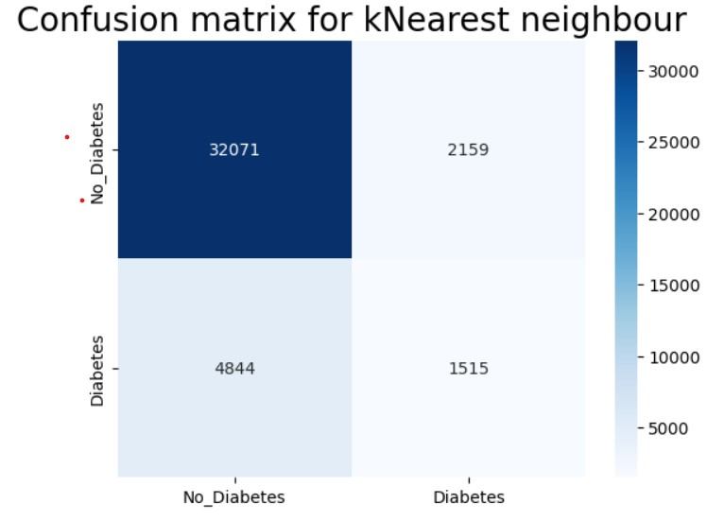
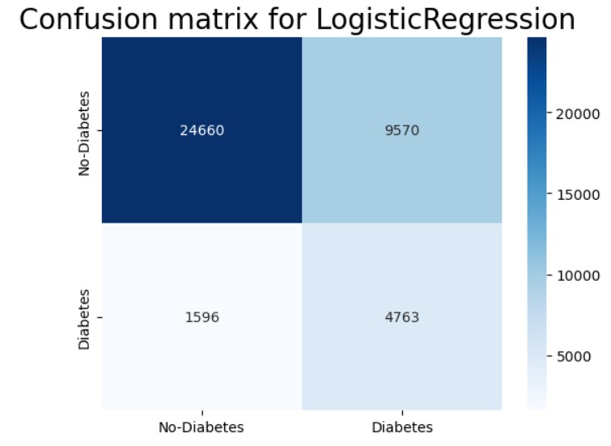
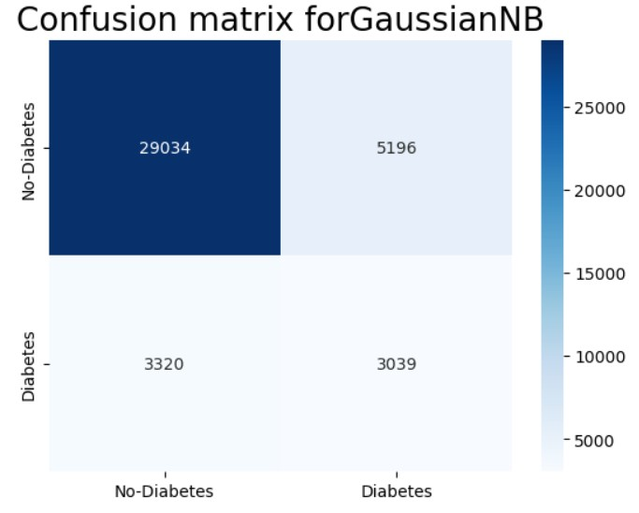
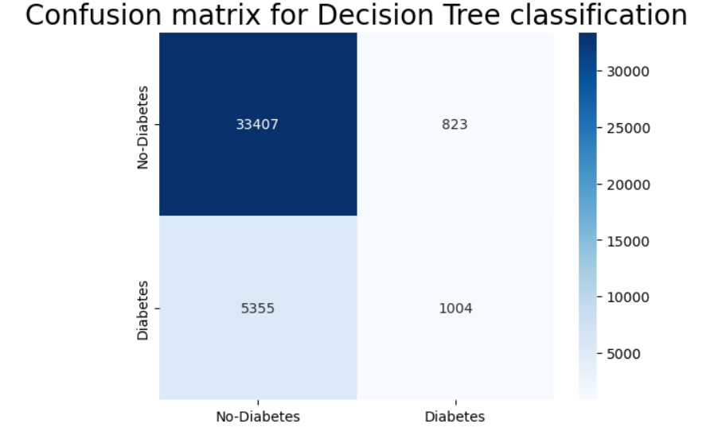

Slide 8
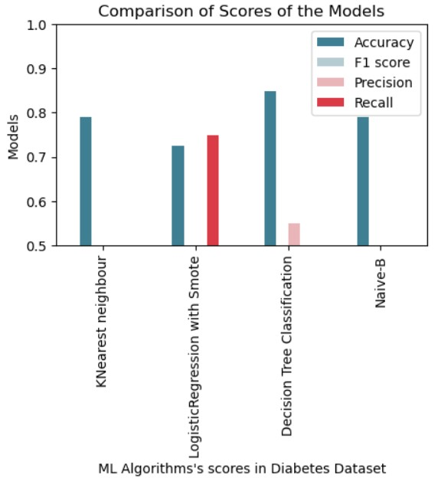
Final result

Slide 9
Conclusion
The model compared the accuracy of the different algorithms and found that the decision tree algorithm is best for predicting diabetes
This model helps public health officials and the community to absorb and predict the risks of diabetes and further risks
Limitations:- Feature Limitations, Ethical and Privacy Concerns, External Factors
Future work:- can implement advanced algorithms for better accuracy

Slide 10
References
Kaggle
Github
Sklearn, numpy, matplotlib, pandas, seaborn documentation
https://www.cdc.gov/pcd/issues/2019/19_0109.htm
https://www.cdc.gov/brfss/annual_data/2015/pdf/codebook15_llcp.pdf

Slide 11
Thank you

