Slide 1
IDS PROJECT - 2018
LIFE EXPECTANCY DATA
By Varun, Malavikka, Richa

Slide 2


INTRODUCTION
Data Science helps one to gain new insights from large data sets by asking right questions, manipulating data and visualising one’s findings in a way that is presentable and easy to understand.
In this project, we hope to understand how to work with large data sets and analyse them.
We are using Python to analyse data. Here, data manipulation and visualisation are done with the libraries pandas and matplotlib.

Slide 3
OUR DATASET
The data set that we have chosen is of life expectancy from the years 2000-2015 over different countries. The columns of the data set specifies the GDP, population of these countries, general data about the population such as BMI, as well as different causes of death such as Hepatitis B, Polio etc.
These are the parameters that are used to infer data about life expectancy. Therefore, with the analysis drawn from this dataset, we can see the changes in different categories and countries over the 15 year time period.

Slide 4
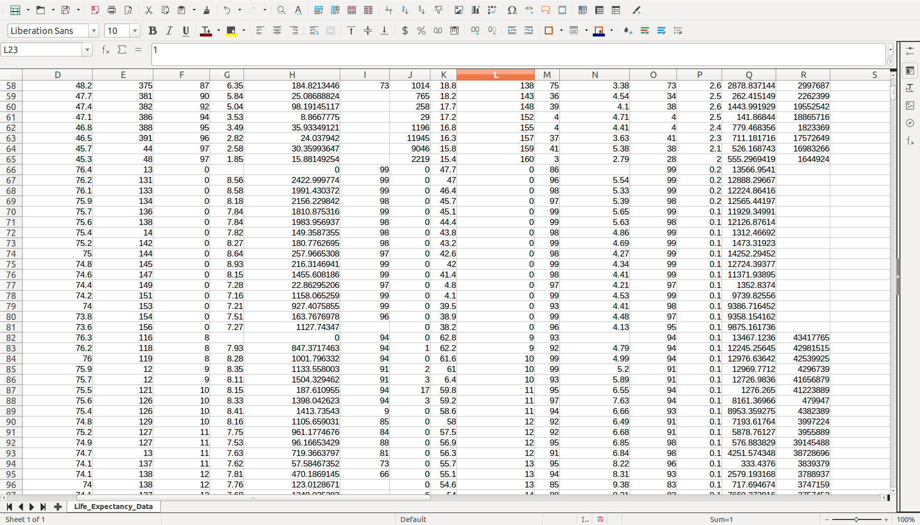
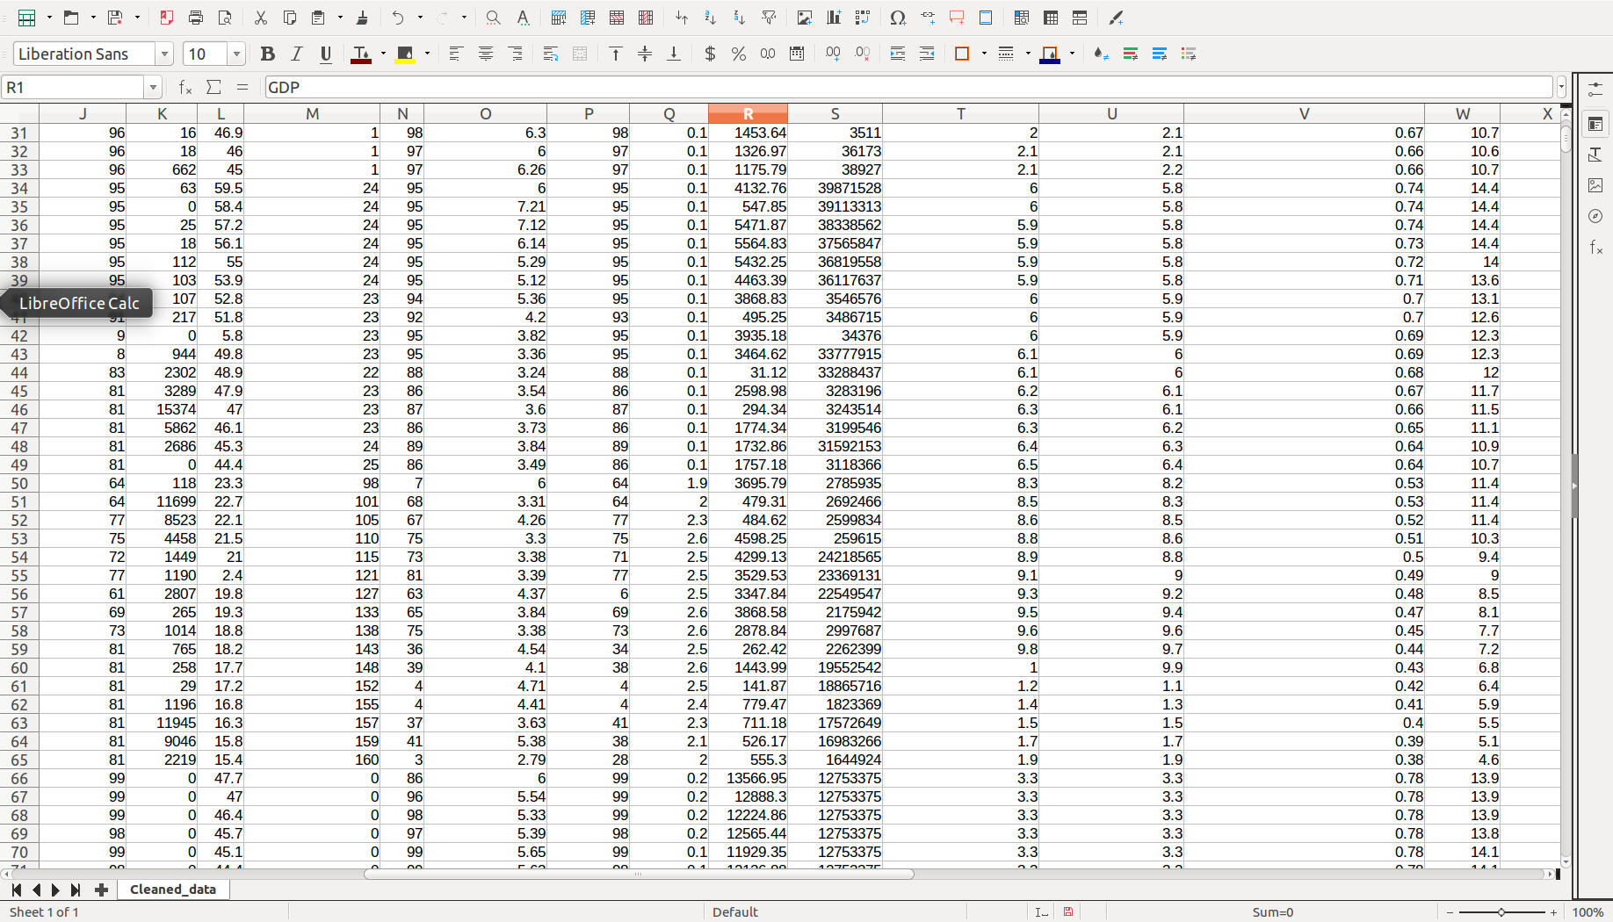
DATA CLEANING
In order to clean our dataset with 22 columns, we began with analyzing each column to see if they contained any missing values.
Categorical data- missing data was filled with the previous value
Numerical data- missing data was filled with the mean of the column

Slide 5
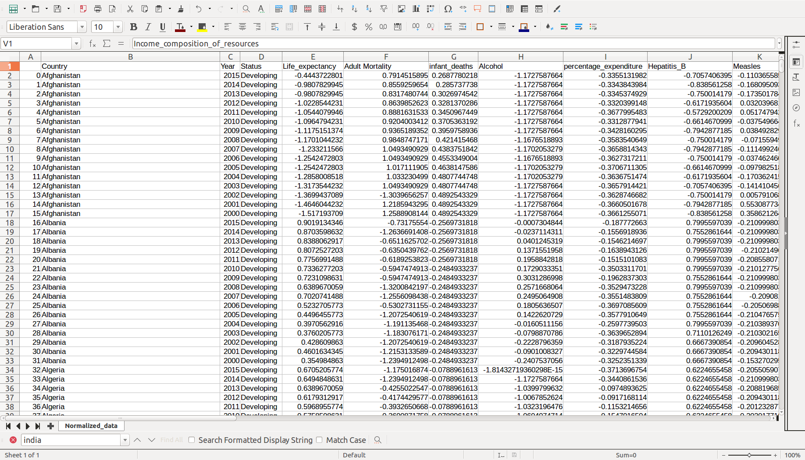
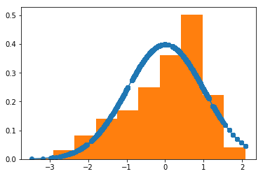
DATA NORMALISATION
The goal of normalization is to change the values of numeric columns in the dataset to use a common scale, without distorting differences in the ranges of values or losing information.
We have achieved this by calculating the z-scores of each numeric column
Life Expectancy
pdf
Z-score

Slide 6
DATA VISUALISATION

Slide 7
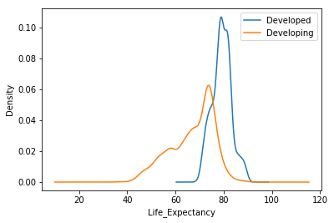
This is a graph of the life expectancy versus the density function of the the same across all the developed and developing countries.
From this graph, we understand the following:
1. The lowest value for a developed country is 60 while for a developing country it is less than 20.
2. Most of the population of a developed country has a life expectancy of around 70-90 while for a developing country it is in the range of around 43-80.
Hence, we conclude that A developed country has a higher Life Expectancy than a developing country.

Slide 8
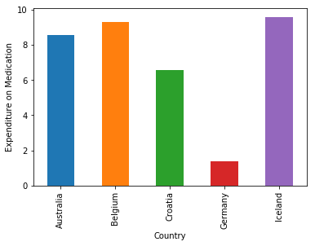
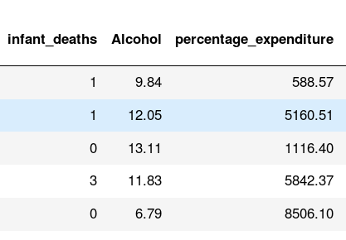
This bar graph depicts the percentage expenditure on medication in 5 different countries in the year 2004.
From the graph, we infer the following
Iceland which had a high percentage on expenditure had no infant death that particular year.
While Germany had the least percentage and hence the most number of infant deaths.
Hence, we conclude that greater the percentage of expenditure, lesser the infant death rate.

Slide 9
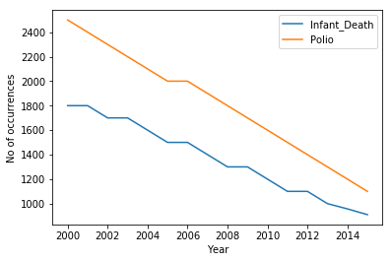
The graph shows the Infant Deaths and Polio decrease over the years 2000-2015.
We can infer that-
Due the the reduction in Polio over the years, Infant_Deaths has also reduced. Polio could have been one of the main causes of Infant Death.
Not all Polio cases could lead to an Infant_Death. Since number of cases of Polio are much higher than Infant_Death for any particular year.
Hence, we conclude that Through the years, as the polio rates decreased the infant death rate also decreased. Also, polio is not the only reason for infant death.

Slide 10
Hypothesis Test
H0: The number of reported cases of measles is less than 2 per 1000 people
H1: The number of reported cases of measles is greater than or equal to 2 per 1000 people
We take p value threshold to be p<0.5 And as per screenshot, For a value of 2 we get the p-value as 0.4

Slide 11
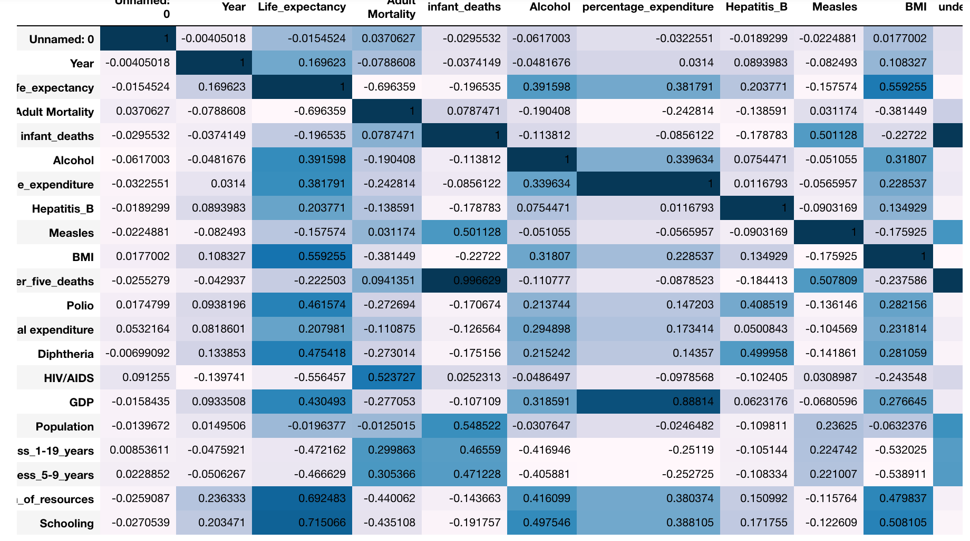
Correlation
infant_deaths and under_five_deaths highly correlated: 0.996629
Population and Income Composition of Resource have less correlation:
-0.00795144

