Slide 1
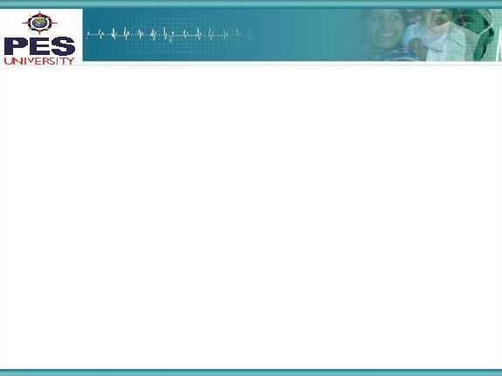



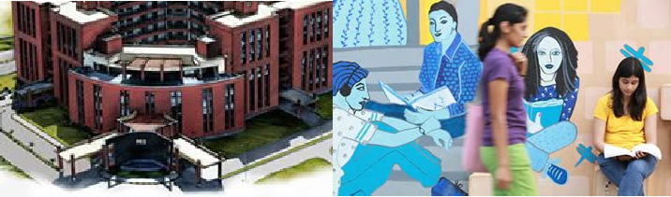

Project Presentation
(Final - ESA)
Project Title
: Neural Machine Translation with Attention Mechanism
Project Team : Malavikka Rajmohan PES1201700794
Sirisha Lanka PES1201700294
Navneetha Rajan PES1201700161
1

Slide 2
Project Abstract and Scope
Problem Statement: Neural Machine translator which translates Hindi sentences to English sentences.
Deep learning techniques implemented: Sequence to Sequence Translator, Auto Encoder, GRU and Attention Mechanism.
Reason for this problem: Language translation is a key part of communication, Hindi and English are most commonly used Indian languages, Machine translation has a great significance and is beneficial in commercial sectors.
Unique Solution: Consists of sequence to sequence translation with attention mechanism. This makes it context sensitive and hence provides better results.
Existing Solutions: Word to Word Translation, Using RNN, S2S without attention mechanism.
2
Notes:
Wanted to do Neural Machine Translator using sequence to sequence translation using encoding decoding. Popular. Hindi and English.
Unique -

Slide 3
Project Scope -2
Importance of the project:
The key idea behind the project is that the neural machine translator has an attention mechanism with sequence to sequence translation, which makes the solution more efficient, as it will not load the decoder with all the input but rather only the most important ones at each time step. This can be useful even for context sensitive sentences, which was not feasible using word to word translator or Recurrent Neural Networks.
3

Slide 4
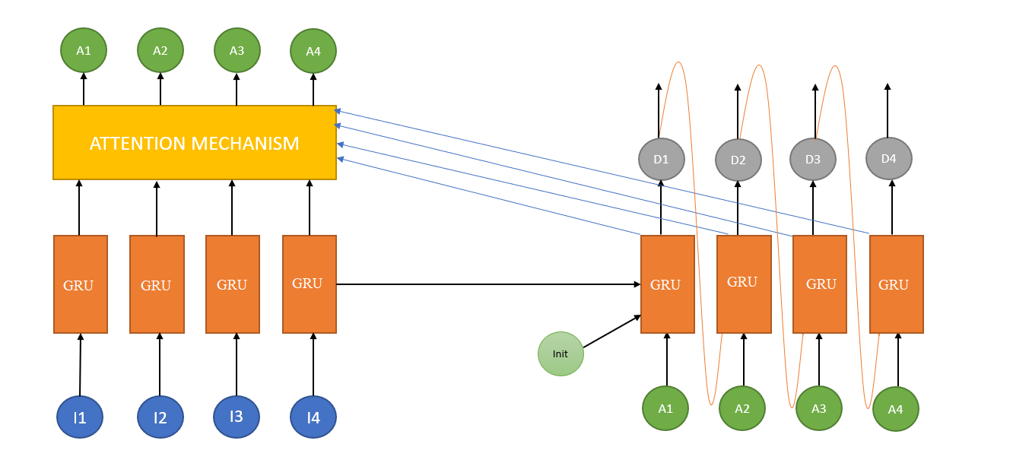
Solution Architecture
Encoder: The input was put through an encoder model which gave us the encoded input
Decoder: Decoder considers input from previous state of decoder and present input from encoder followed by Attention.
Bahdanau Attention: At time t we consider about t-1 hidden state of the decoder. Then we calculate alignment , context vectors. And then we concatenate this context with hidden state of the decoder at t-1. So before the softmax this concatenated vector goes inside the GRU.
4

Slide 5
Solution-1
Algorithm
Pre-processing:
Added a start and end token to each sentence.
Made dataset homogeneous by converting all upper-case letters to lower-case
Cleaned the sentences by removing special characters and stop words using the regular expression library
Created a word index and reverse word index by applying integer encoding for every token generated in the input language(hindi) and the target language(english) and outputted as tensors
Padded each sentence to a maximum length (30 in our case)
Training:
Passed the input through the encoder which returned encoder output and the encoder hidden state.
The encoder output, encoder hidden state and the decoder input (which is the <start> token) was passed to the decoder.
The decoder returned the predictions and the decoder hidden state.
The decoder’s hidden state was then passed back into the model and the predictions were used to calculate the loss.
Used teacher forcing - technique where the target word was passed as the next input to the decoder
The final step was to calculate the gradients and apply it to the optimizer and backpropagate.
Loss function: SparseCategoricalCrossentropy
Optimizer: Adam Optimizer

Slide 6
Solution-2
Mathematical Equations:
Input:
{x_{i} = source_{i} , y_{i} = target_{i} }^{N}_{i = 1}
Encoder:
h_{t} = GRU(h_{t-1}, x_{t})
s₀ = h_{T}
Decoder:
e_{jt} = V^{T}_{attn} tanh(U_{attn}h_{j} + W_{attn}s_{t})
alpha_{jt} = softmax(e_{jt})
c_{t} = ∑alpha_{jt} h_{t}
s_{t} = GRU(s_{t-1} , [e(y’_{t-1}),c_{t}])
l_{t} = softmax(Vs_{t} + b)
Loss function:
Sum of cross-entropy
L(theta) = ∑ L_{t}(theta)
L_{t} (theta) = -log P(y_{t} = l_{t} | y^{t-1}₁)

Slide 7
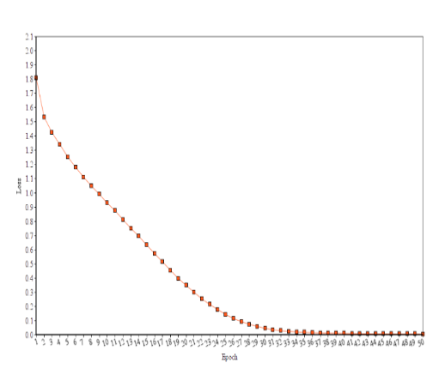
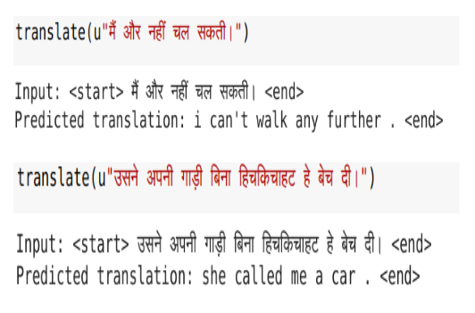
Solution-3
Training Results:
The model was trained for 50 epochs. 50 was ideal as the loss converged to 0 by the 50th epoch.
Out of 10 randomly sampled input statements, 7 were correctly translated, while 3 were wrong. This proves that the model was not overfitted.

Slide 8
Constraints, Assumptions & Dependencies
Our model works on only a very limited set of statements as the dataset is very small. Hence we are not able to capture all the features with this constraint
8

Slide 9
Future work plan
The performance of the model can be increased by increasing the training dataset and using Bi-directional LSTM for better context vector.
Use the beam search strategy for decoding the test sequence instead of using the greedy approach (argmax).
One drawback of attention is that it’s time-consuming. To overcome this problem Google introduced “Transformer Model”
Use of “Luong Attention Mechanism” which performs better
9

Slide 10
References
[1] NPTEL Online course on encoder-decoder model with attention
[2] towardsdatascience.com/attn-illustrated-attention-5ec4ad276ee
[3] towardsdatascience.com/neural-machine-translation-15ecf6b0b

Slide 11
Thank You

