Slide 1

Money Growth and Inflation
0
30
P R I N C I P L E S O F
F O U R T H E D I T I O N
Notes:
For most students, the hardest concepts to grasp are the most theoretical ones in the chapter: the classical dichotomy and monetary neutrality. Most of the other material in the chapter is fairly straightforward for most students.
In the last section of the chapter – “The Costs of Inflation” – the Shoeleather cost is not difficult for students to understand, but it’s difficult for them to relate to, due to the ready availability of ATMs and internet access to bank accounts. Most students have a harder time learning about the arbitrary redistributions of wealth that arise when inflation is different from expected.
This chapter is longer than average. To get through it more quickly, you might consider skipping or moving fairly quickly through some of the easier concepts, telling students to learn them from the textbook. Such concepts might include:
some of the costs of inflation (menu costs, confusion and inconvenience)
the inflation tax
hyperinflation

Slide 2
In this chapter, look for the answers to these questions:
0
How does the money supply affect inflation and nominal interest rates?
Does the money supply affect real variables like real GDP or the real interest rate?
How is inflation like a tax?
What are the costs of inflation? How serious are they?
CHAPTER 30 MONEY GROWTH AND INFLATION

Slide 3
Introduction
0
This chapter introduces the quantity theory of money to explain one of the Ten Principles of Economics from Chapter 1:
Prices rise when the govt prints
too much money.
Most economists believe the quantity theory
is a good explanation of the long run behavior
of inflation.
CHAPTER 30 MONEY GROWTH AND INFLATION

Slide 4
The Value of Money
0
P = the price level
(e.g., the CPI or GDP deflator)
P is the price of a basket of goods, measured in money.
1/P is the value of $1, measured in goods.
Example: basket contains one candy bar.
  If P = $2, value of $1 is 1/2 candy bar
  If P = $3, value of $1 is 1/3 candy bar
Inflation drives up prices, and drives down the value of money.
CHAPTER 30 MONEY GROWTH AND INFLATION

Slide 5
The Quantity Theory of Money
0
Developed by 18th century philosopher
David Hume, and the classical economists.
Advocated more recently by Nobel Prize Laureate Milton Friedman.
Asserts that the quantity of money determines the value of money.
We study this theory using two approaches:
  a supply-demand diagram
  an equation
CHAPTER 30 MONEY GROWTH AND INFLATION

Slide 6
Money Supply (MS)
0
In real world, determined by Federal Reserve,
the banking system, consumers.
In this model, we assume the Fed precisely controls MS and sets it at some fixed amount.
CHAPTER 30 MONEY GROWTH AND INFLATION

Slide 7
Money Demand (MD)
0
Refers to how much wealth people want to hold in liquid form.
Depends on P:
An increase in P reduces the value of money,
so more money is required to buy g&s.
Thus, quantity of money demanded
is negatively related to the value of money
and positively related to P, other things equal.
(These “other things” include real income, interest rates, availability of ATMs.)
CHAPTER 30 MONEY GROWTH AND INFLATION
Notes:
Some students may think that money demand is negatively related to P, reasoning that an increase in P reduces the demand for goods and services, so less money is required to buy goods & services. However, the relationship between P and money demand holds real income constant. Thus, “other things equal” means that an increase in P does NOT reduce real income, and therefore does not reduce the demand for goods and services.
Here’s a handy way to explain it:
Real income determines the quantity of g&s people demand.
P determines how many dollars will be needed to buy this quantity of g&s.

Slide 8
The Money Supply-Money Demand Diagram
0
Value of Money, 1/P
Price
Level, P
As the value of money rises, the price level falls.
1
1
¾
1.33
½
2
¼
4
Quantity of Money
CHAPTER 30 MONEY GROWTH AND INFLATION

Slide 9
The Money Supply-Demand Diagram
0
Value of Money, 1/P
Price
Level, P
MS₁
1
1
¾
1.33
The Fed sets MS
at some fixed value, regardless of P.
½
2
¼
4
$1000
Quantity of Money
CHAPTER 30 MONEY GROWTH AND INFLATION

Slide 10
The Money Supply-Demand Diagram
0
Value of Money, 1/P
A fall in value of money (or increase in P) increases the quantity of money demanded:
Price
Level, P
1
1
¾
1.33
½
2
¼
4
MD₁
Quantity of Money
CHAPTER 30 MONEY GROWTH AND INFLATION

Slide 11
The Money Supply-Demand Diagram
0
Value of Money, 1/P
P adjusts to equate quantity of money demanded with money supply.
Price
Level, P
MS₁
1
1
¾
1.33
eq’m
value
of money
eq’m
price
level
A
½
2
¼
4
MD₁
$1000
Quantity of Money
CHAPTER 30 MONEY GROWTH AND INFLATION

Slide 12
The Effects of a Monetary Injection
0
Value of Money, 1/P
Price
Level, P
MS₁
MS₂
Suppose the Fed increases the money supply.
1
1
Then the value of money falls,
and P rises.
¾
1.33
A
½
2
eq’m
value
of money
eq’m
price
level
B
¼
4
MD₁
$1000
$2000
Quantity of Money
CHAPTER 30 MONEY GROWTH AND INFLATION

Slide 13
A Brief Look at the Adjustment Process
0
Result from graph: Increasing MS causes P to rise.
How does this work? Short version:
  At the initial P, an increase in MS causes
  excess supply of money.
  People get rid of their excess money by spending it on g&s or by loaning it to others, who spend it. Result: increased demand for goods.
  But supply of goods does not increase,
  so prices must rise.
(Other things happen in the short run, which we will study in later chapters.)
CHAPTER 30 MONEY GROWTH AND INFLATION

Slide 14
Real vs. Nominal Variables
0
Nominal variables are measured in monetary units.
  examples: nominal GDP,
  nominal interest rate (rate of return measured in $)
  nominal wage ($ per hour worked)
Real variables are measured in physical units.
  examples: real GDP,
  real interest rate (measured in output)
  real wage (measured in output)
CHAPTER 30 MONEY GROWTH AND INFLATION
Notes:
Students seem to readily understand that the real wage is the purchasing power of the wage, or that the real wage is corrected for inflation. From either of these interpretations of the real wage, it is just a small step to understand that the real wage is measured in units of ouptut.
What does “the purchasing power of the wage” mean? If students think about it, they will grasp that it means the quantity of output workers can buy with their wage. Hence, the real wage is measured in units of output.
What does “corrected for inflation” mean? A simple example helps. Suppose the nominal wage rises 20% and the price level also rises 20%. Students will immediately understand that the wage – corrected for inflation – is unchanged. Which is to say, it can buy the same quantity of output as before.
The next slide discusses relative prices, demonstrating that they, too, are measured in physical units, which makes them real variables. The following slide returns to the real wage, showing that it is a relative price, and demonstrating that it is measured in units of ouptut.
How is it that the real interest rate is measured in output? Suppose we measure the value of a deposit in terms of how much output the deposit can buy (i.e., the purchasing power of the deposit). Then, think of the real interest rate as the rate at which the purchasing power of the deposit grows. Thinking in these terms, students should begin to grasp that the real interest rate is the amount of output earned on the deposit (as a % of the deposit).

Slide 15
Real vs. Nominal Variables
0
Prices are normally measured in terms of money.
  Price of a compact disc: $15/cd
  Price of a pepperoni pizza: $10/pizza
A relative price is the price of one good relative to (divided by) another:
  Relative price of CDs in terms of pizza:
price of cd
$15/cd
=
= 1.5 pizzas per cd
price of pizza
$10/pizza
Relative prices are measured in physical units,
so they are real variables.
CHAPTER 30 MONEY GROWTH AND INFLATION

Slide 16
Real vs. Nominal Wage
0
An important relative price is the real wage:
  W = nominal wage = price of labor, e.g., $15/hour
  P = price level = price of g&s, e.g., $5/unit of output
  Real wage is the price of labor relative to the price
  of output:
W
$15/hour
=
= 3 units output per hour
P
$5/unit of output
CHAPTER 30 MONEY GROWTH AND INFLATION

Slide 17
The Classical Dichotomy
0
Classical dichotomy: the theoretical separation of nominal and real variables
Hume and the classical economists
suggested that monetary developments
affect nominal variables, but not real variables.
If central bank doubles the money supply,
Hume & classical thinkers contend
  all nominal variables – including prices –
  will double.
  all real variables – including relative prices –
  will remain unchanged.
CHAPTER 30 MONEY GROWTH AND INFLATION

Slide 18
The Neutrality of Money
0
Monetary neutrality: the proposition that changes
in the money supply do not affect real variables
Doubling money supply causes all nominal prices
to double; what happens to relative prices?
Initially, relative price of cd in terms of pizza is
price of cd
$15/cd
=
= 1.5 pizzas per cd
price of pizza
$10/pizza
The relative price is unchanged.
After nominal prices double,
price of cd
$30/cd
=
= 1.5 pizzas per cd
price of pizza
$20/pizza
CHAPTER 30 MONEY GROWTH AND INFLATION
Notes:
This result is important because relative prices, not nominal prices, determine the economy’s allocation of resources.

Slide 19
The Neutrality of Money
0
Monetary neutrality: the proposition that changes
in the money supply do not affect real variables
Similarly, the real wage W/P remains unchanged, so
  quantity of labor supplied does not change
  quantity of labor demanded does not change
  total employment of labor does not change
The same applies to employment of capital and
other resources.
Since employment of all resources is unchanged,
total output is also unchanged by the money supply.
CHAPTER 30 MONEY GROWTH AND INFLATION
Notes:
The material on this slide does not appear explicitly in this chapter, but it helps explain how money can be neutral.

Slide 20
The Neutrality of Money
0
Most economists believe the classical dichotomy and neutrality of money describe the economy in the long run.
In later chapters, we will see that monetary changes can have important short-run effects
on real variables.
CHAPTER 30 MONEY GROWTH AND INFLATION

Slide 21
The Velocity of Money
0
Velocity of money: the rate at which money changes hands
Notation:
P x Y = nominal GDP
= (price level) x (real GDP)
M = money supply
V = velocity
Velocity formula:
P x Y
V =
M
CHAPTER 30 MONEY GROWTH AND INFLATION
Notes:
The textbook’s definition of velocity appears on this slide. You may prefer a more precise definition: The number of transactions in which the average dollar is used.
The following slide provides a simple example to clarify the meaning of velocity.

Slide 22
The Velocity of Money
0
P x Y
Velocity formula:
V =
M
Example with one good: pizza.
In 2006,
Y = real GDP = 3000 pizzas
P = price level = price of pizza = $10
P x Y = nominal GDP = value of pizzas = $30,000
M = money supply = $10,000
V = velocity = $30,000/$10,000 = 3
The average dollar was used in 3 transactions.
CHAPTER 30 MONEY GROWTH AND INFLATION
Notes:
If $10,000 worth of money purchases $30,000 worth of pizza, it must be true that the average dollar is used three times.

Slide 23
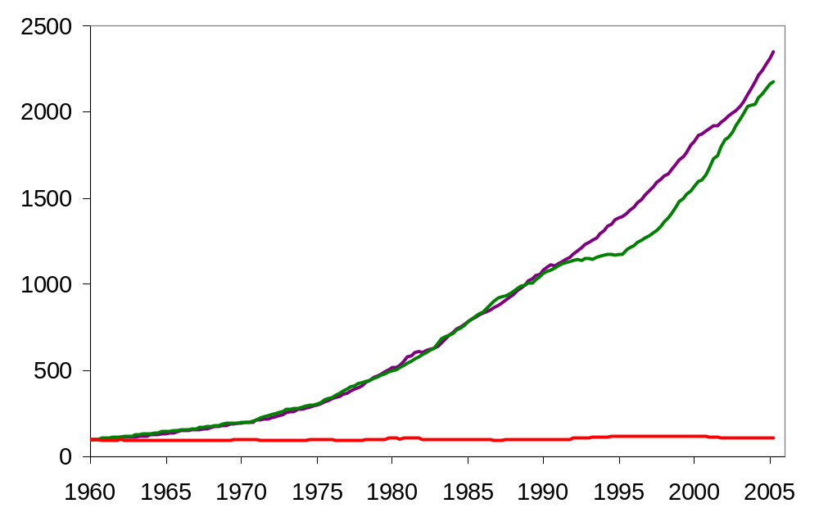
U.S. Nominal GDP, M2, and Velocity (1960=100)
1960-2005
0
Velocity is fairly stable over time.
Nominal GDP
M2
Velocity
Notes:
Note: Each variable has been scaled to equal 100 to make variables comparable.
This graph appears in the textbook. Its purpose is to demonstrate that velocity is fairly stable over time. This observation justifies the assumption of constant velocity in the quantity theory of money.
Original sources:
M1 and M2 are from Board of Governors, Federal Reserve Board
GDP is from U.S. Department of Commerce, Bureau of Economic Analysis.
I obtained all data from FRED database, Federal Reserve Bank of St. Louis, at:
http://research.stlouisfed.org/fred2/

Slide 24
The Quantity Equation
0
P x Y
Velocity formula:
V =
M
Multiply both sides of formula by M:
M x V = P x Y
Called the quantity equation
CHAPTER 30 MONEY GROWTH AND INFLATION

Slide 25
The Quantity Theory in 5 Steps
0
Start with quantity equation: M x V = P x Y
1. V is stable.
2. So, a change in M causes nominal GDP (P x Y)
to change by the same percentage.
3. A change in M does not affect Y:
money is neutral,
Y is determined by technology & resources
4. So, P changes by same percentage as
P x Y and M.
5. Rapid money supply growth causes rapid inflation.
CHAPTER 30 MONEY GROWTH AND INFLATION

Slide 26
A C T I V E L E A R N I N G 1:
Exercise
0
One good: corn. The economy has enough labor, capital, and land to produce Y = 800 bushels of corn. V is constant. In 2005, MS = $2000, P = $5/bushel.
a. Compute nominal GDP and velocity in 2005.
For 2006, the Fed increases MS by 5%, to $2100.
b. Compute the 2006 values of nominal GDP and P. Compute the inflation rate for 2005-2006.
c. Suppose tech. progress causes Y to increase to 824 in 2006. Compute 2005-2006 inflation rate.
Notes:
This exercise makes the quantity theory more concrete for students.
If you’re pressed for time, you can delete part c, or ask students to do it on their own.

Slide 27
A C T I V E L E A R N I N G 1:
Answers
0
Given: Y = 800, V is constant,
MS = $2000 and P = $5 in 2005.
a. Compute nominal GDP and velocity in 2005.
Nominal GDP = P x Y = $5 x 800 = $4000
P x Y
$4000
V =
=
= 2
M
$2000

Slide 28
A C T I V E L E A R N I N G 1:
Answers
0
Given: Y = 800, V is constant,
MS = $2000 and P = $5 in 2005.
For 2006, the Fed increases MS by 5%, to $2100.
b. Compute the 2006 values of nominal GDP and P. Compute the inflation rate for 2005-2006.
Nominal GDP = P x Y
= M x V (Quantity Eq’n)
= $2100 x 2 = $4200
P x Y
$4200
P =
=
= $5.25
Y
800
$5.25 – 5.00
Inflation rate =
= 5% (same as MS!)
5.00

Slide 29
A C T I V E L E A R N I N G 1:
Answers
0
Given: Y = 800, V is constant,
MS = $2000 and P = $5 in 2005.
For 2006, the Fed increases MS by 5%, to $2100.
c. Suppose tech. progress causes Y to increase 3% in 2006, to 824. Compute 2005-2006 inflation rate.
First, use Quantity Eq’n to compute P:
M x V
$4200
P =
=
= $5.10
Y
824
$5.10 – 5.00
Inflation rate =
= 2%
5.00

Slide 30
Hyperinflation
0
Hyperinflation is generally defined as inflation exceeding 50% per month.
Recall one of the Ten Principles from Chapter 1:
Prices rise when the government
prints too much money.
Excessive growth in the money supply always causes hyperinflation.
CHAPTER 30 MONEY GROWTH AND INFLATION
Notes:
The 4th edition of the textbook has a new “In the News” box with an excellent article from The Economist on the German interwar hyperinflation.

Slide 31
The Inflation Tax
0
When tax revenue is inadequate and ability to borrow is limited, govt may print money to pay for its spending.
Almost all hyperinflations start this way.
The revenue from printing money is the
inflation tax: printing money causes inflation, which is like a tax on everyone who holds money.
In the U.S., the inflation tax today accounts for less than 3% of total revenue.
CHAPTER 30 MONEY GROWTH AND INFLATION

Slide 32
The Fisher Effect
0
Rearrange the definition of the real interest rate:
nominal interest rate
inflation rate
real interest rate
=
+
The real interest rate is determined by saving & investment in the loanable funds market.
Money supply growth determines inflation rate.
So, this equation shows how the nominal interest rate is determined.
CHAPTER 30 MONEY GROWTH AND INFLATION

Slide 33
The Fisher Effect
0
nominal interest rate
inflation rate
real interest rate
=
+
In the long run, money is neutral,
so a change in the money growth rate affects
the inflation rate but not the real interest rate.
So, the nominal interest rate adjusts one-for-one with changes in the inflation rate.
This relationship is called the Fisher effect
after Irving Fisher, who studied it.
CHAPTER 30 MONEY GROWTH AND INFLATION

Slide 34
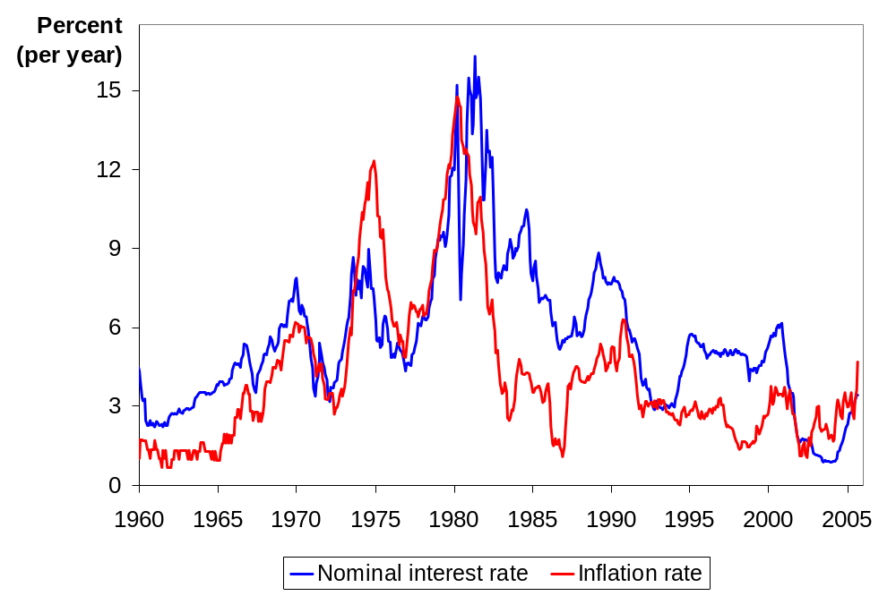
U.S. Nominal Interest & Inflation Rates
0
The close relation between these variables is evidence for the Fisher effect.
Notes:
The nominal interest rate is the 3-month Treasury Bill rate. The inflation rate is calculated as the percent change in the CPI from 12 months earlier.
Most of the time, these two variables move very closely together: increases in inflation correspond to similar increases in the nominal interest rate.
When the two variables are not moving precisely together, the real interest rate is changing. This would occur if, for example, there were changes in the supply and/or demand for loanable funds. Starting in the early 1980s, the emergence of huge budget deficits caused the supply of loanable funds to fall, which increased the real interest rate. On this graph, the gap between the nominal interest rate and inflation rate clearly grows in the early 1980s.
Original sources:
CPI, not seasonally adjusted: Bureau of Labor Statistics, U.S. Department of Labor
Treasury Bill rate: Board of Governors of the Federal Reserve System
Where I got this data:
FRED database, Federal Reserve Bank of St. Louis
http://research.stlouisfed.org/fred2/

Slide 35
The Fisher Effect & the Inflation Tax
0
nominal interest rate
inflation rate
real interest rate
=
+
The inflation tax applies to people’s holdings of money, not their holdings of wealth.
The Fisher effect: an increase in inflation causes an equal increase in the nominal interest rate, so the real interest rate (on wealth) is unchanged.
CHAPTER 30 MONEY GROWTH AND INFLATION

Slide 36
The Costs of Inflation
0
The inflation fallacy: most people think inflation erodes real incomes.
But inflation is a general increase in prices,
of the things people buy and the things they sell (e.g., their labor).
In the long run, real incomes are determined by real variables, not the inflation rate.
CHAPTER 30 MONEY GROWTH AND INFLATION

Slide 37
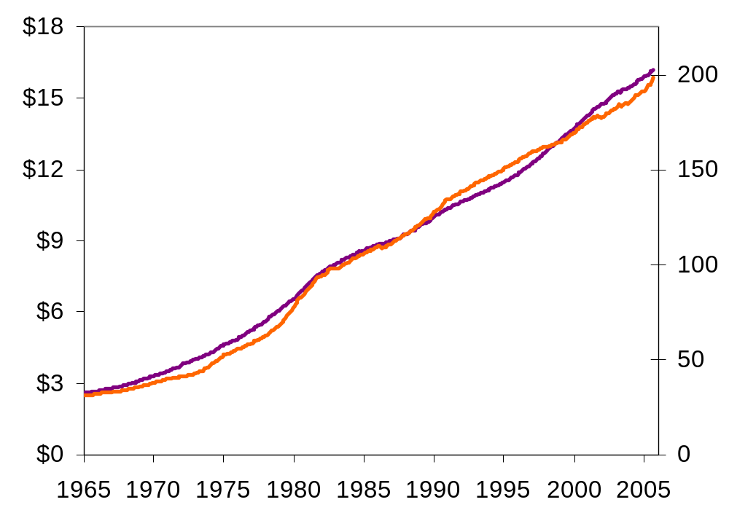
U.S. Average Hourly Earnings & the CPI
0
CPI
(right scale)
Nominal wage
(left scale)
Inflation causes
the CPI and
nominal wages
to rise together over the long run.
Notes:
This graph is not in the textbook, but it helps expose the inflation fallacy.
Note: If you change the scale of the CPI axis, you can make it look like the CPI is rising faster or slower than the average worker’s nominal wage. However, you can normalize both series to equal 100 in 1965 and plot them on the same vertical axis, and the result would be remarkably similar to what you see here: the average wage divided by the CPI is virtually the same today as 40 years ago (despite a few ups and downs in the interim, which of course should not be surprising, as the determinants of the real wage - labor supply and the marginal product of labor – are not likely to be constant over such a long time period).
I decided to go with this graph instead of a graph of the two variables equal to 100 in 1965, because the units of this graph are more natural, and because it gives students practice interpreting graphs with variables measured on different scales.
The nominal wage is average hourly earnings, total for private sector, seasonally adjusted, from the Bureau of Labor Statistics, U.S. Department of Labor. The CPI in this graph is seasonally adjusted, also from the BLS.

Slide 38
The Costs of Inflation
0
Shoeleather costs: the resources wasted when inflation encourages people to reduce their money holdings
  includes the time and transactions costs of more frequent bank withdrawals
Menu costs: the costs of changing prices
  printing new menus, mailing new catalogs, etc.
CHAPTER 30 MONEY GROWTH AND INFLATION

Slide 39
The Costs of Inflation
0
Misallocation of resources from relative-price variability: Firms don’t all raise prices at the same time, so relative prices can vary…
which distorts the allocation of resources.
Confusion & inconvenience: Inflation changes the yardstick we use to measure transactions.
Complicates long-range planning and the comparison of dollar amounts over time.
CHAPTER 30 MONEY GROWTH AND INFLATION

Slide 40
The Costs of Inflation
0
Tax distortions:
Inflation makes nominal income grow faster than real income.
Taxes are based on nominal income,
and some are not adjusted for inflation.
So, inflation causes people to pay more taxes even when their real incomes don’t increase.
CHAPTER 30 MONEY GROWTH AND INFLATION

Slide 41
A C T I V E L E A R N I N G 2:
Tax distortions
0
You deposit $1000 in the bank for one year.
  CASE 1: inflation = 0%, nom. interest rate = 10%
  CASE 2: inflation = 10%, nom. interest rate = 20%
  a. In which case does the real value of your deposit grow the most?
Assume the tax rate is 25%.
  b. In which case do you pay the most taxes?
  c. Compute the after-tax nominal interest rate,
  then subtract off inflation to get the
  after-tax real interest rate for both cases.
Notes:
Most principles-level students have difficulty the first time they are asked to calculate the after-tax real interest rate, because the calculation involves several intermediate steps. The intermediate steps are, at first, not obvious to most students. This exercise walks students through these steps.
The exercise leads students to see for themselves that inflation reduces the after-tax real interest rate.
Suggestion: Display this slide, and give students 3-4 minutes to work the problem on their own.

Slide 42
A C T I V E L E A R N I N G 2:
Answers
0
Deposit = $1000.
  CASE 1: inflation = 0%, nom. interest rate = 10%
  CASE 2: inflation = 10%, nom. interest rate = 20%
  a. In which case does the real value of your deposit grow the most?
  In both cases, the real interest rate is 10%,
  so the real value of the deposit grows 10% (before taxes).
Notes:
Suggestion: If you can spare the class time, ask students for the answers before you display them.

Slide 43
A C T I V E L E A R N I N G 2:
Answers
0
Deposit = $1000. Tax rate = 25%.
  CASE 1: inflation = 0%, nom. interest rate = 10%
  CASE 2: inflation = 10%, nom. interest rate = 20%
  b. In which case do you pay the most taxes?
  CASE 1: interest income = $100,
  so you pay $25 in taxes.
  CASE 2: interest income = $200,
  so you pay $50 in taxes.

Slide 44
A C T I V E L E A R N I N G 2:
Answers
0
Deposit = $1000. Tax rate = 25%.
  CASE 1: inflation = 0%, nom. interest rate = 10%
  CASE 2: inflation = 10%, nom. interest rate = 20%
  c. Compute the after-tax nominal interest rate,
  then subtract off inflation to get the
  after-tax real interest rate for both cases.
  CASE 1: nominal = 0.75 x 10% = 7.5%
  real = 7.5% – 0% = 7.5%
  CASE 2: nominal = 0.75 x 20% = 15%
  real = 15% – 10% = 5%

Slide 45
A C T I V E L E A R N I N G 2:
Summary & lessons
0
Deposit = $1000. Tax rate = 25%.
  CASE 1: inflation = 0%, nom. interest rate = 10%
  CASE 2: inflation = 10%, nom. interest rate = 20%
Inflation…
  raises nominal interest rates (Fisher effect) but not real interest rates
  increases savers’ tax burdens
  lowers the after-tax real interest rate
Notes:
By lowering the after-tax interest rate, inflation reduces the incentive to save. Recall that saving is critically important for future productivity and living standards.

Slide 46
CONCLUSION
0
This chapter explains one of the Ten Principles of economics:
Prices rise when the govt prints
too much money.
We saw that money is neutral in the long run, affecting only nominal variables.
In later chapters, we will see that money has important effects in the short run on real variables like output and employment.
CHAPTER 30 MONEY GROWTH AND INFLATION

Slide 47
CHAPTER SUMMARY
0
To explain inflation in the long run, economists use the quantity theory of money. According to this theory, the price level depends on the quantity of money, and the inflation rate depends on the money growth rate.
The classical dichotomy is the division of variables into real & nominal. The neutrality of money is the idea that changes in the money supply affect nominal variables, but not real ones. Most economists believe these ideas describe the economy in the long run.
CHAPTER 30 MONEY GROWTH AND INFLATION

Slide 48
CHAPTER SUMMARY
0
The inflation tax is the loss in the real value of people’s money when the government causes inflation by printing money.
The Fisher effect is the one-for-one relation between changes in the inflation rate and changes in the nominal interest rate.
The costs of inflation include menu costs, shoeleather costs, confusion and inconvenience, distortions in relative prices and the allocation of resources, tax distortions, and arbitrary redistributions of wealth.
CHAPTER 30 MONEY GROWTH AND INFLATION

