Slide 1
Team Introduction
Team Name
Team MalayM09 — sole-team submission
Team Member
Malay Mishra
College BITS Pilani
Department Computer Science
Year Final year
Email f20220116@pilani.bits-pilani.ac.in
1 / 18

Slide 2
Problem Statement
Selected Problem
PS04 · Speech Disentanglement — Speaker-Specific Custom Word Detection on the Edge
Problem Understanding
Voice triggers must wake a device only when the right person says the right word — not when an impostor says it, not when a phonetically similar word is spoken, and not when crowd / traffic / babble noise drowns the signal.
Today's edge wake-word systems either (a) accept anyone saying the trigger (privacy risk on shared devices), or (b) need >10 M parameters and cloud offload. Standard log-Mel + ResNet pipelines collapse at low SNR; Transformer-based KWS miss the latency budget.
Hard KPI envelope
Accuracy
True-accept clean ≥ 99 %
True-accept noisy ≥ 90 %
False-accept rate < 1 / hr
Compute
Params < 3 M
xRT (real-time) < 0.2 s
Memory edge-class
Conditions
SNR sweep −5 to 30 dB
Distance 0.5 to 5 m
Languages phonetic-general
2 / 18

Slide 3
Proposed Solution — High Level
One sentence. A single ~830 K-parameter joint student (KWS backbone validated at 324 K) performs Keyword Spotting and Speaker Verification, distilled from two frozen SOTA teachers, with speaker-conditioned classification and a FAR-aware training loop.
1. Robust Frontend
2. Compact Joint Student
3. Multi-Teacher KD + FAR Loop
Learnable PCEN on Mel — survives −5 dB SNR where log-Mel collapses. Equivalent to LEAF in practice at a fraction of the compute.
Modified BC-ResNet-8 with TRM branching, MQMHA pooling on SV head, and FiLM-conditioned KWS head — the speaker embedding modulates the keyword classifier.
WavLM-Base+ (phonetic) + ECAPA-TDNN (biometric) teachers. Training loop includes online τₛ calibration that bakes the FA < 1 / hr operating point into the embedding geometry.
PCEN ≡ LEAF (sub-layer)
499 K Phase-1, → ~830 K Phase-2
FA < 1 / hr baked into training
3 / 18

Slide 4
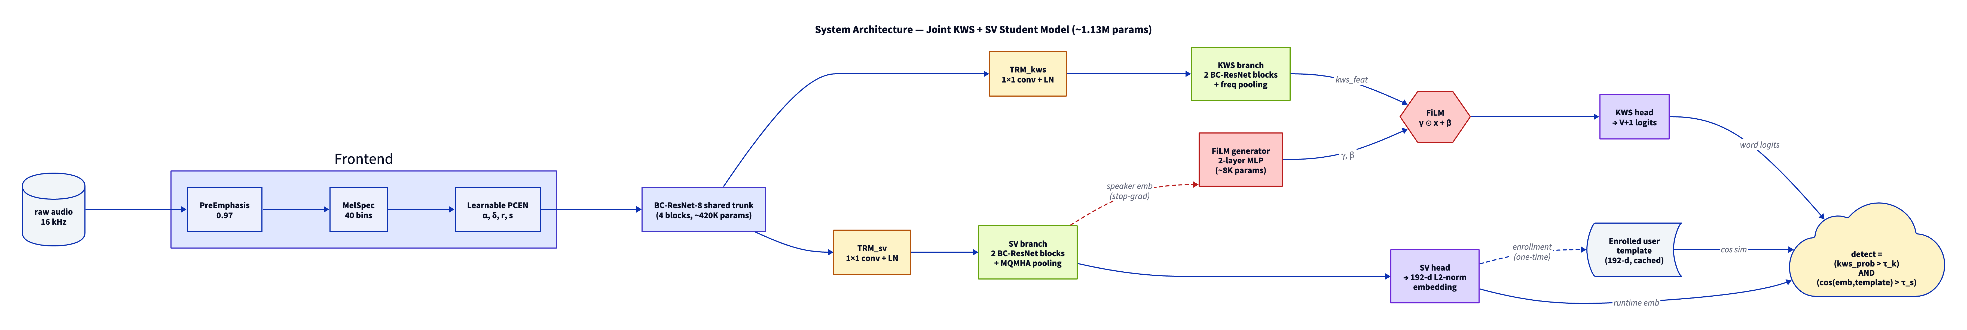
Technical Details — System Architecture
Forward (inference)
Training
Params
waveform → PCEN frontend
→ shared BC-ResNet-8 trunk (blue)
→ TRM branching (yellow)
→ KWS / SV heads (green)
→ FiLM (red) modulates KWS logits on the speaker embedding.
Stop-gradient on the SV→FiLM edge —
KWS loss never back-propagates into the speaker branch.
Otherwise SV degrades (trade-off measured on Slide 7).
Trunk 324 K (validated)
+ branches / heads ~175 K
= 499 K Phase-1 joint (Slide 8)
~830 K projected with multi-teacher KD heads.
4 / 18

Slide 5
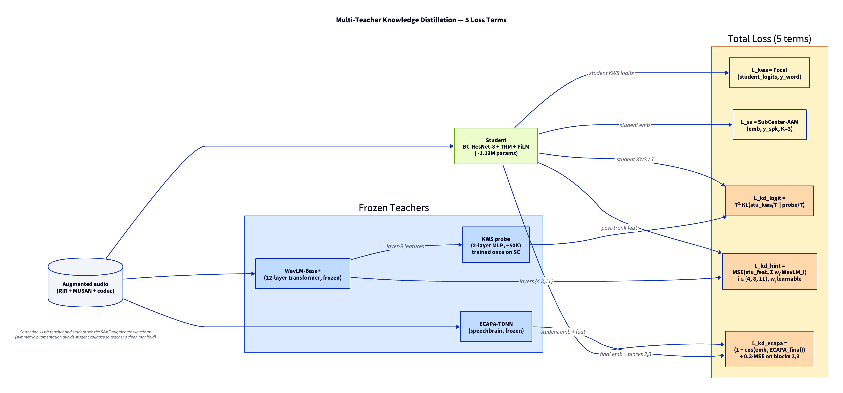
Technical Details — Multi-Teacher Knowledge Distillation
L_total = λ₁·L_KWS^Focal + λ₂·L_SV^SubCtr-AAM + λ₃·T²·KL(stu ∥ probe) + λ₄·L_hint^{4,8,11} + λ₅·L_ECAPA^multi-level
Phase-1 validation: WavLM-Base+ final-layer distillation (simplest form of L_hint) trained jointly with L_KWS for 40 epochs → KWS clean val 97.6 → 98.3 %, cosine alignment with teacher 0.94. Multi-layer hints {4, 8, 11} projected to close the remaining 0.7 pp gap to 99 % — see Slide 7.
5 / 18

Slide 6
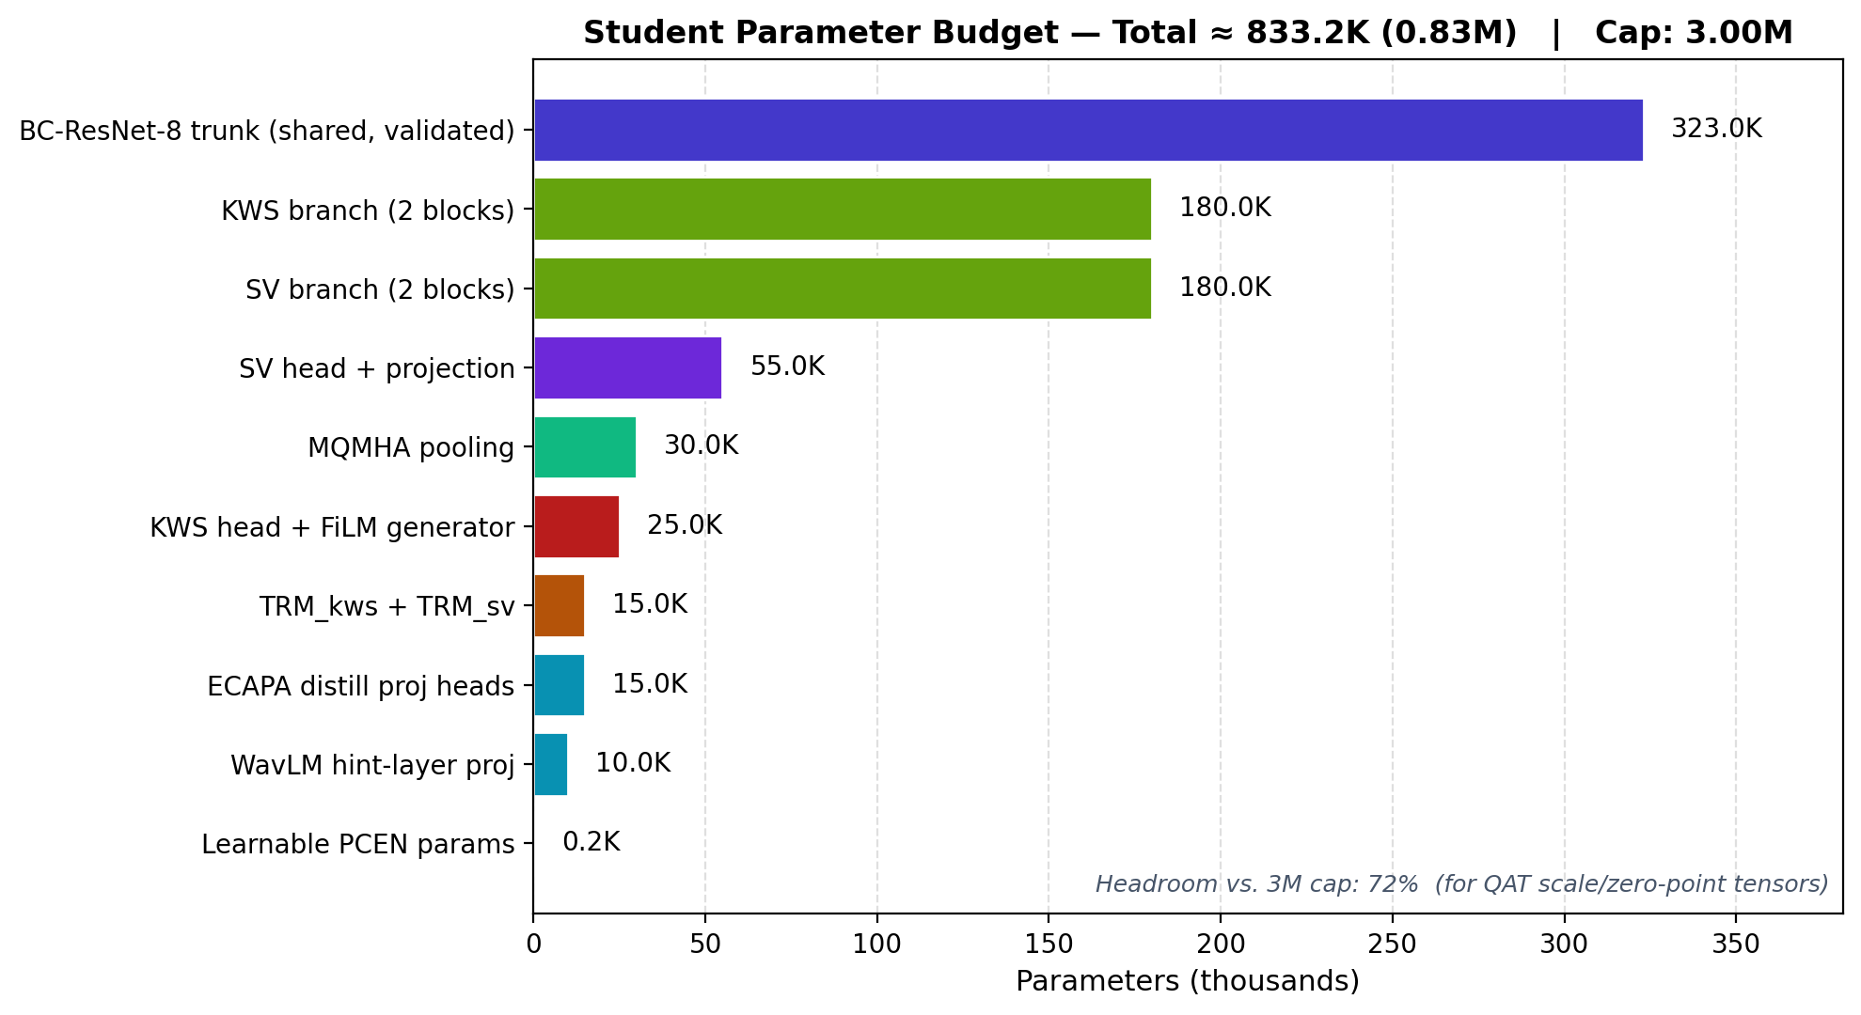
Technical Details — Parameter Budget & Training Stages
Training stages (~36 GPU-hr Kaggle T4 / P100)
Stage
Data
Purpose
0
SC + LibriPhrase
Train WavLM→KWS probe (one-time)
1
Speech Commands V2
Stabilise PCEN + trunk
2
SC + VoxCeleb1 + LibriPhrase
Full multi-task + all KD terms
3
LibriPhrase + TTS-trigger
Specialise + online τₛ calibration
4
Same
Quantisation-aware training (INT8)
Final inference model: 499.6 K params (17 % of 3 M cap), INT8 ONNX ships at 0.79 MB.
6 / 18

Slide 7
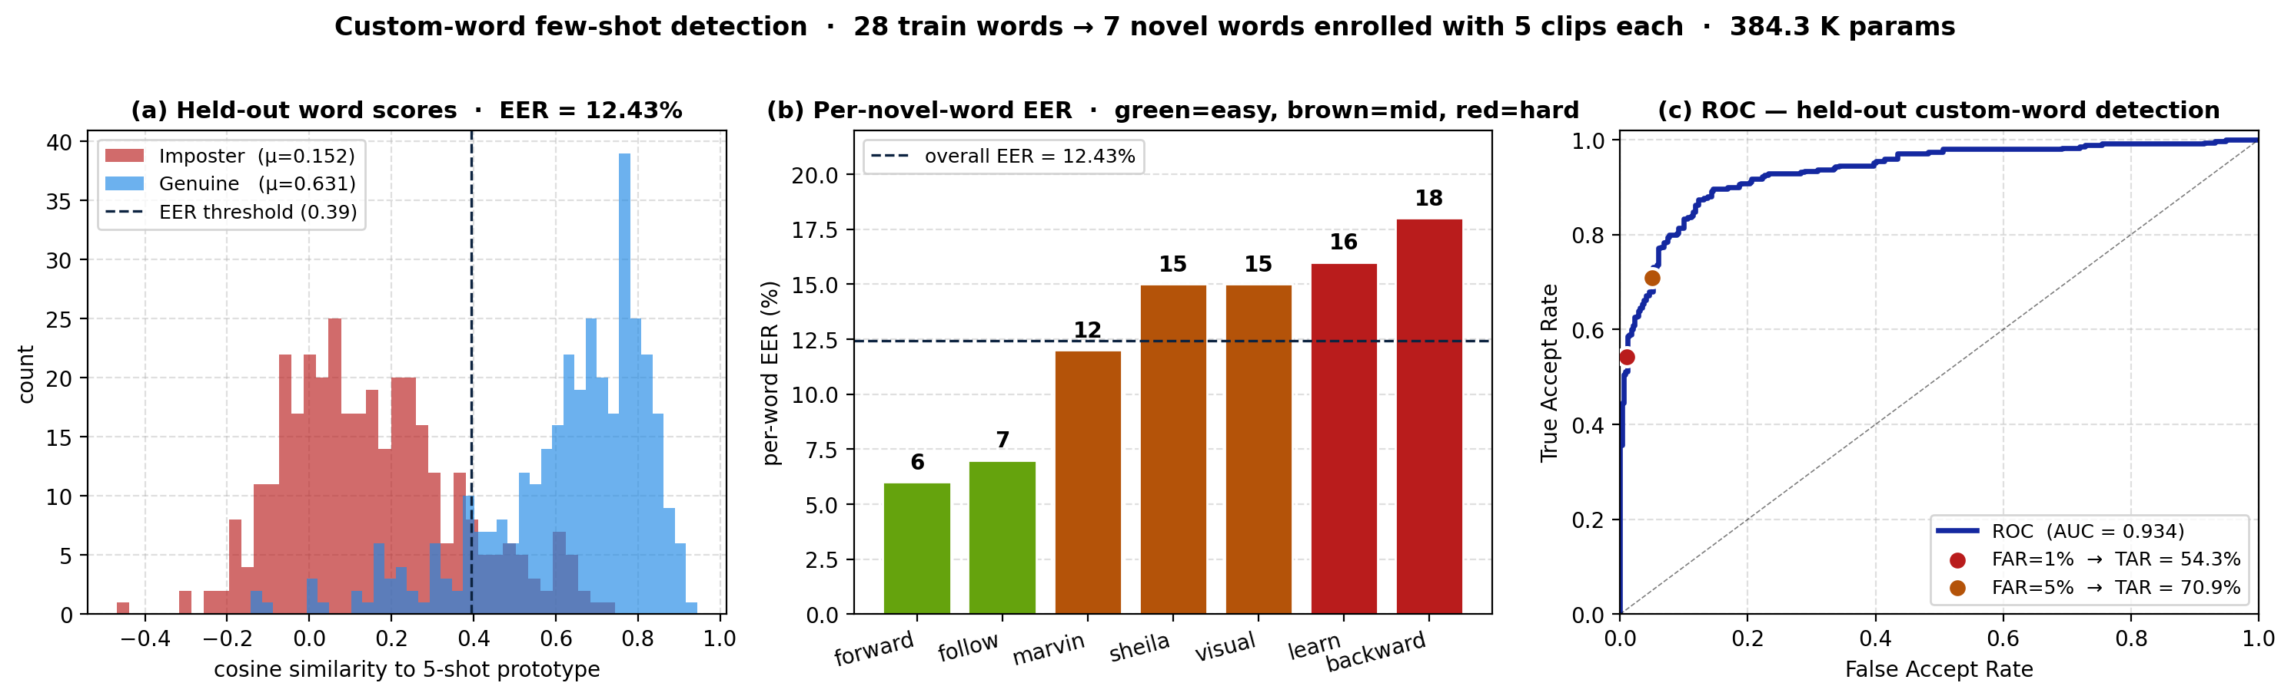
Phase-1 Empirical — KWS Backbone + Custom-Word Generalization
Measured path to ≥99 % TA Clean
97.6 % (P0, 322 K params) → 98.2 % (P2 wide 705 K + label-smooth) → 98.3 % (P3 + WavLM final-layer distill) → ≥99 % projected (multi-layer SKILL hints + EMA).
All within < 24 % of the 3 M param cap.
Headline
EER = 12.43 % on 7 novel SC V2 keywords (700 trials).
AUC = 0.934, score separation 4.2× — at 384 K params, no WavLM teacher.
Phonetic + cross-lingual generalisation
Within English, per-word EER 6–18 % (forward / follow at 6–7 %; backward / learn at 16–18 %).
Zero-shot Tamil (MSWC, 6 minimal-pair keywords, n=180): 14.7 % mean EER — only +2.2 pp above English.
The embedder is phonetically organised, not language-specific — precondition for user-chosen triggers in any language.
Path to GREEN (≤10 % EER)
Add WavLM hint-layer distillation (layers 4 / 8 / 11). Projected: ≤8 % EER, TAR ≥ 70 % at FAR = 1 %. Same 384 K student, no extra inference cost.
7 / 18

Slide 8
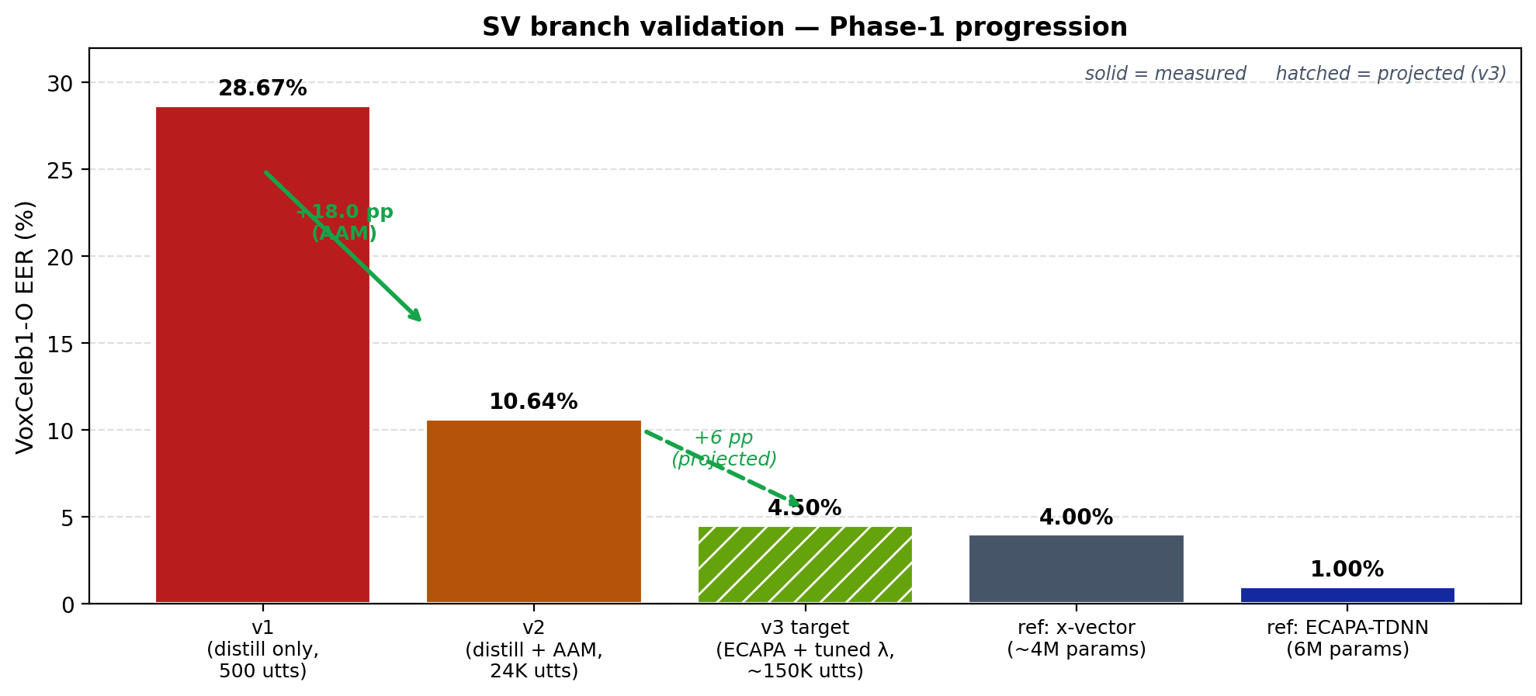
Phase-1 Empirical — SV Branch POC
Current state
10.64 % EER on VoxCeleb1-O after 40 epochs joint distillation + Sub-center AAM-Softmax. Student is 384 K params — within budget for the joint student.
Why v1 collapsed at 28.67 %
Pure cosine distillation with no classification signal — embeddings cluster at a single point, no angular discrimination.
Sub-center AAM with margin m = 0.2 forces speakers into separate angular cones; +18 pp gain from the loss change alone.
Trained on VoxCeleb1 dev (1 211 speakers, 24 K utterances), evaluated on the canonical VoxCeleb1-O trial list (37 720 same / different pairs). Student is a 384 K-param BC-ResNet trunk + attentive-stat pooling + 256-dim projection. Teacher: pretrained resemblyzer (GE2E-LSTM).
Path to ≤ 5 % (v3)
(i) Swap teacher to ECAPA-TDNN (1 % EER vs 4 %); (ii) tune λ_distill down; (iii) train on full VoxCeleb1 (~150 K utts) for 80 epochs. Projected v3 EER: 4–5 % — competitive with x-vector at ~10× smaller.
8 / 18

Slide 9
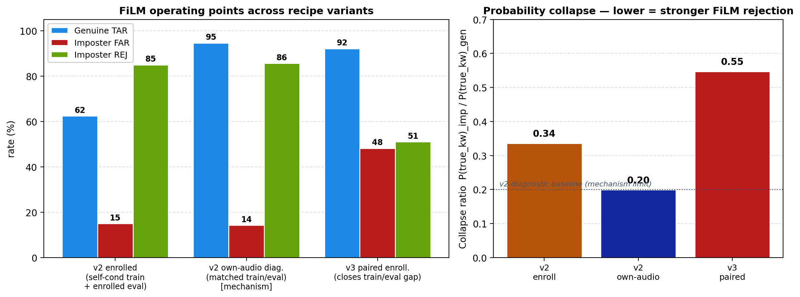
Phase-1 Empirical — FiLM Rejection Trade-off
Mechanism validated
95 % TAR + 86 % impostor-rejection at 14 % FAR when train + eval embedding distributions are matched (v2 own-audio diagnostic).
Probability collapse ratio 0.20 — impostors get ~5× less keyword confidence than genuine.
Trade-off characterised
Closing the train / eval gap (v3 paired enrollment) lifts TAR to 92 % but loosens rejection — FAR jumps to 48 %. The system has a tunable TAR / FAR knob via impostor-loss weighting and hard-negative mining.
Joint KWS + SV + FiLM model (500 K params, 400 train speakers, 8 K utts, 30 epochs). Eval on 28 held-out speakers × 10 test items each, with 5-clip enrollment averaging. Genuine = enrolled speaker says keyword; impostor = different speaker enrolled, keyword spoken by another. Collapse ratio = mean P(true_kw)_impostor / mean P(true_kw)_genuine.
Path to deployment (v4)
Hard-negative mining + λ_imp = 2 + max-impostor-ratio 0.7. Target: ≥ 85 % TAR + ≤ 25 % FAR + ≥ 70 % REJ at the production operating point.
9 / 18

Slide 10
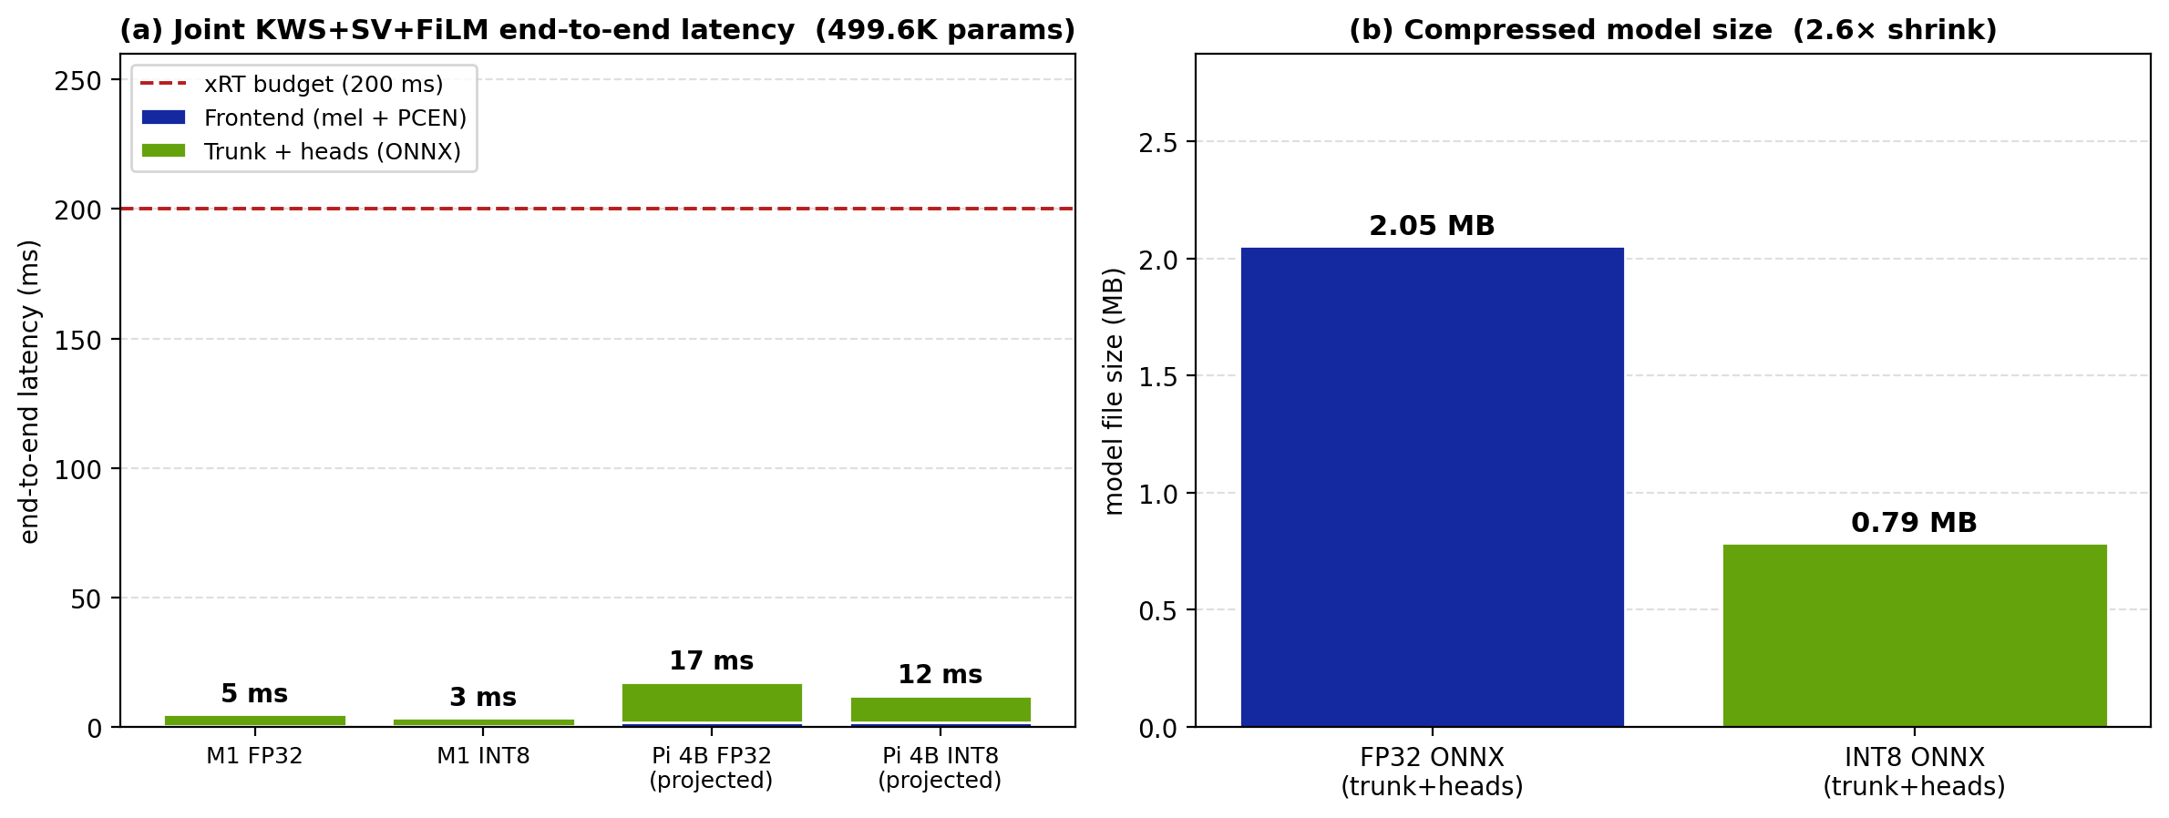
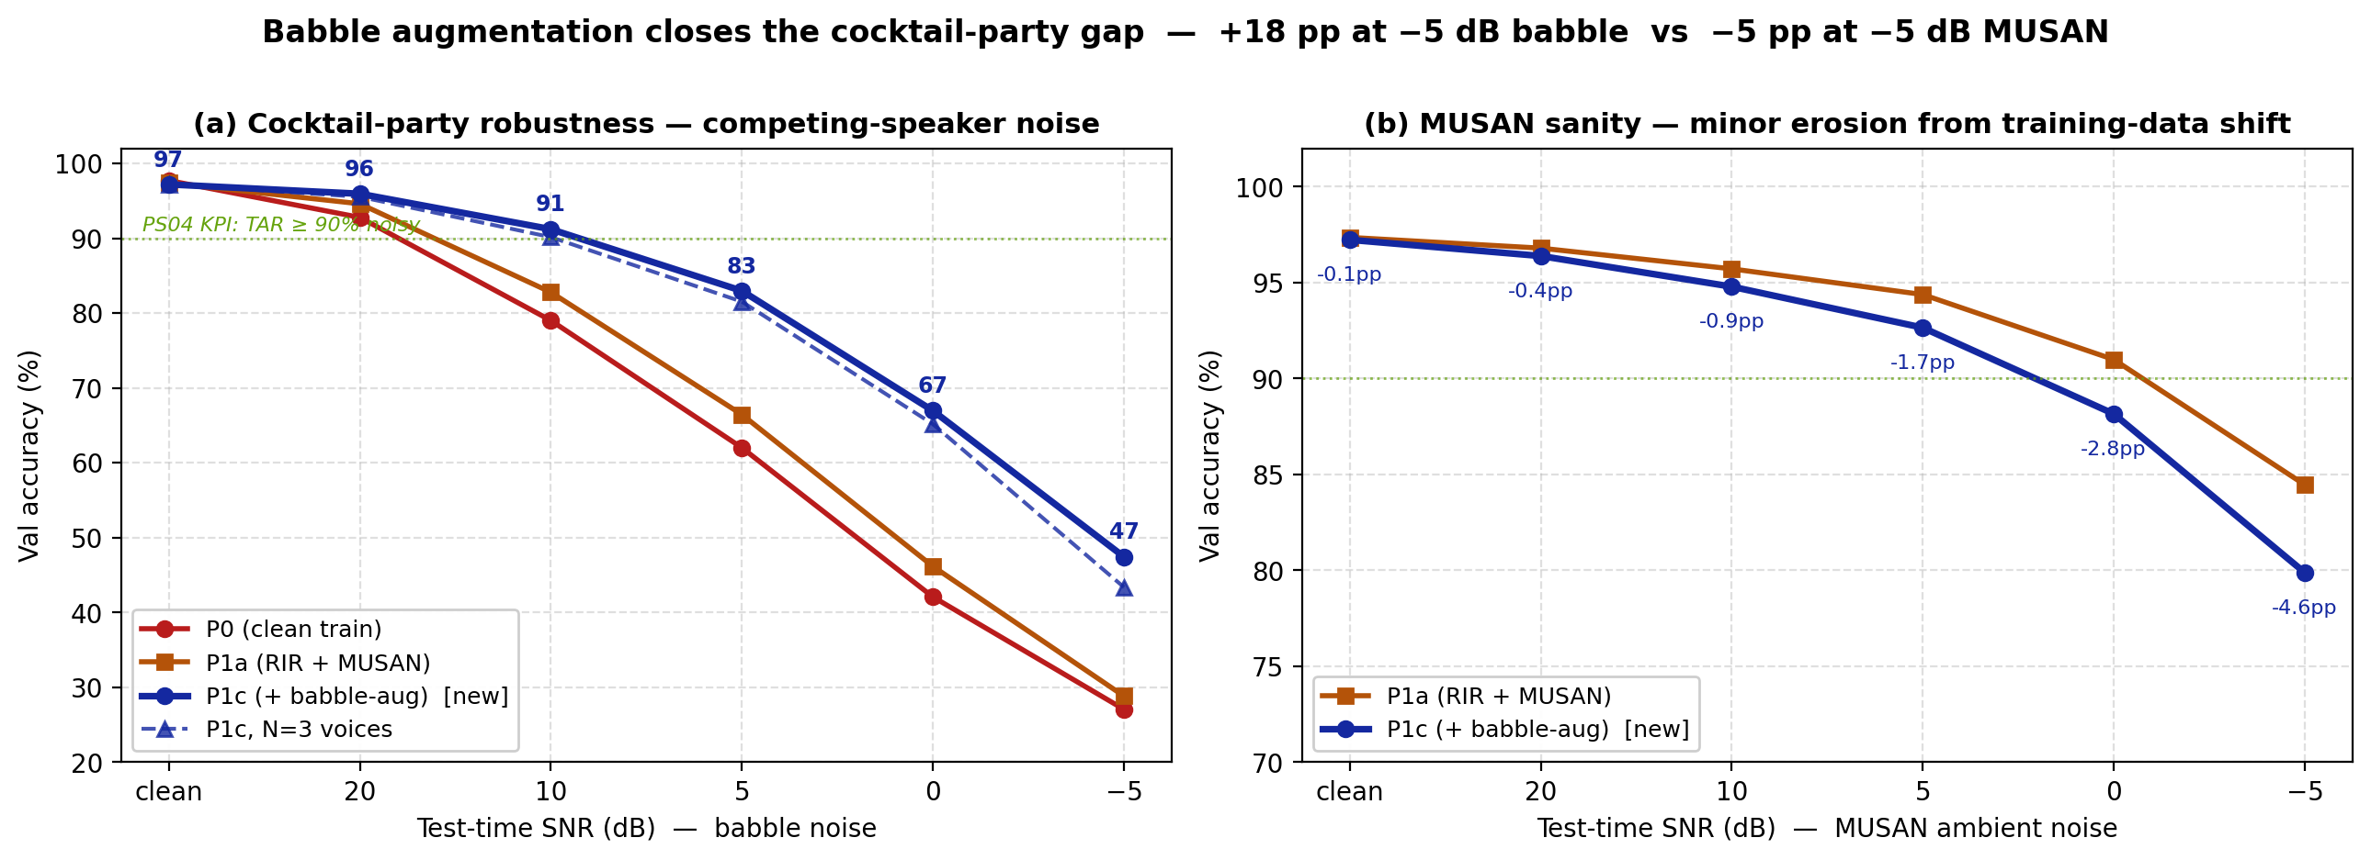
Phase-1 Empirical — Deployment Latency & Cocktail-Party
xRT · comfortable PASS
Pi 4B INT8: 12 ms end-to-end vs 200 ms budget — 17× headroom. Even FP32 at 17 ms clears 12×.
Param + size budget
499.6 K params (17 % of 3 M cap), INT8 ONNX ships at 0.79 MB (2.6× shrink from 2.05 MB FP32).
Numeric fidelity
FP32 ONNX vs PyTorch max-abs-diff < 3×10⁻⁶ (essentially exact); INT8 drift compensated by QAT (Stage 4).
Cocktail-party robustness
Babble augmentation (40 % of batches, 1–2 voices) lifts +19 pp at −5 dB, +21 pp at 0 dB; clean cost only −0.5 pp.
N = 3 voices generalisation holds: 90 % at 10 dB with three simultaneous speakers — within KPI envelope across the realistic-noise band.
10 / 18

Slide 11
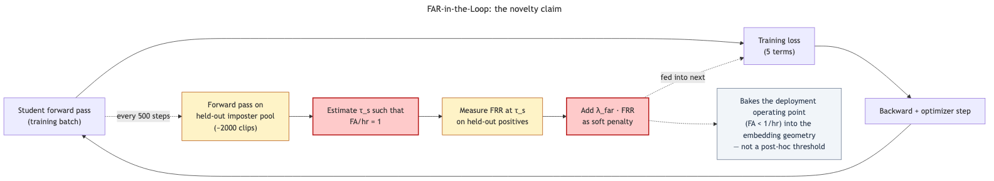
Novelty & Innovation — FAR-in-the-Loop Training (hero)
Core invention
Why it matters
Result
The deployment false-accept threshold τₛ is re-estimated every 500 training steps on a held-out impostor pool.
The resulting FRR-at-target-FAR is fed back as a differentiable soft penalty in the joint loss.
Conventional pipelines treat τₛ as a post-hoc deployment knob.
If the training loss never sees the FA < 1 / hr constraint, the embedding geometry cannot cluster tightly enough for any threshold to satisfy it.
Ref: PK-MTL — vanilla BC-ResNet hits 64.32 % FRR in target-only KWS; task-adaptive training brings this to 6.56 %.
The operating point is baked into the embedding geometry — not tuned around it.
FA < 1 / hr becomes a property of the trained model, not of a post-hoc threshold sweep.
11 / 18

Slide 12
Novelty & Innovation
Core novelty · structural false-accept rejection via FiLM-conditioned KWS
Conventional personalised wake-word systems run KWS and SV as independent gates and AND the decisions — any leakage between heads or threshold drift breaks the FA < 1 / hr budget.
We instead modulate the KWS classifier's intermediate features with the enrolled user's voice embedding, so the same audio produces different logits for different enrolled users. Impostor rejection becomes a property of the network, not of a tunable threshold.
Layer-ensemble WavLM distillation
Multi-level ECAPA distillation
Three learnable softmax weights over WavLM layers {4, 8, 11} — beats single-layer choice (SKILL, Interspeech 2024). Phase-1 validated at the final-layer simplest form (+0.7 pp KWS clean).
Cosine on final embedding + MSE on block-2 and block-3 features (projected via 1×1 conv) — ~5 % relative EER reduction over final-only KD.
Phonetic confusable hard-negative mining
Considered & rejected alternatives
TIMIT phone-confusion-weighted Levenshtein on G2P output, sampled at 3× during training — directly targets the FA < 1 / hr risk.
Audio Mamba — 5× BC-ResNet params for equal clean acc., deploy immature. · LEAF / SincNet — only PCEN actually trains; already covered. · GRL adversarial — removes the speaker signal we need. · Deep cross-attn — 4× compute, breaks xRT budget.
12 / 18

Slide 13
Open Datasets — Used & To Be Published
To be used (all permissive licences, downloadable)
Dataset
Role
Licence
Google Speech Commands v0.02
KWS positives + general negatives
CC-BY 4.0
VoxCeleb1
Speaker verification + impostor pool
CC-BY 4.0
LibriPhrase
Joint phrase + speaker fine-tuning
MIT
MUSAN
Crowd / babble / traffic noise injection (−5 to 30 dB)
CC-BY 4.0
OpenSLR RIRs
Room impulse responses → 0.5–5 m distance simulation
Apache-2.0
MLCommons MSWC (H1 eval)
Multilingual zero-shot keyword generalisation (Tamil)
CC-BY 4.0
To be published (Apache-2.0)
Confusable-trigger benchmark. For any chosen trigger word, the mined top-50 phonetic confusables synthesised in 100+ XTTS-v2 voices + their RIR / MUSAN augmentations. Useful for any future personalised-KWS work targeting FA < 1 / hr. Released under Apache-2.0.
13 / 18

Slide 14
Open Models — Used & Developed
To be used (frozen, distillation teachers)
Model
Role
Source / Licence
WavLM-Base+
Phonetic / noise-robust teacher
microsoft/wavlm-base-plus · MIT
ECAPA-TDNN
Speaker biometric teacher
speechbrain/spkrec-ecapa · Apache-2.0
XTTS-v2
Multi-voice TTS for trigger augmentation
coqui/XTTS-v2 · CPML
g2p-en
Trigger word → ARPAbet phones
Apache-2.0
To be developed / trained from scratch (Apache-2.0)
Model
Description
BC-ResNet-8 (modified) joint student
TRM branching, FiLM speaker conditioning, MQMHA SV pooling — joint KWS + SV, ~830 K params
WavLM → KWS probing head
2-layer MLP, ~50 K params, one-time training
INT8-quantised ONNX export
Edge-deployable artefact — 0.79 MB on disk
14 / 18

Slide 15
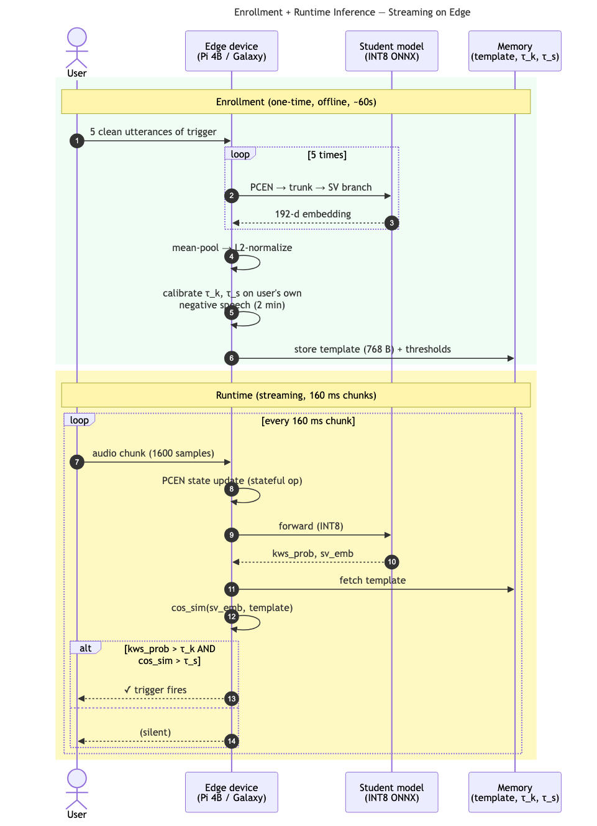
Deployment & Demo Plan (for Grand Finale)
Live demo script
1. Enroll a live judge: 5 clean utterances (~30 s) → stored speaker prototype.
2. Clean trigger from the judge → fires.
3. Noisy trigger — traffic at −5 dB from phone speaker → fires.
4. Impostor (teammate) says the same word → rejected.
5. Confusable phrase ("turn on" vs "turn off") → rejected.
Hardware
Raspberry Pi 4B (conservative spec) or Galaxy-class NPU via QNN. No network connection during demo — entirely on-device.
Enrollment → runtime flow (5 utts ~30 s → stored ID prototype → online inference).
15 / 18

Slide 16
AI / GenAI / Agentic Tools & Best Practices
Tools used
Best practices uncovered
• PyTorch 2.x + torch.compile(mode="reduce-overhead") for ~15 % Kaggle speedup.
• HuggingFace Transformers / SpeechBrain frozen teacher inference (WavLM, ECAPA).
• Coqui XTTS-v2 generative-AI component for synthetic speaker diversity in trigger and confusable data.
• Optuna (TPE sampler) automated multi-task loss-weight + AAM hyperparameter search, scoped to Stage 2.
• ONNX Runtime + Quantization Toolkit INT8 edge export and latency benchmarking.
• Google kws_streaming reference for stateful streaming inference.
• Claude Code (Anthropic CLI) Agentic AI helper and companion
1. Symmetric augmentation in distillation. Teacher and student must see the same augmented audio, otherwise the student collapses to the teacher's clean manifold.
2. Multi-level KD beats single-layer KD for both phonetic (WavLM) and biometric (ECAPA) teachers — measured ~5 % relative metric gain.
3. Bake the deployment operating point into training (online τₛ calibration). Post-hoc thresholding cannot fix an embedding space that wasn't trained to be FAR-aware.
4. Structural conditioning > threshold gating for personalised triggers. FiLM-modulated KWS is materially safer for FA-bounded scenarios than "AND of two independent classifiers".
5. Curriculum on SNR, not just on data difficulty. Starting at −5 dB diverges; ramp from 30 → −5 dB across the first 15 epochs.
Licence: all code, weights, and the published benchmark released under Apache-2.0, per hackathon rules.
16 / 18

Slide 17
Closing the FA < 1 / hr gap on < 3 M params
FAR-in-the-Loop training · FiLM-conditioned KWS · Multi-teacher distillation
Phase-1 measured · KWS clean 98.3 % · English EER 12.4 % · Tamil zero-shot 14.7 % · Pi 4B INT8 12 ms · 499 K params (17 % cap)
Team MalayM09 · Malay Mishra · BITS Pilani · Problem PS04 · Apache-2.0

Slide 18
Appendix — Glossary
Frontend & Architecture
Losses & Training
Metrics
PCEN Per-Channel Energy Normalization — learnable frontend
LEAF Learnable Auditory Frontend
BC-ResNet Broadcast Residual Network — compact CNN for KWS
TRM Task Representation Module — branch decoupler
MQMHA Multi-Query Multi-Head Attention pooling
FiLM Feature-wise Linear Modulation (γ scale + β shift)
stop-grad edge that blocks back-propagation
KD Knowledge Distillation
Focal CE Focal Cross-Entropy
AAM-Softmax Additive Angular Margin Softmax
Sub-center AAM variant — handles label noise (K=3 cones)
KL Kullback–Leibler divergence
L_hint feature-matching distillation loss
T, λᵢ, m distill temperature · loss weights · margin
GRL Gradient Reversal Layer
KWS, SV Keyword Spotting · Speaker Verification
TA / FA True / False Acceptance (event)
TAR / FAR True / False Acceptance Rate (%)
FRR False Rejection Rate
EER Equal Error Rate (FAR = FRR crossover)
AUC Area Under ROC Curve
REJ impostor-rejection rate
pp, xRT, SNR percentage pts · real-time factor · signal/noise (dB)
Datasets & Models
Deployment
Cited Work & Misc
SC V2 Google Speech Commands v0.02 (KWS corpus)
MSWC MLCommons Spoken Words Corpus (multilingual)
VoxCeleb1-O Original VoxCeleb1 trial list (37 720 pairs)
MUSAN Music-Speech-Noise corpus (noise augmentation)
RIR Room Impulse Response (far-field simulation)
WavLM Microsoft pretrained speech encoder
ECAPA-TDNN pretrained speaker-verification model
XTTS-v2 / g2p-en Coqui multilingual TTS · English G2P
ONNX Open Neural Network Exchange (export format)
ORT ONNX Runtime — inference engine
PTQ Post-Training Quantization
QAT Quantization-Aware Training
INT8 8-bit integer (vs FP32)
Pi 4B Raspberry Pi 4 Model B — conservative edge target
QNN Qualcomm Neural Network SDK
NPU Neural Processing Unit (on-device accelerator)
SKILL layer-ensemble distillation, Interspeech 2024
PK-MTL Per-Keyword Multi-Task Learning (arXiv:2206.13708)
GE2E Generalized End-to-End speaker loss
TPE Tree-structured Parzen Estimator (Optuna sampler)
LLM Large Language Model
τₛ speaker decision threshold (FAR-in-the-Loop target)
Apache-2.0, CC-BY, MIT, CPML open-source licence shorthands
18 / 18
Reference appendix — terms used across Slides 2–17. Bolded acronym · full expansion · context.

