Slide 1
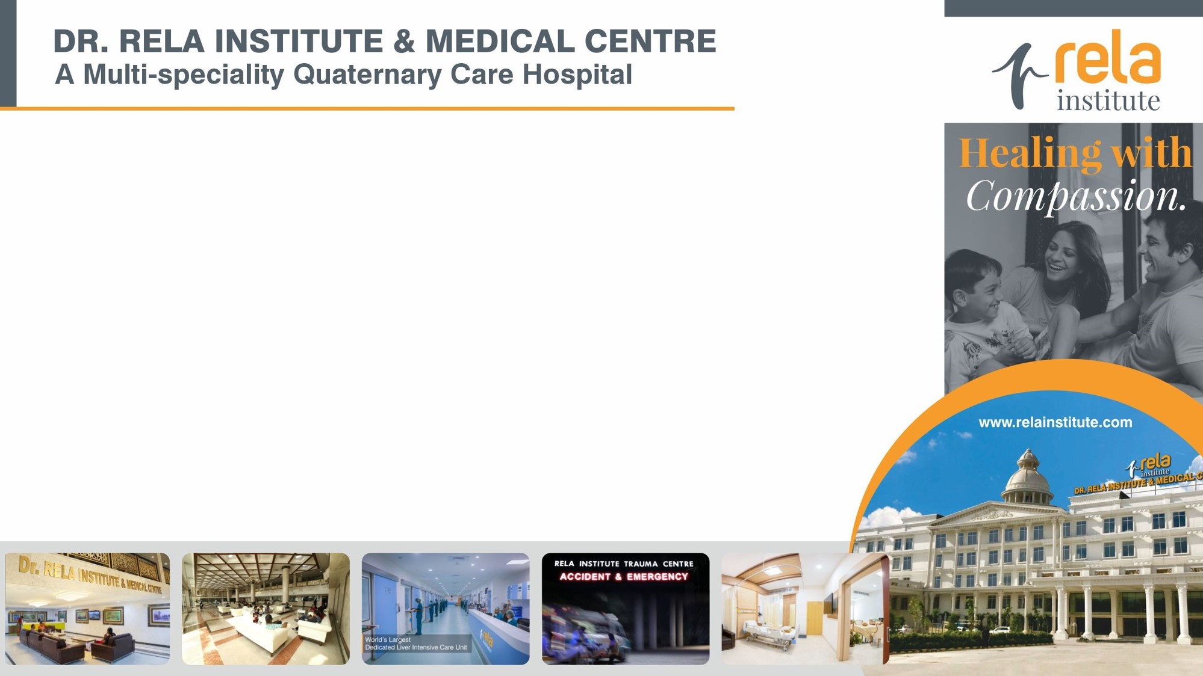
MEDICATION ERRORS

Slide 2
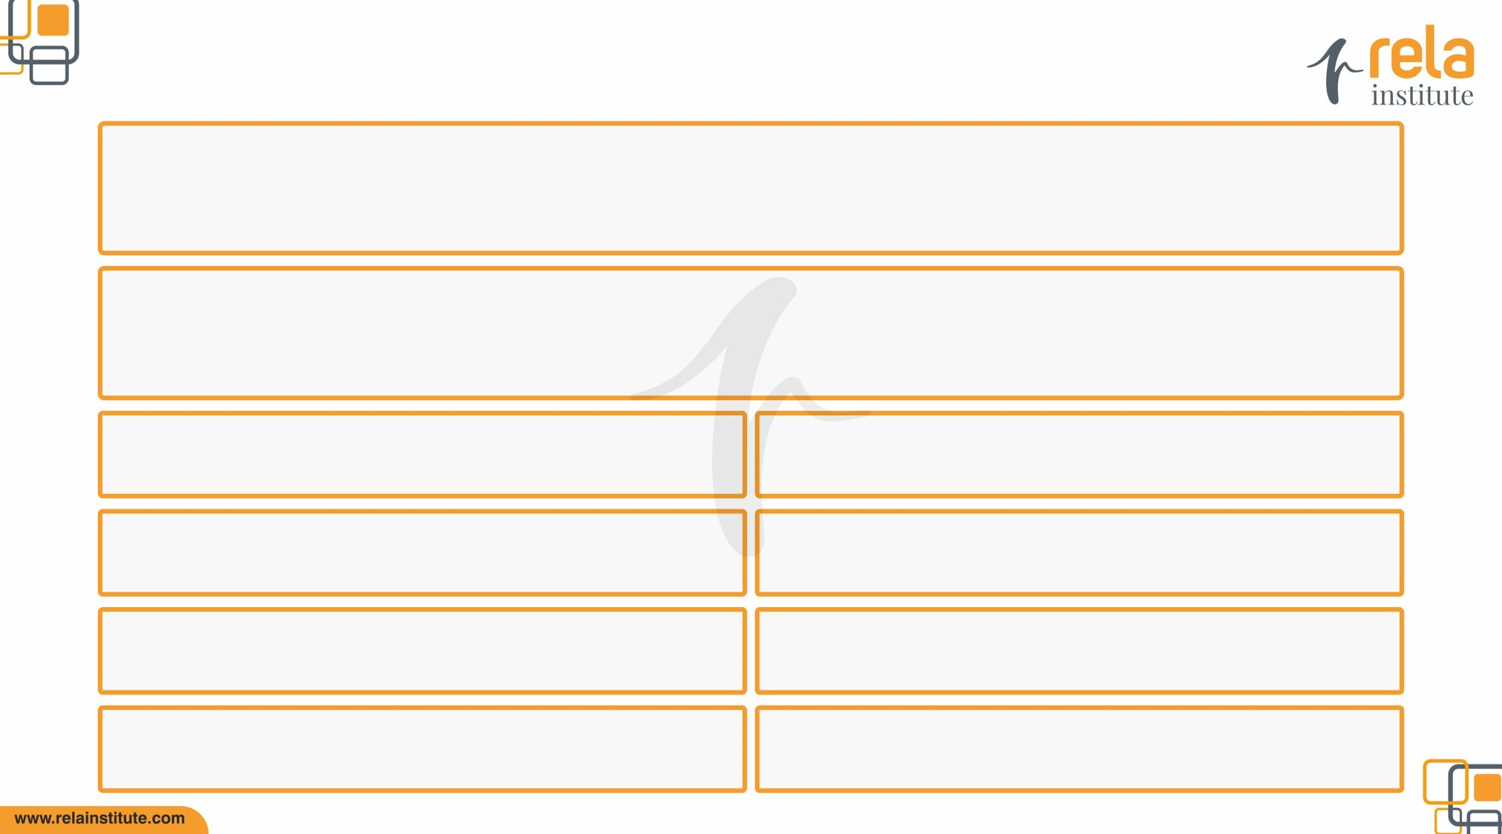
Medication error
Any error in the prescribing, transcribing, indenting, dispensing or administration of a drug, irrespective of whether such errors lead to adverse consequences or not, are the single most preventable cause of patient harm. A medication error is any preventable event that may cause or lead to inappropriate medication use or patient harm while the medication is in the control of the health care professional, patient, or consumer
Medication errors represents the culture of patient safety in a hospital To analyze the reasons of medication errors to identify the training needs & improvement opportunities to prevent the occurrence of same in future
Process & Outcome
Incident forms, Appropriateness review & prescription audit form
By 8th of every month
NA
Monthly
Continuous
Concurrent
All inpatient areas

Slide 3
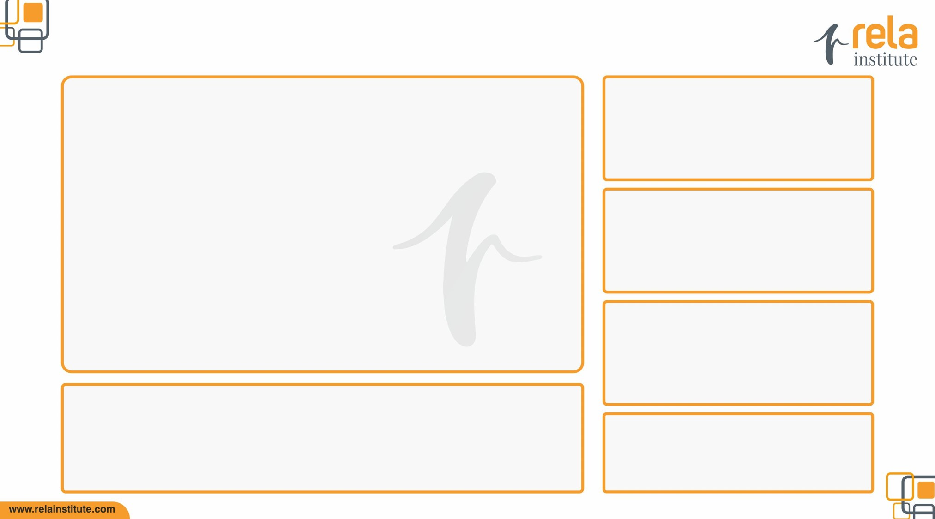
Medication error
Errors in the prescribing, transcribing, dispensing, administering and monitoring of medications.
Marks | Oct’20 | Nov’20 | Dec’20 | Jan’21 | Feb’21 | Mar’21
Total Number of Medicational Errors | 11 | 0 | 4 | 7 | 6 | 5
Number of Patient Days | 4243 | 2608 | 2722 | 2186 | 2122 | 2886
1000 | 1000 | 1000 | 1000 | 1000 | 1000 | 1000
Rate | 2.59 | 0 | 1.47 | 3.20 | 2.83 | 1.75
Error in OPD settings
7.68

Slide 4
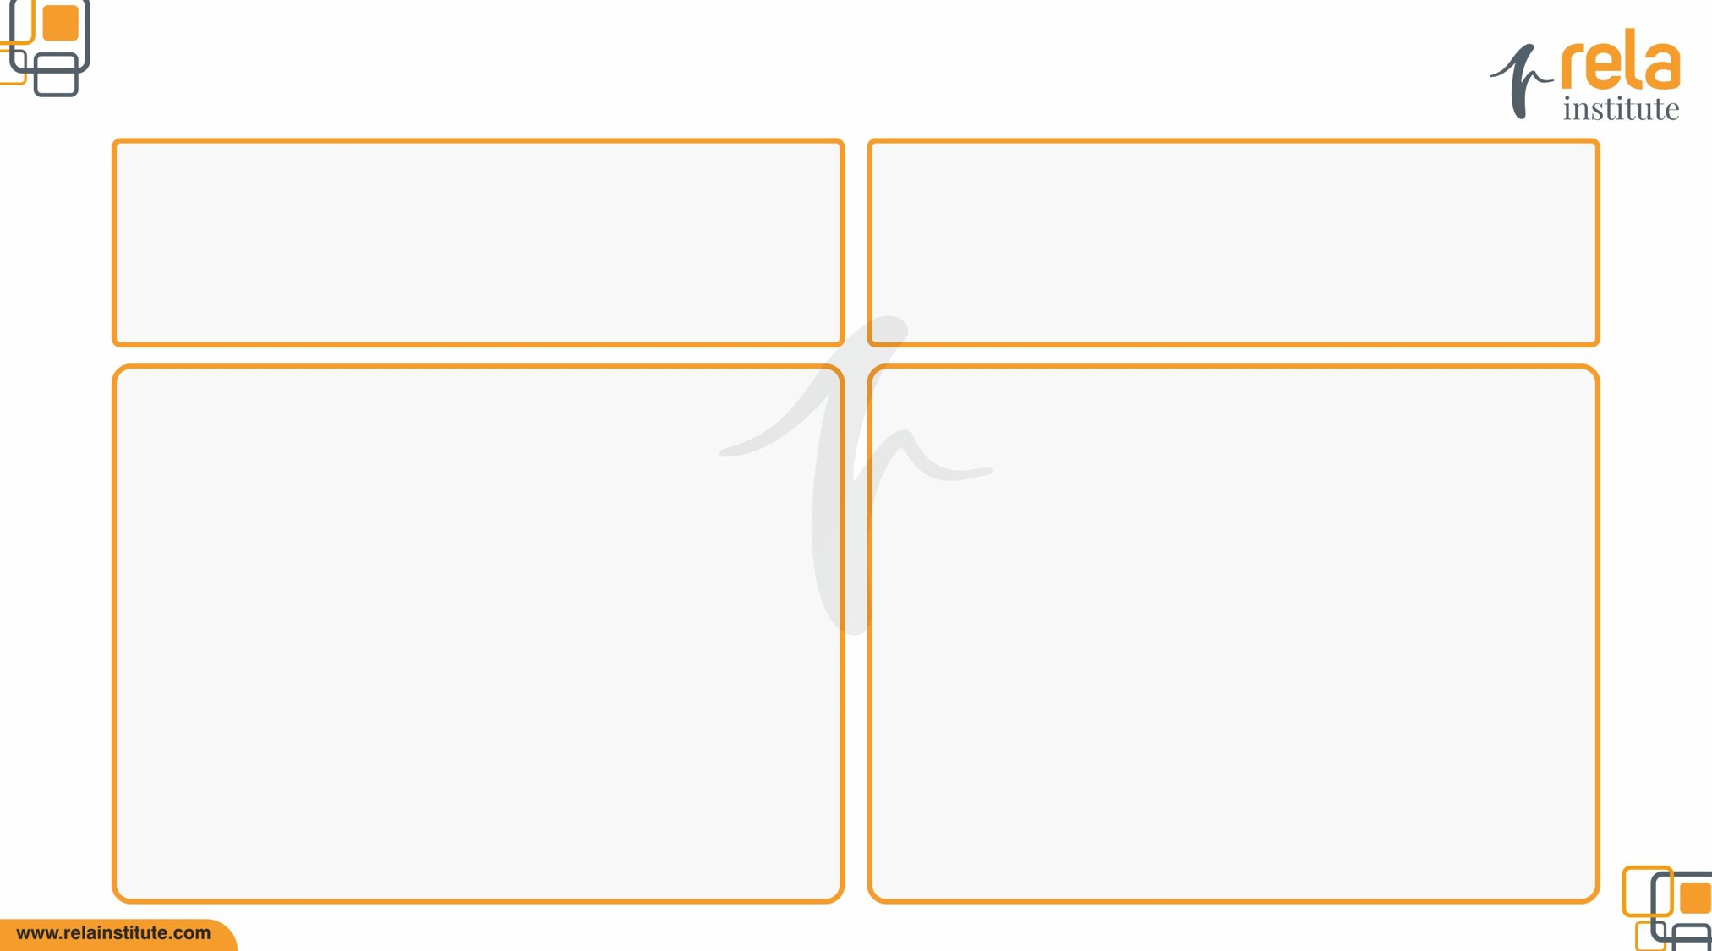
Medication error
The data will be collected through Incident forms, Appropriateness review & prescription audit form. The analysis will be done by Quality & Clinical Pharmacist collectively and the same will be presented to management through Apex Quality improvement and Pharmacy & Therapeutic Committee meetings.
The monthly compiled data will be circulated electronically by quality department to Clinical Pharmacist for further dissemination to all employees working in the department.
Timings of the prescription were written by nursing staff instead of doctors. Elements of prescriptions not verified properly. Lack of availability of drug in markets/ pharmacy. Unawareness about the brand names of combination drugs. Illegibile prescription writing Use of unapproved abbrevations. Nurses didnot verify the 10 rights of administration.
Appropriate training to all doctors,nurses and pharmacists in regards to MAR writing, administration techniques, storage and dispensing respectively. Availability of formulary & E-Cims in all patient care areas through the intranet for clarifying drug related queries. Display of High Alert, LASA list throughout the hospital. Reported Medication errors presented in the PTC meeting and suggestions were made to respective department heads to take neccessary actions to minimize the medication errors.

