Slide 1
AdHoc Network and Home Automation
Applications of Networking Systems

Slide 2
Independent Study and Research II
Course Code: ETISR102
Name: Malayanil Senapati
Enrolment No.: A91005215020
Semester/Year: 6th Semester/ 3rd Year
Section: A

Slide 3
Overview Index
Introduction to Networking
Introduction to AdHoc Networks
Introduction to Home Automation
Introduction to The Project
Discussion of The Project
Conclusion

Slide 4
Introduction to Networking
The process of exchange of information or resources over a medium among two or more inter connected devices is referred to as Networking.
There are two types of medium through which the transmission occurs:
>Wired
>Wireless
The term Internet is the acronym to Interconnected Network (of multiple devices across the globe).

Slide 5
Introduction to AdHoc Network
AdHoc is a Latin phrase which means “for this”. In English, it generally signifies the solution for a specific problem.
AdHoc Network is a type of wireless network which is decentralised in nature.
Decentralised means the network doesn’t depend upon any specific device or a pre-existing infrastructure.
It has a dynamic topology.

Slide 6
Introduction to Home Automation
Home automation or domotics is basically a smart home.
A home automation system will control lighting, climate, entertainment systems, and appliances. It may also include home security such as access control and alarm systems.
When connected with the Internet, home devices are an important constituent of the Internet of Things.
A home automation system typically connects controlled devices to a central hub. The user interface for control of the system uses either wall-mounted terminals, tablet or desktop computers, a mobile phone application, or a Web interface, that may also be accessible off-site through the Internet.

Slide 7
Introduction to The Project
The project which has been developed uses the ideologies of AdHoc Network and Home Automation.
Since we discussed that AdHoc Network is decentralised and Home Automation is centralised, we should focus upon the irony beneath.
This project on Home Automation uses Routers and Repeaters, but the fact that these are not controllers will be stated. For example, the Air Condition can be switched on via the Smart Phone or the Remote provided or even the PC; since all of the devices are inter connected .

Slide 8
Discussion of The Project
The project has been developed in a virtual environment. The devices used in it are as follows:
>CCTV Cameras (Wi-Fi enabled)
>Alarm Speakers
>Fingerprint Scanner and Door Open-Close Detector (Wi-Fi enabled)
>Repeater
>Router
>Air Conditioners (Wi-Fi enabled)
>Lights (Phillips Hue)
>Printer (Wi-Fi enabled)
>Personal Computer
>Home Theatre (Wi-Fi enabled)

Slide 9
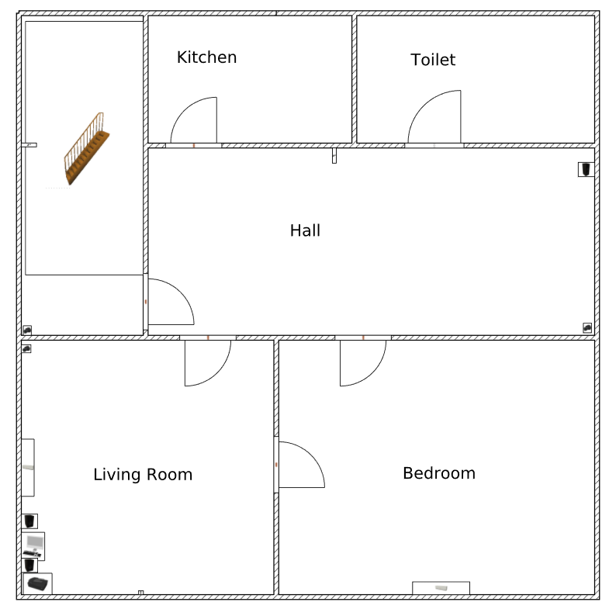
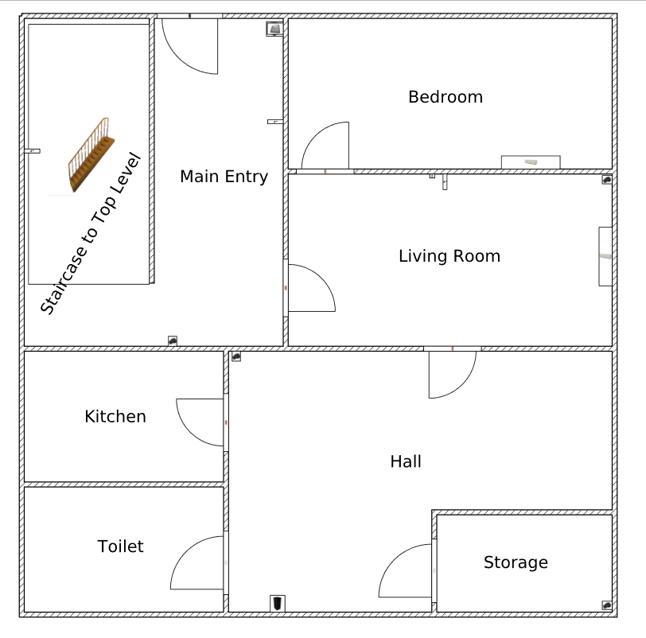
Discussion of The Project (contd.)
Level Two
Level One
These two pictures are the plan of the Home in which the Automated Network has been
implemented.
The 3D Model is ready as well.

Slide 10
Discussion of The Project (contd.)
Level One of the Home where the AdHoc Network is configured. The devices used are :-
a) 4 CCTV Cameras (Wi-Fi and IP Enabled)
b) 2 Alarm Speakers
c) 3 Hue Lights (Wi-Fi Enabled)
d) 1 Repeater (can control every device in the network via Router in Level 1)
e) 1 Fingerprint Scanner collaborated with a Door Opener Detection System (Wi-Fi enabled) for the main entrance into the house.
f) 2 Air Conditioners (Wi-Fi enabled and Split Model)

Slide 11
Discussion of The Project (contd.)
Level Two of the Home where the AdHoc Network is configured. The devices used are: -
a) 3 CCTV Cameras (Wi-Fi and IP Enabled)
b) 1 Alarm Speaker and a 2.1 Home Theatre (Wi-Fi Enabled)
c) 2 Hue Lights (Wi-Fi Enabled)
d) 1 Router (can control every device in the network)
e) PC (can control every device in the network)
f) 2 Air Conditioners (Wi-Fi enabled and Split Model)
g) Printer (Wi-Fi enabled and shared among devices)

Slide 12
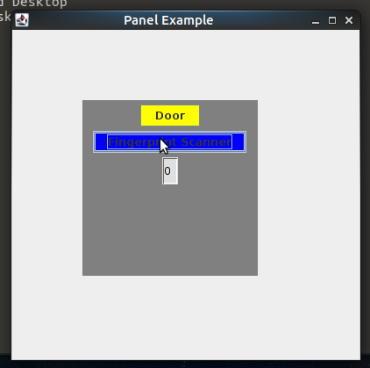
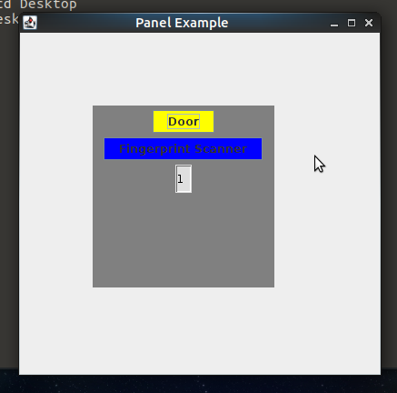
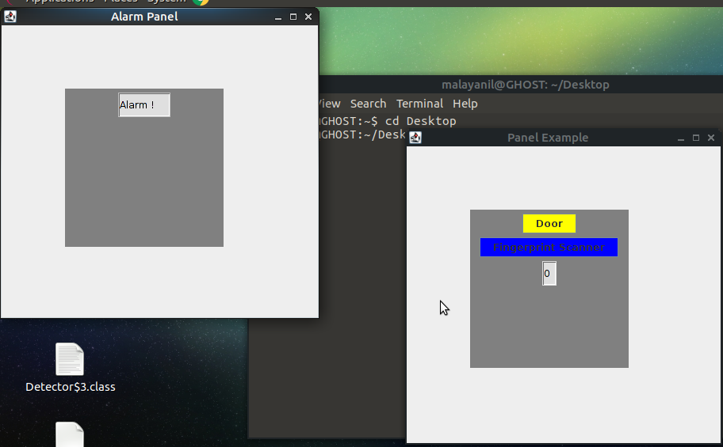
Discussion of The Project (contd.)
A simple Java Program has been coded to show the security systems at the main entrance of the Home.
The code is ready and the outputs are given below.

Slide 13
Discussion of The Project (contd.)
Explanation of the Java Code:
The program has been done using a simple applet. There is a button marked Door, a button marked Fingerprint Scanner and a Timer. When the door is clicked, the timer starts it’s countdown. If the fingerprint scanner is clicked before the timer runs out, the alarm isn’t activated. Otherwise the alarm is activated and shown in another panel.
After the alarm is activated, if the fingerprint scanner is clicked again, the alarm is deactivated.

Slide 14
Discussion of The Project (contd.)
Feed the Fingerprint System with Fingerprints of User.
A stable Internet Connection must be chosen.
Two or more fingerprints should be used.
Alarm Speakers must be tested out.
Repeater and Router must be setup.
The devices must be connected.
These are some of the basic requirements for the Home Automation to be applied after the devices have been bought and fixed in their proper positions.

Slide 15
Discussion of The Project (contd.)
If the project is deployed in the market, it may become quite a success. It is the age of ever evolving technology. The deployment of such a project won’t be rejected by the modern society and will be accepted humbly.
The perception of security and controlling via various means can attract a lot of people to give a tech-look to their homes.
There would be a high possibility of gaining good shares in the market if the deployment price is reasonable as a large portion of India’s population are middle class and expensive equipment may change their minds.

Slide 16
Conclusion
A summary of the project can be described as Home Automation system using various home appliances connected over an AdHoc Network. The user can control the devices in the network using his smart phone or PC or just by using switches or remotes (which are provided by the manufacturer).
Thank you !

