Slide 1

SMART INDIA HACKATHON 2026
AAVARAN — a privacy veil for browser agents
Problem Statement ID – 26171
Problem Statement Title – On-device Visual Perception for Light-weight Browser Agents
Theme – Smart Automation
PS Category- Software
Team ID – <Team ID>
Team Name (Registered on portal) – <Team name>

Slide 2
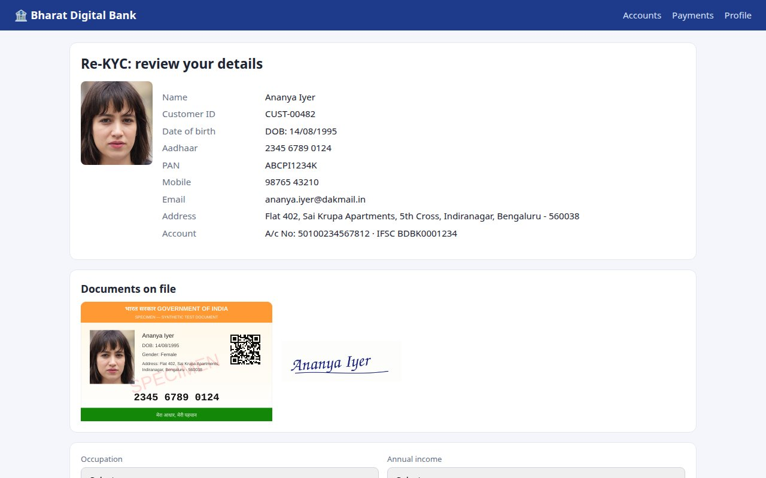
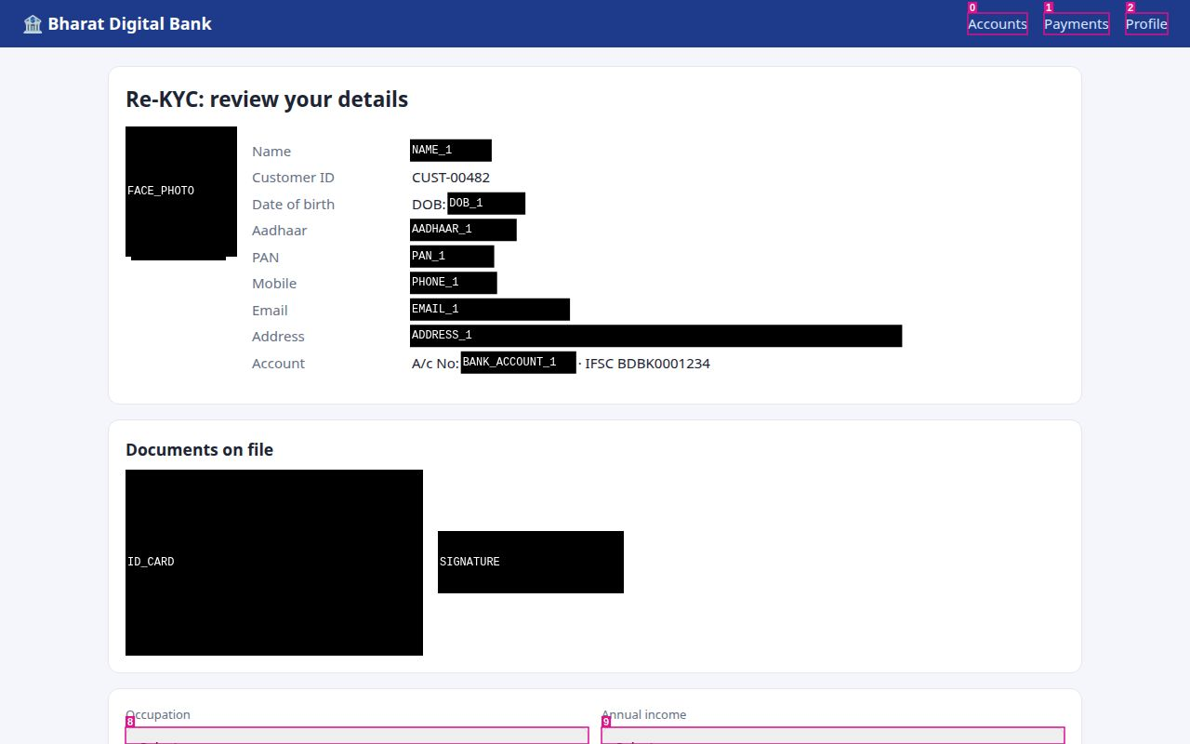
AAVARAN — ON-DEVICE PRIVACY VEIL
<Team name>
Proposed solution
Browser extension (Chrome, Edge, Brave, Firefox) + FastAPI server. Three small models run in the browser (WebGPU → WASM) and read the screen: YuNet faces, MobileCLIP-S0 vision transformer, BERT-small PII NER (52 MB total).
Before any request, personal data is replaced by consistent tokens ([NAME_1], [AADHAAR_1], [OTP_1]) and black-boxed at pixel level in the screenshot, with the same labels.
An open-weights VLM on the server (Qwen2.5-VL / Llama-4 / Gemma-3) plans actions over tokens + numbered UI marks; the client swaps real values back in on the device.
How it addresses the problem
Server-side agents can't be trusted with Aadhaar cards, OTPs, faces and bank pages; a local-only agent is too weak. Aavaran splits the work: perception + privacy local, reasoning remote.
Redaction is verifiable: a Privacy X-ray shows the exact frame and tokens that leave; the server's own audit log is checked after every task — 0 leaks in 5 end-to-end tasks.
What the user sees
Innovation & uniqueness
DOM-grounded pixel redaction: PII found in text is mapped to exact screen rectangles (Range.getClientRects) — no OCR guessing; vision covers pixels the DOM can't describe (faces, ID-card photos, signatures).
Reversible pseudonym vault: the agent can fill your form with your details without ever seeing them.
Pixels × structure: a ViT fused with DOM structure understands unseen websites 54.0% vs 39.1% from pixels alone.
India-first PII: Aadhaar (Verhoeff), PAN, GSTIN (mod-36), UPI, IFSC-context accounts, OTPs.
What the server receives — redacted on the device

Slide 3
TECHNICAL APPROACH
<Team name>
1
Screen + DOM
2
On-device perception
3
Redact & tokenise
4
Egress gate
5
Open-weights VLM
6
Act on device
tokenise task first;
visible text, fields,
images, UI elements
YuNet · MobileCLIP-S0
· BERT-small NER
(ONNX Runtime Web)
pixel-exact black boxes
same tokens in text
and image · Vault
fail-closed re-check of
every outgoing string
(no image if tab moved)
server re-checks; reasons
over tokens + Set-of-
Marks screenshot
tokens → real values
locally; direct DOM
events; loop
user's browser — raw pixels and values never leave the device
server
Technologies
Methodology (built and measured)
Client
Manifest V3 extension, JavaScript, esbuild; Chrome/Edge/Brave + Firefox from one source
Text PII → pixels: visible text grouped per block, scanned by checksum rules + NER + known Vault values; each span → Range.getClientRects() → black box labelled with its token.
Vision: all on-page images packed into one 640² YuNet mosaic (avatars become detectable); one batched MobileCLIP pass for screen state + image regions (ID card, signature, QR, face photo), fused with DOM cues.
Adaptive compute: dHash frame cache, per-page screen cache, NER/region caches, eco / balanced / max modes, models warmed while the user types.
Grounding: numbered Set-of-Marks on interactive elements; actions reference node ids; tokens rehydrated only at execution.
Defence in depth: sensitive-field values never serialised; egress gate; server-side re-check (Aadhaar/Verhoeff, PAN, UPI, Luhn); audit log.
On-device ML
ONNX Runtime Web — WebGPU, multi-threaded WASM SIMD (cross-origin isolated); offscreen document hosts all models once
Models
YuNet FP32 0.2 MB · MobileCLIP-S0 image tower FP16 22.9 MB (prompt embeddings precomputed) · BERT-small PII INT8 28.7 MB
Server
Python FastAPI; OpenAI-compatible open-weights VLM (vLLM / Ollama): Qwen2.5-VL-7B, Llama-4-Scout, Gemma-3
Evaluation
Puppeteer + real Chrome, onnxruntime-node; WIDER FACE, ai4privacy, 217-screen web set

Slide 4
FEASIBILITY AND VIABILITY
<Team name>
Working prototype, measured against all five evaluation criteria (reproducible scripts in eval/):
54.0%
0.97
0.91
37–173 MB
0.38 s
0
screen understanding on
unseen websites (? sites)
PII F1, Indian set
(R 0.96 · P 0.98)
pixel redaction precision
46/46 sensitive objects covered
total on-device engine
memory (eco–balanced)
on-device perception per
step (median, laptop CPU)
leaks in 5 end-to-end
tasks (server audit log)
Challenges, risks and how we handle them
Challenge | Risk | Strategy (implemented)
Low-end client devices | Models too heavy / slow | 52 MB total; measured precision choice (FP32 YuNet 2.6× faster than INT8 in WASM, see docs/model-contract.md); eco mode 37 MB; caches make an unchanged frame ~0.14 s; WebGPU when present
Missed PII = privacy leak | Rules or NER miss a value | Four layers: checksum rules + NER + Vault-guided matching + sensitive-field boxing; fail-closed egress gate; server re-check; audit log
Over-redaction | Agent loses context | Typed, consistent tokens keep structure; checksum validation keeps order ids, PNRs, prices, IFSC readable (1/120 false alarms on hard negatives)
Unfamiliar UIs | ViT not trained on screens | Fuse pixels with DOM structure (+14.9 pts on unseen sites); element grounding via DOM + Set-of-Marks is exact
Server model availability | Cloud dependence | Any OpenAI-compatible open-weights endpoint (vLLM / Ollama offline); stateless server; mock mode for demos

Slide 5
IMPACT AND BENEFITS
<Team name>
Who benefits
1
Citizens — use AI assistants on DigiLocker, UPI, bank, e-KYC and government portals without handing Aadhaar, OTPs or faces to a server
2
Government & ISRO / DoS — automate internal web workflows on sensitive screens; the server can run on-premise with open weights
3
Enterprises & startups — build agents that comply with the DPDP Act 2023 by design (data minimisation, purpose limitation, auditability)
4
Low-end & rural devices — runs on a 4-core laptop CPU with no GPU; small payloads (~50 KB image per step) suit slow networks
Benefits
Social: trust in AI assistance; privacy that users can inspect (Privacy X-ray).
Economic: open-weights models, no per-token vendor lock-in; smaller prompts (tokens, one ~50 KB JPEG).
Strategic: sovereign, offline-deployable stack, aligned with Atmanirbhar Bharat and DPDP.
Environmental: caches skip repeated inference; less data moved per step.

Slide 6
RESEARCH AND REFERENCES
<Team name>
Research & models
Prototype & evidence
Vasu et al., MobileCLIP: Fast Image-Text Models through Multi-Modal Reinforced Training, CVPR 2024 — arxiv.org/abs/2311.17049
Wu et al., YuNet: A Tiny Millisecond-level Face Detector, Machine Intelligence Research 2023 — github.com/opencv/opencv_zoo
Yang et al., Set-of-Mark Prompting Unleashes Extraordinary Visual Grounding in GPT-4V, 2023 — arxiv.org/abs/2310.11441
Bai et al., Qwen2.5-VL Technical Report, 2025 — arxiv.org/abs/2502.13923 (open-weights server VLM)
Radford et al., Learning Transferable Visual Models from Natural Language Supervision (CLIP), ICML 2021
ONNX Runtime Web (WebGPU / WASM) — onnxruntime.ai · Transformers.js — huggingface.co/docs/transformers.js
BERT-small PII detection (ONNX) — huggingface.co/onnx-community/bert-small-pii-detection-ONNX
Datasets: WIDER FACE (Yang et al., CVPR 2016); ai4privacy/pii-masking-200k
Digital Personal Data Protection Act, 2023 (MeitY); UIDAI Aadhaar number checksum (Verhoeff)
Code: github.com/Malaybhai11/SIH2026-SIH26171
Extension for Chrome/Edge/Brave (dist/) and Firefox (dist-firefox/)
Demo sites (synthetic data, AI-generated faces): bank KYC, webmail OTP, social feed, checkout, ISRO outreach registration
Scorecard: eval/results/SUMMARY.md — every number reproducible with one npm script
End-to-end tasks: checkout 7 s, inbox 6 s, kyc 22 s, register 17 s, social 6 s — all passed, 0 leaks
Faces (WIDER val): P 0.78 / R 0.73; ai4privacy PII F1 0.85

