Slide 1
CareerUp
Sprint Cycle 0 — Team Setup & Project Preparation
Nafee Ahmed • Isaiah Alfred • Jordan Monts • Malcolm Richards
Notes:
About 30–40 seconds. Introduce CareerUp and the team. Explain that this presentation covers what the team completed during Sprint Cycle 0.

Slide 2
What is CareerUp?
Project overview
A media-first professional networking platform for college students and employers.
Students can showcase projects, internships, research, creative work, skills, images, and short videos.
Employers can discover students, review portfolios, communicate with candidates, and post opportunities.
Primary roles: Student, Recruiter, Company Representative, Career Advisor, and Administrator.
2
Notes:
About 1 minute. Give the audience the big picture of CareerUp. Keep this high-level; Sprint 0 is about preparation, not building features yet.

Slide 3
Sprint Cycle 0 Goals
Preparation before development
Review the functional requirements as a team.
Establish one shared GitHub repository and initial project structure.
Make sure every team member can clone, pull, commit, and push.
Create the README, setup instructions, and project documentation.
Discuss the development technology and environment before implementation begins.
Important: No project-specific functionality, final UI, or database design was implemented in Sprint 0.
3
Notes:
About 1 minute. Explain that Sprint 0 was about getting the team ready to develop. Mention that the final UI and database design belong to later sprint cycles.

Slide 4
Repository & Team Setup
CareerUp GitHub workflow
Created the shared CareerUp GitHub repository.
Added the README with the project description, team members, user roles, and setup instructions.
Created the initial repository structure for source code and documentation.
Each team member made an individual, nonfunctional contribution using their own GitHub account.
Each member verified repository access by cloning/pulling the current project.
4
Notes:
About 1 minute. Show that the repository is the team's official working location and that everyone participated individually.

Slide 5
Development Technology
Current status
Currently documented in README
Java / HTML / CSS / JavaScript
Spring Boot / React
MySQL
IntelliJ / Visual Studio
JUnit / Jest
Still under team discussion
The team has discussed frontend and backend options, but the final choices should not be treated as permanent until the group confirms them.
Sprint 0 requires the team to finalize the selected development technology before submission.
5
Notes:
About 1 minute. Be careful here: the README currently lists technologies, but the group is still discussing the final frontend/backend choices. Do not present those choices as permanent until the team confirms them.

Slide 6
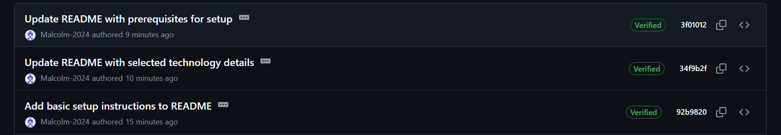
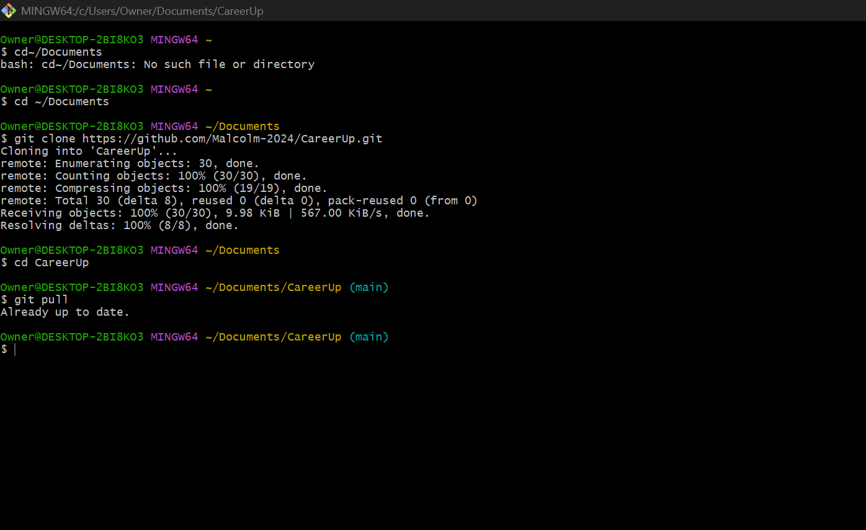
GitHub Verification
Individual contribution and pull evidence
Commit history verifies individual contributions • Git Bash verifies a successful clone and pull
6
Notes:
About 1 minute. Briefly point out the commit history and the terminal showing a successful pull. Explain that each team member is expected to provide similar evidence.

Slide 7
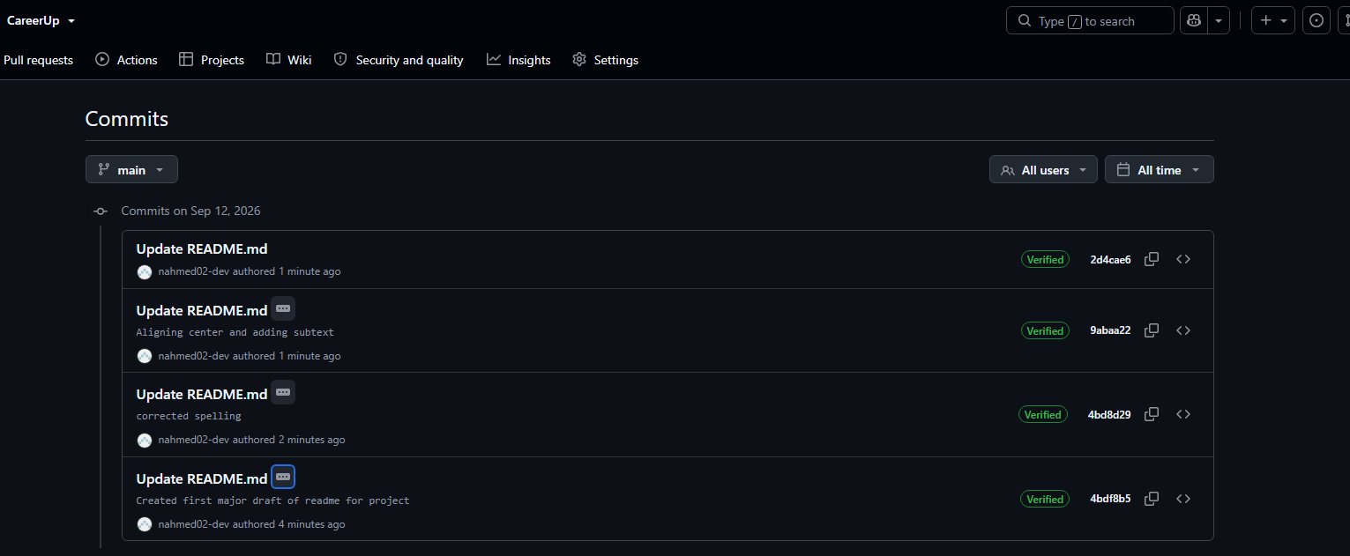
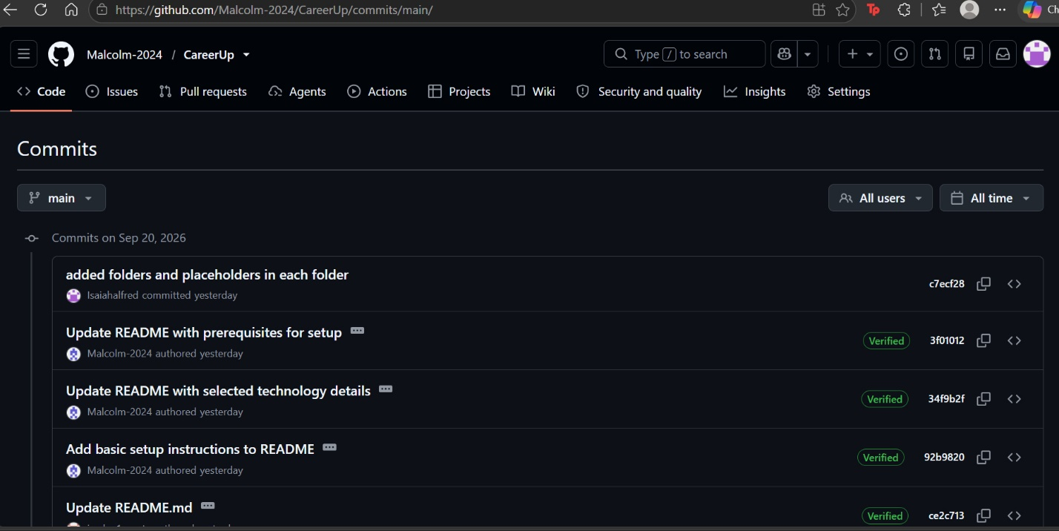
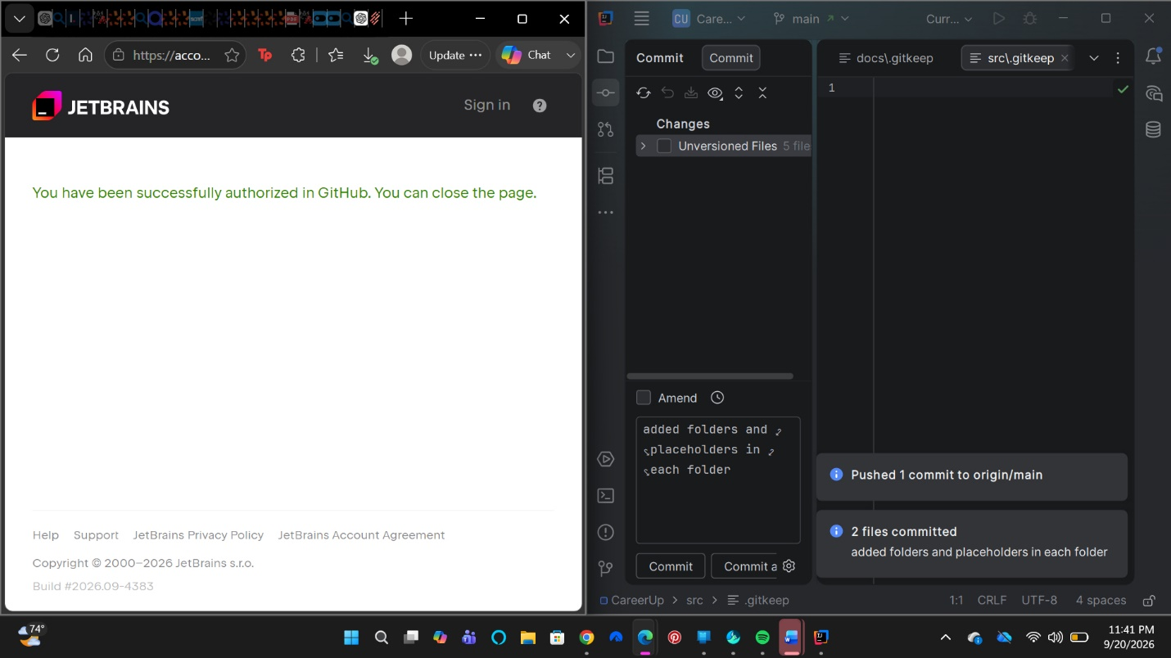
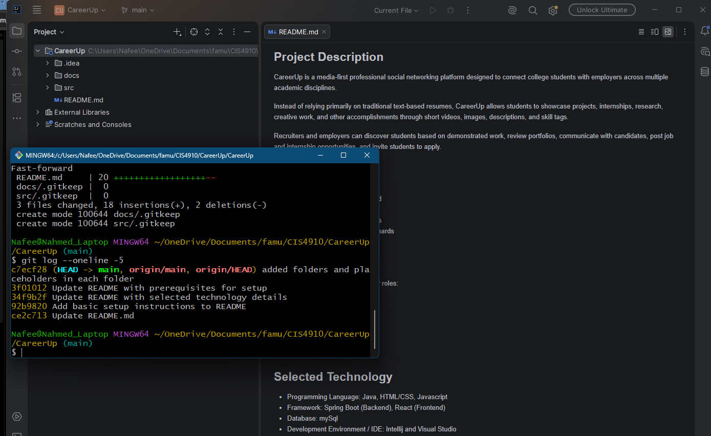
Tried to get Jordan’s gh verifications but Jordan refused to answer and give pictures. I have proof of trying to do so since 6 pm and reminders of doing so before that day as well. I have 3 of 4 team members verifications but only due to Jordan not cooperating.

Slide 8
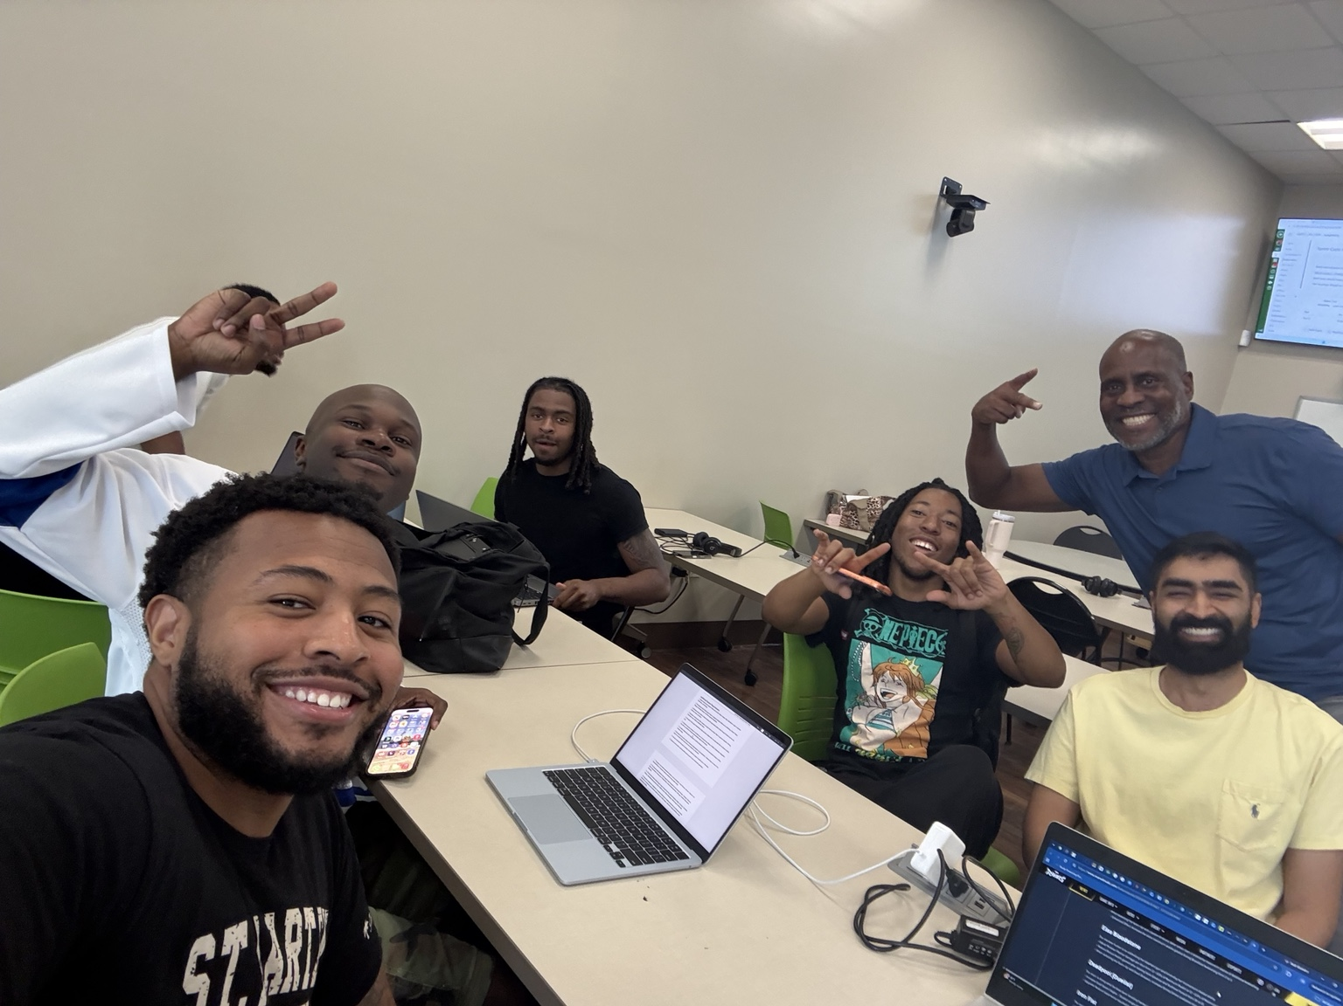
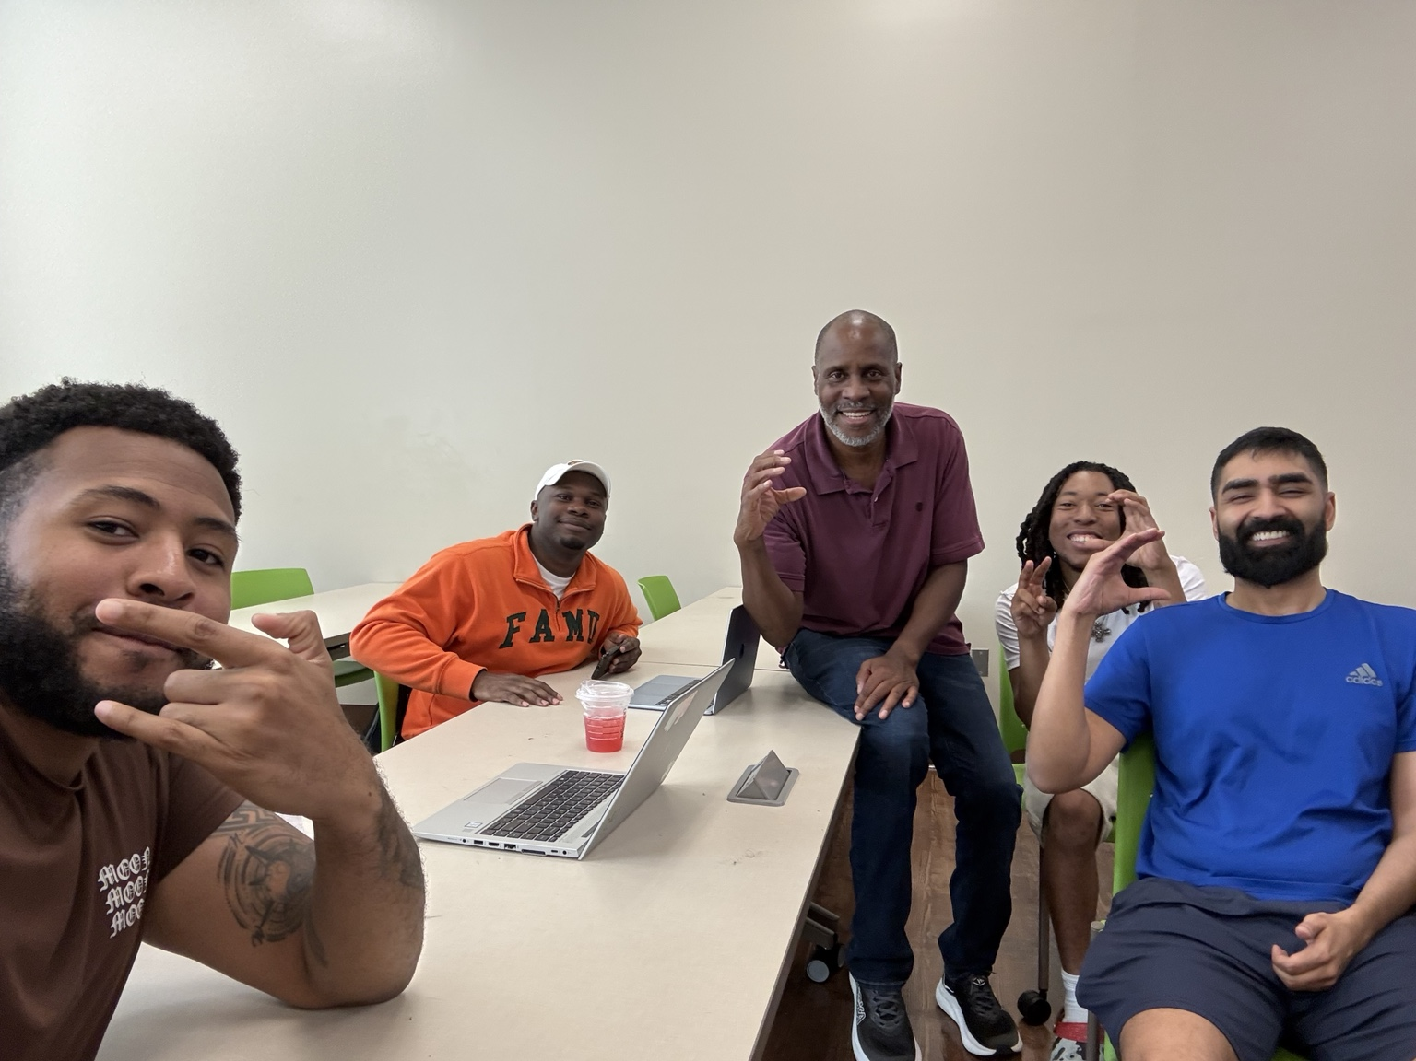
Team Meetings & Sprint 0 Completion
How the team coordinated
First meeting
Created the repository, reviewed the project direction, and discussed possible frontend/backend approaches.
Sprint 0 completion
Reviewed the completed setup work, GitHub contributions, verification evidence, presentation, and meeting documentation.
7
Notes:
About 1 minute. Explain what happened in the first meeting and the Sprint 0 completion meeting. Mention that additional meetings were not needed for this sprint because the required setup work was completed through these meetings and team coordination.

Slide 9
Sprint Cycle 0 Status
✓ Shared repository established
✓ README and setup documentation created
✓ Individual GitHub contributions completed
✓ Clone / pull verification collected
✓ Meeting documentation completed
→ Final technology choices still need team confirmation
CareerUp is prepared to move into the next sprint once the remaining technology decision is finalized.
Notes:
About 45 seconds. Summarize what Sprint 0 accomplished and state that the team is ready to move forward once the remaining technology choices are confirmed.

