Slide 1

Quality Adjusted Survival Analysis
Malcolm Hudson
Professor
Department of Statistics
Macquarie University
Program Grant (Principal Investigator)
NHMRC Clinical Trials Centre
ARCS ASC,
Sydney, 5 June, 2007

Slide 2
Quality Adjusted Survival Analysis
Why QAS?
What to include in trials to evaluate quality of life (QoL)
Analysis contexts
  decision trees
  discrete health states (constant QoL -> QALYs)
  'continuous' QoL variation
    small subgroups with severe outcomes
Utility based QALYs
  How to determine utility coefficients/ valuations
  Statistical methods

Slide 3
Ex 1: Warfarin decision tree

Slide 4
Ex. 1: Valuation of outcomes

Slide 5
Ex 1: Standard gamble utility assessment
study subject identifies risk of death, 1-p, they would accept to return to good health from their disabled state
utility u follows from p
Valuation perspective:
societal
government / insurer
hospital / physician
patient / past patient

Slide 6
Ex. 2: Advanced breast cancer (ABC)

Slide 7
Goals of treatment
The goals of treatment in
advanced breast cancer
are palliative, ie
To improve length and
quality of life
without realistic hope of cure

Slide 8
Effects of chemotherapy on quality of life
Reduce
cancer-related
symptoms
Add
side-effects
inconvenience

Slide 9
What do we know about palliative chemotherapy in advance breast cancer ?
Stockler, Wilcken, Ghersi, Simes.
The management of advanced breast cancer:
systematic reviews of randomised controlled trials regarding the use of cytotoxic chemotherapy and endocrine therapy.
NHMRC National Breast Cancer Centre 1996
12 questions
65 RCTs
90 comparisons

Slide 10
Systematic reviews of CT for ABC
Stockler & Wilcken. Cancer Treat Rev 2000
100s of RCTs comparing recipes
no RCTs of chemotherapy vs control
better survival and quality of life with
  more rather than fewer cycles CTCoates ANZBCTG
  standard rather than 1/2 doses of CTTannock

Slide 11
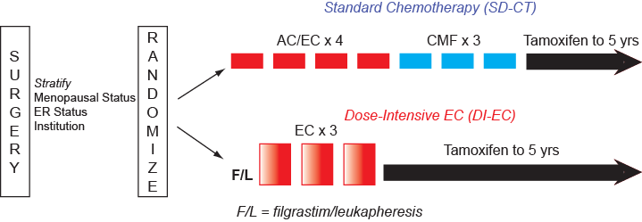
IBCSG Trial 15-95

Slide 12
QL Schema
Months from Randomization
0 3 6 9 12 15 18 21 24 36 48 60 72
SD-CT
F/L
DI-EC
SD-CT = Standard Dose Chemotherapy
DI-EC = Dose-Intensive Epirubicin and Cyclophosphamide
Tamoxifen
QL Assessment: Core & Module
QL Assessment: Core
F/L
Filgrastim/Leukapheresis

Slide 13
QL Endpoints
Core Form
Module
Physical Well-Being
PACIS (Coping)
Mood
Appetite
Tiredness
Nausea/Vomiting
Hot Flushes
Social Support
Arm Movement
Subjective Health Estimation
(SHE)
Hair Loss
Numbness
Thought of Actually Having Treatment
Loss of Sexual Interest/Ability
Sore Mouth
Pain
Bothered by Treatment Related Difficulties
Performing Daily Activities

Slide 14
QL Form Submission Rates
QL Patient Population
243 Analyzable Patients
Baseline: 78% (N = 193)
Month 3: 82%
Month 6: 78%
Month 9: 84%
Month 12: 82%
Month 18: 85% (N = 209)

Slide 15
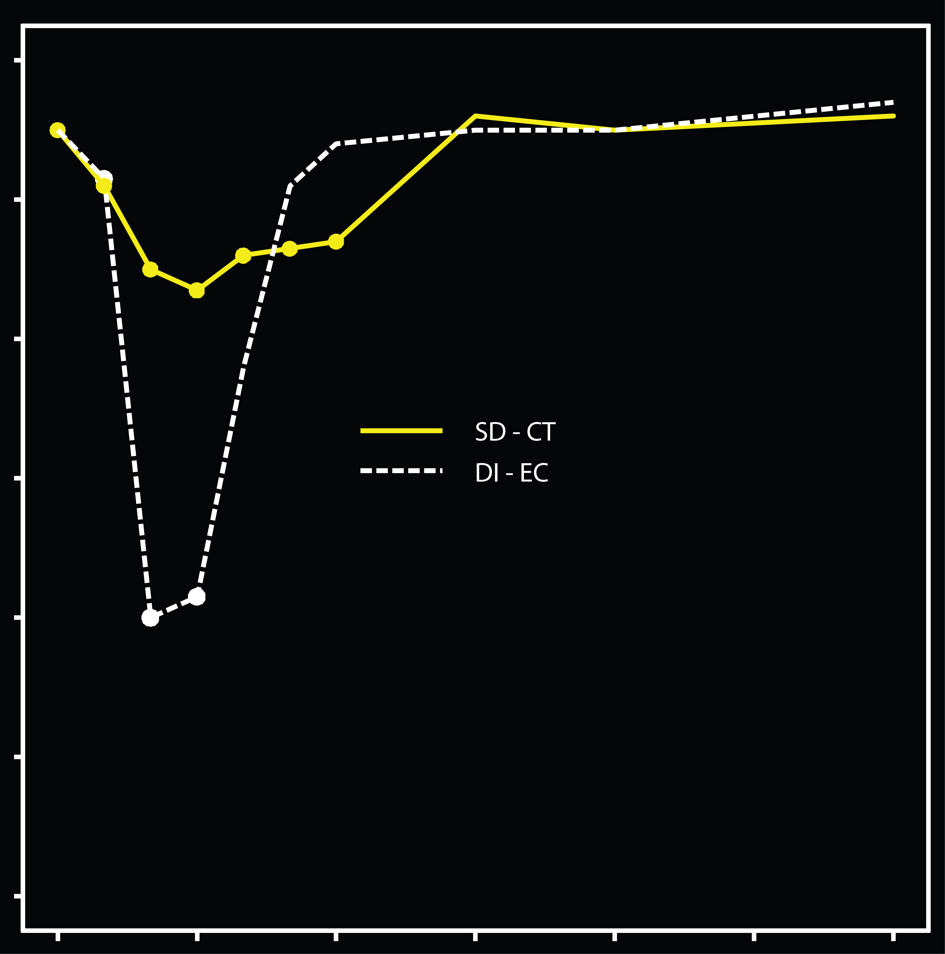
Appetite
better
100
90
80
Median Appetite Score
70
60
50
40
worse
0
3
6
9
12
15
18
QL Assessments (Months)
P:
0.50
<0.01
0.09
0.67

Slide 16
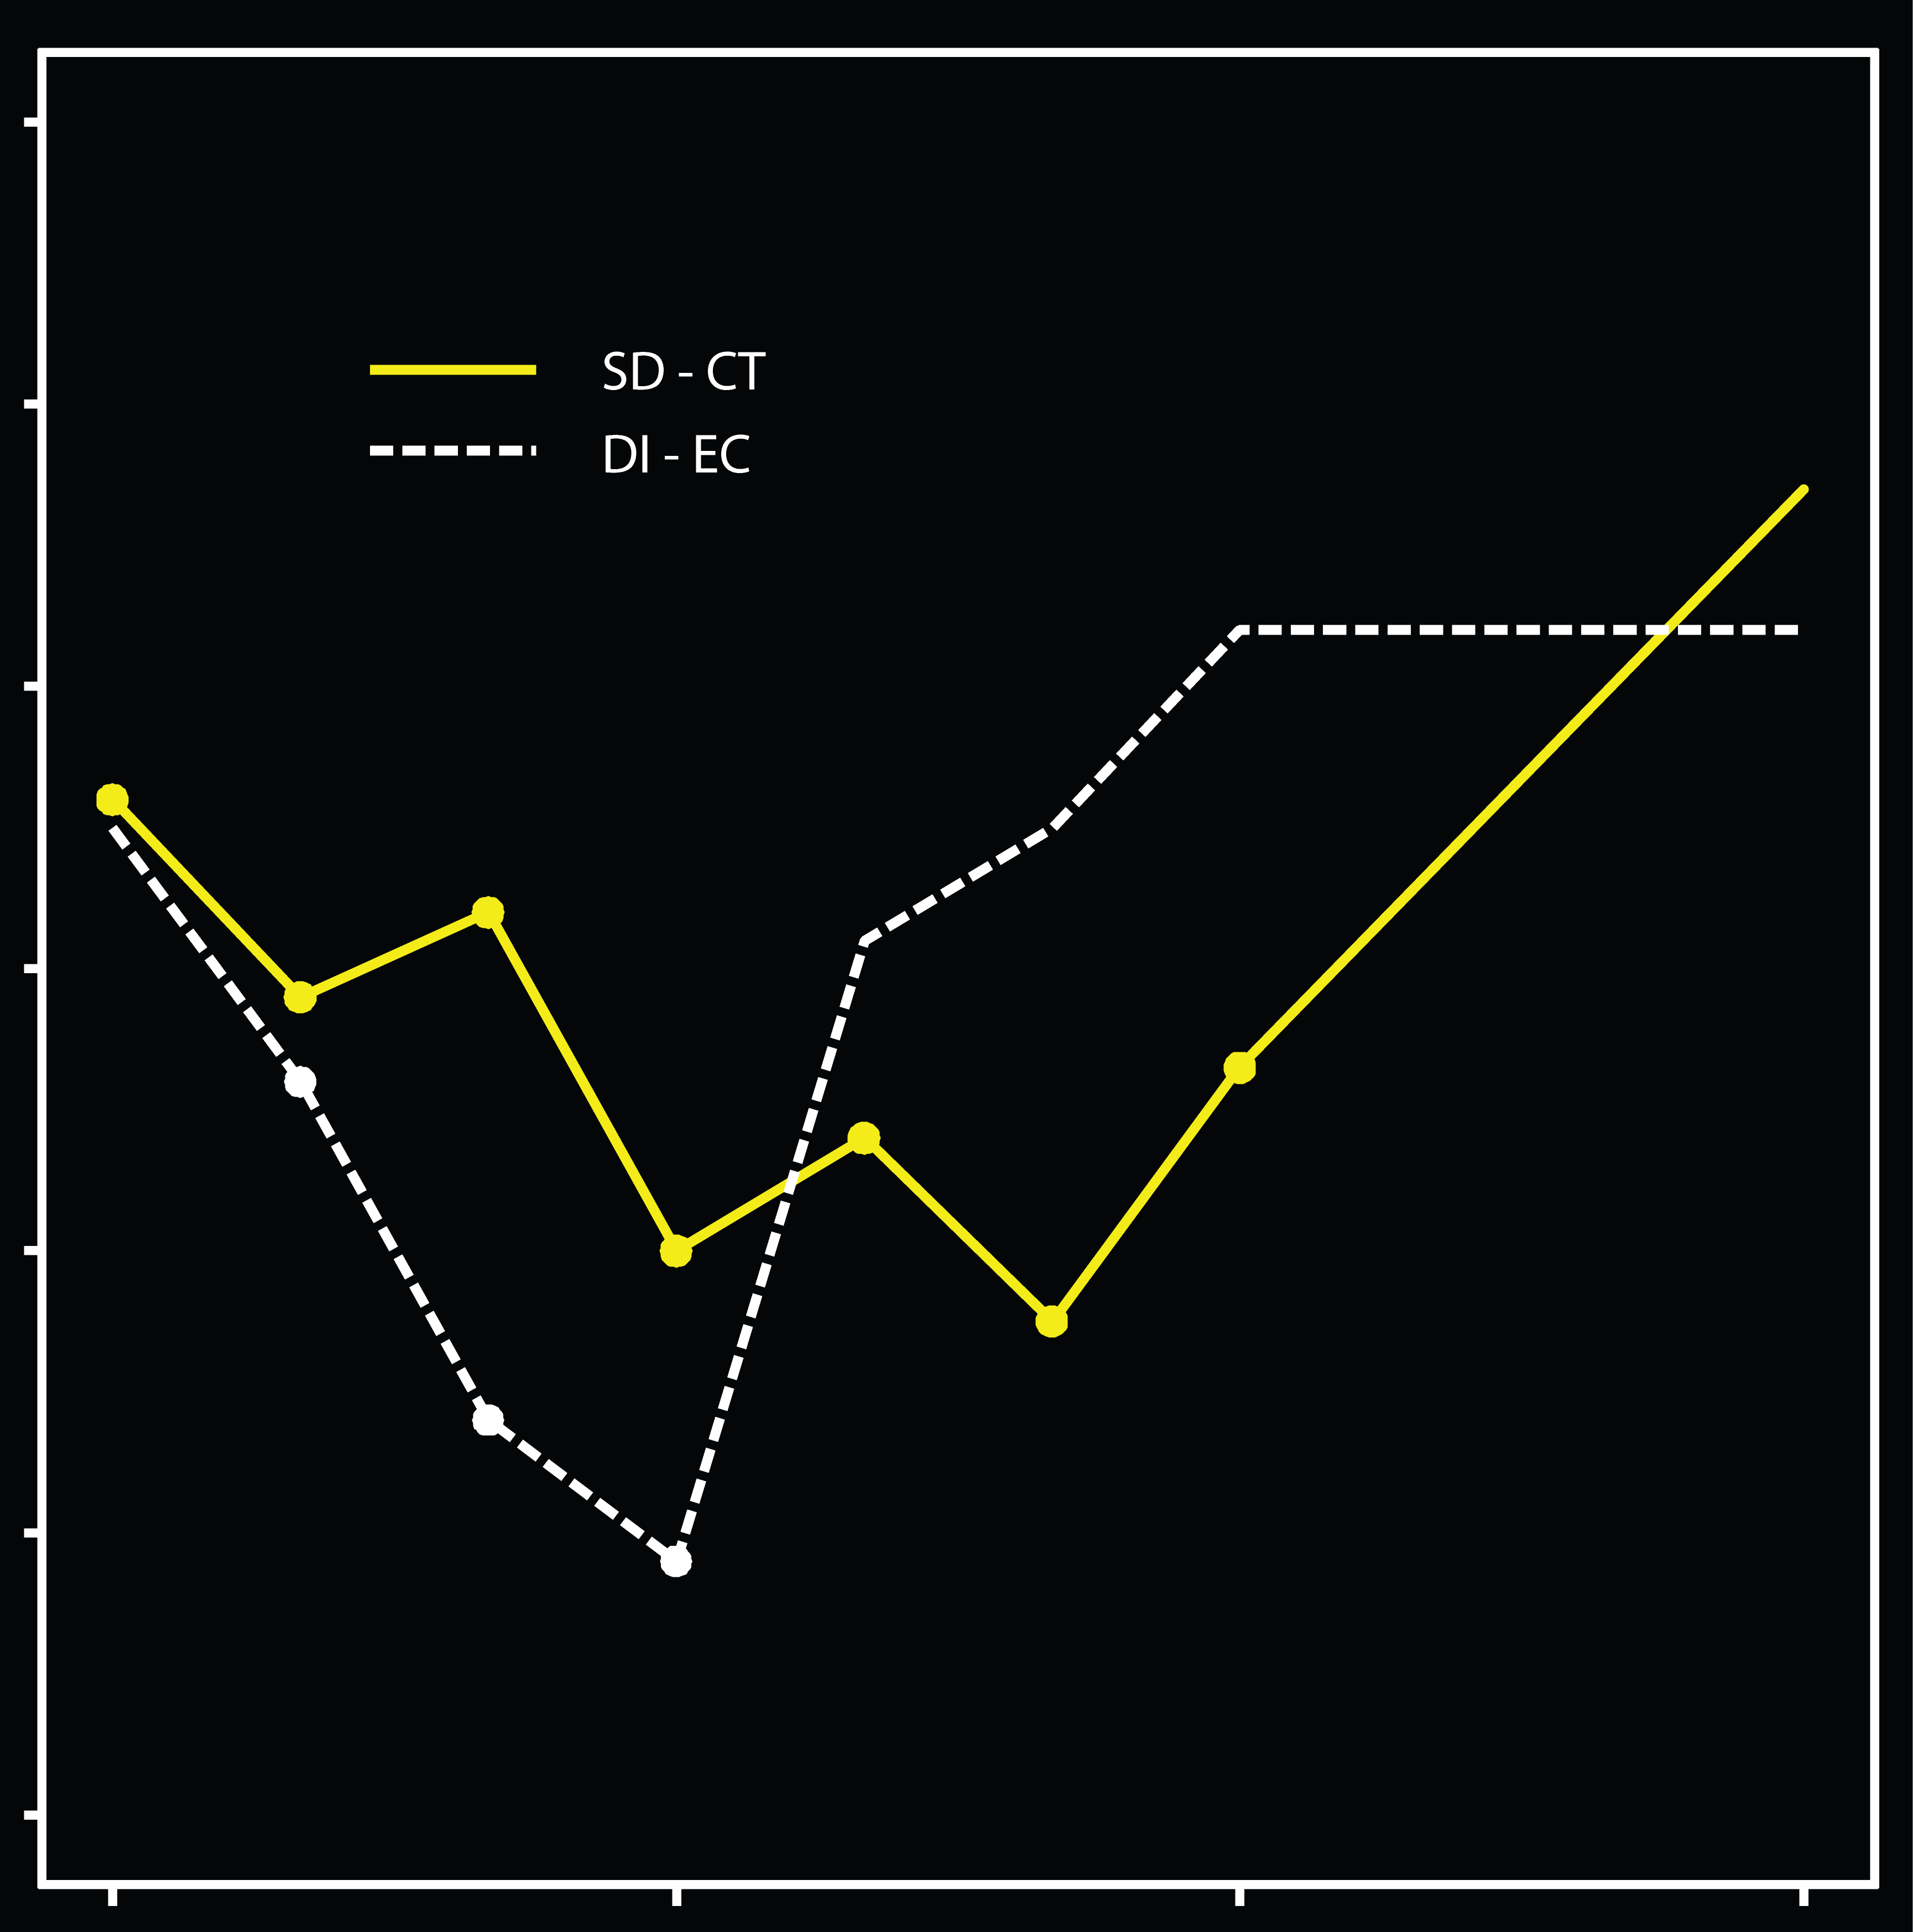
Treatment Burden
better
100
90
80
70
Median Overall Treatment Burden Score
60
50
40
worse
0
3
6
9
QL Assessments (Months)
P:
0.58
0.03
<0.01
0.28

Slide 17
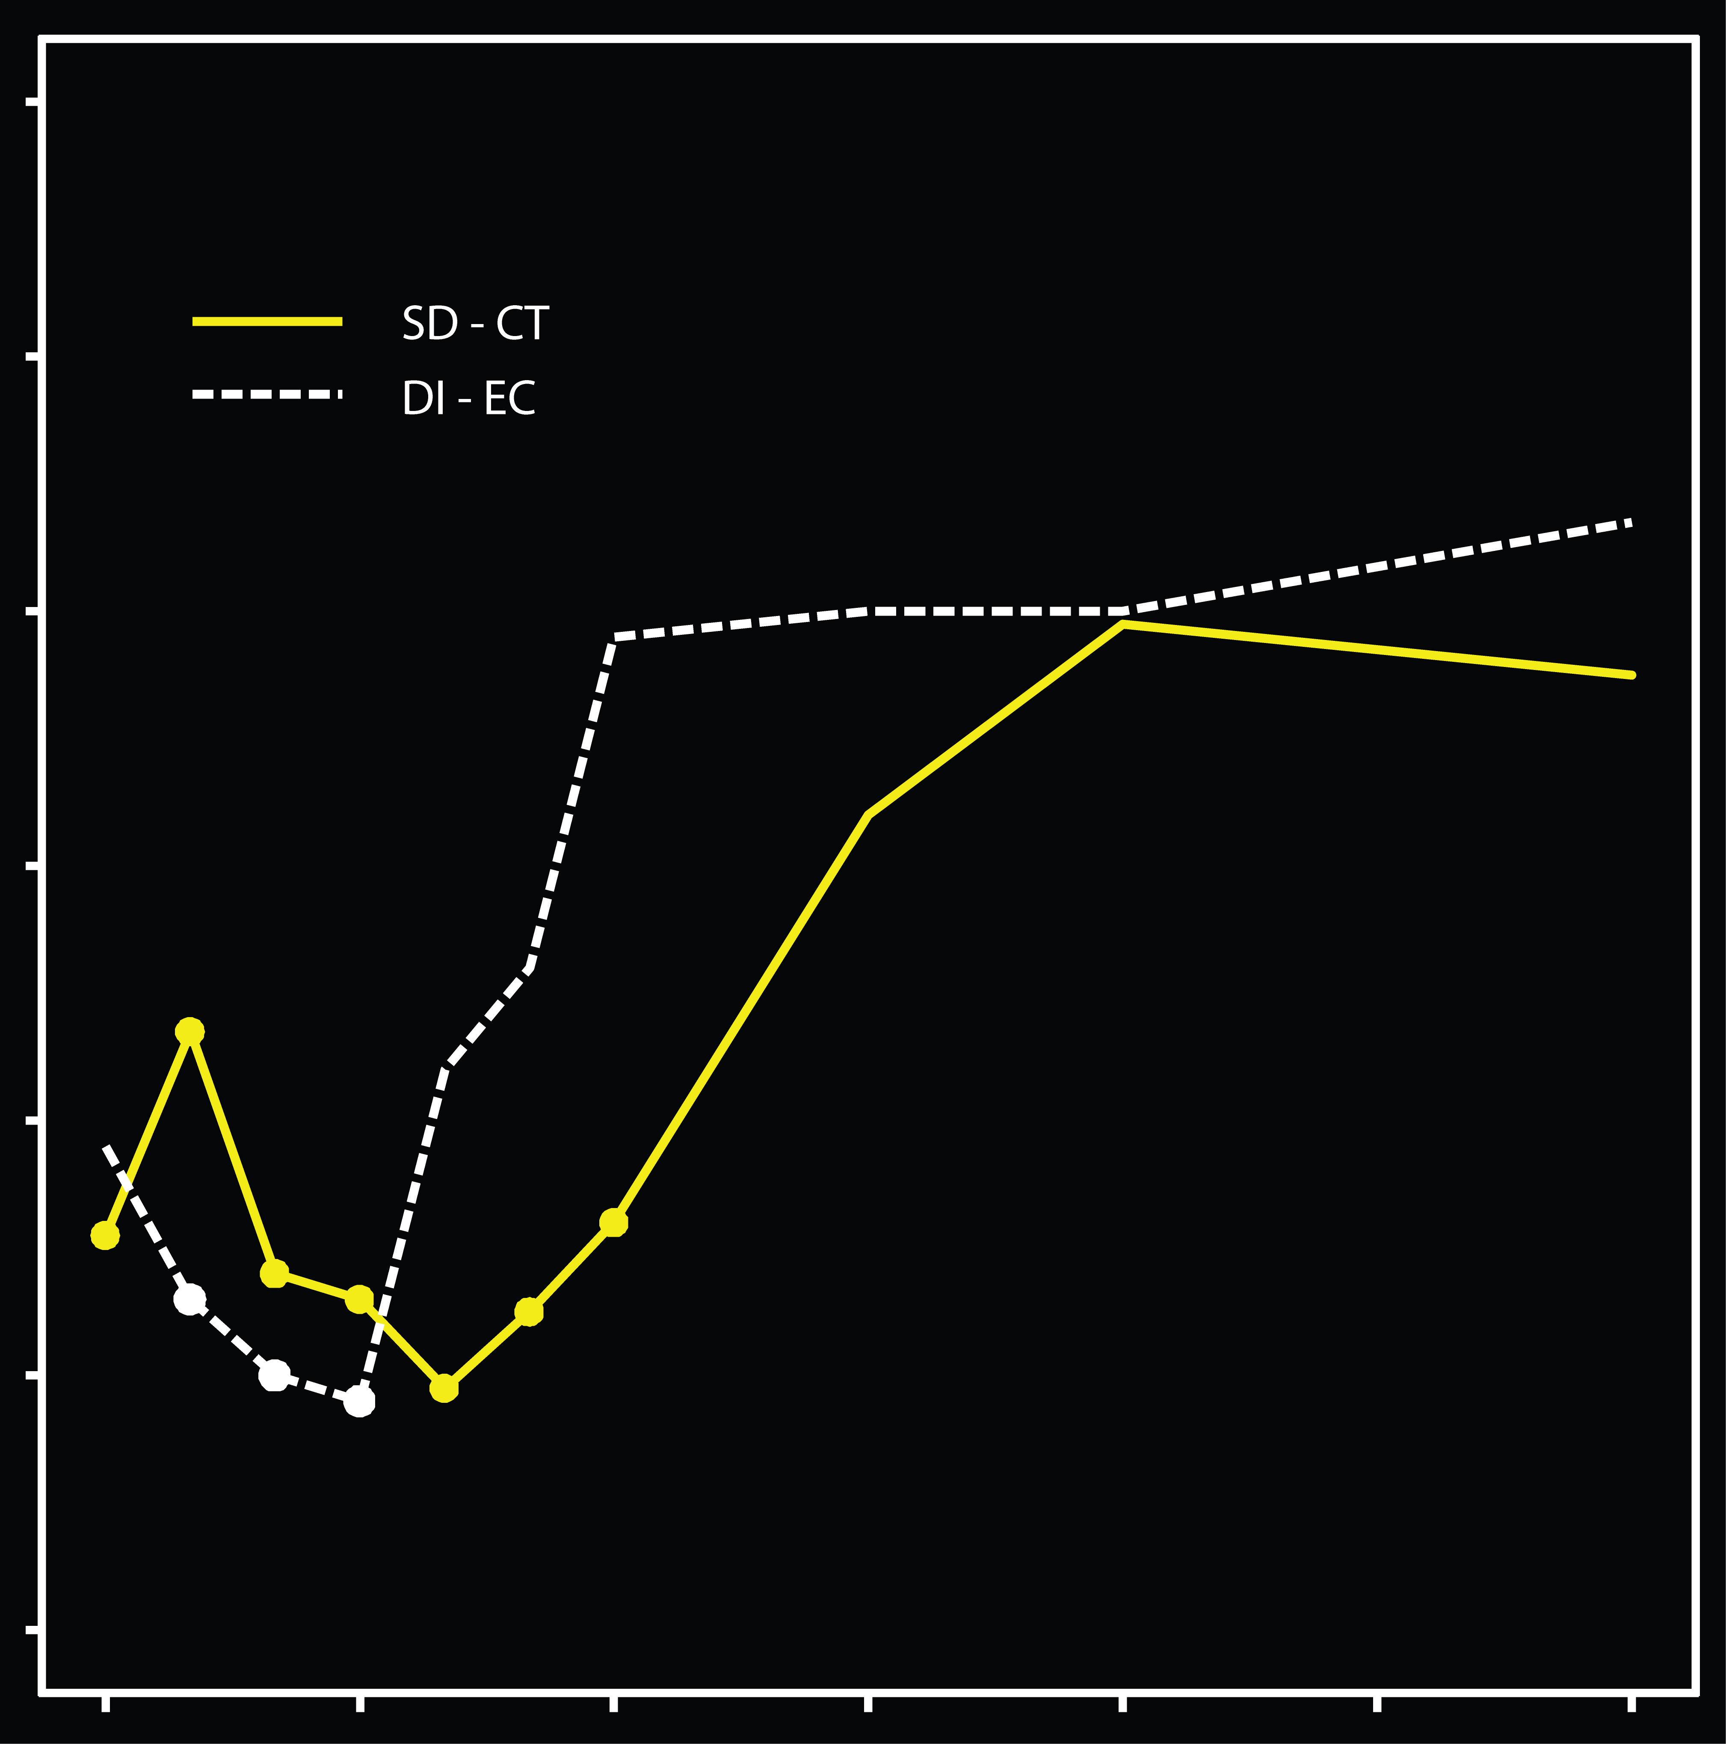
PACIS (Coping)
better
100
90
80
Median PACIS Score
70
60
50
40
worse
0
3
6
9
12
15
18
QL Assessments (Months)
P:
0.85
0.26
<0.01
0.11

Slide 18
Q-TWiST
Quality-adjusted Time Without Symptoms or Toxicity
Incorporate QL information into survival analysis ?
Evaluate “trade offs” in clinical trials

Slide 19
Q-TWiST
Quality-adjusted Time Without Symptoms or Toxicity
Utility
1.0
TOX
TWiST
REL
Death
0
Time
Q-TWiST = u_{TOX} x TOX + TWiST + u_{REL} x REL

Slide 20
Lumley et al Fig.3, Tbl. I
MEG 8901 trial in advanced cancer patients
  – double blind, placebo controlled, n =240
  3 regimens of megestrol acetate usage (“placebo”, “low dose”, “high dose”)
  weight loss, nutrition, 5 P&B LASA lines to measure QoL.
  - GLQ uniscale
  Test retest reliabilities of these scales measured in Coates, Glaziou and McNeil
  Demonstrates improved precision

Slide 21
Lumley et al
ANZ 8614 trial
  Mitozantrone (Mz) vs CMFP chemotherapy
  better QoL with Mz (if similar survival)? n=391
  five LASA GLQ-8 + five (P&B) LASA scales
    2 questions in common from the two instruments (on appetite, nausea-vomiting) omitted from GLQ-8
    the scale “Sexual interest and ability” omitted (low response rate)
  Spitzer LASA uniscale measurement of overall QoL
  Test retest reliabilities of these scales measured in Coates, Glaziou, McNeil (1990)
    GLQ-8 around 0.80+, LASA around 0.70+

Slide 22
ANZ8644 Treatment comparison:
QL battery components

Slide 23
ANZ8644 Treatment comparison:
overall QL indices

Slide 24
Utility and QoL
Methodology for valuing quanity and quality of life
How do we measure the utility of present symptoms or of a health state?
How do we determine which components of QoL are important to an individual patient?
Review two recent papers:
  Lumley, Simes, Gebski, Hudson (2001)
  Martin Glasziou, Simes and Lumley (2000)

Slide 25
Ex 3: LIPID trial
Background
  Long term intervention with Pravastatin, a cholesterol lowering drug (Simes, NEJM, 1998)
  randomized n=9014 patients with CHD and average cholesterol levels
    - powered to detect reduced mortality outcomes
  Pravastatin in Lipid cohort extension (10 yrs f/u)
    - safety and cost-effectiveness
    - Myocardial infarction (MI) and other CVD events

Slide 26
Ex 1: LIPID trial (cont.)
Hypothesis: statin will reduce hazards in
  MI incidence and its severity;
  strokes and their severity;
  revascularisation procedures (stent, CABG)
    health state following revasc
  hospitalisations and associated costs
Analysis of multivariate outcomes?

Slide 27
  How do we determine the utility of a health state?

Slide 28
Value and utility scales
(Martin, Lumley, Simes 1996)
Value scales reflect preference for certain or sure outcomes, whereas utility scales reflect strength of preference for uncertain outcomes.
Two broad strategies to combine outcomes, decide trade-offs in QoL:
ask individuals to make a trade-off evaluation;
combine QoL data to form a summary reflecting typical or group preference.

Slide 29
Time trade-off
If you consider yourself in less than full health, please help us determine how important quality of life versus length of life is to you by answering the following hypothetical question.
Imagine a friend who is expected to live for 15 years with the same quality of life as you have now. Suppose treatment could restore them to full health, but would shorten their life. At most, how much time would you advise giving up out of 15 years?
I would advise giving up at most ____ years and/or _____ months in order to return to full health.

Slide 30
Time trade offs:
Top. Number of years good health judged equivalent to 15 yrs, 10 yrs, 5 yrs survival, with the continuation of present symptoms.
Bottom. Number of years of life (as a proportion of the total survival frame) that would be sacrificed for good health.
TTO proportions appear independent of time frame. Any effects small compared to variability between subjects.

Slide 31
Standard gamble: For the specified survival period, what risk would you accept for a miracle worker with outcome full health (or death) to treat present QoL/ symptoms.
A risk of death equivalent to present QoL is measured.
Standard gamble judgements appear independent of time frame.

Slide 32
Relationships between TTO, SG and CE, early time frames
Relationship for latest time frame

Slide 33
  How do we determine which components of QoL are important to an individual patient?
  A disadvantage of single-item QoL assessments is that they provide no descriptive information on the components comprising quality of life.

Slide 34
LASA scale measurement of QoL

Slide 35
Measuring QoL in Cancer: Scales
Priestman and Baum (1976) introduced use of Linear Analogue Self-Assessment (LASA) scales.
  In advanced breast cancer the linear scales recorded responses on
  physical well-being,
  mood,
  pain,
  nausea/vomiting,
  appetite.
GLQ-8, LASA, chemotherapy toxicity, Coates, Glaziou, McNeil, 1990
QLQ-C30 30 items, cancer specific, multi-dimensional, EORTC
Spitzer 5 items, scored 1-5, Spitzer et al, 1981
Physician rating – incomplete data bias, use these scales?

Slide 38
ANZ 8614 characteristics:
QoL components and overall:
Baseline
Weeks 1-13

Slide 39
Comparison of weights in different studies
MEG8901 other cancer patients
ANZ8614 advanced breast cancer patients

