Slide 1

Jahia – OpenSource WCM
Part I: Introduction
Notes:
Ändern des Bildes: Rechtsklick/Bild ändern; Wählen des Bildausschnitts: Bild anklicken, Reiter „Bildtools“/Zuschneiden/Füllbereich – Bildgröße durch Ziehen variieren, Ausschnitt festlegen, Esc drücken. Der Untertitel kann auch zweizeilig werden.

Slide 2
Part I - Introduction
Fundamentals
Architekturen
Q & A
Part II – Jahia in Action
Jahia in action
Conclusion
Q & A
Notes:
Agendafolie. Hervorhebung des aktuellen Punktes durch Verwendung von FagoOfficeSansBold und 28pt.

Slide 3
Part I - Introduction
Fundamentals
Overview
Licencing and pricing
Architecture
Software
Server
Q & A
Part II – Jahia in Action

Slide 4

Jahia - Fundamentals
Introduction
Notes:
Zwischentitel ohne Bild mit der Möglichkeit Text in der orangefarbenen Fläche unterzubringen.

Slide 5
Fundamentals - Introduction
What is Jahia?
“What Jahia really is, is software listening to HTTP requests with the ability to produce responses using HTML, any markup or even binary data that users might need”
Java WCMS
© Jahia Solutions Group SA
Based on Spring MVC and opensource technologies
Current version 6.6.x

Slide 6
Fundamentals - Facts
Dev-Team
27 developers*
13 active*
Codebase
460,455 loc* **
Stable number of commits over the last 12 months*
~30% of javacode is documented*
*information obtained by Black Duck Software, 2013 **including external libraries ***only tracked for current svn

Slide 7
Part I - Introduction
Fundamentals
Overview
Licencing and pricing
Architecture
Software
Server
Q & A
Part II – Jahia in Action

Slide 8

Fundamentals – Pricing/ Licencing

Slide 9

Fundamentals - Licence
Community Edition
Full platform
Extended GPL v.2 licence
100% free
Full access to sourcecode
Modified Source code needs to be republished
No official support or sla‘s
Final product may use any FLOSS licence („Free/Libre Open Source Software“ )
Limited features (e.g. only community stack)
Notes:
Textfolie. Text erster Ebene 20 pt regular, 26 pt Zeilenabstand, 4,8 pt Abstand nach oben; Unterüberschrift in 20 pt Bold; Schriftfarbe Grau 80%
Text zweiter Ebene in 18 pt regular, 24 pt Zeilenabstand

Slide 10
Essentials - Licence
Enterprise Subscription
JSEL (Jahia Sustainable Enterprise Licence)
Licence based on contributions and/or payments
Extended support-, developement- and deploymenttools
Standart or Professional Subscription
Enterprise Stack

Slide 11
Essentials – General Support
Pdf documentation
Javadoc / Taglibdoc
Videos / webinars
Jahiapedia (Wiki)
How-To‘s
Case Studies
Jira
Some features are not documented on purpose

Slide 12
Essentials – Enterprise Support
Consulting
Jahia Customer Extranet
Training
Certification program
Partner program
Certified migration
Annual subscription
High Priority Jira

Slide 13
Fundamentals – Community Support
Forum
Since June 7th, 2011
989 threads
3348 posts
JahiApps Forge
Marketplace for community modules
Only 13 Apps currently, 3 non-official
Only few propretary support/tutorial provider

Slide 14
Fundamentals - Stacks
Standart Stack
Operating system | Windows Server 2003, Windows Server 2008 R1 + Red Hat Enterprise Linux 6 Ubuntu 10.04, Ubuntu 12.04 Debian 5, Debian 6
Database | PostGres 9.x MySQL 5.5 MS SQLServer 2008, 2012
Application Server | Apache Tomcat 6, Apache Tomcat 7
Browser | IE 8, IE 9 Safari 5+ Firefox 9+ Chrome 16+
JDK | SUN 1.5, 1.6

Slide 15
Fundamentals - Stacks
Professional Stack
Operating system | Windows Server 2003, 2008 R1 + Red Hat Enterprise Linux 6 Ubuntu 10.04, Ubuntu 12.04 Debian 5, Debian 6
Database | PostGres 9.x MySQL 5.5 MS SQLServer 2008, 2012
Application Server | Apache Tomcat 6, Apache Tomcat 7
Browser | IE 8, IE 9, Safari 5+ ,Firefox 9+,Chrome 16+
JDK | SUN 1.5, 1.6
LDAP | Open LDAP
Authentication | CAS 2, CAS 3, Kerberos 5
Clustered server env. | YES

Slide 16
Fundamentals - Stacks
Advanced Stack
Operating System | AIX Solaris 10
Application Server | Websphere Application Server 7 Jboss 4.2.3 Jboss 4.3
JDK | IBM Java 5.0, 6.0
Database | Oracle 10G - 11G Oracle 10GRac - 11GRac
LDAP | Microsoft Active Directory ©

Slide 17
Fundamentals - Stacks
Community Stack
Operating system | Windows Ubuntu 12.04
Database | PostGres 9.x MySQL 5.5
Application Server | Apache Tomcat 6, Apache Tomcat 7
Browser | IE 8, IE 9 Safari 5+ Firefox 9+ Chrome 16+
JDK | SUN 1.5, 1.6

Slide 18
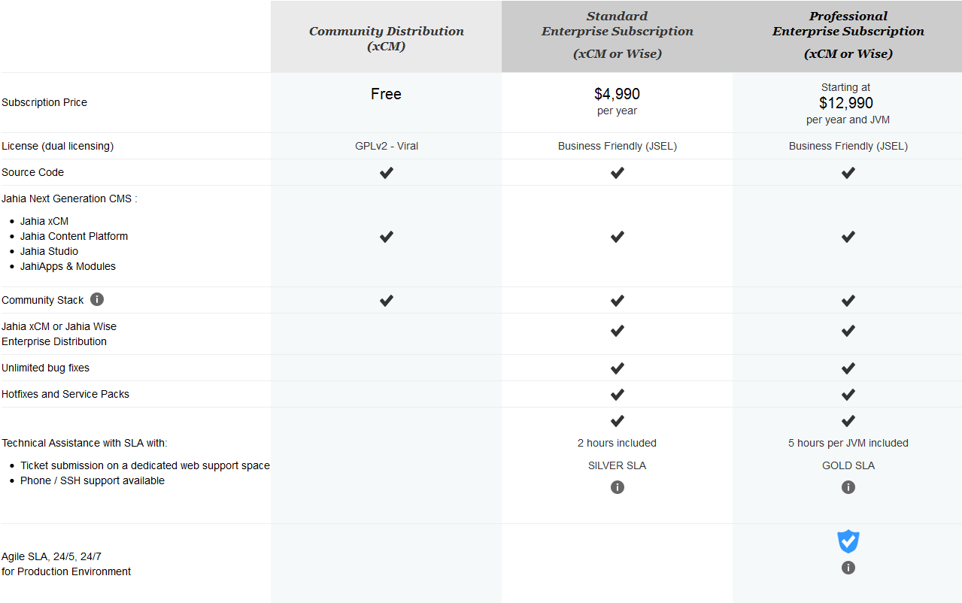
Fundamentals - Pricing

Slide 19
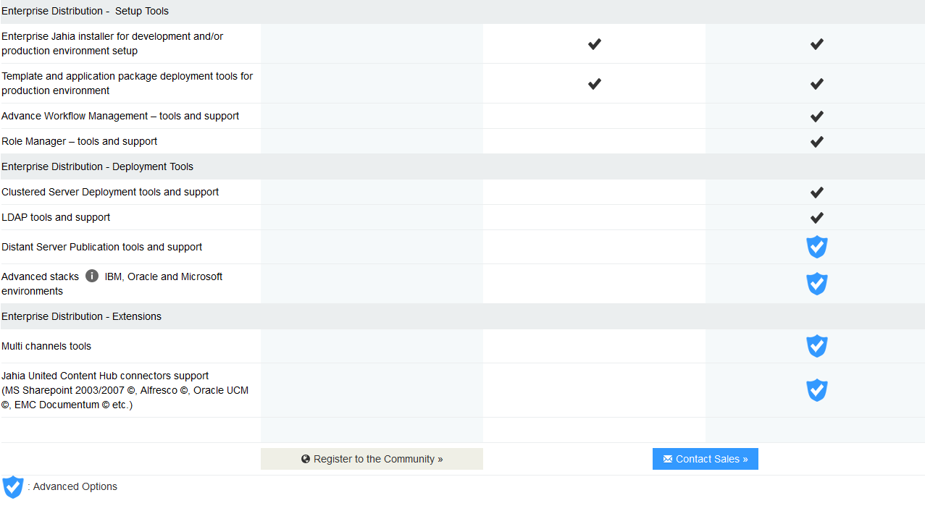

Fundamentals - Pricing

Slide 20
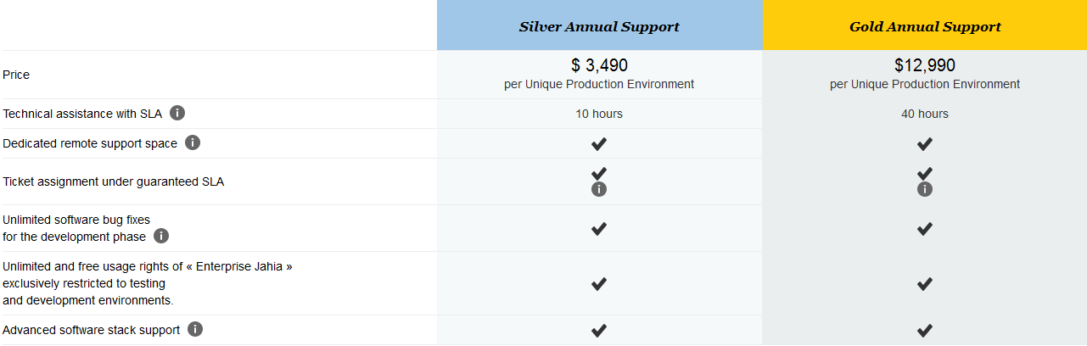
Fundamentals - Pricing
Annual Support Subscriptions
*Unique Production Environment = An instance or a group of instance connected through clustering and/or through remote publishing, and that are not used for test or development purposes.

Slide 21
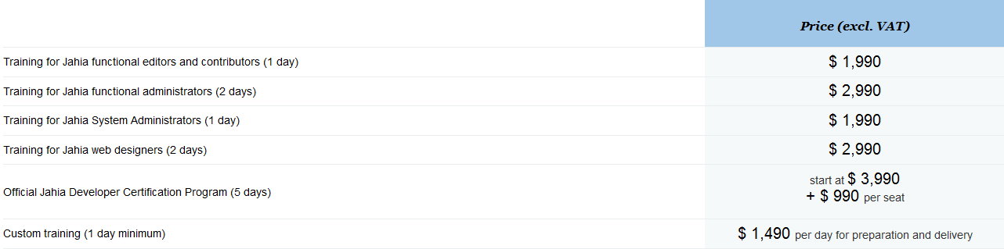
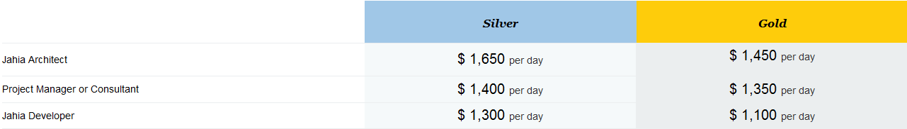
Fundamentals - Pricing
Knowlege Transfer
Consulting

Slide 22
Part I - Introduction
Fundamentals
Overview
Licencing and pricing
Architecture
Software
Server
Q & A
Part II – Jahia in Action

Slide 23

Architecture - Software

Slide 24
Architecture - Core Components
Core Components
Contentrepository (Data)
Templating- and rendering-engine (live + preview)
Module management system
Business rules engine
Workflow engine
Search engine
RESTful-webservices
Scheduler
Filter
Portlet / Portal Container
Jahia Studio
User Experience Builder

Slide 25
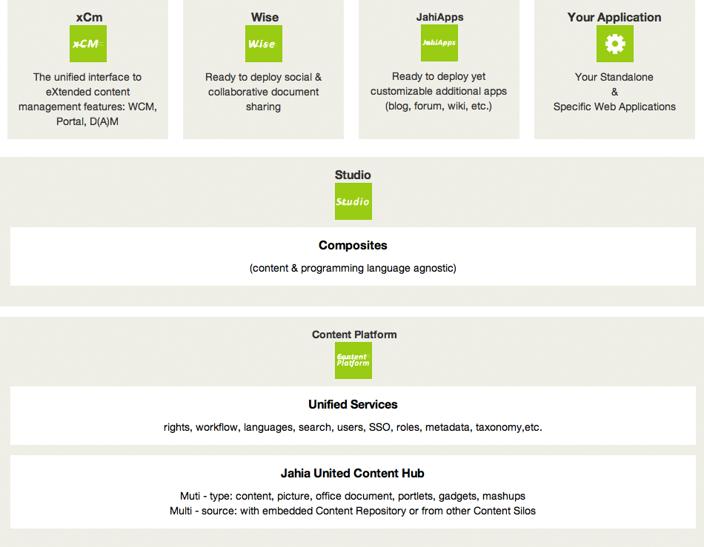
Architecture – Jahia Components
Jahia architecture ©2002 – 2013 Jahia Solutions Group SA

Slide 26
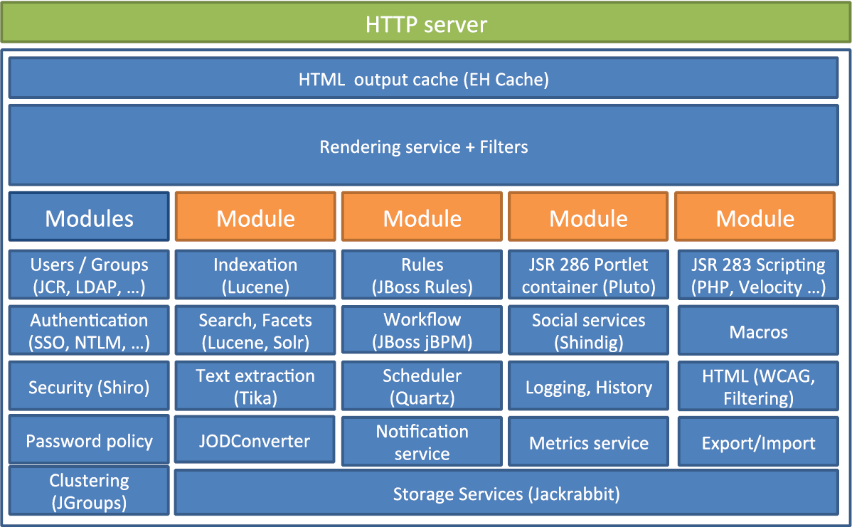
Architecture – Technologies
Jahia Components ©2002 – 2013 Jahia Solutions Group SA
Notes:
Textfolie. Text erster Ebene 20 pt regular, 26 pt Zeilenabstand, 4,8 pt Abstand nach oben; Unterüberschrift in 20 pt Bold; Schriftfarbe Grau 80%
Text zweiter Ebene in 18 pt regular, 24 pt Zeilenabstand

Slide 27
Architecture - Content
Everything is content
All items/data stored in Jahia are content
Common properties (name, UUID, metadata, …)
Common services (editing UI, permissions, versions, …)
Common rendering and handling systems
All Contents are nodes and defined by a node type
Apache Content Node Type Definition (CND)
Inheritance

Slide 28
Architecture - Authorization
Definition in XML documents
Easy access via JSP taglib / Java API
Permissions
Atomic action that can be performed on a node
Stored as tree
Identified by name (automated resolution)
Unique (system-wide)
Roles
List of permissions
Advanced tools in Enterprise Distribution
Stored as flat list (with groups)

Slide 29
Architecture – Content Platform
Java Content Repository
Unified API to access Contentrepositories (JSR-283)
XML im-/export
Node-tree-architecture
Node: type and properties
Typed references
SQL & QOM
ACL for rights management
Implemented with Apache Jackrabbit
JTA support

Slide 30
Architecture - Search
Features (Technologies)
Full-text searches (Apache Lucene)
Multi query languages support (Apache Jackrabbit)
Facets (Apache Solr)
“Did you mean” (Apache Solr)
Open search
Connectors to other repositories e.g. Alfresco (EntropySoft)
API
full-text search tag libraries
query languages

Slide 31
Architecture - Search
Indexing
No seperate index data schema (Apache Jackrabbit)
Rich document parsing (Apache Tika)
(Immediate indexing after content change)- not in 6.6.x
(Asynchronous Document Parsing)- not in 6.6.x
Local index per cluster node
Templating
Tag library for searchforms/queries/facets
Different templates for search results

Slide 32
Architecture - Search
Search
Supports relevance (any number of fields), limit, exclude
Structured search based on any number of constraints on any content and metadata field
Supports QOM
Type awereness
Unstructured search (fulltext)
optional and mandatory words
phrase search
without words
wildcards

Slide 33
Architecture – Rules
jBOSS Drools Engine
Similar to native language
Custom jahia rules set
Extendable
rule "A task has been created"
when
A new node is created
- the node has the type jnt:task
The node has a property assignee
then
Set the property state of the node with the value "active"
Assign permissions "rw-" on the node to the user property.getNode().getName()
end

Slide 34
Architecture – BPM / Workflows
Buisiness Process Management
Workflow rules for content nodes
Support of permissions (based on user roles)
inherited by child nodes
Interaction / collaboration
jBMPN
BPMN 2.0 specification
Compatible with propretary GUI workflow definition tools
Advanced tools available in Enterprise Distribution

Slide 35
Architecture - Intersection Points
Webservices
REST API
CRUD operations on content
access to different servlets
cms/render
cms/login
custom
…
Actions
Extension to HTTP API
Simple java class
Response: statuscode, redirect and/or json

Slide 36
Architecture - Templating
Templates
set of nodes that will define the layout (positions, style, view...)
Mainly created and edited in the Studio
Views
Any output format possible (e.g. html, json, .pdf, …)
Multiple view-skripts for same content type
Default JSP
Support of all JSR-286 compatible scriptlanguages
PHP support by „Caucho’s Quercus PHP engine“
Macros
All JSR-286 (default: Velocity, Groovy, Freemarker)

Slide 37
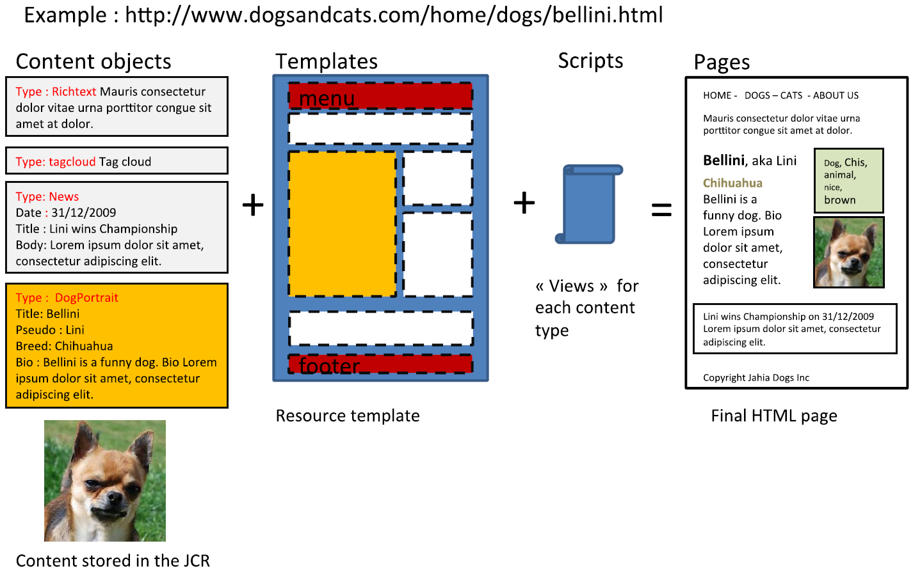
Architecture – Rendering
Rendering ©2002 – 2013 Jahia Solutions Group SA

Slide 38
Architecture – Rendering
Rendering filters
Similar to servlet filter
Executed independantly for all/any module/s
Configuration via Spring bean definition files
Implemented in a single Java class
Conditional execution
Predefined conditions (e.g. on template, node type, …)
Custome conditions using regular expressions

Slide 39
Architecture - Modules
Reusable packages
Any content
module types imply certain structure
Logical bundling/seperation units
Easy maintenance
Easy deployment
Dependency resolution
Reliability

Slide 40
Part I - Introduction
Fundamentals
Overview
Licencing and pricing
Architecture
Software
Server
Q & A
Part II – Jahia in Action

Slide 41
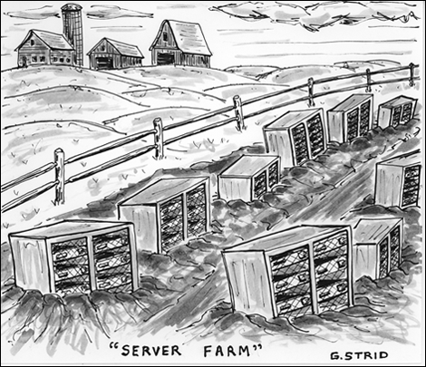
Architecture - Server
Server Farm ©2002 – 2013 Jahia Solutions Group SA

Slide 42
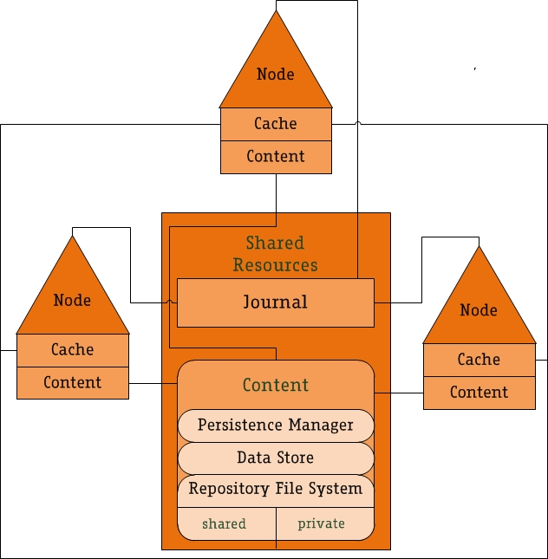
Architecture - Server
Clustering
JackRabbit Clustering
Shared content (private Workspaces)
Repository as central point of exchange / bottleneck
Transaction loggin using Journals
Node synchronization
Channelcommunication between nodes
Cache synchronization

Slide 43
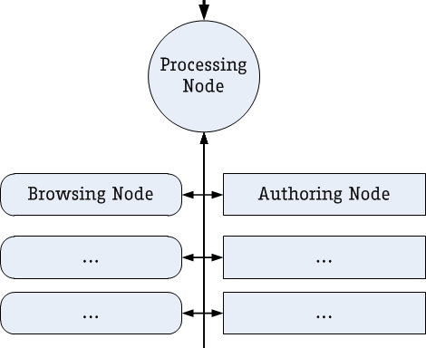
Architecture - Server
Processing node
Management
background tasks
browsing/visitors Node
read access
authoring node
read / write access

Slide 44
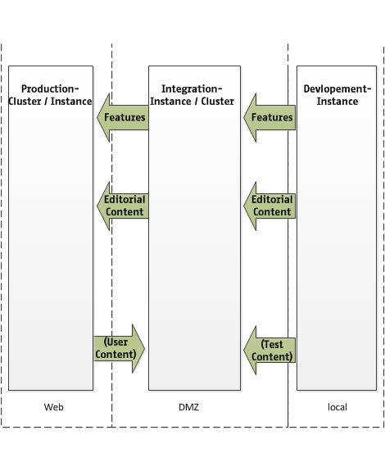
Architecture - Server
Production setup
Differend workspaces
Developement-Instance
usally bundled installer
Integration-Instance/-Cluster
usually kept in DMZ
developement mode (all modules)
Production-Cluster/-Instance
conntected to web
production mode (needed modules only)

Slide 45
End of Part I To be continued…

Slide 46
Part I - Introduction
Fundamentals
Overview
Licencing and pricing
Architecture
Software
Server
Q & A
Part II – Jahia in Action

Slide 47
Q&A

Slide 48
Jahia – OpenSource WCM
Part II : Jahia in Action

Slide 49
PART I - Introduction
Fundamentals
Architekturen
Part II – Jahia in Action
Jahia in Action
Introduction
Demo
Conclusion
Q & A
Notes:
Agendafolie. Hervorhebung des aktuellen Punktes durch Verwendung von FagoOfficeSansBold und 28pt.

Slide 50
Jahia in action
Indroduction

Slide 51
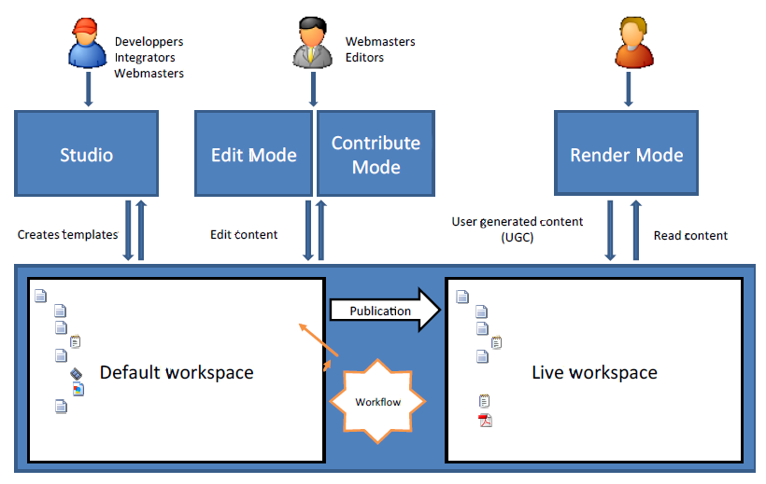
Jahia in action – Actors
Jahia Actors ©2002 – 2013 Jahia Solutions Group SA

Slide 52
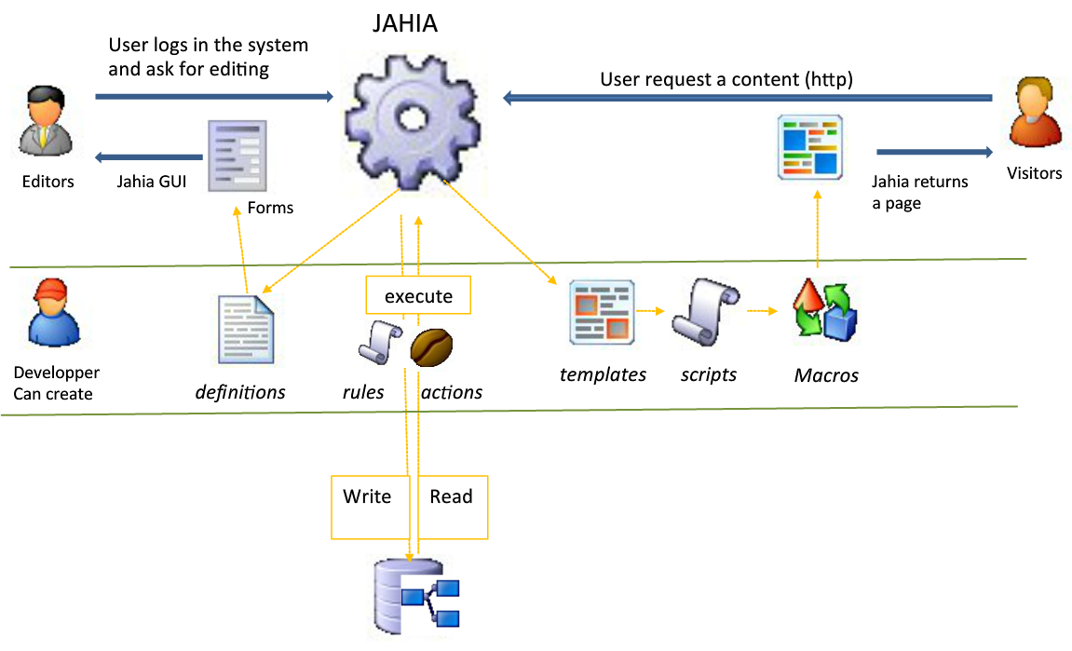
Jahia in Action – Content flow
Jahia Content FLow ©2002 – 2013 Jahia Solutions Group SA

Slide 53
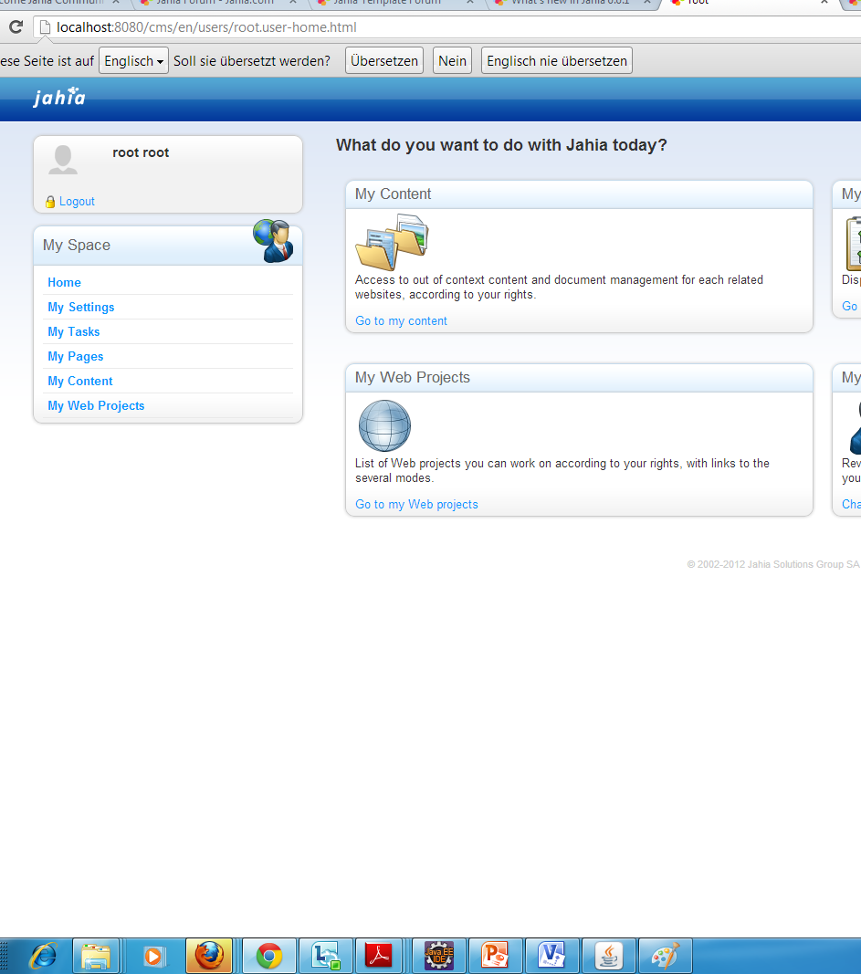
Jahia in Action - Webclient
What is the Jahia Webclient
Native Jahia client for administration, editing and integration
Based on AJAX and GWT
Components
Studio – Visual User Experience Builder
Administration tools
Permormance monitoring and management tools

Slide 54
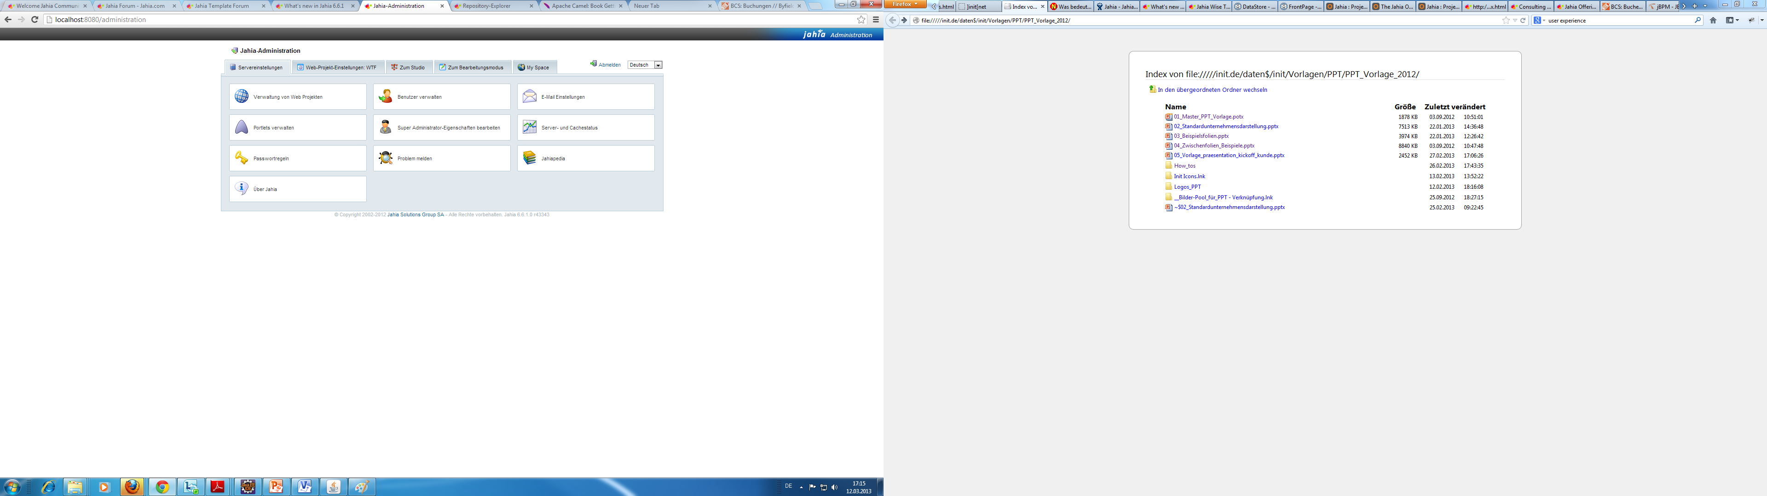
Jahia in Action – Administration / Management
Repository browser
User/Roles/Rights management
Portlet manager
Site manager
Tag manager
Component manager
Cache Manager
Version Control

Slide 55
Jahia in Action - Visual User Experience Builder
Visual User Experience Builder
GUI design tools (WYSIWYG)
Different editorial Roles allow limitation of changes for specific roles
Drag & Drop usage of site components (content with associated view)
Live Preview
Review Worklfow
Publication / deployment workflows
Support for mobile devices

Slide 56
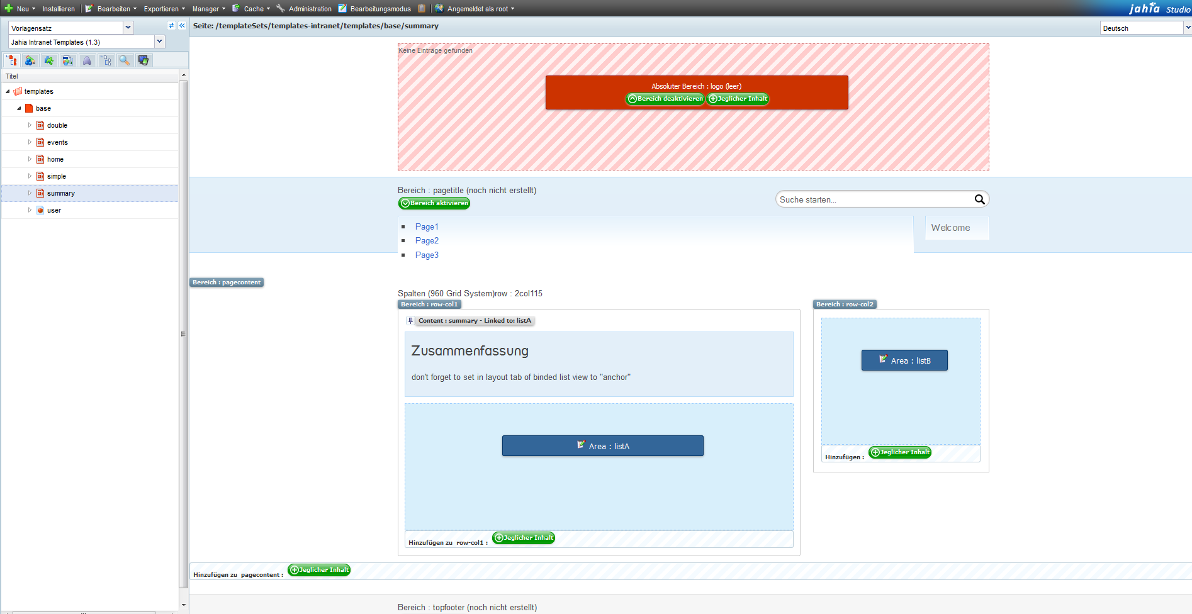
Jahia in Action - Visual User Experience Builder

Slide 57
Jahia in Action - Visual User Experience Builder
Jahia Studio
Create templates(raw design) for modules and sites
Used by integrator/developer
Editor Mode
Limited Access to WYSIWYG tools and component options
Used by integrator/developer/editor
Contributor Mode
Limits acces even more, usually only content creation/manipulation
Used by editor
Preview Mode
Renders the site like the user will see it
no changes possible (only those awailable on the real site)

Slide 58
Jahia in Action - Modules
Module content
(XML-) Imports
View Scripts
Java classes (e.g. Actions)
Static assets
Rules
Roles
Permissions
Workflows

Slide 59
Jahia in Action - Modules
Structure and deployment
Custom Maven generate archetype
Custom target jahia:deploy
Modules are deployed into maven repository
Dependency definition and resolution
Hot deployment of non java classes
No recompiling of the project
No redeployment of project
No changes in CMS Source (almost)
Clean separation

Slide 60
PART I - Introduction
Fundamentals
Architekturen
Part II – Jahia in Action
Jahia in Action
Introduction
Demo
Conclusion
Q & A

Slide 61

Demo Time!
© Radio Hamburg

Slide 62
Demonstration
Choose your destiny
Module creation / deployment / structure - done
Template creation / deployment / structure - done
Custom content types creation / deployment / views / structure -done
Custom roles / permission - done
Custom workflows - failed
Custom rules - failed
Using Portals - failed
Using Filters – todo
Custom actions - todo
Clustered Instances - failed

Slide 63
PART I - Introduction
Fundamentals
Architekturen
Part II – Jahia in Action
Jahia in Action
Introduction
Demo
Conclusion
Q & A

Slide 64
Conclusion
Pro
All-in-one
OpenSource (free)
Rapid developement with visual design tools
Scalable
Many interfaces
Huge compatibility
Modular, extendable architecture
Community modules
Contra
Free Licence is GPL v2
Typical OpenSource Issues
Security
Limited Features
Performance
Activity
Maturity
LTS
Inherited bugs
Lack of Enterprise Certifications

Slide 65
PART I - Introduction
Fundamentals
Architekturen
Part II – Jahia in Action
Jahia in Action
Introduction
Demo
Conclusion
Q & A

Slide 66
Q&A

Slide 67
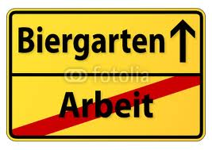
Feierabend

