Slide 1
StrongDBMS Built from immutable components
Malcolm Crowe, SANTIAGO MATALOMGA, Martti Laiho
June 2019

Slide 2
Introducing StrongDBMS
Relational DBMS, fully ACID
All transactions serialised in a log file
Novel design for concurrency
It uses shareable immutable classes
Like strings in C# and Java
But avoid copy on write: it is too slow
Instead we design special classes
Where all fields are public and final

Slide 3
Shareable classes mean
Sharing of instant snapshots
No need to lock shared objects
No DB objects locked by Strong
Optimistic concurrency
First committer wins
During commits the DB is locked
All steps checked at that stage
Conflicting commit attempts will fail

Slide 4
Benchmark StrongDBMS
Experiments on data structures
Show that shareable BTrees work
Logarithmic behaviour O(NlogN)
Cost/N behaves like logN
TPCC results in Keynote on Friday

Slide 5
Previous work: PyrrhoDB
Similarities with PyrrhoDB include
Transaction log file, append-only
Data format platform-independent
Not Localised or for single timezone
ACID guarantee
Differences: better design, faster
Uids rather than object names
SQL parsing done by client library

Slide 6
Database objects
Serialisable classes
Implement basic types
Integer, string, numeric, date
And database objects
Table, Column, Role, Function, Expression,..
Records are lists of uid-value pairs
Lots of shareable B-Tree indexes

Slide 7
Shareable B-Tree: SDict
SDict<K,V> leaf nodes contain
Key-value pairs c<#<2c (c is e.g. 4)
Inner nodes contain
Key-leaf pairs c<#<2c+1
The Root node is allowed fewer
Even 0 for an empty tree
The BTree is not kept balanced
But worst case is still logarithmic

Slide 8
Operations on SDict<K,V>
Adding a (k,v) pair
T = T.Add(k,v)
Note that we get a new tree!
In C# we define + so we write
T += (k,v)
There is also Remove(k) (or -)
With T.Lookup(k) we can get v

Slide 9
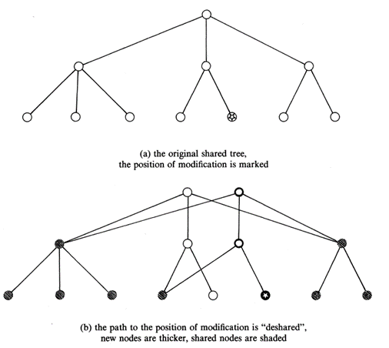
When we add a node

Slide 10
When we add a node
We get at most logN new nodes
On a path from root to new leaf
Remaining nodes all shared
Between old and new version
This proportion only improves
As the tree gets larger

Slide 11

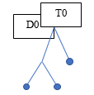
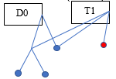
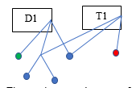
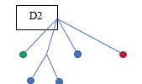
Transaction and B-Tree

Slide 12
Database versions
Current version D of database
Objects in sync match the log file F
Static list (F,D)
Transaction T has a version of this
Add some uncommitted db-objects
No link from T to D except same F
Commit: new versions of db-obs
T’s db-objects replaced with file obs

Slide 13
Compare with MVCC
Multi-version concurrency control
Versions of records co-exist
StrongDBMS does this but:
Only one version of R in D (from F)
Each T can have R or its own R’
In principle have a set (R,R',..)
But no way of traversing this set

Slide 14
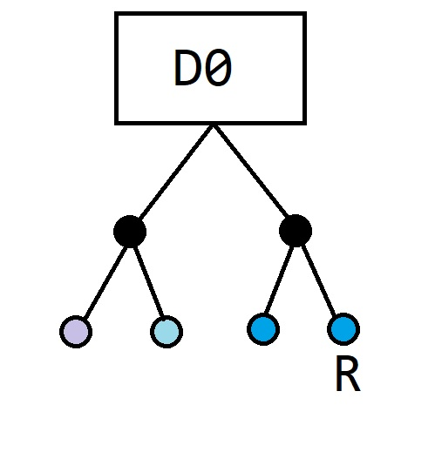
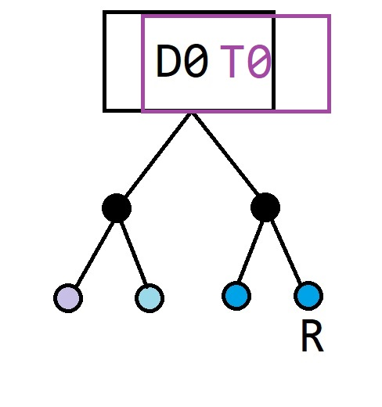
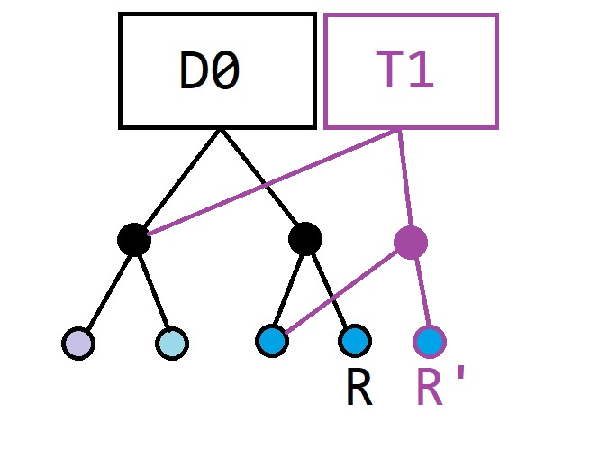
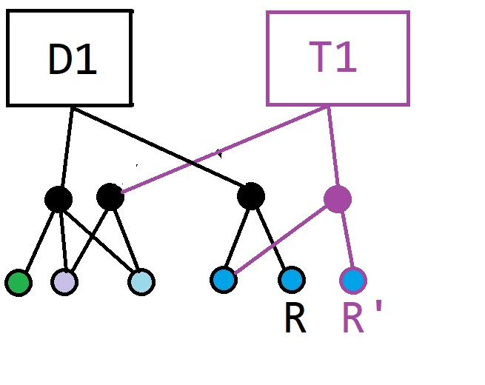
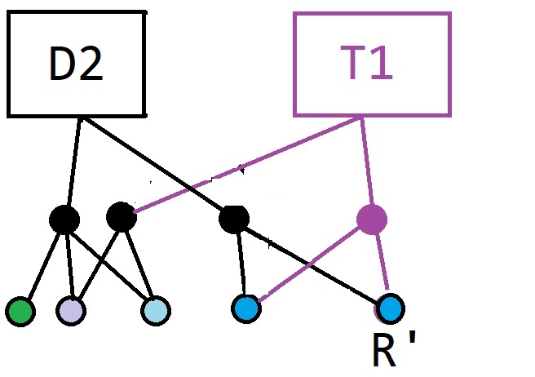
Illustrating MVCC

Slide 15
Enumerating an SDict
Bookmarks instead of Iterators
for(var b=T.First();
b!=null;b=b.Next())
Then b.Value is null or a pair (k,v)
Everything in Strong uses this code

Slide 16
Consequences of design
So objects have immutable uids
The defining position in the log file
Updates will have the same uid
But obviously later positions in the file
T.rows is an SDict<long,long>
Giving the (defpos, curpos) of rows
Indexes have tree of (key,curpos)

Slide 17
Uid is assigned on commit
When an objects is sent by client
It has a client-side uid
So each statement from a client
Is preceded by a list (uid,name)
When the server receives this
Real uids of Names are looked up
Transaction uids for anything new
Uids assigned on commit

Slide 18
Commit code for object
protected SDbObject (SDbObject s,AStream f) :base(s.type)
{
uid = f.Length;
f.uids += (s.uid,uid);
f.WriteByte((byte)s.type);
}
Any change constructs a new object

Slide 19
What was the uid before?
Each transaction has a uid:
protected SDbObject(Types t, STransaction tr)
{
uid = tr.uid+1;
}
But installing this new object
Will create a new transaction
With a new uid for further objects

Slide 20
Database structure
Database has a schema and role
SDatabase(string fname)
{
name = fname;
objects = SDict<long,SDbObject>.Empty;
role = SRole.Empty;
curpos = 0;
}
Role has names of added objects

Slide 21
A snapshot of SDatabase
Just copy 4 pointers:
protected SDatabase(SDatabase db)
{
name = db.name;
objects = db.objects;
role = db.role;
curpos = db.curpos;
}

Slide 22
Update SDatabase
Adding a new object gives
protected virtual SDatabase New
(SDict<long,SDbObject> o,
SRole ro, long c)
{
return new SDatabase(this, o, ro, c);
}
Within a transaction there will be an override of this method for a new STransaction

Slide 23
The constructor used here
protected SDatabase(SDatabase db, SDict<long, SDbObject> obs, SRole ro, long c)
{
name = db.name;
objects = obs;
role = ro;
curpos = c;
}

Slide 24
Install a database object
We can now use the above
As follows
public SDatabase Install(STable t,
long c)
{
return New(objects+(t.uid, t),
role+(Name(t.uid), t),
c);
}

Slide 25
Install a new Column
Tables have their own structure
public SDatabase Install(SColumn c, string n, long p)
{
var obs = objects;
if (c.uid >= STransaction._uid)
obs += (c.uid, c);
var tb = ((STable)obs[c.table]);
if (role.subs.Contains(c.table) &&
role.subs[c.table].defs.Contains(n))
throw new Exception("Table already has column " + n);
return New(obs + (c.table,tb+(-1,c,n))+(c.uid,c),
role+(c.table,-1,c.uid,n)+(c.uid,n), p);
}

Slide 26
Transaction
This is a subclass of SDatabase
public STransaction(SDatabase d,ReaderBase rdr, bool auto) :base(d)
{
autoCommit = auto;
uid = _uid;
readConstraints = SDict<long, bool>.Empty;
rdr.db = tr;
}
By inheritance, has its own objects

Slide 27
Committing a transaction
We traverse its objects
And commit them as above
We manage transaction references
Using a list of commits in class Writer
But first we check for conflicts
With recent database commits
Uids >= inherited curpos

Slide 28
Query processing, RowSet
RowSet constructed recursively
For results of Select
And items for Insert
Performing grouping, ordering etc
Traversed with RowBookmark
Which contains current context
Context contains current values
Indexed by uid (field, row, group,..)

Slide 29
Questions?

