Slide 1
Point Processing
Histogram Equalisation and CLAHE
ARI 2129 | Principles of Computer Vision for AI
Notes:
INTRO (~20 sec)
Say: 'Hi everyone. Our presentation is on Histogram Equalisation and CLAHE — two techniques that automatically fix contrast in images. I am covering the foundations: what images are, what contrast is, what a histogram shows, and what we are trying to fix. Over to my teammates after that.'

Slide 2
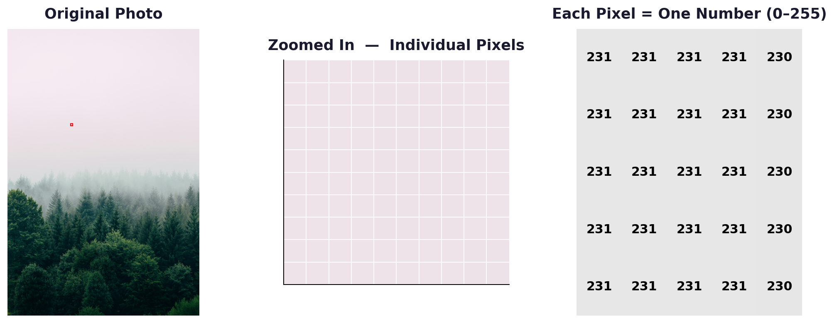
What is a Digital Image?
• A digital image is a grid of tiny squares, each one called a pixel
• Every pixel holds one number. Zero is black, 255 is white, anything else is grey
• A 1080p photo has over 2 million of these numbers
• Image processing is just maths on those numbers
1
Notes:
SLIDE 1 (~35 sec)
Say: 'Let's start from scratch. A digital image is a grid. Every tiny square in that grid is called a pixel, and each pixel holds a single number. Zero is pure black, 255 is pure white — everything in between is grey.
You can see it here on the right: the photo on the left, zoomed in so the pixels are visible in the middle, and the actual numbers on the right.
When we do image processing, we are just doing maths on those numbers. That is the entire foundation.'

Slide 3
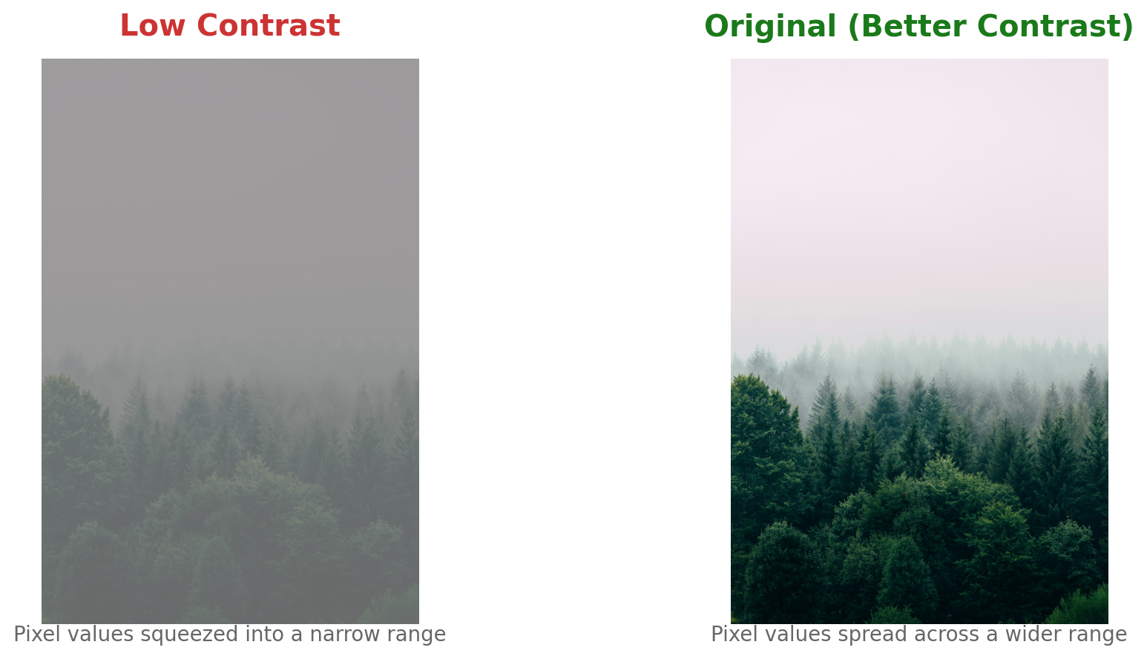
What is Contrast?
• Contrast is how spread out the pixel values are in an image
• High contrast: values run wide, the image looks sharp
• Low contrast: values are all bunched in a narrow range, everything looks flat
• Foggy photos are the obvious example. Medical scans have the same problem
• Without contrast, the eye cannot tell one thing from another
2
Notes:
SLIDE 2 (~35 sec)
Say: 'Now contrast. Contrast is just how spread out the pixel values are.
On the right you can see the same foggy forest scene twice. On the left version, the values are all squashed into a narrow range — everything looks grey and flat. On the right version, the values cover a wider range — you can see more trees, more depth, more detail.
The only difference is the range of numbers. That is what contrast is.'

Slide 4
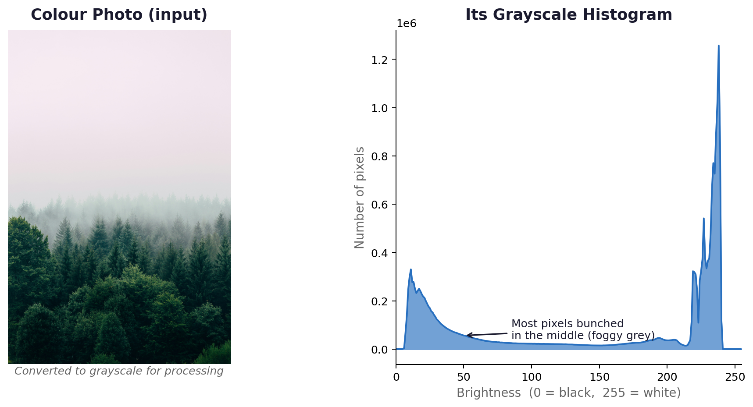
What is a Histogram?
• A histogram counts how many pixels sit at each brightness level, 0 to 255
• Bars on the left: lots of dark pixels. Bars on the right: lots of bright ones
• A narrow spike means low contrast. A wide spread means good contrast
• You can read the problem off the chart before you even look at the photo
• Histogram equalisation reshapes this chart to cover the full range
3
Notes:
SLIDE 3 (~35 sec)
Say: 'To measure contrast in a way we can work with, we use a histogram. It is a bar chart that counts pixels — for every brightness value from 0 to 255, it shows how many pixels have that value.
On the right you can see our foggy forest photo and its actual histogram. Notice the bars are all bunched in the middle — that spike tells us almost all pixels are a similar shade of grey. No real blacks, no real whites.
This histogram shape confirms the problem. Now we can fix it.'

Slide 5
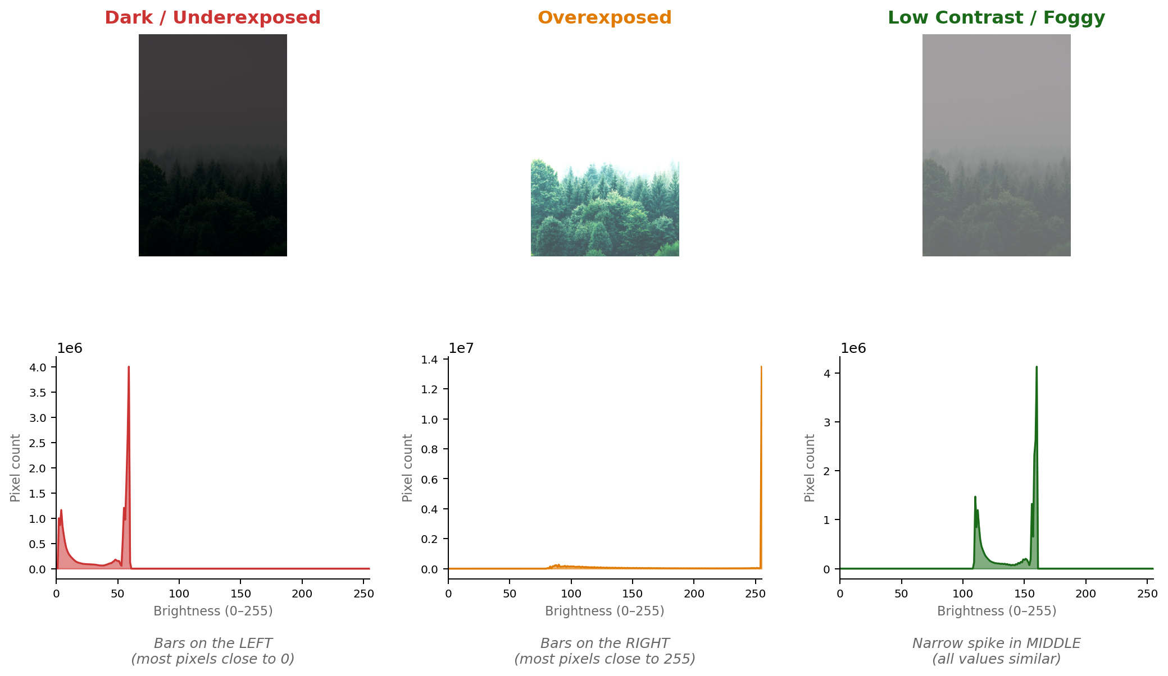
Reading a Histogram
Three shapes. Each one tells you something different about the image:
4
Notes:
SLIDE 4 (~35 sec)
Say: 'Three shapes to know. Left: a dark image — bars piled on the left side, most pixels close to zero. Middle: overexposed — bars pushed right, everything too bright. Right: low contrast, like our forest — narrow spike in the middle, all values similar.
In each case the histogram diagnoses the problem immediately. You do not even need to look at the photo.'

Slide 6
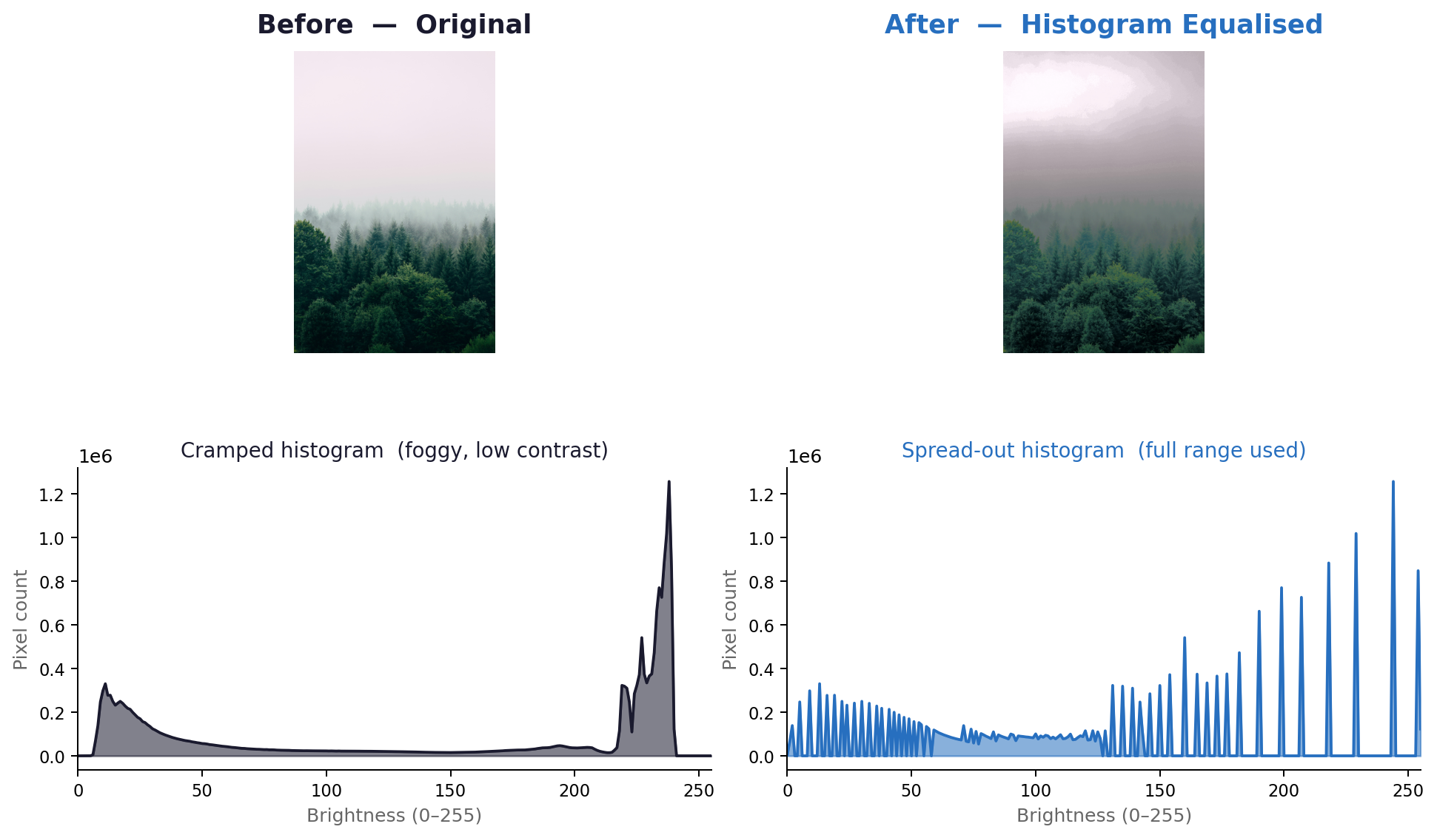
The Goal: Spread the Histogram
The algorithm reads the image's own histogram and remaps every pixel's brightness to cover the full 0 to 255 range. You give it an image, it works out the rest.
5
Notes:
SLIDE 5 (~35 sec)
Say: 'The goal is simple: take that cramped histogram and stretch it across the full 0 to 255 range. When that happens, the image automatically looks sharper — more contrast between areas means more visible detail.
Here is the result on our foggy forest. Before on the left: flat and grey. After on the right: same image, same scene, just with the pixel values remapped. Look at the histograms below — before is squashed, after is spread.
That is the idea. My teammate will now show you the exact maths behind how those new values are calculated.'

Slide 7
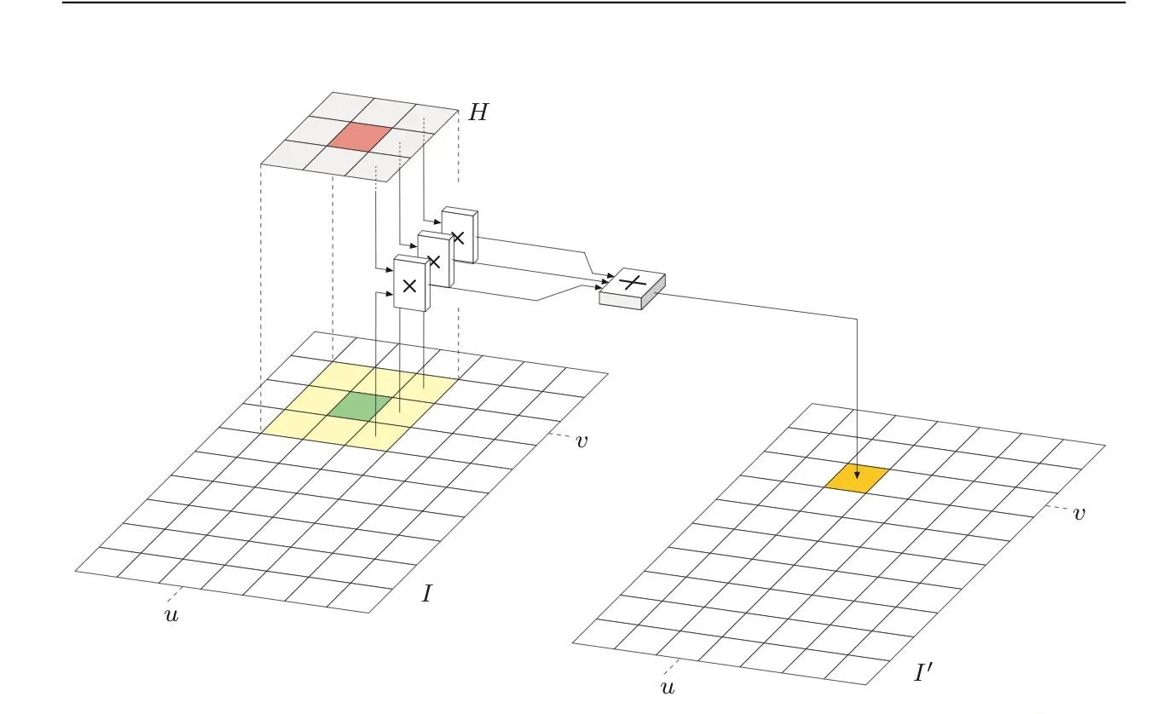
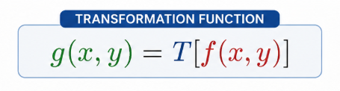
Point Processing
What is Point Processing?
Point processing is a basic image processing technique where each output pixel depends only on the corresponding input pixel.
The same transformation rule is applied independently to every pixel in the image.
No neighbouring pixels are involved.
Key Idea: Histogram equalisation is still a point processing method because once the mapping function is created, every pixel is remapped independently.

Slide 8
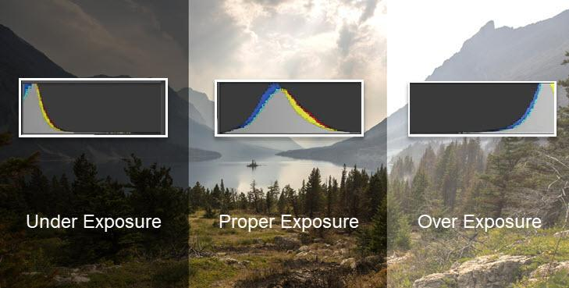

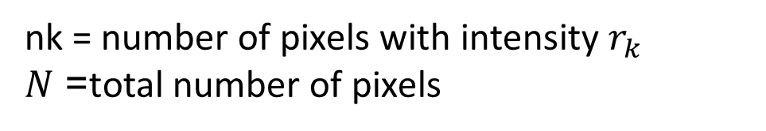
The Normalised Histogram
What is a Histogram?
A histogram counts how many pixels exist at each brightness level.
In an 8-bit image there are 256 possible intensity levels from 0 to 255.
The normalised histogram converts raw counts into probabilities:
Key Idea: The normalised histogram tells us how image brightness values are distributed across the image.
nk​ = number of pixels with intensity $r_{k}$
$N$= total number of pixels

Slide 9

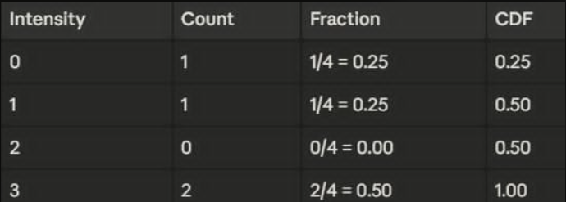
The Cumulative Distribution Function (CDF)
What is the CDF?
The CDF is the running total of histogram probabilities.
The CDF becomes the transformation function used in histogram equalisation.
It spreads intensity values across a wider brightness range.
The CDF answers the question:
“How much of the image is this bright or darker?” A CDF just answers one question for every intesity level: "what fraction of all piels are at or below this value"
Key Idea: Histogram equalisation works because the CDF redistributes pixel intensities more evenly across the available range.

Slide 10
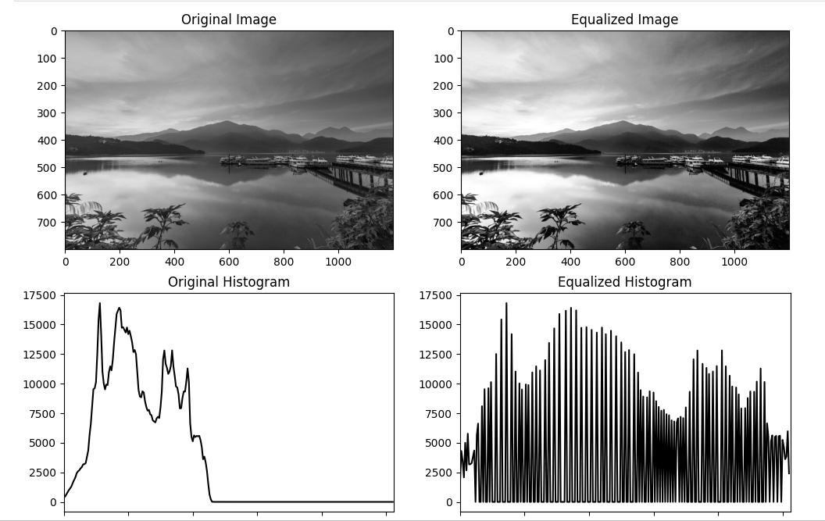
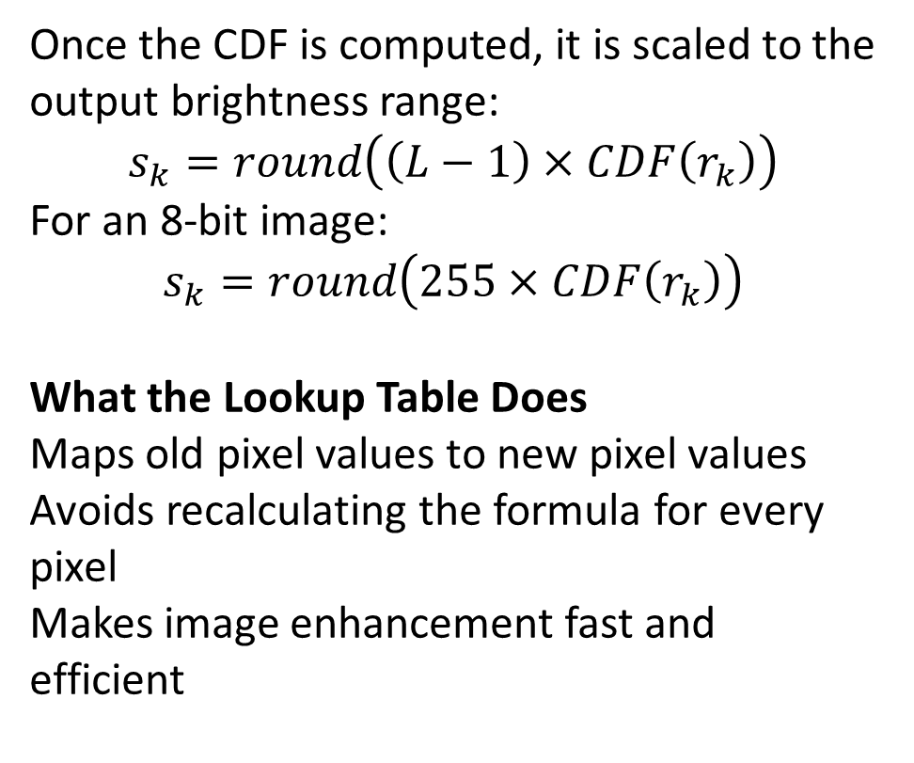
Deriving the Lookup Table
From CDF to New Pixel Values
Once the CDF is computed, it is scaled to the output brightness range:
$$s_{k}=round\left(\left(L−1\right)×CDF\left(r_{k}\right)\right)$$
For an 8-bit image:
$$s_{k}=round\left(255×CDF\left(r_{k}\right)\right)$$
What the Lookup Table Does
Maps old pixel values to new pixel values
Avoids recalculating the formula for every pixel
Makes image enhancement fast and efficient
Key Idea: The lookup table acts like a brightness translation table for the whole image.

Slide 11
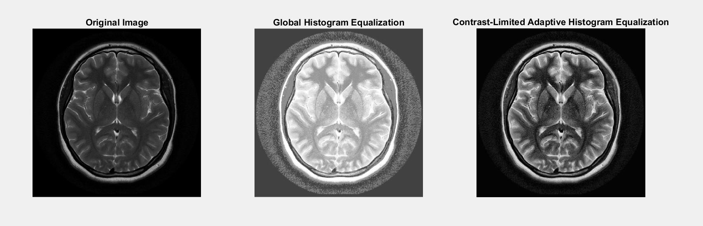
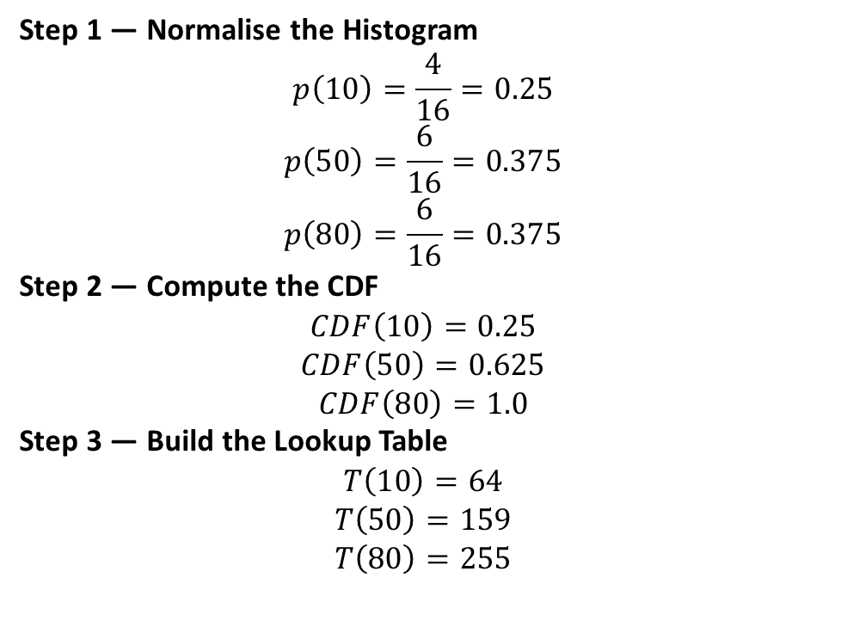
Worked Numerical Example
Assume a small 4×4 image with only three brightness values:
10 appears 4 times , 50 appears 6 times, 80 appears 6 times, So total pixels=16
Step 1 — Normalise the Histogram
$$p\left(10\right)=\frac{4}{16}=0.25$$
$$p\left(50\right)=\frac{6}{16}=0.375$$
$$p\left(80\right)=\frac{6}{16}=0.375$$
Step 2 — Compute the CDF
$$CDF\left(10\right)=0.25$$
$$CDF\left(50\right)=0.625$$
$$CDF\left(80\right)=1.0$$
Step 3 — Build the Lookup Table
$$T\left(10\right)=64$$
$$T\left(50\right)=159$$
$$T\left(80\right)=255$$
Final Result: The image now spans a much wider brightness range.
Contrast is improved because the intensity values are more spread out.
Key Takeaway: Histogram equalisation can be summarised in three steps:
Count, Accumulate, Scale

Slide 12
When HE Works
Best case: a uniformly dark or flat image
Histogram: before → after HE
Foggy scenes, underexposed portraits
Pixels bunched in one zone
No extreme spikes
For uniformly dull images, HE is very effective.

Slide 13
Failure Case: Bimodal Histograms
A concert photo — dark crowd around 30, bright LEDs near 250.
✓ Crowd becomes visible — dark cluster stretched.
✗ LEDs blow out to white — noise amplified.
HE treats the whole image as one. That's the problem.

Slide 14
Other Cases Where HE Breaks
Already high-contrast images — HE overshoots — clipping and artefacts.
Medical & scientific imaging — Subtle diagnostic gradients get crushed.
Large uniform regions — Sky or walls develop patchy banding.
Locally varying scenes — Global statistics don't fit local regions.
Equalising a good image breaks it.

Slide 15
When NOT to Use HE
Avoid HE when…
Use instead…
the image is already well-exposed
fine gradient detail matters (medical, scientific)
large uniform regions dominate the frame
lighting varies strongly across the image
CLAHE — adaptive, tile-based
Gamma correction — manual brightness curve
Histogram stretching — gentler linear remap
Tone mapping — for HDR
HE is a blunt tool. Sometimes you need a scalpel.

Slide 16
CLAHE: The Adaptive Fix
Contrast Limited Adaptive Histogram Equalisation
1
Divide into tiles
Split the image into small non-overlapping blocks, typically 8×8.
2
Equalise each tile
Apply histogram equalisation independently inside every tile.
3
Blend the seams
Bilinear interpolation at the borders prevents blocky artefacts.
CLAHE thinks locally, not globally.

Slide 17

16
The Clip Limit
Problem
Solution: Clip Limit
Small tiles have noisy histograms.
When we equalise them, noise gets amplified along with the real signal.
Result: grainy, over-enhanced patches — especially in smooth regions like sky or skin.
Before computing the CDF, cap every histogram bin at a threshold β.
Any counts above β are collected as "excess" and redistributed evenly across all 256 bins.
This flattens the CDF slope → limits the maximum contrast amplification any pixel can receive.
OpenCV default: clipLimit = 2.0 (often called "clip factor" in papers).
Tall histogram
bar
Clip at β
Redistribute
excess
Flatter CDF
(limited slope)
Gentler
output
Higher clip limit → stronger enhancement (more contrast, more noise risk). Lower → more conservative.
Formula: β = (M/N)(1 + α/100(s_max − 1)), α = clip factor 0–100%, M = pixels in tile, N = 256.
α = 0 → identity (no change). α = 100 → max slope s_max (typically 4 for X-ray).
"The clip limit controls how aggressive the enhancement is"

Slide 18
17
The tileGridSize Parameter
4 × 4
8 × 8
16 × 16
Small tiles
Default (OpenCV)
Large tiles
Very local enhancement
Can over-process fine detail
More tiles → more histograms to compute
Good for images with tiny structures
64 regions of ~64×64 px (for 512×512)
Good balance: local enough to adapt, global enough to stay stable
Recommended starting point
Used in most CLAHE papers
Closer to global HE behaviour
Less local correction
Fewer regions → faster
Better for uniformly lit images
Both parameters interact: a small tile with a high clip limit will over-enhance; a large tile with a low clip limit barely changes anything. Always tune them together.
Bilinear interpolation is applied at tile borders to avoid visible seams between neighbouring regions.
"Tile size controls how local vs global the correction is"

Slide 19


18
CLAHE vs HE: Side by Side
Global HE Result
CLAHE Result
Blown-out highlights (whites clip to 255)
Preserved highlights, no clipping
Amplified noise in uniform regions
Natural shadow recovery, no banding
Global artefacts — whole image shifts
Noise controlled by clip limit
Uses one histogram for the entire image, so local detail is lost.
Each tile gets its own histogram → adapts to local contrast conditions.
 | Global HE | CLAHE
Scope | Whole image at once | Tile by tile (e.g. 8×8 grid)
Noise | Amplifies noise everywhere | Clip limit caps amplification
Parameters | None | clipLimit, tileGridSize
Border artefacts | None (single region) | Removed via bilinear interpolation
Best for | Uniformly flat images | Complex / uneven lighting
"Same idea, smarter execution"

Slide 20





19
Real-World Applications
Medical Imaging
Satellite Imagery
CLAHE reveals soft tissue detail in MRI/X-ray without destroying bone contrast. Used in CT-scans, mammography, retinal fundus images. Studies show improved Dice scores for spine segmentation when CLAHE is applied before U-Net.
Enhances ground features in hazy or low-light aerial captures. Helps distinguish terrain, vegetation, and water bodies in remote-sensing images.
Night Vision / Surveillance
Face Detection Preprocessing
Lifts dark regions without blowing out street lights or headlights. Critical for CCTV analysis and UAV imagery under low-light conditions.
Normalises illumination across faces shot under mixed lighting. The Musa et al. study achieved 95% face recognition accuracy using CLAHE + LBPH at 98 lux.
Fingerprint Scanning
Enhances ridge detail for more reliable minutiae matching. Particularly useful for latent (partial) fingerprints captured in poor conditions.
"Anywhere lighting is uneven, CLAHE is useful"

Slide 21

20
Full Recap: The Teaching Journey
Full Recap: The Teaching Journey
Complete Pipeline
Image
Histogram
Normalise
p(r)
Compute
CDF
Derive
LUT T(r)
Apply
Equalised
Image
Key Formulas
p(r) = h(r) / N
→ normalised histogram (probability of grey level r)
CDF(r) = Σ p(0..r)
→ cumulative distribution function (monotonically increasing)
T(r) = round(255 × CDF(r))
→ the look-up table that maps old grey levels to new ones
Failure: Global HE
Fix: CLAHE
Breaks bimodal histograms (e.g. dark object on bright background).
Over-enhances already well-exposed images.
Can cause washed-out, unnatural results.
Local tiles → adapts to each region independently.
Clip limit → prevents noise amplification.
Bilinear interpolation → smooth transitions, no tile borders.
One-slide visual summary of the complete pipeline

