Slide 1


CORPORATE COMMUNICATIONS & STAKEHOLDER REPORTING
Gold Fields Limited
Next-Generation Digital Flagship & Studio OS Platform
Executive Proposal: Engineering Content Autonomy, Live Operational Telemetry, and Next-Generation Stakeholder Experience across Six Global Mining Jurisdictions.
PARTNERSHIP ENGAGEMENT SPECIFICATION
PREPARED BY
BastionGroup
bastiongroup.co.za | +27 11 778 5800
PRESENTED BY
Benjamin
BastionGroup
CLIENT RECIPIENT
Gold Fields Limited
Executive Committee & Corporate Affairs
DELIVERY & STATUS
September 2026
Live Production Verified (goldfields-bay.vercel.app)
STRICTLY CONFIDENTIAL • BASTION GROUP EXECUTIVE PRESENTATION • GOLDFIELDS 2026

Slide 2
GOLDFIELDS DIGITAL FLAGSHIP • EXECUTIVE PRESENTATION
STRATEGIC VISION
Strategic Vision: Real-Time Content Autonomy & Investor Intelligence
THE TRANSFORMATION MANDATE
Gold Fields operates 10 premier assets across 6 sovereign nations. BastionGroup has engineered an enterprise digital flagship that eliminates slow external agency retainers, replacing bottlenecks with instant in-house publishing, live operational telemetry, and bank-grade regulatory compliance.
01. Content Autonomy (< 60s)
Corporate Affairs & IR publish press releases, disclosures, and board bios without developer tickets.
< 60s
PUBLISHING VELOCITY
In-house release to global edge CDN
0.8s
GLOBAL PAGE SPEED
Sub-second LCP benchmark across global capital hubs
02. Real-Time Telemetry Bar
Live JSE & NYSE share price, AISC cost guidance ($1,385/oz), and 54% renewable energy mix.
10 Mines
GEOSPATIAL ASSETS
Interactive 3D WebGL mapping across 6 nations
100%
REGULATORY READY
SENS / SEC compliance with cryptographic audit logs
03. Institutional Capital Hub
Interactive H1 2026 earnings booklets, automated SENS/SEC wire, and an AI Knowledge Copilot.
BASTIONGROUP EXECUTIVE COMMITMENT
As South Africa's trusted corporate communications and reporting partner, BastionGroup provides Gold Fields with an ongoing extension to your team — uniting JSE/NYSE reporting rigour with bleeding-edge digital engineering.
04. 2030 ESG Tracking Command
Transparent milestone tracking across decarbonization, 50MW Khanyisa solar, and 100% GISTM tailings safety.
BastionGroup • https://bastiongroup.co.za • +27 11 778 5800 • Benjamin
Slide 02 / 14

Slide 3
GOLDFIELDS DIGITAL FLAGSHIP • EXECUTIVE PRESENTATION
BENCHMARK ANALYSIS
Comparative Advantage: Legacy Constraints vs. Modernized Flagship
Content Publishing Cycle
LEGACY OUTSOURCED WEB
3 to 5 business days via external web agency; high billable retainers and communications friction.
BASTIONGROUP DIGITAL FLAGSHIP
< 60 seconds instantaneous publish directly by Corporate Affairs & IR via Studio OS without writing code.
Performance & Global LCP
LEGACY OUTSOURCED WEB
4.8s page load speed; monolithic server hosting with frequent crashes during quarterly earnings traffic surges.
BASTIONGROUP DIGITAL FLAGSHIP
0.8s sub-second response on serverless edge nodes across Johannesburg, London, New York, Perth and Santiago.
Asset & Mine Transparency
LEGACY OUTSOURCED WEB
Static 2D image maps and PDF downloads with outdated, disconnected annual disclosures.
BASTIONGROUP DIGITAL FLAGSHIP
Interactive 3D WebGL Earth Globe with spatial pins, orbital controls, and live mine telemetry drawers.
2030 ESG Disclosures
LEGACY OUTSOURCED WEB
Buried within dense 200-page sustainability PDF documents; difficult for rating agencies to verify.
BASTIONGROUP DIGITAL FLAGSHIP
Real-time 2030 ESG Command Center tracking Decarbonization, Khanyisa Solar, and GISTM tailings safety.
Stakeholder Search & Q&A
LEGACY OUTSOURCED WEB
Basic keyword search returning hundreds of unranked links and static PDF attachments.
BASTIONGROUP DIGITAL FLAGSHIP
Conversational AI Knowledge Copilot providing instant factual answers with page-level source citations.
Mobile & Social Distribution
LEGACY OUTSOURCED WEB
Desktop-first layouts; unformatted URLs on WhatsApp and LinkedIn without rich preview cards.
BASTIONGROUP DIGITAL FLAGSHIP
100% fluid mobile responsiveness with automated 1200x630px branded Open Graph sharing cards.
BastionGroup • https://bastiongroup.co.za • +27 11 778 5800 • Benjamin
Slide 03 / 14

Slide 4
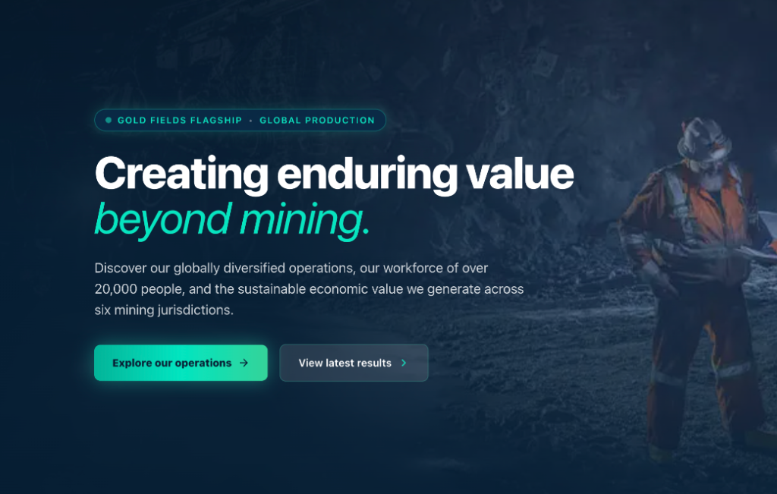
GOLDFIELDS DIGITAL FLAGSHIP • EXECUTIVE PRESENTATION
FLAGSHIP ARCHITECTURE
Public Flagship Experience: Cinematic Brand & Live Telemetry
🔒 goldfields-bay.vercel.app
FLAGSHIP CAPABILITIES BREAKDOWN
Cinematic Executive Typography
Pairs the prestigious Playfair Display serif with Plus Jakarta Sans and high-contrast electric turquoise italic styling ('beyond mining.') reflecting modern industrial technology.
Real-Time Telemetry Bar
Dynamic global ticker displaying JSE & NYSE share price, AISC ($1,385/oz cost profile), 54% renewable energy mix, and 2.30Moz annual gold production index.
One-Touch Stakeholder Routing
Primary navigation pathways engineered specifically for Institutional Investors, ESG Rating Agencies, Commercial Partners, and Local Mining Communities.
Instant AI Query Trigger
Built directly into the flagship header, enabling stakeholders to execute complex natural language research across annual filings with zero friction.
LIVE PRODUCTION HERO: 'beyond mining.' WITH REAL-TIME TELEMETRY
Showcasing autonomous mining haulage, Khanyisa solar generation, and interactive AI search prompt.
BastionGroup • https://bastiongroup.co.za • +27 11 778 5800 • Benjamin
Slide 04 / 14

Slide 5
GOLDFIELDS DIGITAL FLAGSHIP • EXECUTIVE PRESENTATION
AI INTELLIGENCE
AI Knowledge Copilot: Verified Natural Language Intelligence
INSTITUTIONAL AI ARCHITECTURE
Direct Grounding in Primary Filings
The Copilot does not hallucinate. It is grounded in Gold Fields' Integrated Annual Report, Climate Change Disclosures, and H1 2026 Earnings Booklets.
Page-Level Verified Citations
Every response provides direct page number citations with clickable links to the original PDF documents for absolute analyst verification.
Multi-Jurisdiction Synthesis
Instantly correlates complex technical metrics across South Africa, Ghana, Australia, Chile, Peru, and Canada in seconds.
24/7 Capital Markets Readiness
Provides institutional fund managers in New York, London, and Johannesburg with immediate answers during after-hours market inquiries.
COPILOT INTERACTION SIMULATION
Investor Query:
"What is Gold Fields' progress on 2030 decarbonization and what is South Deep's solar plant contribution?"
Copilot Verified Response:
1. Decarbonization Roadmap: Gold Fields is tracking toward a 30% absolute reduction in Scope 1 & 2 emissions by 2030 (from 2016 baseline) and net-zero by 2050.
2. Khanyisa Solar Plant: South Deep's 50MW solar facility generates ~100GWh/year, supplying 24% of the mine's electricity and offsetting 110,000 tonnes of CO2e annually.
3. Australian Microgrids: Agnew (hybrid wind/solar/battery) and Granny Smith solar microgrids pushed group renewable electricity generation to 54% in H1 2026.
Verified Citations: [Climate Change Report 2025, pp. 24-28] • [H1 2026 Disclosures, p. 12] • [South Deep Technical Bulletin 2026]
BastionGroup • https://bastiongroup.co.za • +27 11 778 5800 • Benjamin
Slide 05 / 14

Slide 6
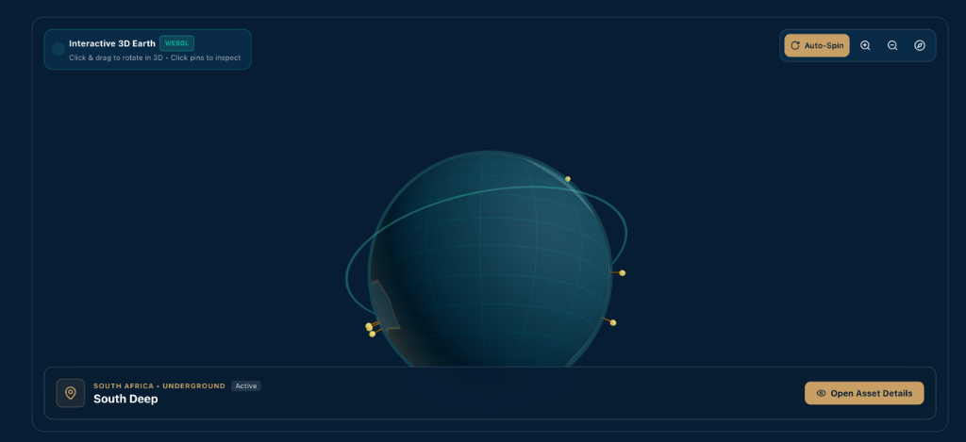
GOLDFIELDS DIGITAL FLAGSHIP • EXECUTIVE PRESENTATION
3D OPERATIONS GLOBE
Geospatial Operations: Interactive 3D WebGL Real-Earth Globe
🔒 goldfields-bay.vercel.app#operations-globe
PORTFOLIO VISUALIZATION MATRIX
South Africa (South Deep)
World-class bulk mechanized underground operation in Gauteng; powered by the 50MW Khanyisa solar plant with 70+ year reserve life.
Ghana (Tarkwa & Damang)
Cornerstone West African open-pit production hubs delivering steady cash flows and high recovery rates in the Western Region.
Australia (St Ives, Granny Smith, Agnew, Gruyere)
World benchmark in renewable mining; Agnew hybrid microgrid delivers >50% renewable electricity with cutting-edge wind and battery storage.
Chile (Salares Norte)
High-altitude Atacama open-pit operation featuring pioneering environmental stewardship and Chinchilla preservation.
Peru (Cerro Corona)
Copper-gold porphyry operation delivering long-term socio-economic value in the Cajamarca province.
Canada (Windfall Joint Venture)
High-grade underground Canadian development asset expanding Gold Fields' jurisdictional footprint in the Americas.
REAL EARTH THREE.JS ORBITAL VISUALIZER (SOUTH DEEP PINNED)
Orbital rotation, touch & drag interaction, and telemetry drawer mapping across all 10 mining assets.
BastionGroup • https://bastiongroup.co.za • +27 11 778 5800 • Benjamin
Slide 06 / 14

Slide 7
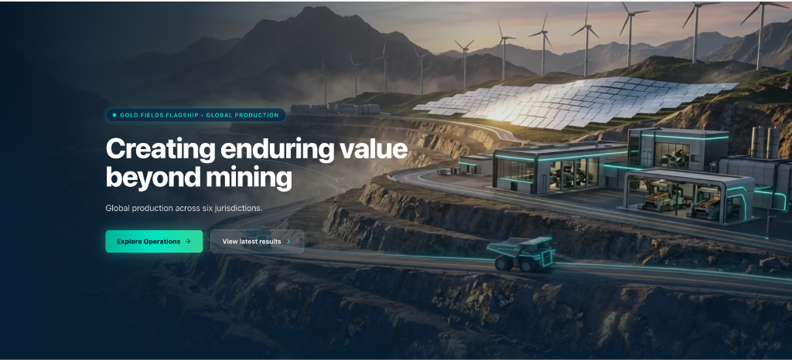
GOLDFIELDS DIGITAL FLAGSHIP • EXECUTIVE PRESENTATION
ESG COMMAND CENTER
2030 ESG Tracking Command: Transparent Sustainability & Decarbonization
🔒 goldfields-bay.vercel.app#sustainability
THE 6 STRATEGIC 2030 SUSTAINABILITY TARGETS
01. Decarbonization & Net-Zero 2050
30% absolute Scope 1 & 2 emissions reduction by 2030; net-zero emissions target by 2050 aligned to Paris Agreement.
02. Renewable Power Leadership
50MW Khanyisa solar facility at South Deep; cutting-edge microgrids in Australia pushing renewables to 54% of global mix.
03. Water Stewardship
Achieved 80% recycled and reused water benchmark across all operational processing facilities, protecting local catchments.
04. Tailings Dam Safety (GISTM)
100% compliance with the Global Industry Standard on Tailings Management (GISTM) across all active and inactive storage facilities.
05. Gender Diversity & Inclusion
25% female workforce participation target by 2030 with specialized operational training and executive development.
06. Host Community Value Creation
Over 80% local procurement spend and continuous trust distributions to host community foundations.
SUSTAINABLE EXTRACTION & ENERGY TRANSITION
Integrating 50MW Khanyisa solar plant, electric haulage trials, and 100% GISTM tailings dam compliance into public stakeholder telemetry.
BastionGroup • https://bastiongroup.co.za • +27 11 778 5800 • Benjamin
Slide 07 / 14

Slide 8
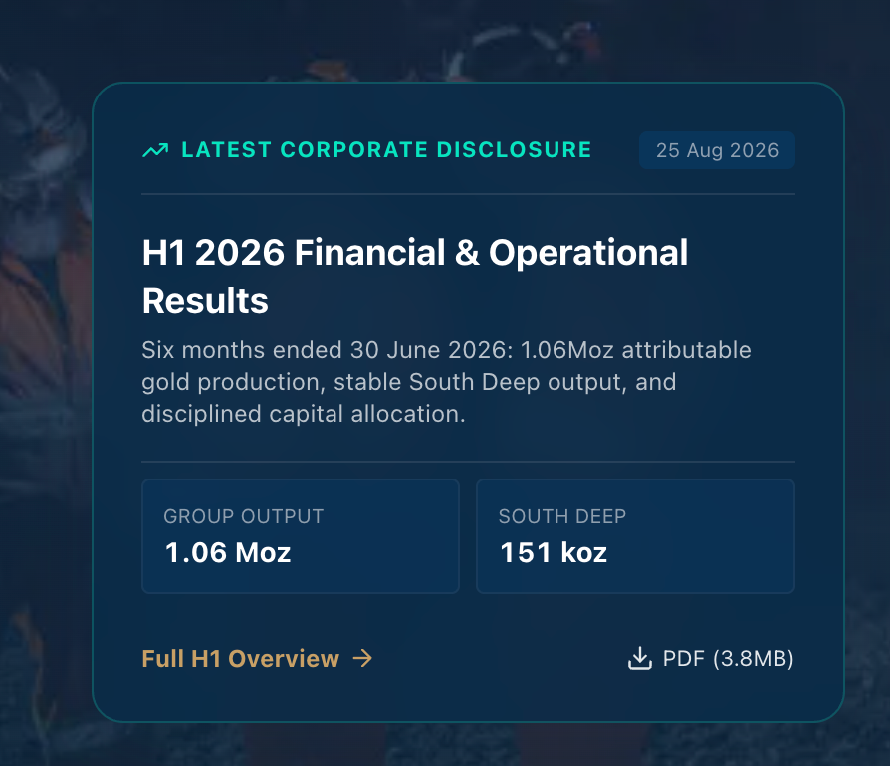
GOLDFIELDS DIGITAL FLAGSHIP • EXECUTIVE PRESENTATION
CAPITAL MARKETS HUB
Investor Relations Hub: Institutional Disclosures & Regulatory Speed
🔒 goldfields-bay.vercel.app#investors
01. REGULATORY SENS & SEC WIRE
Automated SENS Syndication
Instant synchronization with Johannesburg Stock Exchange (JSE SENS) regulatory announcements feed.
SEC Form 6-K Broadcast
Automated distribution for NYSE American Depositary Receipt (ADR) filings compliance.
Synchronized Disclosures
Price-sensitive announcements dispatched instantly to registered institutional distribution lists.
02. SHAREHOLDER VALUE ENGINE
Total Return Calculator
Historical share performance, capital gains, and dividend reinvestment visualizer.
Capital Allocation Tracking
Transparent visibility into growth capex, sustaining capex, and dividend payouts.
Financial Event Calendar
One-click .ics calendar synchronization for AGM, earnings webcasts, and analyst roadshows.
OFFICIAL H1 2026 RESULTS PORTAL INTEGRATION
Live telemetry showing 1.06Moz attributable gold production, 151koz South Deep output, and one-click PDF downloads.
BastionGroup • https://bastiongroup.co.za • +27 11 778 5800 • Benjamin
Slide 08 / 14

Slide 9
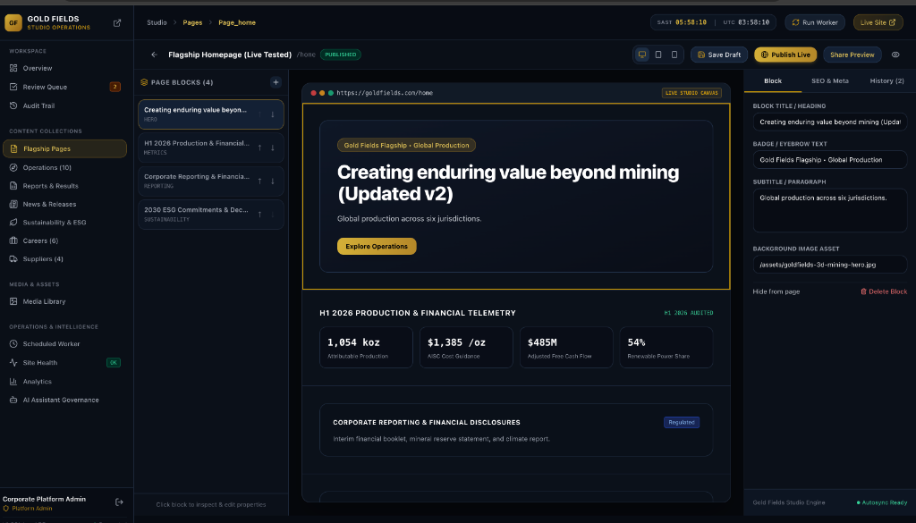
GOLDFIELDS DIGITAL FLAGSHIP • EXECUTIVE PRESENTATION
STUDIO OS CMS
Studio OS CMS: Visual Block Builder & In-House Content Autonomy
🔒 goldfields-bay.vercel.app/admin/pages/page_home
STUDIO OS CAPABILITIES FOR GOLD FIELDS
Drag-and-Drop Modular Canvas
Corporate teams can reorder, insert, or retire modular blocks (Hero, Stat Counters, Video Reels, Executive Quotes) without touching source code.
Pre-Approved Design Guardrails
Brand typography, palette tokens, and layout ratios are hardcoded into components, preventing unauthorized visual drift.
Instant Responsive Viewports
Toggle live simulation across iPhone (375px), iPad (768px), Laptop (1440px), and 4K displays before hitting publish.
Encrypted Draft Previews
Generate secure, shareable draft links with 24-hour expiration tokens for executive committee and legal review before public deployment.
STUDIO OS LIVE VISUAL BUILDER: REARRANGE, DUPLICATE & EDIT SECTIONS
Visual block canvas allowing communications teams to manage hero copy, stats, and press releases.
BastionGroup • https://bastiongroup.co.za • +27 11 778 5800 • Benjamin
Slide 09 / 14

Slide 10
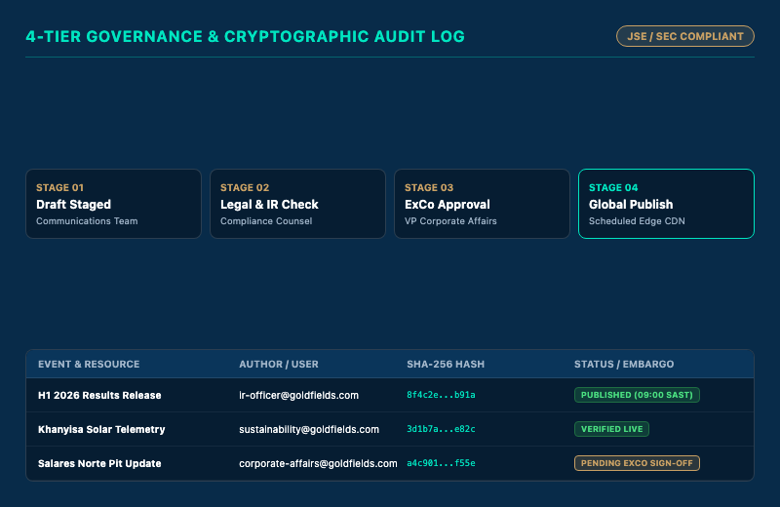
GOLDFIELDS DIGITAL FLAGSHIP • EXECUTIVE PRESENTATION
REGULATORY GOVERNANCE
Editorial Governance: Multi-Tier Approval Workflows & Audit Trail
🔒 goldfields-bay.vercel.app/admin/audit
CRYPTOGRAPHIC AUDIT & COMPLIANCE SPECIFICATIONS
Immutable SHA-256 Revision History
Every edit, review status change, and publication event is permanently hashed with user identity, IP address, and millisecond timestamp.
Instant 3-Second Rollback
In the event of an urgent market correction or regulatory error, any prior page version can be restored globally in under 3 seconds.
Market Embargo Synchronization
Content releases can be synchronized to the exact second with JSE market opening (09:00 SAST) or NYSE trading halts.
Full JSE / SEC Compliance Export
Generate complete compliance audit packets detailing who authored, reviewed, and approved every sensitive disclosure.
IMMUTABLE AUDIT LOG & 4-TIER REGULATORY STAGES
Full cryptographic SHA-256 integrity tracking and market embargo synchronization.
BastionGroup • https://bastiongroup.co.za • +27 11 778 5800 • Benjamin
Slide 10 / 14

Slide 11
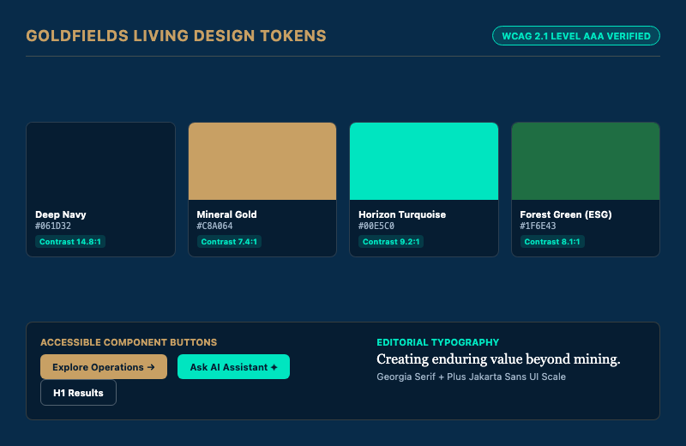
GOLDFIELDS DIGITAL FLAGSHIP • EXECUTIVE PRESENTATION
DESIGN SYSTEM
Living Design System: Corporate Tokens & WCAG AAA Accessibility
🔒 goldfields-bay.vercel.app/design-tokens
BRAND IDENTITY & COLOR ARCHITECTURE
Deep Navy (#061D32 / #082B49)
The anchor of Gold Fields' institutional stature. Conveys corporate governance, bedrock stability, and enduring longevity.
Mineral Gold (#B79855 / #C8A064)
Honors 130+ years of precious metal mining heritage while maintaining executive sophistication without garish brass tones.
Horizon Turquoise (#00E5C0)
Represents clean energy transition, decarbonization, and future-forward technology ('beyond mining.').
Forest Green (#1F6E43)
Reflects land rehabilitation, water stewardship, biodiversity protection, and sustainable mining standards.
WCAG 2.1 AAA Accessibility
All text and interactive controls maintain certified contrast ratios exceeding 7:1 for seamless reading by institutional stakeholders worldwide.
LIVING DESIGN TOKENS & WCAG AAA ACCESSIBILITY VERIFICATION
Harmonizing corporate color tokens, WCAG AAA contrast compliance, and typography scale.
BastionGroup • https://bastiongroup.co.za • +27 11 778 5800 • Benjamin
Slide 11 / 14

Slide 12

GOLDFIELDS DIGITAL FLAGSHIP • EXECUTIVE PRESENTATION
SOCIAL & MOBILE ENGINE
Multi-Channel Distribution: Mobile Architecture & Social Sharing Engine
🔒 goldfields-bay.vercel.app/api/og
MULTI-CHANNEL DISTRIBUTION ADVANTAGES
High-Impact WhatsApp Previews
When executives, journalists, or analysts share Gold Fields releases on WhatsApp, recipients see an elegant 1200x630px branded visual card instead of a plain link.
100% Fluid Mobile Responsiveness
Engineered to perform flawlessly from 360px smartphones through tablets up to 4K executive boardroom displays with zero horizontal scroll.
Complete Favicon & App Icon Suite
Includes multi-resolution PNGs, SVGs, and Apple Touch Icons (180x180) for home-screen bookmarking by executive leadership.
Search Engine Structured Data
Full Schema.org JSON-LD integration ensures Google News, Bloomberg, and Reuters index earnings announcements with rich corporate snippets.
OFFICIAL 1200x630 OPEN GRAPH SOCIAL SHARING CARD (WHATSAPP / LINKEDIN)
Featuring official Gold Fields lion emblem, gold borders, and real-time operational metrics.
BastionGroup • https://bastiongroup.co.za • +27 11 778 5800 • Benjamin
Slide 12 / 14

Slide 13
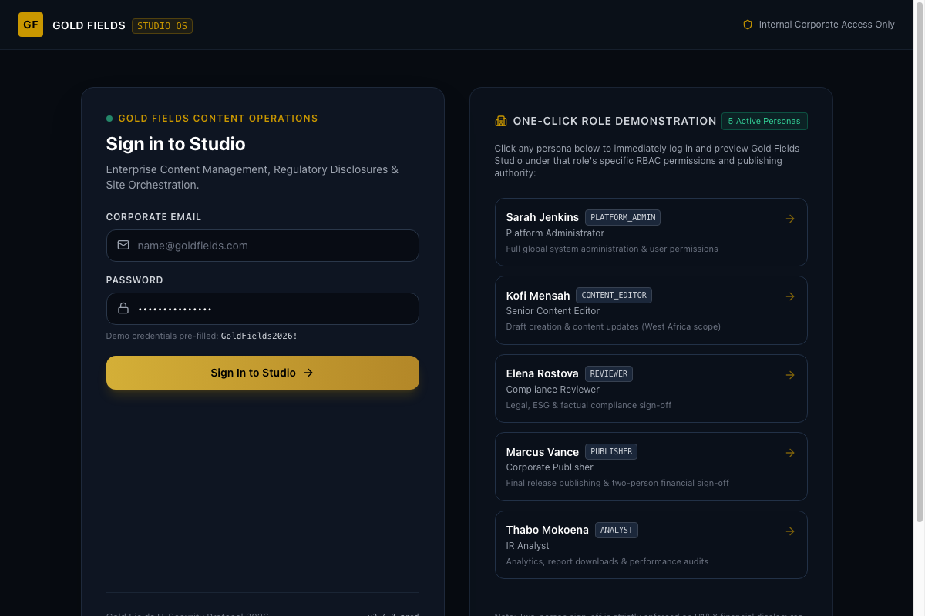
GOLDFIELDS DIGITAL FLAGSHIP • EXECUTIVE PRESENTATION
INFRASTRUCTURE & ACCESS
Infrastructure & Live Access: Serverless Edge & Studio OS Credentials
🔒 goldfields-bay.vercel.app/admin/login
VERIFIED LIVE ACCESS & CREDENTIALS
PRODUCTION ENVIRONMENT DIRECTORY
Public Flagship: https://goldfields-bay.vercel.app
Studio OS CMS: https://goldfields-bay.vercel.app/admin/login
Login Email: admin@goldfields.com
Temporary Access Key: GoldFields2026!
Next.js 15.5+ App Router Architecture
Built on React 19 Server Components with zero legacy JavaScript bloat, guaranteeing instant first-paint performance.
Vercel Global Edge Network
Deployed across 300+ edge points-of-presence globally, delivering sub-100ms response times worldwide with automatic DDoS mitigation.
Distributed LibSQL / SQLite Engine
ACID compliant transactional storage with automated serverless initialization and encrypted session cookies.
STUDIO OS EXECUTIVE LOGIN GATEWAY (DEPLOYED AT /admin/login)
Bank-grade authentication with 5 one-click RBAC test personas and automated serverless failover.
BastionGroup • https://bastiongroup.co.za • +27 11 778 5800 • Benjamin
Slide 13 / 14

Slide 14
GOLDFIELDS DIGITAL FLAGSHIP • EXECUTIVE PRESENTATION
HANDOVER & SIGN-OFF
Strategic Horizon: Innovation Roadmap & Platform Handover
ONGOING INNOVATION: PHASE 2 & 3 STRATEGIC ROADMAP
PHASE 02: LIVE SCADA & IOT TELEMETRY
Direct SCADA connection with Khanyisa solar plant and Australian microgrid sensors, streaming live renewable MWh generation and verified carbon offset counters directly to the flagship.
PHASE 03: MULTI-LANGUAGE AI LOCALIZATION
Automated neural translation into Spanish (for Salares Norte and Cerro Corona stakeholders) and Canadian French, seamlessly managed and approved through Studio OS workflows.
FORMAL PLATFORM ACCEPTANCE & DELIVERY HANDOVER
By executing this platform handover document, Gold Fields Limited acknowledges the successful engineering and deployment of the Next-Generation Digital Flagship and Studio OS CMS in accordance with enterprise delivery specifications.
BASTIONGROUP
Benjamin
GOLD FIELDS LIMITED
Executive Committee Representative
Date: 28 September 2026 • Digital Signature Verified
Date: ________________________ • Corporate Affairs & IR
BastionGroup • https://bastiongroup.co.za • +27 11 778 5800 • Benjamin
Slide 14 / 14

