Slide 1
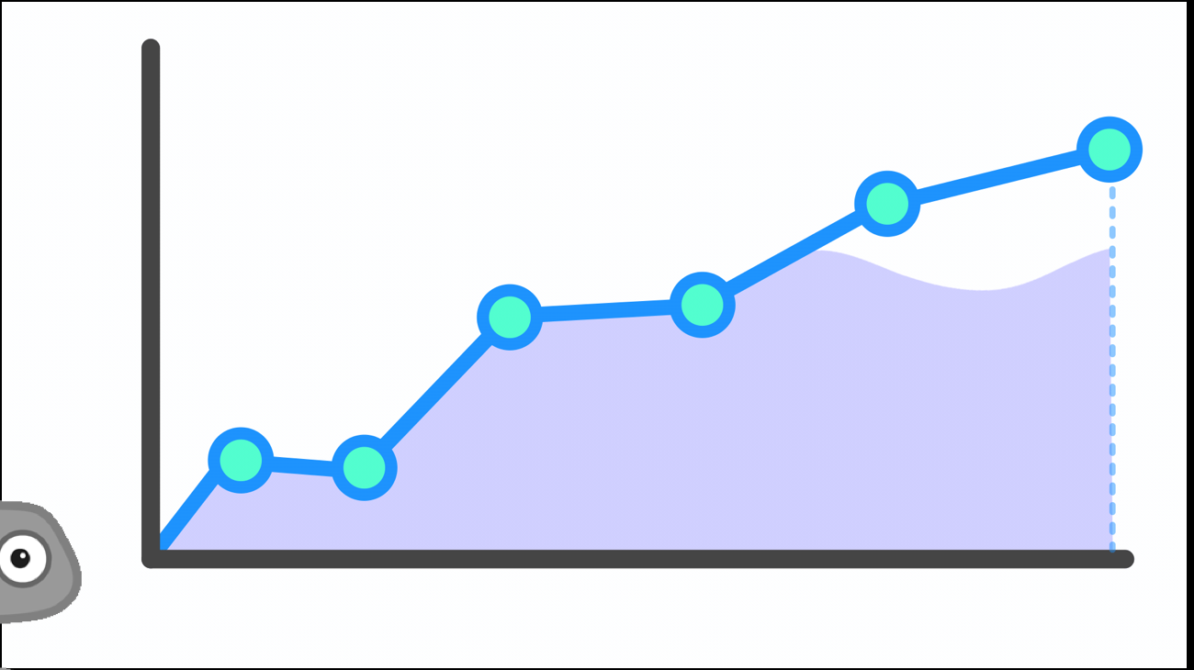
Autonomous Portfolio Manager
Malcolm Mashig

Slide 2
Goal
Design an autonomous agent that decides stock market trades
Utilize Reinforcement Learning
Agent attempts various strategies and converges to strategy with highest reward
Reward:
Performance compared to benchmark (percent difference)
Benchmark: maximum of wealth based on investing equally in all available stocks OR… initial capital * growth rate
Identify investment strategy that is:
useful (outperforms arbitrary strategy / market) AND…
risk-averse (wealth does not decrease)

Slide 3
Design – Setup
Pull daily opening and closing stock prices
5,000+ symbols (NYSE + NASDAQ)
From 2000 through 2019
From two different sources (to identify and filter out erroneous data)
Split data into training, validation, and testing sets of studies
Study: 50 trading day period with ~500 stock symbols
500+ total studies
Some time periods reserved solely for validation or testing so that the agent is robust in unseen market environments
Iterate through each training study in random order with newly-selected strategy each time
Iterate sequentially through each trading day in the study
Execute entries and exits + update wealth (cash + value of holdings) each day

Slide 4
Design – Reinforcement Learning
After simulating portfolio management for a study…
Evaluate daily performance (compared to benchmark)
Update reward table with strategy attempted and performance / reward
Update probability of selecting/using each strategy
Best average performance → highest probability (promote exploitation)
Strategy for next study is determined based on these probabilities
Each time, there is a (ε) chance of choosing random strategy (promote exploration)
ε decays over time so that agent converges to the selection/use of optimal strategy
To promote convergence, worst strategies are removed (collapse) each training epoch (run-through)

Slide 5
Simulation Process
At end of each trading day…
Agent uses closing prices to:
Evaluate wealth → later compared to benchmark
Decides actions/trades based on relative prices in a trailing window
Agent uses next trading day’s opening prices to:
Execute exits then entries
*Closing prices are highly correlated with next trading day’s opening prices
*All exits involve exiting all shares of a stock

Slide 6
Simulation Process – Timeline
Closing Prices
Opening Prices
Update Estimated Wealth
Evaluate Wealth
Schedule Exits
Schedule Enters
Execute Exits
Execute Enters
End of Trading Day
4pm
(pull data)
Start of Trading Day
9:30am

Slide 7
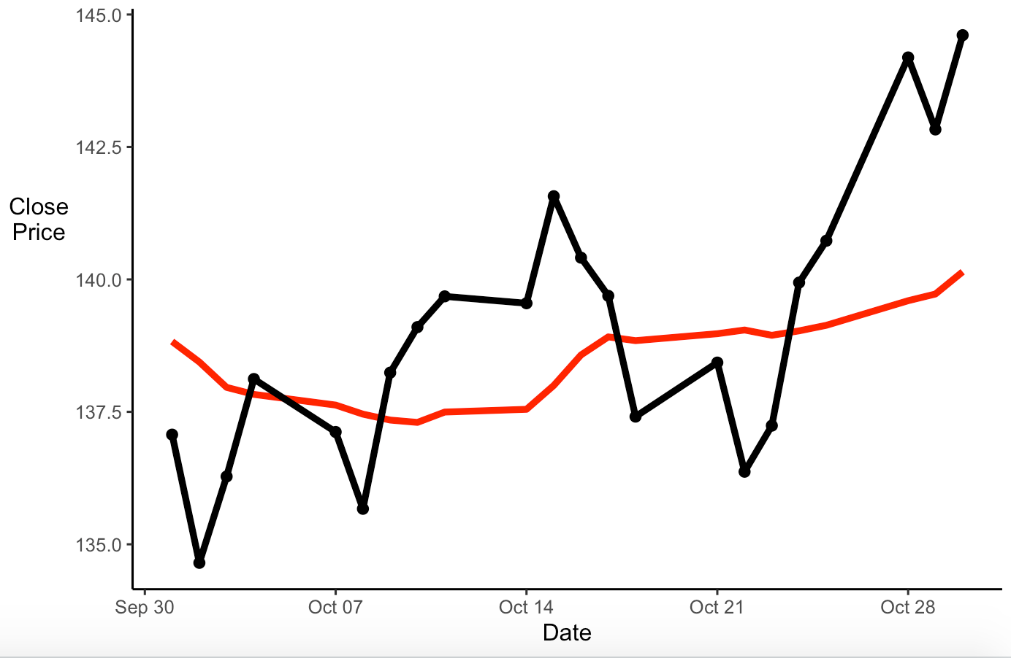
Relative Price
relative high
10 day trailing average
relative low

Slide 8
Training Parameters
Strategy: combination of parameters
Philosophy
Reversion (buy low, sell high) vs…
Momentum (buy high, sell low)
Relative price trailing window size + cutoffs
The window size and cutoffs for determining high and low relative prices
Max long proportion
Maximum proportion of wealth invested in stocks
Max short proportion
Maximum proportion of wealth invested against stocks (borrow, sell now, buy later)
Trade proportion range
Maximum and minimum proportion of wealth invested on one trade
Max trades
Maximum number of stocks to long (invest in) and short (invest against)
Stop losses / wins + respective cutoffs
Whether or not to exit poorly or strongly performing holdings
Timed exits + max holding period
Whether or not to exit holdings after certain period of time

Slide 9

Hyper-Parameters
Parameters that may influence the training process / convergence
Benchmark + growth rate of capital (reward function)
Determines reward calculation and thus strongly influences what the agent will consider optimal
Random-selection probability ($ε$)
Initial probability of randomly selecting/using a strategy
Epsilon decay
Factor by which to decrease ε each training iteration / study simulation
Random-sampling entry
Whether or not to randomly choose trades that satisfy requirements for entry
If not, most extreme entries (farthest above/below cutoffs) are chosen
Epochs
Number of times to iterate through set of training studies
Collapse Rate
Factor by which to decrease pool of possible strategies after each epoch

Slide 10
Demonstration

Slide 11
Training Specifications
Hyper-parameters:
Growth Rate: 0.0005%
Initial Epsilon: 0.4
Epsilon Decay: 0.998
Random-Sampling Entry: TRUE
Epochs: 4
1,224 total simulations/iterations
Collapse Rate: 0.5
Parameters Tested:
*32 Total Strategies (2⁵)
Philosophy
Relative Price Window Size
Max Long Trades
Max Short Trades
Max Short Proportion

Slide 12
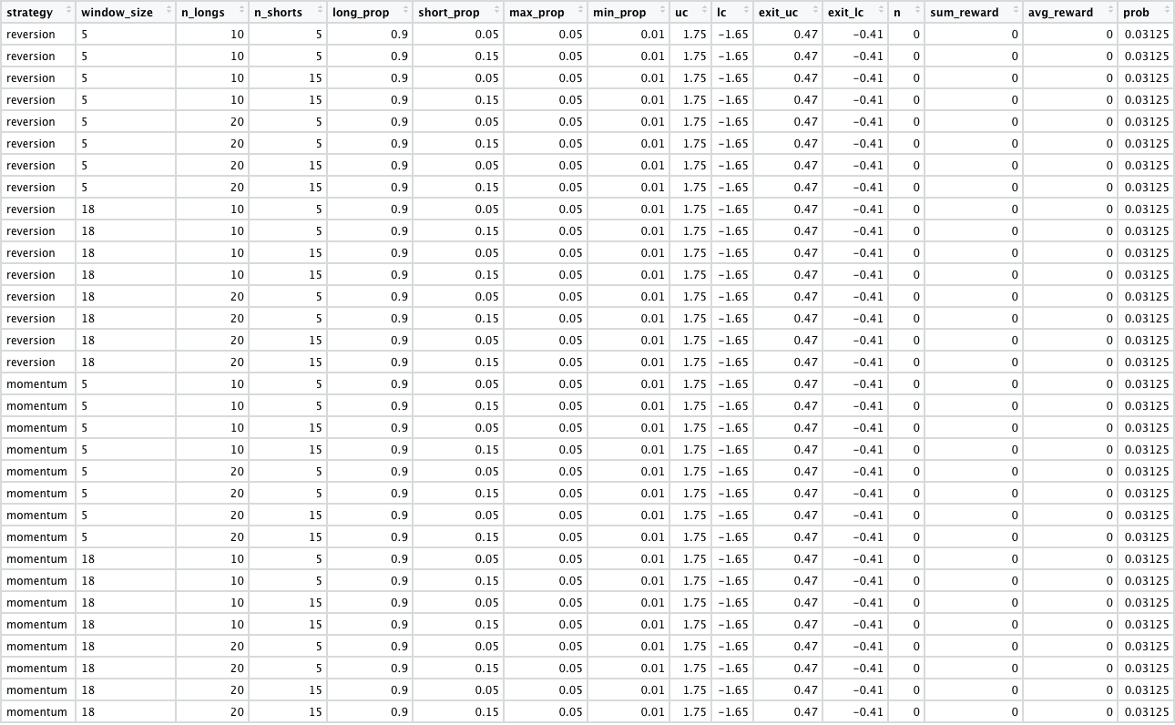
Initial Reward Table:
Optimal Strategy:
Philosophy: Reversion
Window Size: 18
Max Long Trades: 10
Max Short Trades: 5
Max Short Proportion: 0.15
Final Reward Table:
after training

Slide 13
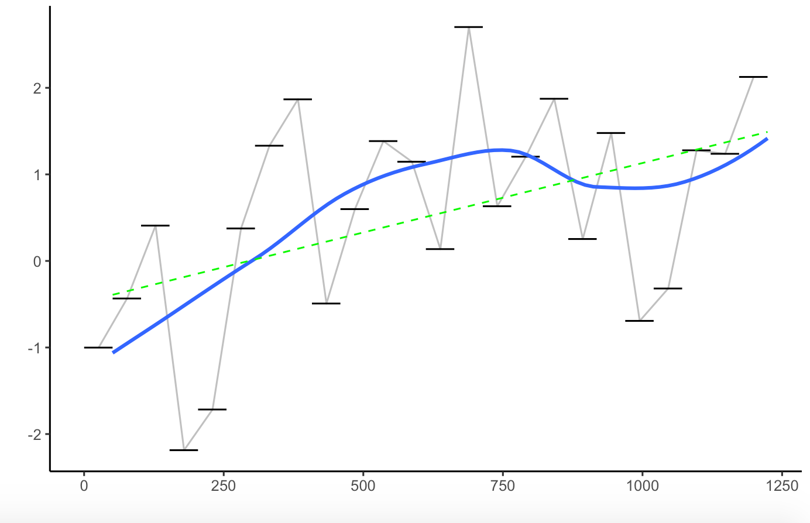
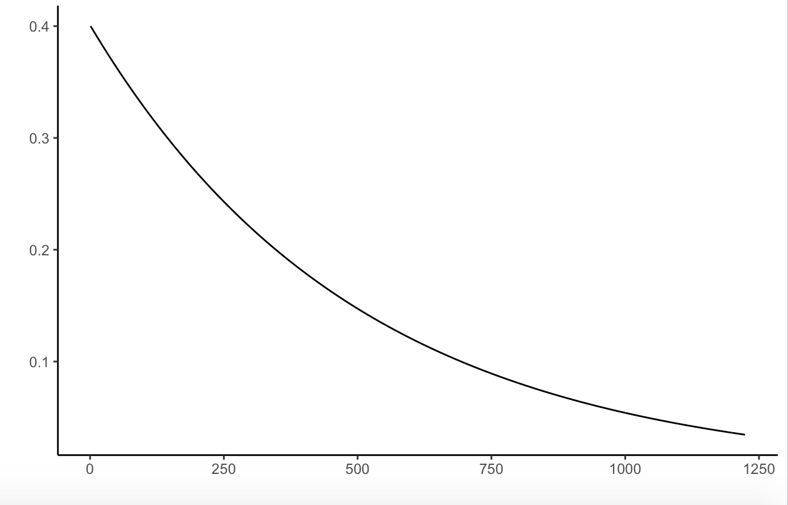
Average Performance
performance improves
as agent learns
exploration decreases
&
exploitation increases
Epsilon (𝜀)
Simulations

Slide 14
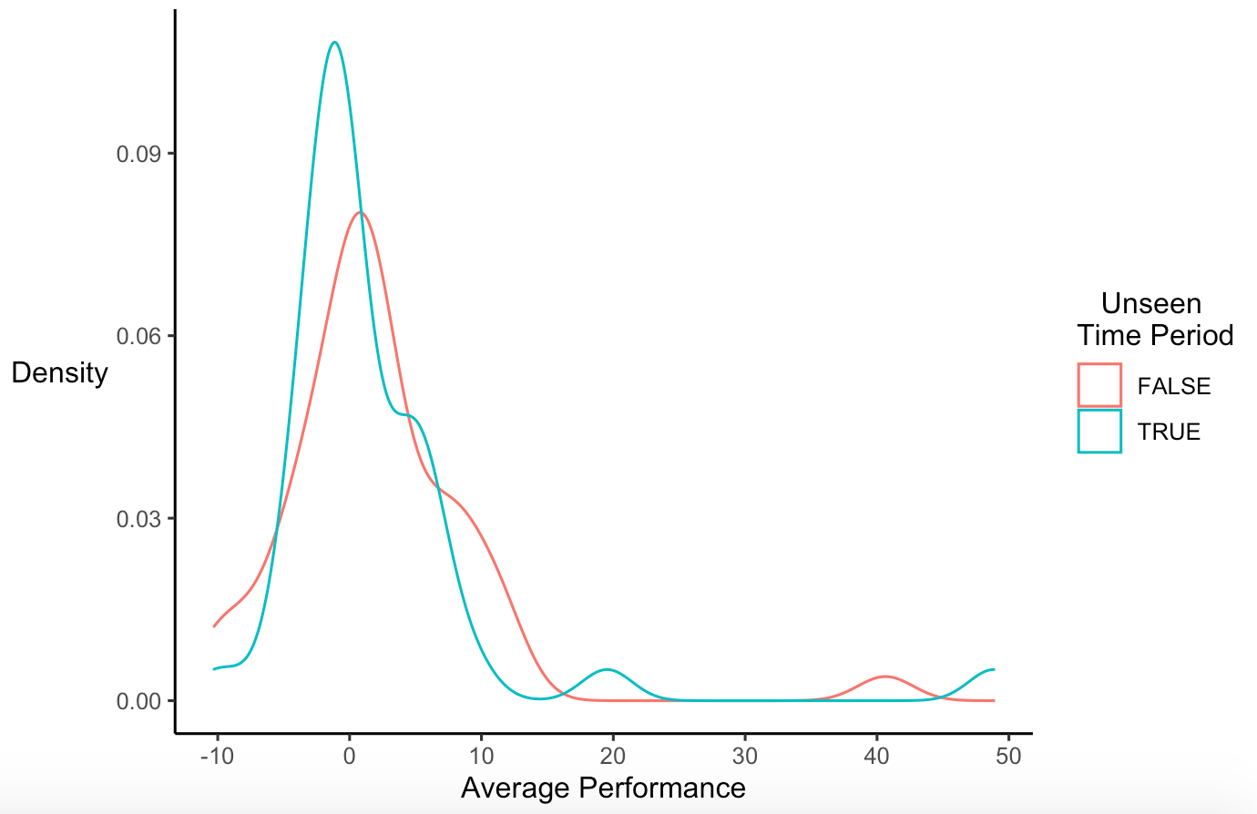
Validation Performance
Studies Simulated: 89
Average Performance = 2.04
Median Performance = 0.28
Familiar Time Periods (trained on):
Studies Simulated: 48
Average Performance = 2.14
Median Performance = 1.17
Unseen Time Periods (not trained on):
Studies Simulated: 41
Average Performance = 1.93
Median Performance = -0.56
*While some time periods were ”seen” in training, the cohort of available stocks makes each study unique

Slide 15
Next Steps / Improvements
Continue simulations with new parameter options and hyper-parameter specifications
Implement stop-loss & timed-exit parameters
Implement continuous parameter testing
Speed-up simulation function
Simulate optimal strategy on studies reserved for testing as final evaluation
Incorporate dividends
You earn dividends when they are paid out by stocks invested in (longed)
You owe dividends when they are paid out by stocks invested against (shorted/borrowed)
Incorporate other nuances of short trades
Maintenance requirements, hard-to-borrow fees, etc.
Incorporate taxes (on investment profits)
Incorporate stock splits (currently removed from data)
Improve data collection & validation process
Test strategy in the real-time market

Slide 16
Practicality
With an optimal strategy, we can test our agent in the real-time market
*Rather than in historical market environments
Pull stock prices at the end of each trading day
Feed the agent this new data
Manually schedule and execute trades decided by the agent
Manually fix any inconsistencies (erroneous prices, failed trades, etc.)
Continue to simulate different strategies on new data (online RL)

Slide 17
Thank you!
Questions?

