Slide 1
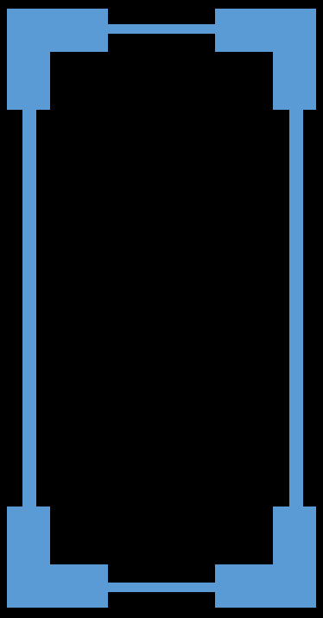
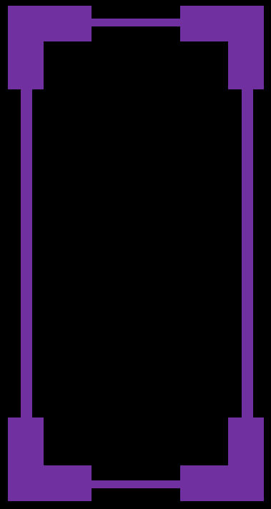
Tennis for Two
Implemented with Modern Approach
START
ABOUT ME
EXIT
Copyright © 2016 Malcom Wang

Slide 2
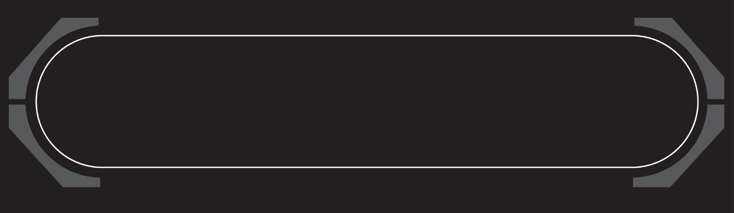

ABOUT ME
This game is designed for the Digit Circuit Lab. The inspiration is from the very first electro-game in the world which is created in Brookhaven National Laboratories. Its name is Tennis For Two. Since then, the human history of the game went to another chapter. My lab is to do my honor for Mr. Higginbotham, the one who starts a revolution of how people having fun. Moreover, I also added some patterns of the modern game and implement it with modern approach and devices which will make it more fun.

Slide 3


CONTINUE
EXIT TO DESKTOP

Slide 4
VICTORY
DEFEAT

Slide 5
DEFEAT
VICTORY

Slide 6
DRAW
DRAW

Slide 8


Slide 9



