Slide 1
Chapter 5
SQL: Data Manipulation
Transparencies
© Pearson Education Limited 1995, 2005
Notes:
Chapter Name
September 98

Slide 2
Chapter 5 - Objectives
Purpose and importance of SQL.
How to retrieve data from database using SELECT and:
  Use compound WHERE conditions.
  Sort query results using ORDER BY.
  Use aggregate functions.
  Group data using GROUP BY and HAVING.
  Use subqueries.
© Pearson Education Limited 1995, 2005

Slide 3
Chapter 5 - Objectives
  Join tables together.
  Perform set operations (UNION, INTERSECT, EXCEPT).
How to update database using INSERT, UPDATE, and DELETE.
© Pearson Education Limited 1995, 2005

Slide 4
Objectives of SQL
Ideally, database language should allow user to:
  create the database and relation structures;
  perform insertion, modification, deletion of data from relations;
  perform simple and complex queries.
Must perform these tasks with minimal user effort and command structure/syntax must be easy to learn.
It must be portable.
© Pearson Education Limited 1995, 2005

Slide 5
Objectives of SQL
SQL is a transform-oriented language with 2 major components:
  A DDL for defining database structure.
  A DML for retrieving and updating data.
Until SQL:1999, SQL did not contain flow of control commands. These had to be implemented using a programming or job-control language, or interactively by the decisions of user.
© Pearson Education Limited 1995, 2005

Slide 6
Objectives of SQL
SQL is relatively easy to learn:
  it is non-procedural - you specify what information you require, rather than how to get it;
  it is essentially free-format.
© Pearson Education Limited 1995, 2005

Slide 7
Objectives of SQL
Consists of standard English words:
1) CREATE TABLE Staff(staffNo VARCHAR(5),
  lName VARCHAR(15),
  salary DECIMAL(7,2));
2) INSERT INTO Staff VALUES (‘SG16’, ‘Brown’, 8300);
3) SELECT staffNo, lName, salary
FROM Staff
WHERE salary > 10000;
© Pearson Education Limited 1995, 2005

Slide 8
Objectives of SQL
Can be used by range of users including DBAs, management, application developers, and other types of end users.
An ISO standard now exists for SQL, making it both the formal and de facto standard language for relational databases.
© Pearson Education Limited 1995, 2005

Slide 9
History of SQL
In 1974, D. Chamberlin (IBM San Jose Laboratory) defined language called ‘Structured English Query Language’ (SEQUEL).
A revised version, SEQUEL/2, was defined in 1976 but name was subsequently changed to SQL for legal reasons.
© Pearson Education Limited 1995, 2005

Slide 10
History of SQL
Still pronounced ‘see-quel’, though official pronunciation is ‘S-Q-L’.
IBM subsequently produced a prototype DBMS called System R, based on SEQUEL/2.
Roots of SQL, however, are in SQUARE (Specifying Queries as Relational Expressions), which predates System R project.
© Pearson Education Limited 1995, 2005

Slide 11
History of SQL
In late 70s, ORACLE appeared and was probably first commercial RDBMS based on SQL.
In 1987, ANSI and ISO published an initial standard for SQL.
In 1989, ISO published an addendum that defined an ‘Integrity Enhancement Feature’.
In 1992, first major revision to ISO standard occurred, referred to as SQL2 or SQL/92.
In 1999, SQL:1999 was released with support for object-oriented data management.
In late 2003, SQL:2003 was released.
© Pearson Education Limited 1995, 2005

Slide 12
Importance of SQL
SQL has become part of application architectures such as IBM’s Systems Application Architecture.
It is strategic choice of many large and influential organizations (e.g. X/OPEN).
SQL is Federal Information Processing Standard (FIPS) to which conformance is required for all sales of databases to American Government.
© Pearson Education Limited 1995, 2005

Slide 13
Importance of SQL
SQL is used in other standards and even influences development of other standards as a definitional tool. Examples include:
  ISO’s Information Resource Directory System (IRDS) Standard
  Remote Data Access (RDA) Standard.
© Pearson Education Limited 1995, 2005

Slide 14
Writing SQL Commands
SQL statement consists of reserved words and user-defined words.
Reserved words are a fixed part of SQL and must be spelt exactly as required and cannot be split across lines.
User-defined words are made up by user and represent names of various database objects such as relations, columns, views.
© Pearson Education Limited 1995, 2005

Slide 15
Writing SQL Commands
Most components of an SQL statement are case insensitive, except for literal character data.
More readable with indentation and lineation:
  Each clause should begin on a new line.
  Start of a clause should line up with start of other clauses.
  If clause has several parts, should each appear on a separate line and be indented under start of clause.
© Pearson Education Limited 1995, 2005

Slide 16
Writing SQL Commands
Use extended form of BNF notation:
- Upper-case letters represent reserved words.
- Lower-case letters represent user-defined words.
- | indicates a choice among alternatives.
- Curly braces indicate a required element.
- Square brackets indicate an optional element.
- … indicates optional repetition (0 or more).
© Pearson Education Limited 1995, 2005

Slide 17
Literals
Literals are constants used in SQL statements.
All non-numeric literals must be enclosed in single quotes (e.g. ‘London’).
All numeric literals must not be enclosed in quotes (e.g. 650.00).
© Pearson Education Limited 1995, 2005

Slide 18
SELECT Statement
  SELECT [DISTINCT | ALL]
  {* | [columnExpression [AS newName]] [,...] }
  FROM TableName [alias] [, ...]
  [WHERE condition]
  [GROUP BY columnList] [HAVING condition]
  [ORDER BY columnList]
© Pearson Education Limited 1995, 2005

Slide 19
SELECT Statement
FROM Specifies table(s) to be used.
WHERE Filters rows.
GROUP BY Forms groups of rows with same
  column value.
HAVING Filters groups subject to some
  condition.
SELECT Specifies which columns are to
  appear in output.
ORDER BY Specifies the order of the output.
© Pearson Education Limited 1995, 2005

Slide 20
SELECT Statement
Order of the clauses cannot be changed.
Only SELECT and FROM are mandatory.
© Pearson Education Limited 1995, 2005

Slide 21
Example 5.1 All Columns, All Rows
List full details of all staff.
SELECT staffNo, fName, lName, address,
  position, sex, DOB, salary, branchNo
  FROM Staff;
Can use * as an abbreviation for ‘all columns’:
  SELECT *
  FROM Staff;
© Pearson Education Limited 1995, 2005

Slide 22
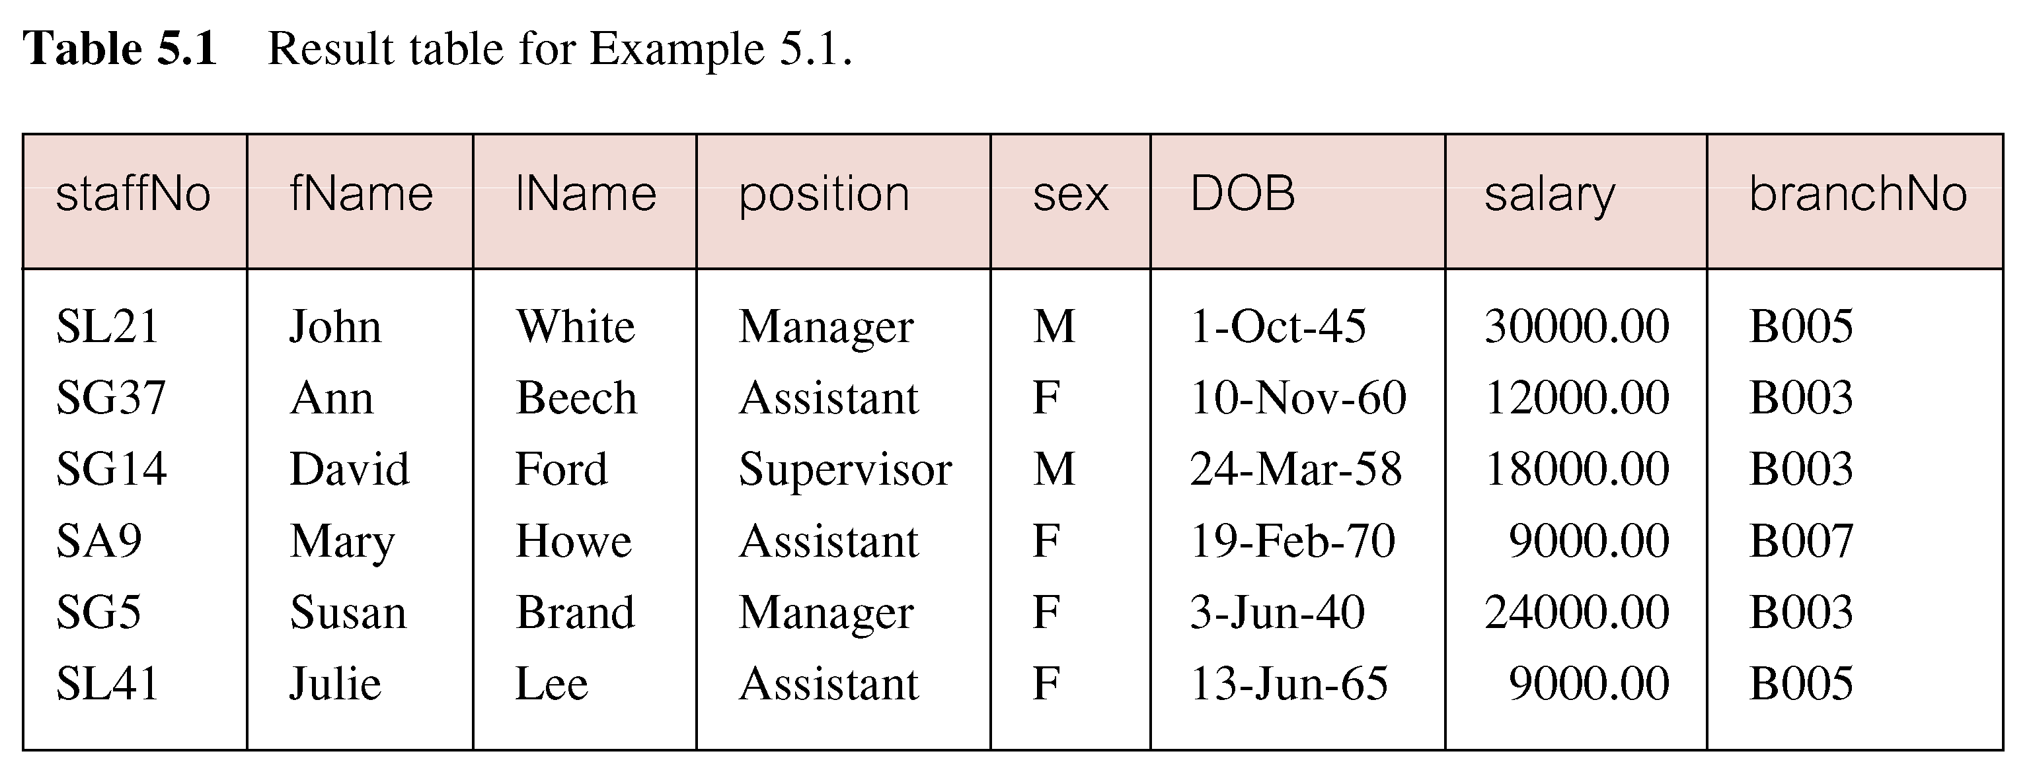
Example 5.1 All Columns, All Rows
© Pearson Education Limited 1995, 2005

Slide 23
Example 5.2 Specific Columns, All Rows
Produce a list of salaries for all staff, showing only staff number, first and last names, and salary.
  SELECT staffNo, fName, lName, salary
  FROM Staff;
© Pearson Education Limited 1995, 2005

Slide 24
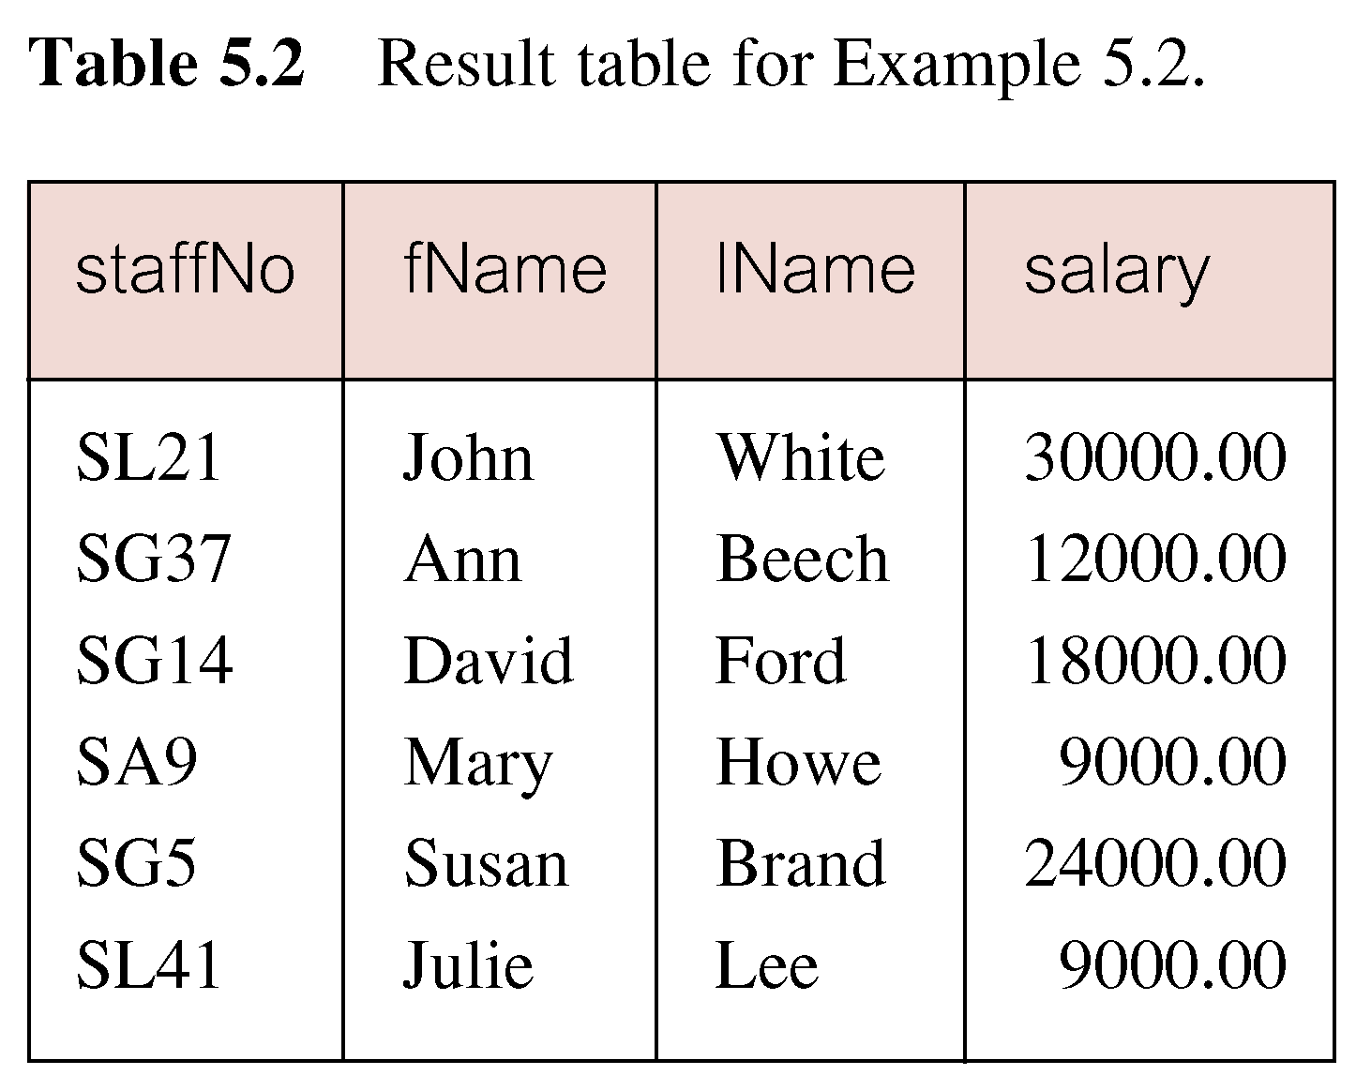
Example 5.2 Specific Columns, All Rows
© Pearson Education Limited 1995, 2005

Slide 25
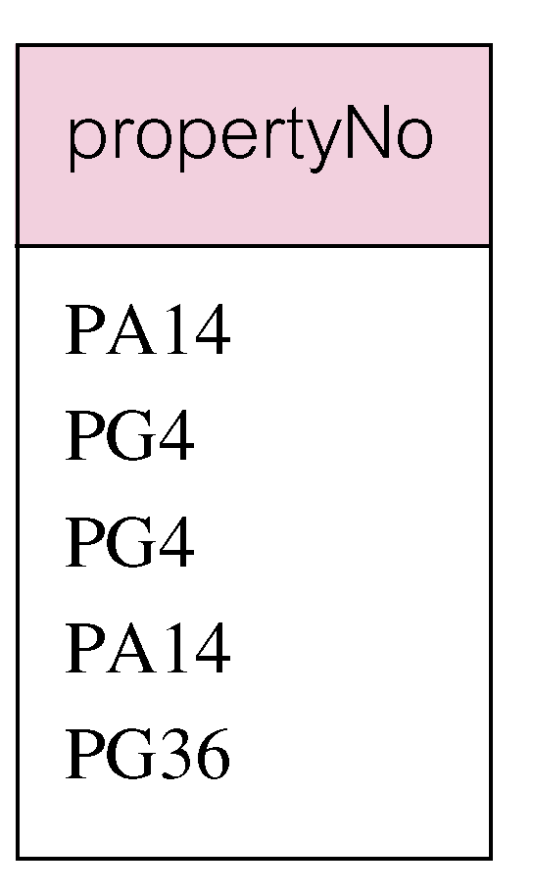
Example 5.3 Use of DISTINCT
List the property numbers of all properties that have been viewed.
SELECT propertyNo
  FROM Viewing;
© Pearson Education Limited 1995, 2005

Slide 26
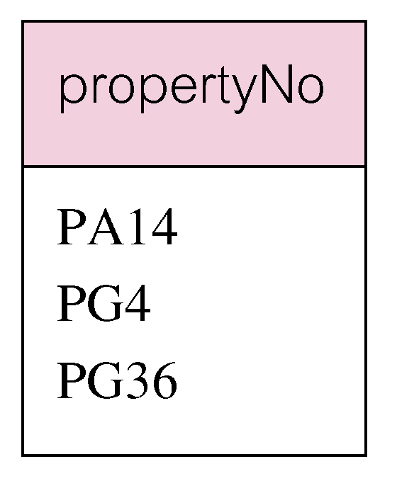
Example 5.3 Use of DISTINCT
Use DISTINCT to eliminate duplicates:
SELECT DISTINCT propertyNo
  FROM Viewing;
© Pearson Education Limited 1995, 2005

Slide 27
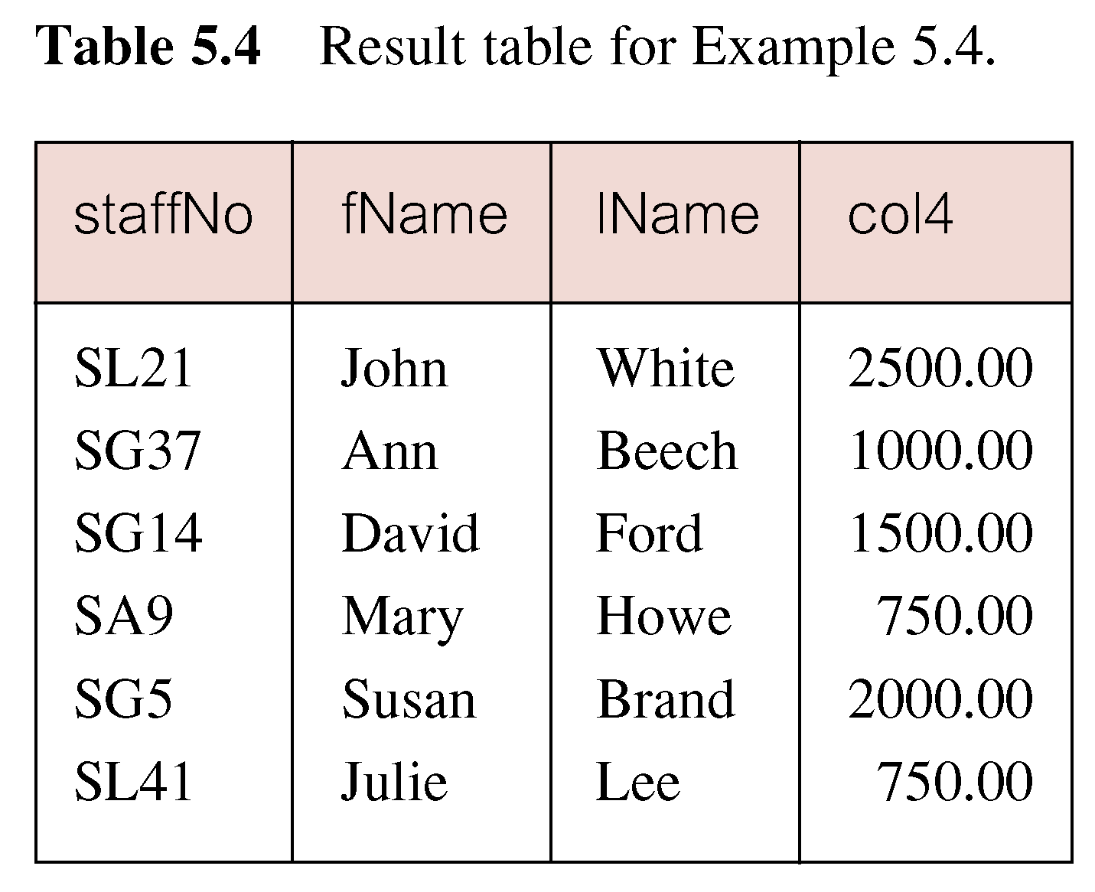
Example 5.4 Calculated Fields
Produce list of monthly salaries for all staff, showing staff number, first/last name, and salary.
SELECT staffNo, fName, lName, salary/12
  FROM Staff;
© Pearson Education Limited 1995, 2005

Slide 28
Example 5.4 Calculated Fields
To name column, use AS clause:
SELECT staffNo, fName, lName, salary/12
  AS monthlySalary
  FROM Staff;
© Pearson Education Limited 1995, 2005

Slide 29
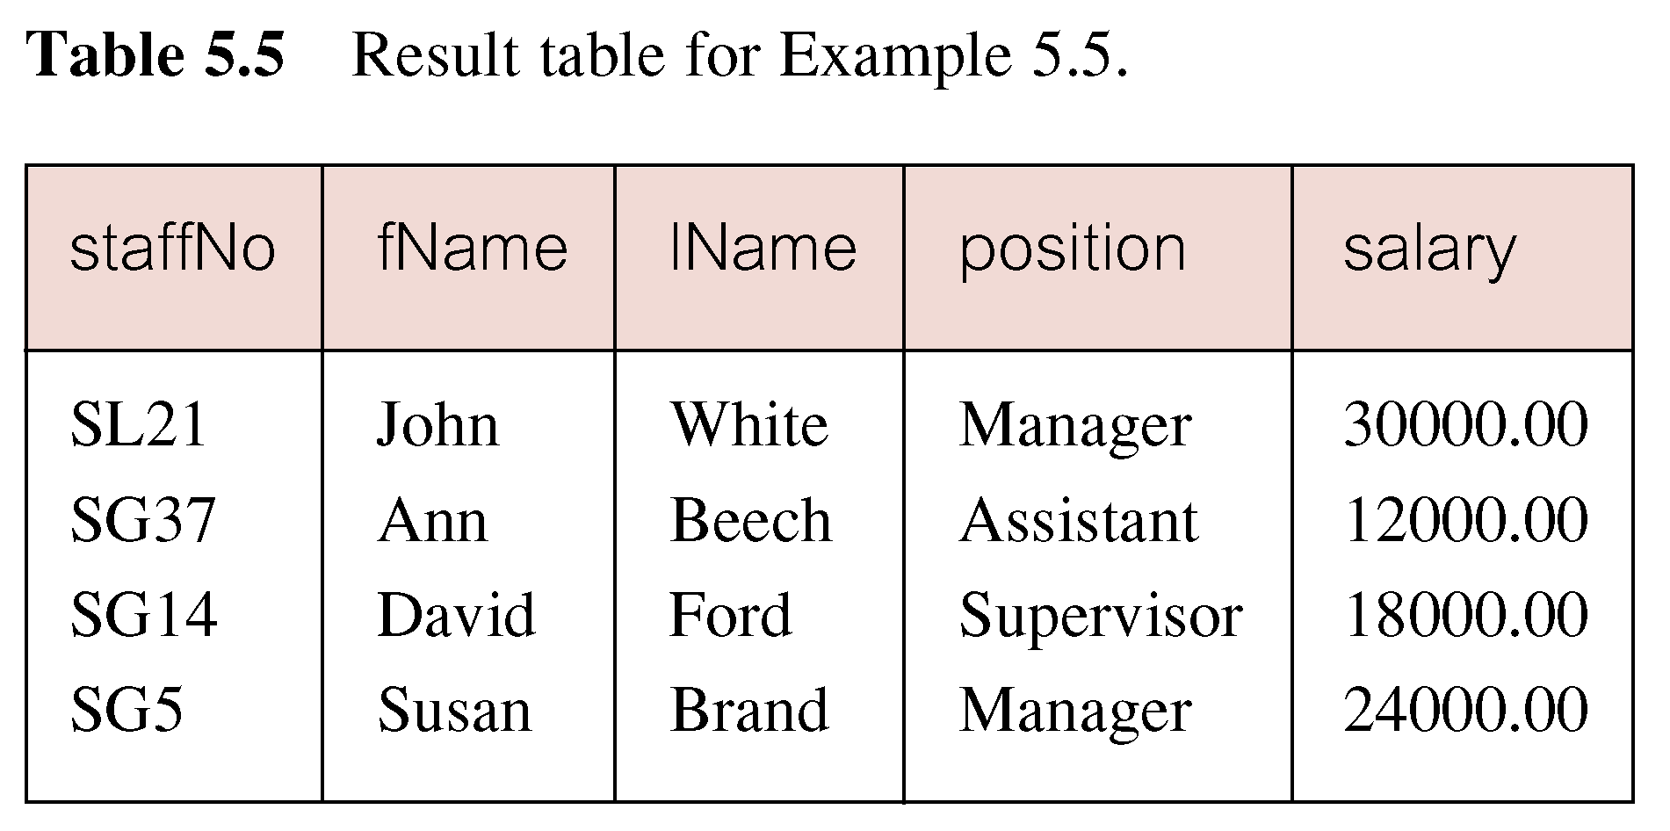
Example 5.5 Comparison Search Condition
List all staff with a salary greater than 10,000.
SELECT staffNo, fName, lName, position, salary
  FROM Staff
  WHERE salary > 10000;
© Pearson Education Limited 1995, 2005

Slide 30
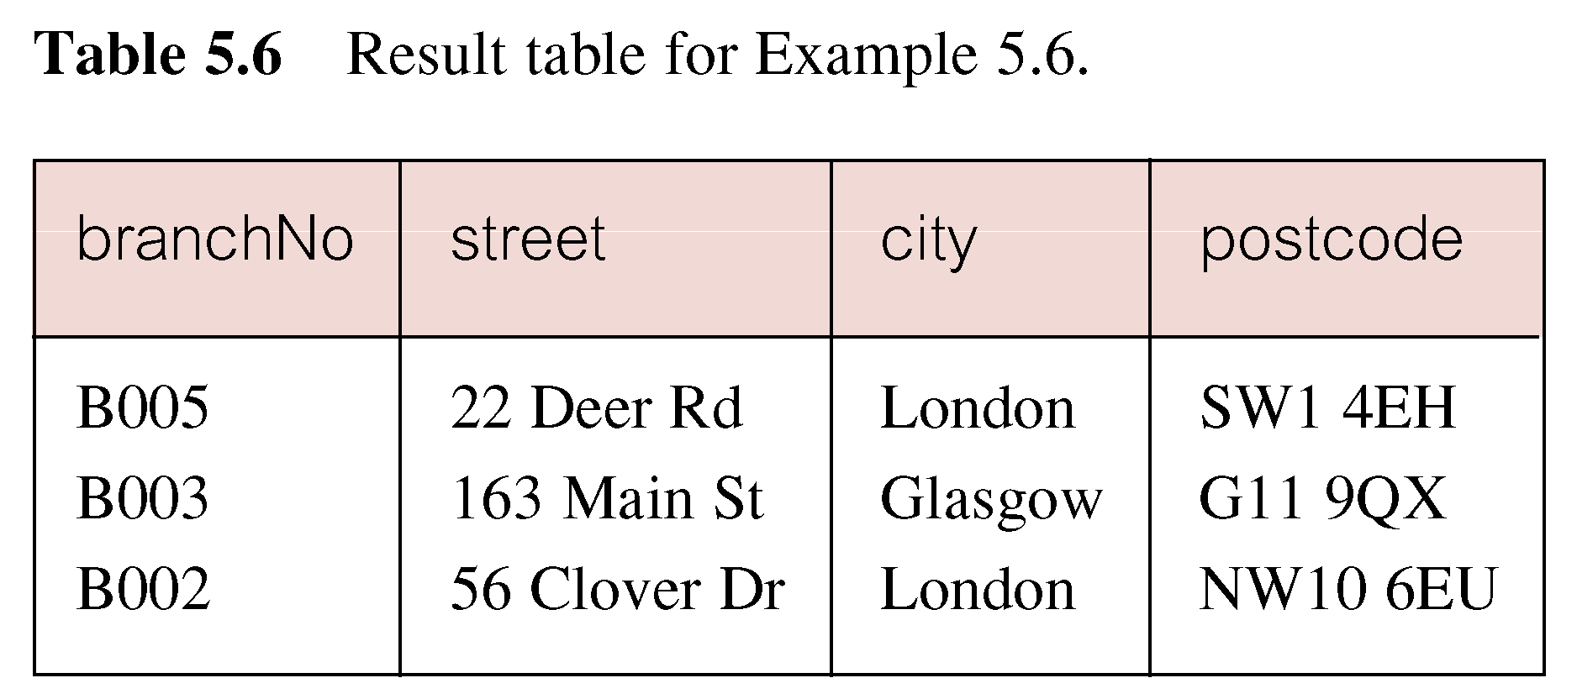
Example 5.6 Compound Comparison Search Condition
List addresses of all branch offices in London or Glasgow.
SELECT *
  FROM Branch
  WHERE city = ‘London’ OR city = ‘Glasgow’;
© Pearson Education Limited 1995, 2005

Slide 31
Example 5.7 Range Search Condition
List all staff with a salary between 20,000 and 30,000.
SELECT staffNo, fName, lName, position, salary
  FROM Staff
  WHERE salary BETWEEN 20000 AND 30000;
BETWEEN test includes the endpoints of range.
© Pearson Education Limited 1995, 2005

Slide 32
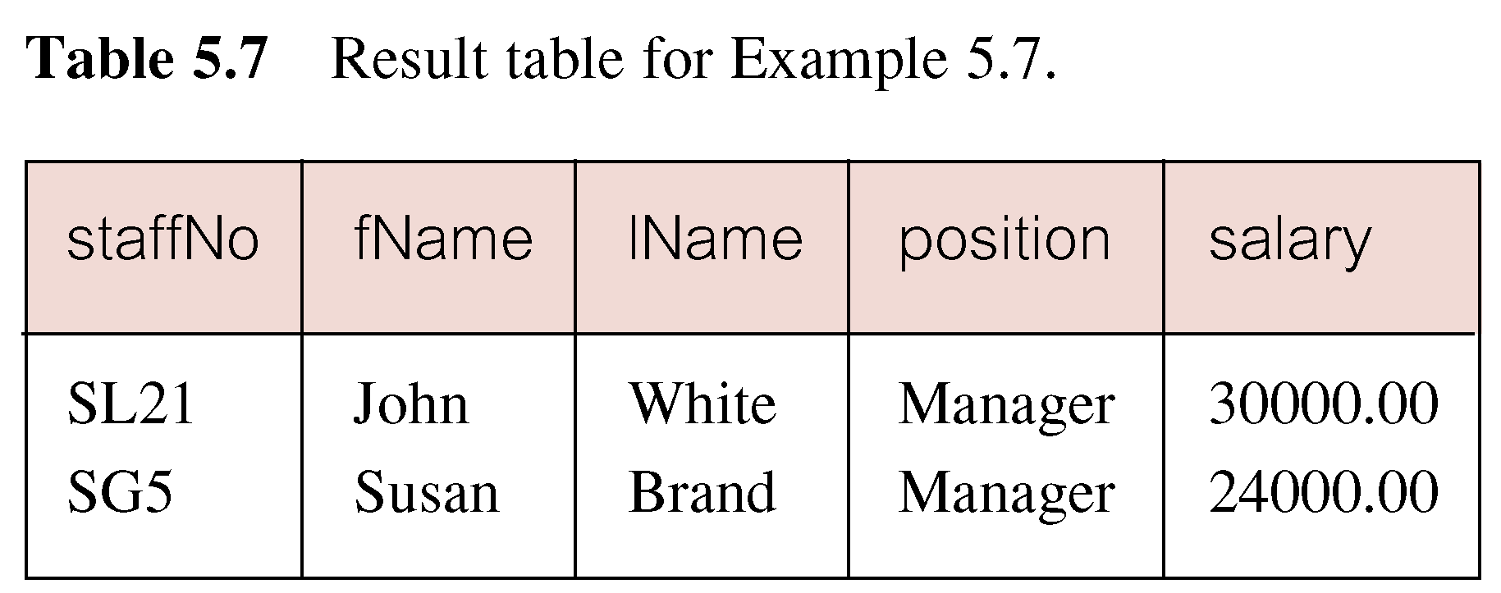
Example 5.7 Range Search Condition
© Pearson Education Limited 1995, 2005

Slide 33
Example 5.7 Range Search Condition
Also a negated version NOT BETWEEN.
BETWEEN does not add much to SQL’s expressive power. Could also write:
SELECT staffNo, fName, lName, position, salary
  FROM Staff
  WHERE salary>=20000 AND salary <= 30000;
Useful, though, for a range of values.
© Pearson Education Limited 1995, 2005

Slide 34
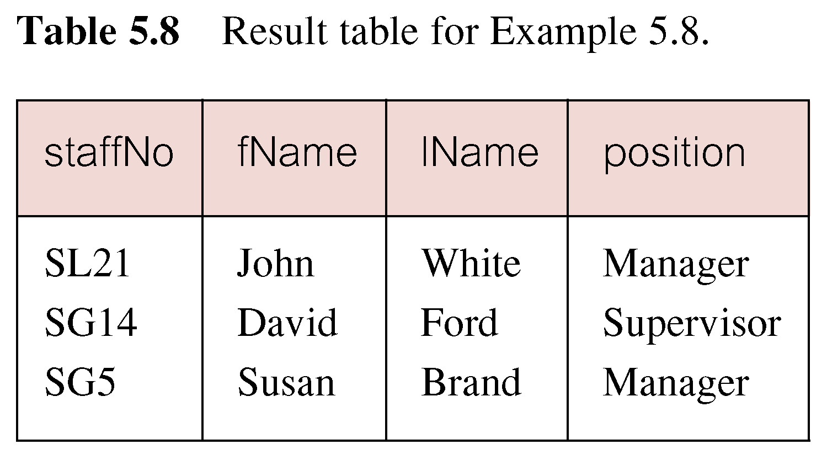
Example 5.8 Set Membership
List all managers and supervisors.
  SELECT staffNo, fName, lName, position
  FROM Staff
  WHERE position IN (‘Manager’, ‘Supervisor’);
© Pearson Education Limited 1995, 2005

Slide 35
Example 5.8 Set Membership
There is a negated version (NOT IN).
IN does not add much to SQL’s expressive power. Could have expressed this as:
  SELECT staffNo, fName, lName, position
  FROM Staff
  WHERE position=‘Manager’ OR
  position=‘Supervisor’;
IN is more efficient when set contains many values.
© Pearson Education Limited 1995, 2005

Slide 36
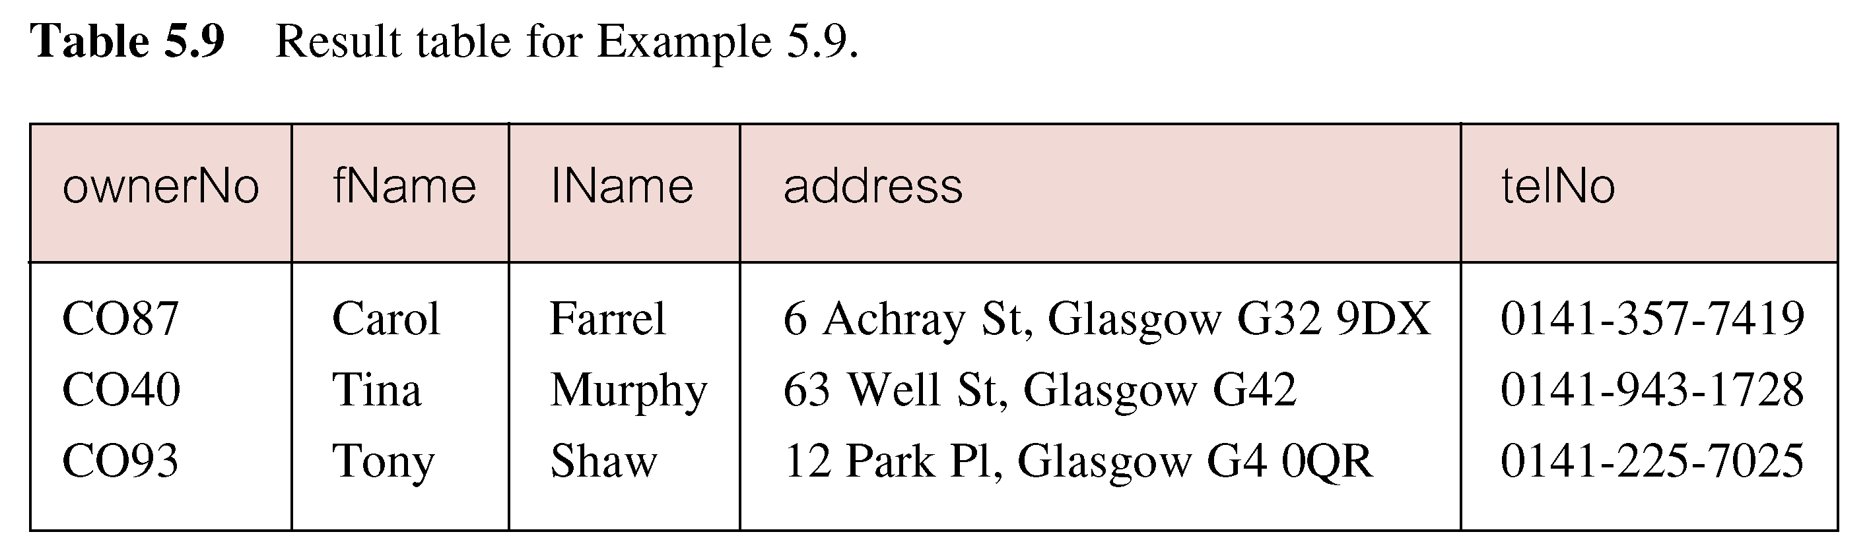
Example 5.9 Pattern Matching
Find all owners with the string ‘Glasgow’ in their address.
SELECT ownerNo, fName, lName, address, telNo
  FROM PrivateOwner
  WHERE address LIKE ‘%Glasgow%’;
© Pearson Education Limited 1995, 2005

Slide 37
Example 5.9 Pattern Matching
SQL has two special pattern matching symbols:
  %: sequence of zero or more characters;
  _ (underscore): any single character.
LIKE ‘%Glasgow%’ means a sequence of characters of any length containing ‘Glasgow’.
© Pearson Education Limited 1995, 2005

Slide 38
Example 5.10 NULL Search Condition
List details of all viewings on property PG4 where a comment has not been supplied.
There are 2 viewings for property PG4, one with and one without a comment.
Have to test for null explicitly using special keyword IS NULL:
SELECT clientNo, viewDate
  FROM Viewing
  WHERE propertyNo = ‘PG4’ AND
  comment IS NULL;
© Pearson Education Limited 1995, 2005

Slide 39
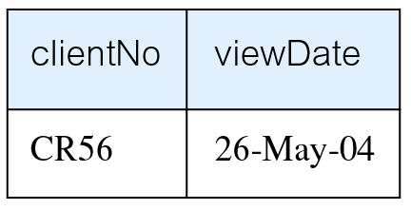
Example 5.10 NULL Search Condition
Negated version (IS NOT NULL) can test for non-null values.
© Pearson Education Limited 1995, 2005

Slide 40
Example 5.11 Single Column Ordering
List salaries for all staff, arranged in descending order of salary.
SELECT staffNo, fName, lName, salary
  FROM Staff
  ORDER BY salary DESC;
© Pearson Education Limited 1995, 2005

Slide 41
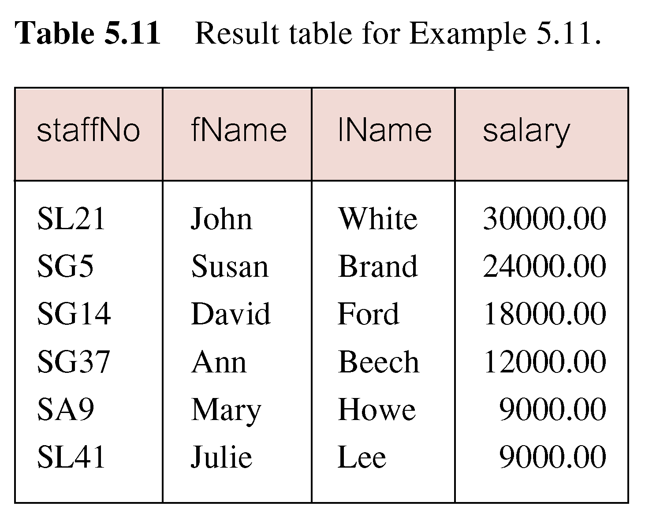
Example 5.11 Single Column Ordering
© Pearson Education Limited 1995, 2005

Slide 42
Example 5.12 Multiple Column Ordering
Produce abbreviated list of properties in order of property type.
SELECT propertyNo, type, rooms, rent
  FROM PropertyForRent
  ORDER BY type;
© Pearson Education Limited 1995, 2005

Slide 43
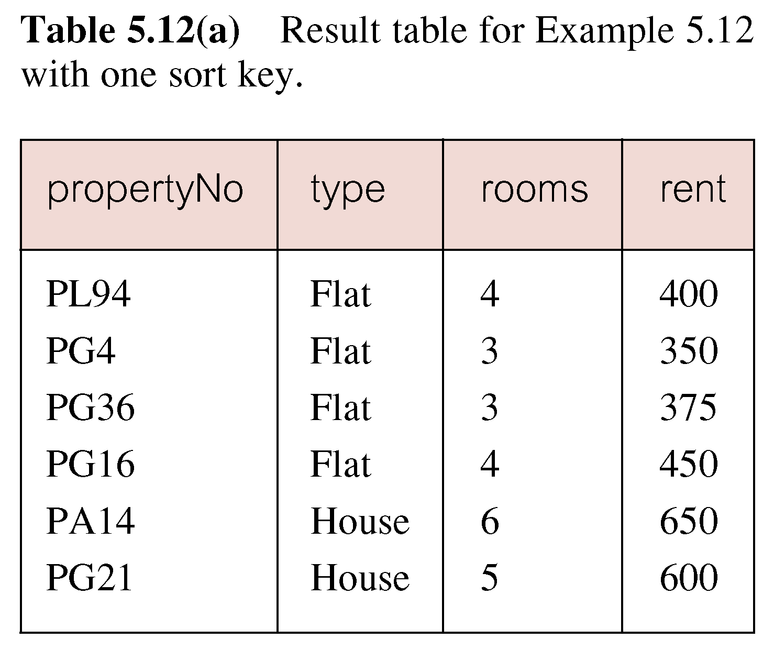
Example 5.12 Multiple Column Ordering
© Pearson Education Limited 1995, 2005

Slide 44
Example 5.12 Multiple Column Ordering
Four flats in this list - as no minor sort key specified, system arranges these rows in any order it chooses.
To arrange in order of rent, specify minor order:
SELECT propertyNo, type, rooms, rent
  FROM PropertyForRent
  ORDER BY type, rent DESC;
© Pearson Education Limited 1995, 2005

Slide 45
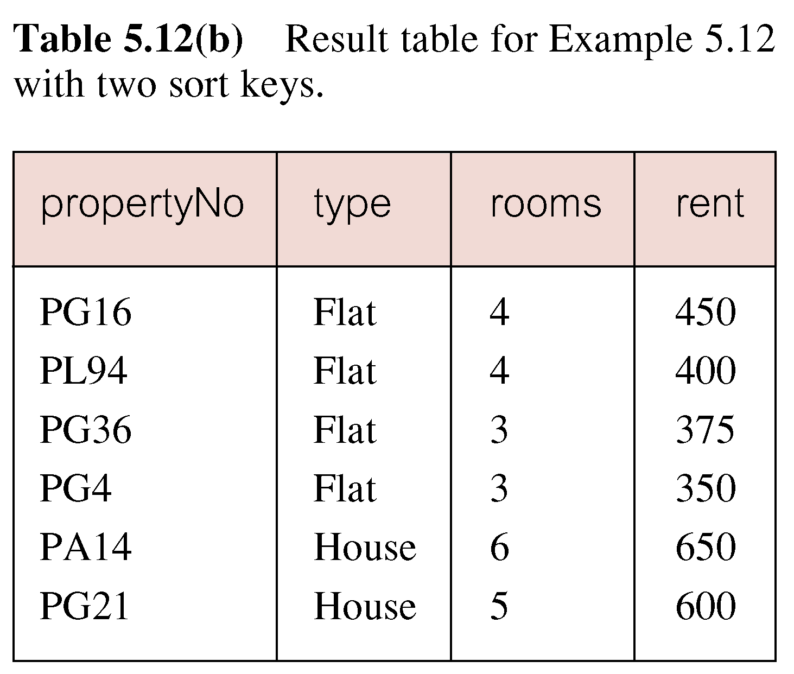
Example 5.12 Multiple Column Ordering
© Pearson Education Limited 1995, 2005

Slide 46
SELECT Statement - Aggregates
ISO standard defines five aggregate functions:
COUNT returns number of values in specified column.
SUM returns sum of values in specified column.
AVG returns average of values in specified column.
MIN returns smallest value in specified column.
MAX returns largest value in specified column.
© Pearson Education Limited 1995, 2005

Slide 47
SELECT Statement - Aggregates
Each operates on a single column of a table and returns a single value.
COUNT, MIN, and MAX apply to numeric and non-numeric fields, but SUM and AVG may be used on numeric fields only.
Apart from COUNT(*), each function eliminates nulls first and operates only on remaining non-null values.
© Pearson Education Limited 1995, 2005

Slide 48
SELECT Statement - Aggregates
COUNT(*) counts all rows of a table, regardless of whether nulls or duplicate values occur.
Can use DISTINCT before column name to eliminate duplicates.
DISTINCT has no effect with MIN/MAX, but may have with SUM/AVG.
© Pearson Education Limited 1995, 2005

Slide 49
SELECT Statement - Aggregates
Aggregate functions can be used only in SELECT list and in HAVING clause.
If SELECT list includes an aggregate function and there is no GROUP BY clause, SELECT list cannot reference a column out with an aggregate function. For example, the following is illegal:
SELECT staffNo, COUNT(salary)
  FROM Staff;
© Pearson Education Limited 1995, 2005

Slide 50
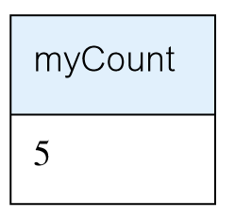
Example 5.13 Use of COUNT(*)
How many properties cost more than £350 per month to rent?
SELECT COUNT(*) AS myCount
  FROM PropertyForRent
  WHERE rent > 350;
© Pearson Education Limited 1995, 2005

Slide 51
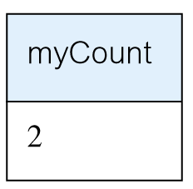
Example 5.14 Use of COUNT(DISTINCT)
How many different properties viewed in May ‘04?
SELECT COUNT(DISTINCT propertyNo) AS myCount
  FROM Viewing
  WHERE viewDate BETWEEN ‘1-May-04’
  AND ‘31-May-04’;
© Pearson Education Limited 1995, 2005

Slide 52
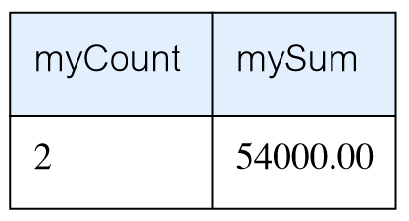
Example 5.15 Use of COUNT and SUM
Find number of Managers and sum of their salaries.
SELECT COUNT(staffNo) AS myCount,
  SUM(salary) AS mySum
  FROM Staff
  WHERE position = ‘Manager’;
© Pearson Education Limited 1995, 2005

Slide 53
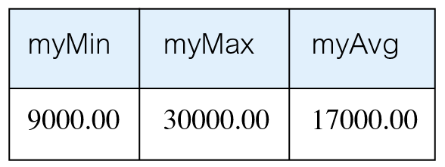
Example 5.16 Use of MIN, MAX, AVG
Find minimum, maximum, and average staff salary.
SELECT MIN(salary) AS myMin,
  MAX(salary) AS myMax,
  AVG(salary) AS myAvg
  FROM Staff;
© Pearson Education Limited 1995, 2005

Slide 54
SELECT Statement - Grouping
Use GROUP BY clause to get sub-totals.
SELECT and GROUP BY closely integrated: each item in SELECT list must be single-valued per group, and SELECT clause may only contain:
  column names
  aggregate functions
  constants
  expression involving combinations of the above.
© Pearson Education Limited 1995, 2005

Slide 55
SELECT Statement - Grouping
All column names in SELECT list must appear in GROUP BY clause unless name is used only in an aggregate function.
If WHERE is used with GROUP BY, WHERE is applied first, then groups are formed from remaining rows satisfying predicate.
ISO considers two nulls to be equal for purposes of GROUP BY.
© Pearson Education Limited 1995, 2005

Slide 56
Example 5.17 Use of GROUP BY
Find number of staff in each branch and their total salaries.
  SELECT branchNo,
  COUNT(staffNo) AS myCount,
    SUM(salary) AS mySum
    FROM Staff
    GROUP BY branchNo
    ORDER BY branchNo;
© Pearson Education Limited 1995, 2005

Slide 57
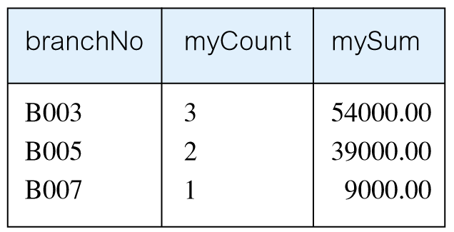
Example 5.17 Use of GROUP BY
© Pearson Education Limited 1995, 2005

Slide 58
Restricted Groupings – HAVING clause
HAVING clause is designed for use with GROUP BY to restrict groups that appear in final result table.
Similar to WHERE, but WHERE filters individual rows whereas HAVING filters groups.
Column names in HAVING clause must also appear in the GROUP BY list or be contained within an aggregate function.
© Pearson Education Limited 1995, 2005

Slide 59
Example 5.18 Use of HAVING
For each branch with more than 1 member of staff, find number of staff in each branch and sum of their salaries.
  SELECT branchNo,
  COUNT(staffNo) AS myCount,
    SUM(salary) AS mySum
    FROM Staff
    GROUP BY branchNo
    HAVING COUNT(staffNo) > 1
    ORDER BY branchNo;
© Pearson Education Limited 1995, 2005

Slide 60
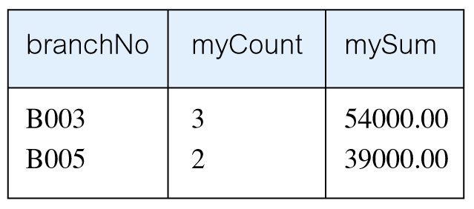
Example 5.18 Use of HAVING
© Pearson Education Limited 1995, 2005

Slide 61
Subqueries
Some SQL statements can have a SELECT embedded within them.
A subselect can be used in WHERE and HAVING clauses of an outer SELECT, where it is called a subquery or nested query.
Subselects may also appear in INSERT, UPDATE, and DELETE statements.
© Pearson Education Limited 1995, 2005

Slide 62
Example 5.19 Subquery with Equality
List staff who work in branch at ‘163 Main St’.
SELECT staffNo, fName, lName, position
  FROM Staff
  WHERE branchNo =
  (SELECT branchNo
  FROM Branch
  WHERE street = ‘163 Main St’);
© Pearson Education Limited 1995, 2005

Slide 63
Example 5.19 Subquery with Equality
Inner SELECT finds branch number for branch at ‘163 Main St’ (‘B003’).
Outer SELECT then retrieves details of all staff who work at this branch.
Outer SELECT then becomes:
  SELECT staffNo, fName, lName, position
    FROM Staff
    WHERE branchNo = ‘B003’;
© Pearson Education Limited 1995, 2005

Slide 64
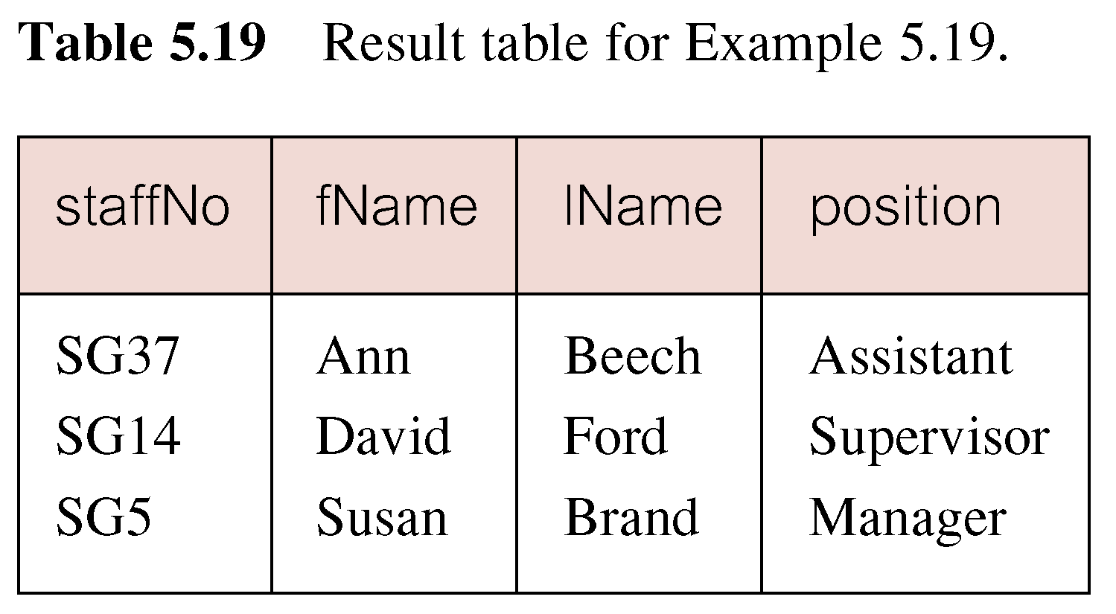
Example 5.19 Subquery with Equality
© Pearson Education Limited 1995, 2005

Slide 65
Example 5.20 Subquery with Aggregate
List all staff whose salary is greater than the average salary, and show by how much.
  SELECT staffNo, fName, lName, position,
  salary – (SELECT AVG(salary) FROM Staff) As SalDiff
  FROM Staff
  WHERE salary >
    (SELECT AVG(salary)
    FROM Staff);
© Pearson Education Limited 1995, 2005

Slide 66
Example 5.20 Subquery with Aggregate
Cannot write ‘WHERE salary > AVG(salary)’
Instead, use subquery to find average salary (17000), and then use outer SELECT to find those staff with salary greater than this:
  SELECT staffNo, fName, lName, position,
  salary – 17000 As salDiff
  FROM Staff
  WHERE salary > 17000;
© Pearson Education Limited 1995, 2005

Slide 67
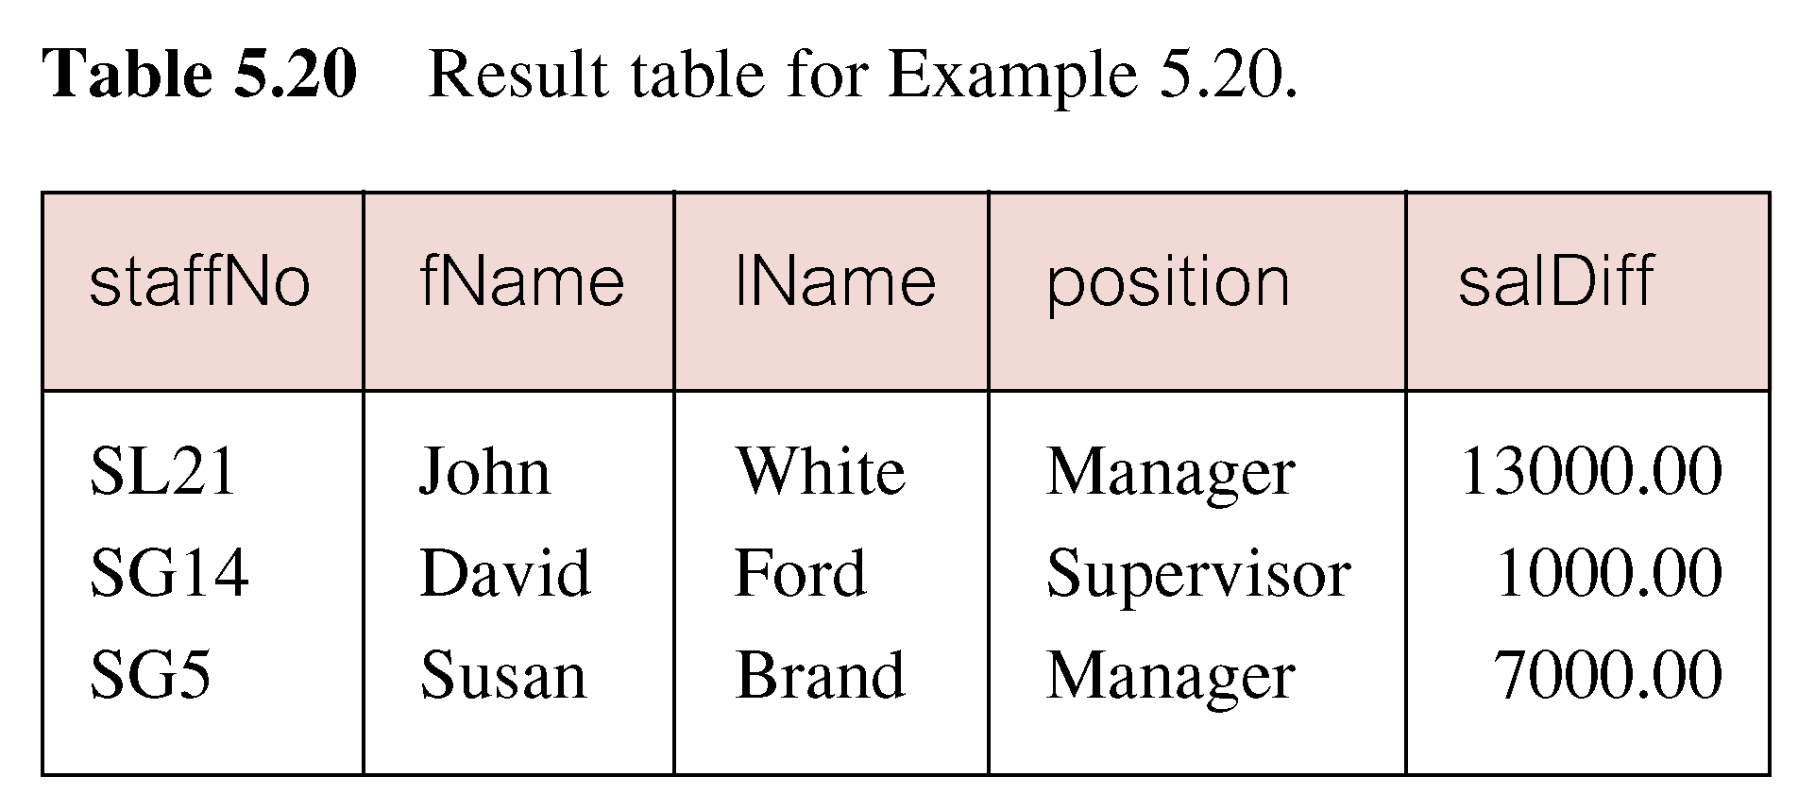
Example 5.20 Subquery with Aggregate
© Pearson Education Limited 1995, 2005

Slide 68
Subquery Rules
ORDER BY clause may not be used in a subquery (although it may be used in outermost SELECT).
Subquery SELECT list must consist of a single column name or expression, except for subqueries that use EXISTS.
By default, column names refer to table name in FROM clause of subquery. Can refer to a table in FROM using an alias.
© Pearson Education Limited 1995, 2005

Slide 69
Subquery Rules
When subquery is an operand in a comparison, subquery must appear on right-hand side.
A subquery may not be used as an operand in an expression.
© Pearson Education Limited 1995, 2005

Slide 70
Example 5.21 Nested subquery: use of IN
List properties handled by staff at ‘163 Main St’.
  SELECT propertyNo, street, city, postcode, type, rooms, rent
  FROM PropertyForRent
  WHERE staffNo IN
    (SELECT staffNo
    FROM Staff
    WHERE branchNo =
    (SELECT branchNo
    FROM Branch
    WHERE street = ‘163 Main St’));
© Pearson Education Limited 1995, 2005

Slide 71
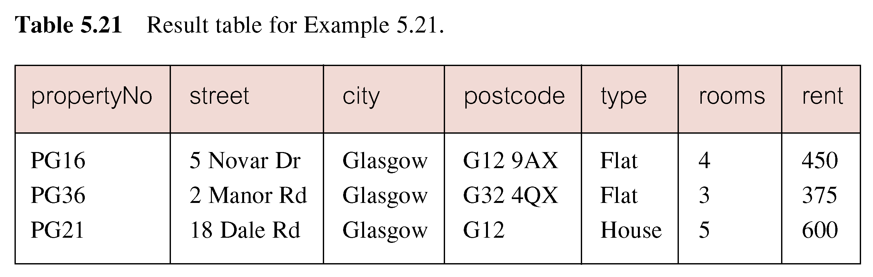
Example 5.21 Nested subquery: use of IN
© Pearson Education Limited 1995, 2005

Slide 72
ANY and ALL
ANY and ALL may be used with subqueries that produce a single column of numbers.
With ALL, condition will only be true if it is satisfied by all values produced by subquery.
With ANY, condition will be true if it is satisfied by any values produced by subquery.
If subquery is empty, ALL returns true, ANY returns false.
SOME may be used in place of ANY.
© Pearson Education Limited 1995, 2005

Slide 73
Example 5.22 Use of ANY/SOME
Find staff whose salary is larger than salary of at least one member of staff at branch B003.
SELECT staffNo, fName, lName, position, salary
  FROM Staff
  WHERE salary > SOME
  (SELECT salary
  FROM Staff
  WHERE branchNo = ‘B003’);
© Pearson Education Limited 1995, 2005

Slide 74
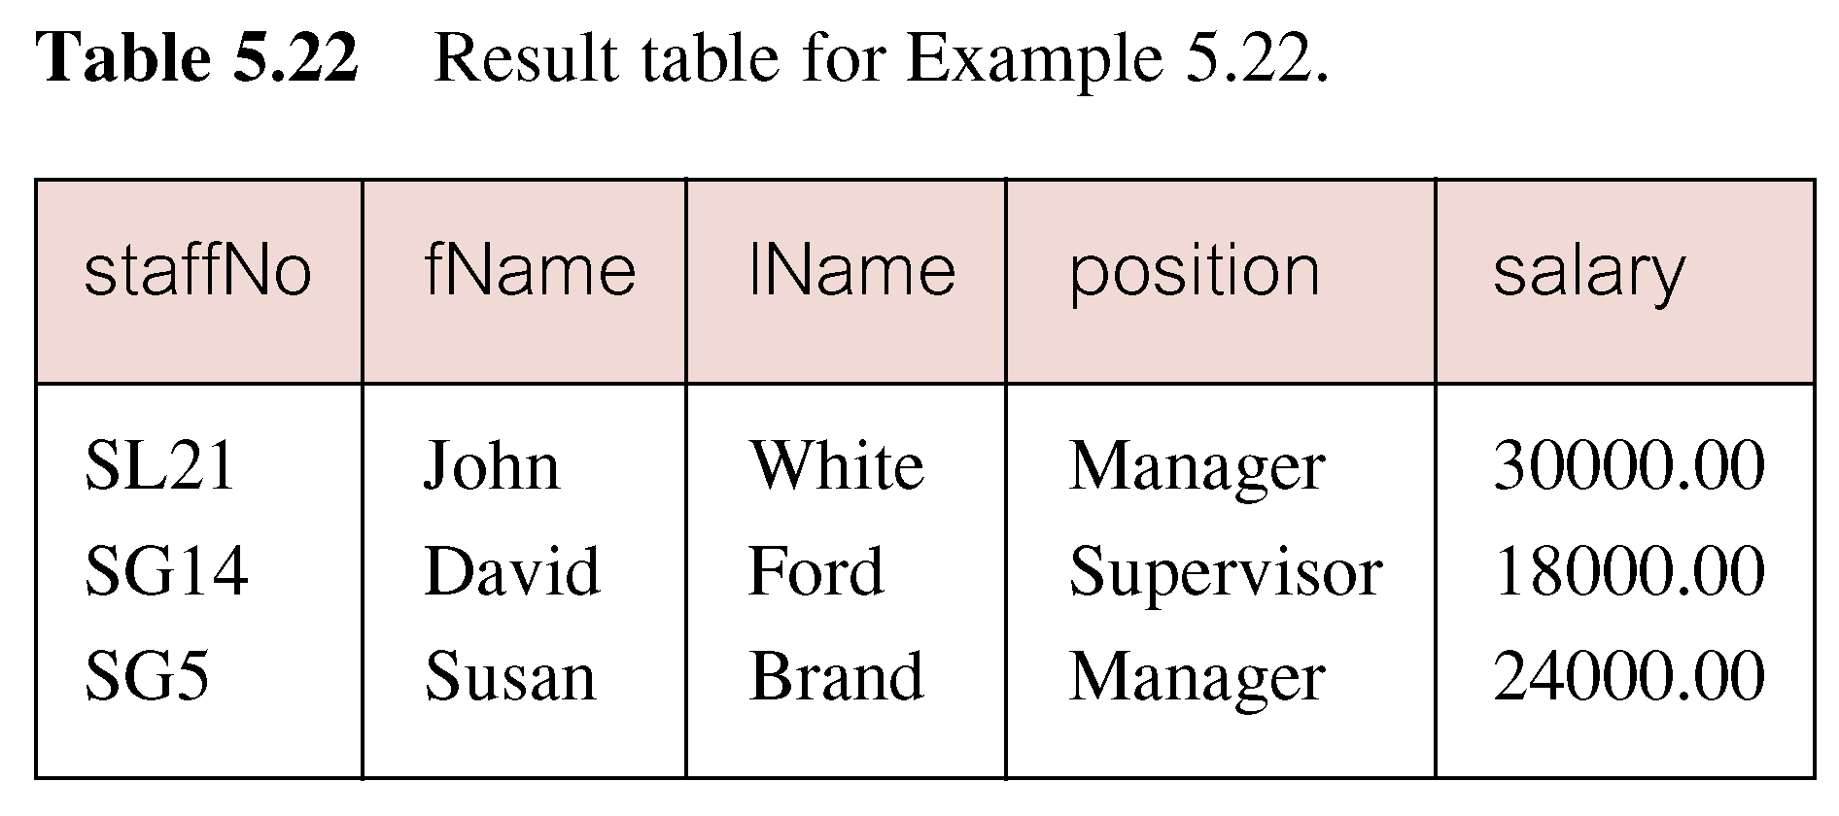
Example 5.22 Use of ANY/SOME
Inner query produces set {12000, 18000, 24000} and outer query selects those staff whose salaries are greater than any of the values in this set.
© Pearson Education Limited 1995, 2005

Slide 75
Example 5.23 Use of ALL
Find staff whose salary is larger than salary of every member of staff at branch B003.
SELECT staffNo, fName, lName, position, salary
  FROM Staff
  WHERE salary > ALL
  (SELECT salary
  FROM Staff
  WHERE branchNo = ‘B003’);
© Pearson Education Limited 1995, 2005

Slide 76
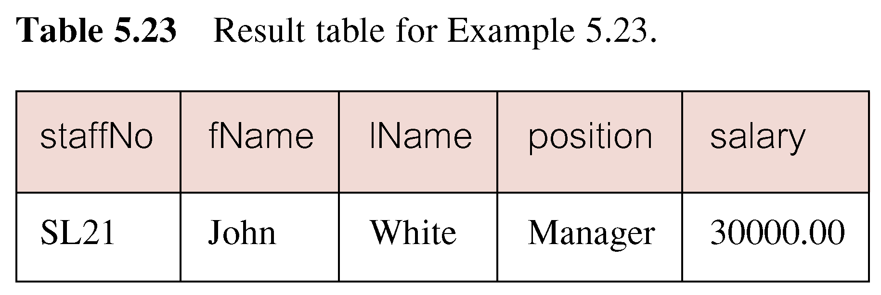
Example 5.23 Use of ALL
© Pearson Education Limited 1995, 2005

Slide 77
Multi-Table Queries
Can use subqueries provided result columns come from same table.
If result columns come from more than one table must use a join.
To perform join, include more than one table in FROM clause.
Use comma as separator and typically include WHERE clause to specify join column(s).
© Pearson Education Limited 1995, 2005

Slide 78
Multi-Table Queries
Also possible to use an alias for a table named in FROM clause.
Alias is separated from table name with a space.
Alias can be used to qualify column names when there is ambiguity.
© Pearson Education Limited 1995, 2005

Slide 79
Example 5.24 Simple Join
List names of all clients who have viewed a property along with any comment supplied.
SELECT c.clientNo, fName, lName,
  propertyNo, comment
  FROM Client c, Viewing v
  WHERE c.clientNo = v.clientNo;
© Pearson Education Limited 1995, 2005

Slide 80
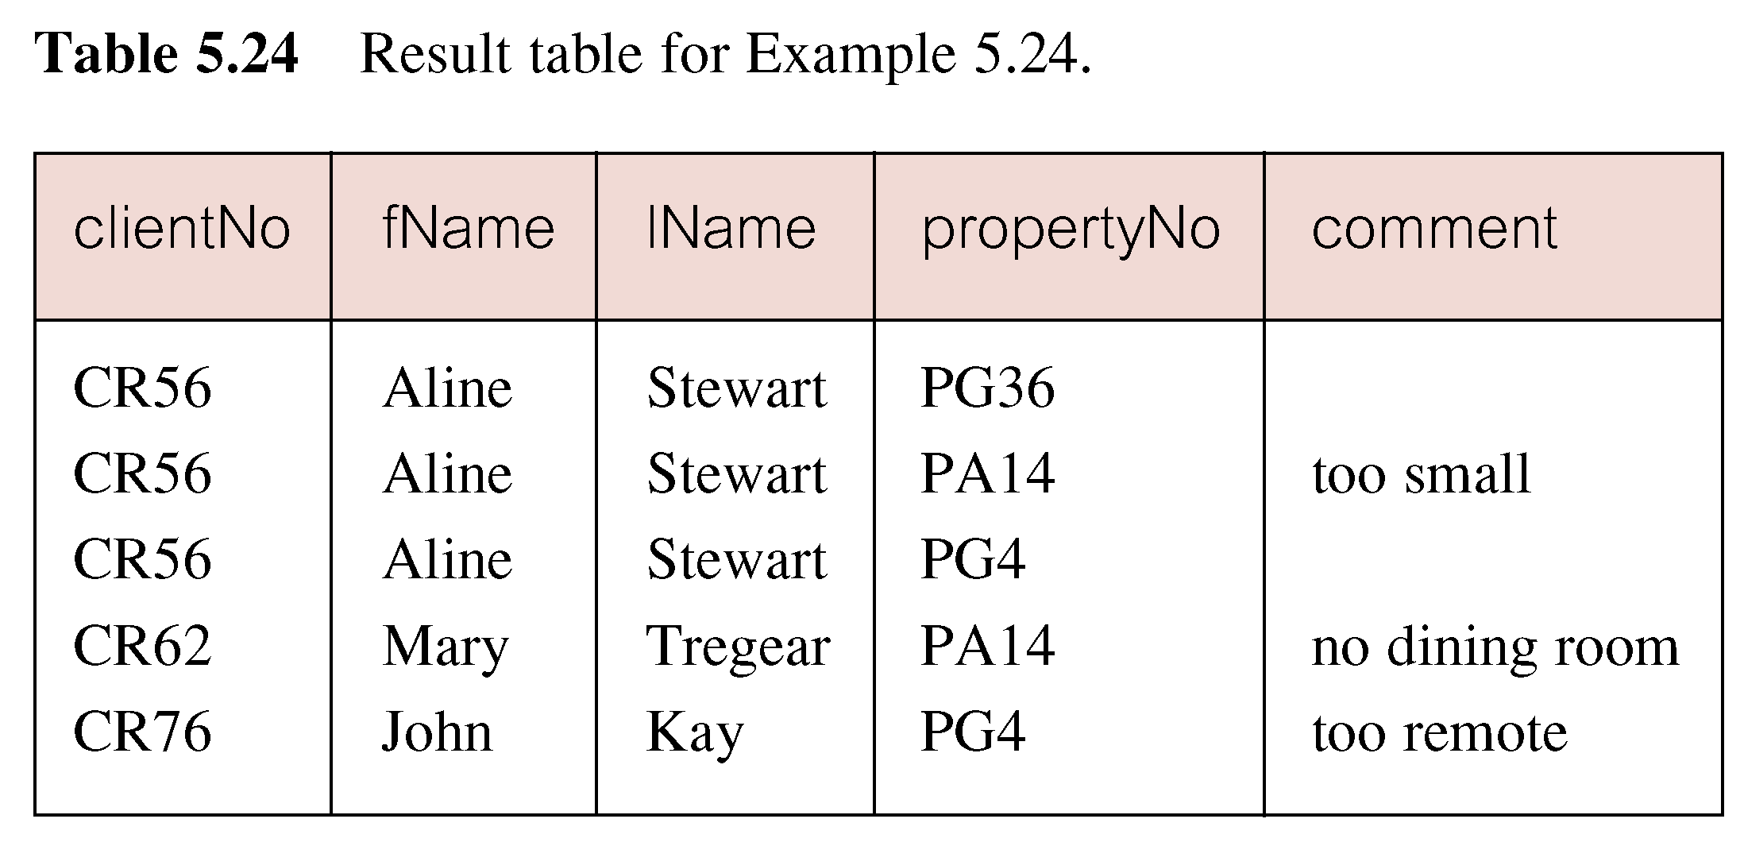
Example 5.24 Simple Join
Only those rows from both tables that have identical values in the clientNo columns (c.clientNo = v.clientNo) are included in result.
Equivalent to equi-join in relational algebra.
© Pearson Education Limited 1995, 2005

Slide 81
Alternative JOIN Constructs
SQL provides alternative ways to specify joins:
FROM Client c JOIN Viewing v ON c.clientNo = v.clientNo
FROM Client JOIN Viewing USING clientNo
FROM Client NATURAL JOIN Viewing
In each case, FROM replaces original FROM and WHERE. However, first produces table with two identical clientNo columns.
© Pearson Education Limited 1995, 2005

Slide 82
Example 5.25 Sorting a join
For each branch, list numbers and names of staff who manage properties, and properties they manage.
SELECT s.branchNo, s.staffNo, fName, lName,
  propertyNo
  FROM Staff s, PropertyForRent p
  WHERE s.staffNo = p.staffNo
  ORDER BY s.branchNo, s.staffNo, propertyNo;
© Pearson Education Limited 1995, 2005

Slide 83
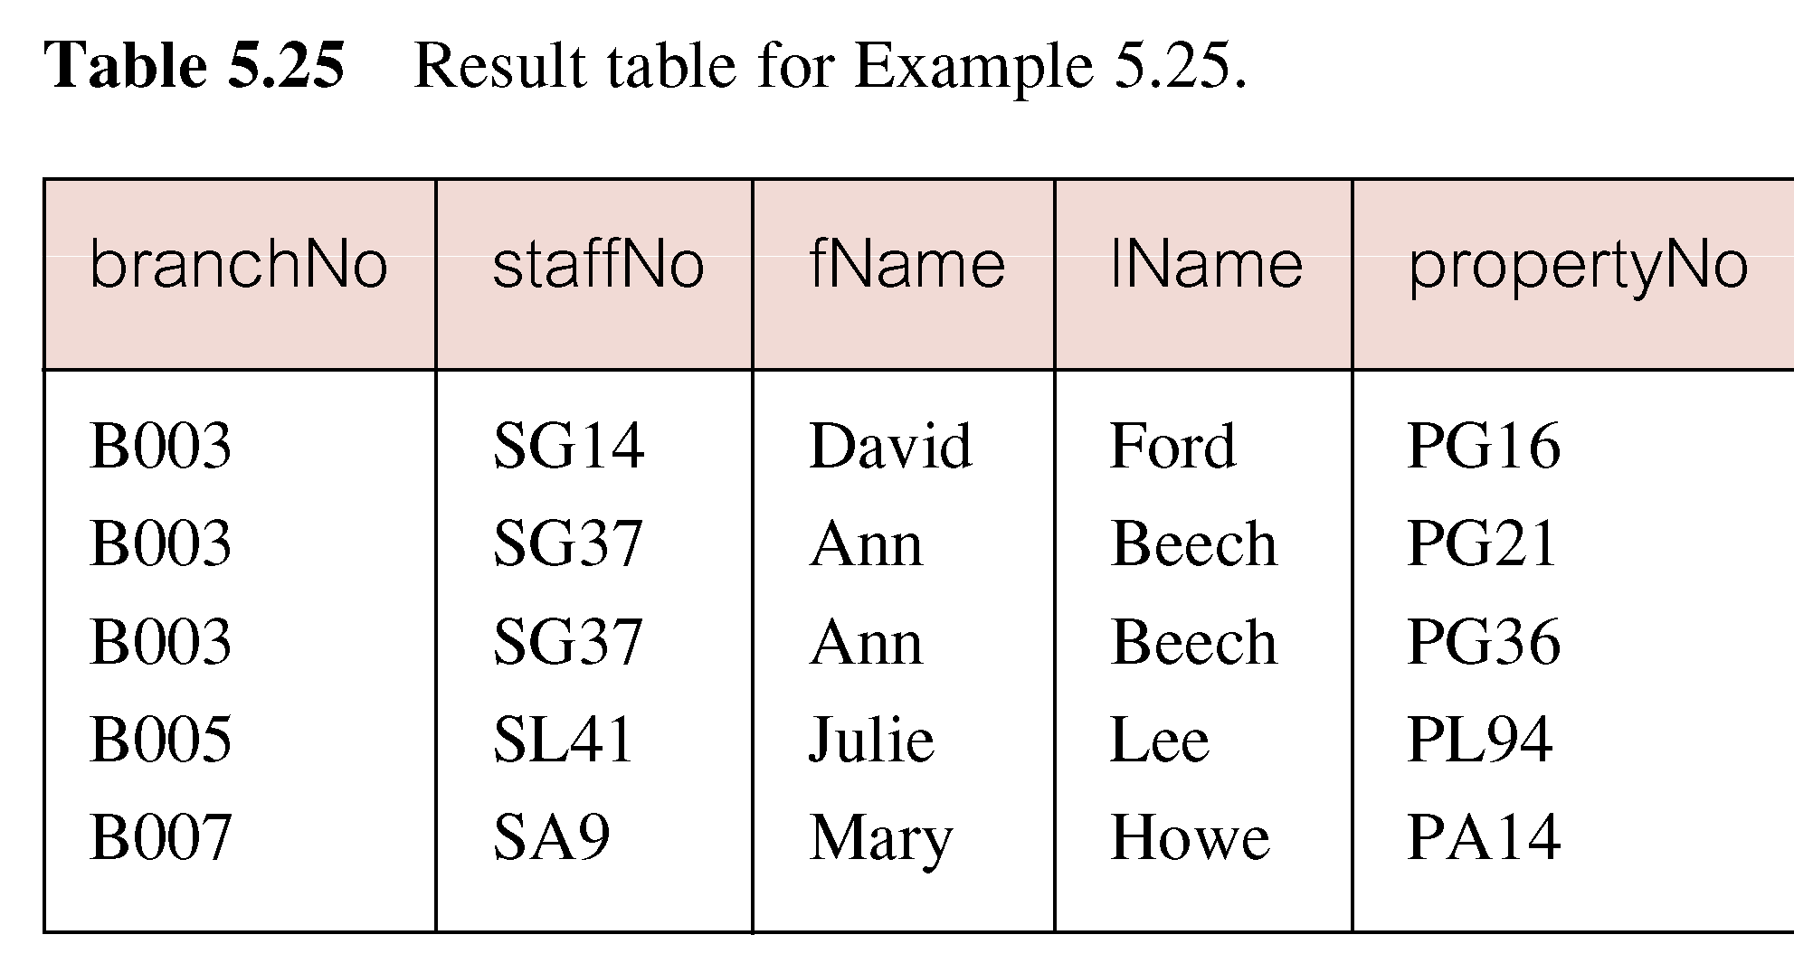
Example 5.25 Sorting a join
© Pearson Education Limited 1995, 2005

Slide 84
Example 5.26 Three Table Join
For each branch, list staff who manage properties, including city in which branch is located and properties they manage.
SELECT b.branchNo, b.city, s.staffNo, fName, lName,
  propertyNo
  FROM Branch b, Staff s, PropertyForRent p
  WHERE b.branchNo = s.branchNo AND
  s.staffNo = p.staffNo
  ORDER BY b.branchNo, s.staffNo, propertyNo;
© Pearson Education Limited 1995, 2005

Slide 85
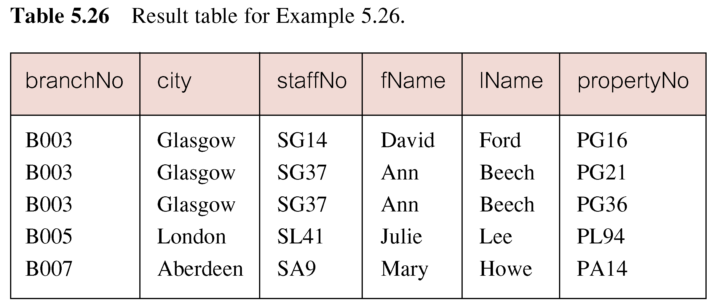
Example 5.26 Three Table Join
Alternative formulation for FROM and WHERE:
  FROM (Branch b JOIN Staff s USING branchNo) AS
  bs JOIN PropertyForRent p USING staffNo
© Pearson Education Limited 1995, 2005

Slide 86
Example 5.27 Multiple Grouping Columns
Find number of properties handled by each staff member.
SELECT s.branchNo, s.staffNo, COUNT(*) AS myCount
  FROM Staff s, PropertyForRent p
  WHERE s.staffNo = p.staffNo
  GROUP BY s.branchNo, s.staffNo
  ORDER BY s.branchNo, s.staffNo;
© Pearson Education Limited 1995, 2005

Slide 87
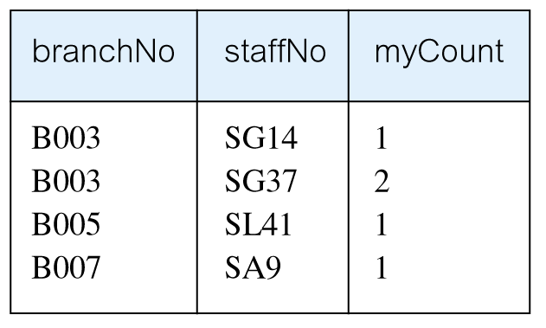
Example 5.27 Multiple Grouping Columns
© Pearson Education Limited 1995, 2005

Slide 88
Computing a Join
Procedure for generating results of a join are:
1. Form Cartesian product of the tables named in FROM clause.
2. If there is a WHERE clause, apply the search condition to each row of the product table, retaining those rows that satisfy the condition.
3. For each remaining row, determine value of each item in SELECT list to produce a single row in result table.
© Pearson Education Limited 1995, 2005

Slide 89
Computing a Join
4. If DISTINCT has been specified, eliminate any duplicate rows from the result table.
5. If there is an ORDER BY clause, sort result table as required.
SQL provides special format of SELECT for Cartesian product:
  SELECT [DISTINCT | ALL] {* | columnList}
  FROM Table1 CROSS JOIN Table2
© Pearson Education Limited 1995, 2005

Slide 90
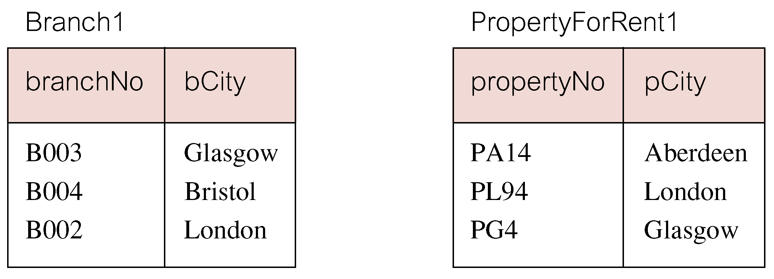
Outer Joins
If one row of a joined table is unmatched, row is omitted from result table.
Outer join operations retain rows that do not satisfy the join condition.
Consider following tables:
© Pearson Education Limited 1995, 2005

Slide 91
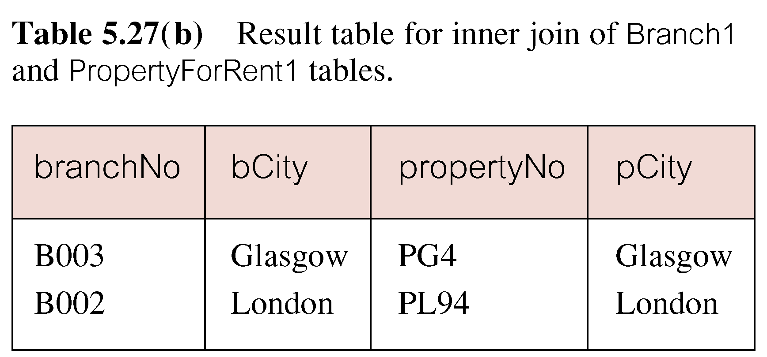
Outer Joins
The (inner) join of these two tables:
  SELECT b.*, p.*
    FROM Branch1 b, PropertyForRent1 p
    WHERE b.bCity = p.pCity;
© Pearson Education Limited 1995, 2005

Slide 92
Outer Joins
Result table has two rows where cities are same.
There are no rows corresponding to branches in Bristol and Aberdeen.
To include unmatched rows in result table, use an Outer join.
© Pearson Education Limited 1995, 2005

Slide 93
Example 5.28 Left Outer Join
List branches and properties that are in same city along with any unmatched branches.
SELECT b.*, p.*
  FROM Branch1 b LEFT JOIN
  PropertyForRent1 p ON b.bCity = p.pCity;
© Pearson Education Limited 1995, 2005

Slide 94
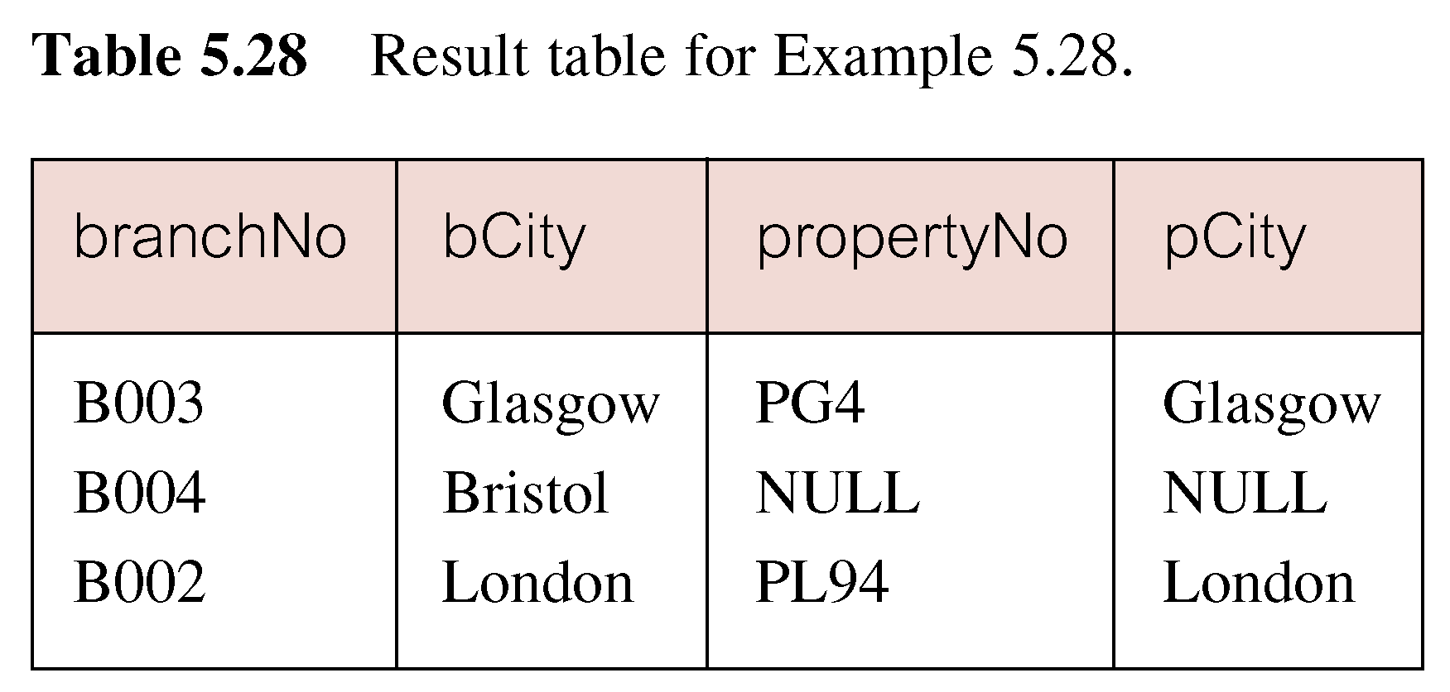
Example 5.28 Left Outer Join
Includes those rows of first (left) table unmatched with rows from second (right) table.
Columns from second table are filled with NULLs.
© Pearson Education Limited 1995, 2005

Slide 95
Example 5.29 Right Outer Join
List branches and properties in same city and any unmatched properties.
SELECT b.*, p.*
  FROM Branch1 b RIGHT JOIN
  PropertyForRent1 p ON b.bCity = p.pCity;
© Pearson Education Limited 1995, 2005

Slide 96
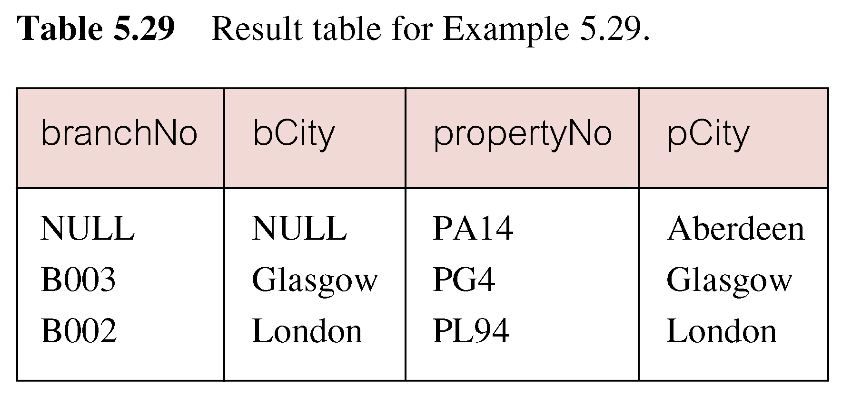
Example 5.29 Right Outer Join
Right Outer join includes those rows of second (right) table that are unmatched with rows from first (left) table.
Columns from first table are filled with NULLs.
© Pearson Education Limited 1995, 2005

Slide 97
Example 5.30 Full Outer Join
List branches and properties in same city and any unmatched branches or properties.
SELECT b.*, p.*
  FROM Branch1 b FULL JOIN
  PropertyForRent1 p ON b.bCity = p.pCity;
© Pearson Education Limited 1995, 2005

Slide 98
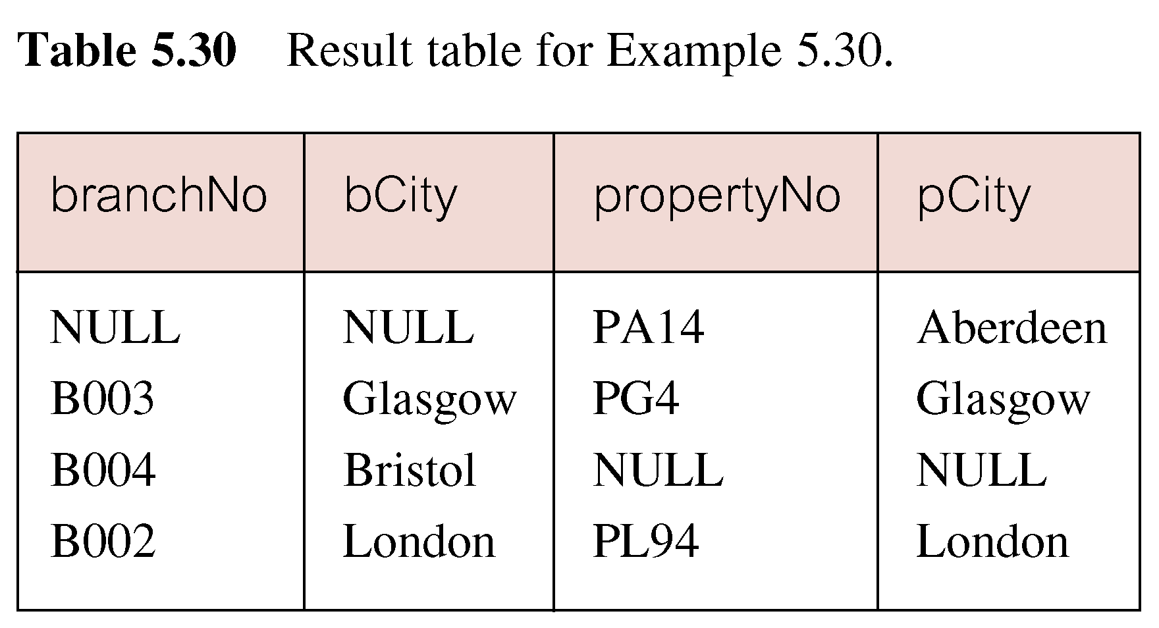
Example 5.30 Full Outer Join
Includes rows that are unmatched in both tables.
Unmatched columns are filled with NULLs.
© Pearson Education Limited 1995, 2005

Slide 99
EXISTS and NOT EXISTS
EXISTS and NOT EXISTS are for use only with subqueries.
Produce a simple true/false result.
True if and only if there exists at least one row in result table returned by subquery.
False if subquery returns an empty result table.
NOT EXISTS is the opposite of EXISTS.
© Pearson Education Limited 1995, 2005

Slide 100
EXISTS and NOT EXISTS
As (NOT) EXISTS check only for existence or non-existence of rows in subquery result table, subquery can contain any number of columns.
Common for subqueries following (NOT) EXISTS to be of form:
  (SELECT * ...)
© Pearson Education Limited 1995, 2005

Slide 101
Example 5.31 Query using EXISTS
Find all staff who work in a London branch.
SELECT staffNo, fName, lName, position
  FROM Staff s
  WHERE EXISTS
  (SELECT *
  FROM Branch b
  WHERE s.branchNo = b.branchNo AND
  city = ‘London’);
© Pearson Education Limited 1995, 2005

Slide 102
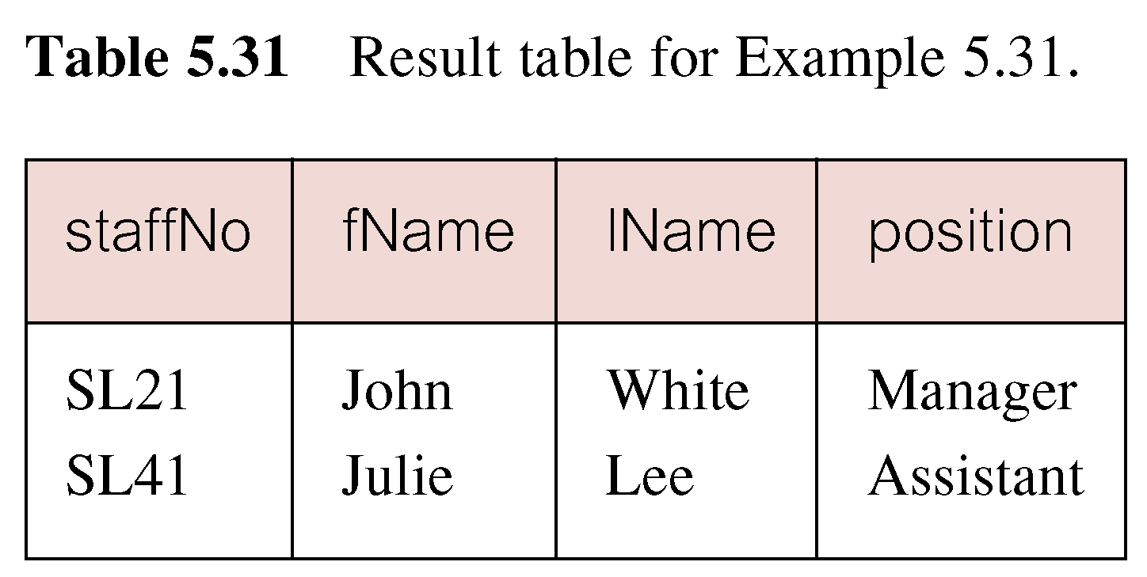
Example 5.31 Query using EXISTS
© Pearson Education Limited 1995, 2005

Slide 103
Example 5.31 Query using EXISTS
Note, search condition s.branchNo = b.branchNo is necessary to consider correct branch record for each member of staff.
If omitted, would get all staff records listed out because subquery:
  SELECT * FROM Branch WHERE city=‘London’
would always be true and query would be:
  SELECT staffNo, fName, lName, position FROM Staff
  WHERE true;
© Pearson Education Limited 1995, 2005

Slide 104
Example 5.31 Query using EXISTS
Could also write this query using join construct:
  SELECT staffNo, fName, lName, position
  FROM Staff s, Branch b
  WHERE s.branchNo = b.branchNo AND
  city = ‘London’;
© Pearson Education Limited 1995, 2005

Slide 105
Union, Intersect, and Difference (Except)
Can use normal set operations of Union, Intersection, and Difference to combine results of two or more queries into a single result table.
Union of two tables, A and B, is table containing all rows in either A or B or both.
Intersection is table containing all rows common to both A and B.
Difference is table containing all rows in A but not in B.
Two tables must be union compatible.
© Pearson Education Limited 1995, 2005

Slide 106
Union, Intersect, and Difference (Except)
Format of set operator clause in each case is:
  op [ALL] [CORRESPONDING [BY {column1 [, ...]}]]
If CORRESPONDING BY specified, set operation performed on the named column(s).
If CORRESPONDING specified but not BY clause, operation performed on common columns.
If ALL specified, result can include duplicate rows.
© Pearson Education Limited 1995, 2005

Slide 107
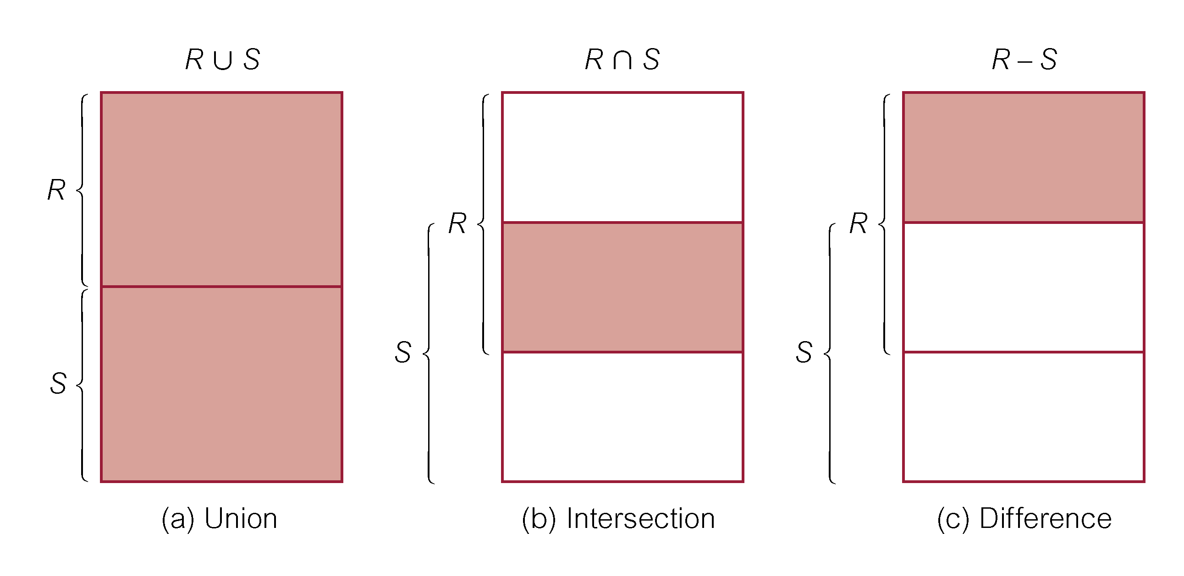
Union, Intersect, and Difference (Except)
© Pearson Education Limited 1995, 2005

Slide 108
Example 5.32 Use of UNION
List all cities where there is either a branch office or a property.
(SELECT city
  FROM Branch
  WHERE city IS NOT NULL) UNION
  (SELECT city
  FROM PropertyForRent
  WHERE city IS NOT NULL);
© Pearson Education Limited 1995, 2005

Slide 109
Example 5.32 Use of UNION
Or
  (SELECT *
  FROM Branch
  WHERE city IS NOT NULL)
  UNION CORRESPONDING BY city
  (SELECT *
  FROM PropertyForRent
  WHERE city IS NOT NULL);
© Pearson Education Limited 1995, 2005

Slide 110
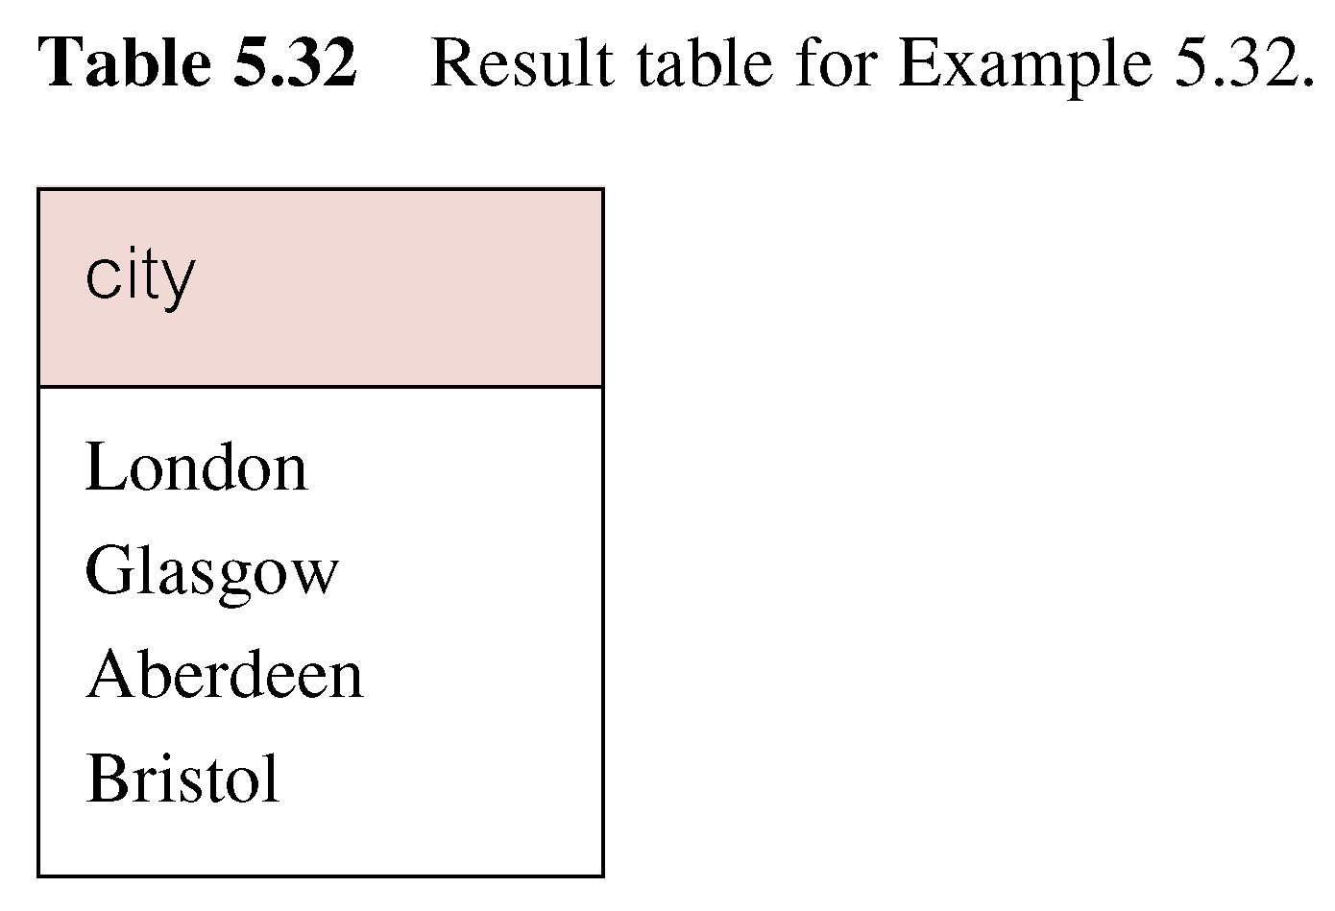
Example 5.32 Use of UNION
Produces result tables from both queries and merges both tables together.
© Pearson Education Limited 1995, 2005

Slide 111
Example 5.33 Use of INTERSECT
List all cities where there is both a branch office and a property.
(SELECT city FROM Branch)
  INTERSECT
  (SELECT city FROM PropertyForRent);
© Pearson Education Limited 1995, 2005

Slide 112
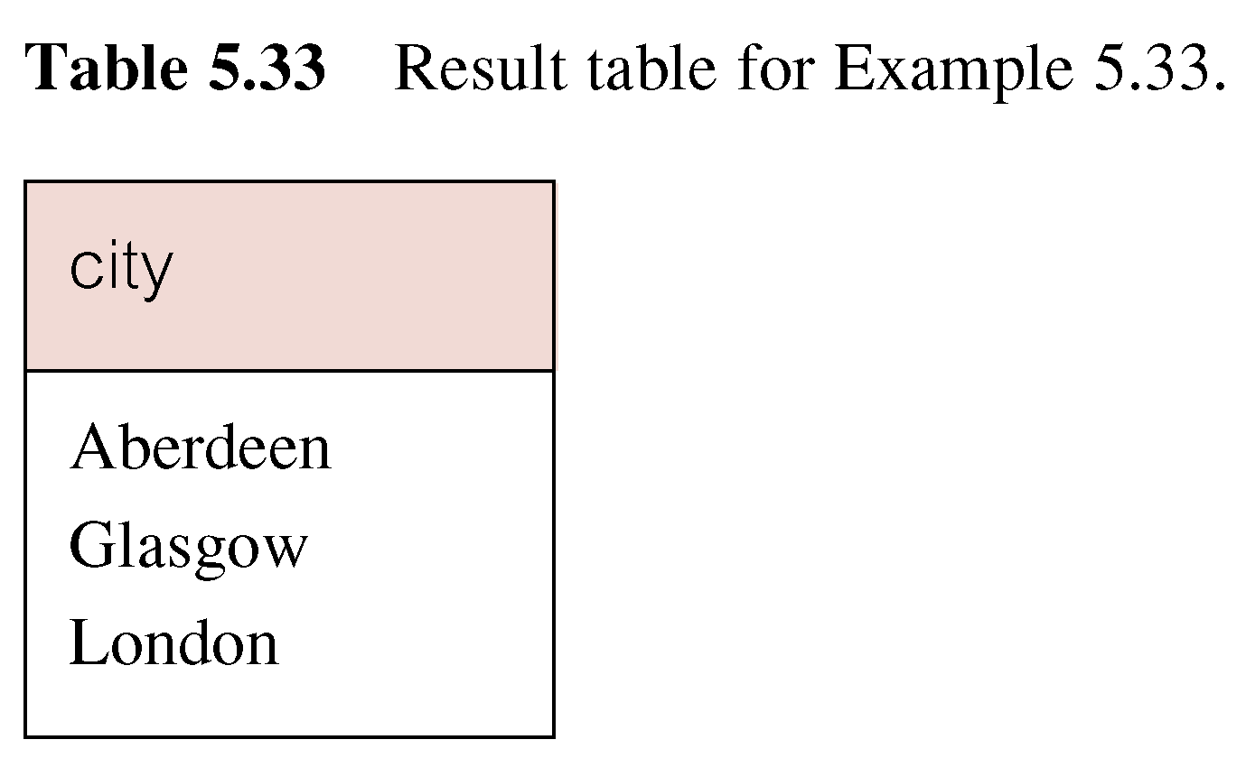
Example 5.33 Use of INTERSECT
Or
  (SELECT * FROM Branch)
  INTERSECT CORRESPONDING BY city
  (SELECT * FROM PropertyForRent);
© Pearson Education Limited 1995, 2005

Slide 113
Example 5.33 Use of INTERSECT
Could rewrite this query without INTERSECT operator:
  SELECT b.city
  FROM Branch b PropertyForRent p
  WHERE b.city = p.city;
Or:
  SELECT DISTINCT city FROM Branch b
  WHERE EXISTS
  (SELECT * FROM PropertyForRent p
  WHERE p.city = b.city);
© Pearson Education Limited 1995, 2005

Slide 114
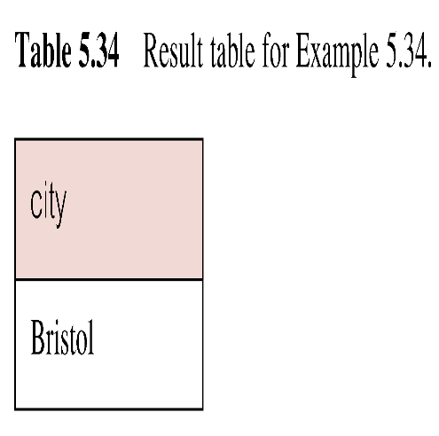
Example 5.34 Use of EXCEPT
List of all cities where there is a branch office but no properties.
(SELECT city FROM Branch)
  EXCEPT
  (SELECT city FROM PropertyForRent);
Or
  (SELECT * FROM Branch)
  EXCEPT CORRESPONDING BY city
  (SELECT * FROM PropertyForRent);
© Pearson Education Limited 1995, 2005

Slide 115
Example 5.34 Use of EXCEPT
Could rewrite this query without EXCEPT:
  SELECT DISTINCT city FROM Branch
  WHERE city NOT IN
  (SELECT city FROM PropertyForRent);
Or
  SELECT DISTINCT city FROM Branch b
  WHERE NOT EXISTS
  (SELECT * FROM PropertyForRent p
  WHERE p.city = b.city);
© Pearson Education Limited 1995, 2005

Slide 116
INSERT
INSERT INTO TableName [ (columnList) ]
  VALUES (dataValueList)
columnList is optional; if omitted, SQL assumes a list of all columns in their original CREATE TABLE order.
Any columns omitted must have been declared as NULL when table was created, unless DEFAULT was specified when creating column.
© Pearson Education Limited 1995, 2005

Slide 117
INSERT
dataValueList must match columnList as follows:
  number of items in each list must be same;
  must be direct correspondence in position of items in two lists;
  data type of each item in dataValueList must be compatible with data type of corresponding column.
© Pearson Education Limited 1995, 2005

Slide 118
Example 5.35 INSERT … VALUES
Insert a new row into Staff table supplying data for all columns.
INSERT INTO Staff
  VALUES (‘SG16’, ‘Alan’, ‘Brown’, ‘Assistant’, ‘M’, Date‘1957-05-25’, 8300, ‘B003’);
© Pearson Education Limited 1995, 2005

Slide 119
Example 5.36 INSERT using Defaults
Insert a new row into Staff table supplying data for all mandatory columns.
INSERT INTO Staff (staffNo, fName, lName,
  position, salary, branchNo)
  VALUES (‘SG44’, ‘Anne’, ‘Jones’,
  ‘Assistant’, 8100, ‘B003’);
Or
  INSERT INTO Staff
  VALUES (‘SG44’, ‘Anne’, ‘Jones’, ‘Assistant’, NULL,
  NULL, 8100, ‘B003’);
© Pearson Education Limited 1995, 2005

Slide 120
INSERT … SELECT
Second form of INSERT allows multiple rows to be copied from one or more tables to another:
INSERT INTO TableName [ (columnList) ]
  SELECT ...
© Pearson Education Limited 1995, 2005

Slide 121
Example 5.37 INSERT … SELECT
Assume there is a table StaffPropCount that contains names of staff and number of properties they manage:
  StaffPropCount(staffNo, fName, lName, propCnt)
Populate StaffPropCount using Staff and PropertyForRent tables.
© Pearson Education Limited 1995, 2005

Slide 122
Example 5.37 INSERT … SELECT
  INSERT INTO StaffPropCount
  (SELECT s.staffNo, fName, lName, COUNT(*)
  FROM Staff s, PropertyForRent p
  WHERE s.staffNo = p.staffNo
  GROUP BY s.staffNo, fName, lName)
  UNION
  (SELECT staffNo, fName, lName, 0
  FROM Staff
  WHERE staffNo NOT IN
  (SELECT DISTINCT staffNo
  FROM PropertyForRent));
© Pearson Education Limited 1995, 2005

Slide 123
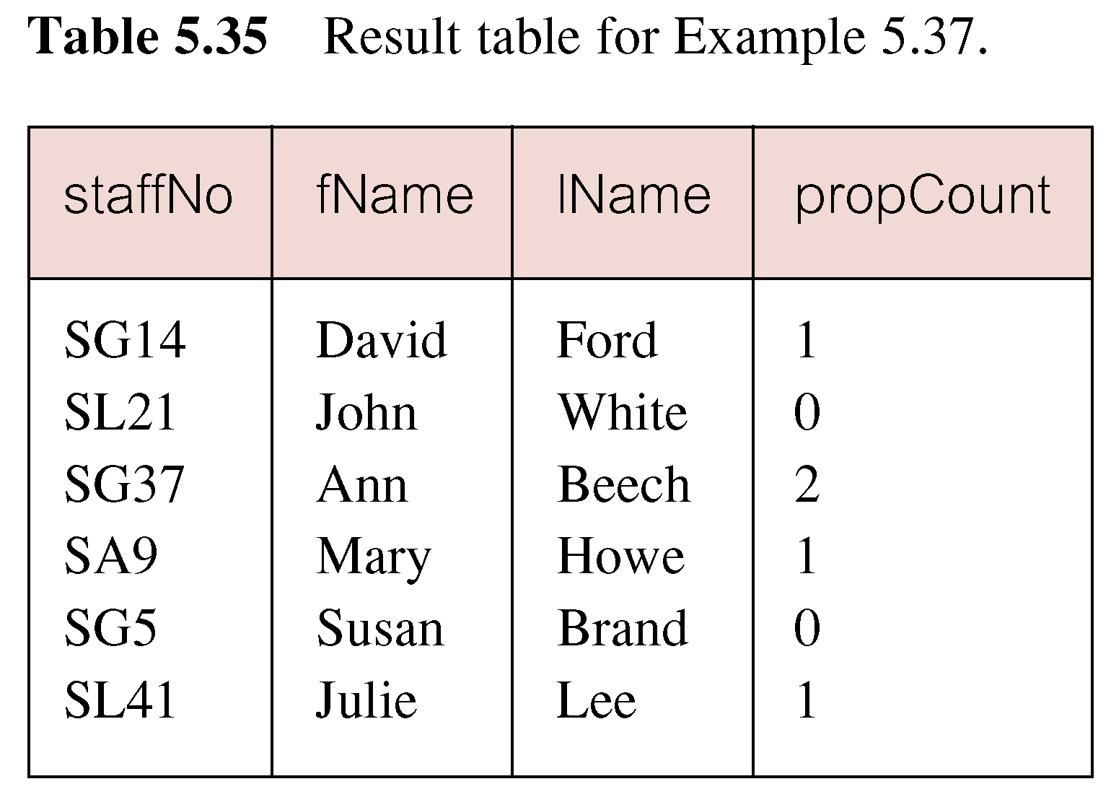
Example 5.37 INSERT … SELECT
If second part of UNION is omitted, excludes those staff who currently do not manage any properties.
© Pearson Education Limited 1995, 2005

Slide 124
UPDATE
  UPDATE TableName
  SET columnName1 = dataValue1
  [, columnName2 = dataValue2...]
  [WHERE searchCondition]
TableName can be name of a base table or an updatable view.
SET clause specifies names of one or more columns that are to be updated.
© Pearson Education Limited 1995, 2005

Slide 125
UPDATE
WHERE clause is optional:
  if omitted, named columns are updated for all rows in table;
  if specified, only those rows that satisfy searchCondition are updated.
New dataValue(s) must be compatible with data type for corresponding column.
© Pearson Education Limited 1995, 2005

Slide 126
Example 5.38/39 UPDATE All Rows
Give all staff a 3% pay increase.
UPDATE Staff
  SET salary = salary*1.03;
Give all Managers a 5% pay increase.
UPDATE Staff
  SET salary = salary*1.05
  WHERE position = ‘Manager’;
© Pearson Education Limited 1995, 2005

Slide 127
Example 5.40 UPDATE Multiple Columns
Promote David Ford (staffNo=‘SG14’) to Manager and change his salary to £18,000.
UPDATE Staff
  SET position = ‘Manager’, salary = 18000
  WHERE staffNo = ‘SG14’;
© Pearson Education Limited 1995, 2005

Slide 128
DELETE
  DELETE FROM TableName
  [WHERE searchCondition]
TableName can be name of a base table or an updatable view.
searchCondition is optional; if omitted, all rows are deleted from table. This does not delete table. If search_condition is specified, only those rows that satisfy condition are deleted.
© Pearson Education Limited 1995, 2005

Slide 129
Example 5.41/42 DELETE Specific Rows
Delete all viewings that relate to property PG4.
DELETE FROM Viewing
  WHERE propertyNo = ‘PG4’;
Delete all records from the Viewing table.
  DELETE FROM Viewing;
© Pearson Education Limited 1995, 2005

