Slide 1
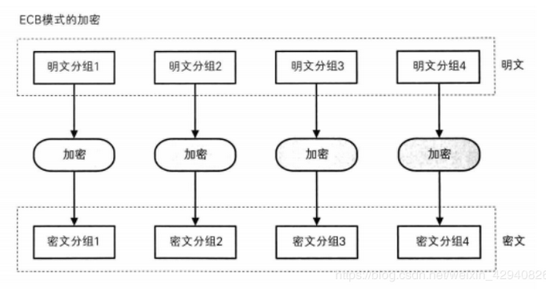
ECB - Electronic Code Book

Slide 2
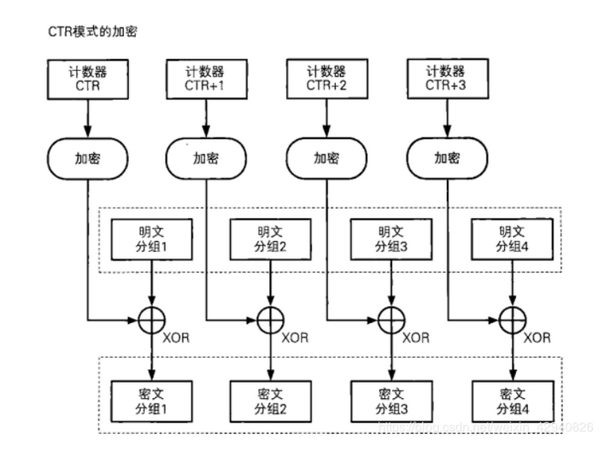
CTR - Counter

Slide 3
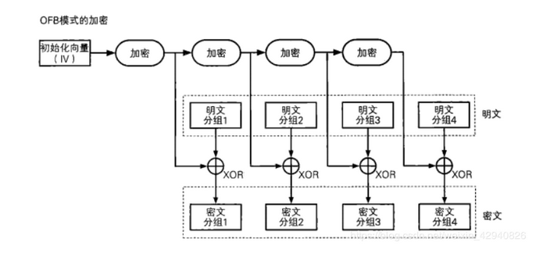
OFB - Output-Feedback

Slide 4
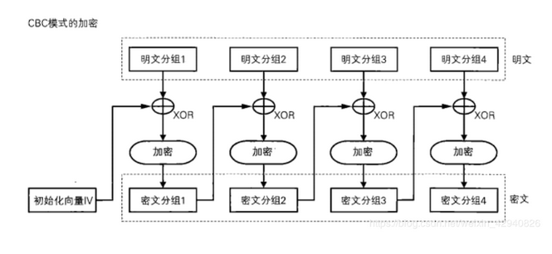
CBC - Cipher Block Chaining

Slide 5
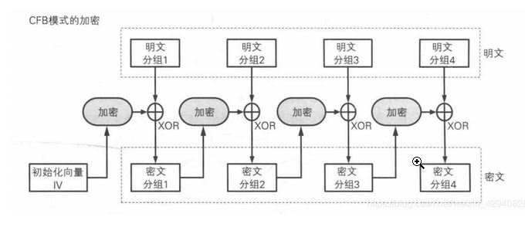
CFB - Cipher Feedback

