Slide 1
Review

Slide 2
System Calls
request to the operating system to allow user to wait for I/O completion.

Slide 3
Processes
Process contains a program counter, stack, and data section.
Text section: program code itself
Stack: temporary data (function parameters, return addresses, local variables)
Data section: global variables
Heap: contains memory dynamically allocated during run-time

Slide 4
Process Control Block (PCB)
contains information associated with each process: Process state
Process number
Process counter
Registers
Memory limits
List of open files

Slide 5
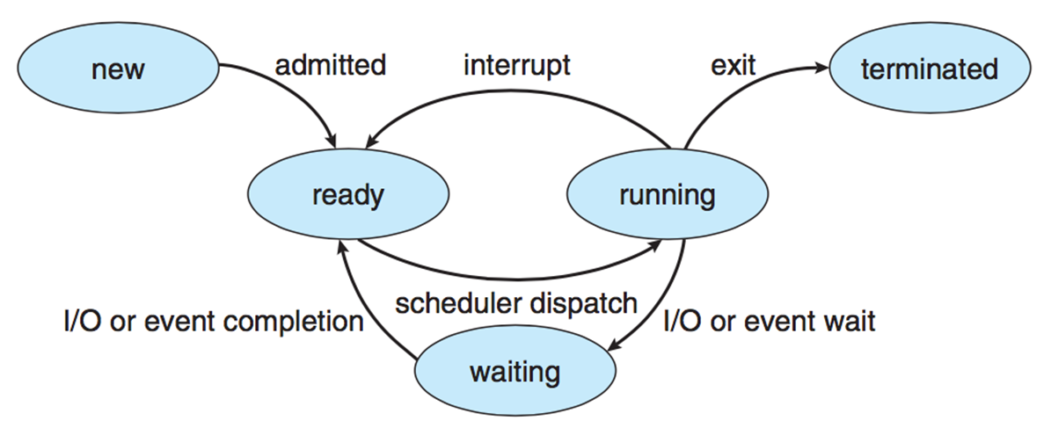
Process states
New
Ready
Running
Waiting
Terminated

Slide 6
Context Switch
When CPU switches to another process, the system must save the state of the old process (to PCB) and load the saved state (from PCB) for the new process via a context switch
Time of a context switch is dependent on hardware

Slide 7
Thread
Threads are fundamental unit of CPU utilization that forms the basis of multi-threaded computer systems

Slide 8
User Threads and Kernel Threads
User threads are supported above the kernel and are managed without kernel support, whereas kernel threads are supported and managed directly by the operating system.
Multi-threading models include: Many-to-One, One-to-One, Many-to-Many
◦Many-to-One: Many user-level threads mapped to single kernel thread
◦One-to-One: Each user-level thread maps to kernel thread
◦Many-to-Many: Many user-level threads mapped to many kernel threads

Slide 9
Monitor
Monitor is a high-level abstraction that provides a convenient and effective mechanism for process synchronization
Only one process may be active within the monitor at a time
Can utilize condition variables to suspend a resume processes (ex: condition x, y;)
x.wait() – a process that invokes the operation is suspended until x.signal()
x.signal() – resumes one of processes (if any) that invoked x.wait()
Can be implemented with semaphores

Slide 10
Mutex Locks
We use the mutex lock to protect critical regions and thus prevent race conditions. A mutex lock has a boolean variable available whose value indicates if the lock is available or not. If the lock is available, a call to acquire() succeeds, and the lock is then considered unavailable. A process that attempts to acquire an unavailable lock is blocked until the lock is released.

Slide 11
spin lock
In fact, this type of mutex lock is also called a spinlock because the process “spins” while waiting for the lock to become available.

Slide 12
semaphores
Semaphore: Synchronization tool that does not require busy waiting
Standard operations: wait() and signal() ← these are the only operations that can access semaphore S
Can have counting (unrestricted range) and binary (0 or 1) semaphores

Slide 13
Deadlock
Deadlock Characteristics: deadlock can occur if these conditions hold simultaneously
Mutual Exclusion: only one process at a time can use a resource
Hold and Wait: process holding one resource is waiting to acquire resource held by another process
No Preemption: a resource can be released only be the process holding it after the process completed its task
Circular Wait: set of waiting processes such that Pn-1 is waiting for resource from Pn, and Pn is waiting for P0
“Dining Philosophers” in deadlock

Slide 14
CIA Triad
Confidentiality
Integrity
Availability

Slide 15
Principle of least privilege
Principle of least privilege: programs, users, systems should be given just enough privileges to perform their tasks

Slide 16
Memory-Management Unit (MMU)
Hardware device that maps logical (virtual) to physical address
In MMU scheme, the value in the relocation register (base register) is added to every address generated by a user process at the time it is sent to memory

Slide 17
Fragmentation
External Fragmentation – total memory space exists to satisfy a request, but it is not contiguous
Internal Fragmentation – allocated memory may be slightly larger than requested memory, the leftover unused memory caused internal fragmentation

Slide 18
Reduce External Fragmentation
Compaction – shuffle memory contents to place all free memory together in one large block

Slide 19
Translation Look-Aside Buffer (TLB)
Transition Look-aside Buffer (TLB) is a CPU cache that memory management hardware uses to improve virtual address translation speed
Typically small – 64 to 1024 entries
On TLB miss, value loaded to TLB for faster access next time
TLB is associative – searched in parallel

Slide 20
Structure for the Page Table
Hashed Page Tables: virtual page number hashed into page table
Page table has chain of elements hashing to the same location
Each element has
(1) virtual page number
(2) value of mapped page frame
(3) a pointer to the next element
Search through the chain for virtual page number

Slide 21
Virtual Memory
separation of user logical memory and physical memory
Only part of program needs to be in memory for execution → logical address space > physical address space
Allows address spaces to be shared by multiple processes → less swapping
Allows pages to be shared during fork(), speeding process creation

Slide 22
First-In-First-Out (FIFO) Algorithm
A FIFO replacement algorithm associates with each page the time when that page was brought into memory. When a page must be replaced, the oldest page is chosen.

Slide 23
Optimal page replacement:
Replace the page that will not be used for the longest period of time.

Slide 24
Least recently used (LRU)
LRU replacement associates with each page the time of that page’s last use. When a page must be replaced, LRU chooses the page that has not been used for the longest period of time.

Slide 25
RAID
Redundant Array of Independent Disk
Multiple disk drives provide reliability and performance via redundancy
Probability of more than 1 disk fail at the same time is low
6 levels of RAID
(a) RAID 0: non-redundant striping.
(b) RAID 1: mirrored disks.
(c) RAID 2: memory-style error-correcting codes.
(d) RAID 3: bit-interleaved parity.
(e) RAID 4: block-interleaved parity.
(f) RAID 5: block-interleaved distributed parity.

Slide 26
FCFS
The simplest form of disk scheduling is, of course, the first-come, first-served (FCFS) algorithm. This algorithm is intrinsically fair, but it generally does not provide the fastest service.

Slide 27
SSTF
This assumption is the basis for the shortest-seek-time-first (SSTF) algorithm. The SSTF algorithm selects the request with the least seek time from the current head position. In other words, SSTF chooses the pending request closest to the current head position.

Slide 28
SCAN
In the SCAN algorithm, the disk arm starts at one end of the disk and moves toward the other end, servicing requests as it reaches each cylinder, until it gets to the other end of the disk. At the other end, the direction of head movement is reversed, and servicing continues. The head continuously scans back and forth across the disk. The SCAN algorithm is sometimes called the elevator algorithm, since the disk arm behaves just like an elevator in a building, first servicing all the requests going up and then reversing to service requests the other way.

Slide 29
C-SCAN/ C-LOOK
Circular SCAN (C-SCAN) scheduling is a variant of SCAN designed to provide a more uniform wait time. Like SCAN, C-SCAN moves the head from one end of the disk to the other, servicing requests along the way. When the head reaches the other end, however, it immediately returns to the beginning of the disk without servicing any requests on the return trip (Figure 10.7). The C-SCAN scheduling algorithm essentially treats the cylinders as a circular list that wraps around from the final cylinder to the first one.

Slide 30
File control block
A file control block (FCB) contains information about the file, including ownership, permissions, and location of the file contents.

