Slide 1
Presentation for DoS Attack and Defence
Group leader:
Minhao Jin 1717576
Group members:
Shuheng Mo 1718532
Jiayi Zhu 1716941
Yingqiang Chen 1717161
Weihao Jin 1717605

Slide 2
TCP Connect Flood Attack

Slide 3
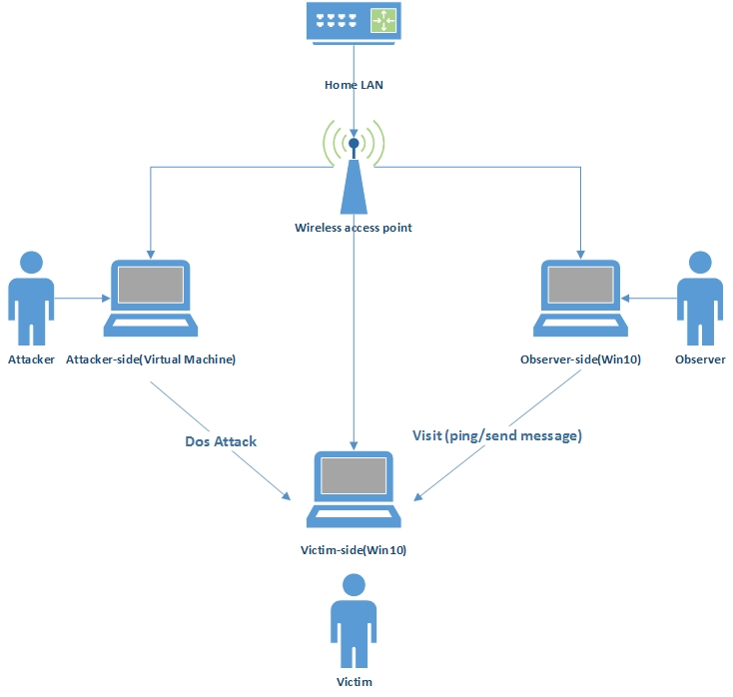
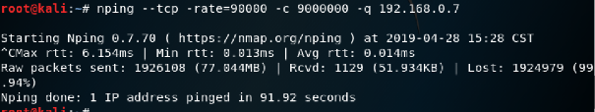
Experiment Procedure
Three roles: attacker (use Kali Linux VM), victim (Win10 OS), observer (Win10 OS).
Connect to the same home LAN network.
Shut down the firewall and DoS filters.
Attacker implements the TCP connect attack.
Victim captures the packets and CPU utility.
Observer ping to victim to check the connection between them, if “request time out”, attack succeeded.
Collect data from all sides and analyze.
Experiment finished.
*rate illustrates how many TCP attacks per second and *c implies count for TCP connects per attack, *q states decrease verbosity for one time

Slide 4
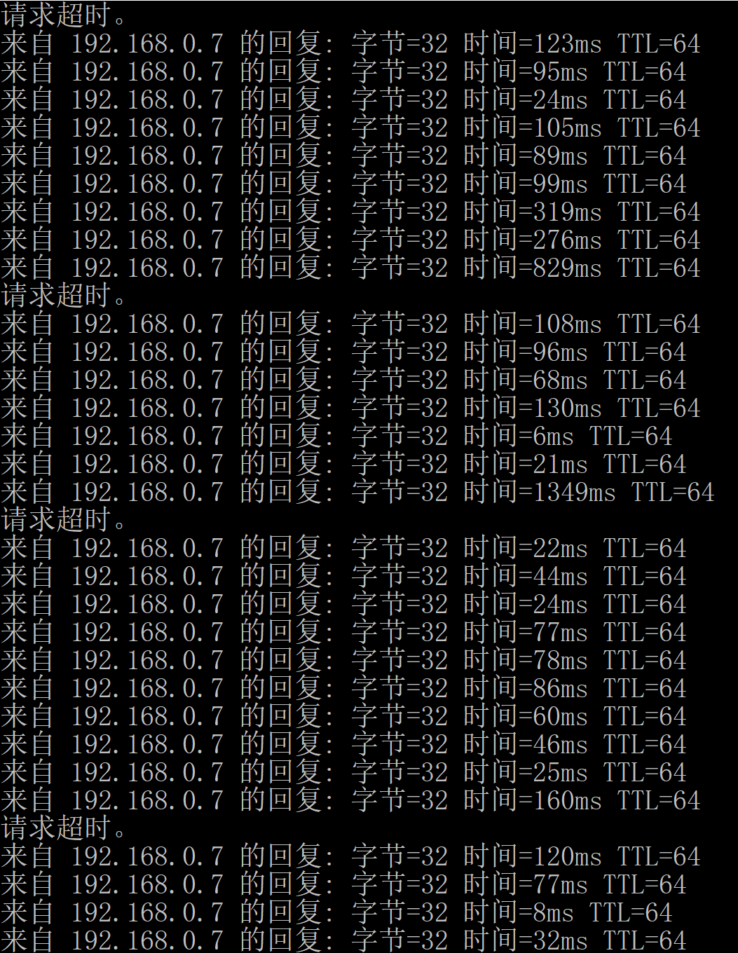
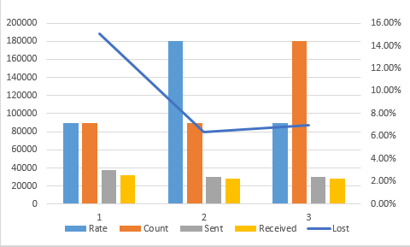
Result
Experimental data:
(i) rate 90,000 count 90,000
(ii)rate 180,000 count 90,000
(iii) rate 90,000 count 180,000
(iv) rate 90,000 count 9,000,000
# | Min time | Max time | Average time | Lost packets
(i) | 3ms | 2587ms | 130ms | 3%
(ii) | 2ms | 539ms | 56ms | 0%
(iii) | 2ms | 230ms | 29ms | 0%
Experiment (iv):
Minimum time 6ms
Max time 1349ms
Average transmission time 166ms
Packets loss rate: 10%
*ping data: packets size 32 byte, 50 packets were sent each time.

Slide 5
Objective
How does TCP Connect flood attack work?
Hard to measure what’s the precise upper limit for CPU process ability
Flaw of this attack method?
No available data to analyze
Why it doesn’t work?
Analyze the external factors which could affect this attack method

Slide 6
Analysis
Possible Explanations:
Principle of TCP connect flood attack
CPU processing ability/ TCP buffer
OOO issue (Out-of-Order Delivery)

Slide 7
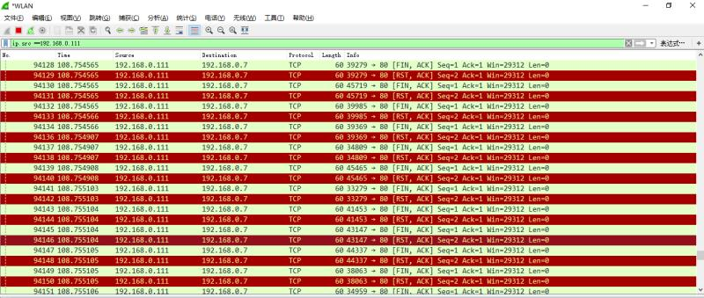
I. Principle of TCP connect flood attack
Experiment | Path(from) | Packets Type
(i) Rate= 90000 Count=90000 | Attacker Victim Victim Victim | [SYN], [ACK] [SYN + ACK] [RST + ACK] [TCP Retransmission]
(ii)Rate=180000 Count=90000 | Victim Victim Victim Attacker | [SYN + ACK] [RST + ACK] [FIN + ACK] [SYN],[ACK]
(iii)Rate=90000 Count=180000 | Attacker Victim Victim Victim Victim | [SYN], [ACK] [SYN + ACK] [RST + ACK] [FIN + ACK] [TCP Retransmission]
Four-way-handshake detected, TCP connection are not retained.
Conclusion: possible filters/ mechanism to handle TCP exceptions
(Could be OS built-in algorithms or TCP/IP protocols)
RST (Resetting a connection) packets detected
5 possible scenario that RST packets occur:
Ports on the server are not open
Request time out
Port are shut down beforehand (mandatory)
Receive data on a socket that has been closed
To deny a illegal/ abnormal connection

Slide 8
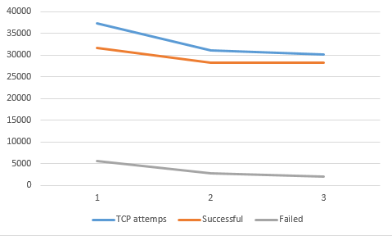
II. CPU processing ability/ TCP buffer
TCP packets that were successfully sent in
experiments (i), (ii), (iii) remained constant
(only slight change, around 30,000)
TCP connections are limited → TCP buffer has
restricted the amount of TCP connections
* In general, a server was supposed to handle at least
10,000 HTTP request simultaneously, that is, nearly
98MB data. This is another proof that this attack
packets size was reduced largely because the result in
the Kali Linux has shown that about 0.85MB data
was sent to victim-side per second and this data size
is completely manageable for average computer.

Slide 9
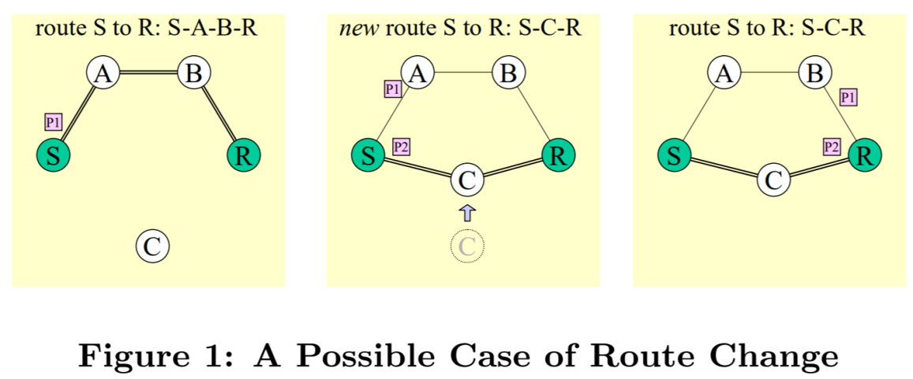
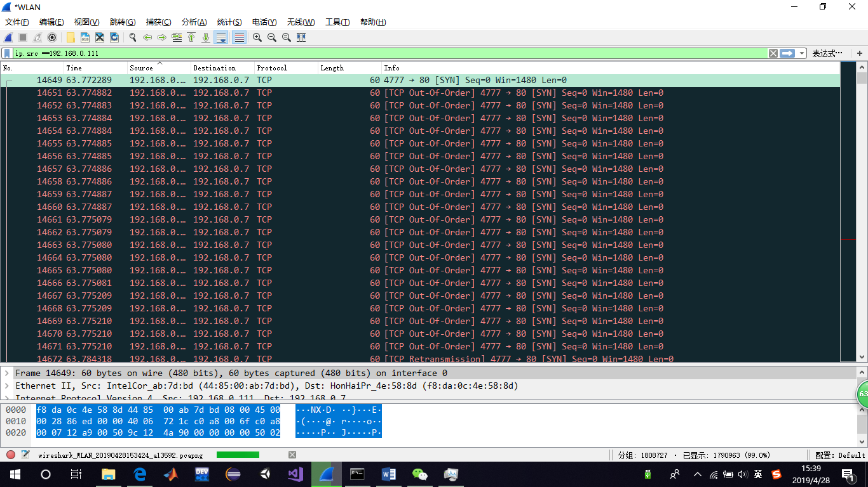
III. Out-of-Order Delivery Issue
The OOO (out-of-order delivery) illustrates the route changes in the network and indicates that the earlier sent TCP packet arrived later than the one sent after it
OOO has no relation with network congestion→ was not caused by flood attack→ OS measurement to handle network delay
TCP Out-of-order packets implies large TCP packets loss
or delay.

Slide 10
Denial of Service Attack with UDP Flood

Slide 11
Devices information
Device | IP Address | MAC Address | Role
Router | 192.168.0.1 | C4:36:55:76:5F:FB | Local Network Gateway
PC1 | 192.168.0.111 | 08:00:27:D3:23:2D | Attacker
PC2 | 192.168.0.14 | AC:FD:CE:E0:C7:61 | Visitor
PC3 | 192.168.0.7 | F8:DA:0C:4E:58:8D | FTP server (Victim)

Slide 12
The Framework of Experimental Platform

Slide 13
Before attack
Experiment Results for Sending Ping Command Status
Status | FTP server response time |  |  | packet loss
 | Maximum | Minimum | Average
Sending ping command | 244ms | 2ms | 34ms | 0%

Slide 14
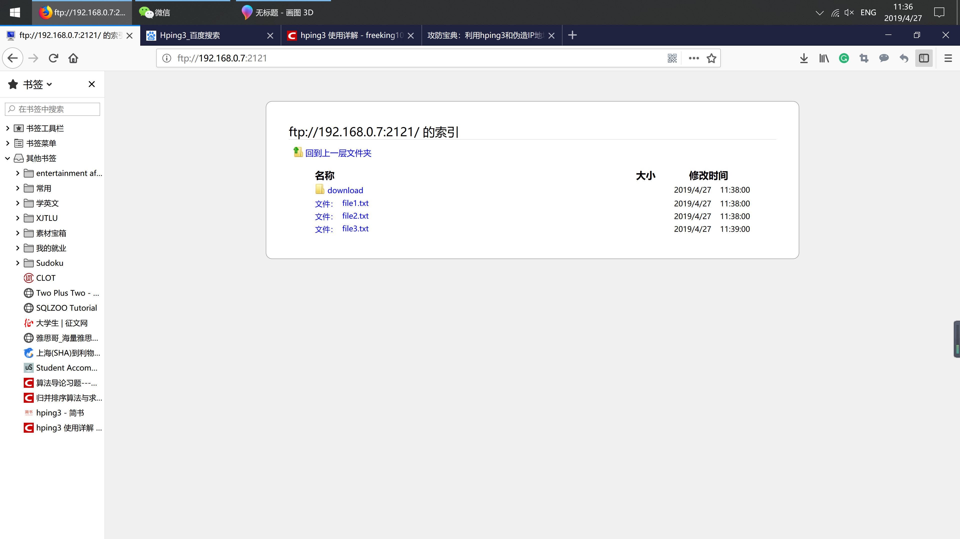
Before attack

Slide 15
During attack
Packet size | Average response time | Package loss percentage
100 bytes | 506ms | 48%
600 bytes | 562ms | 54%
1100 bytes | 1539ms | 48%

Slide 16
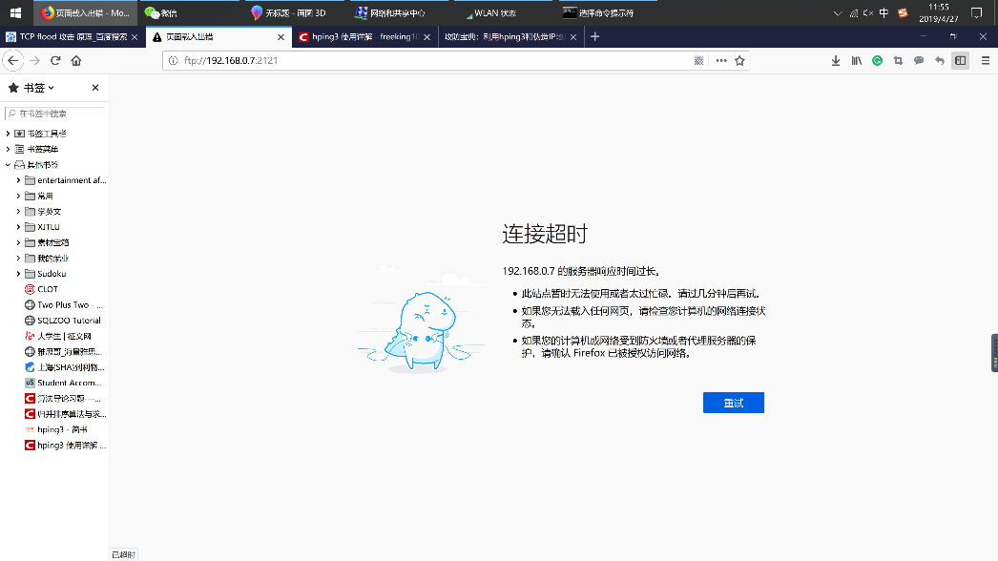
During attack

Slide 17
Conclusion
In the experiment of Denial of Service Attack with UDP Flood, the response time of the FTP server is proportional to the packet size, which implies that the attack with lager packet size will be more effective.

Slide 18
LAND Attack
the local area network denial attack

Slide 19
Attack principle
Send SYN packet that addresses of source and destination are the same.
Misleading servers to establish void links.

Slide 20
SYN packet example

Slide 21
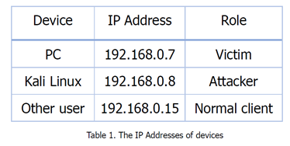
Experiment

Slide 22
Result
Fail.

Slide 23
Analysis
Kali linux
Mechanism in the router
Mechanism in the OS

Slide 24
SYN Flood Attack

Slide 25
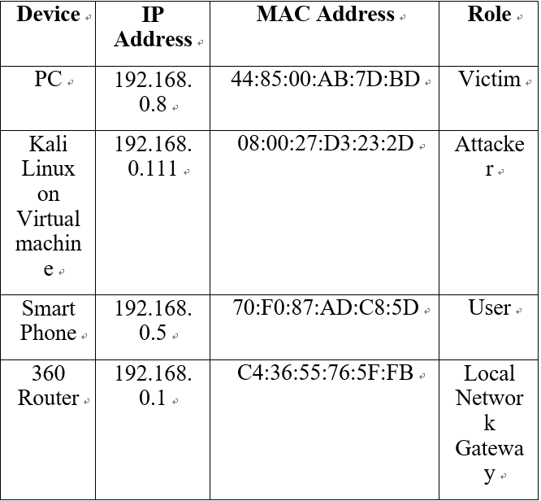
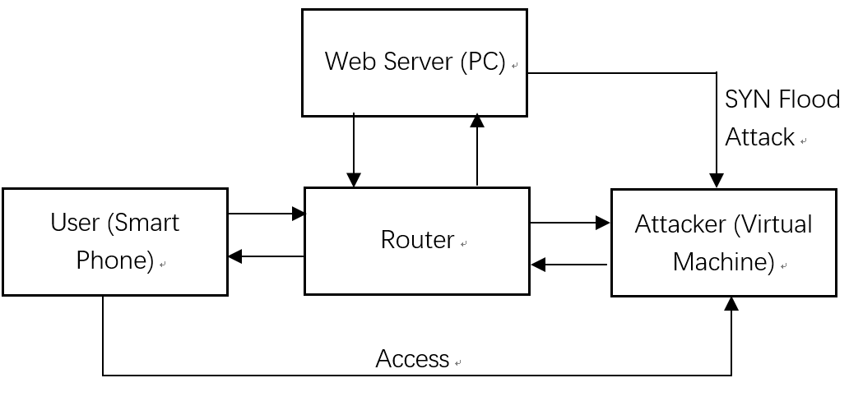
The Experiment’s Framework
Attacker
(Virtual Machine)
Web Server (PC)

Slide 26
The Experiment Content
SYN Flood Attack with Attacker’s Real IP
SYN Flood Attack with random IP
1) Attack with random IP and Different Count
2) SYN Flood Attack with random IP and Different Data Bytes

Slide 27
The considered references for every attack command
Test 1: Tester keeps sending SYN packets for 1 minute then stop the command. After that, tester will record the time for success of user’s re-access.
Test 2: During the attack, the Kali Linux will use the command which is shown in Figure 4 to send 50 TCP packets in normal frequency to simulate multiple users’ access requirement. In this test, the packets’ loss rate and the receptions’ distribution among 50 requirement will be considered.

Slide 28
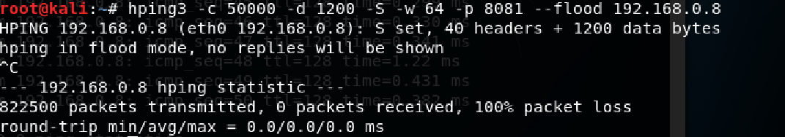
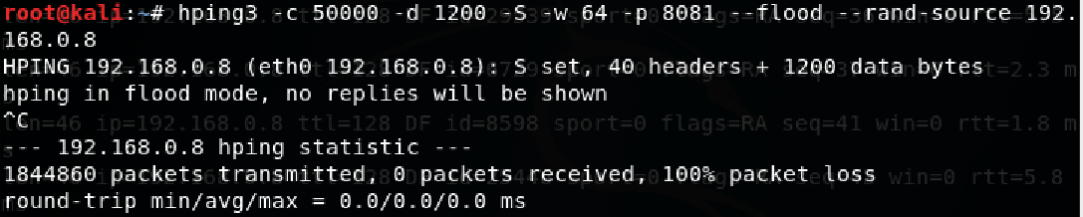
SYN Flood Attack with Attacker’s Real IP
Failed
SYN Flood Attack with Random IP
Succeed

Slide 29
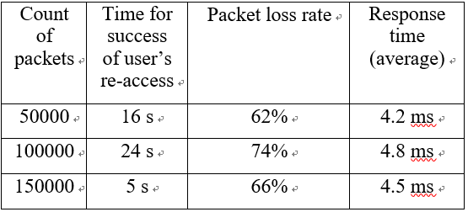
Attack with random IP and Different Count (Data bytes 1200)
Test 1 Result: Time for success of user’s re-access
Test 2 Result: Packet loss rate

Slide 30
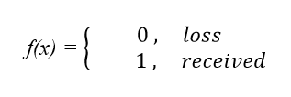
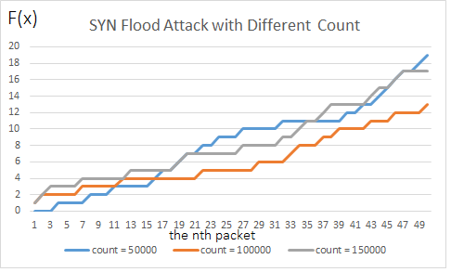

Attack with random IP and Different Count (Data bytes 1200)
Analyzation : According to the receptions’ distribution of 50 packets
The figure shows that attack performance
is related to time

Slide 31
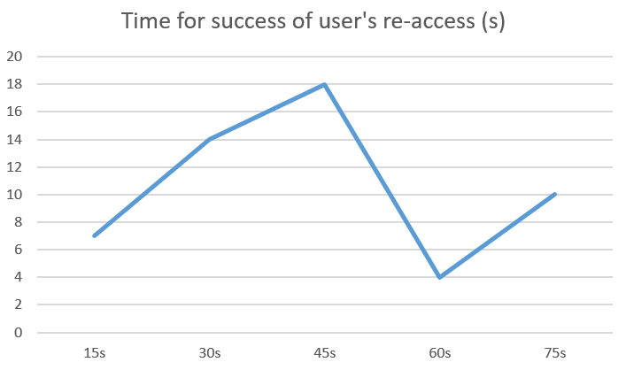
Attack with random IP and Different Count (Data bytes 1200)
Confirm the analyzation
The result of “150000” attack command with different execute time

Slide 32
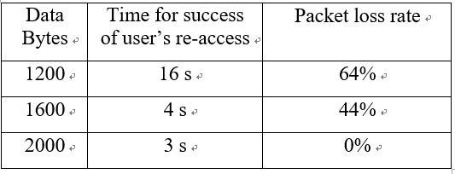
SYN Flood Attack with random IP and Different Data Bytes (Count 50000)
Test 1 Result: Time for success of user’s re-access
Test 2 Result: Packet loss rate

Slide 33
SYN Flood Attack with random IP and Different Data Bytes (Count 50000)
Analyzation: According to theory of DoS attack
1) Attacker aims to use Small data byte packets to elicit large data size of packets which is responded by victim
2) SYN flood is to send spoofed TCP packets with SYN flag as much as possible in per second
3) The larger data size leads more time in preparing single packet, which results in less attack frequency
The large data size is not recommended

Slide 34
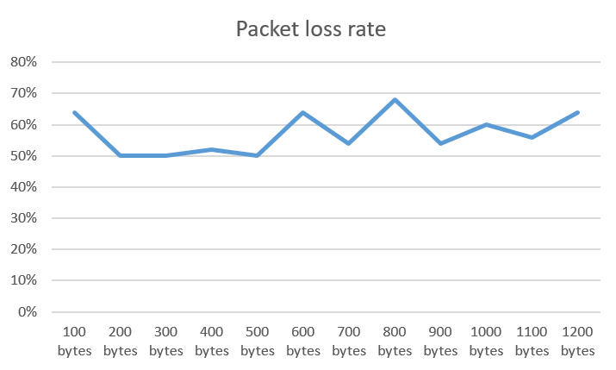
SYN Flood Attack with random IP and Different Data Bytes (Count 50000)
Confirm the analyzation
The packet loss rate of “50000” attack command with different data bytes

Slide 35
Conclusion
If attacker sends more packets in per second, the attack performance will be better.
Furthermore, the attack intensity is related to time and SYN flood attacks with different packet count have different period of attack intensity.
To achieve sending more packets in per second, small data bytes, such as 800, is recommended to be chosen.
In conclusion, among the tested command, the SYN flood with “–c 100000” and “-d 1200” has the best attack performance.

Slide 36
SYN Flood Defense Mechanism
TCP flags decide the status of the TCP packets, so we can know whether it is a SYN packet or not by determine its flag value. The flag of SYN packet is 2, and according to the proportion of SYN packets in this port packets we can know that whether the computer has been attacked.
After the attacked port is detected, closing the running process on that port then the defense is completed.

Slide 37
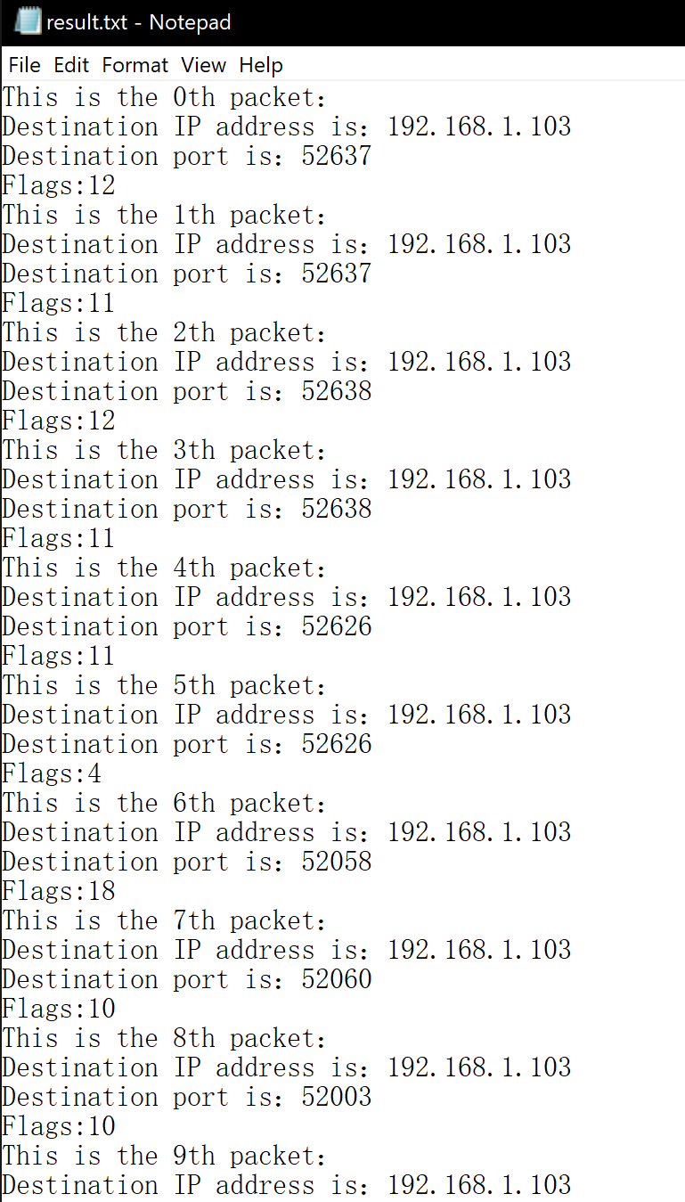
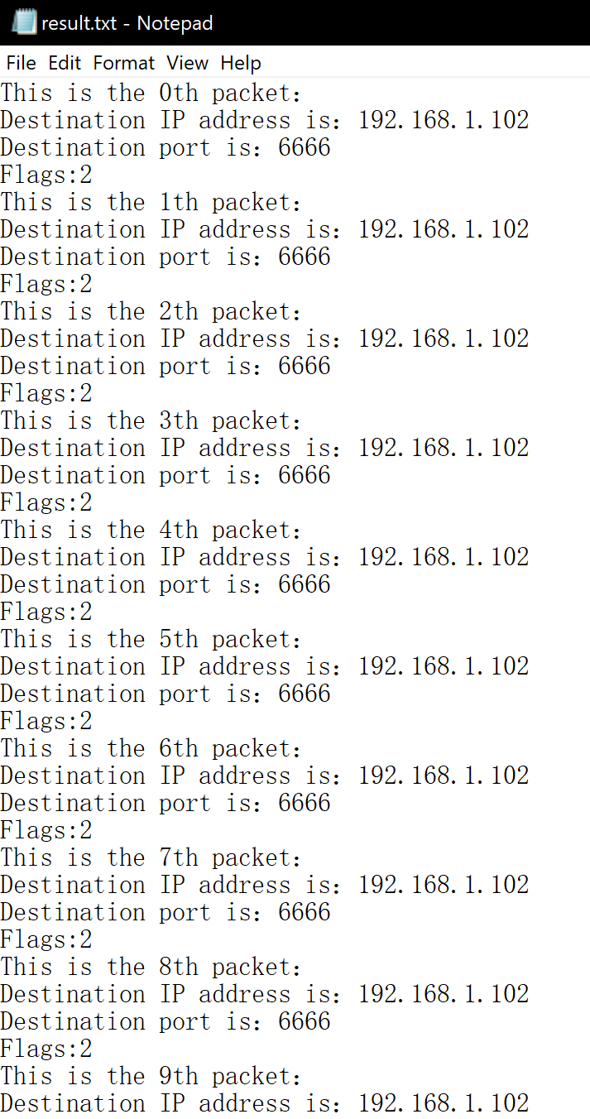
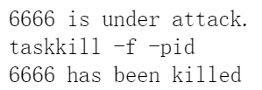
SYN Flood Defense Flow
Using Wireshark to capture the TCP packets that the attacker sends to the victim, then analyzing and disposing the .pcap file by a defense program written in python.

Slide 38
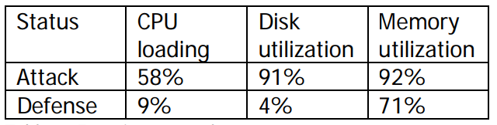
SYN Flood Defense Result
Three criterion:
1. CPU loading
2. Disk utilization
3. Memory utilization

Slide 39
Thanks for watching!

