Slide 1
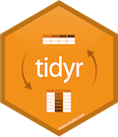


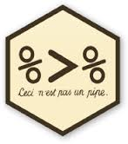

tidyr & dplyr
Aitor Ameztegui
@multivac42
UdL
Víctor Granda
@malditobarbudo
CREAF

Slide 2
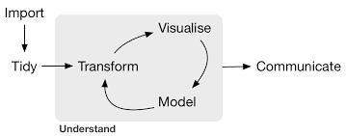

tidyr & dplyr: the tidyverse
Created by Hadley Wickham, chief scientist of RStudio, and author of more than 30 R packages (readr, ggplot2, plyr, devtools, roxygen2, rmarkdown…)
Forman parte del tidyverse, una serie de paquetes de R pensado para facilitar el análisis de datos y comunicarse entre si
ggplot2, ggvis
readr
tidyr
dplyr
tidyr
tidyr
dplyr
dplyr
rmarkdown
broom

Slide 3
Before we start…
Neither tidyr nor dplyr or purr do anything that can’t be done with base code, apply functions, for loops or other packages
Designed to be more efficient (in time) and easier to use (requires some adaptation if used to base code)
Valid mostly for data frames. For other formats (matrices, arrays) plyr can be used.

Slide 4
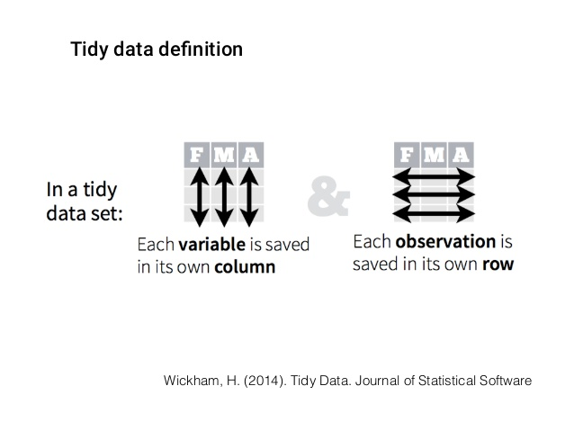
the tidyverse: tidy data
data in ‘tidy’ format eases the processing and analysis, particularly in vectorized languages as R

Slide 5
our data
plots [11,858 x 15]: all plots from the Third Spanish Forest Inventory (IFN3) in Catalonia
trees [111,756 x 12]: all trees with dbh > 7.5 cm measured in both IFN2 and IFN3
species [14,778 x 15]: number of trees per hectare in each plot, by species and size class
coordinates [11,858 x 6]: X and Y UTM coordinates of each plot

Slide 6
let’s have a look at the data
Tibbles, not usual data frames
class tbl_df
print 10 rows
inform about variable types

Slide 7
dplyr

Slide 8
5 verbs of dplyr
filter: keep the rows that match a condition
select: keep columns by name
arrange: sort rows
mutate: add new variables
summarise: do some summary statistics and reduce data

Slide 9
common structure (for most of the tidyverse)
first argument: data frame
the rest of arguments specify what to do with the data frame
output is always another data frame
don’t modify the original data frame (unless we assign it with “<-“)

Slide 10
filter (select rows)
filter (df, color == “blue”)
df
color | value | shape
blue | 1 | square
blue | 3 | circle
blue | 2 | triangle
color | value | shape
blue | 1 | square
black | 5 | square
blue | 3 | circle
blue | 2 | triangle
black | 4 | circle
filter (df, shape == “circle”)
color | value | shape
blue | 3 | circle
black | 4 | circle

Slide 11
filter
df
filter(df, value %in% c(1, 4))
color | value | shape
blue | 1 | square
black | 2 | square
blue | 3 | circle
blue | 4 | triangle
black | 5 | circle
color | value | shape
blue | 1 | square
blue | 4 | triangle

Slide 12
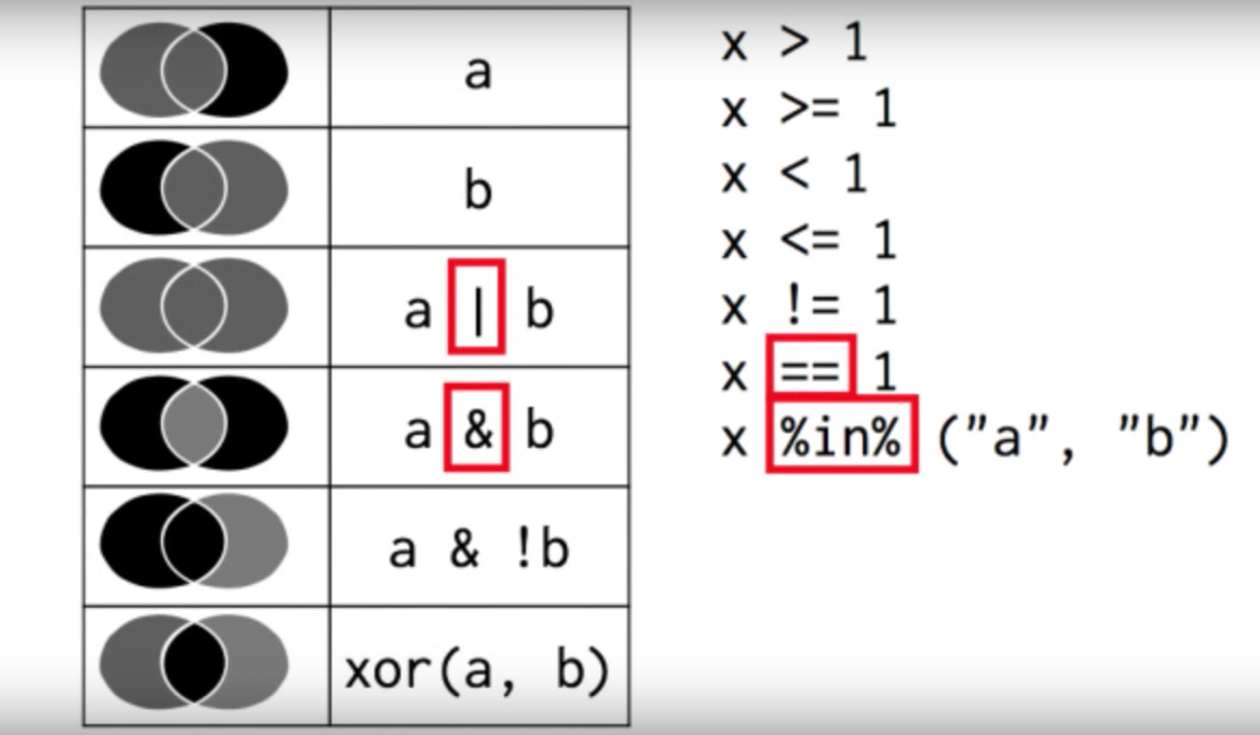
filter

Slide 13
filter
Ex.1: Let’s find those plots in IFN3n (plots) that:
1.1 Are located either in Barcelona (08) or Girona (17)
1.2 Were measured before January 2001
1.3 It took more than 2 hours to measure (7200s)

Slide 14
select (select columns)
df
select(df, color)
color | value | shape
blue | 1 | square
black | 5 | square
blue | 3 | circle
blue | 2 | triangle
black | 4 | circle
color
blue
black
blue
blue
black

Slide 15
select
df
select (df, -color)
color | value | shape
blue | 1 | square
black | 5 | square
blue | 3 | circle
blue | 2 | triangle
black | 4 | circle
value | shape
1 | square
5 | square
3 | circle
2 | triangle
4 | circle

Slide 16
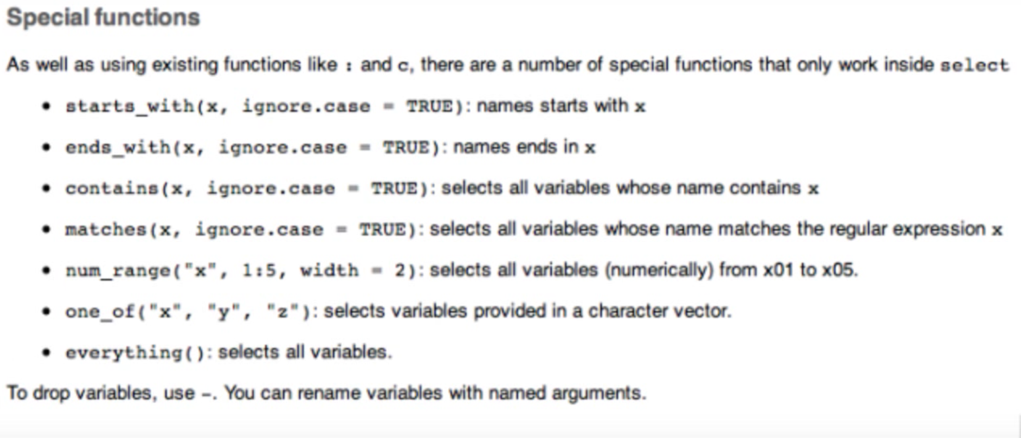
select

Slide 17
select
Ex.2: Think of 3/4 ways to select the variables that define the start and finish date of plot measuring

Slide 18
arrange (sort rows)
df
arrange(df, value)
color | value | shape
blue | 1 | square
black | 5 | square
blue | 3 | circle
blue | 2 | triangle
black | 4 | circle
color | value | shape
blue | 1 | square
blue | 2 | triangle
blue | 3 | circle
black | 4 | circle
black | 5 | square

Slide 19
arrange
df
arrange(df, desc(value))
color | value | shape
blue | 1 | square
black | 5 | square
blue | 3 | circle
blue | 2 | triangle
black | 4 | circle
color | value | shape
black | 5 | square
black | 4 | circle
blue | 3 | circle
blue | 2 | triangle
blue | 1 | square

Slide 20
arrange
Your turn
Ex.3.1 Sort plots by date and hour of measurement
Ex. 3.2 Which plots were started to be measured later in the day?
Ex. 3.3 Which plots took longer to be measured?

Slide 21
mutate (add new variables)
df
mutate(df, double = 2 * value)
color | value | shape
blue | 1 | square
black | 5 | square
blue | 3 | circle
blue | 2 | triangle
black | 4 | circle
color | value | shape | double
blue | 1 | square | 2
black | 5 | square | 10
blue | 3 | circle | 6
blue | 2 | triangle | 4
black | 4 | circle | 8

Slide 22
mutate
df
mutate(df, double = 2 * value,
quadr = 2 * double)
color | value | shape
blue | 1 | square
black | 5 | square
blue | 3 | circle
blue | 2 | triangle
black | 4 | circle
color | value | shape | double | quadr
blue | 1 | square | 2 | 4
black | 5 | square | 10 | 20
blue | 3 | circle | 6 | 12
blue | 2 | triangle | 4 | 8
black | 4 | circle | 8 | 16

Slide 23
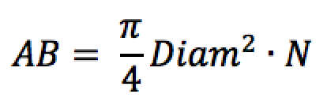
mutate
Your turn
Ex.4.1 Get growth (in cm) of each tree between IFN2 and IFN3.
Ex 4.2 Create two new variables with basal area per hectare of each tree, both for IFN2 and IFN3. Which is the species of the fastest-growing tree in Básala Area? Clue:

Slide 24
summarise (reduce variables)
df
summarise ( df, total = sum(value))
color | value | shape
blue | 1 | square
black | 5 | square
blue | 3 | circle
blue | 2 | triangle
black | 4 | circle
total
15

Slide 25
summarise
Summary functions
min (x), median (x), max (x), quantile (x, p)
n(), n_distinct (x), sum (x), mean (x)
sd(x), var(x), IQR (x)
sum (x > 10), mean (x > 10)

Slide 26
grouped summarise
df
by_color <- group_by (df, color)
color | value | shape
blue | 1 | square
black | 5 | square
blue | 3 | circle
blue | 2 | triangle
black | 4 | circle
summarise (by_color, total = sum (value), max = max(value))
color | total | max
blue | 6 | 3
black | 9 | 5

Slide 27
summarise
by_province <- group_by (trees, Provincia)
by_plot <- group_by (trees, Codi)
by_species <- group_by (trees, Especie)
by_CD <- group_by (trees, CD)
by_plot_species <- group_by (trees, Codi, Especie)

Slide 28
summarise
Your turn
Ex.5: Which statistics would you calculate to characterize diameter values in each plot?

Slide 29
data pipelines
We will often used several verbs (filter, arrange, group_by…)
Multiple operations are difficult to read or require to create multiple intermediate objects
diam_especie <- filter(
summarise(
group_by(
filter(
mayores,
!is.na(DiamIf3)
),
Codi, Especie
),
diam = mean (DiamIf3),
n = n()
),
n > 5)
Notes:
permite crear cadenas de operaciones complejas, uniendo trozos de operaciones simples
siguiendo un orden más lógico y sencillo

Slide 30
data pipelines
Solution: ‘pipe’ operator (%>%) from magrittr
The result of the left side is passed to the function in the right as first argument
f (x, y) x %>% f(y)
f (x, y, z) x %>% f(y, z)
In tidyr y dplyr, %>% makes each function be applied to the data frame resulting from the previous step
filter (df, color==“blue”) df %>% filter(color==“blue”)
mutate (df, double = 2*value) df %>% mutate(double = 2*value)
Notes:
permite crear cadenas de operaciones complejas, uniendo trozos de operaciones simples
siguiendo un orden más lógico y sencillo

Slide 31
data pipelines
diam_especie <- filter(
summarise(
group_by(
filter(
mayores,
!is.na(DiamIf3)
),
Codi, Especie
),
diam = mean (DiamIf3),
n = n()
),
n > 5)
diam_especie <- mayores %>%
filter(!is.na (DiamIf3)) %>%
group_by(Codi, Especie) %>%
summarise(diam=mean(DiamIf3),
n = n()) %>%
filter(n > 5)
nested functions
Functions key
Notes:
permite crear cadenas de operaciones complejas, uniendo trozos de operaciones simples
siguiendo un orden más lógico y sencillo

Slide 32
pipelines
Ex.6: create pipelines to answer the following questions
6.1 Which plots have the fastest average growth rate?
6.2 Which is the plot with the most species?
6.3 Is there any relationship between both variables?

Slide 33
grouped mutate/ grouped filter
We will commonly use groups (group_by) with summarizing variables: n inputs —> 1 output (mean, sd, n, n_distinct…) group_by (Especie) %>% summarise (mean=mean(Diam))
Sometimes, however, we may be interested in calculating variables by group, but in an n:n way n inputs —> n outputs group_by (Especie) %>% mutate (std_diam = Diam - mean (Diam))

Slide 34
grouped mutate/ grouped filter
Your turn (Ex.7)
7.1 Identify those trees that grow most as compared to the average in that plot
7.2 Identify those plots where a species grows much more than the average for the species
If you get bored…
7.3 Select IFN plots with pure Pinus nigra stands (Especie = 025). Note: we consider a forest to be monospecific when >80% in BA corresponds to a single species

Slide 35
do
Sometimes none of the specialized verbs do what we need
We can use do: it’s slower but can be applied to everything
Equivalent to ddply() and dlply(), very useful to use with models
Requires the pronoun ., to indicate it should be applied to the current group
Notes:
permite crear cadenas de operaciones complejas, uniendo trozos de operaciones simples
siguiendo un orden más lógico y sencillo

Slide 36
do
We can use it to apply functions…
mayores %>%
group_by(Codi, Especie) %>%
do(head(.,3))
mayores %>%
group_by(Especie) %>%
do(summ = summary(.))
…and even to fit models
models <- mayores %>%
group_by(Especie) %>%
do(mod=lm(HeiIf3 ~DiamIf3, data=.))
Notes:
permite crear cadenas de operaciones complejas, uniendo trozos de operaciones simples
siguiendo un orden más lógico y sencillo

Slide 37
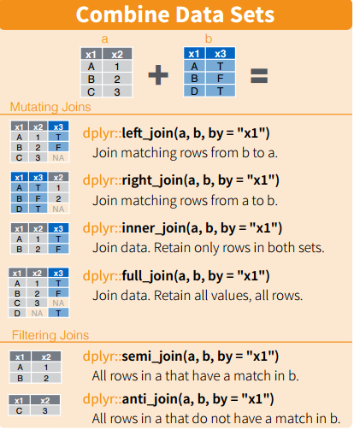
working with two tables: mutating joins
left_join(x, y) añade las observaciones de y que también estén en x. Aseguramos no perder observaciones de la lista original.
right_join(x, y) añade las observaciones de x que también estén en y. Es equivalente a left_join, pero las variables se ordenarán de manera diferente.
full_join(x,y) incluye todas las observaciones en x e y. Si no coinciden, pone NA
inner_join(x, y) incluye observaciones que coinciden en x e y (repite filas si se da el caso)

Slide 38
working with two tables: filtering joins
Filtering joins: they work as ‘mutating joins’, but they affect the observations, THEY DO NOT ADD COLUMNS! There are two types:
semi_join(x, y) mantiene las observaciones de x que coinciden con observaciones en y. Similar a inner_join pero sin repetir observaciones.
anti_join(x, y) elimina las observaciones de x que coinciden con observaciones en y

Slide 39
joins
Your turn
Ex.8 Add X & Y coordinates that are included in the coordinates data frame to each plot in the data frame plots

Slide 40
tidyr

Slide 41
el tidyverse: tidy data
el formato ‘tidy’ facilita el procesado y análisis, sobre todo en lenguajes vectorizados tipo R

Slide 42
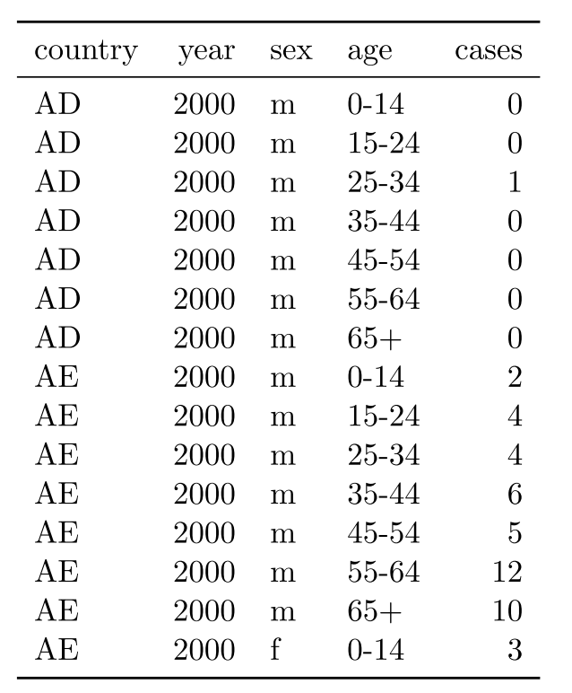
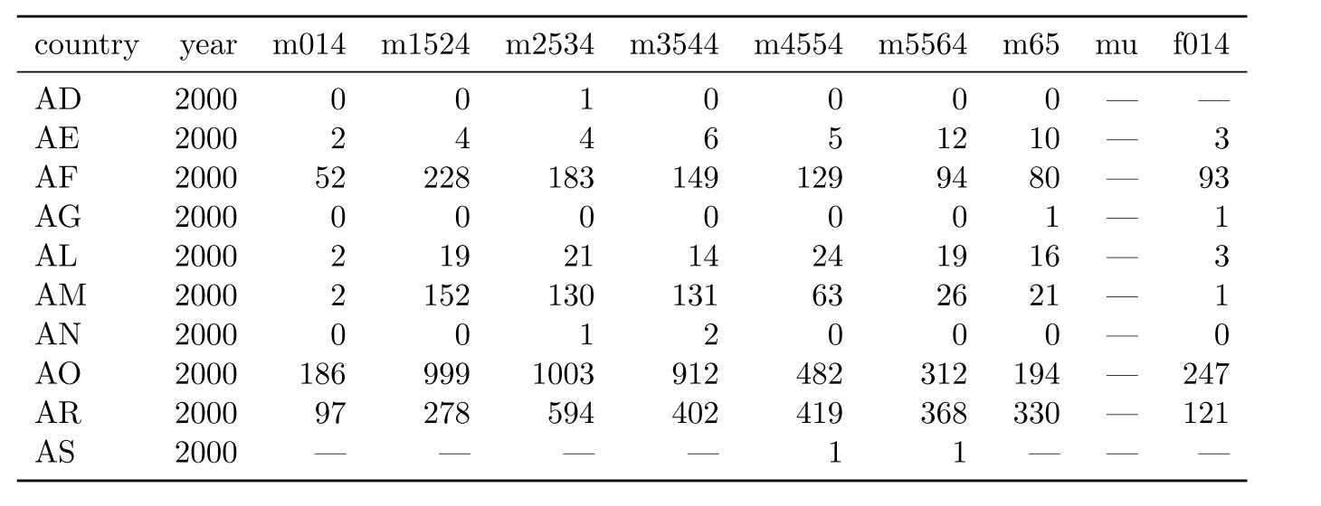
no siempre los datos están organizados
WHO, TB dataset (Wickham, 2014)

Slide 43
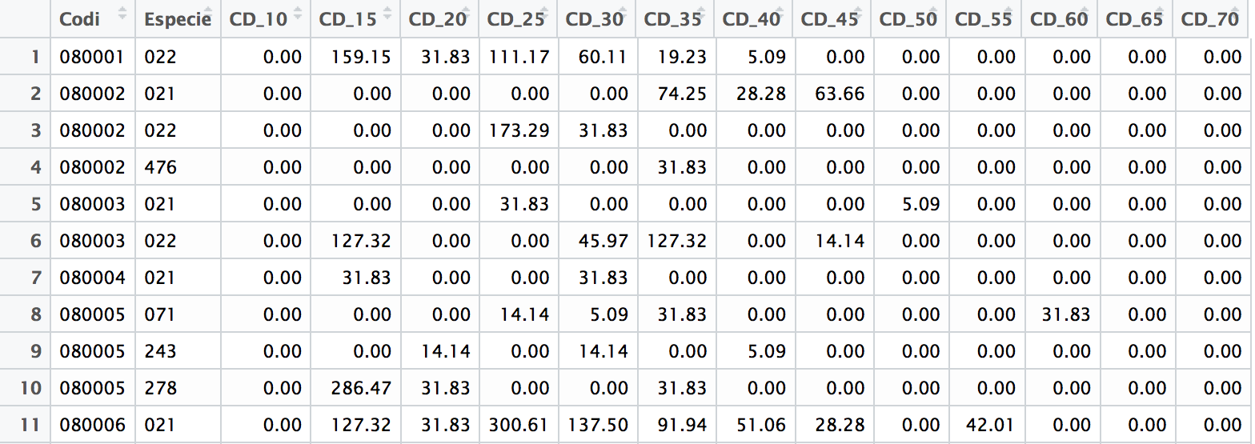
no siempre los datos están organizados
A veces es más conveniente tomar los datos en formato “amplio” (más rápido de tomar, tipo de análisis) View (especies)
el formato ‘tidy’ facilita el procesado y análisis, sobre todo en lenguajes vectorizados tipo R

Slide 44
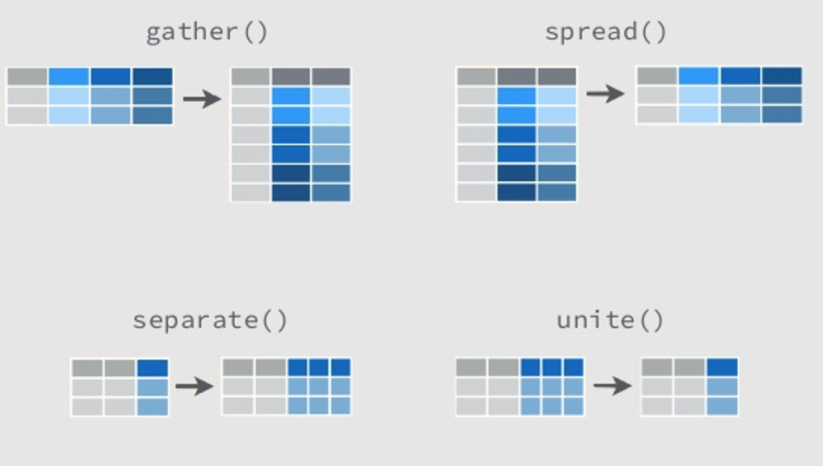
los 4 verbos de tidyr
gather: convertir datos “anchos” en “largos”. Convierte columnas en pares de factor-valor
spread: el inverso de gather. Toma los niveles de un factor y los “esparce” en distintas columnas
separate: toma valores de una columna y los separa en varias
unite: opuesto a separate. Añade una nueva variable basadas en varias

Slide 45
estructura
primer argumento: data frame
el resto de argumentos especifican qué hacer con el data frame
el output siempre será un data frame
no modifican el data frame original (a menos que se asigne)

Slide 46
gather
new factor
numeric variable
gather(df,IFN,n,IFN_2,IFN_3)
df
data frame
variables to gather
Prov | IFN_2 | IFN_3
Lleida | 16 | 18
Girona | 78 | 79
Barcelona | 60 | 67
Tarragona | 34 | 36
Prov | IFN | n
Lleida | IFN_2 | 16
Girona | IFN_2 | 78
Barcelona | IFN_2 | 60
Tarragona | IFN_2 | 34
Lleida | IFN_3 | 18
Girona | IFN_3 | 79
Barcelona | IFN_3 | 67
Tarragona | IFN_3 | 36
gather(df,IFN,n,IFN_2:IFN_3)
intervalo de var. a reunir
gather(df,IFN,n,-Prov)
var. a excluir

Slide 47
separate
df
separate(df,IFN,c("name","n_IFN"))
Prov | IFN | n
Lleida | IFN_2 | 16
Girona | IFN_2 | 78
Barcelona | IFN_2 | 60
Tarragona | IFN_2 | 34
Lleida | IFN_3 | 18
Girona | IFN_3 | 79
Barcelona | IFN_3 | 67
Tarragona | IFN_3 | 36
data frame
nuevas variables
Prov | name | n_IFN | n
Lleida | IFN | 2 | 16
Girona | IFN | 2 | 78
Barcelona | IFN | 2 | 60
Tarragona | IFN | 2 | 34
Lleida | IFN | 3 | 18
Girona | IFN | 3 | 79
Barcelona | IFN | 3 | 67
Tarragona | IFN | 3 | 36
separate(df,col=IFN,into=c("name","n_IFN"),sep=4)
variable to separate
character to separate
separate(df,IFN,c("name","n_IFN"),sep="_")
separate(df,IFN,c("name","n_IFN"))

Slide 48
gather & separate
Your turn
Ex.9: Use gather and separate to transform the data frame species into a ‘tidy’ format, where each column is a variable and each row, an observation

Slide 49
spread
factor (will form the new columns)
spread(df,IFN,n)
df
data frame
value
Prov | IFN | n
Lleida | IFN_2 | 16
Girona | IFN_2 | 78
Barcelona | IFN_2 | 60
Tarragona | IFN_2 | 34
Lleida | IFN_3 | 18
Girona | IFN_3 | 79
Barcelona | IFN_3 | 67
Tarragona | IFN_3 | 36
Prov | IFN_2 | IFN_3
Lleida | 16 | 18
Girona | 78 | 79
Barcelona | 60 | 67
Tarragona | 34 | 36

Slide 50
unite
name of the column to add
separator (optional)
unite(df,IFN,name,n_IFN,sep=“_”)
df
Prov | name | n_IFN | n
Lleida | IFN | 2 | 16
Girona | IFN | 2 | 78
Barcelona | IFN | 2 | 60
Tarragona | IFN | 2 | 34
Lleida | IFN | 3 | 18
Girona | IFN | 3 | 79
Barcelona | IFN | 3 | 67
Tarragona | IFN | 3 | 36
data frame
columns to join
Prov | IFN | n
Lleida | IFN_2 | 16
Girona | IFN_2 | 78
Barcelona | IFN_2 | 60
Tarragona | IFN_2 | 34
Lleida | IFN_3 | 18
Girona | IFN_3 | 79
Barcelona | IFN_3 | 67
Tarragona | IFN_3 | 36

Slide 51
spread & unite
Your turn
Ex.10: Use unite and spread to transform the data in ex. 9 into its original format

Slide 52
other interesting aspects (I)
dplyr and tidyr understand each other, and with the rest of the packages in the tidyverse (ggplot2, ggvis, broom…)
EXAMPLE Which is the diameter distribution of the main pine species in Catalonia?

Slide 53
other interesting aspects (II)
Functional sequences (save a set of orders as pseudofunctions)
av_growth <- . %>%
mutate(crec=DiamIf3-DiamIf2) %>%
group_by(Codi) %>%
summarise(media=mean(crec), n=n())
These sequences can then be applied to a data frame
trees %>% av_growth()
Or be combined with new dplyr or tidyr functions
trees %>%
filter(Provincia=="17") %>%
av_growth()

Slide 54
otros aspectos interesantes (III)
dplyr and dbplyr allow to work with remote databases (PostgreSQL, MySQL, SQLite, MonetDB, BigQuery, Oracle…) —> it translates R orders into SQL

Slide 55
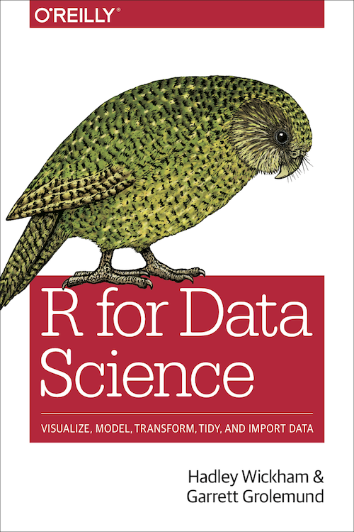
to know more…
https://github.com/ameztegui/dplyr_workshop
Cheatsheets
dplyr —> vignette(“introduction”)
tidyr —> vignette("tidy-data")
joins —> vignette(“two-table")
use with databases —> vignette("databases")
http://r4ds.had.co.nz/

