Slide 1

AUTHOR BOOKS APPLICATION
Team Members(Batchno:7471) GUIDE NAME
M.DEEKSHA Mrs. Pooja Menhta
ASMITHA REDDY

Slide 2
AGENDA
Introduction
Hardware and software requirements
System Architecture
Module description
UML Diagrams
Annotations description
Output Screenshots
Future Enhencement

Slide 3
AUTHOR BOOKS APPLICATION
INTRODUCTION
Author Books Application is useful to all learners.it will show the best way for learning to learners
In this Author Books Application I implemented onetomany and manytoone mappings .Concept is one author(scientist) can write many books(onetomany)
Many books list have one Author(manytoone)
Use of my project is we now histroy of the Scientist ,if we know the good Author then only we get knowledge or we understand concept clearly.

Slide 4
One-To-Many Mapping: The One-To-Many mapping comes into the category of collection-valued association where an entity is associated with a collection of other entities. Hence, in this type of association the instance of one entity can be mapped with any number of instances of another entity. @OneToMany Example In this example, we will create a One-To-Many relationship between a Author and Books in such a way that one Author will write more than one books.

Slide 5
Many-To-One Mapping: The Many-To-One mapping represents a single-valued association where a collection of entities can be associated with the similar entity. Hence, in relational database any more than one row of an entity can refer to the similar rows of another entity. @ManyToOne Example In this example, we will create a Many-To-One relationship between a Books and Author in such a way that more than one Books can write the same Author.

Slide 6
SYSTEM REQUIREMENTS:
2.1 HARDWARE REQUIREMENTS:
System : Intel i5 6 core.
Hard Disk : 500 GB SSD.
Monitor : 15’ LED
Input Devices : Keyboard, Mouse
Ram : 32 GB.
2.2 SOFTWARE REQUIREMENTS:
Operating system : Windows 10.
Tool : Spring Boot
Backend : MySQL

Slide 7
Spring Boot
It’s a open source java-based framework
For large website application must &should we required spring framework, like
>Amazon
>bank application
Advantages:
Light weight
Aspect oriented
Inversion of control

Slide 8
MySQL
MySQL is a database management system.
It may be anything from a simple shopping list to a picture gallery or the vast amounts of information in a corporate network.
To add, access, and process data stored in a computer database, you need a database management system such as MySQL Server.

Slide 9
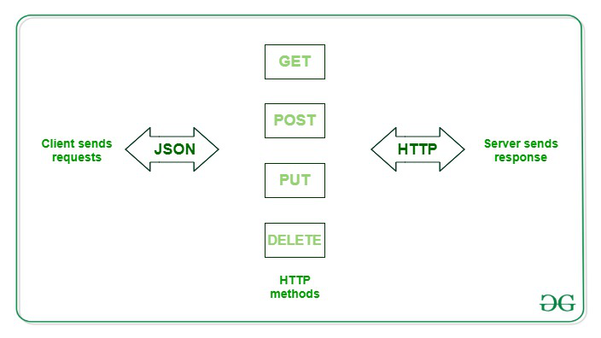
POSTMAN
RESTAPI PROCESS DIAGRAM:

Slide 10
Postman is an API client that makes it easy for developers to create, share, test and document APIs. With this open-source solution, users can create and save simple and complex HTTP/s requests, as well as read their responses.

Slide 11
SYSTEM ARCHITECTURE:
Entity
Repository
Service
Controller
BOOK
BOOK
Add data using postman
Display data
Update data
Delete,search

Slide 12
MODULES
Modules Are:
Entity:
An entity is an object, element, or ‘thing’ with particular attributes that distinguish it. For example, it could be a ‘user’ of which we need to know its attributes such as names, age, email, etc.
Repository:
Spring @Repository annotation is used to indicate that the class provides the mechanism for storage, retrieval, search, update and delete operation on objects.

Slide 13
Service:
Spring boot service component is defined as a class file that includes the @Service annotation and allows developers to add business functionalities. The annotation is used with the classes that provide these business functionalities.
Controller:
The @Controller annotation indicates that a particular class serves the role of a controller. Spring Controller annotation is typically used in combination with annotated handler methods based on the @RequestMapping annotation. It can be applied to classes only. It's used to mark a class as a web request handler

Slide 14
USECASE DIAGRAM
Describe the high level
Functions &scope of the
system
Add details
Get details
Update
details
Delete
details
Books
Author
Search
details

Slide 15
ER DIAGRAM
bookId
authorId
author
Name
bName
experience
onetomany
Author
Books
price
about
author
Content
status

Slide 16
Annotations Description
@Service: It is also used at class level. It tells the Spring that class contains the business logic.
@RestController: It can be considered as a combination of @Controller and @ResponseBody annotations. The @RestController annotation is itself annotated with the @ResponseBody annotation. It eliminates the need for annotating each method with @ResponseBody.
@Repository: It is a class-level annotation. The repository is a DAOs (Data Access Object) that access the database directly. The repository does all the operations related to the database.
@RequestMapping: It is used to map the web requests. It has many optional elements like consumes, header, method, name, params, path, produces, and value. We use it with the class as well as the method.

Slide 17
@GetMapping: It maps the HTTP GET requests on the specific handler method. It is used to create a web service endpoint that fetches It is used instead of using:@RequestMapping(method = RequestMethod.GET)
@PostMapping: It maps the HTTP POST requests on the specific handler method. It is used to create a web service endpoint that creates It is used instead of using: @RequestMapping(method = RequestMethod.POST)
@PutMapping: It maps the HTTP PUT requests on the specific handler method. It is used to create a web service endpoint that creates or updates It is used instead of using: @RequestMapping(method = RequestMethod.PUT)

Slide 18
@DeleteMapping: It maps the HTTP DELETE requests on the specific handler method. It is used to create a web service endpoint that deletes a resource. It is used instead of using: @RequestMapping(method = RequestMethod.DELETE)
@RequestBody: It is used to bind HTTP request with an object in a method parameter. Internally it uses HTTP MessageConverters to convert the body of the request. When we annotate a method parameter with @RequestBody, the Spring framework binds the incoming HTTP request body to that parameter.@ResponseBody: It binds the method return value to the response body.
@RequestParams :extract values from the query string,
@PathVariables :extract values from the URI path:

Slide 19
@Autowired in spring boot is used to auto-wire a bean into another bean.
@PathVariable is a Spring annotation which indicates that a method parameter should be bound to a URI template variable. It has the following optional elements: name - name of the path variable to bind to. required - tells whether the path variable is required.

Slide 20
@Entity: annotation specifies that the class is an entity and is mapped to a database table.
@Table: annotation specifies the name of the database table to be used for mapping.
@Id :annotation specifies the primary key of an entity @GeneratedValue: If we want to automatically generate the primary key value, we can add the @GeneratedValue annotation. This can use four generation types: AUTO, IDENTITY, SEQUENCE and TABLE.

Slide 21
@JoinColumn: Specifies a column for joining an entity association or element collection. If the JoinColumn annotation itself is defaulted, a single join column is assumed and the default values apply. (Optional) The SQL fragment that is used when generating the DDL for the column.

Slide 22
Validation annotations
@NotNull: It determines that the value can't be null.
@Min: It determines that the number must be equal or greater than the specified value.
@Max: It determines that the number must be equal or less than the specified value.
@Size: It determines that the size must be equal to the specified value.
@Pattern:It determines that the sequence follows the specified regular expression.

Slide 23
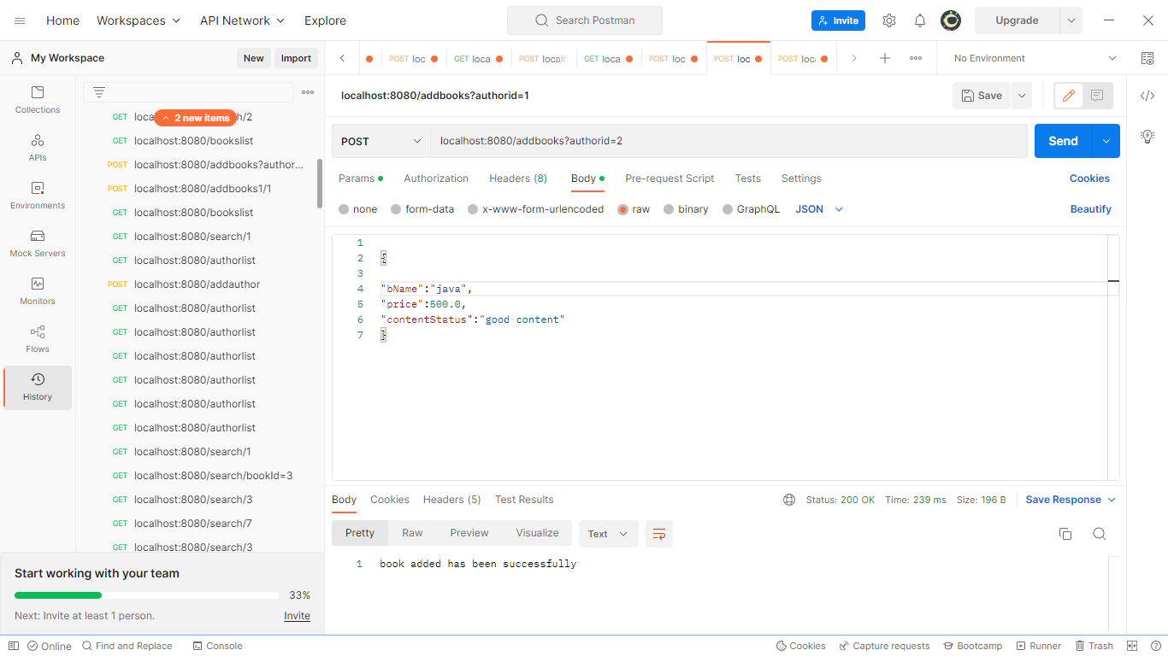
Output Screens
postman outputscreen

Slide 24
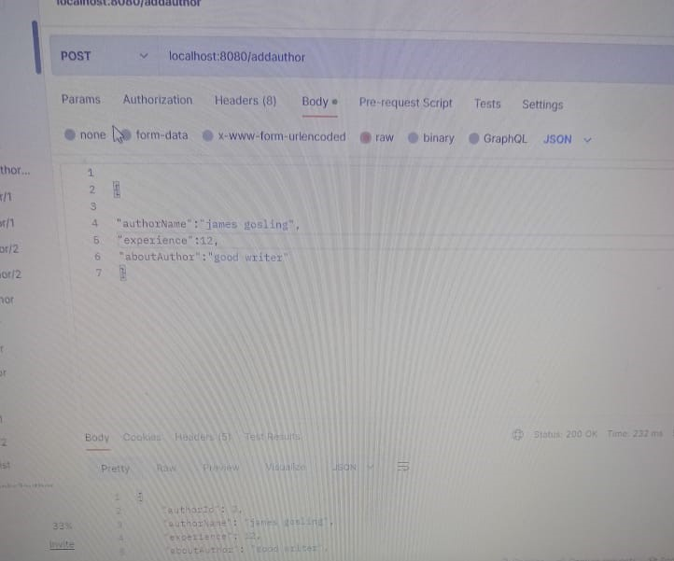

Slide 25
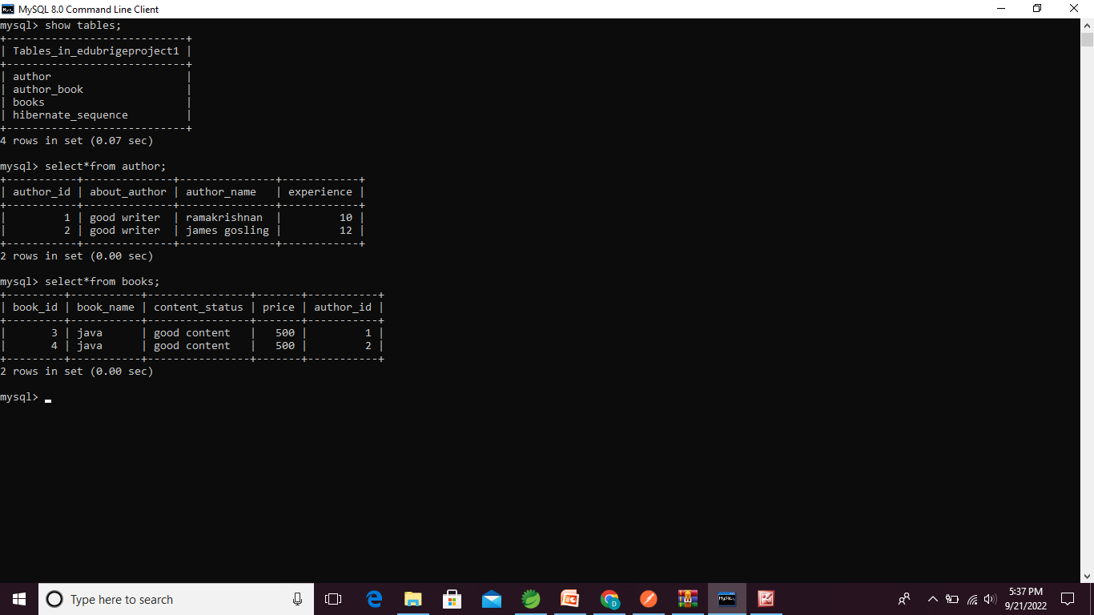
My SQL OutputScreen

Slide 26
FutureEnhencement
We will update the books ontime //uptodate
And we will create admin page for books and authors
This project is usefull for students,beacause if they know best Author ,then content understanding for students very easy

Slide 27


