Slide 1

IWA19 Capstone Project
By MALLEG088 in PTO2303 Group B

Slide 2
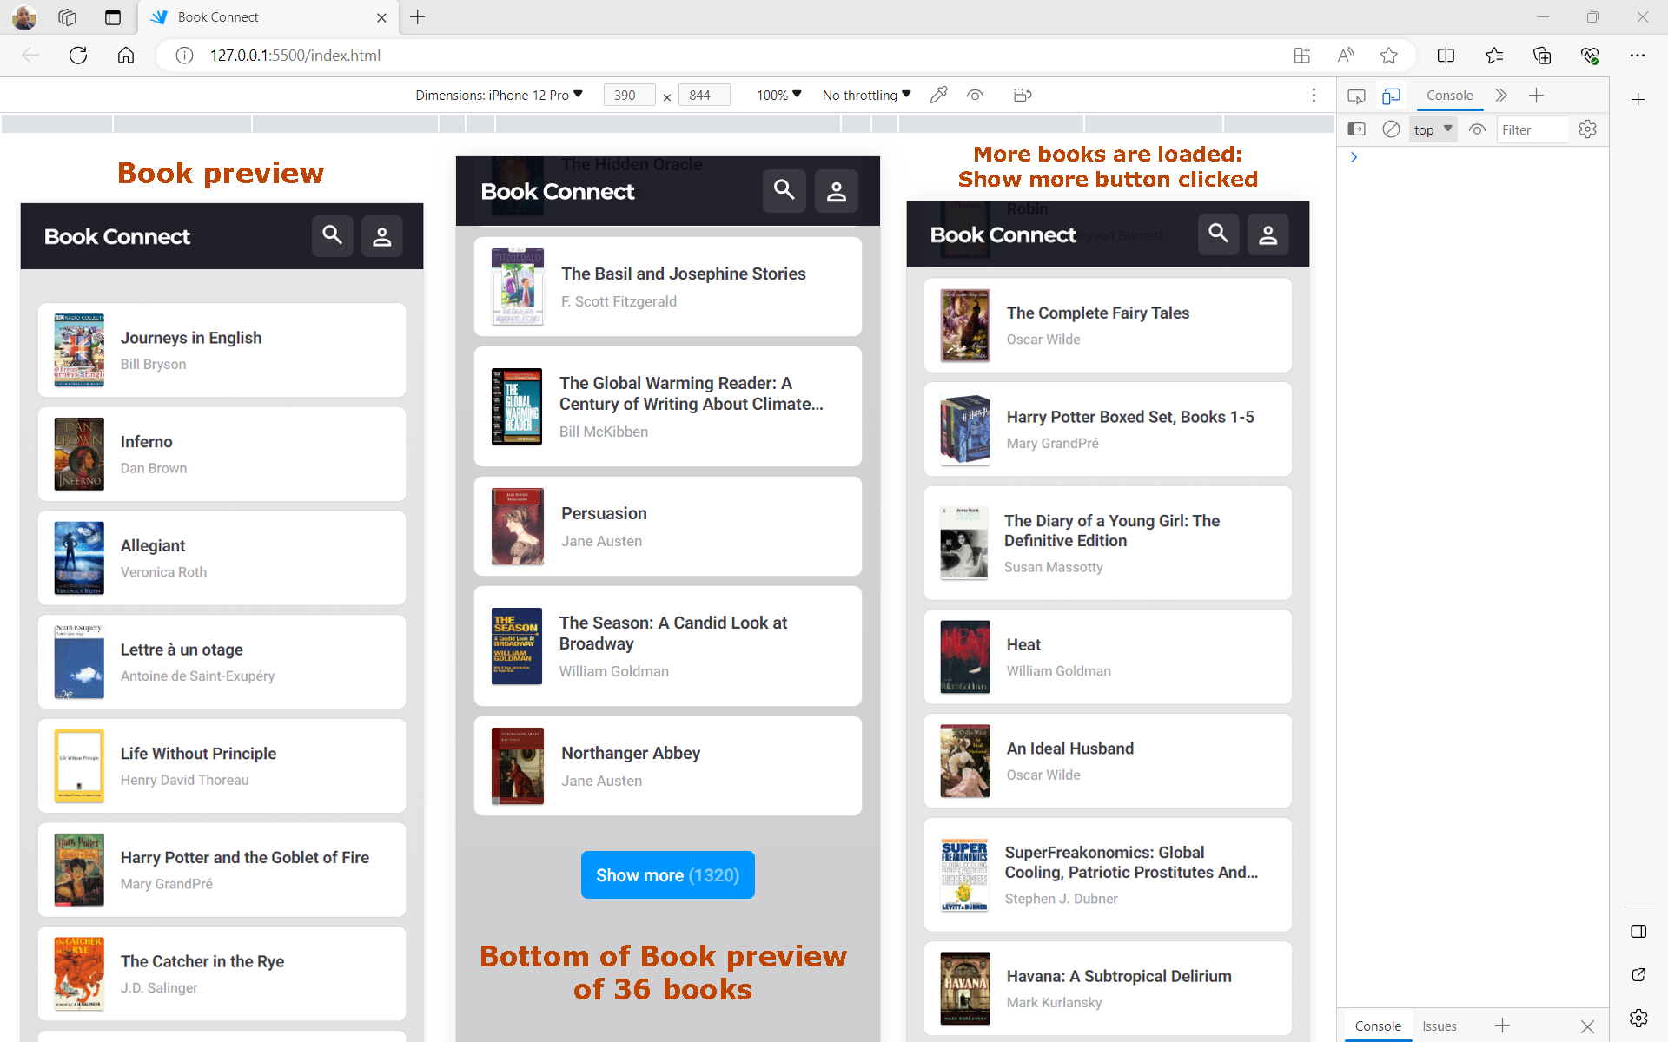
Table of Content
Project Overview
Errors and Fixes
Challenge
Code Snippets and Screenshots
Conclusion
Questions and Answers

Slide 3
Project Overview
Problem Statement
Requirements: App’s intended behaviour
Currently, the App throws several errors preventing the code from running. The goal is to do a full audit of the existing code and fix all critical issues by meeting all requirements of the prioritised user stories. The user stories express the product’s intended behaviour.
Users should be able to scroll through the displayed list of book previews. Each book should display associated image, title, and author. Users should also be able to click on each book to view a summary of the book with the title, author, and published date. Using the search icon, users should be able to search for books by text phrases or author or genre. Lastly users should also be able to set theme mode between dark and light modes.

Slide 4
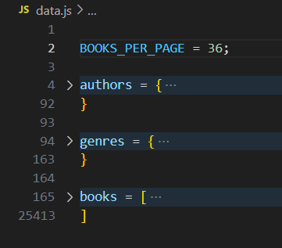
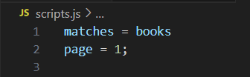

Errors and fixes
In total, there were 41 errors that need to be fixed.
Data objects are turned into a module by adding exports statements. inside the scripts.js, the destructured from the exports of the data.js by importing them.
All undeclared variables were fixed by adding const to them and extracted variable was declared as a global scope variable then later in the search filter code, it was redeclared with an attempt to change its value.

Slide 5
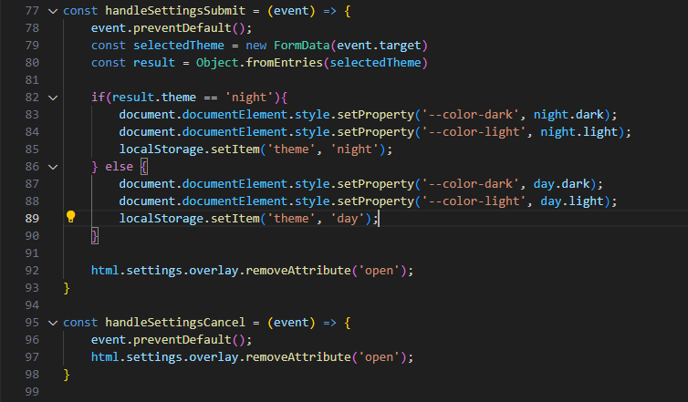
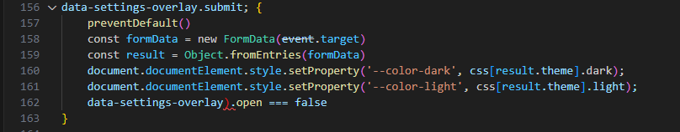
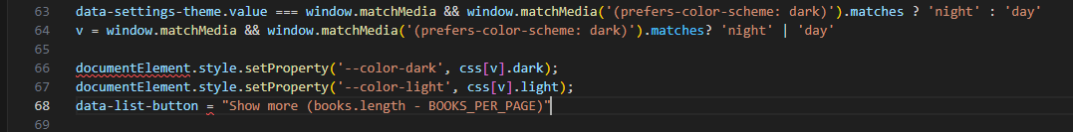
Challenges and solutions
The biggest challenge amongst others, was making sense of what they were trying to do in setting the theme (theme code):
To stop the title, subtitle, and the image from being clickable. All elements of each returned card were clickable instead of the card element being the clickable object.
I had to touch the stylesheet because it was leading to unpredictable behavior which was not the intended behavior.

Slide 6
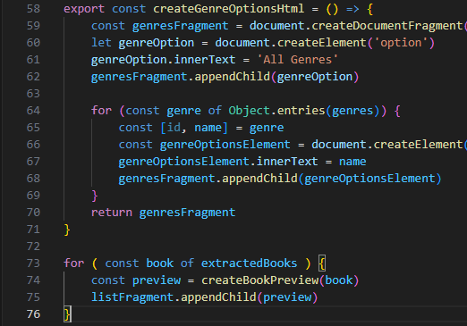
Code Snippets and Screenshots
When visiting this URL, the user is presented with a list of 36 book previews with the Day theme set by default. Using the ’Show more’ button at end of the 36 book previews, users can load more books. Each book is displayed with an associated image, title, and author.

Slide 7
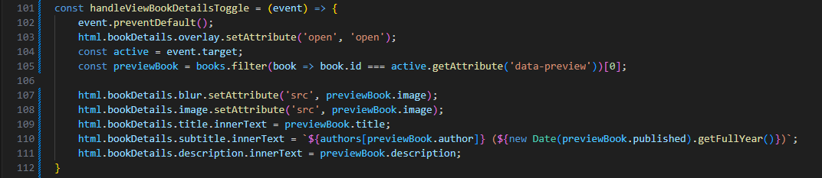
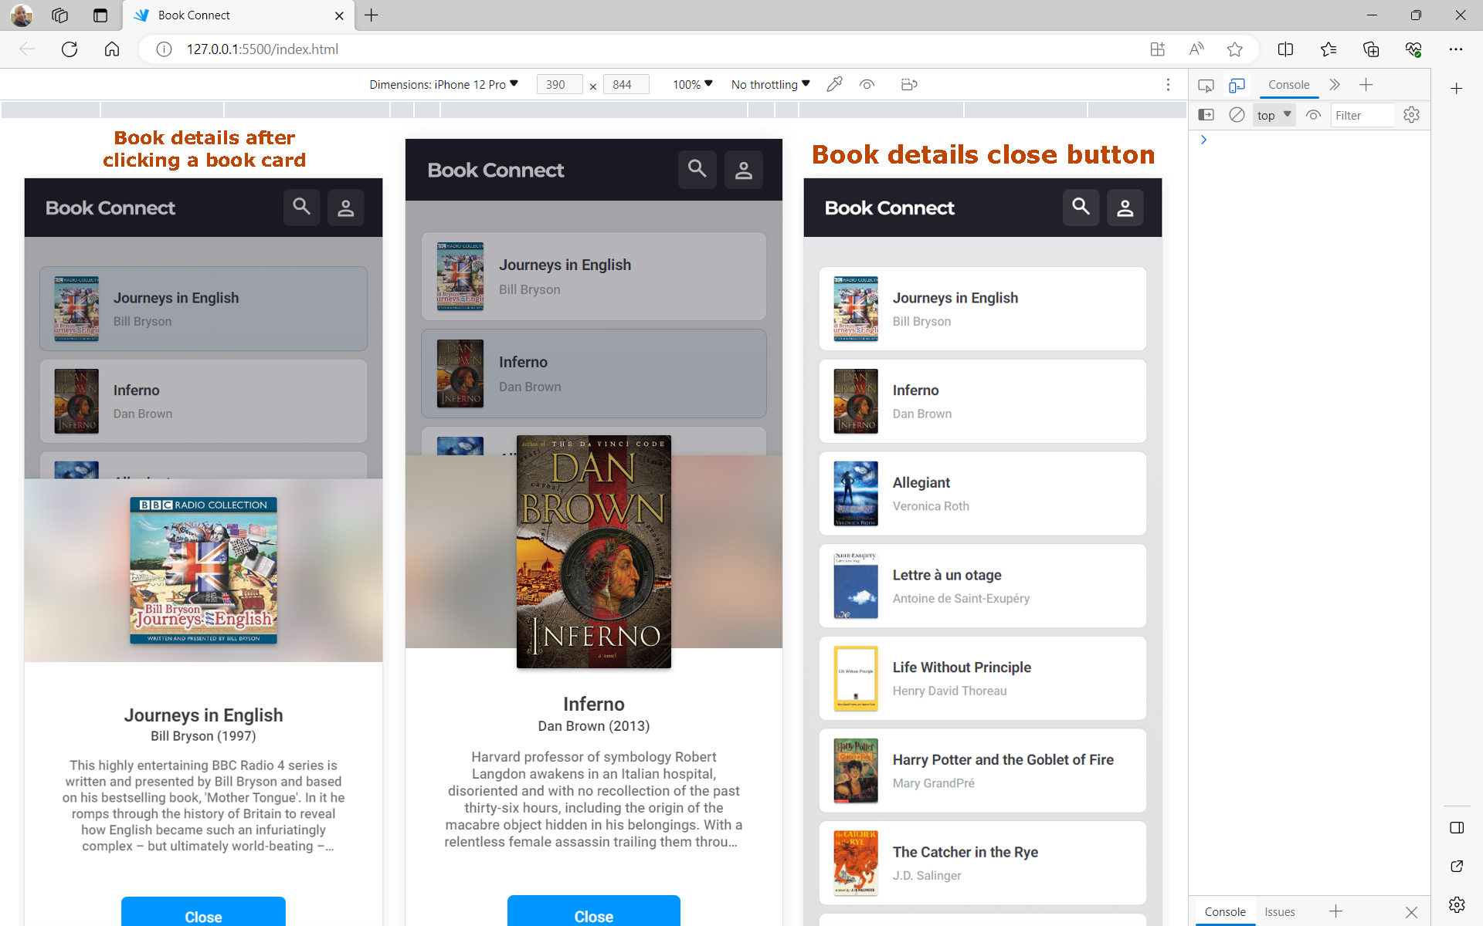
Code Snippets and Screenshots
Clicking on each book opens up its details in an overlay. On the overlay, users can see the title, author, and published date, and a summary of the book.

Slide 8
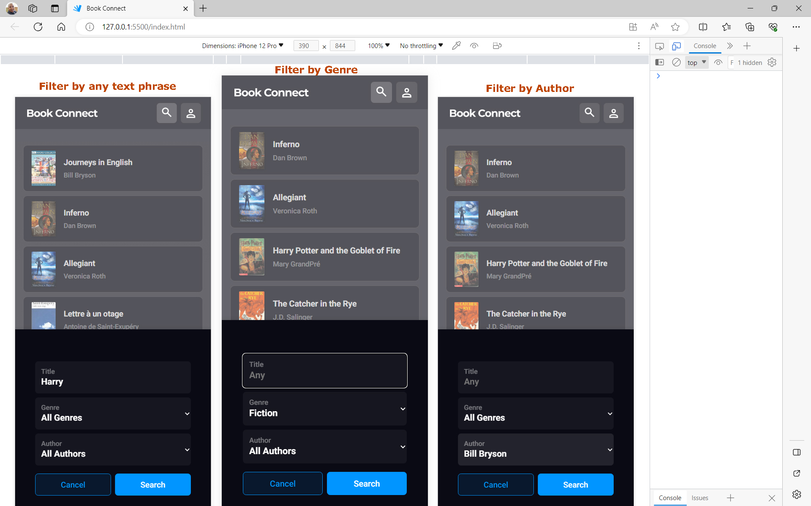
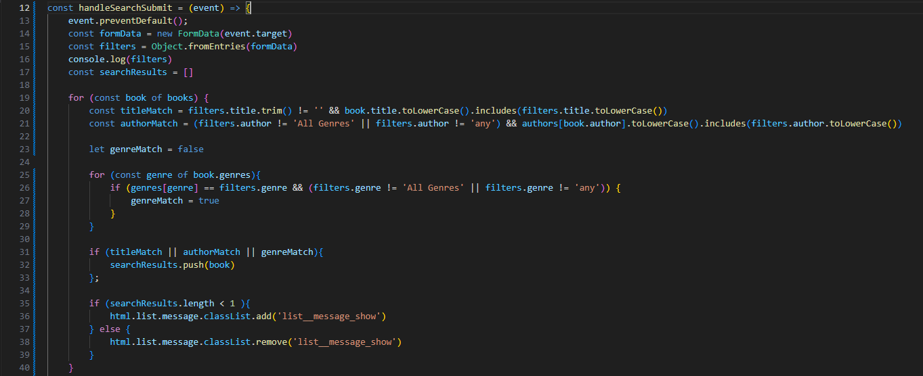
Code Snippets and Screenshots
Clicking on the search icon opens up the Filter overlay. On the overlay, ‘All authors’ and ‘All genres’ are selected by default and users can use text phrases or a key search term to narrow their search for books. They can also select an author or genre from their respective filter fields to search for books by either an author or genre.

Slide 9
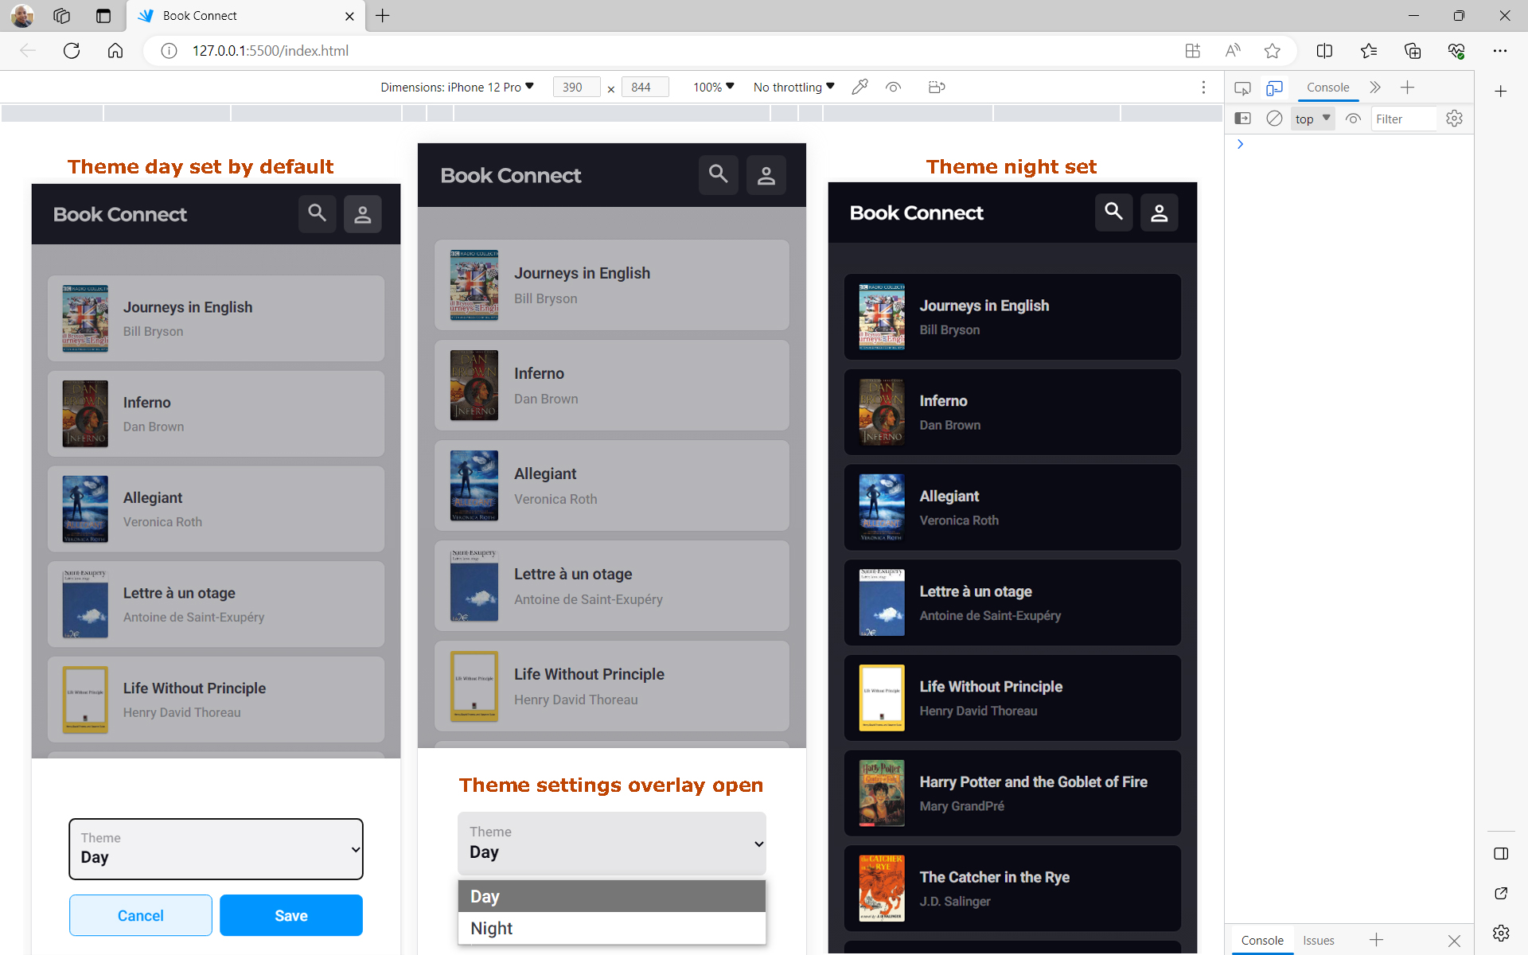
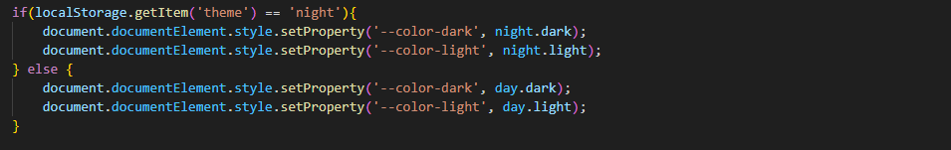
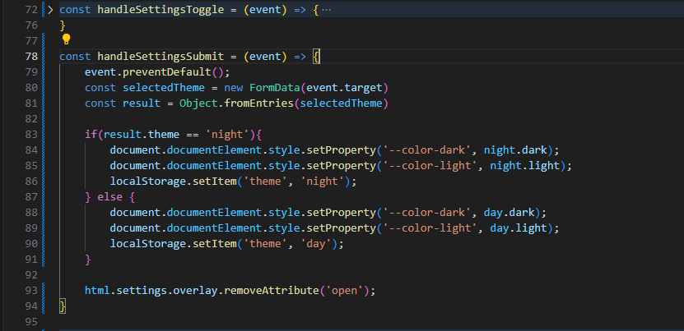
Code Snippets and Screenshots
Clicking on the search icon opens up the Filter overlay. On the overlay, ‘All authors’ and ‘All genres’ are selected by default and users can use text phrases or a key search term to narrow their search for books. They can also select an author or genre from their respective filter fields to search for books by either an author or genre.

Slide 10
conclusion
`console.log()` was used to debug as I was coding along to make sense of the code presented to me.
To get the data for each book, I turned the `data.js` into a module by adding exports statements to our data objects. I then created a new `view.js` that deals with anything related to the DOM, then used the exports in our main `scripts.js` and `view.js` file as imports to make them available for use.
I opted to use “for” loops to iterate through data, to create the book preview, present only the first 36 to the user on initial load with the Show more button to load more books showing number of remaining books.

Slide 11


Questions and Answers

