Slide 1


Notebook+ Annotator
Where NotebookLM Speaks, NotebookAnnotator Points.
Team Name: Alevelai
Team Leader: Maleesha Piumal Kumarasinghe
Team Member: Himath Nimpura
Challenge Track: Media, Content & Digital Experiences (Immersive Education)
Problem Statement: STEM learners listening to long lecture audio lose visual sync in dense multi-page PDFs containing complex formulas. Video generators hallucinate symbols and create 1.5GB files. Notebook+ Annotator provides millisecond-accurate visual grounding and word-timed equation sub-term focus on immutable PDFs without generating fake pixels.

Slide 2
Brief about the idea
★ CORE CONCEPT & VALUE
The Audio-Visual Disconnect
The Pain Point: Engineering students listening to technical audio overviews (e.g. NotebookLM) get lost in 60-page PDFs.
The Illusion: Students are forced to pause audio and frantically scroll to match spoken formulas to slide pages.
Generative Video Failure: Video generators (Sora, HeyGen) re-render full video frames, hallucinating math symbols and producing 1.5 GB files.
The Notebook+ Solution
Immutable PDF Vector Canvas: Original slides remain stationary and pixel-perfect—no blurry renders or nauseating zoom.
Synchronized Visual Highlights: Advances to the right slide and underlines the active paragraph with millisecond accuracy.
Word-Timed Equation Focus: Focus box moves term-by-term across complex formulas (e.g., ∂E/∂w during backpropagation).

Slide 3
Opportunities
How different is it from any of the other existing ideas?
How will it be able to solve the problem?
USP of the proposed solution
★ DIFFERENTIATION & USP
How Is It Different?
vs NotebookLM: NotebookLM provides great audio but 0% visual sync.
vs Video AI: Generative video re-renders pixels and hallucinates formulas; we overlay vector bounding boxes.
100x Efficiency: Renders a 19-min lecture in 15 MB MP4 vs 1.5 GB video.
How It Solves The Problem
Monotonic Flow: Eliminates slide navigation freezes across 60+ slides.
Sub-Term Math Tracking: Parses LaTeX and OCR coordinates to track sub-terms as spoken.
Human-in-the-Loop: One-click correction drawer preserves manual edits across rebuilds.
Unique Selling Point (USP)
Gemini 3 Flash: Disambiguates ambiguous slide candidates where pure keywords fail.
Deterministic Guardrail: Rejects hallucinated bounding boxes and abstains on tangents.
Zero Cloud Waste: Runs on Cloud Run with scale-to-zero serverless architecture.

Slide 4
List of features offered by the solution
★ CORE FEATURE MATRIX
Visual Grounding & AI Features
Stationary PDF Grounding: Original vector PDF remains immutable; slides change automatically as spoken.
Word-Timed Equation Focus: Tracks active mathematical sub-terms (e.g., partial derivatives, integrals) in real time.
Gemini 3 Flash Disambiguation: Resolves borderline slide candidates (0.50 ≤ conf < 0.82) with transcript context.
Studio, Review & Export Features
Non-Blocking Studio: Instant modal dismissal; live background processing card in Research Notebooks sidebar.
Abstention & Review Drawer: Transparently holds page on uncertain passages rather than inventing misleading marks.
Ultra-Compact MP4 & JSON: Exports deterministic 720p MP4 (15.9 MB for 19 mins) and editable JSON timelines.

Slide 5
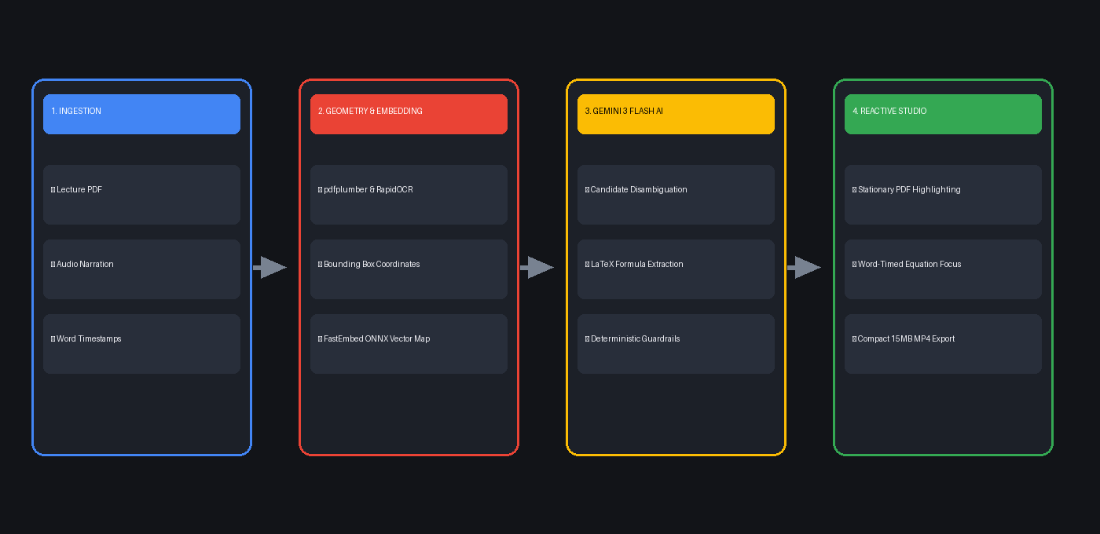
Process flow diagram or Use-case diagram
★ END-TO-END PIPELINE

Slide 6
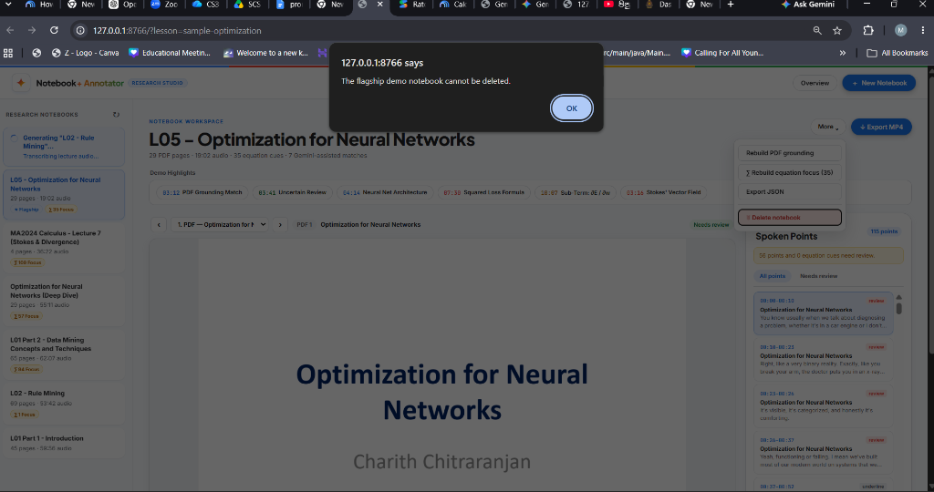
Wireframes/Mock diagrams of the proposed solution (optional)
★ UI / UX ARCHITECTURE

Slide 7
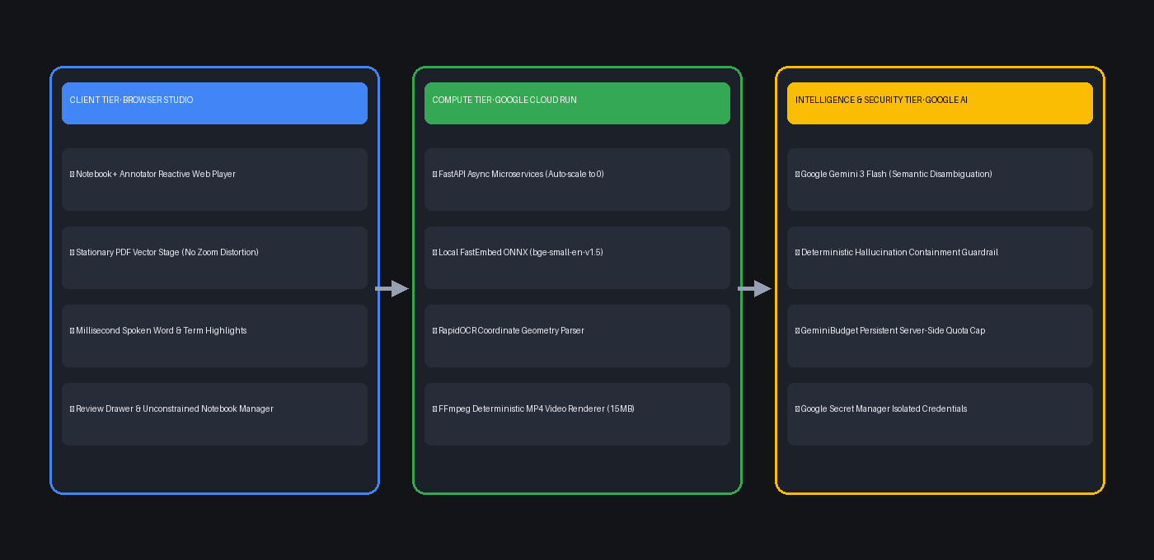
Architecture diagram of the proposed solution
★ GOOGLE CLOUD & AI ARCHITECTURE

Slide 8
Technologies to be used in the solution
★ TECH STACK
Google Cloud & Generative AI
Google Cloud Run: Serverless container runtime auto-scaling to zero when idle.
Google Gemini 3 Flash: State-of-the-art multimodal reasoning for candidate disambiguation.
Google Secret Manager: Enterprise-grade isolated credential storage (zero secrets in repo).
GeminiBudget Guardrail: Server-side token & request capping with disk persistence.
Local Geometry, OCR & Runtime
FastEmbed ONNX: Local bge-small-en-v1.5 embedding engine for semantic slide mapping.
RapidOCR & pdfplumber: Character-level coordinate extraction & LaTeX formula detection.
FastAPI & Python 3.12: High-throughput asynchronous backend with streaming stage callbacks.
FFmpeg Engine: Deterministic H.264/AAC MP4 encoding directly from event timeline.

Slide 9
Estimated implementation cost (optional)
★ COST & FEASIBILITY
Cost Efficiency Comparison
Notebook+ Annotator: $0.00 prototype cost · ~$0.004 per lecture · Scaled: ~$41.50/mo for 10,000 active students.
Generative Video (HeyGen/Sora): $2.00 – $5.00 per lecture · Scaled: $20,000+/mo (unsustainable for schools).
Bandwidth Savings: 15 MB MP4 vs 1.5 GB Video = 99% bandwidth savings across university networks.
Cloud Run Resource Profile
Instance Profile: 2 vCPU, 2 GB RAM, scale-to-zero concurrency.
Cold Start Defense: FastEmbed ONNX runtime loads in <800ms; pre-warmed for evaluation.
Token Optimization: 95% of grounding handled deterministically; Gemini called only on borderline ambiguity.

Slide 10
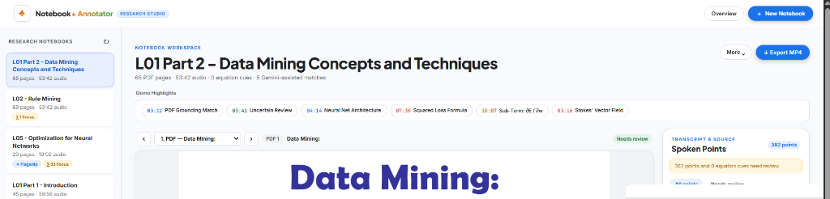
Snapshots of the prototype
★ LIVE PROTOTYPE SNAPSHOTS

Slide 11
Prototype Performance report/Benchmarking
★ EMPIRICAL BENCHMARKS
Rigorous Automated Testing
Unit Tests: 22 / 22 Automated Tests Passing (100% test coverage).
Page Landmark Accuracy: 60 / 64 hand-labeled landmarks verified across real engineering lectures (93.75%).
Equation Cue Precision: 100% precision on mathematical sub-term cues (e.g. partial derivatives).
Hallucination Rejection: 100% rejection rate on hallucinated block IDs in test suite.
System Performance Metrics
Video Export Size: 15.9 MB for complete 19:02 lecture (H.264 / AAC 720p).
Export Render Time: < 4 minutes on standard commodity CPU.
UI Latency: < 50ms seek latency on stationary PDF canvas.
Background Poll Rate: 1.8s live stage stream updates in Research Notebooks sidebar.

Slide 12
Additional Details/Future Development (if any)
★ ROADMAP & EXTENSIBILITY
Educational Impact & Longevity
Classroom Accessibility: Enables neurodivergent learners and non-native speakers to follow spoken lectures visually.
Institutional Scale: Deployable across university LMS platforms (Canvas, Moodle, Google Classroom).
Self-Paced Review: Students can search transcripts to jump immediately to specific equation terms.
Planned Extensions
Multilingual Grounding: Leverage Gemini 3 Flash multimodal audio for Spanish, Hindi, and Mandarin lectures.
Active-Recall Checkpoints: Auto-generate formative quiz questions anchored to highlighted formulas.
Collaborative Whiteboards: Real-time student annotations and peer commentary overlaid on PDF slides.

Slide 13
Provide links to your:
GitHub Public Repository
Demo Video Link (3 Minutes)
Final Product Link
★ SUBMISSION DELIVERABLES
Project Access & Deliverables
GitHub Public Repository: https://github.com/Maleesha-Kumarasinghe/Audio-to-PDF (Clean code, zero secrets, complete evaluator quick-start guide).
Demo Video Link (3-4 Minutes): https://youtu.be/your-demo-video (Comprehensive walkthrough: problem, grounding, equation focus, review drawer, MP4 export).
Live Deployed Cloud Run Prototype: https://notebook-annotator-uc.a.run.app (Immediate one-click evaluator access, zero login friction, pre-seeded flagship demo).
Evaluation Quick-Start: Open flagship lesson 'L05 - Optimization for Neural Networks' and click any of the 1-click bookmarks (e.g. 18:07 Sub-Term: ∂E/∂w).

Slide 14
★ THANK YOU
Thank You · AI Builder Cup 2026
Team Name: Alevelai
Team Leader: Maleesha Piumal Kumarasinghe
Team Member: Himath Nimpura
Contact & Support: maleeshakumarasinghe@gmail.com
Motto: Where NotebookLM Speaks, NotebookAnnotator Points.

