Slide 1

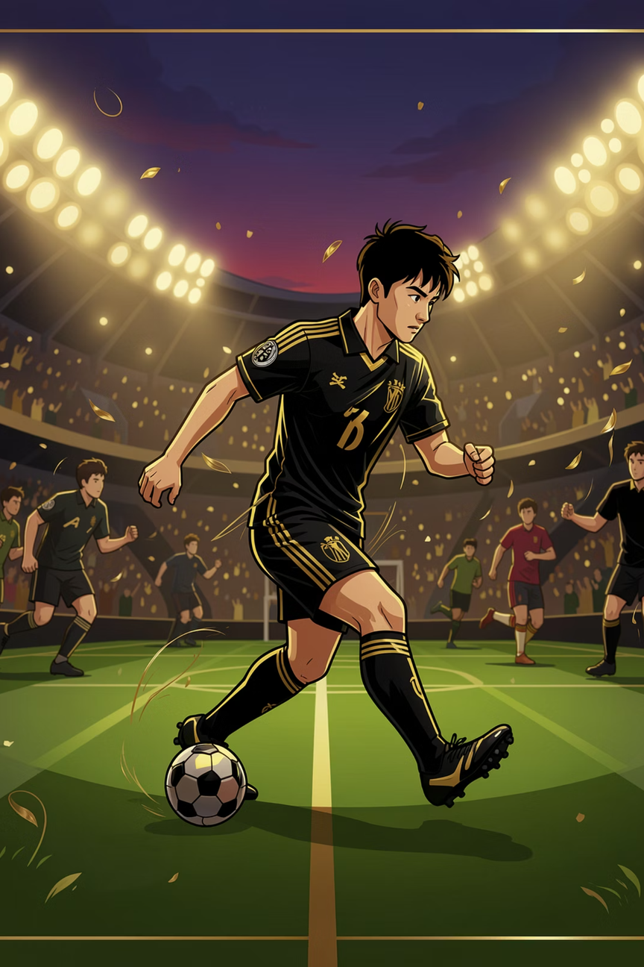
Football
Player Tracking System
Image Processing Assignment
N.H.M.S. De Silva
Index: ASP/2023/112
Notes:
1

Slide 2
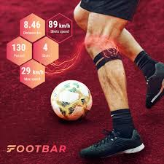
Introduction
Detect and track a single football player in a video
Convert video into multiple frames (images)
Segment the player from the background
Use a tracking algorithm to follow the player
Implemented using Python and OpenCV
Notes:
2

Slide 3
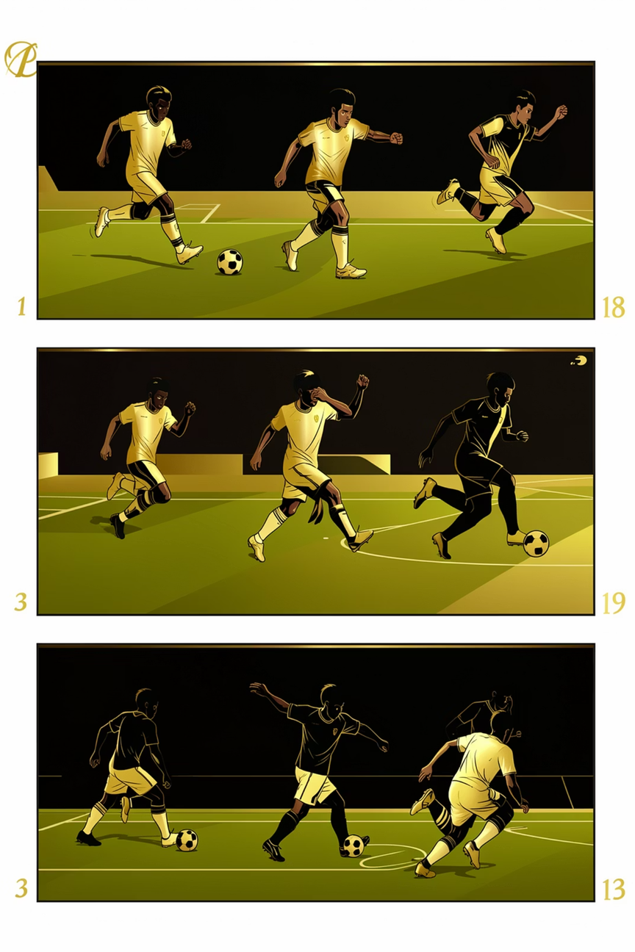
Objectives
Frame Extraction
Extract individual frames from a short football clip for per frame analysis.
Image Enhancement
Improve visual quality (contrast, noise reduction) so detectors perform better.
Segmentation
Separate the target player from background using background subtraction and masks.
Tracking & Analysis
Track the selected one player across frames.
Notes:
3

Slide 4
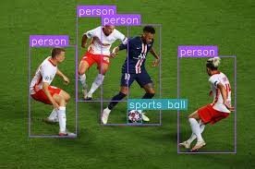
Tools & Technologies
Python
OpenCV (cv2)
NumPy
Jupyter Notebook
GitHub
Notes:
4

Slide 5
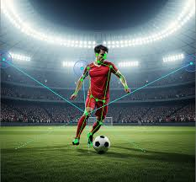
Video & Frame Extraction
Short video (2–5 seconds) downloaded from YouTube
Video opened using cv2.VideoCapture()
Frames read one by one (sequentially)
Each frame saved as .jpg image
Frame sampling rate is selected carefully
Balances quality (details) and processing speed
Notes:
5

Slide 6
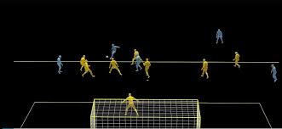
Image Enhancement
Convert to grayscale to simplify processing.
Apply Gaussian blur to reduce high-frequency noise.
Use CLAHE (adaptive histogram equalization) to boost local contrast.
Apply a sharpening kernel to restore edge clarity for detection.
Enhancement increases signal to noise ratio so segmentation and trackers can perform reliably.
Notes:
6

Slide 7
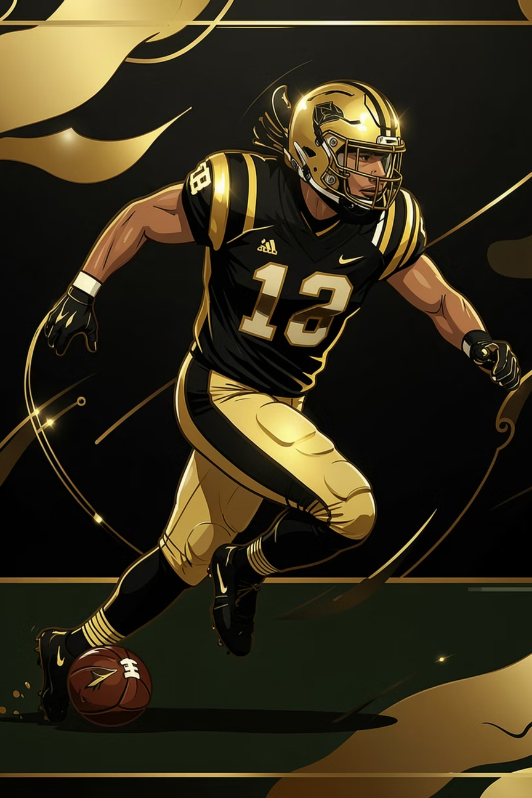
Segmentation
Compares current frame with background model
Detects moving objects (player)
Generates a binary mask (black & white image)
White = player (foreground)
Black = background
Uses morphological operations to improve mask
Erosion removes small noise
Dilation fills gaps and improves object shape
Notes:
7

Slide 8
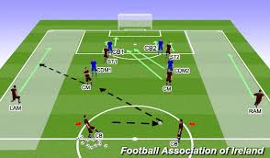
Player Tracking
Select target using a bounding box on one frame.
Initialize tracker
For each subsequent frame, update the tracker and redraw the bounding box.
Optional: combine mask-based detections to reinitialize tracker if it drifts.
Simple visual feedback: green rectangle shows real-time tracking.
Notes:
8

Slide 9
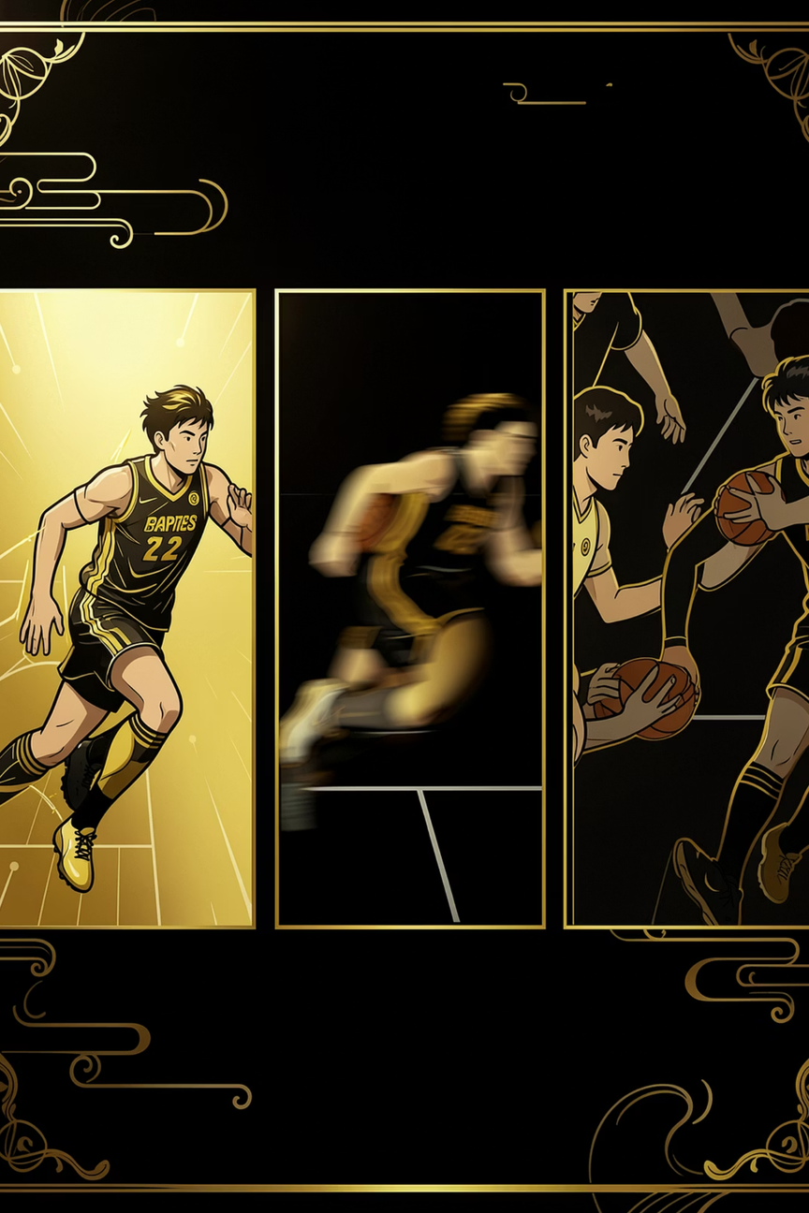
Results & Challenges
Results
Tracking succeeded in controlled scenes with clear contrast. Image enhancement measurably improved detection rates.
Challenges
Fast motion causes motion blur and tracking loss.
Camera movement (panning/zoom) confuses background subtraction.
Multiple players in close proximity cause identity swaps.
Notes:
9

Slide 10
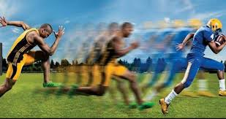
Conclusion & Next Steps
System can track one football player successfully
Works well in simple conditions
Uses basic image processing techniques
Results are reliable for short videos
Performance can be improved further
Enhancements can increase accuracy and robustness
Use AI based detectors (e.g., YOLO) for robust player detection and multi player re identification.
Notes:
10

Slide 11
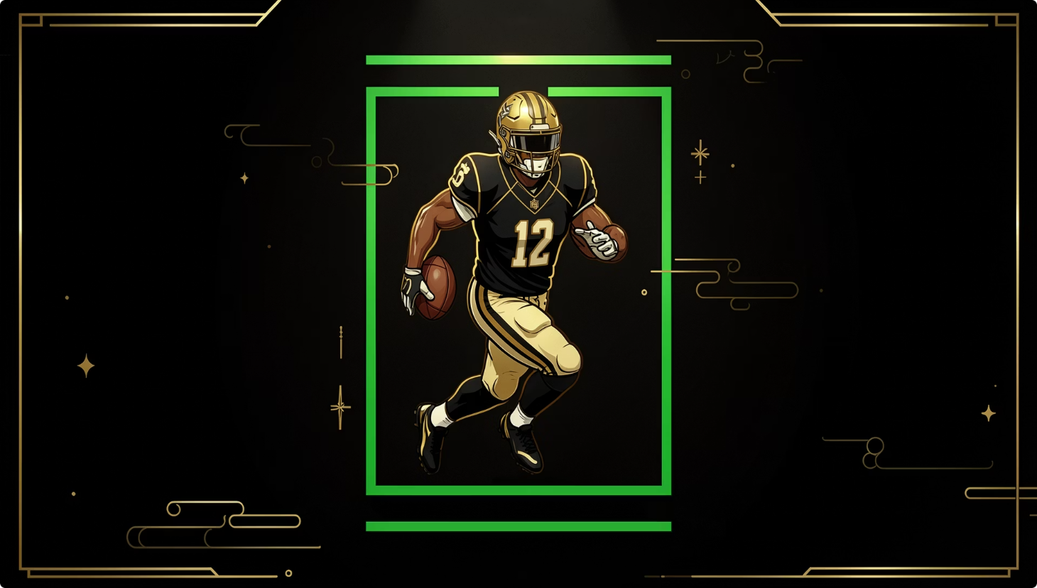
Thank You !
This project shows basic image processing can be used for sports analysis.
Notes:
10

