Slide 1
Snort lab
Snort is a powerful open-source network intrusion detection and prevention system (IDS/IPS).
t can be used for real-time traffic analysis, packet logging, and detecting a wide range of malicious activities on your network.
Capabilities:
Packet Capture: Like a tcpdump, Snort can capture network traffic, allowing you to analyze individual packets for suspicious content.
Protocol Analysis: Snort understands various network protocols and can dissect their contents to identify potential threats.
Content Matching: Snort uses a rule-based system to compare network traffic against predefined rules that flag malicious activity. These rules can target specific protocols, payloads, or network anomalies.
Alerting & Logging: Snort generates alerts when it detects suspicious activity, notifying you of potential threats. It can also log traffic for later analysis and forensic investigation.
Intrusion Prevention (Optional): In addition to detection, Snort can be configured to actively block identified threats by dropping packets or redirecting them.

Slide 2
Deployment Modes:
1-Packet Sniffer: For passive monitoring and traffic analysis.
2-IDS: Alerts about suspicious activity but doesn’t actively block threats.
3-IPS: Actively blocks identified threats based on predefined rules.

Slide 3
Benefits:
1)Open-source & Free: Accessible to individuals and organizations of all sizes.
2)Highly Customizable: Rule-based system allows for tailoring Snort to your specific needs and threats.
3)Lightweight & Efficient: Runs effectively on various systems, even with limited resources.
4)Widely Used & Supported: Large community and plenty of available resources.

Slide 4
Snort vs. IDS vs. IPS:
1-IDS: Intrusion Detection System. Focuses on identifying suspicious activity but doesn’t necessarily block it.
2-IPS: Intrusion Prevention System. Actively blocks identified threats based on predefined rules.
3-Snort: Can function as both an IDS and an IPS, depending on your configuration.
Overall, Snort is a versatile tool that can significantly enhance your network security posture. With its powerful capabilities and flexible deployment options, it’s a valuable asset for organizations of all sizes.
In this lab we have the Metasploit 2 & Snort

Slide 5
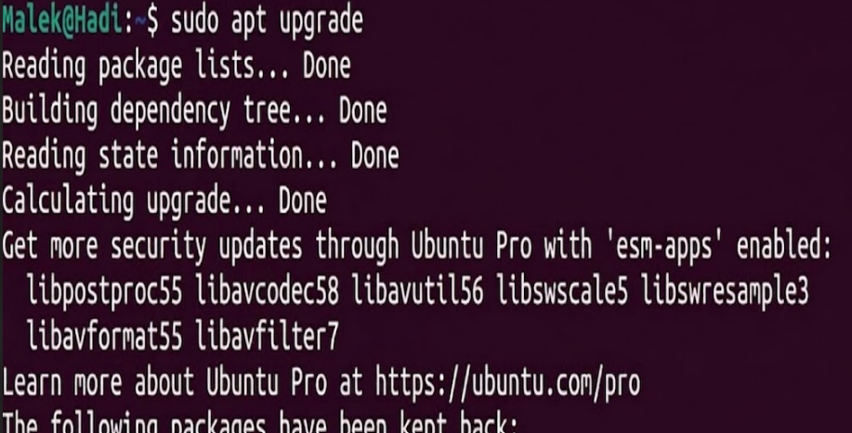
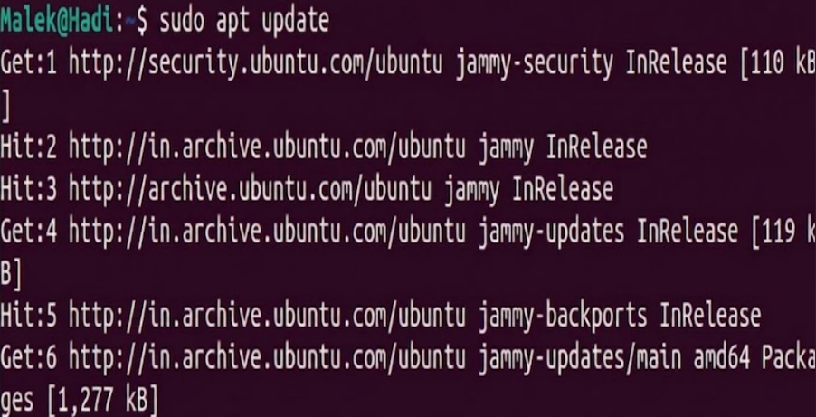
Setting up a Lab:
Steps Before Installation
Open Terminal and run some commands:
sudo apt update
sudo apt upgrade

Slide 6
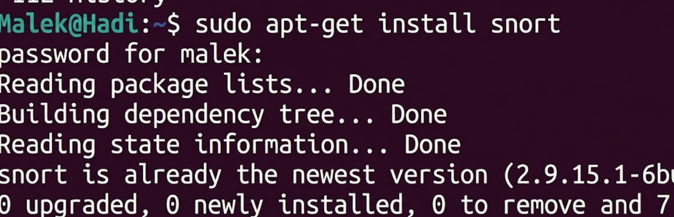
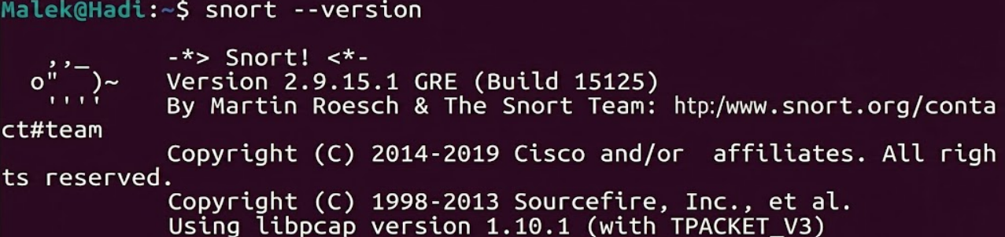
Installation on snort on Ubuntu Linux
Open command terminal
Paste the command
sudo apt-get install snort
Check snort is install or not by checking version
snort — version

Slide 7
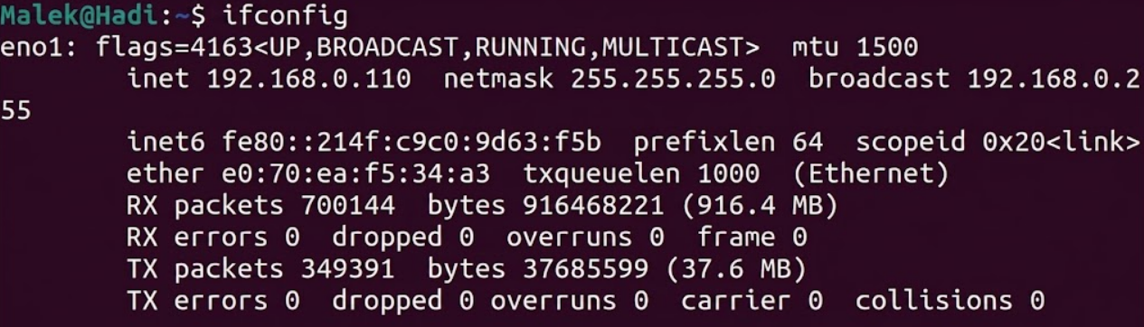
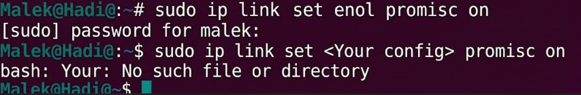
Check for your ifconfiig
Ifconfig
For me it is eno1 and ip address is 192.168.0.110
For turning on promisc ip type command
sudo ip link set <Your config> promisc on
Type your configuration in Your config

Slide 8
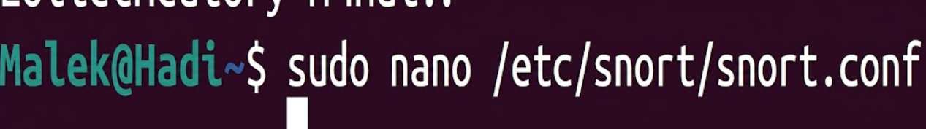
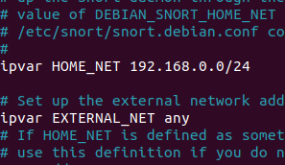
Go the the directory
sudo nano /etc/snort/snort.conf
Do some changes in file
ipvar “HOME_NET any “ will be shown change any to your ip address
192.168.0.0/24
Your ip address will be different
if your ip is 192.168.1.125 so type your ip as
192.168.1.0/24
Change last 3 digit as 0

Slide 9
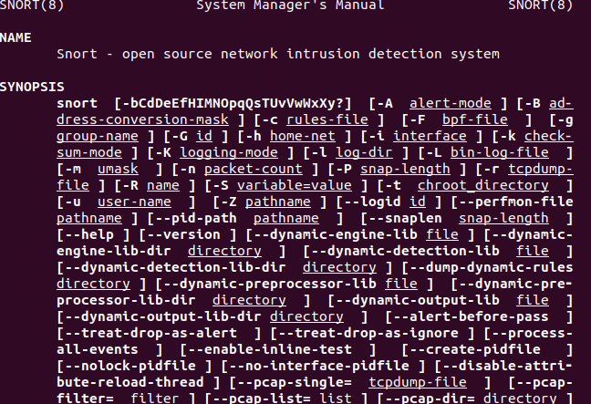
You can type man for getting information about snort.
man snort
Press q to exit

Slide 10
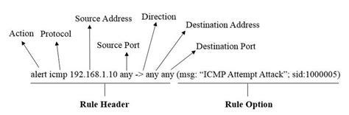
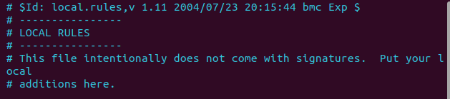
Writing Rules in Snort
Basic rules Can be written as the following
Enter Command
sudo vim /etc/snort/rules/local.rules
It will look like these
Enter some basic rules
press “ I ” insert then paste the command and press “esc” to exit insert.

Slide 11
alert icmp any any -> $HOME_NET any (msg :”ICMP Ping Detected”; sid: 100001; rev:1;)
Save the rule by pressing: :x
Type command for checking the logs
sudo snort -q -l /var/log/snort -i eno1 -A console -c /etc/snort/snort.conf
Type your config in the place of “eno1”.
If the console does not get any error the it is good
If it get error so please check what mistake you have done

Slide 12
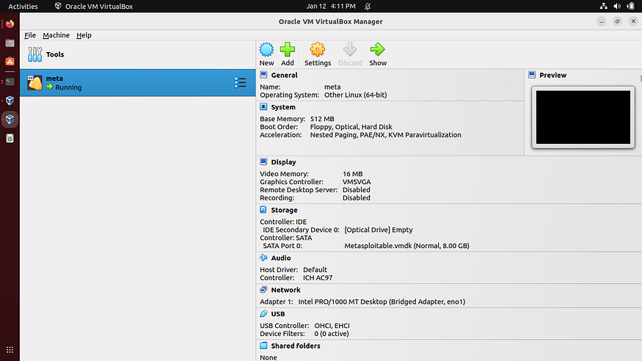
Run Metasploit 2

Slide 13
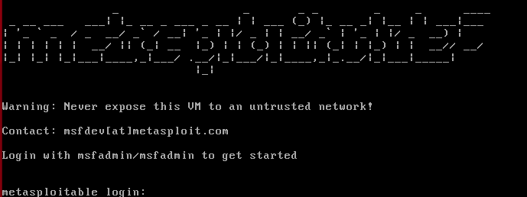
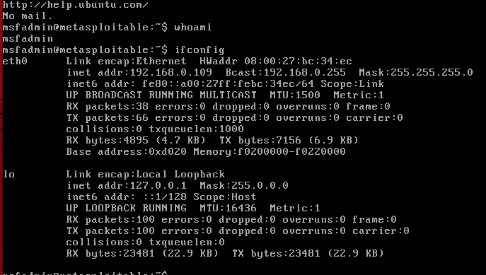
Type Command
Ifconfig

Slide 14
Open Terminal and type
sudo snort -q -l /var/log/snort -i eno1 -A console -c /etc/snort/snort.conf
Split the windows in two parts
Add Metasploit lab on Left side and terminal on Right side
Type ping command on the metasploit
ping google.com
Check whether the things are change on the terminal.

Slide 15
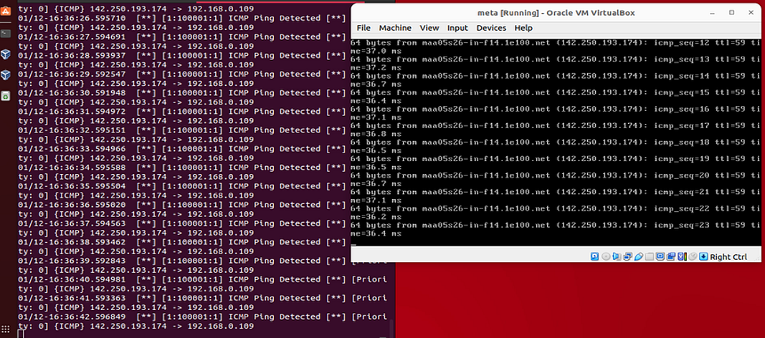
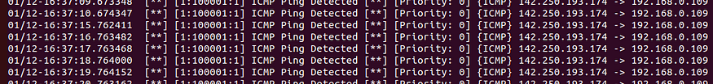

Slide 16
The logs are working.
We now get to know that some one is doing scan on our network.
By Malek Hadi

