Slide 1


Slide 2


Morshed: Smart Financial Advisor
Intelligent Transaction Analysis Agent
By: BioMed Squad
Date: 10/May/2025

Slide 3
Overview
Our solution is an AI-powered financial analysis agent designed to revolutionize retail transaction management in Jordan. By combining natural language processing (NLP) with autonomous workflow automation, the system enables users to query transaction data conversationally (e.g., “Show failed transactions at Z Mall last week”) and triggers automated actions like alerts, reports, and anomaly detection. Leveraging RAG (Retrieval-Augmented Generation) and SQL-based retrieval, the AI delivers precise insights while tools like Make (Integromat) or nSn execute responses in real time—such as sending branch managers daily digests or flagging unusual patterns. Integrated with Slack/Telegram, the solution offers on-the-go access, supports Arabic/English queries, and reduces manual analysis by 80%. Built with LangChain, vector databases (Weaviate/Pinecone), and LLMs, it aligns with the hackathon’s goals by enhancing accuracy, automation, and scalability for Jordan’s retail sector.

Slide 4
Problem
1- Manual transaction analysis is slow and error-prone.
2- No real-time alerts for anomalies/failures.
3- Branch managers lack actionable insights.

Slide 5
Solution
Conversational AI + automated workflows for instant analysis and proactive actions.
You can access Morshed-AI via:
Website | WhatsApp
https://morshed-ai.web.app | +1 (555) 766-7113

Slide 6

Key Features
Natural Language Queries
1
Automated Workflows
2
Multi-Platform Integration
3
Anomaly Detection
4

Slide 7
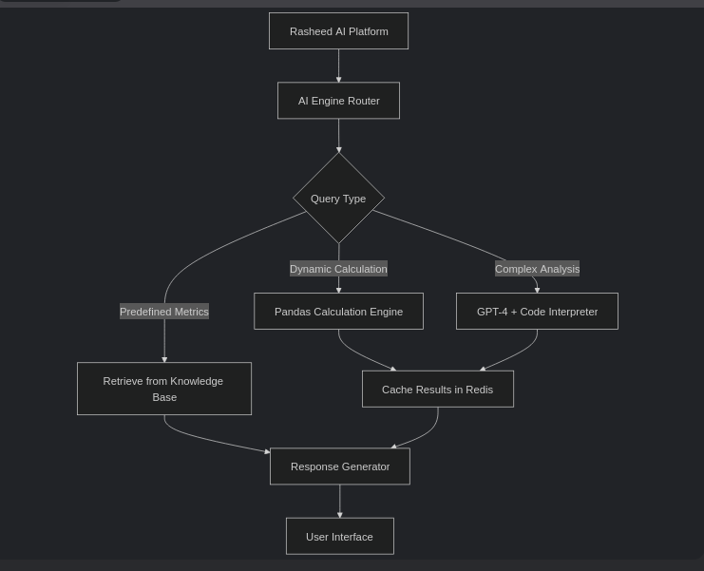
Workflow Block-Diagram

Slide 8
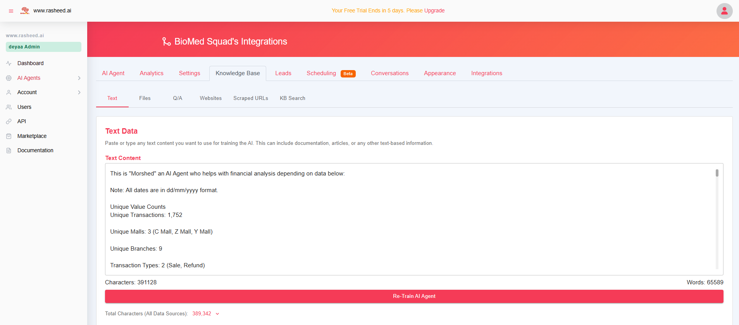
Knowledge-Base by Rasheed.ai

Slide 9
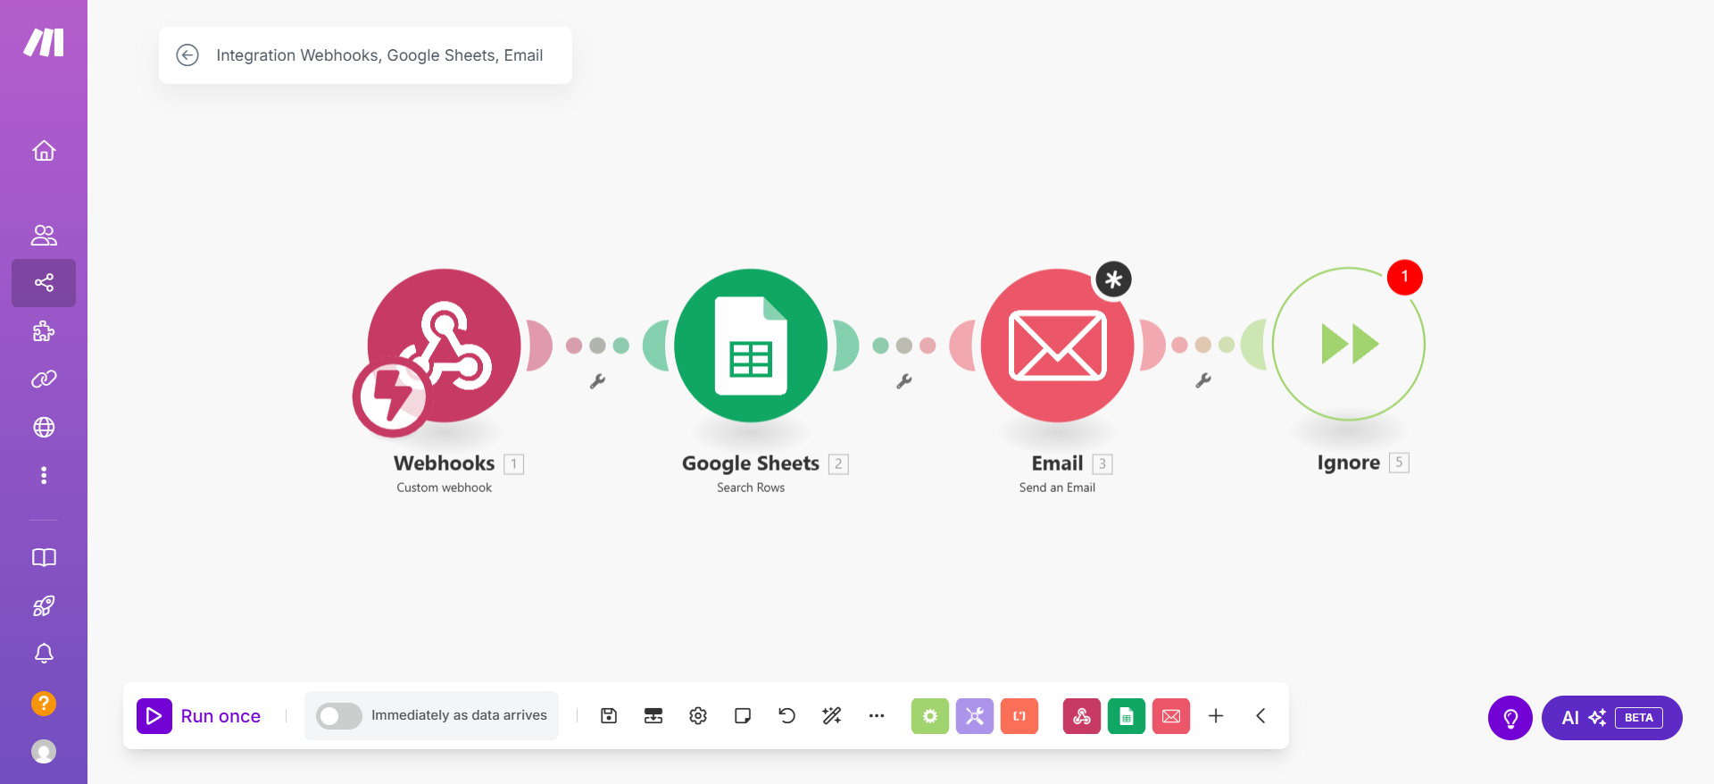
Workflow by Make.com

Slide 10
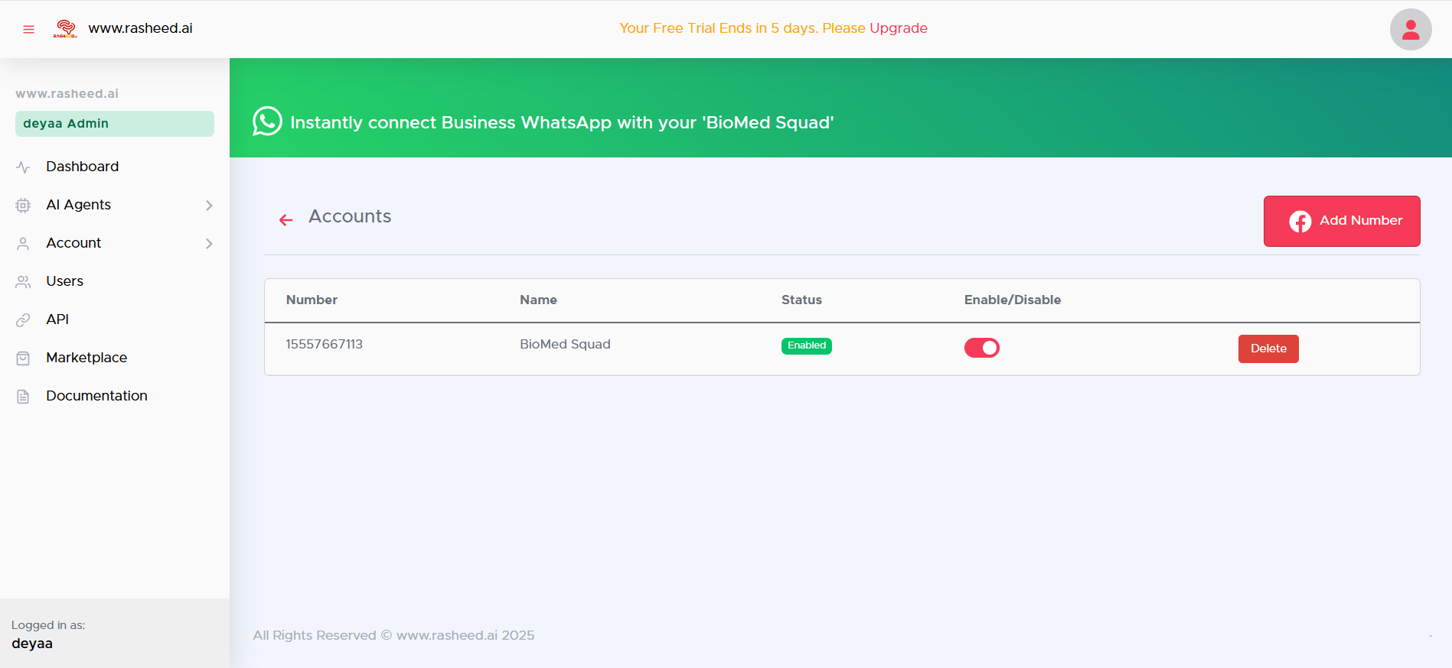
Business WhatsApp Integration

Slide 11
Thank You!

