Slide 1
Introduction to Algorithm Design
Lecture Notes 2

Slide 2
ROAD MAP
Recurrence Relations
  Exact Solution
    Forward substitution
    Backward substitution
    Methods similar to those used in solving differential equations
  Asymptotic Solution
    Master theorem

Slide 3
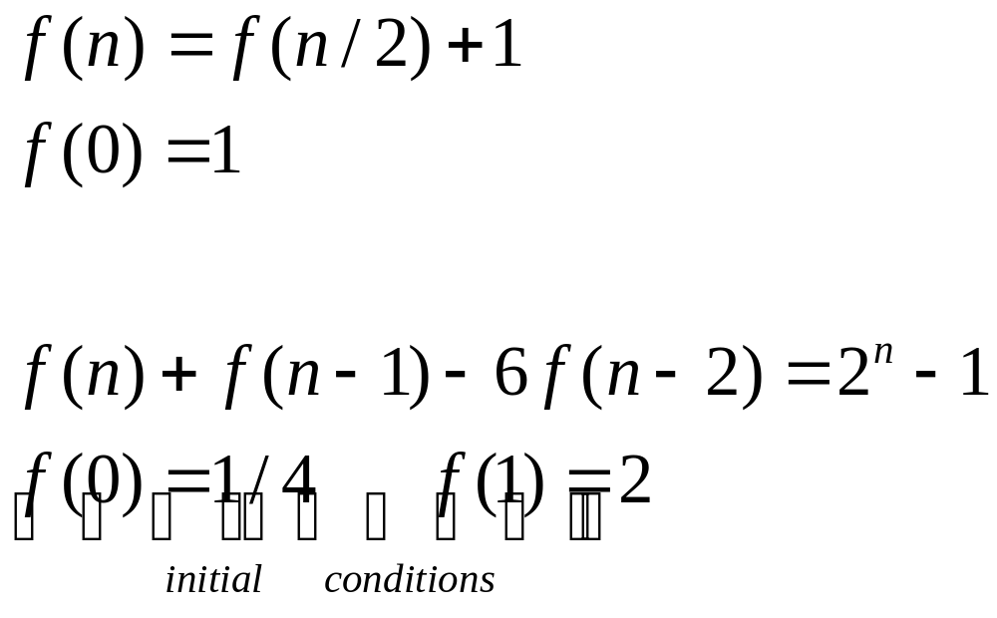
Recurrence Relations
Generally arise in recursive algorithms
Examples :

Slide 4
Analysis of Recursive Algorithms
General plan for analyzing efficiency of recursive algorithm
Decide on parameters indicating input’s size
Identify the algorithm’s basic operation
Calculate the number of times the basic operation is executed at each recursive call
  If it varies on different inputs of the same size
    worst-case, average-case, and best-case efficiencies must be investigated separately
Set up a recurrence relation for the number of times the basic operation is executed
  Identify the recursive calls and the input size for each recursive call
  Identify appropriate initial condition
Solve the recurrence
  at least ascertain the order of growth of its solution

Slide 5
Examples
Finding the largest element in an array
  One recursive call
  Two recursive calls
Insertion sort
Binary search

Slide 6
Recurrence Relations
Solution Methods
  Exact
    Forward substitution
    Backward substitution
    Methods similar to those used in solving differential equations
  Asymptotic
    Master theorem

Slide 7
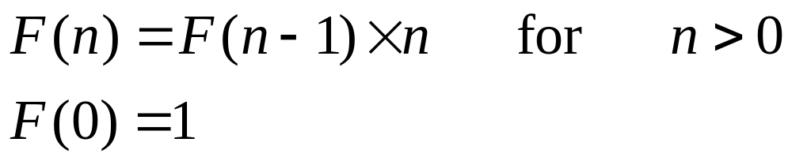
Example 1 – Factorial Calculation
Goal:
Computing the factoral function F(n)=n! for an arbitrary non-negative integer n.
Since
by definition.

Slide 8
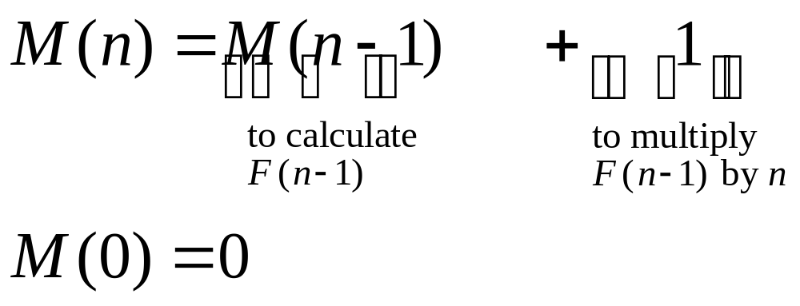
Factorial Calculation
Algorithm :
if n=0 return 1
else return F(n-1)*n
Analysis:

Slide 9
Forward Substitution
Start with the initial condition
Generate first few terms of the solution
  Using the recurrence equation and values of previous terms
Try to guess a pattern
Form a closed-form formula
Check the validity of the formula
  Using induction or
  Substituting in the recurrence equation and initial condition

Slide 10
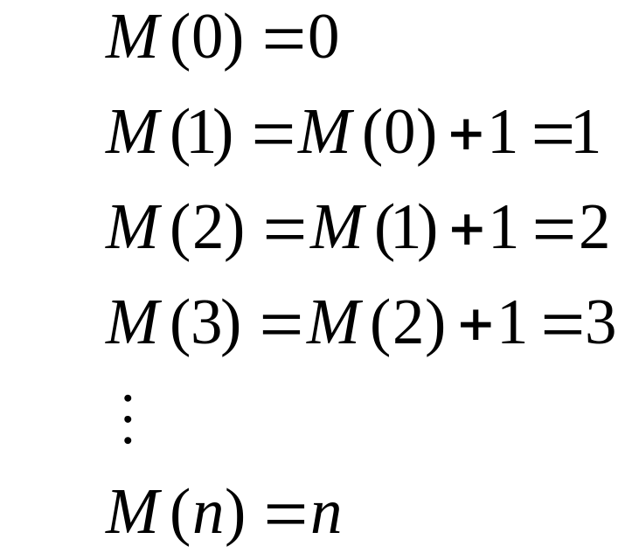
Factorial Function
Using forward substitution:
Need to prove the resulting formula

Slide 11
Backward Substitution
Start with the recurrence equation
Substitute f(n-1)
  with its value using recurrence equation
Perform similar substitution few more times
  for f(n-2), f(n-3) etc..
Try to guess a pattern for f(n) in terms of f(n-i)
Check the validity of the pattern
  usually using induction
Pick an i which makes n-i to reach the initial condition
Obtain a closed-form formula

Slide 12
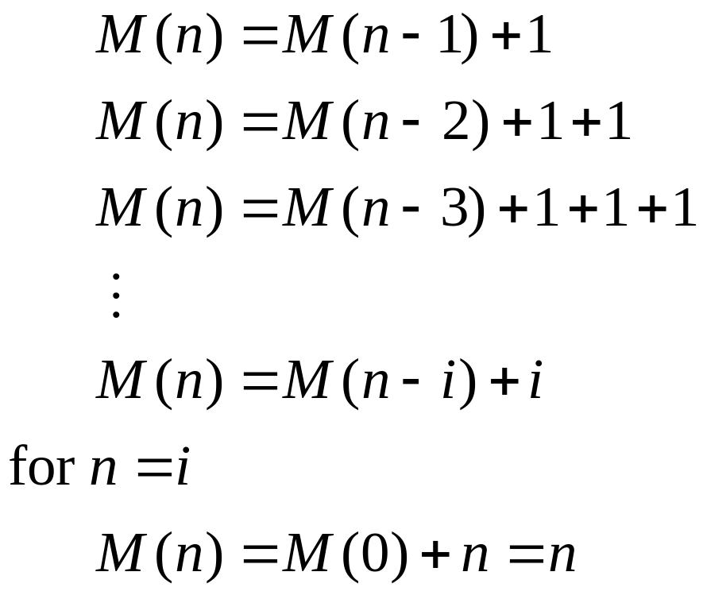
Factorial Function
Using back substitution:

Slide 13
Example 2- Towers of Hanoi
Goal:
Transfer n disks from peg A to peg C using peg B
Approach: (recursive)
  transfer n-1 disks from A to B using C
  move largest disk from A to C
  transfer n-1 disks from B to C using A
  Total number of moves
  T(n) = 2T(n-1) + 1
  T(1) = 1

Slide 14
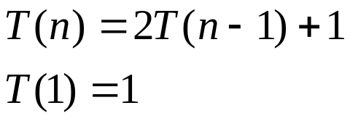
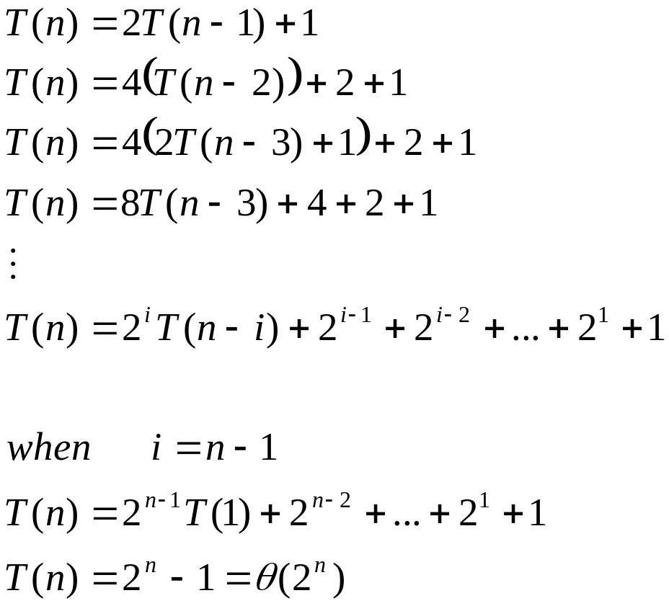
Towers of Hanoi
Solution by backward substitution
← needs proving

Slide 15
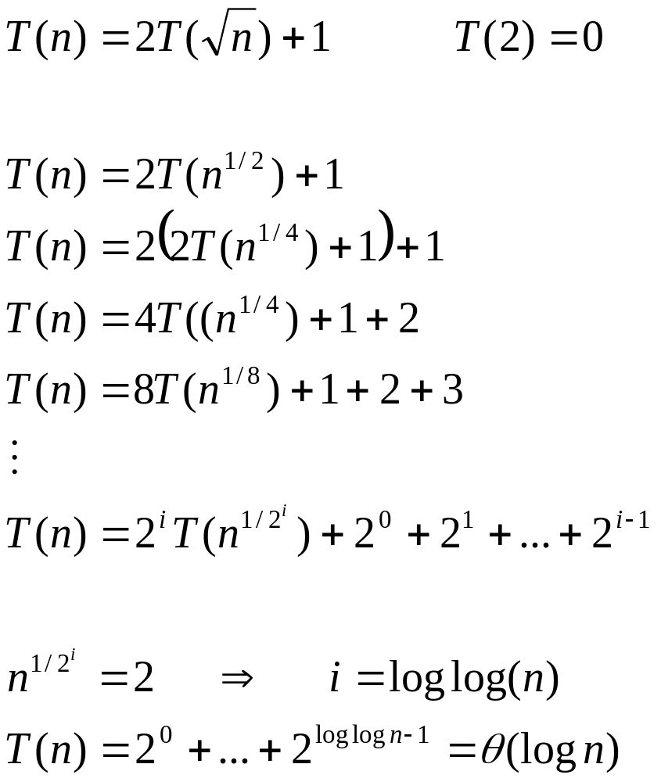
Example

Slide 16
ROAD MAP
Recurrence Relations
  Exact Solution
    Forward substitution
    Backward substitution
    Methods similar to those used in solving differential equations
  Asymptotic Solution
    Master theorem

Slide 17
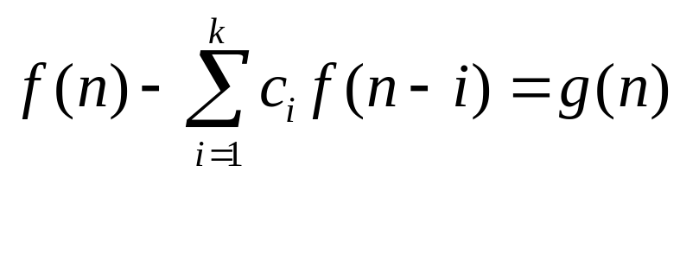

Linear Recurrences with Constant Coefficients
General form
where
‘s are some fixed numbers
is any integer

Slide 18
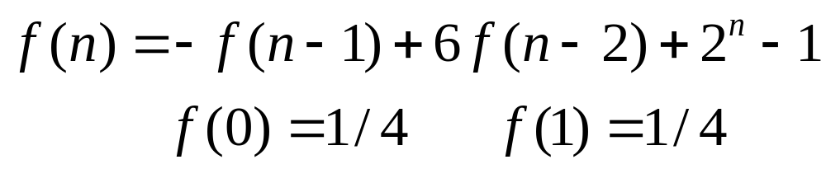
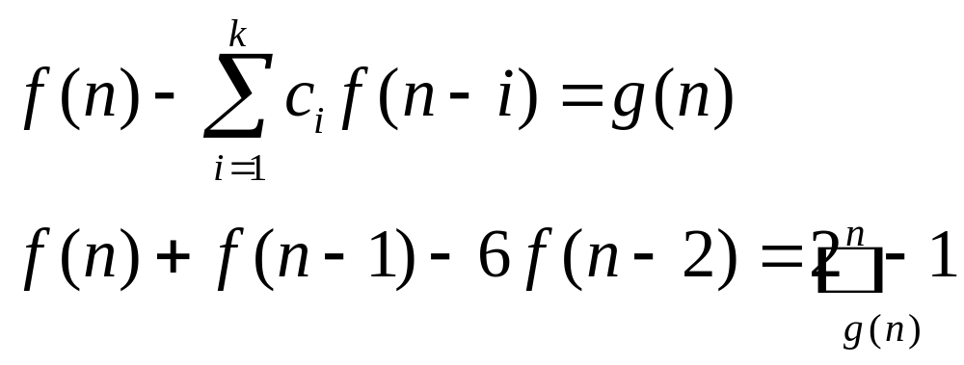
Linear Recurrences with Constant Coefficients
Example
Write the equations as

Slide 19
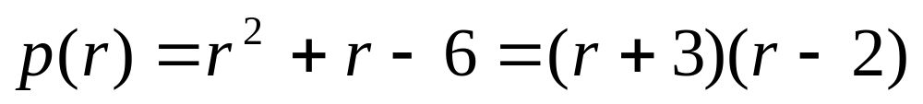
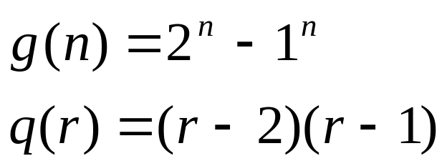
Linear Recurrences with Constant Coefficients
Write the characteristics polynomial for homogeneous part and factor it
Find the simplest equation for which g(n) is solution

Slide 20
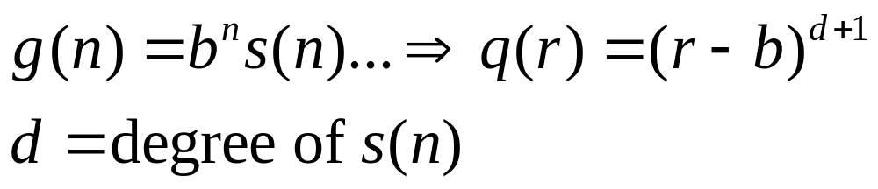
Linear Recurrences with Constant Coefficients
In general

Slide 21
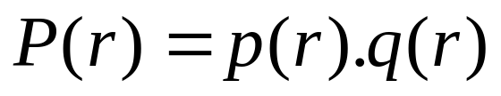
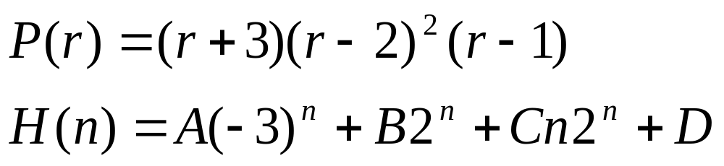
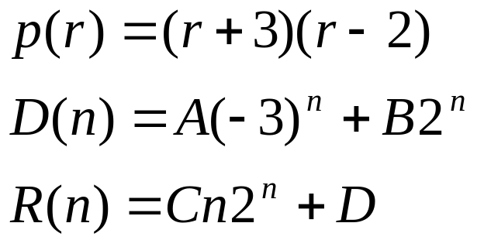
Linear Recurrences with Constant Coefficients
a
find the solution for P(r) ═> H(n)
Delete the part of H(n) coming from p(r)

Slide 22
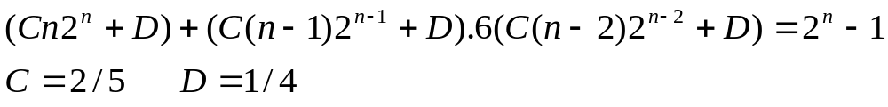
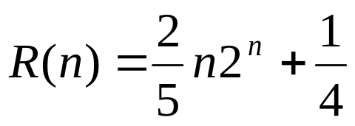
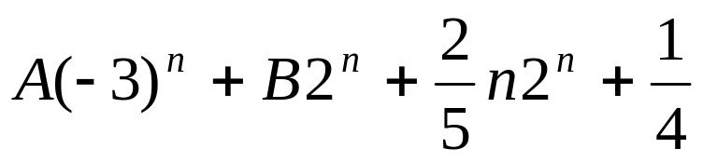
Linear Recurrences with Constant Coefficients
Plug R(n) into original equation and solve the constants
R(n) is a particular solution
Append R(n) and D(n)

Slide 23
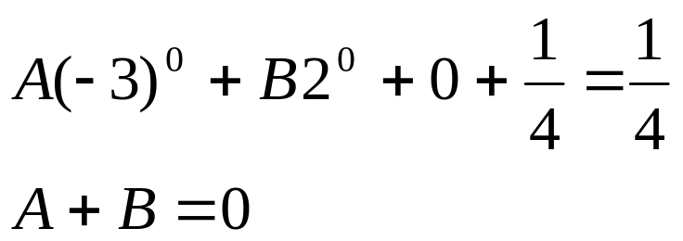
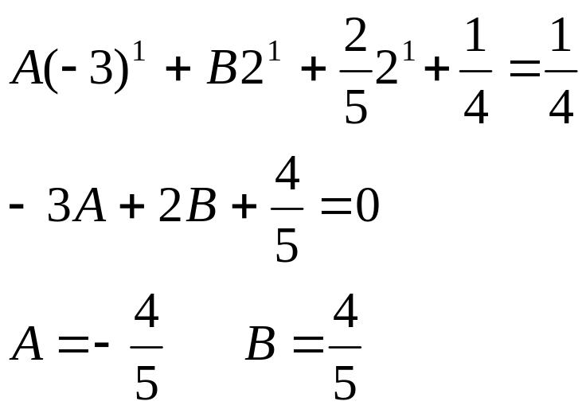
Linear Recurrences with Constant Coefficients
Use initial conditions to find other constants
For n=0
For n=1

Slide 24
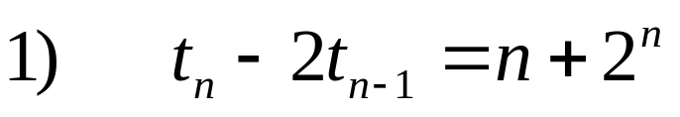
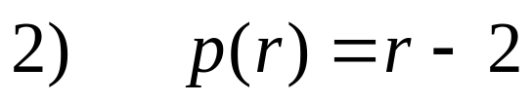
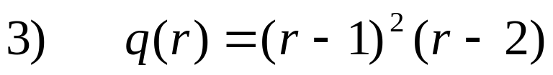
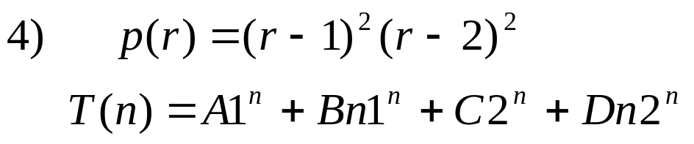
Linear Recurrences with Constant Coefficients
Example

Slide 25
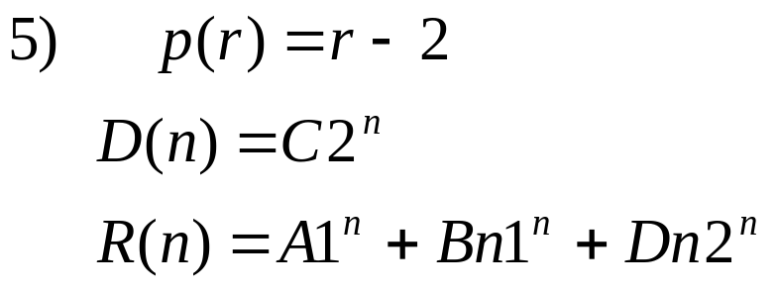
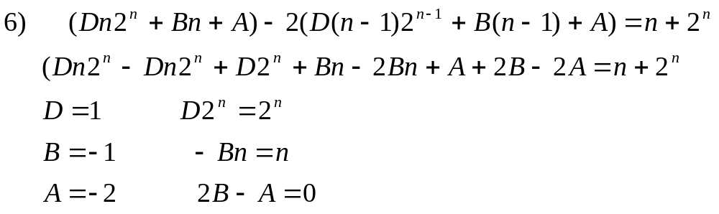
Linear Recurrences with Constant Coefficients

Slide 26
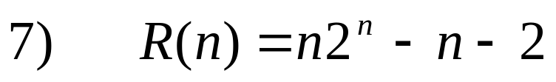

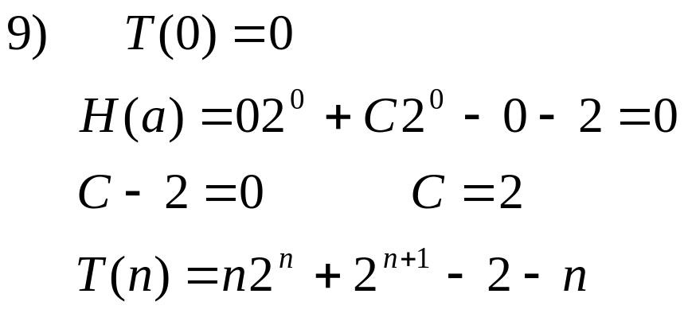
Linear Recurrences with Constant Coefficients

Slide 27
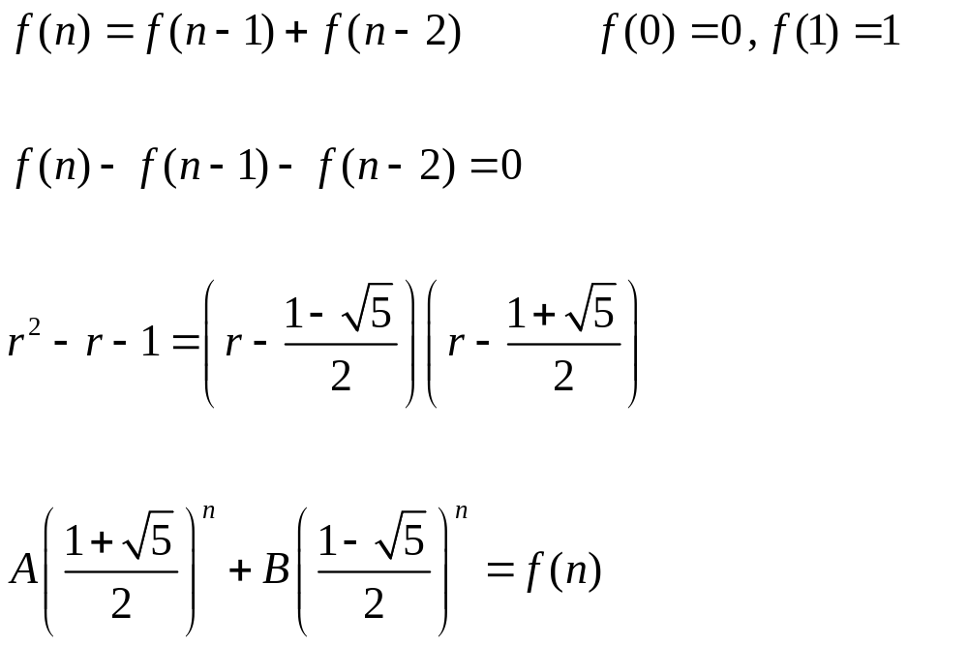
Example

Slide 28
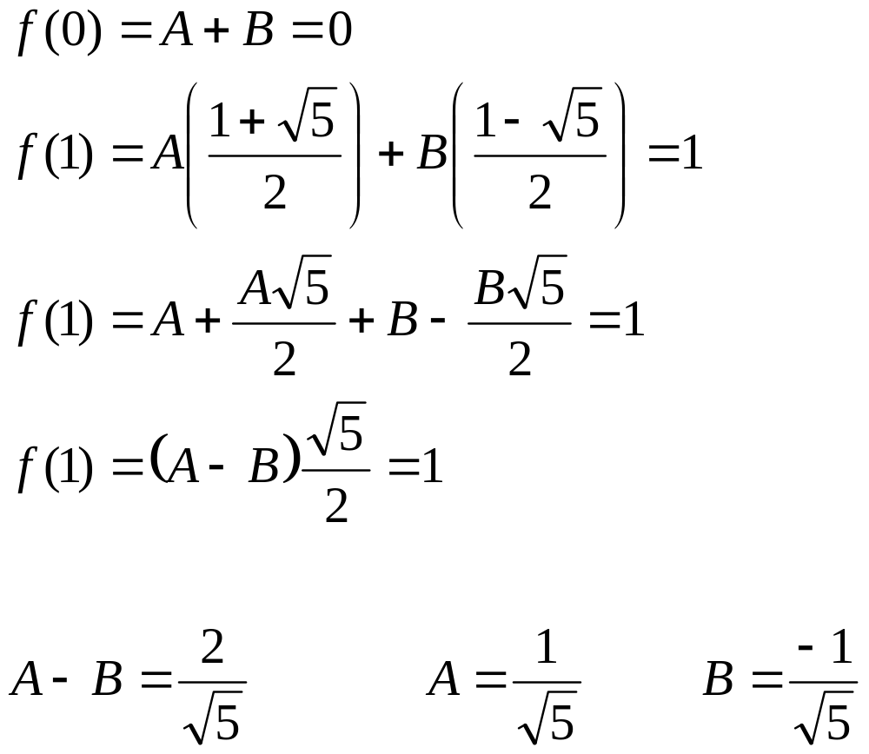

Slide 29
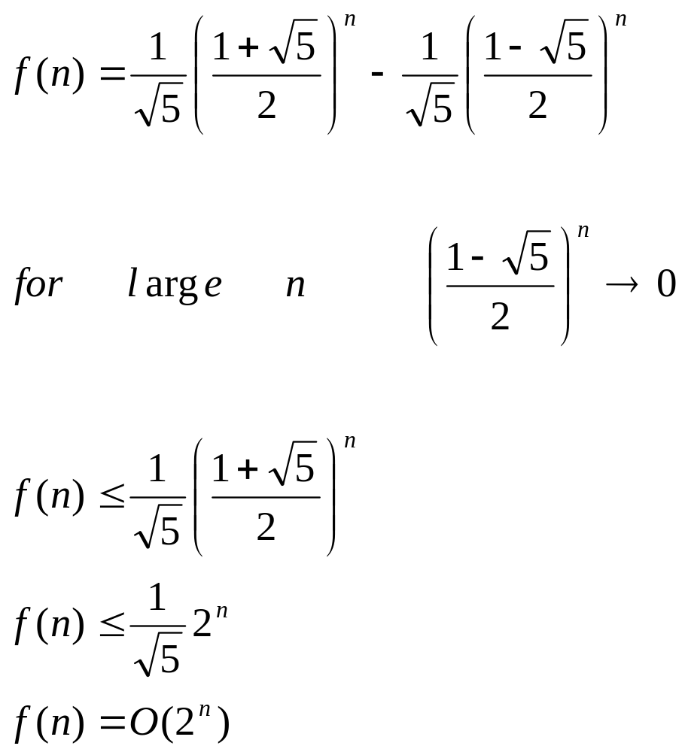

Slide 30
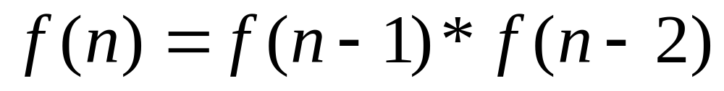
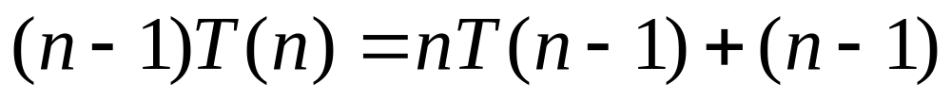
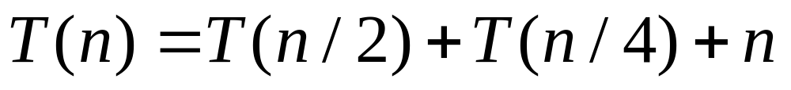
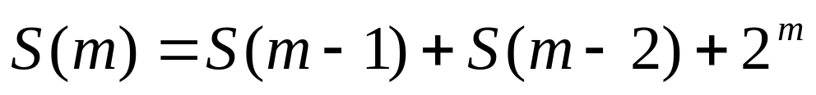
Example
take log
Example
divide by n(n-1)
Example
substitute n=2^{m}

Slide 31
ROAD MAP
Recurrence Relations
  Exact Solution
    Unfolding
    Guess and proove
    Generating functions
    Methods similar to those used in solving difference equations
  Asymptotic Solution
    Master theorem

Slide 32
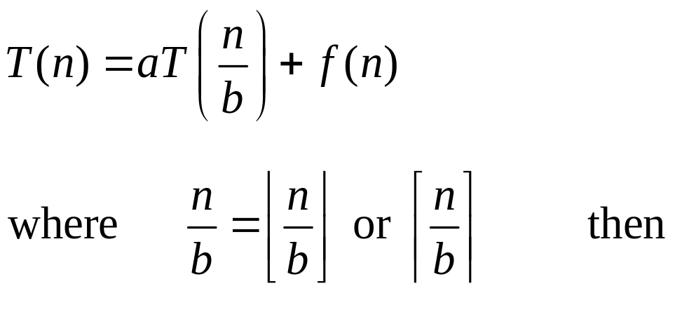
Master Theorem
Let a≥1 and b>1 be constants, f(n) be a function and
let T(n) be defined by the recurrence

Slide 33
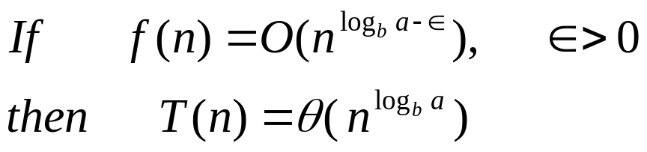
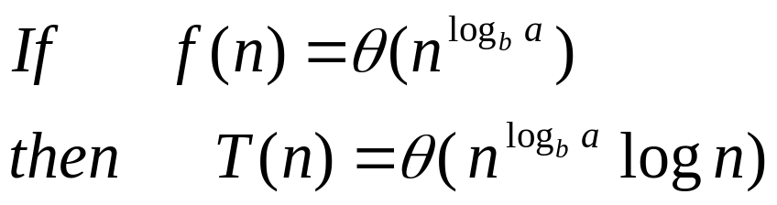
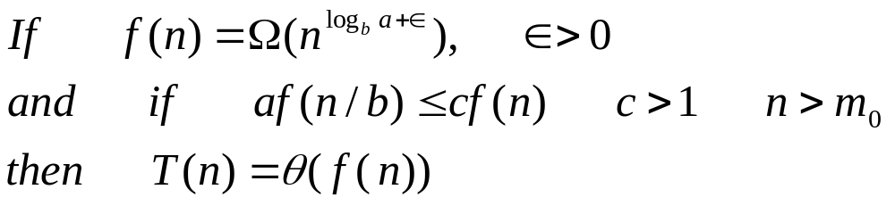
Master Theorem
a
a
a

Slide 34
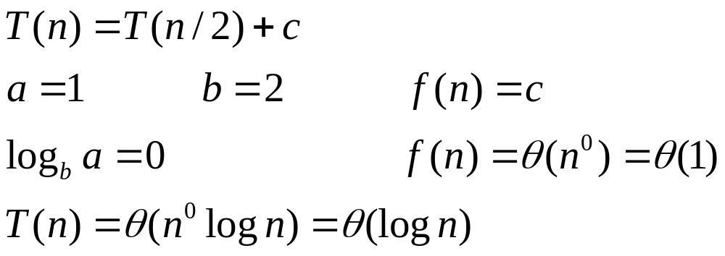
Example

Slide 35
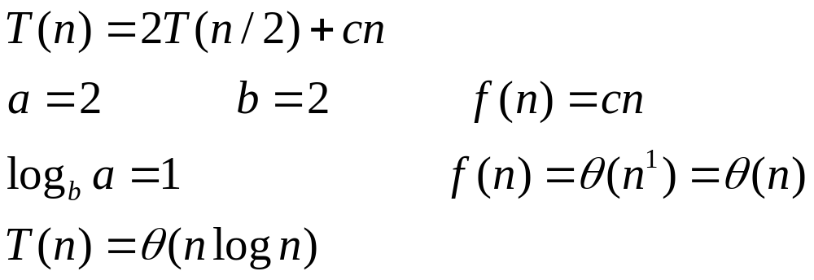
Example

Slide 36
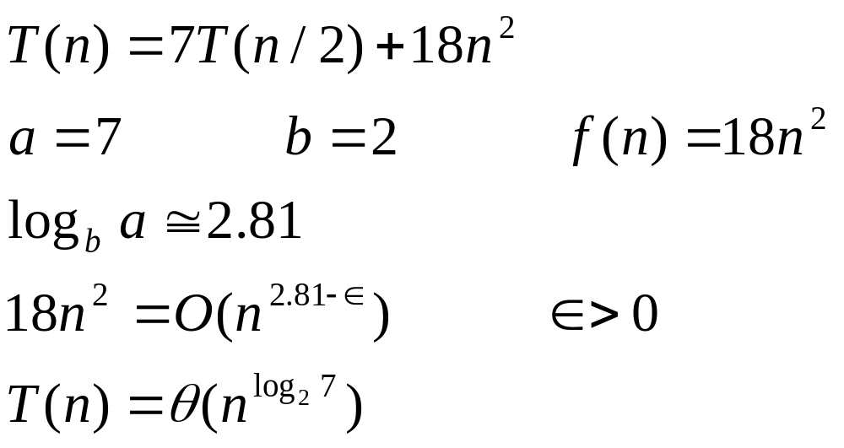
Example

Slide 37
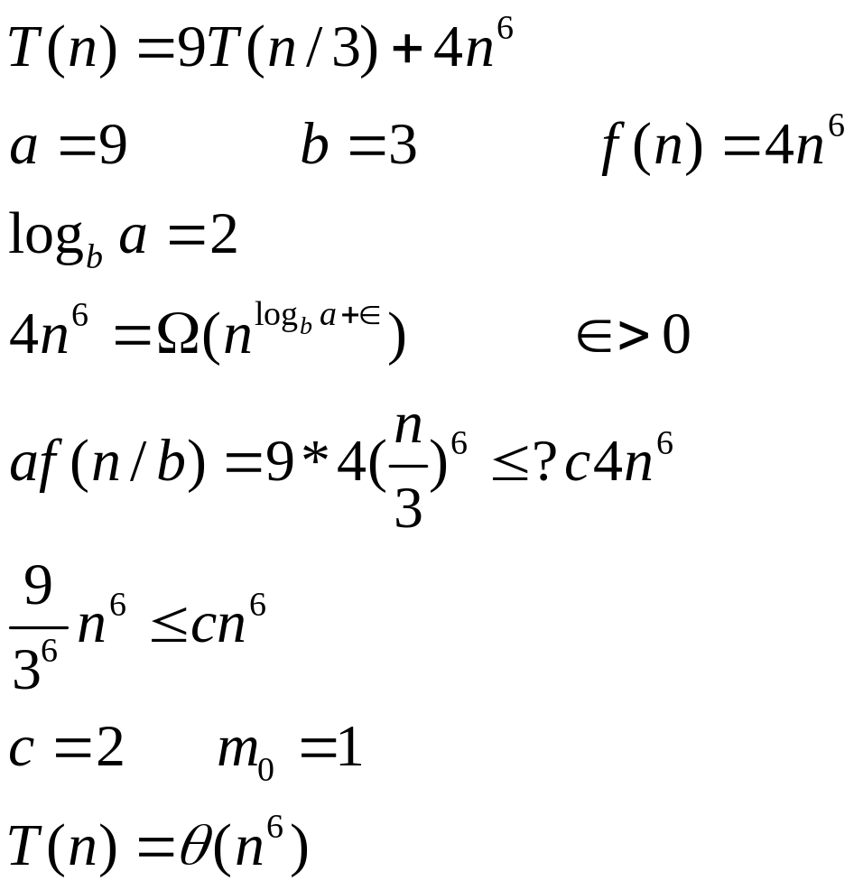
Example

Slide 38
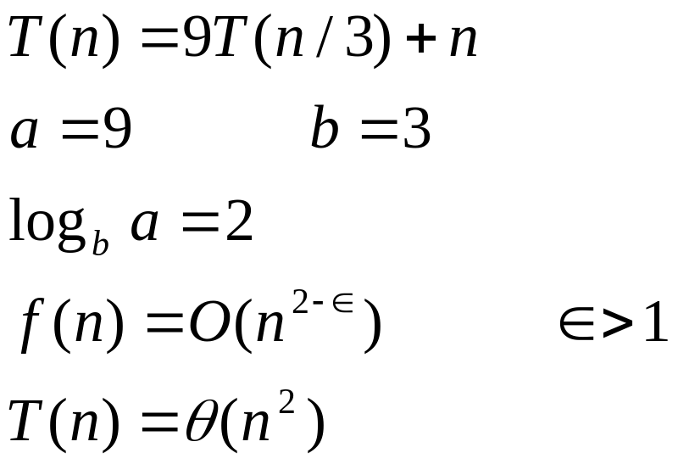
Example

Slide 39
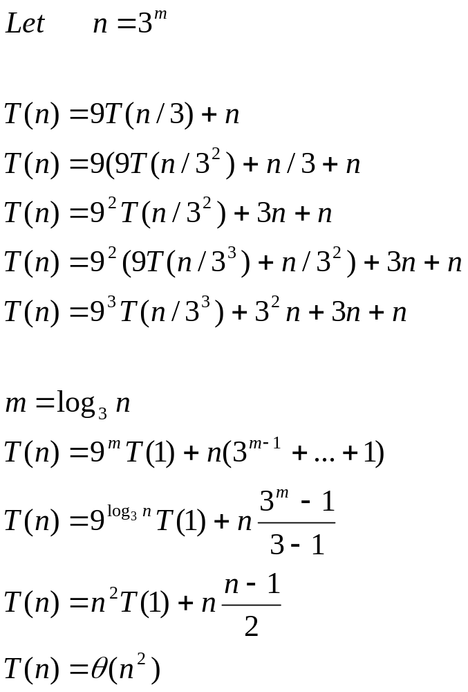
Exact Solution

