Slide 1
Introduction to Algorithm Design
Lecture Notes 9

Slide 2
ROAD MAP
Dynamic Programming
  The Knapsack Problem
  All Pairs Shortest Paths
  Optimal Binary Search Tree
  String Editing
  Matrix Chain Product

Slide 3
Dynamic Programming
Definition :
  Dynamic programming is an interesting algorithm design technique for optimizing multistage decision problems
  It is a technique for solving problems with overlapping subproblems
    Typically arise from a recurrence relations
    Solve subproblems once and record the results for later use
    Bottom up solution of the recurrence
  How to get the recurrence?
    sequence of decisions
    possible choices at each decision point
    Based on principle of optimality write the recurrence relation

Slide 4
Optimal Binary Search Trees
Definition:
  For a given set of elements there are several binary search trees are possible
  Assume probabilities of searching for elements of a BST are known, some of them are better than the others
    average number of comparisons is smaller

Slide 5
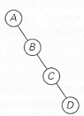
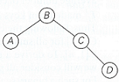
Optimal Binary Search Trees
Example:
  Consider 4 keys A, B, C, D to be searched with probabilities 0.1, 0.2, 0.4, 0.3
  Two out of possible trees
  What is the average number of comparisons in a successfull search?

Slide 6
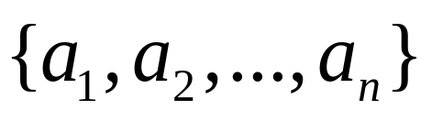
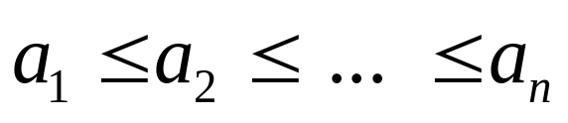
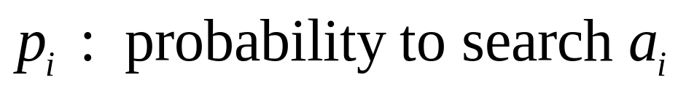
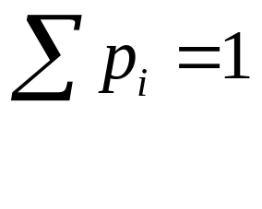
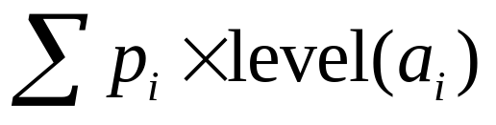
Optimal Binary Search Trees
Given : Set of identifiers
Find : Optimal BST
  Minimizing the average number of comparisons
Minimum

Slide 7
Optimal Binary Search Trees
What is the sequence of decisions?
What are possible choices at each decision point?
What about principle of optimality…
How to write the recurrence relation?
How to solve the recurrence?

Slide 8
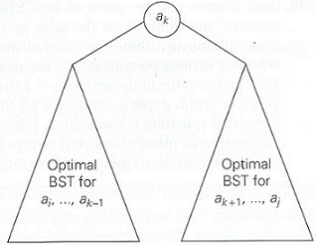
Optimal Binary Search Trees
Because of principle of optimality:
Optimal BST with root a_{k} and two optimal binary search subtrees

Slide 9
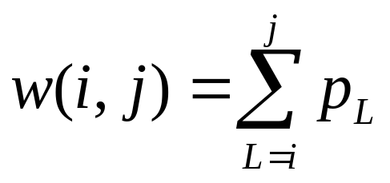
Optimal Binary Search Trees

Slide 10
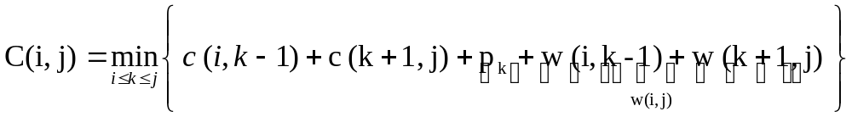
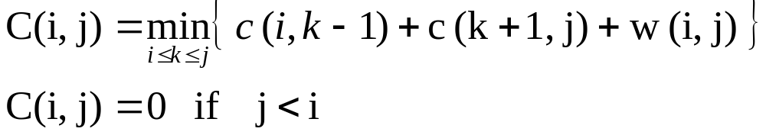
Optimal Binary Search Trees

Slide 11
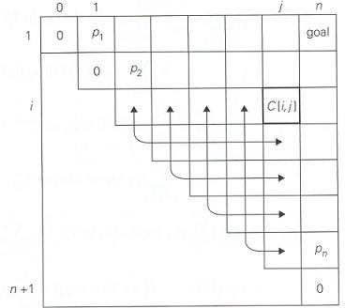
Optimal Binary Search Trees
Table of dynamic programming algorithm for constructing an optimal BST

Slide 12
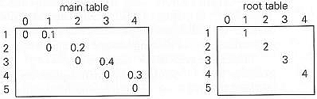
Optimal Binary Search Trees
Example :
  Four key set and probabilities are given
  A → 0.1 B → 0.2 C → 0.4 D → 0.3
  Initial table looks like

Slide 13
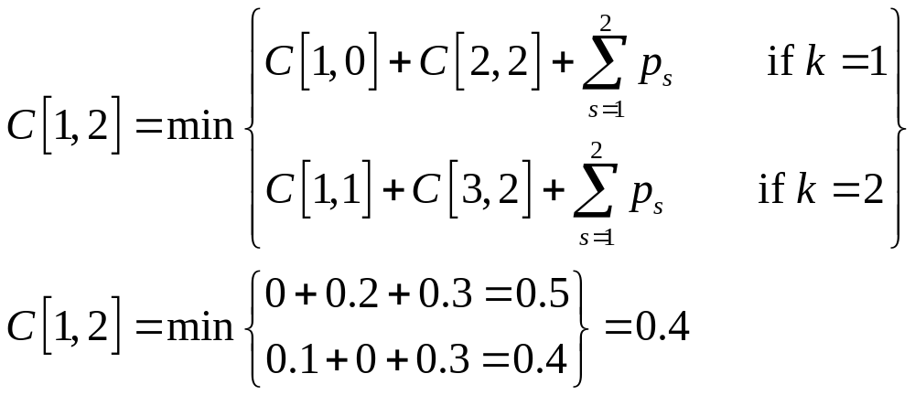
Optimal Binary Search Trees
Let us compute C[1,2] :
  Out of two possible binary trees containing the first two keys A and B
    the root of the optimal tree has index 2
    average number of comparisons in a successfull search is 0.4

Slide 14
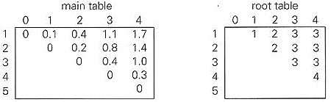
Optimal Binary Search Trees
If the computations are finished, we will arrive at the following final tables

Slide 15
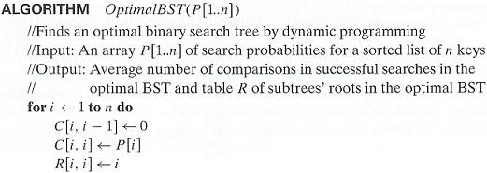
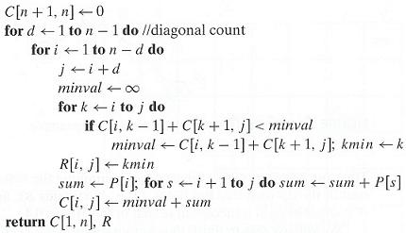

Slide 16
Optimal Binary Search Trees
Analysis:
  Space efficiency is quadratic !
  Time efficiency is cubic !
    A more careful analysis shows that entries in the root table are always nondecreasing along each row and column
    This limits values for R [ i,j ] to the range
    R [ i,j-1 ], … , R [ i+1,j ] and reduce the running time to Θ(n²)

Slide 17
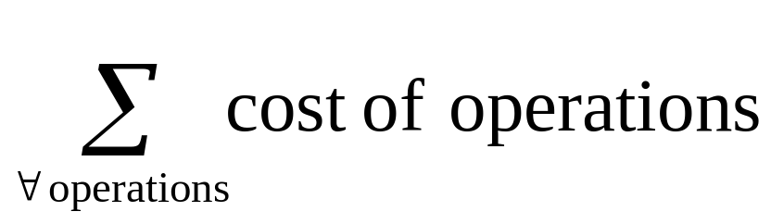
String Editing
Given :
  X = x₁, x₂, …, x_{n}
  Y = y₁, y₂, …, y_{m}
Find :
  A transform from X to Y using
  operation → insert I(y_{i})
  → delete D(x_{j})
  → change C(x_{i},y_{j})
Cost Function :

Slide 18
String Editing
What is the sequence of decisions?
What are possible choices at each decision point?
What about principle of optimality…
How to write the recurrence relation?

Slide 19
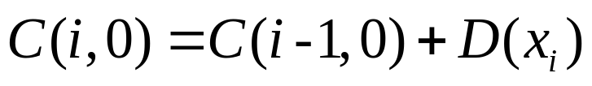
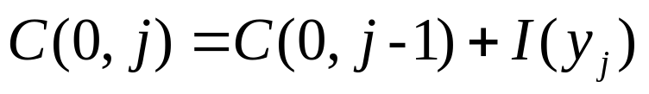

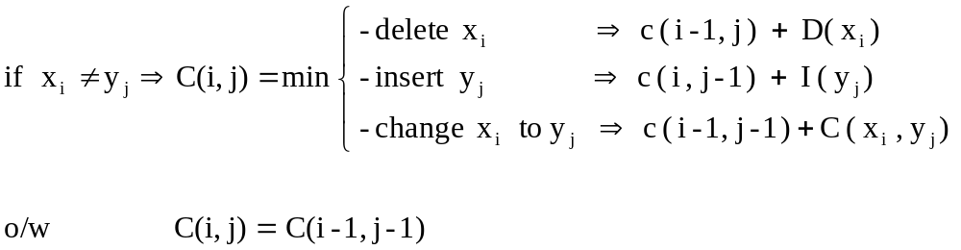
String Editing

Slide 20
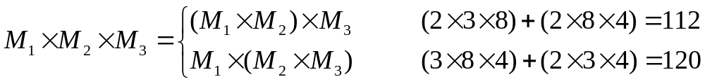
Matrix Chain Product
Multiply n given matrices
    M₁ x M₂ x … x M_{n}
Goal :
  Find the parenthesization to minimize the number of multiplications
    M₁ , M₂ , M₃
    2x3 3x8 8x4
    (n-1) ! = O(2^{n}) different parenthesization

Slide 21
Matrix Chain Product
What is the sequence of decisions?
What are possible choices at each decision point?
What about principle of optimality…
How to write the recurrence relation?

Slide 22
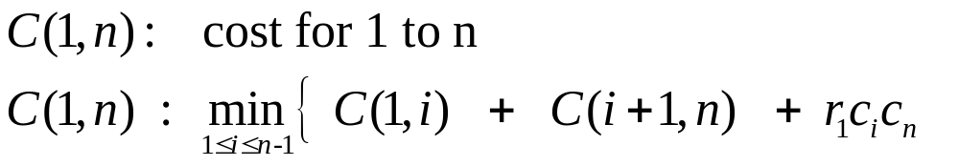
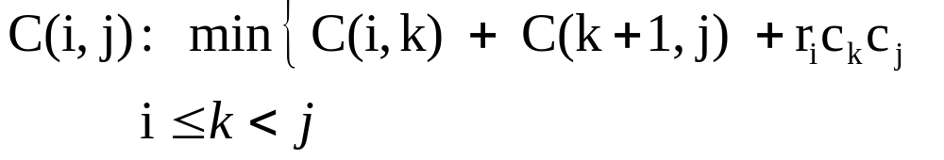
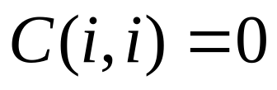

Matrix Chain Product
In general
# of C(i,j)’s = O(n²)
For each C(i,j) we check (j-i) expressions
Overall complexity is O(n³)

