Slide 1

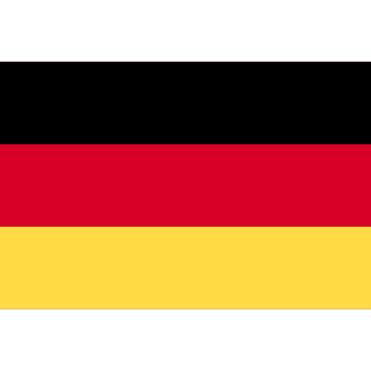



Technology in Germany
Innovation in the tech sector
Germany is known for its strong focus on innovation in the technology sector, with over 40% of companies investing in research and development. For example, in 2019, Germany had the highest number of patents filed in Europe, showcasing its technological advancements.
Digital transformation in industries
Digital transformation is rapidly changing industries in Germany, with a projected investment of €40 billion by 2022. For instance, the automotive industry is embracing Industry 4.0, integrating IoT and AI to enhance production processes and create smart factories.
Start-up ecosystem in Germany
Germany boasts a vibrant start-up ecosystem, with Berlin being a hub for tech start-ups. The country has over 300 incubators and accelerators supporting innovative ventures. Moreover, Germany's strong network of investors and government support contribute to the growth of start-ups.

