Slide 1

Part 1- A Time-series Data Set

Slide 2
Introduction
A prominent source of meteorological data for machine learning research is the weather dataset. The Rattle package, an R-based data mining toolbox, has made this open-source dataset public. The collection includes data from a number of Australian weather stations.
As the Data set is a huge and contains information of many cities. The data of weather pertaining to single city has been taking and model has been trained using first 500 observations and forecasted for next 50 days.
Name: Weather Dataset Rattle Package
Data Type: Meteorological Data
Official Website:https://www.kaggle.com/datasets/jsphyg/weather-dataset-rattle package
Download Link: https://www.kaggle.com/jsphyg/weather-dataset-rattle-package
Time Series Span: 10 years (2007-2017)
Data Points: 1.1 million

Slide 3
Introduction
Rainfall: Amount of rainfall recorded in mm – Numeric
Evaporation: Potential evaporation in mm – Numeric
Sunshine: Number of hours of bright sunshine – Numeric
WindGustDir: Direction of the strongest gust of wind in 24 hours to midnight – Numeric
WindGustSpeed: Speed of the strongest gust of wind in 24 hours to midnight – Numeric
WindDir9am: Direction of the wind at 9am – Numeric
WindDir3pm: Direction of the wind at 3pm – Numeric
WindSpeed9am: Wind speed at 9am – Numeric
WindSpeed3pm: Wind speed at 3pm – Numeric
Humidity9am: Humidity at 9am – Numeric

Slide 4
Introduction
Humidity3pm: Humidity at 3pm – Numeric
Pressure9am: Atmospheric pressure reduced to mean sea level at 9am – Numeric
Pressure3pm: Atmospheric pressure reduced to mean sea level at 3pm – Numeric
Cloud9am: Fraction of sky obscured by cloud at 9am – Numeric
Cloud3pm: Fraction of sky obscured by cloud at 3pm – Numeric
Temp9am: Temperature at 9am – Numeric
Temp3pm: Temperature at 3pm – Numeric
Rain Today: Boolean: 1 if rainfall recorded for the day, 0 otherwise – Boolean
Rain Tomorrow: The target variable
Data structure: The data are organized into columns, where each column represents a different meteorological variable

Slide 5
Part 2: RNN: Simple RNN with Sine Wave Data
The use of neural networks for time-series analysis and prediction has become increasingly popular in recent years
One of the neural network designs that is commonly used for this purpose is the Long Short-Term Memory network
To better understand the construction and evaluation of neural networks for time-series analysis, we can consider the given code for training and evaluating an LSTM model on a sine wave dataset
The neural network design in the code includes an LSTM layer with 64 neurons and a fully connected layer with one neuron for regression
The model's performance was assessed using the mean squared error , which showed that it achieved a very low MSE of 0.00023 on the test data

Slide 6

Part 3: RNN: LSTM Neural Network

Slide 7
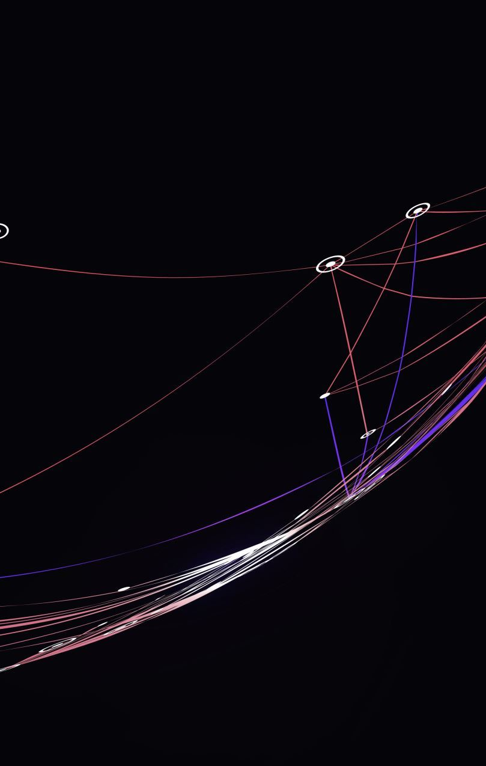
Vanishing Gradient Problem
Deep neural networks, especially recurrent neural networks like LSTM and Simple RNN, frequently experience the vanishing gradient problem during training
The problem develops when the gradients computed by the backpropagation technique shrink to extremely tiny values, causing sluggish convergence and poor model performance
The gradients are generated as the derivative of the loss function with respect to the neural network's parameters during the backpropagation procedure

Slide 8

Exploding Gradient Problem
Short-term memory: SimpleRNNs can only learn simple patterns in sequential input since they cannot retain long-term dependencies
Gradient Vanishing and Exploding Problems: Because SimpleRNNs are recurrent, they are vulnerable to these issues, which might impair their performance
Long-range relationships might be difficult for SimpleRNNs to capture, which can restrict their capacity to effectively predict sequential data

Slide 9

By incorporating a specific memory cell that enables the network to preserve information over a long period of time, LSTM networks solve the vanishing gradient problem
Three gates—the input gate, the forget gate, and the output gate—control the memory cell
This allows the network to capture long-term dependencies without being hampered by the vanishing gradient problem

Slide 10

The expanding gradient problem is also addressed by LSTM networks through the use of a method known as gradient trimming
Gradient clipping limits the gradients' magnitude during training in order to keep them from enlarging and causing instability

Slide 11
Limitations of Simple RNN
Long-term memory: Because LSTMs are made to record long-term dependencies, they are suitable for modelling sequential data with long-distance dependencies
Gradient stability: LSTMs are more stable during training because they utilize a specific memory cell and gating methods to prevent the disappearing and bursting gradient concerns
Robustness to noise: LSTMs can accurately model noisy sequential data because they are resistant to noisy input data and can selectively ignore noisy inputs

Slide 12

Part 4: RNN: LSTM with Time-Series Data
Import Libraries: Matplotlib, NumPy, Pandas, and Keras are imported together with the other essential libraries
Data loading: Pandas is used to load bitcoin data from a CSV file
Data pre-processing: Training and testing sets are created from the normalized data
Define Model Architecture: A sequential model with several LSTM layers and a dense output layer is the definition of the model architecture
Trian Model: Model compilation and training are performed on the training data for a predetermined number of epochs and with a predetermined batch size
Model Evaluation: Mean Squared Error and Mean Absolute Error are used to assess the model's performance on the test set

Slide 13

Part 4: RNN: LSTM with Time-Series Data
Visualize Results: A comparison between the anticipated prices of Bitcoin and Ethereum and their corresponding actual values is done to assess the model's efficacy, and the results are presented visually for easy understanding

Slide 14

Part 5: Redesign the Neural Network

Slide 15
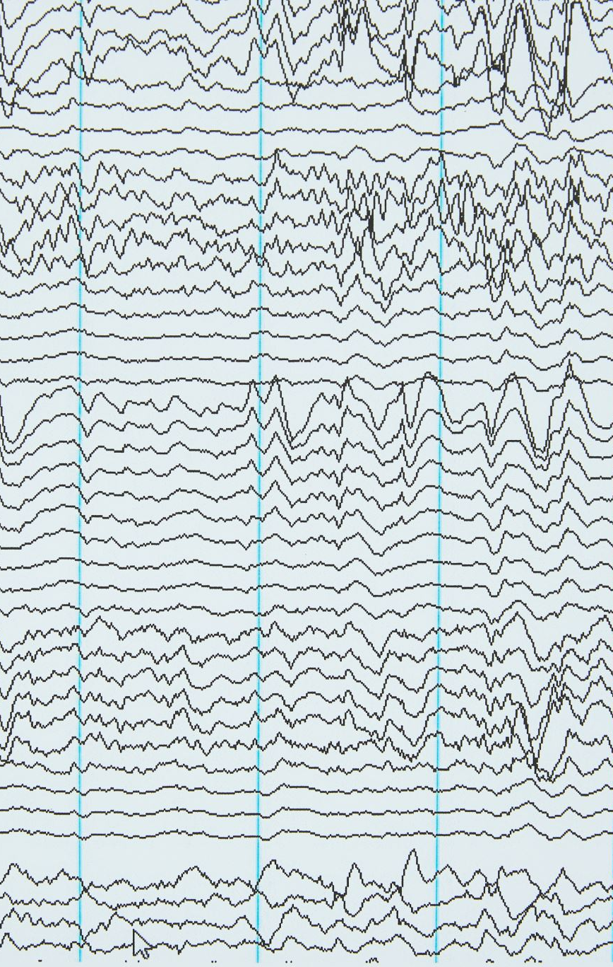
Proposal
To capture more intricate temporal correlations in the data, increase the number of LSTM layers
In order to provide greater expressive capability, increase the number of neurons in each LSTM layer
Increase the number of Dropout layers to avoid overfitting and boost generalization
To better capture long-term temporal relationships, lengthen the time-series input sequence
To hasten the convergence of the model, increase the training batch size

Slide 16
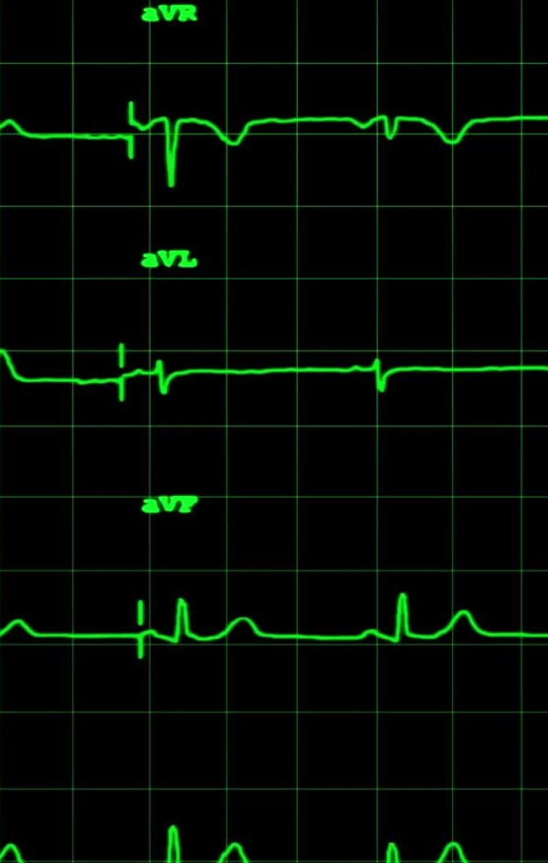
Proposal
After the first LSTM layer, add a second LSTM layer with 150 units to make the total number of LSTM layers 2 instead
By increasing the unit’s parameter to 200 in both LSTM layers, you may increase each LSTM layer's number of neurons to
To increase generality, add a Dropout layer with a rate of 0.2 after each LSTM layer
By changing the window size option to 150, the time-series input sequence can be extended to 150 characters
Set the batch size option to 256 to increase the training batch size

Slide 17
Testing and Training
These modifications enable us to use the same meteorological information to train, test, and forecast the new LSTM neural network
The model's decreased mean squared error on the training and testing sets of data suggests that it is more generic
The model was able to capture more intricate patterns and relationships in the data by adding more LSTM layers

Slide 18
Part 6: Compare Network Performance
The first network contains a single dropout layer with a rate of 0.2, a dense layer for regression, and a single LSTM layer with 50 neurons
The Adam optimizer and mean squared error loss function were used throughout its 50-epoch training process
The second network comprises two LSTM layers with a total of 150 neurons each, as well as a dropout layer with a 0.1 dropout rate
The second LSTM network, which had two layers and more neurons per layer coupled with a lower dropout rate, outperformed the first network, which had a single layer and fewer neurons

Slide 19

Part 8: Project Report

Slide 20
Introduction
The goal of the final project is to demonstrate the student's knowledge of LSTM and RNN neural networks, which are frequently employed for time-series analysis and prediction
In Part II, the student constructs a straightforward RNN model to forecast Apple stock values based on past data
The student assesses both models' effectiveness in Part IV and contrasts their output
Ultimately, the student alters the LSTM model's architecture in Part V to enhance its capability of forecasting meteorological data and contrasts the outcomes with those of the original model
Student has gained knowledge on how to construct, train, test, and predict using RNN and LSTM neural networks through this project

Slide 21

Learnings
The student has also learned the significance of hyperparameters in the construction and optimization of neural networks, including dropout rates, batch sizes, epochs, and the number of layers and neurons
Student now has a thorough grasp of RNN and LSTM neural networks and how they are used in time-series analysis and prediction thanks to the project
The student investigated a straightforward Recurrent Neural Network to forecast the weather in city in PART II of their final project
The student used the developed LSTM model in PART V to predict weather for the following 30 days

Slide 22
Conclusion
In conclusion, our study used meteorological data from an Australian city to examine the effectiveness of straightforward RNN and LSTM neural networks in time-series analysis and forecasting
According to the project's findings, the LSTM neural network performs better than the straightforward RNN model in accurately and precisely forecasting future weather patterns
This project gave the student invaluable experience using neural networks for time-series analysis and prediction, and it allowed them to put their academic learning into practice

Slide 23

References
https://www.educative.io/answers/what-is-exploding-gradient-problem https://jkim2718.medium.com/time-series-prediction-using-rnn-in-tensorflow-738e2dcfca96 https://www.alibabacloud.com/blog/time-series-forecasting-using-variants-of-long-short-term-memory-lstm-recurrent-neural-networks_598410 https://algotech.netlify.app/blog/time-series-prediction-with-lstm/ https://neptune.ai/blog/vanishing-and-exploding-gradients-debugging-monitoring-fixing

