Slide 1

Department of Computer Science & Engineering Community Garden & Crop Sharing Platform Batch no : 80 1. 2411CS010349 MOHAMMAD SHAHEBAZ ALI 2. 2411CS010346 M. POOJITHA 3. 2411CS010315 M. HASINI 4. 2411CS010322 MALEPU SRISHANTH
Maisammaguda, Kompally, Medchal - Malkajgiri District Hyderabad - 500100, Telangana State. www.mallareddyuniversity.
(Telangana State Private Universities Act No. 13 of 2020 &
G.O.Ms. No. 14, Higher Education (UE) Department)

Slide 2
Table of Contents
Abstract
Introduction
Limitations of Existing Systems
Proposed Statement
Proposed Methodology(Architectural/Workflow Diagram)
Results
Screenshots of working model
Conclusion

Slide 3
Abstract
The Community Garden & Crop Sharing Platform is a digital solution designed to connect individuals and communities interested in growing, sharing, and exchanging home-grown crops. It provides a platform for users to list available produce, request items they need, and collaborate on community gardening projects. By enabling efficient crop sharing, the platform reduces food wastage, encourages sustainable living, and supports healthy eating habits.
The application incorporates location-based search, notifications, and real-time updates to ensure that users can find and share produce conveniently within their neighborhood. Users can participate in forums, discussions, and workshops to exchange gardening tips, learn sustainable farming practices, and engage with the community. This fosters a cooperative environment where knowledge and resources are shared effectively.
In addition to promoting community engagement, the platform emphasizes environmental sustainability. By reducing reliance on commercial produce and transportation, it helps minimize carbon footprints and encourages organic gardening practices. Users are able to track their contributions, crop exchanges, and environmental impact, making the process both transparent and rewarding.
Overall, this platform merges technology, community interaction, and sustainability into a single solution. It addresses urban food distribution challenges, provides access to fresh produce, and strengthens social bonds within the community. By leveraging digital tools, the platform empowers users to participate actively in creating greener, healthier, and more self-sufficient neighborhoods.

Slide 4
Introduction
The Community Garden & Crop Sharing Platform is a digital application that connects people within a community who are interested in growing, sharing, and exchanging home-grown crops, fruits, and vegetables. It provides a convenient way for gardeners and residents to collaborate, share surplus produce, and access fresh, healthy food without relying solely on commercial sources. By promoting local food exchange, the platform encourages sustainable living and reduces the environmental impact of transportation and packaging.
Users can create personalized profiles, list the crops they have available, and request items they need from nearby community members. The platform includes features like map-based search, notifications for crop availability, and event participation, making it easy for users to find and share produce efficiently. This helps reduce food wastage and ensures that fresh, organic crops reach those who need them within the community.
In addition to crop sharing, the platform fosters social interaction and learning. Users can participate in forums, gardening discussions, and workshops, where they can exchange tips on sustainable farming, seasonal planting, and organic gardening techniques. Community projects such as group gardens or local harvest events encourage teamwork and strengthen the bonds between neighbors.
Overall, the Community Garden & Crop Sharing Platform combines technology, sustainability, and community engagement into a single platform. It provides a user-friendly solution for eco-conscious living, supports healthy eating habits, and creates a cooperative environment where individuals can contribute to and benefit from local food resources. By integrating digital connectivity with traditional gardening practices, it offers a modern approach to building stronger, greener communities.

Slide 5
Limitations Of Existing System
Manual Matching and Lack of Automation
Many existing platforms rely on manual processes for matching users with available crops, leading to inefficiency.
Users may have to browse multiple listings or wait for responses, which slows down the sharing process.
Current methods do not automatically suggest optimal exchanges based on location, quantity, or user preferences.
Limited Geographic Optimization
Existing crop-sharing algorithms often do not account for precise location or distance, causing delays or wasted effort in physical exchanges.
Lack of route optimization can increase time and transportation effort for both donors and receivers.
Poor Data Handling and Scalability
Many systems cannot handle large-scale data effectively, limiting the number of users and listings.
They may struggle with real-time updates, leading to outdated crop availability information.
Inadequate Personalization and Recommendation
Current platforms rarely offer intelligent recommendations based on user behavior, crop preferences, or seasonal trends.
Users may miss opportunities to receive crops they frequently need or share surplus produce efficiently.

Slide 6
Limited Community Engagement Features
Existing methods focus mainly on listing and exchanging crops but do not encourage social interaction, learning, or community participation.
Lack of integrated forums, events, or knowledge-sharing tools reduces the potential benefits of community gardening.
Security and Privacy Concerns
Many crop-sharing platforms lack robust authentication and data privacy mechanisms.
User location and personal information may be exposed without proper safeguards.
No Integration with Sustainability Metrics
Most existing systems do not track environmental impact, such as food wastage reduction or carbon footprint savings.
There is minimal support for promoting eco-friendly gardening practices.

Slide 7
1. User Registration and Profiles – Users can create personal profiles as gardeners, consumers, or volunteers, including their location and gardening interests. 2. Garden Listing and Crop Management – Gardeners can list their gardens, upload crop details, and manage availability of produce. 3. Crop Sharing and Exchange System – Enables users to post available crops, request items from others, or schedule exchanges and donations. 4. Community Interaction – Integrated discussion boards and messaging system for sharing gardening tips, seasonal updates, and events. 5. Mapping and Geo-Tagging – Displays nearby gardens and available crops using an interactive map to make local sharing more efficient. 6. Event and Workshop Management – Allows organizations or individuals to host gardening workshops or sustainability events.
Proposed Statement

Slide 8
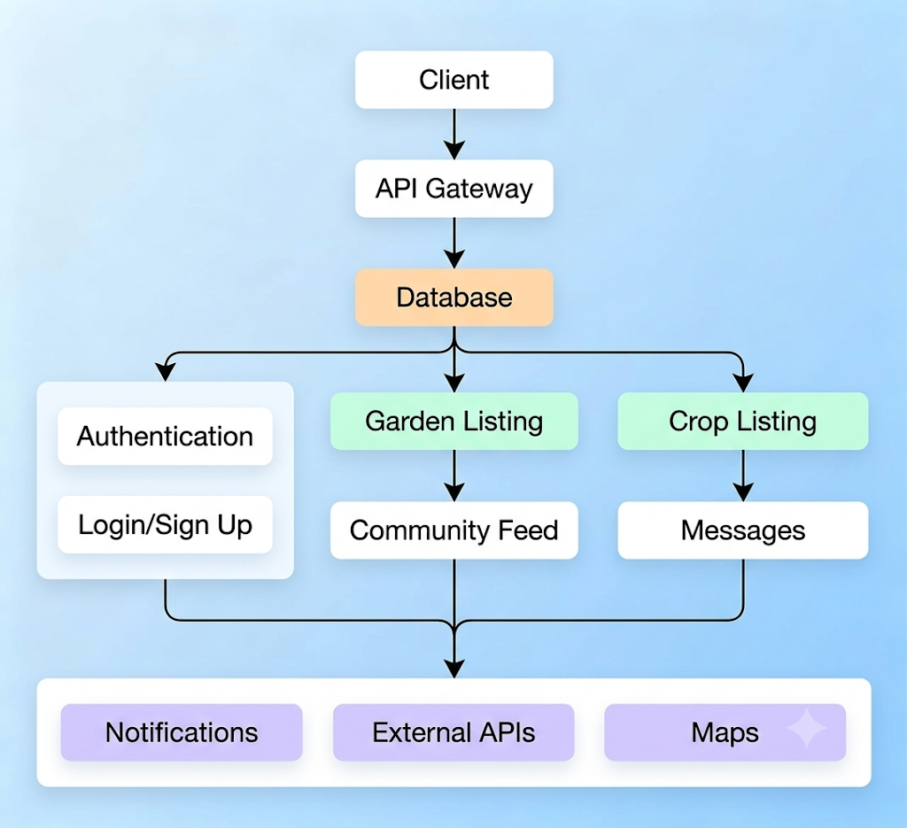
Proposed Methodology(Architectural/Workflow Diagram)

Slide 9
Results
1.Efficient Resource Sharing – Users can easily exchange or donate surplus produce, reducing food wastage and improving sustainability.
2. Increased Community Engagement – Strengthened collaboration among local residents, gardeners, and eco-enthusiasts.
3. Enhanced Accessibility – Simplified access to fresh, local produce for community members, including those without personal gardens.
4. Knowledge Exchange – Improved awareness and knowledge sharing about sustainable gardening practices.
5. Transparency and Accountability – A monitored, user-friendly environment ensuring fair trade and genuine interactions.
6. Scalability and Future Growth – The platform can expand to include new regions, advanced analytics (like crop yield tracking), and integration with government sustainability programs.

Slide 10
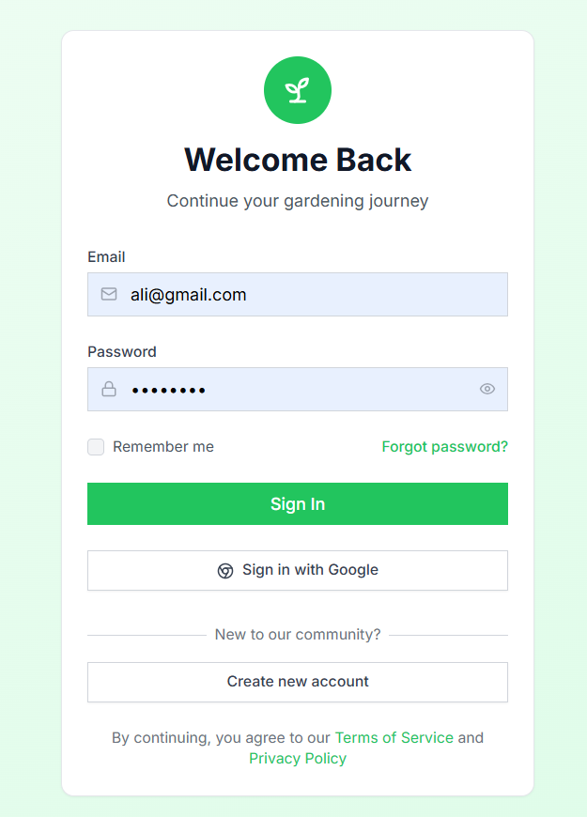
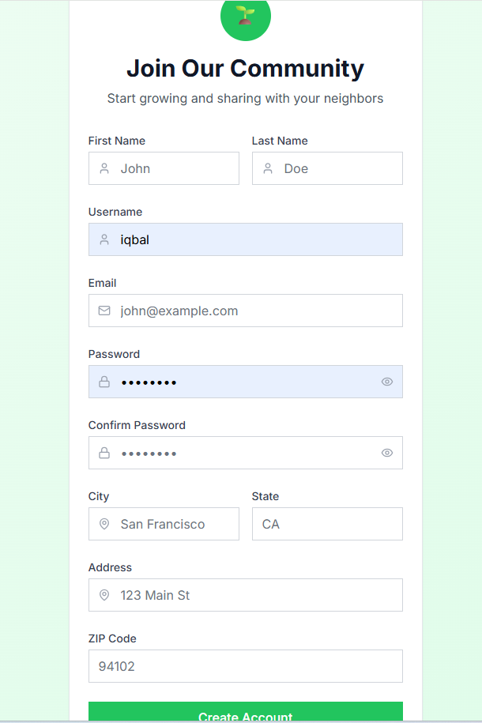
Screenshots of working model
Sign in
Create Account

Slide 11
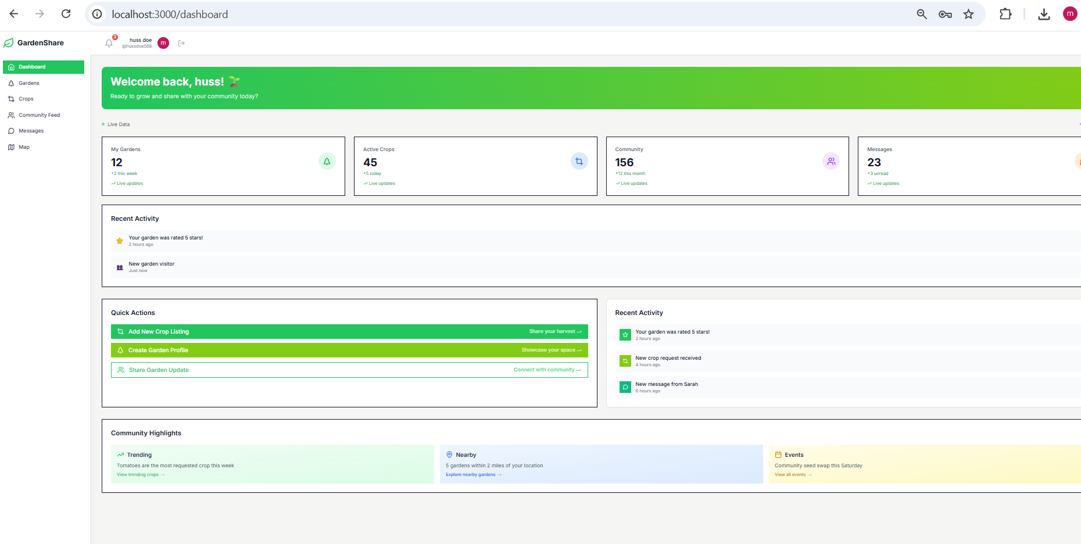
Dashboard

Slide 12
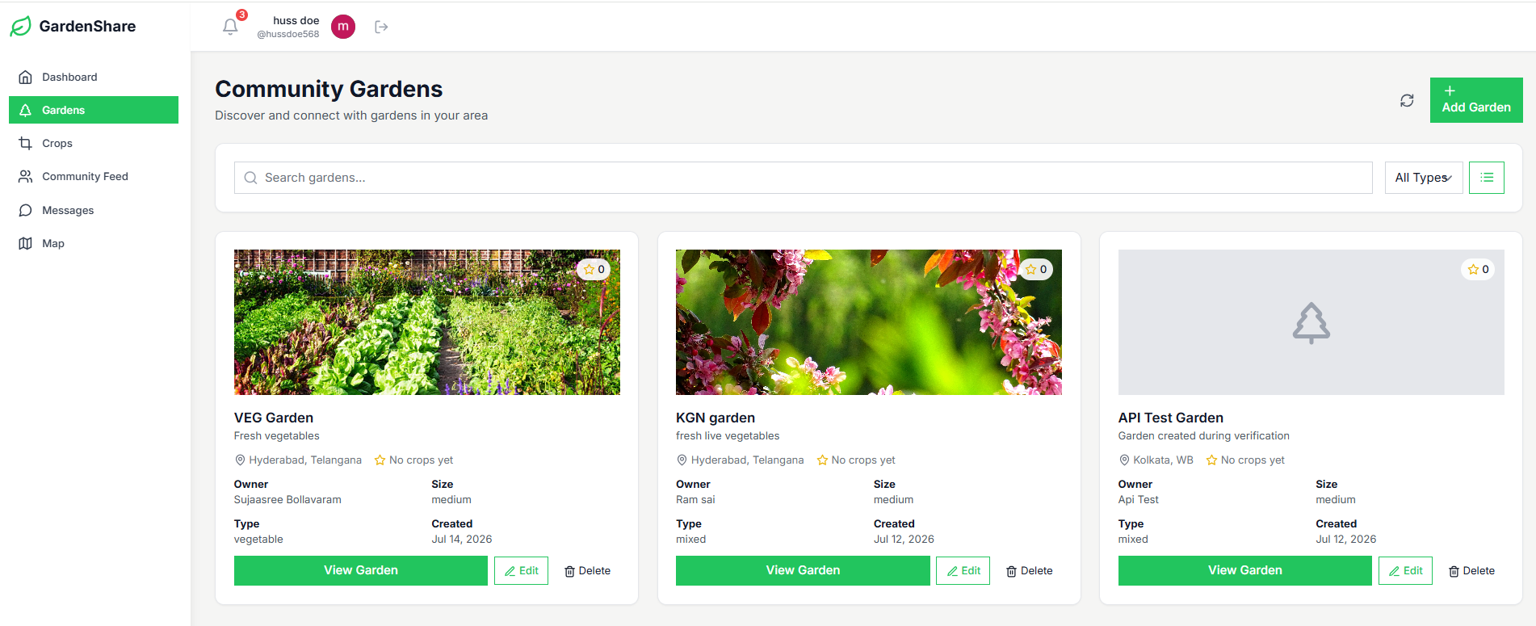
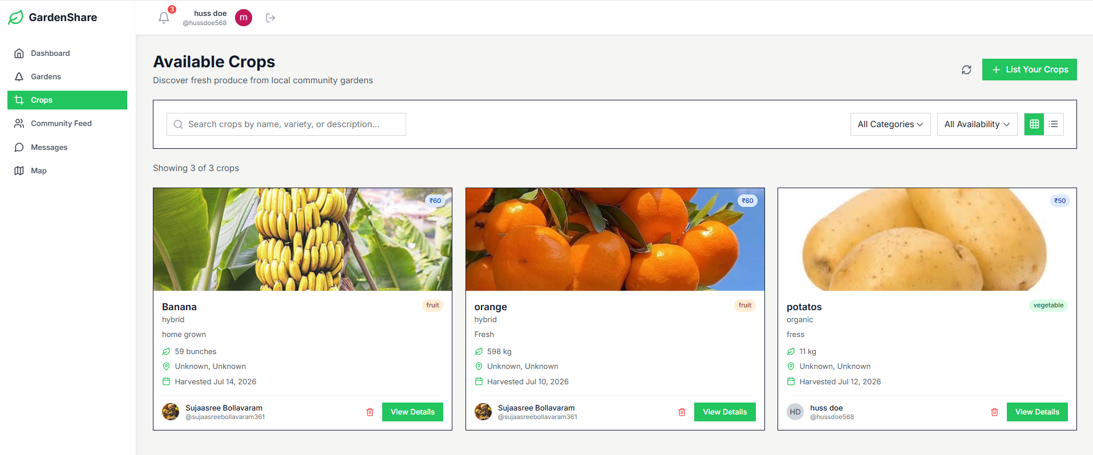
Gardens
Crops

Slide 13
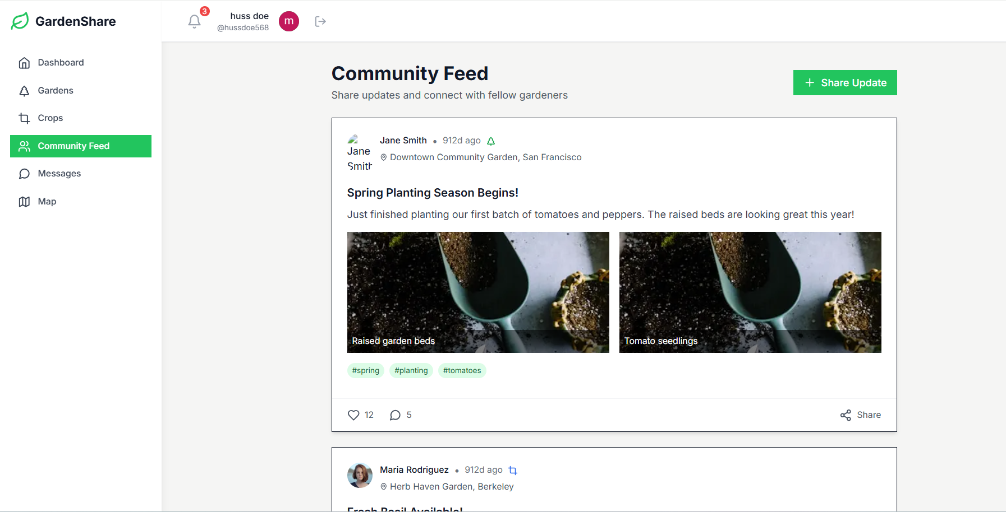
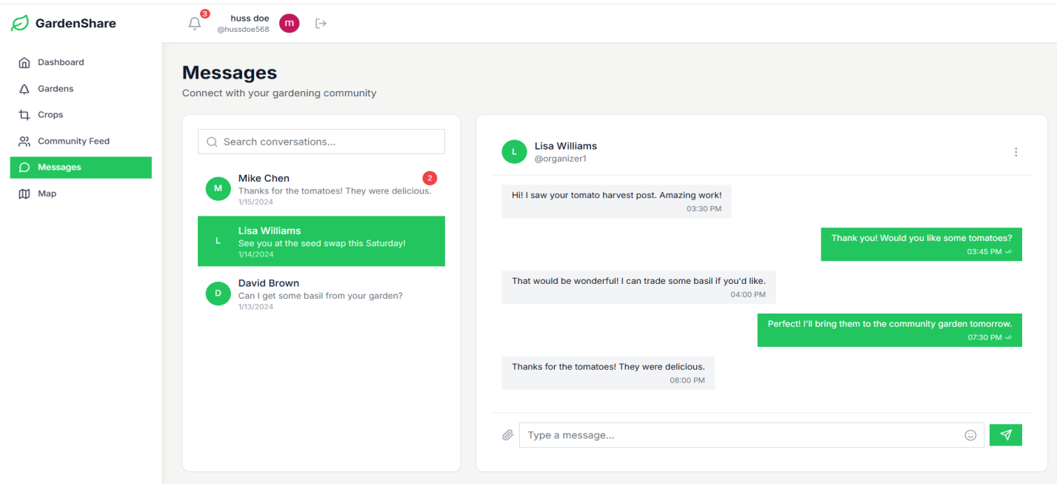
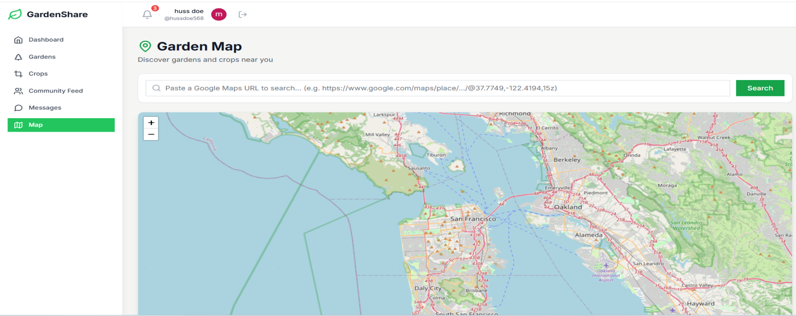
Community feed
Messages
Map

Slide 14
Conclusion
The Community Garden & Crop Sharing Platform provides a modern solution to promote sustainable living, healthy eating, and community engagement. By connecting gardeners and local residents, the platform facilitates the efficient sharing of home-grown crops, reduces food wastage, and encourages eco-friendly gardening practices.
Through features like crop listing, location-based search, notifications, and community forums, the platform makes crop sharing simple, convenient, and interactive. Users can not only access fresh produce but also learn and share knowledge about gardening techniques, seasonal planting, and sustainability practices.
This platform strengthens community bonds by encouraging cooperation, participation in local events, and collaboration on community gardening projects. It provides an effective way for neighborhoods to become more self-sufficient and environmentally conscious while promoting social interaction and knowledge sharing.
In summary, the project demonstrates how technology can be leveraged to support local food systems, foster social connectivity, and promote sustainable practices. It offers a practical, user-friendly, and scalable approach for building healthier, greener, and more resilient communities.

Slide 15
THANK YOU

