Slide 1

Agri Hub
V.Maleshkumar(23BCS106)-Web User Interface Design
M.Manoj(23BCSL04)-Web User Interface Design
T.Prasanna Kumar(23BCSL05)-Web User Interface Design
CSE
CSE

Slide 2
AGENDA
Problem Statement
Objective
ER Diagram
Database Schema
Technology Stack
Screenshot for UI/UX design
CSE

Slide 3
Problem Statement
Farmers across regions like Tamil Nadu and other parts of India face significant challenges in accessing fair and direct marketplaces for selling their produce. Traditional supply chains are dominated by intermediaries, resulting in unfair pricing, lack of transparency, and income instability for farmers. Additionally, poor logistics, limited digital access, and unreliable buyer networks contribute to food wastage and financial losses. These challenges hinder the growth of local agriculture and reduce trust in the agricultural marketplace ecosystem.
CSE
CSE

Slide 4
Objective
The objective of Agri Hub is to create a transparent, user-friendly digital marketplace that connects farmers, sellers, and buyers directly.
Agri Hub aims to:
Empower farmers to market their crops without intermediaries.
Reduce post-harvest losses by integrating delivery services.
Support traceability and compliance for trustworthy trade.
Build a community-driven platform that supports local agriculture and boosts farmer income through digital inclusion.
CSE
CSE

Slide 5
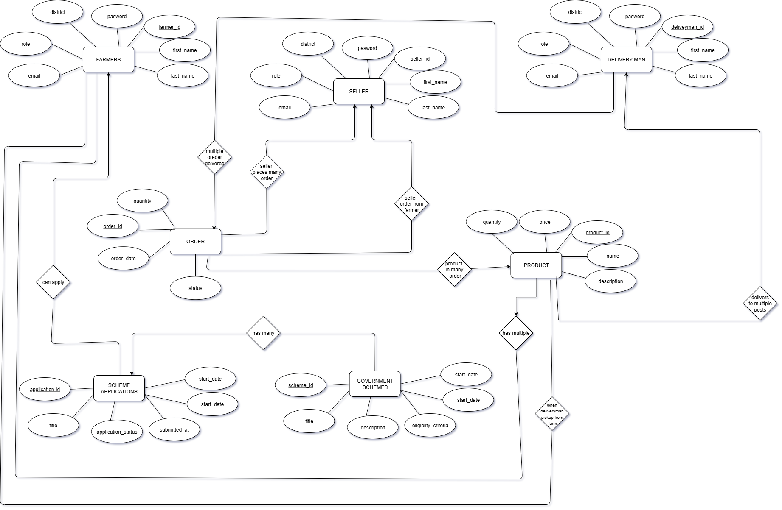
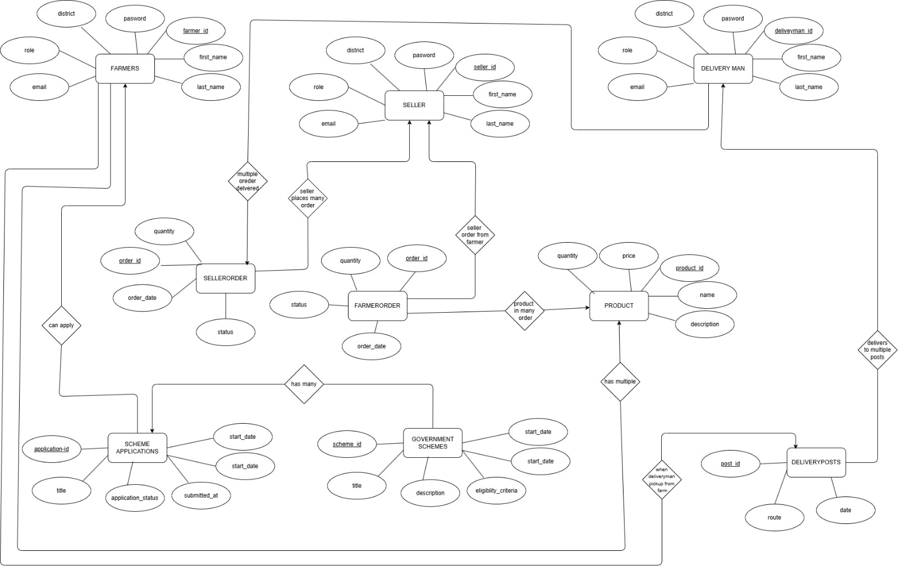
ER Diagram
CSE
CSE

Slide 6
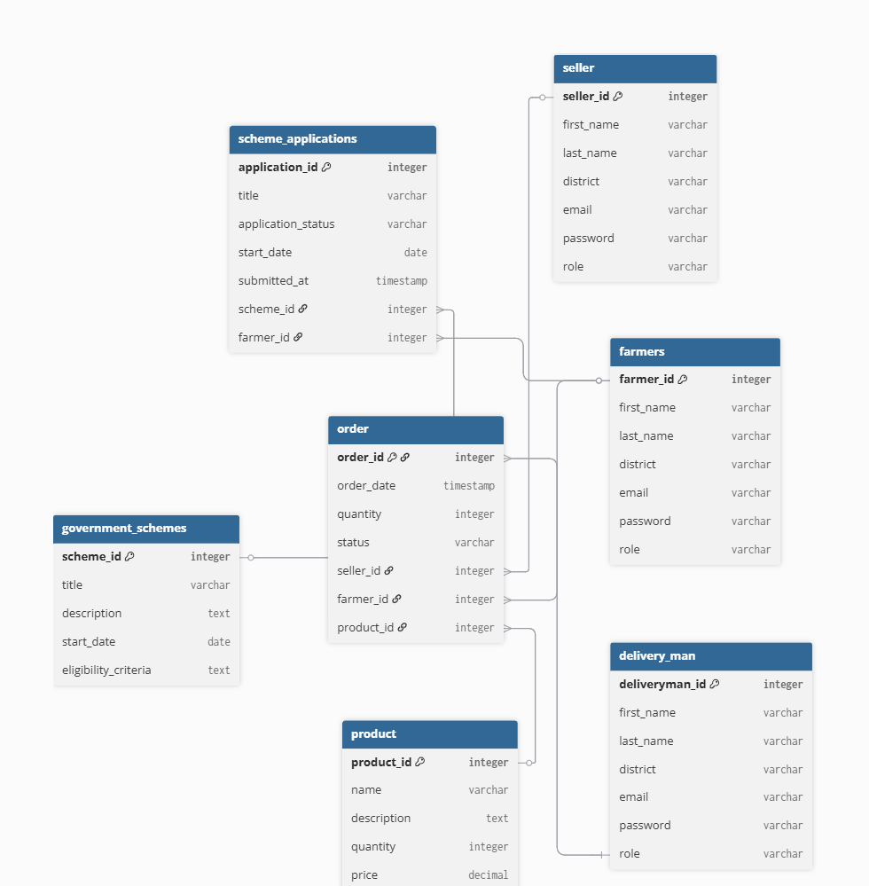
Schema Diagram
CSE

Slide 7
Technology Stack
Frontend (React)
React.js – Frontend library
React Router – For handling routes/pages
Axios / Fetch API – For making HTTP requests
Tailwind CSS – Styling frameworks (Tailwind is modern and developer-friendly)
Backend (Node.js + Express)
Node.js – JavaScript runtime
CORS – Middleware to allow frontend-backend communication
dotenv – To manage environment variables
Database
MongoDB – NoSQL database
Mongoose – ODM (Object Data Modeling) for MongoDB (to interact with DB easily in Node.js)
CSE
CSE

Slide 8
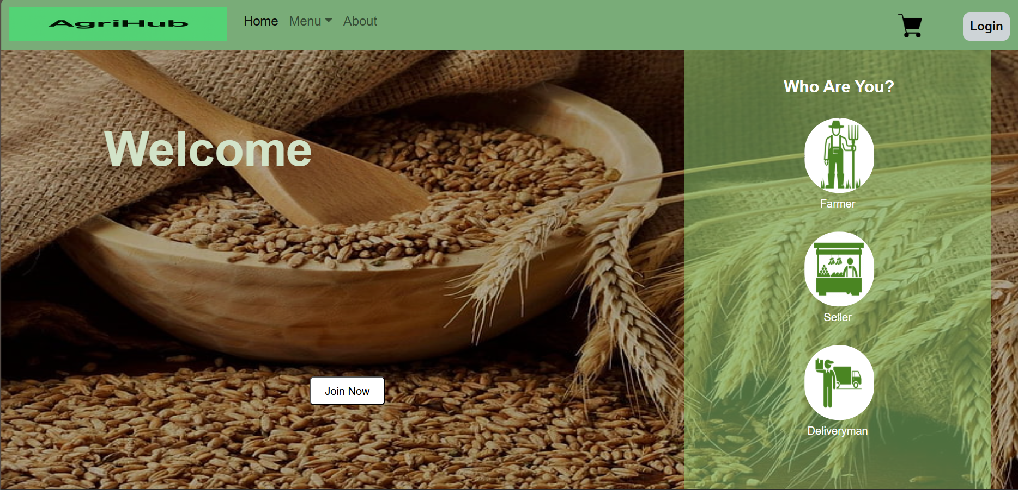
Screenshots
CSE
CSE

Slide 9
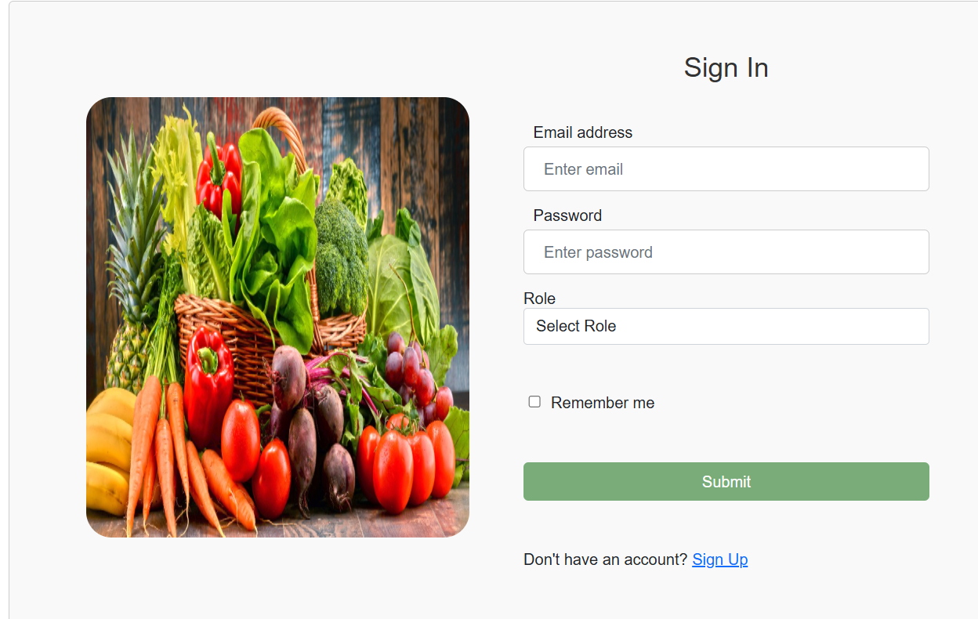
CSE

Slide 10
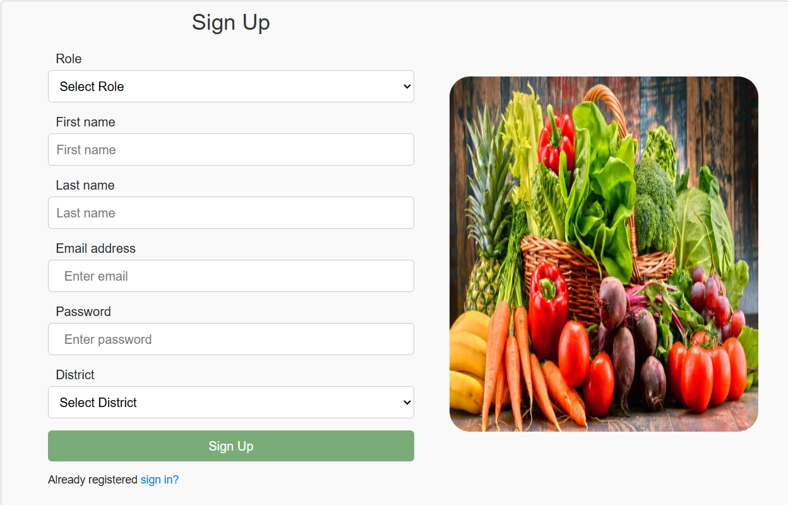
CSE

Slide 11
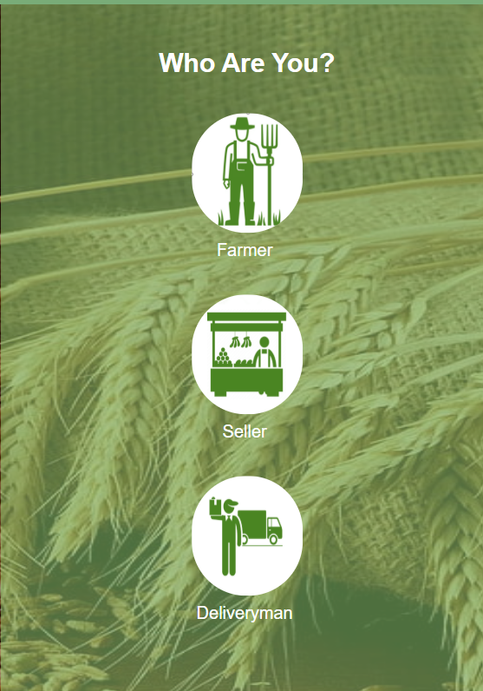
CSE

Slide 12
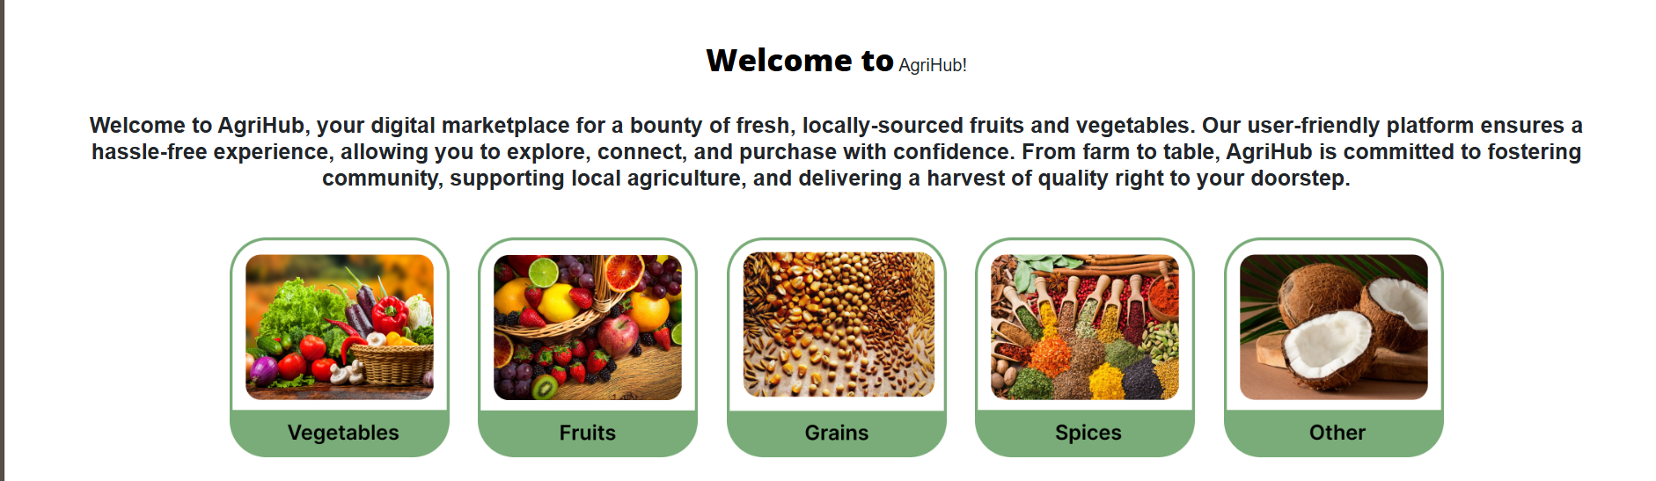
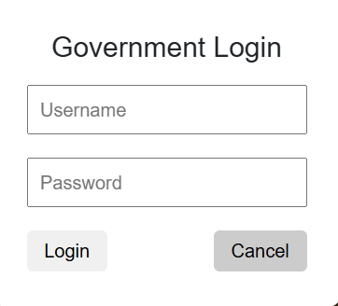
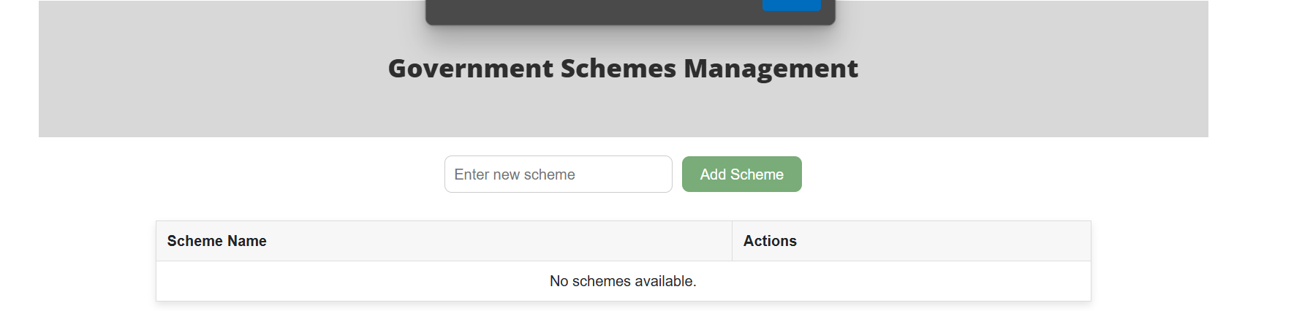
CSE

Slide 13
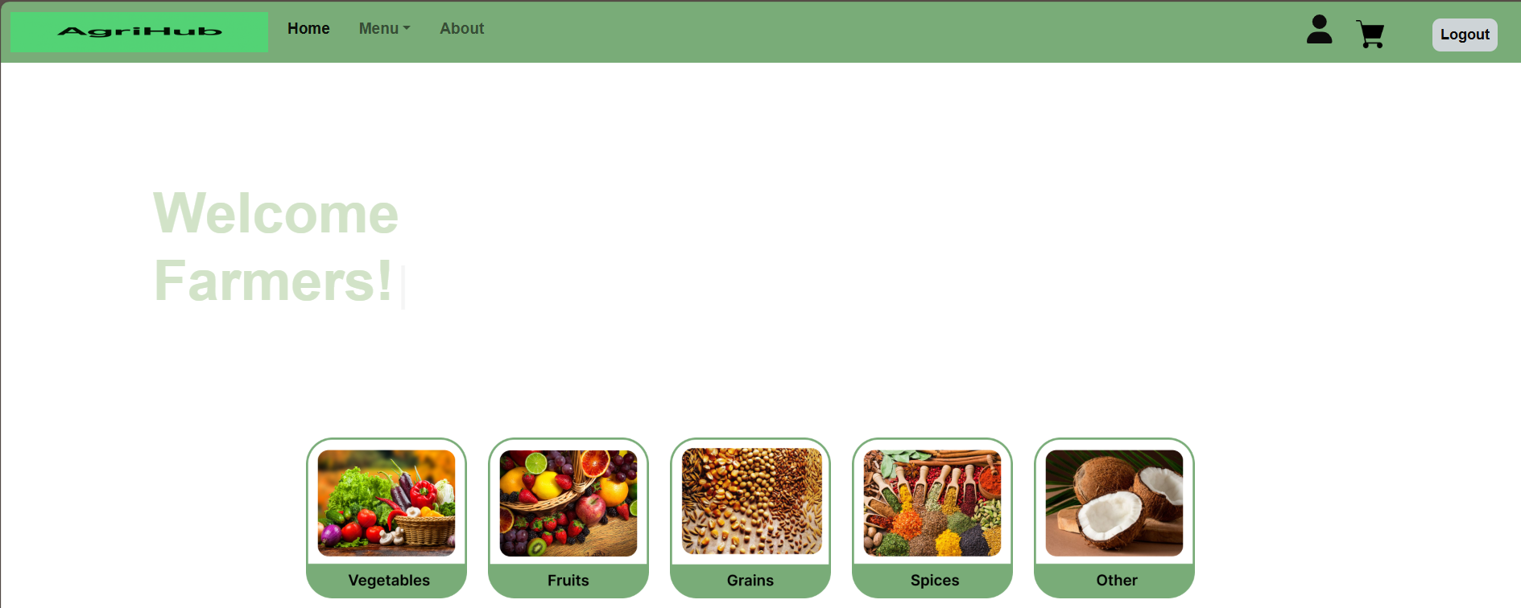
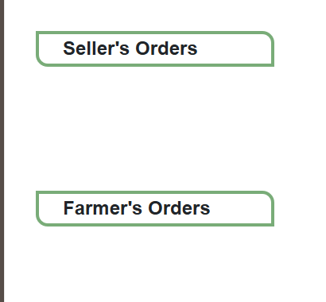
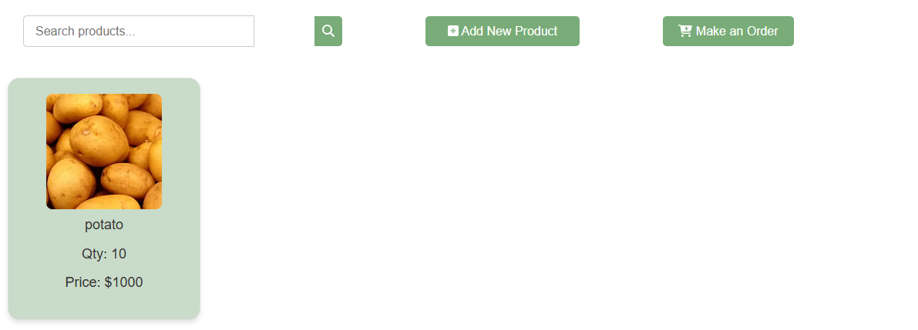
CSE

Slide 14
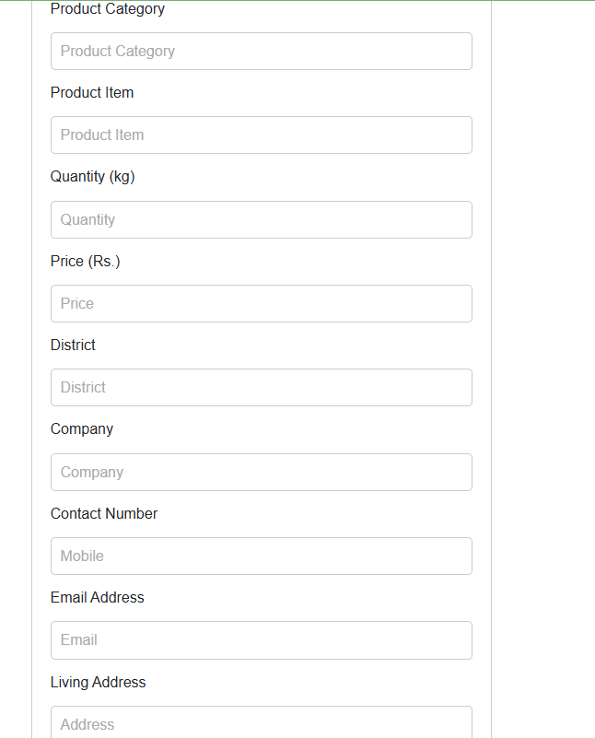
CSE

Slide 15
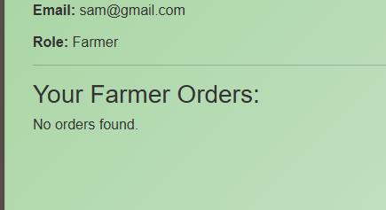
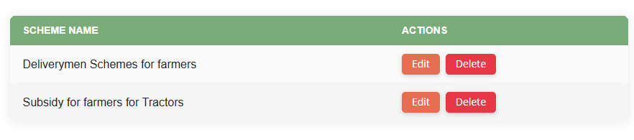
CSE

Slide 16
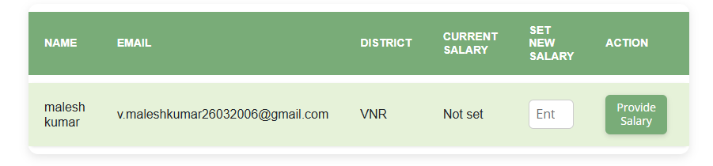
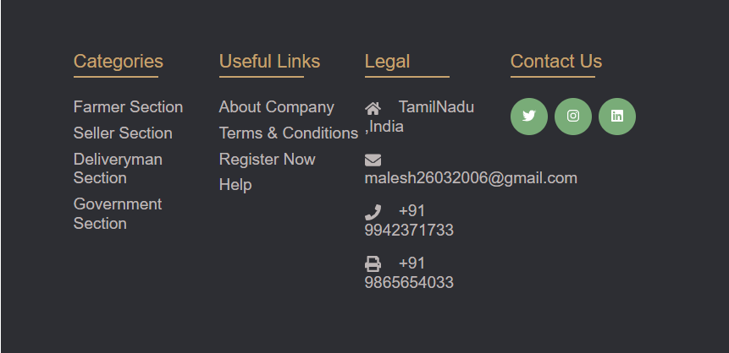
CSE

Slide 17

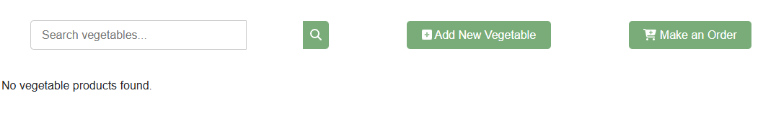
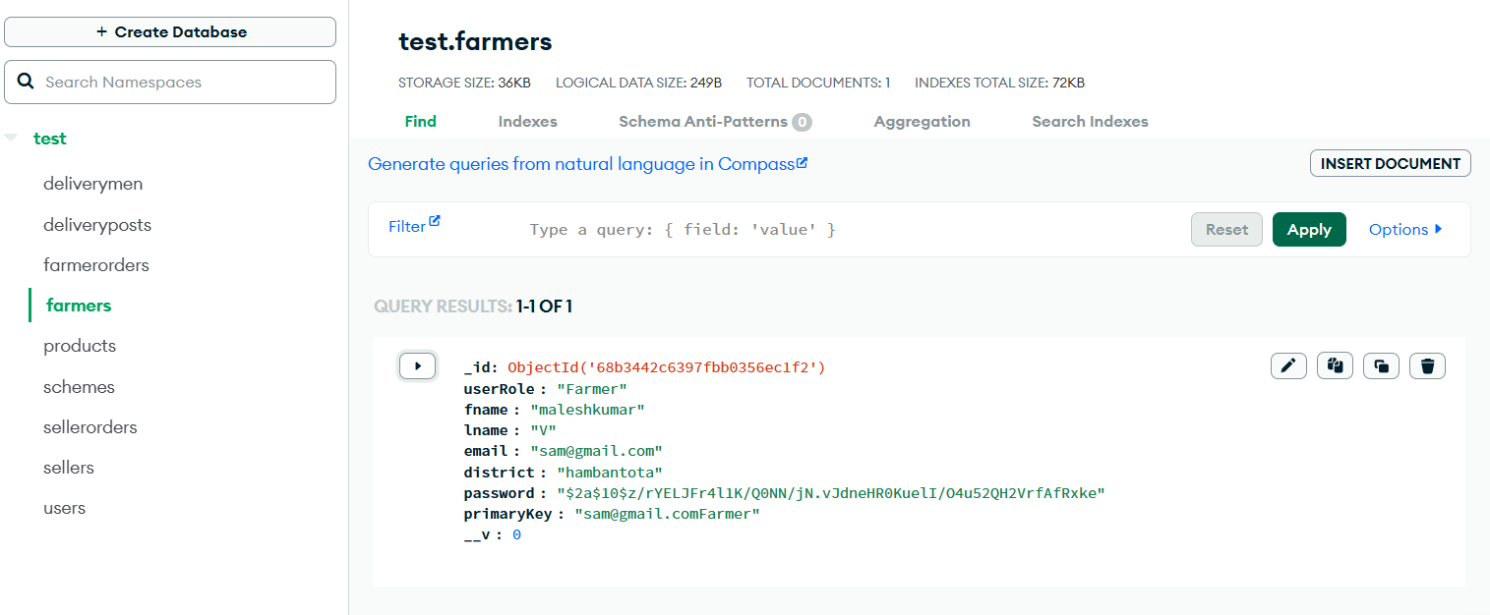
CSE

Slide 18
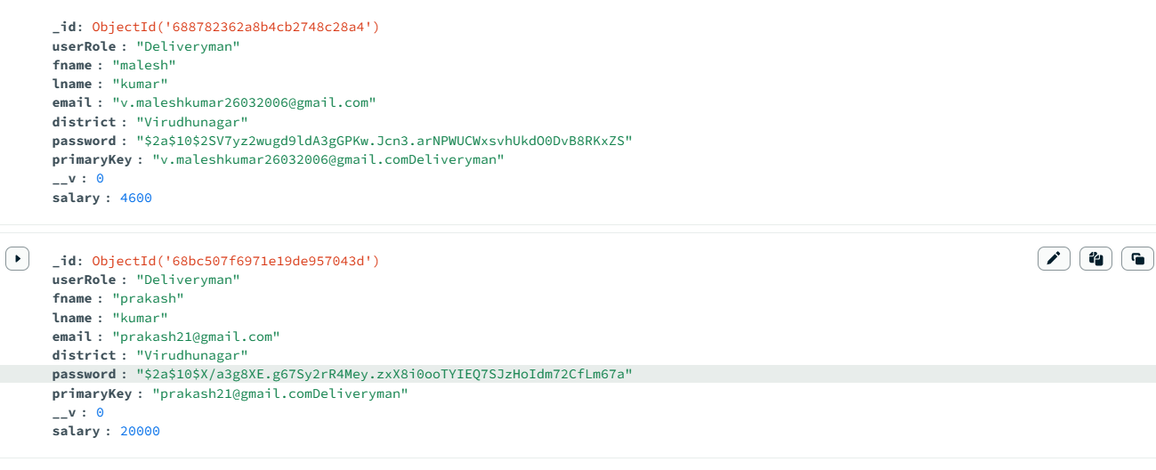
https://agri-hub-black.vercel.app/
CSE

Slide 19
Thank You…
CSE
CSE
CSE

