Slide 1
LOST & FOUND PORTAL
Campus
Track
Find What's Lost,
Return What's Found.
Intelligent Lost & Found Locator
A smart campus portal connecting students with their missing
belongings. Report, search, match, chat — all in one place.
Java Spring Boot 3
MySQL 8
6
8
100%
WebSocket / STOMP
Modules
Weeks
Complete
React.js Frontend
Mentor: Suramya Biswas | Infosys Springboard — Java Batch 13
Team: InbarasanKumar | Bhuvanesh Khanna G | Ariba Kausar | Harchitha N | Varun K | Maleshkumar V | Syed Noureen

Slide 2
AGENDA
What We'll Cover Today
01
Project Overview
02
Technology Stack
Problem statement & objectives
Java, Spring Boot, MySQL, React
03
System Architecture
04
Modules Implemented
3-layer architecture & schema
All 6 modules — Auth to Analytics
05
App Screenshots
06
Chat Module ✓
Full portal walkthrough with real screenshots
WebSocket live chat — completed
07
8-Week Timeline
08
Future Enhancements & Conclusion
Milestones & evaluation criteria
Upcoming features & key takeaways

Slide 3
PROJECT OVERVIEW
Problem Statement & Our Solution
THE PROBLEM
OUR SOLUTION
No centralized campus lost & found platform
Campus-restricted lost and found listings
Students rely on notice boards & word of mouth
Smart keyword + fuzzy matching engine
No way to verify if a found item matches a report
Category browsing, filtering by location
No secure channel for owner & finder to connect
WebSocket live chat — securely connect users

Slide 4
TECHNOLOGY STACK
Tools & Frameworks Used
FRONTEND
BACKEND
DATABASE
AUTH
React.js
Java Spring Boot 3
MySQL 8
Spring Security + JWT
Dynamic UI framework
REST API & business logic
Relational database
Authentication & authorization
REAL-TIME
ORM
IDE
BUILD
WebSocket (STOMP)
Spring Data JPA
VS Code / Eclipse
Maven
Live chat & messaging
Database interaction layer
Development environment
Dependency management

Slide 5
SYSTEM ARCHITECTURE
Three-Layer Architecture
PRESENTATION LAYER
BUSINESS LOGIC LAYER
DATA ACCESS LAYER
React.js Frontend
Spring Boot Controllers
Spring Data JPA
Login / Register UI
JWT Auth & Security
MySQL 8 Database
Dashboard & Forms
Matching Algorithm
User & Item Schemas
Live Chat Interface
WebSocket Handler
Chat Message Storage

Slide 6
MODULES IMPLEMENTED
6 Core Modules — All Completed
01
02
03
Authentication & Role Mgmt
Post Lost / Found Items
Auto-Matching & Search
- Student & Admin roles
- Structured form + image upload
- Keyword + fuzzy matching
- JWT session management
- Category & tag support
- Location-based suggestions
- Campus-verified access
- Auto ID: L0001, F0001...
- Potential Matches panel
04
DONE
05
06
Chat / Contact System [DONE]
Admin Dashboard
Reporting & Analytics
- WebSocket STOMP live chat
- View all posts
- Items reported/matched/recovered
- Online users sidebar
- View all Students
- Filter by date, category, location
- Real-time messaging
- View Matched Items
- User engagement metrics

Slide 7
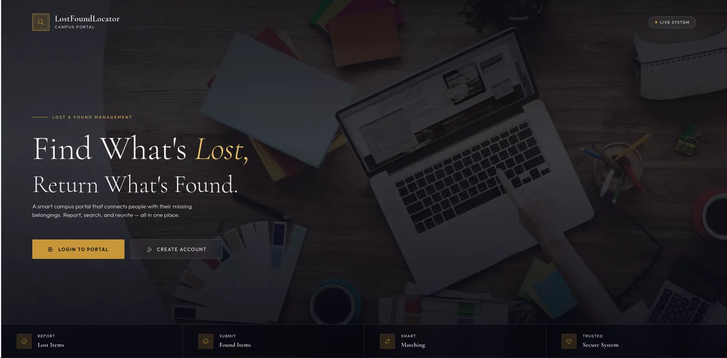
APP SCREENSHOT — SCREEN 1 OF 8
Landing Page
Hero: "Find What's Lost, Return What's Found" | LOGIN TO PORTAL + CREATE ACCOUNT buttons | Report • Submit • Match • Secure feature bar | LIVE SYSTEM status

Slide 8
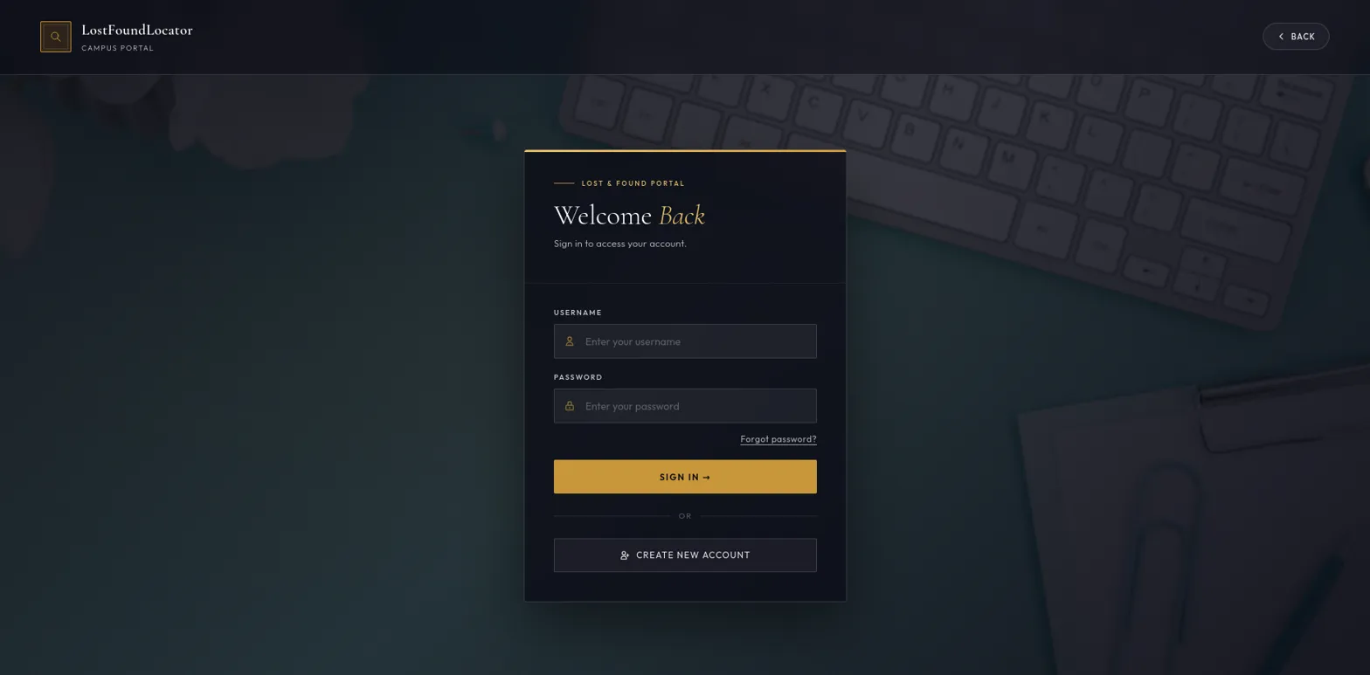
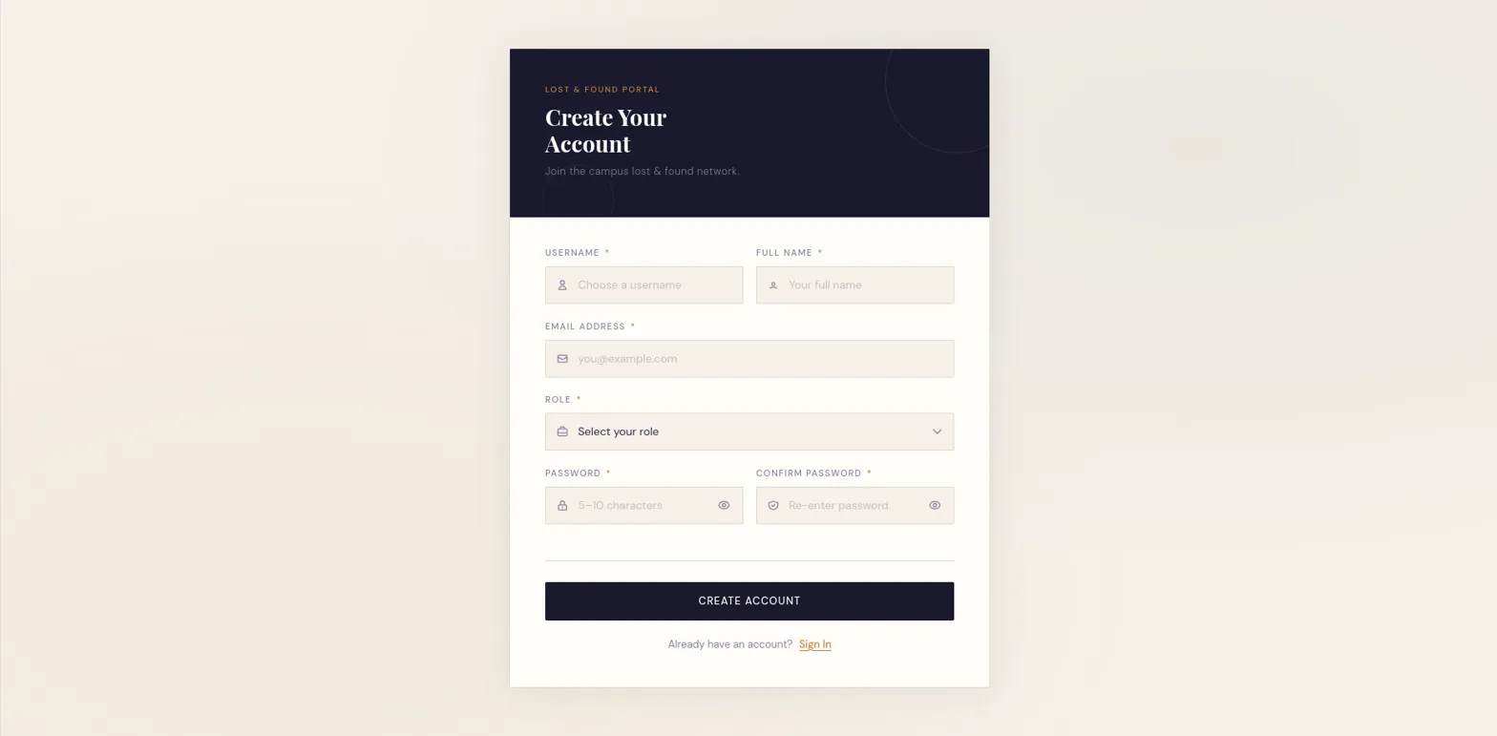
APP SCREENSHOTS — SCREENS 2 & 3 OF 8
Login & Registration
Login — "Welcome Back" | Username + Password + SIGN IN
Register — Username, Name, Email, Role, Password + Confirm

Slide 9
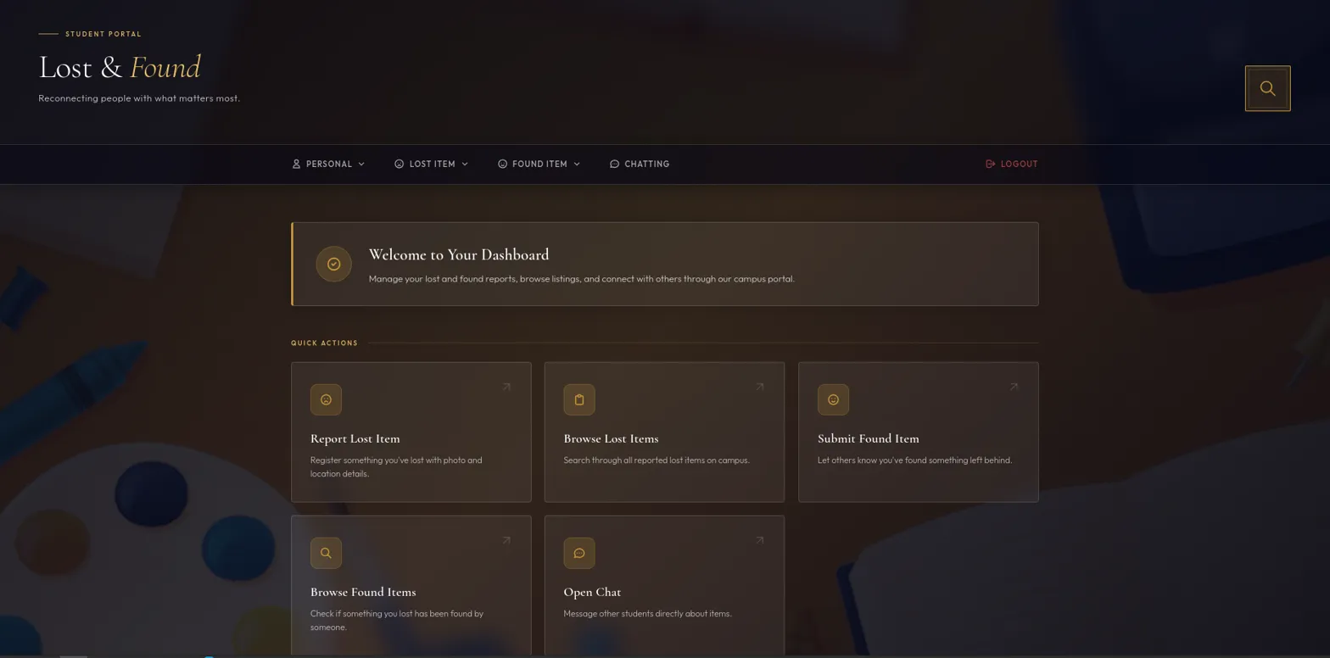
APP SCREENSHOT — SCREEN 4 OF 8
Student Dashboard
Nav: PERSONAL | LOST ITEM | FOUND ITEM | CHATTING | LOGOUT | Quick Actions: Report Lost • Browse Lost • Submit Found • Browse Found • Open Chat

Slide 10
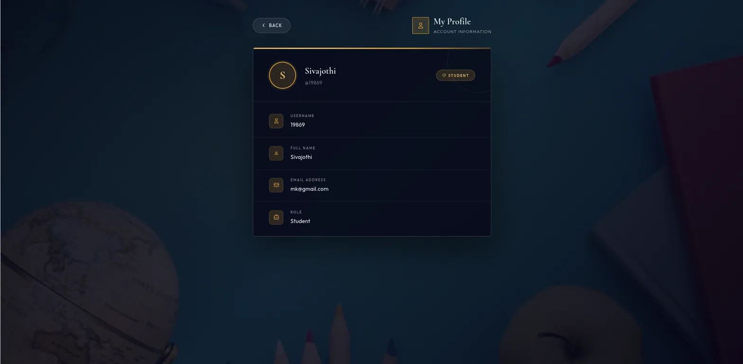
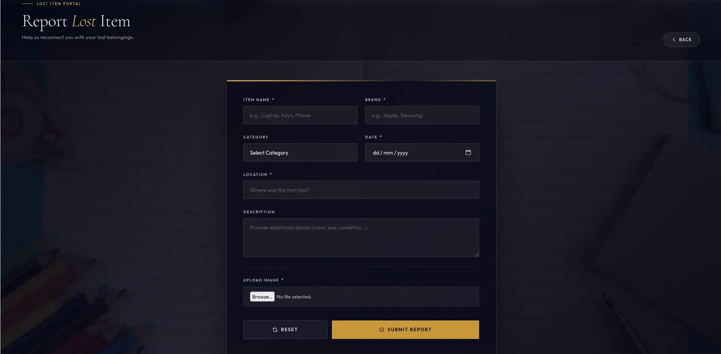
APP SCREENSHOTS — SCREENS 5 & 6 OF 8
My Profile & Report Lost Item
Profile: Username 19869 | Name Sivajothi | Email | Role: Student
Report Lost: Item Name, Brand, Category, Date, Location, Description, Image Upload

Slide 11
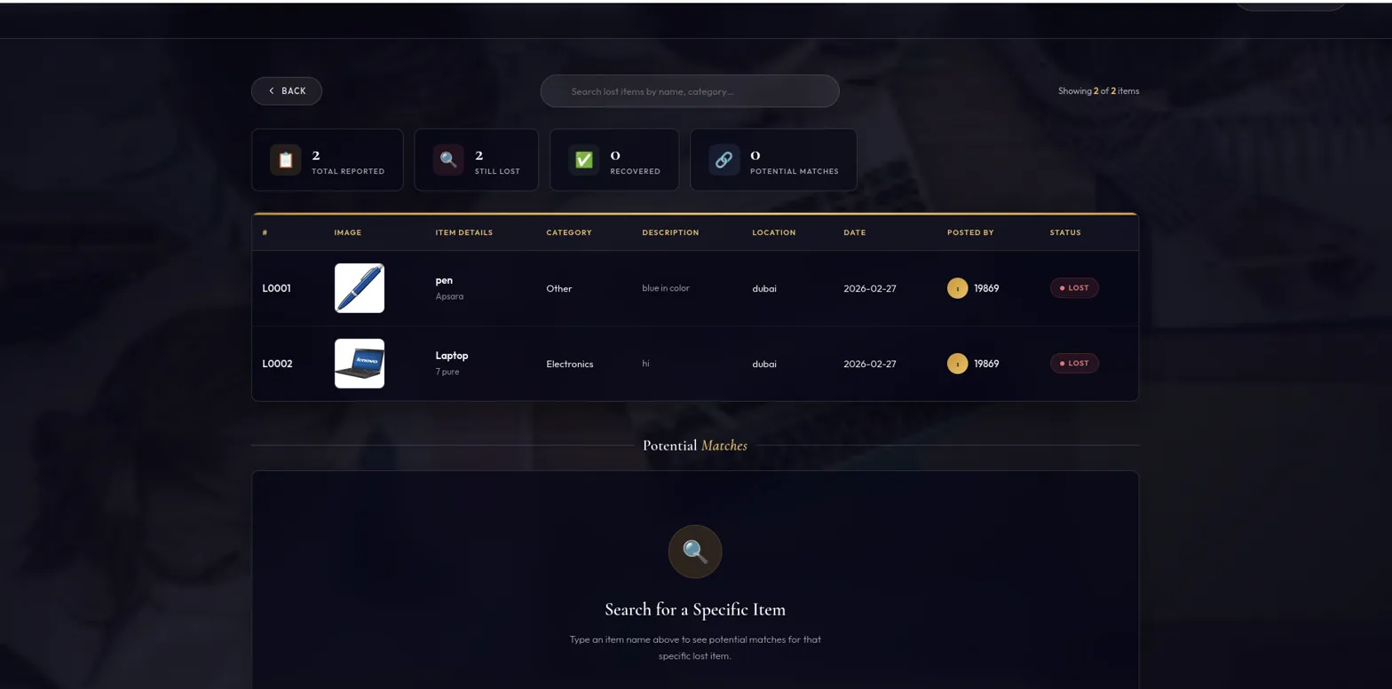
APP SCREENSHOT — SCREEN 7 OF 8
Browse Lost Items & Matching
Stats: 2 Total Reported | 2 Still Lost | 0 Recovered | 0 Potential Matches | Items: L0001 pen/Apsara • L0002 Laptop/7pure | Potential Matches search panel

Slide 12
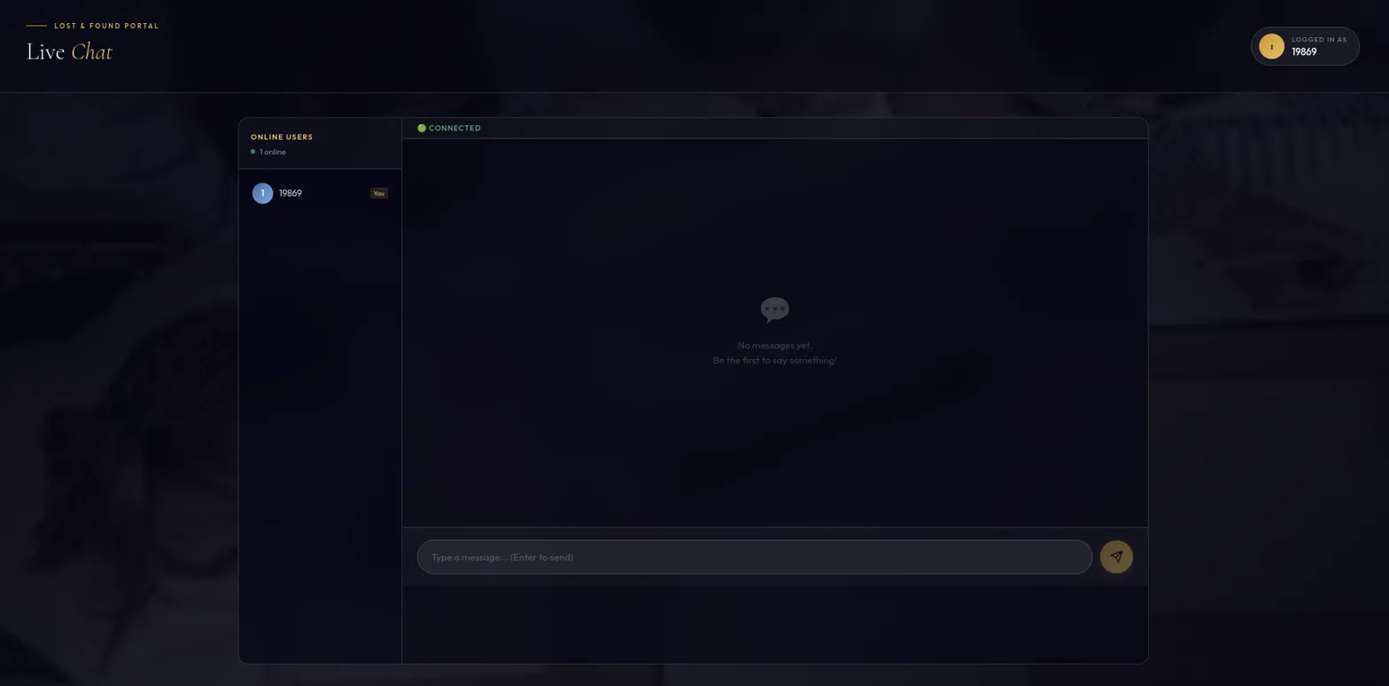
APP SCREENSHOT — SCREEN 8 OF 8 | CHAT MODULE
MODULE COMPLETED
Live Chat — WebSocket Implementation
CONNECTED status | Online Users panel: 1 online (19869 — You) | Chat area: "No messages yet..." | Message input: Enter to send | WebSocket STOMP protocol

Slide 13
MILESTONES & TIMELINE
8-Week Development Journey
W1
W4-5
W7
Auth
Matching
Admin
Login, register, JWT, roles
Keyword + fuzzy + location
Dashboard, moderation
W2-3
W6
W8
Posts
Chat
Reports
Lost/Found forms, categories
WebSocket STOMP — DONE
Analytics, metrics
Evaluation: W1 Login/roles | W3 Posting functional | W5 Matching tested | W6 Chat working | W8 Admin & reports generated

Slide 14
FUTURE ENHANCEMENTS
Upcoming Features & Improvements
AI-Powered Matching
Email & Push Alerts
Private Direct Messages
NLP & ML models for higher accuracy beyond keyword matching
Instant notification when a potential match is found
One-to-one private chat between item owner and finder
Mobile App
Interactive Campus Map
Blockchain Verification
React Native iOS/Android app for on-the-go reporting
Map-based location picker for precise item tagging
Tamper-proof ownership records and item transfer proof

Slide 15
CONCLUSION
KEY TAKEAWAYS
CampusTrack
All 6 Modules Completed
v
Auth, Posts, Matching, Chat, Admin, Analytics — 100%
Intelligent Lost & Found Locator
v
Real-time WebSocket Chat
Live messaging connects reporters & finders instantly
CampusTrack successfully delivers a full-stack campus lost and found portal solving a real everyday problem. Through intelligent matching, JWT security, WebSocket live chat, and admin moderation — the platform creates a complete ecosystem for reconnecting students with their belongings.
v
Smart Matching Engine
Keyword + fuzzy + location-based suggestions
v
Production-Ready Dark UI
Full-Stack Java
JWT Auth
WebSocket Chat
Premium gold-on-dark theme, fully responsive portal
Smart Matching
Admin Panel
Analytics
v
Secure & Campus-Restricted
JWT auth, role management, campus email validation
Thank You | Mentor: Suramya Biswas | Team: InbarasanKumar, Bhuvanesh Khanna, Ariba Kausar, Harchitha Narayanan, Varun K, Maleshkumar V, Noureen

