Slide 1

THE WINNER OF THE NEXT MATCH
ACADEMIC YEAR 2022-2023
SIMONE MALESARDI – ID: 978989

Slide 2
Abstract
The aim of the project is to define an automatic system to predict the outcome of the matches starting from the news concerning the teams involved in the match published in the days and weeks preceding the match.
The outcome problem became a classification problem because an outcome match could belong to 3 different classes:
Home team win → (e.g. Juventus 2 – Inter 0)
Away team win → (e.g. Milan 0 – Juventus 2)
Draw → (e.g. Napoli 0 – Juventus 0)

Slide 3
Project steps
Data collection
Data pre-processing
Vectorizer construction
Text classification
Outcome classification
Evaluation
Applying the model

Slide 4

Data collection
1. DATA COLLECTION - FBREF
To build the predicting model, I used data coming from 2 different sources:
FBref: in this website statistics of various teams belonging to different leagues (male and female league) are published
FootballPredictions: in this website news of teams are published before the matchday
The competition taken into account, also for previous knowledge, is the
Italian Serie A.

Slide 5
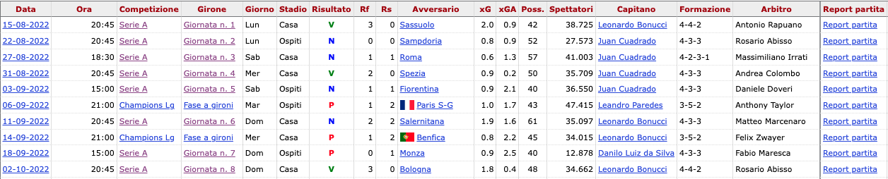
1. DATA COLLECTION - FBREF
Obtaining FBref data
Fbref publishes different HTML statistical tables for each team in the championship (2022-2023)

Slide 6
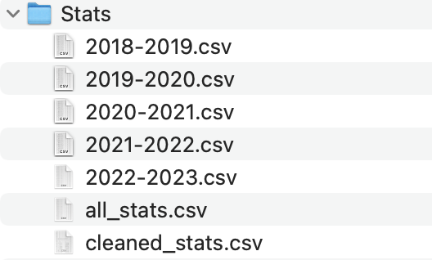
1. DATA COLLECTION - FBREF
Obtaining FBref data
Features extracted from all those HTML tables:
Goals
Goals on penalty
Fouls
Shots on target
Total penalties
Yellow cards
Total shots
Percentage possession
Red cards
Every championship has its csv dataset with statistics.
These datasets are merged into one dataset “all_stats.csv”

Slide 7
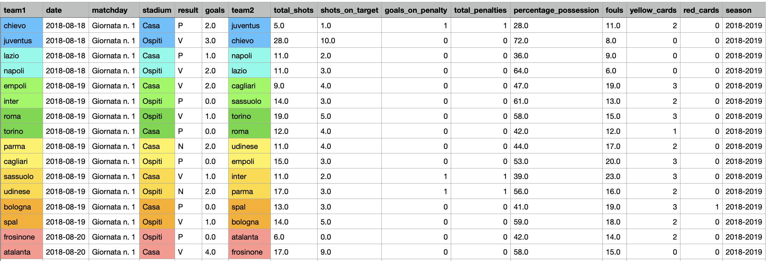
1. DATA COLLECTION - FBREF
Obtaining FBref data
There are two records referring the same match in the obtained dataset: it is due to home and away team statistics

Slide 8
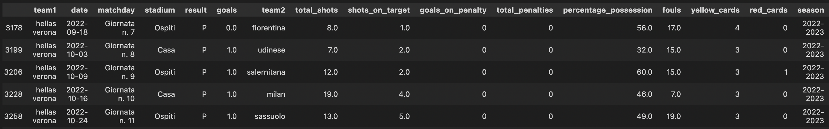
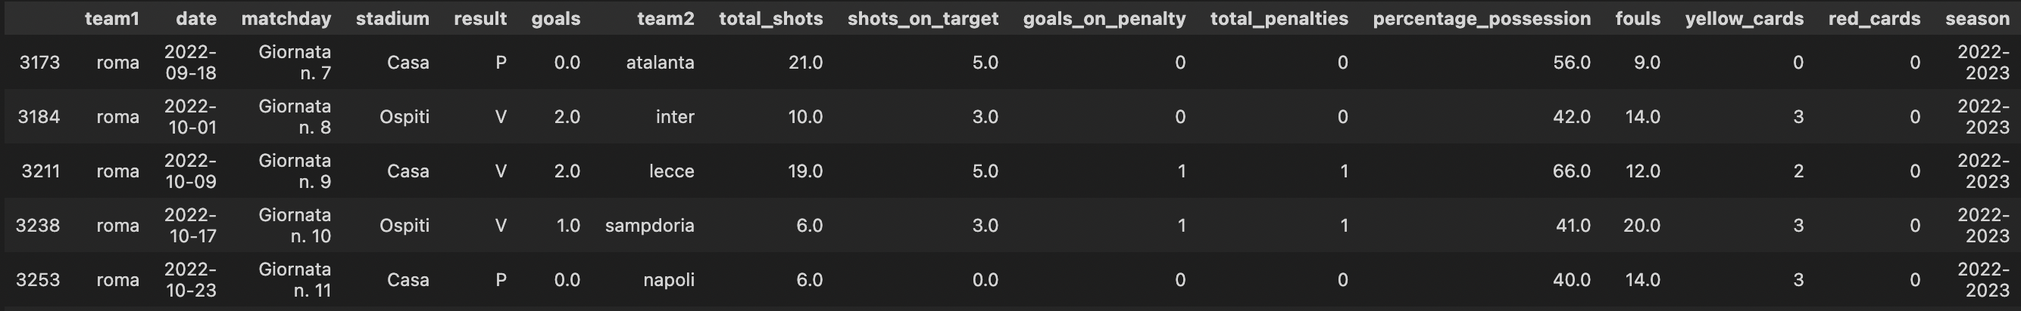
2. DATA COLLECTION - FBREF
Processing FBref data
Each pair of records referring the same match is merged into following 3 steps:
filtering previous statistics of the 2 teams involved in the match
computing the average for each statistic in the previous 5 matches
subtracting features [avg(home features) – avg(away features)]

Slide 9
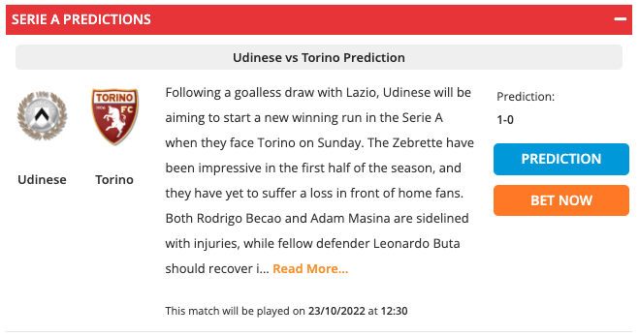
1. DATA COLLECTION - FOOTBALLPREDICTIONS
Obtaining FootballPredictions data
FootballPredictions publishes news for each match reporting the favorite team, performances about previous matches, injured players.
For each match in the statistical dataset the news of the match are searched in FootballPredictions setting the date of the match in the FootballPredictions url.
https://footballpredictions.com/footballpredictions/?date=23-10-2022

Slide 10
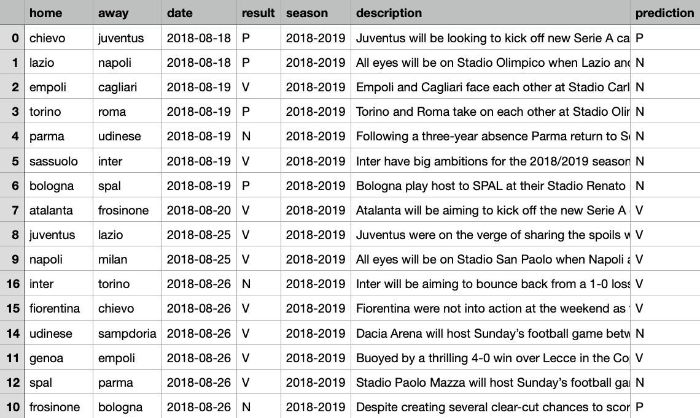
1. DATA COLLECTION - FBREF
FootballPredictions dataset
For each match are got two values:
description: the news published before the match
prediction: the label that represents the prediction made over the final result of the match

Slide 11
Classification
Matches can be classified into 3 classes:
draw (”N" → 0)
home team winner ("V" → 1)
away team winner (”P" → 2)
To build the predictive model I used two different supervised classification models:
Decision Tree: used to analyse the text read from football prediction and to get the label
Random Forest: used to predict the final result of a next match

Slide 12

3. VECTORIZER CONSTRUCTION
Text classification
Texts downloaded from FP can't be used to build the model without being pre-processed, in fact texts must be transformed into vectors of numbers.
TfidfVectorizer is the vectorizer used to build the Decision Tree model.
TfidfVectorizer converts a collection of raw documents to a matrix of TF-IDF features.
Texts have to be processed through 4 phases:
synonyms normalization
remove punctuation, numbers
tokenization
stop word filtering
stemming

Slide 13
3. VECTORIZER CONSTRUCTION
Normalization of synonyms
Taking into account the the text of the match between Sassuolo-Hellas Verona in the 24 October 2022:
“Monday's football game between Sassuolo and orange Verona will bring down the curtain on day 11 of the new Serie A campaign. The Neroverdi aim to make amends for back-to-back losses to Inter and Atalanta, and they are surely capable of matching the Mastini on home soil. Fit-again forward Domenico Berardi is widely expected to return to the starting XI, while both Gregoire Defrel and Mert Muldur continue to miss out with injuries. Verona, on the other hand, are on a five-game losing run in the Italian top flight, meaning that Sassuolo will not have a better chance than this to get back on course. Both Kevin Lasagna and Diego Coppola are sidelined with injuries for the visiting side, while defender Federico Ceccherini is back from suspension. In their last encounter in the Serie A Verona outplayed Sassuolo 4-2, meaning that the hosts are hungry for revenge.”
In text there are words meaning nicknames of the teams involved in a match for example ”Mastini” (Verona’s nickname) and ”Neroverdi” (Sassuolo’s nickname).
These words need to be processed and they are replaced with “home team” or “away team”.

Slide 14
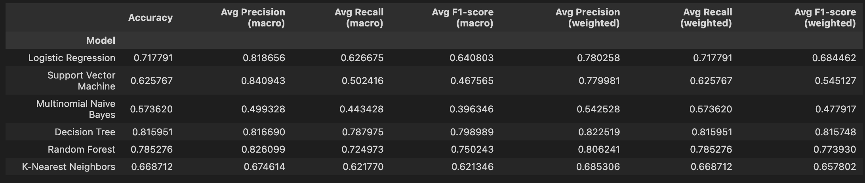
4. TEXT CLASSIFICATION
Decision Tree
6 different ML models, provided by sklearn library, were compared, finding the most performing was Decision Tree reaching an accuracy higher than 80%

Slide 15

4. TEXT CLASSIFICATION - VALIDATION
K-Fold Cross Validation
How good is the built Decision Tree model?
Cross Validation Scores:
[0.61832061 0.66153846 0.76153846 0.83076923 0.84615385 0.79230769 0.76153846 0.76923077 0.78461538 0.76923077]
Average CV Score: 0.7595243687610099
Number of CV Scores used in Average:
10

Slide 16
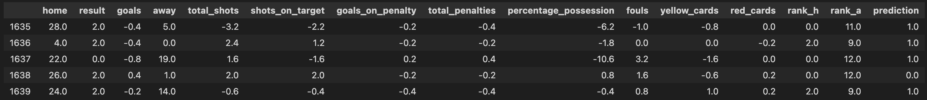
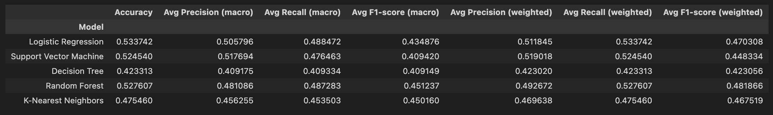
5. OUTCOME PREDICTION
Random Forest
The aim of this point is to build a model which can be used to predict outcomes of future matches.
Random Forest works with numerical features, so names of teams have to be transformed into numbers: it is done using a dictionary created during the download phase.
Models used in this phase are the same of the previous classification without Multinomial Naïve Bayes

Slide 17
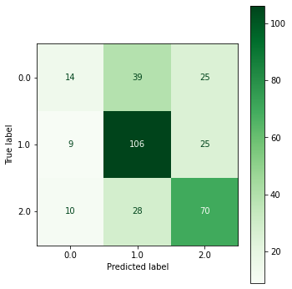
6. EVALUATION
Random Forest
The matrix shows how difficult it is to predict a draw outcome.

Slide 18
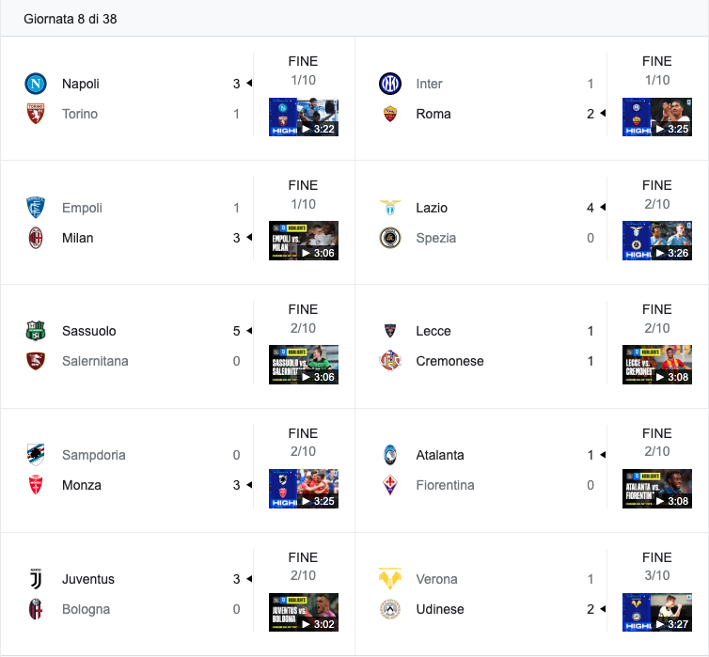
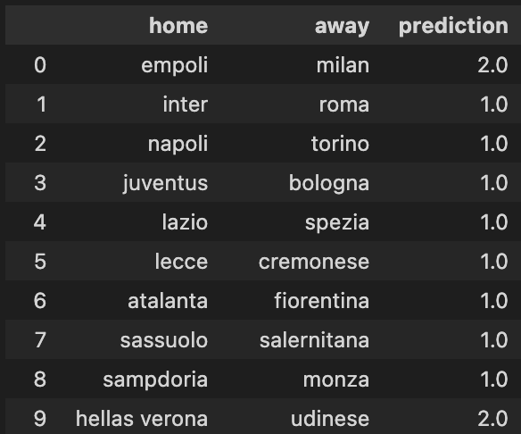
7. APPLYING THE MODEL
Results
This is an example of the prediction of the Serie A’s 8th matchday and the model correctly predicted 7/10 matches
Prediction
Real results

