Slide 1
SEBA MASTER - WEB APPLICATION ENGINEERING
Exercise II: Technical Description & Design
Presented by: Team 52
Notes:
Welcome
Presentation of the results of first exercice

Slide 2

BUSINESS IDEA RECAP
Group tickets are cheaper per person than single tickets!
Our idea: Web application where one can publish a group ticket and share the price with people that are interested in the same activity.
e.g : public transport, festivals, events…
 | 26 €
 | 17 €
 | 14 €
 | 12,5 €
 | 11,6 €
Bavaria Ticket price / person
Notes:
Often the price of group tickets per person is way cheaper then a ticket for one single person
Here we have the example of Bavaria ticket
Our idea: Web application where one can publish a group ticket and share the price with people that are interested in the same activity.

Slide 3
Use Cases

Slide 4
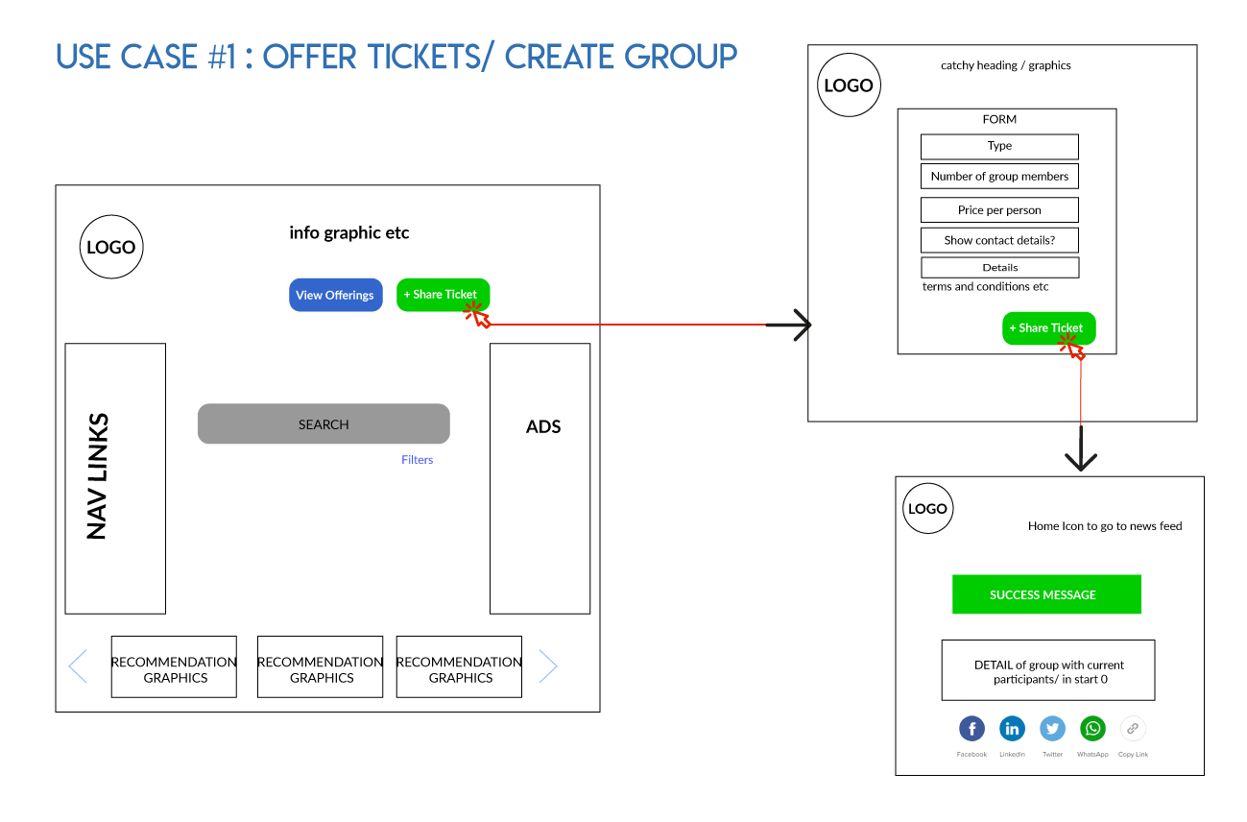

Slide 5
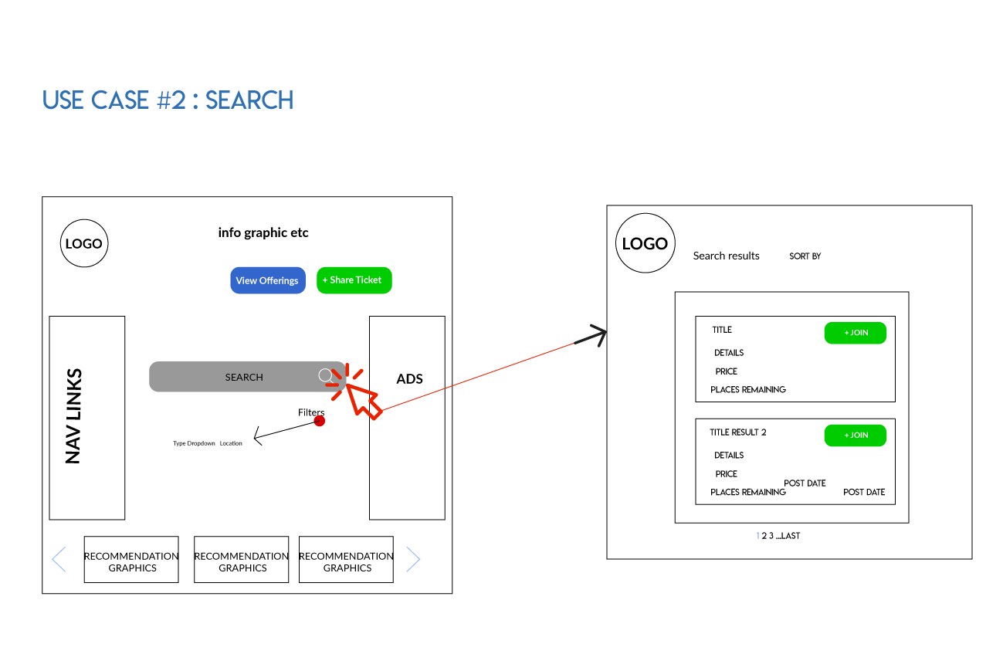

Slide 6
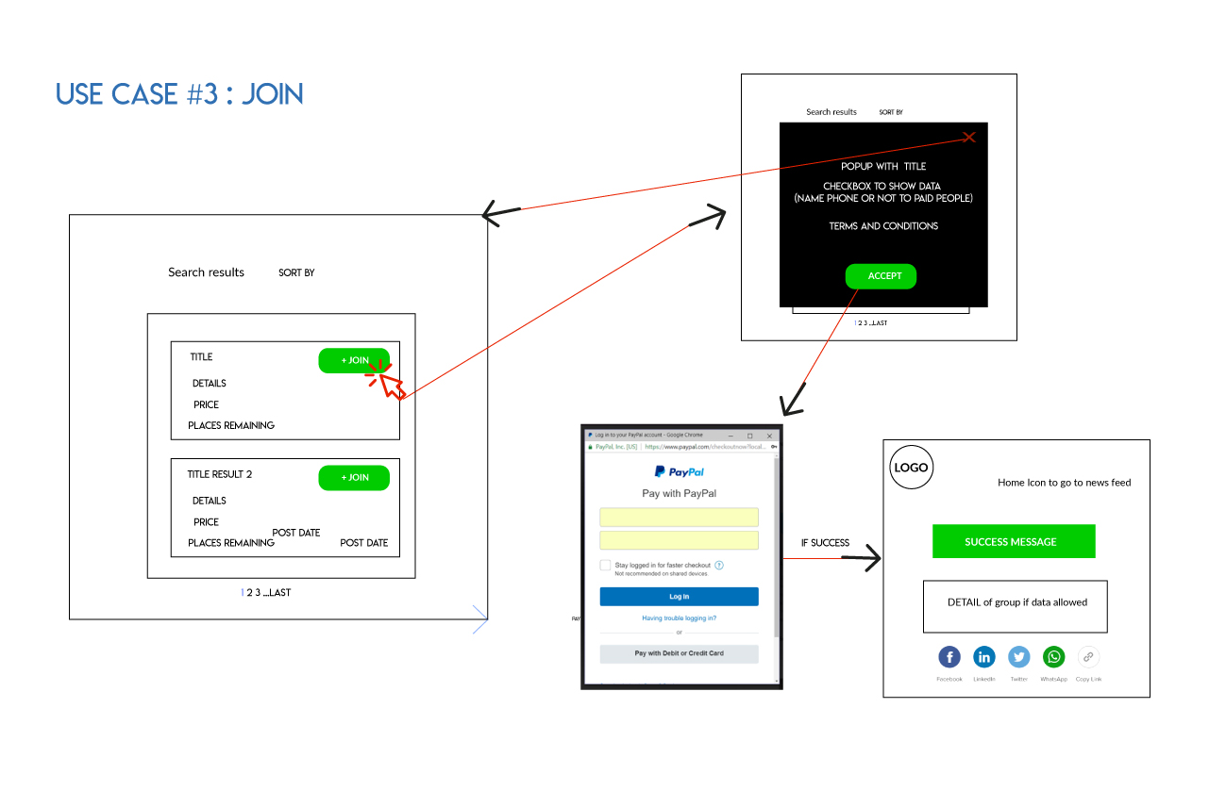

Slide 7
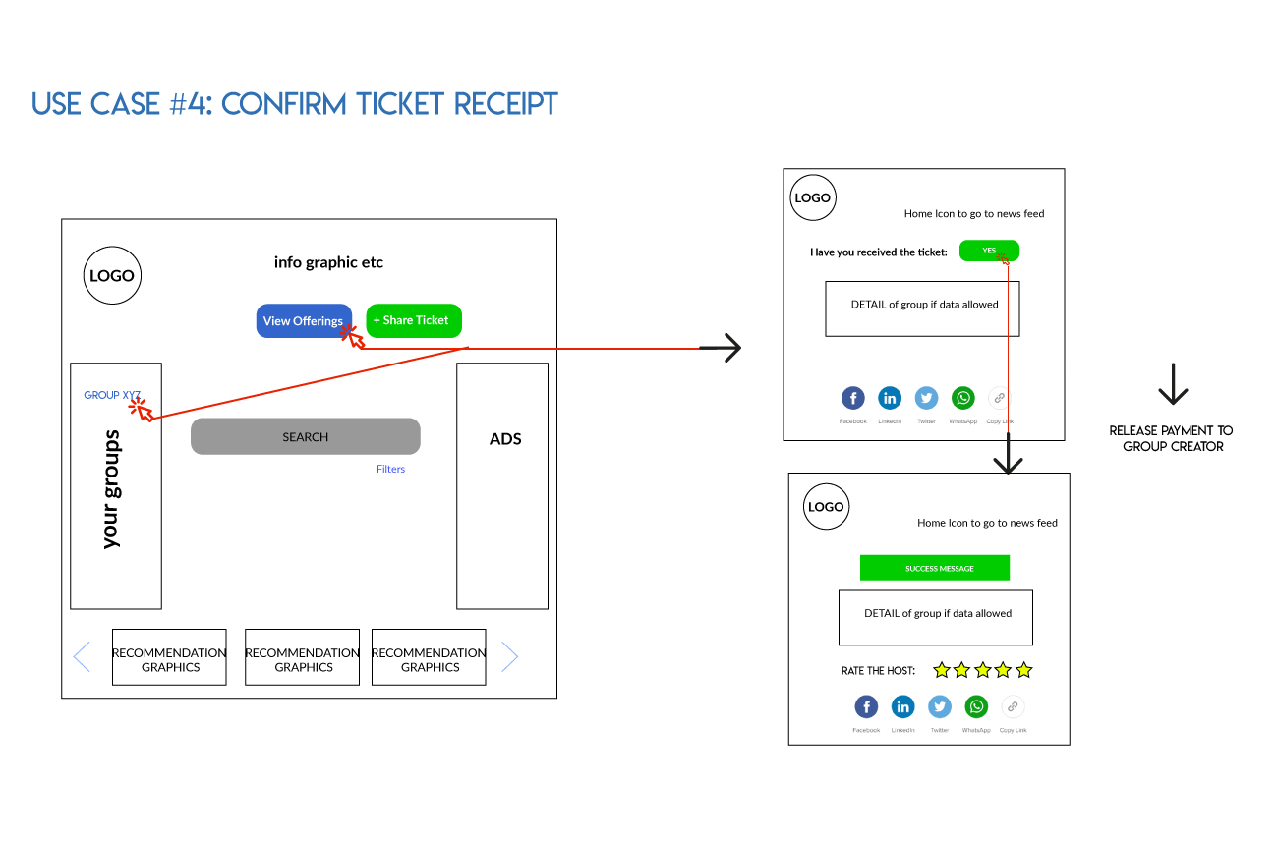

Slide 8
Pretty MockUp

Slide 9
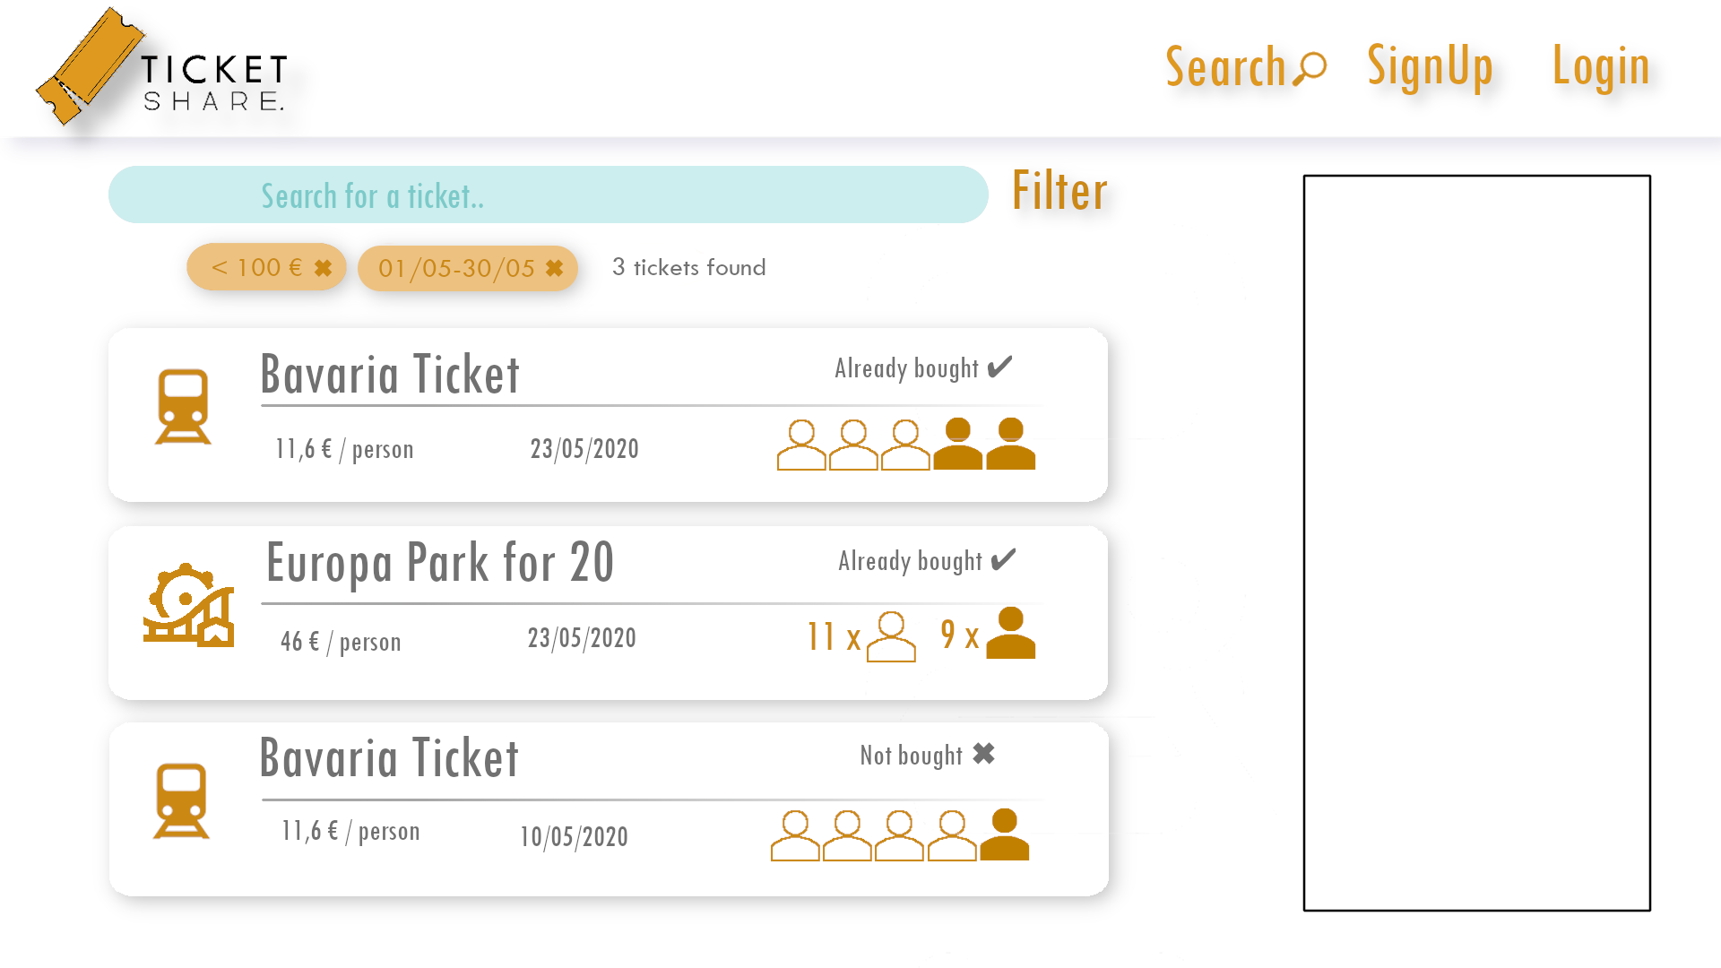

Slide 10
Data Model

Slide 11
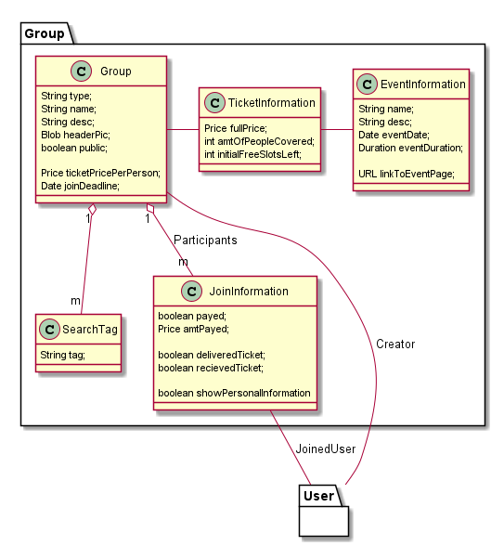
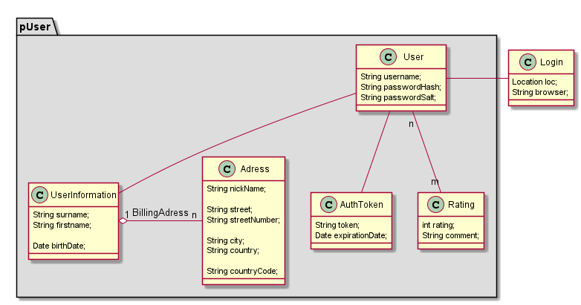
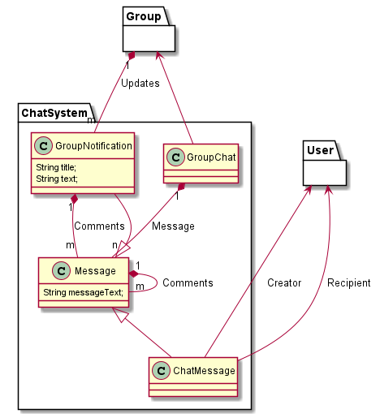

Slide 12
THANK YOU
Q&A

