Slide 1
SkyLink
Airlines
Malgorzata Victor, Raels Santers, Tomás McGrath
Enterprise Systems Architecture

Slide 2





Introduction
What This Architecture Delivers ?
Real-time flight tracking
Global reservation & check-in
Maintenance & safety insights
Crew scheduling optimisation
Seamless data flow across 40+ operational contexts
Business Outcomes: Safety, Efficiency, Profitability, Customer Satisfaction

Slide 3

Context
The Operational Reality We Designed For
Global routes & regulations
Mixed fleet / cargo + passenger
Ground handling & airport collaboration
Code-sharing partnerships
Real-time tracking & telemetry
Passenger management & baggage
Maintenance, safety, regulatory compliance
Crew scheduling & resource management
These constraints shape every technical decision we make

Slide 4
Strategic Drivers
Why This Architecture Must Exist
Safety
• Maintenance logs
• Real-time telemetry
• Incident response
Customer Experience
• Reliable reservations
• Check-in
• Baggage tracking
Punctuality
• Live schedule updates
• Flight tracking
• Crew readiness
Cost Efficiency
• Fuel optimisation
• Aircraft utilisation
•Automation
Purpose: Connect technology to business KPIs.

Slide 5
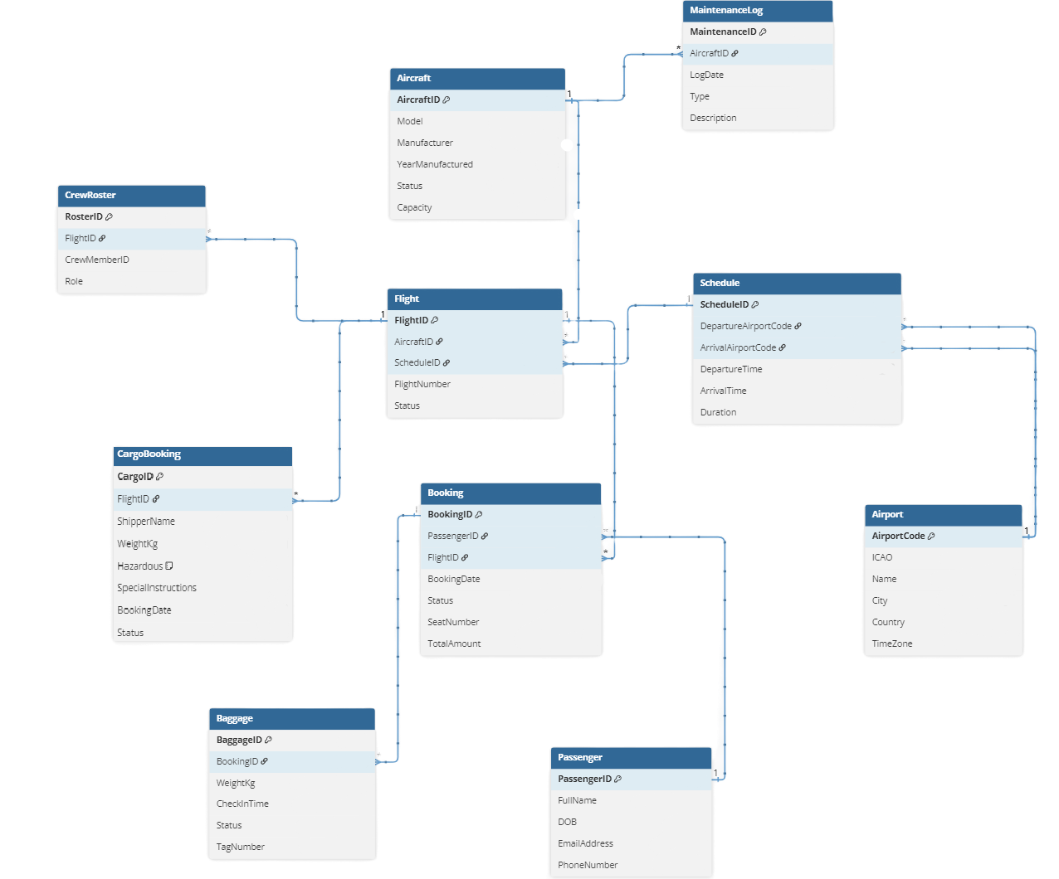

Logical Data Model
Data Models
The Foundation of Operational Truth
Thee-tier modelling
Conceptual Model: flights, aircraft, bookings, schedules, baggage, crew, maintenance
Logical Model: Respected aviation rules, normalization, clear relationships.
Physical Model: Optimized with partitioning (time-based), indexing, and sharding.
Reliable data drives safety,
punctuality, and profitability.

Slide 6






Application Architecture
How the Airline Actually Works
Check-In System
Reservation system
Flight Tracking System
Maintenance Dashboard
Crew
Scheduler
Real-time telemetry pipeline (ADS-B → MQTT)
Bounded context:
Each service owns its domain and database
Faster, Safer, Scalable.

Slide 7
Logical
Physical
Physical and Logical Architecture Models
How We Structured the System
L
P
Presentation
Edge nodes for telemetry
API Gateway
Cloud region for scaling reservations & analytics
Microservices
On-prem for sensitive systems
Datastores
Designed for global scale + low latency + strict regulatory compliance.

Slide 8
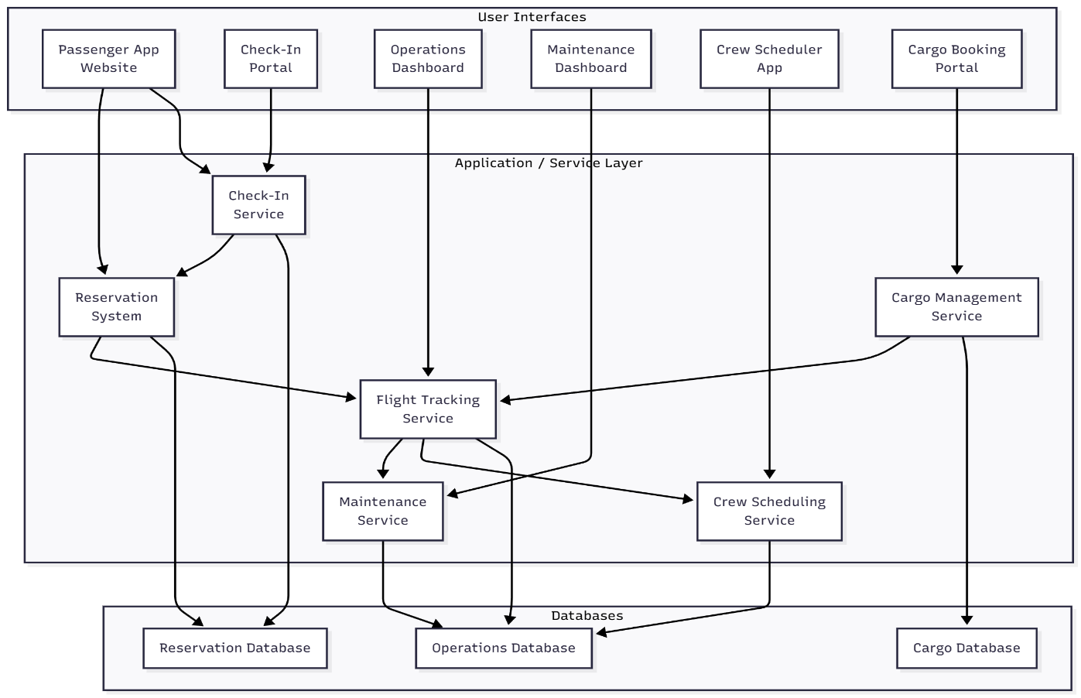
Component Diagram
Functional Breakdown for Each Domain
L
P

Slide 9
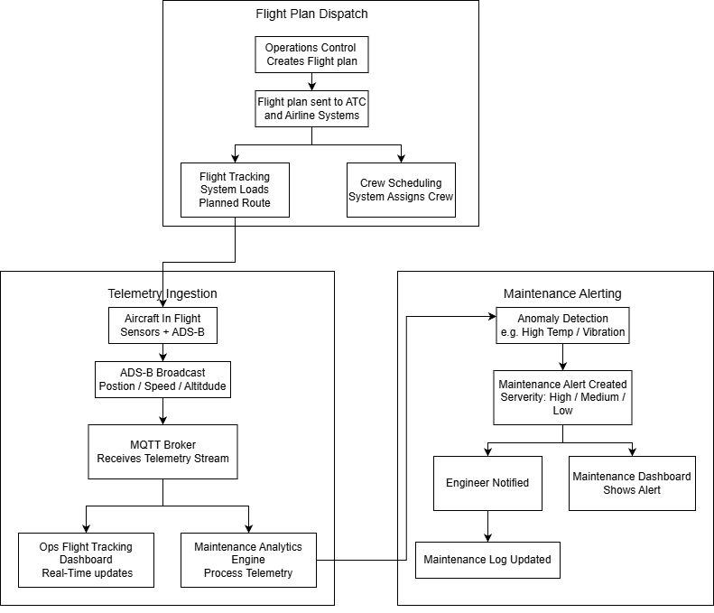
Workflow Diagram
How a Passenger Journey Flows Through the System

Slide 10
Deployment Topology
Where Everything Lives
Compute Platforms | Kubernetes microservices in cloud (auto-scaling) Edge nodes for ADS-B / telemetry On-prem for sensitive partner integrations CDN for passenger app & check-in portal
Network & Connectivity | SATCOM → VPN → Ground Station → Cloud Segmented zones (public, partner, LAN, aircraft private LAN) Failover architecture
APIs & Tech Stack | REST APIs: /flights, /bookings, /check-in MQTT for ADS-B telemetry ESB for internal orchestration API Gateway for authentication & routing Databases: relational, time-series, sharded Observability: ELK, Prometheus, tracing

Slide 11
Improved safety
Conclusion
How It All Comes Together as a Business System
Reduced delays
Through telemetry + predictive maintenance
Through real-time operations & crew scheduling
Higher revenue
Better customer experience
Via optimized load factor & dynamic planning
With fast booking, check-in, and consistent updates
Lower IT overhead
Data-Driven Strategic Advantage
Through microservices, cloud scalability, and automation
Unifying all data to uncover new revenue opportunities and optimize routes.
This architecture is not just technology — it is the backbone of SkyLink’s future operational excellence and competitive advantage

Slide 12
Thanks!
Malgorzata Victor, Raels Santers, Tomás McGrath
Enterprise Systems Architecture

