Slide 1

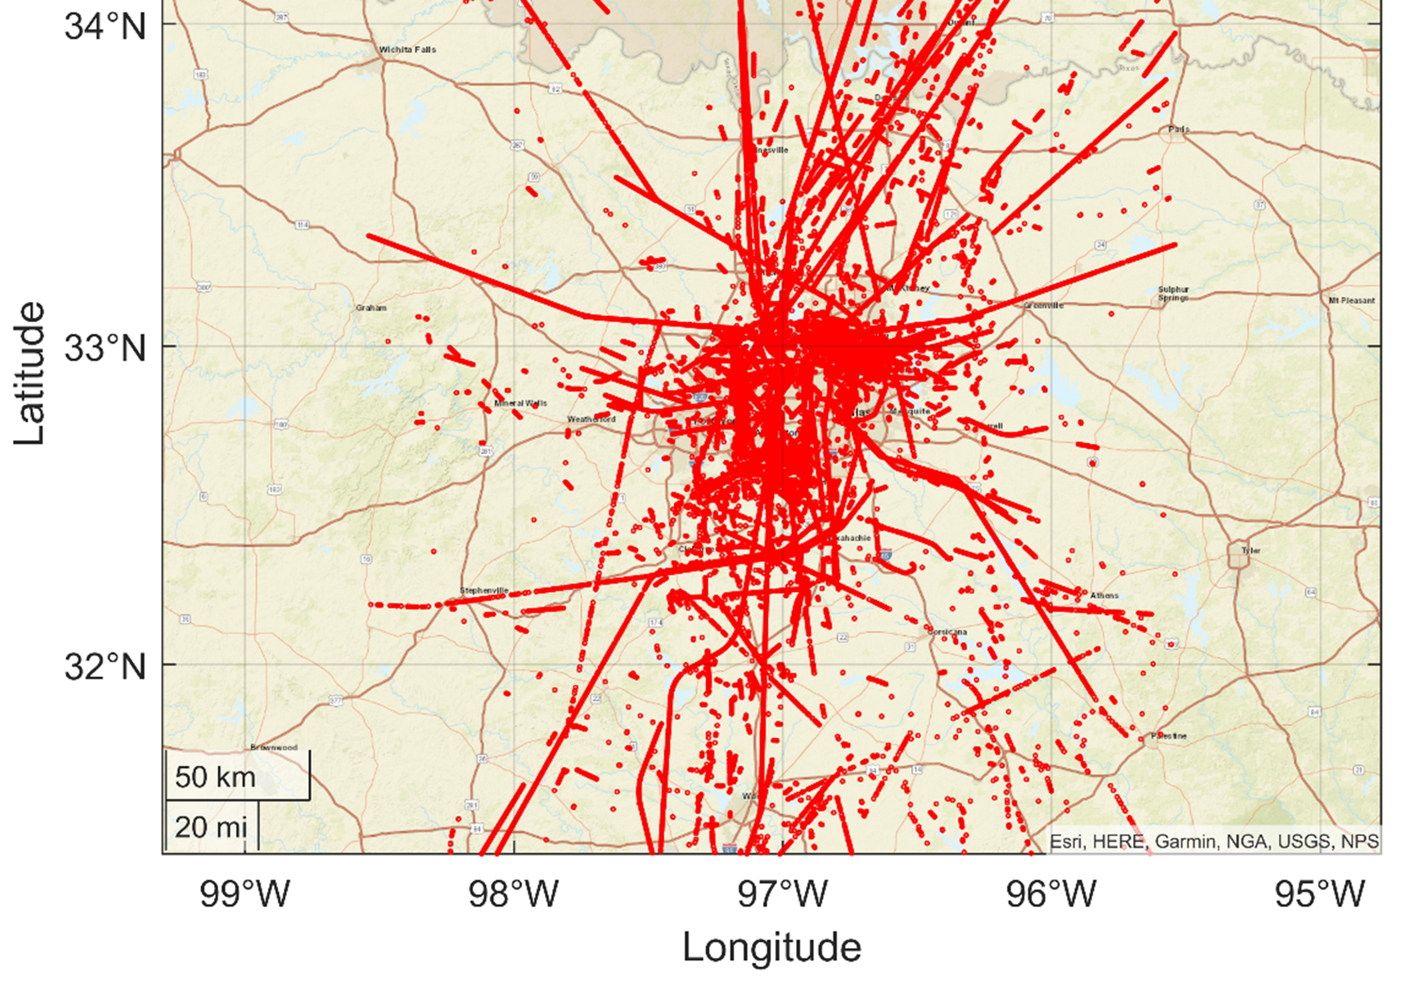
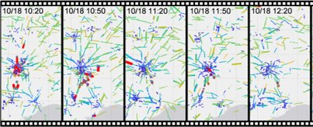
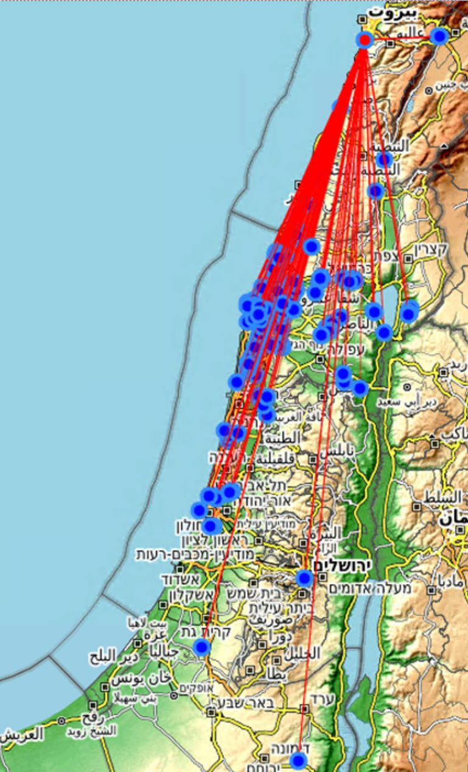
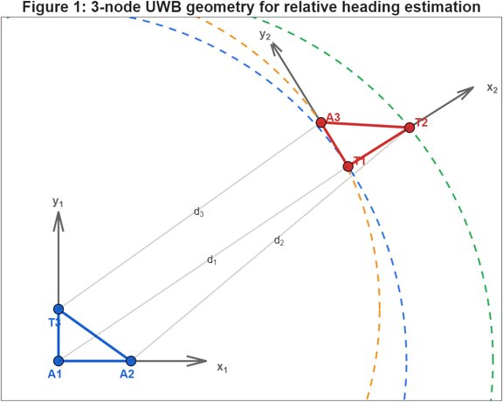
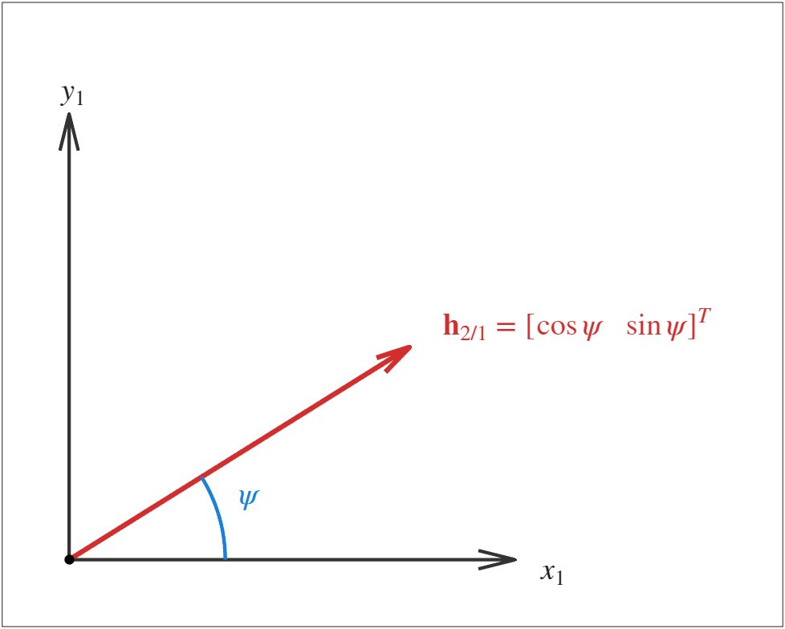
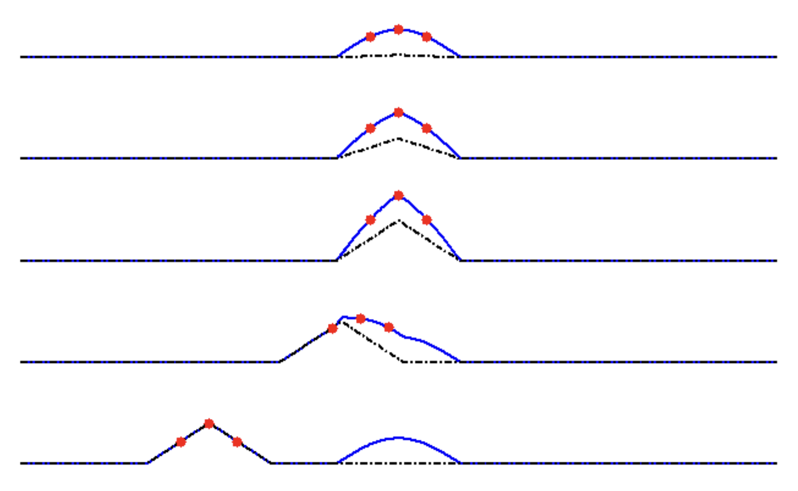
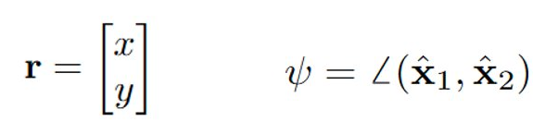
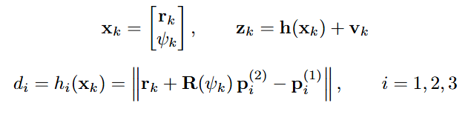
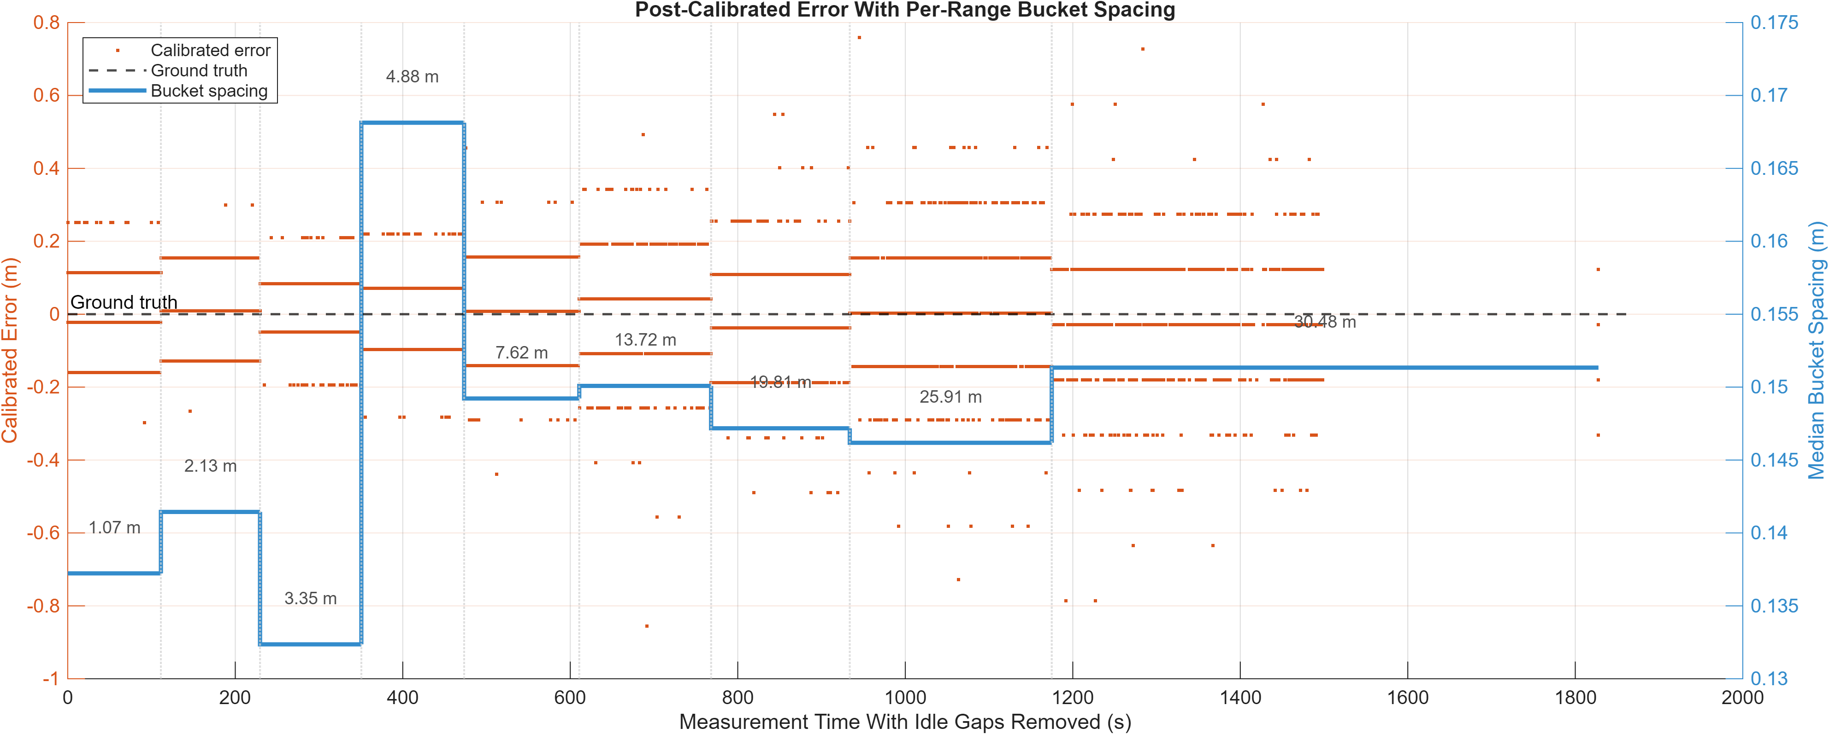
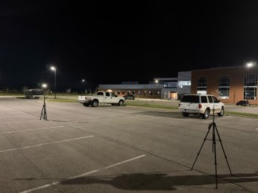
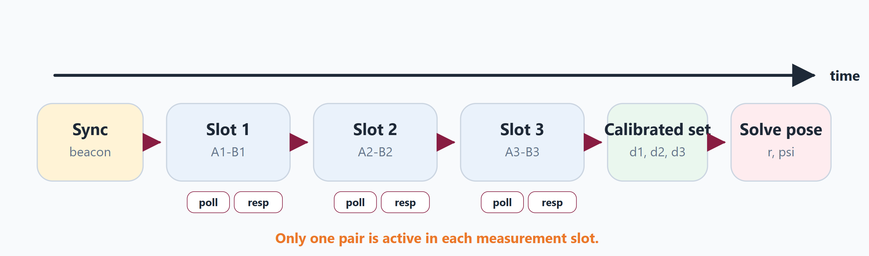


Resilient Collaborative Navigation Using Intervehicle Ultra-Wideband Ranging in GNSS-Degraded Environments
Researchers: J. Cahill & M. Mahajan
University: Virginia Tech
Broader Impacts and Prior Work
Research Objective and Proposed Approach
GNSS spoofing is an integrity threat: a vehicle can converge to a confident but false navigation state while tracking counterfeit satellite signals.
Tanil et al. showed spoofing could drive INS/GNSS estimate to a 10 m error without immediate detection.^{[tanil]}
Previous work showed car key fobs can interfere near GPS L1, so GNSS vulnerability is not limited to attacks.^{[Jada]}
Existing methods help GNSS-denied navigation, but do not fully address inter-vehicle ranging integrity.
LiDAR/IMU can reduce drift but depends on scene features often degrading in rain/snow or fog.^{[Hassani]}
UWB ranging can add direct vehicle-to-vehicle constraints when GNSS degrades
Research Objective: Develop a collaborative navigation framework using intervehicle UWB cross links and characterize UWB measurement errors for future state-estimator integration in GNSS-degraded environments.
Modify DWM1001C modules with custom SS-TWR firmware and scheduling so commercial indoor UWB hardware can support intervehicle ranging
Mount multiple transceivers at known locations in each vehicle body frame so the resulting ranges provide geometric constraints on relative range and relative heading.
Characterize antenna-delay bias, multipath, and other systematic effects, then build an over-bounded error model so UWB measurements can be incorporated safely into a Kalman-filter-based navigation framework.
The unsolved mystery of the October 17-18, 2022 Texas interference that caused a DFW runway shutdown
Relative heading vector
Multi-sensor configuration to extract relative heading and position
r - relative position of the origin of body frame 2 in frame 1
Ψ - angle between vehicle 1 forward axis and vehicle 2 forward axis
Spoofing captures GNSS tracking, then drags the reported position away from truth; live yacht tests showed a false position near Libya._{[Psiaki]}
Measurement model used to calculate relative pose
Phone locations in Israel being spoofed to show Beirut.[Psiaki]
Proposed work: Evaluate if UWBs are adequate sensors to serve as crosslinks in collaborative automotive navigation scenarios
[Tanil] Tanil et al., “An INS Monitor to Detect GNSS Spoofers Capable of Tracking Vehicle Position,” IEEE TAES. 2018.
[Jada] Jada et al., “Identifying Car Key Fobs as a Cause of Interference at GNSS Frequencies,” ION GNSS+ 2023.
[Hassani] Hassani et al., “Experimental Integrity Evaluation of Tightly-Integrated IMU/LiDAR Including Return-Light Intensity Data,” ION GNSS+ 2019.
Experiments and Preliminary Performance Analysis
Future Work and Impact
Calibration resulted in a piecewise correction reducing MAE from 0.110 m to 0.058m
Current single sided TWR firmware causes discrete bucketed measurements
Rigorous calibration using high precision GNSS receivers is necessary before meaningful improvements to integrity
Scheduling SS-TWR Firmware can provide synched data necessary to extract pose, but reduces sampling frequency
Long-range SS-TWR is feasible on commercial UWB hardware, but increases airtime and scheduling load
Sensor market review and selection
Completed milestones include:
UWB sensor options and limits: range, calibration sensitivity, and scheduling constraints;
extended practical UWB operation from about 31 m to 110 m and implemented a scheduled ranging framework
linear correction reduced cross-validation MAE from 0.110 m to 0.058 m;
explored multi-transceiver geometries in simulation to estimate relative range and heading
Remaining work will focus replicating simulated configuration for range and heading with UWB roof mounts
Building the noise and measurement model for the estimator.
Sensor modification
Data collection
Firmware updates
Linear Calibration Model
Collaborative Navigation
Framework
Probabilistic UWB error modeling
Range + heading crosslinks
Bias/noise characterization | Overbounding
Incorporate into Kalman Filter
Proof of concept ground testing

