Slide 1
Smart Loan Application Portal
Machine learning loan amount recommendation system
Objective: Build a machine learning model that recommends an appropriate loan amount based on borrower financial and
credit characteristics.
Domain: Finance
Problem Type: Regression
Dataset: 15,000 Borrower Records
Developed By: Malhar Jojare
1

Slide 2
Project Goal
What the solution is designed to do
BUSINESS PROBLEM
Problem:
Financial institutions receive thousands of loan applications daily.
Traditional loan recommendation methods:
Depend heavily on manual review
Are time-consuming
Produce inconsistent recommendations
Increase operational costs
Goal: Predict a recommended loan amount from borrower financial and credit profile data. Support lending decisions with a data-driven regression model. Turn the model into a simple application that non-technical users can run.
2

Slide 3
Project Goal
What the solution is designed to do
BUSINESS PROBLEM
Why This Problem Exists?
Manual underwriting effort
Inconsistent decisions
Human errors
Slow approval process
Business Consequences
Higher processing costs
Customer dissatisfaction
Delayed approvals
Reduced operational efficiency
2

Slide 4
Dataset Overview
Summary from the notebook
Dataset Facts
Target and Inputs
15,000 records.
17 columns.
Finance domain.
Regression problem.
Target variable: recommended_loan_amount.
Inputs include age, income, credit score, debt ratio, savings, and loan term.
Also includes property ownership, defaults, and employment details.
3

Slide 5
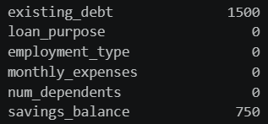
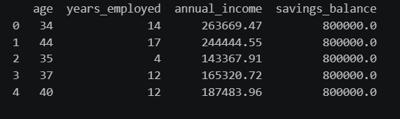
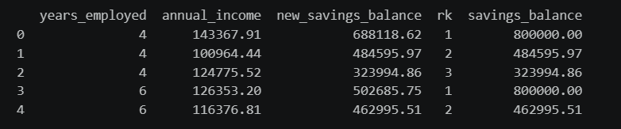
Data Preparation
Cleaning and validation steps
Notebook Cleaning
Explores missing values and outliers.
Handles unusual savings values using income-based replacement logic.
Uses grouped analysis by years employed.
4

Slide 6
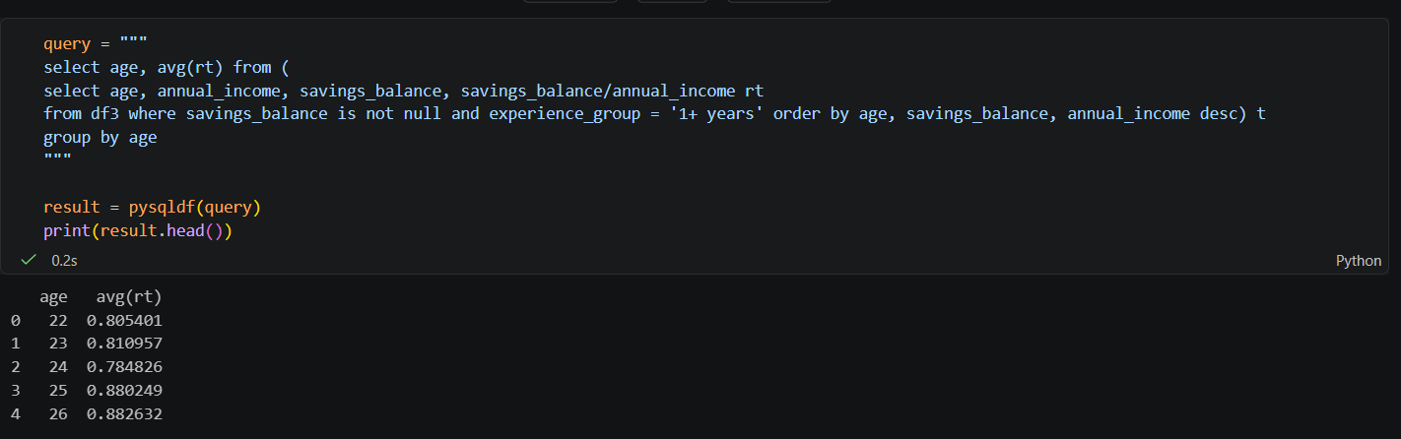
Exploratory Analysis
How the notebook examined the data
The notebook uses SQL-style queries and data visualization to inspect borrower patterns.
It reviews age, years employed, annual income, savings balance, debt, and credit features.
The analysis helps reveal which borrower attributes are likely to influence the loan amount.
5

Slide 7
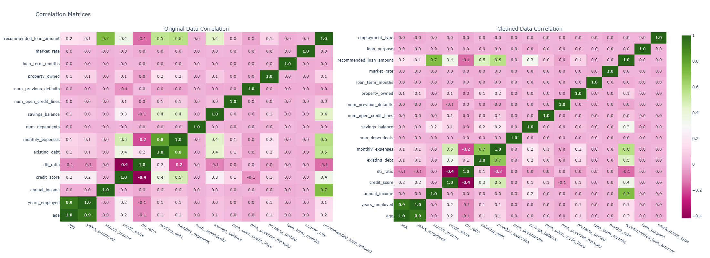
Exploratory Analysis
How the notebook examined the data
5

Slide 8
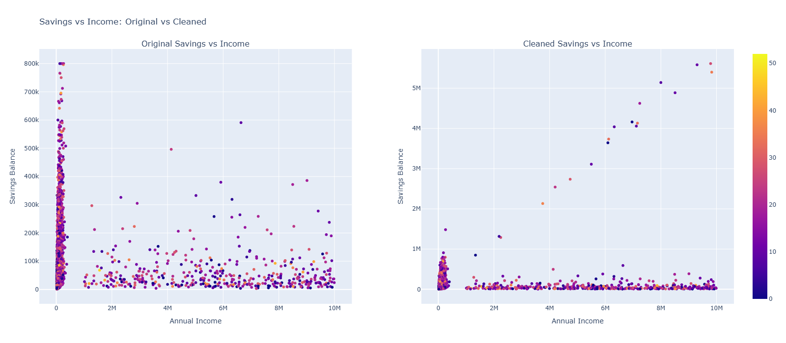
Exploratory Analysis
How the notebook examined the data
5

Slide 9
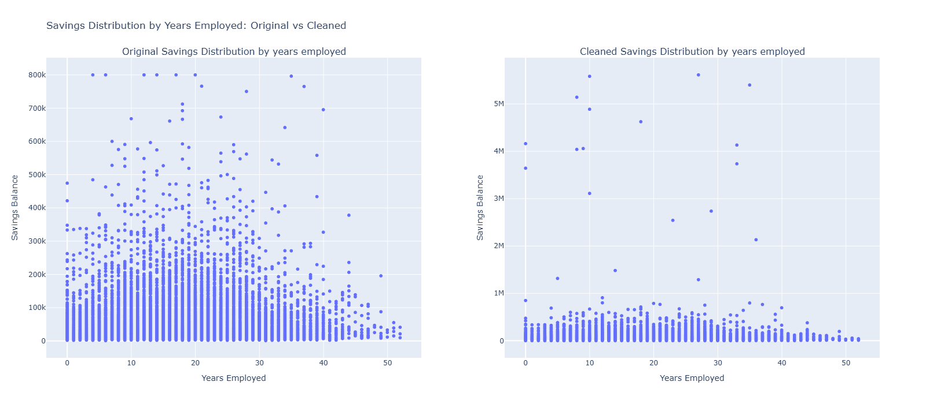
Exploratory Analysis
How the notebook examined the data
5

Slide 10
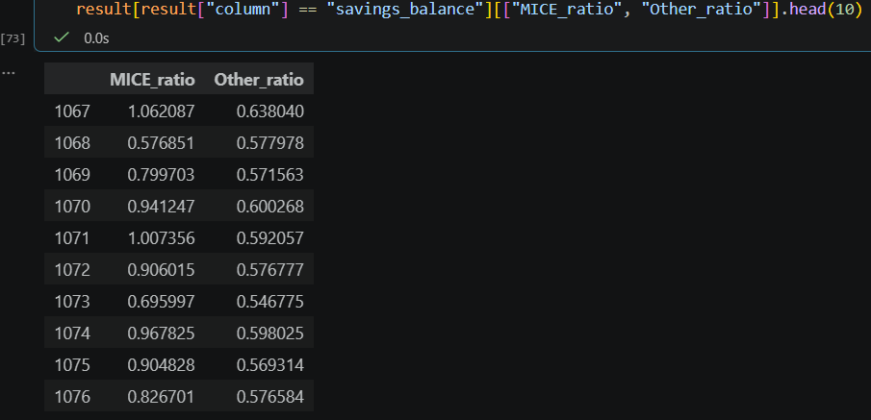
MICE Imputation vs My Approach
MICE is more flexible
Wider spread (0.58 → 1.06)
Reacts to multiple features (credit score, employment, property, etc.)
Allows heterogeneity:
some people saving more than income (ratio > 1)
others closer to 0.6
MICE has ratios > 1 (e.g. 1.06)
That means: Imputed savings > annual income
This can be: realistic only in rare cases (inheritance, assets, lump sums)
but often a sign of overestimation or weak constraints
5

Slide 11
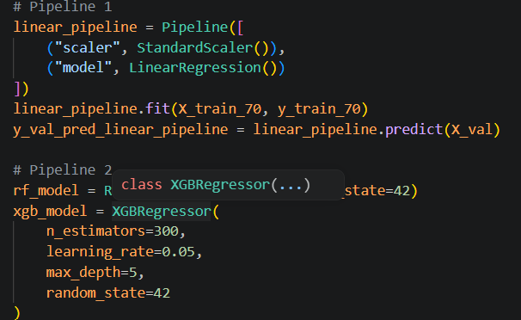
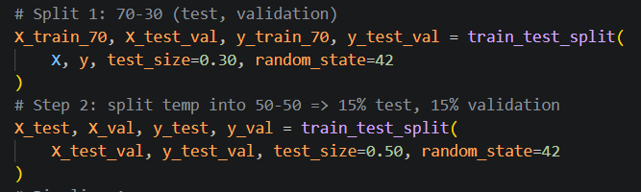
Modeling Approach
Training and model selection
Models Tested
Final Choice
Linear Regression.
Random Forest Regressor.
XGBoost Regressor.
XGBoost is selected as the final model.
The trained model is saved as loan_amount_xgb.pkl.
The Streamlit app loads the persisted model for predictions.
6

Slide 12
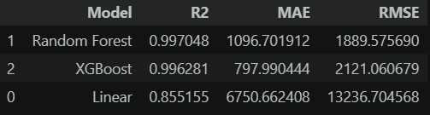
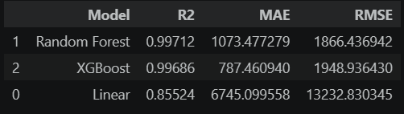
Performance
Reported experimental result
Notebook Result
The notebook reports very strong performance for the final XGBoost model.
Test R2 is about 0.9985.
This is a notebook result and should be presented as the experimental outcome of the training run.
7

Slide 13
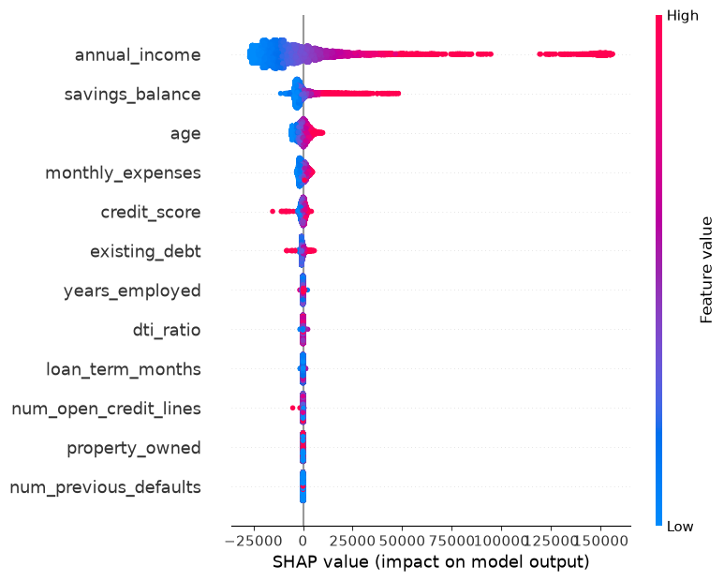

Performance
Reported experimental result
Notebook Result
7

Slide 14
Streamlit App Workflow
How the user experience is structured
Step 1: Personal information.
Step 2: Email verification with OTP.
Step 3: Employment details.
Step 4: Credit profile.
Step 5: Financial information.
Step 6: Loan details.
Step 7: Review and prediction.
SESSION STATE + MODEL PREDICTION
The app stores each step in session state.
Inputs are aligned to the model’s feature order.
The prediction is shown as a recommended loan amount.
Click here for demonstration.
8

Slide 15
Key Takeaways
What this project demonstrates
Analytics Side
Product Side
Data cleaning and outlier handling.
Feature understanding through EDA.
Model comparison and persistence.
Multi-step user experience.
Input validation and session handling.
End-to-end loan recommendation portal.
9

Slide 16
From notebook to product
The notebook builds the modeling foundation.
The Streamlit app turns it into a usable loan recommendation experience.
Together, they show a complete ML workflow from analysis to deployment.
Thank you
10

