Slide 1


NIRMITEE ASSIGNMENT
PROCESS WORKFLOW AND RESULTS
MALHAR KAKADE, MIT WPU

Slide 2
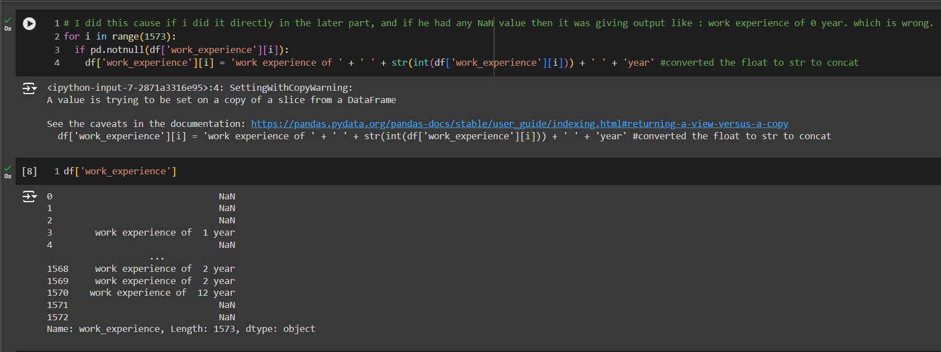

  Firstly, the data was imported, and basic information about the dataset, such as NULL values, was analyzed. Additionally, the work experience column was formatted correctly using the appropriate string format.

Slide 3
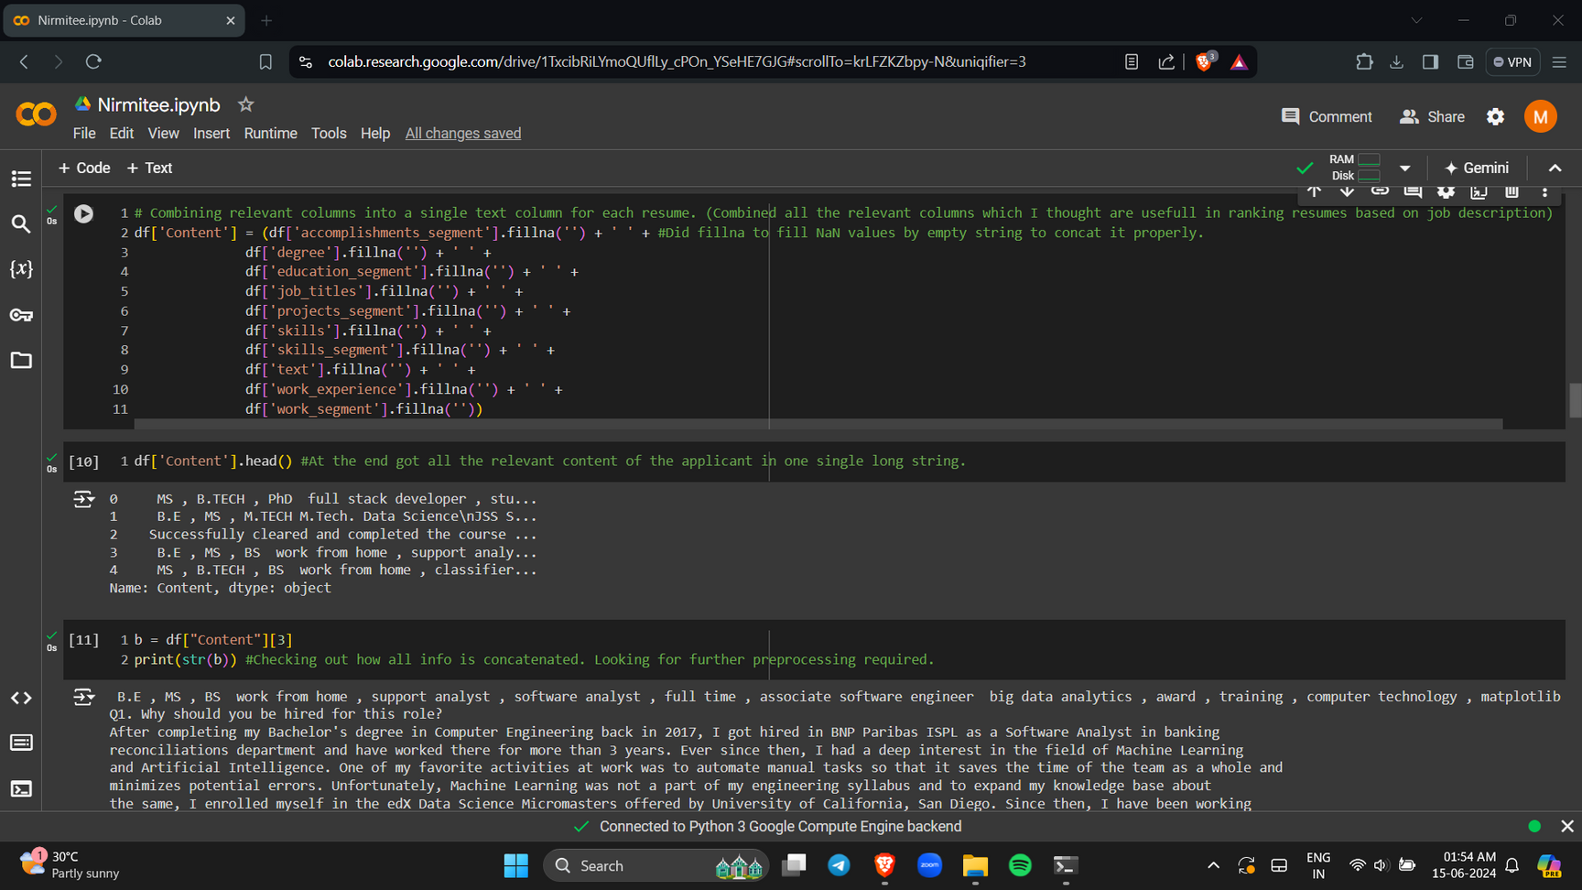
  Relevant columns were combined into a single text column for each resume.

Slide 4
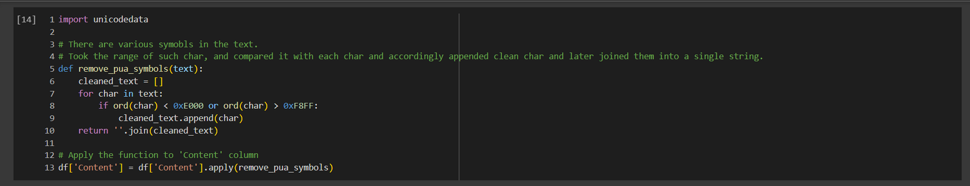
  All the text was converted to lower case, and symbols were replaced with spaces.
  The range of symbols to replace was determined using Google.
  The cleaned content was then converted into numerical vectors using the TF-IDF Vectorizer. Common English stop words were removed during this process, and higher values were assigned to more relevant terms, aiding in capturing the significance of each term.

Slide 5
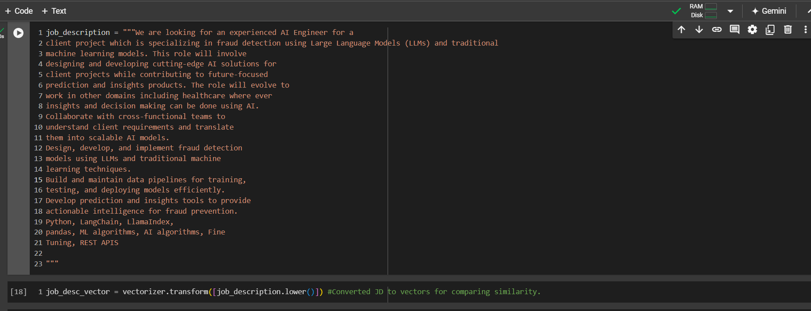
  Nirmitee’s job description (JD) was used for ranking the resumes.
  The job description was also converted into numerical vectors using the TF-IDF Vectorizer. This process assigns higher values to more relevant terms, thereby capturing the significance of each term effectively.

Slide 6
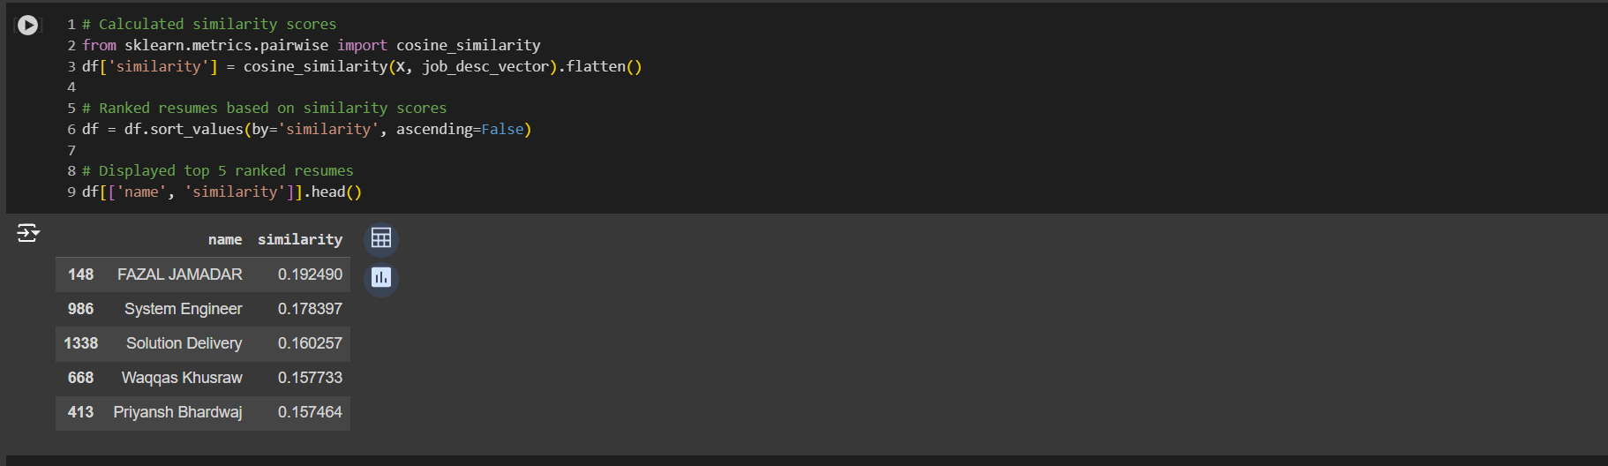
  I used cosine similarity to calculate the similarity between the job description and the resumes. Based on this similarity, the top 5 resumes were listed.

Slide 7
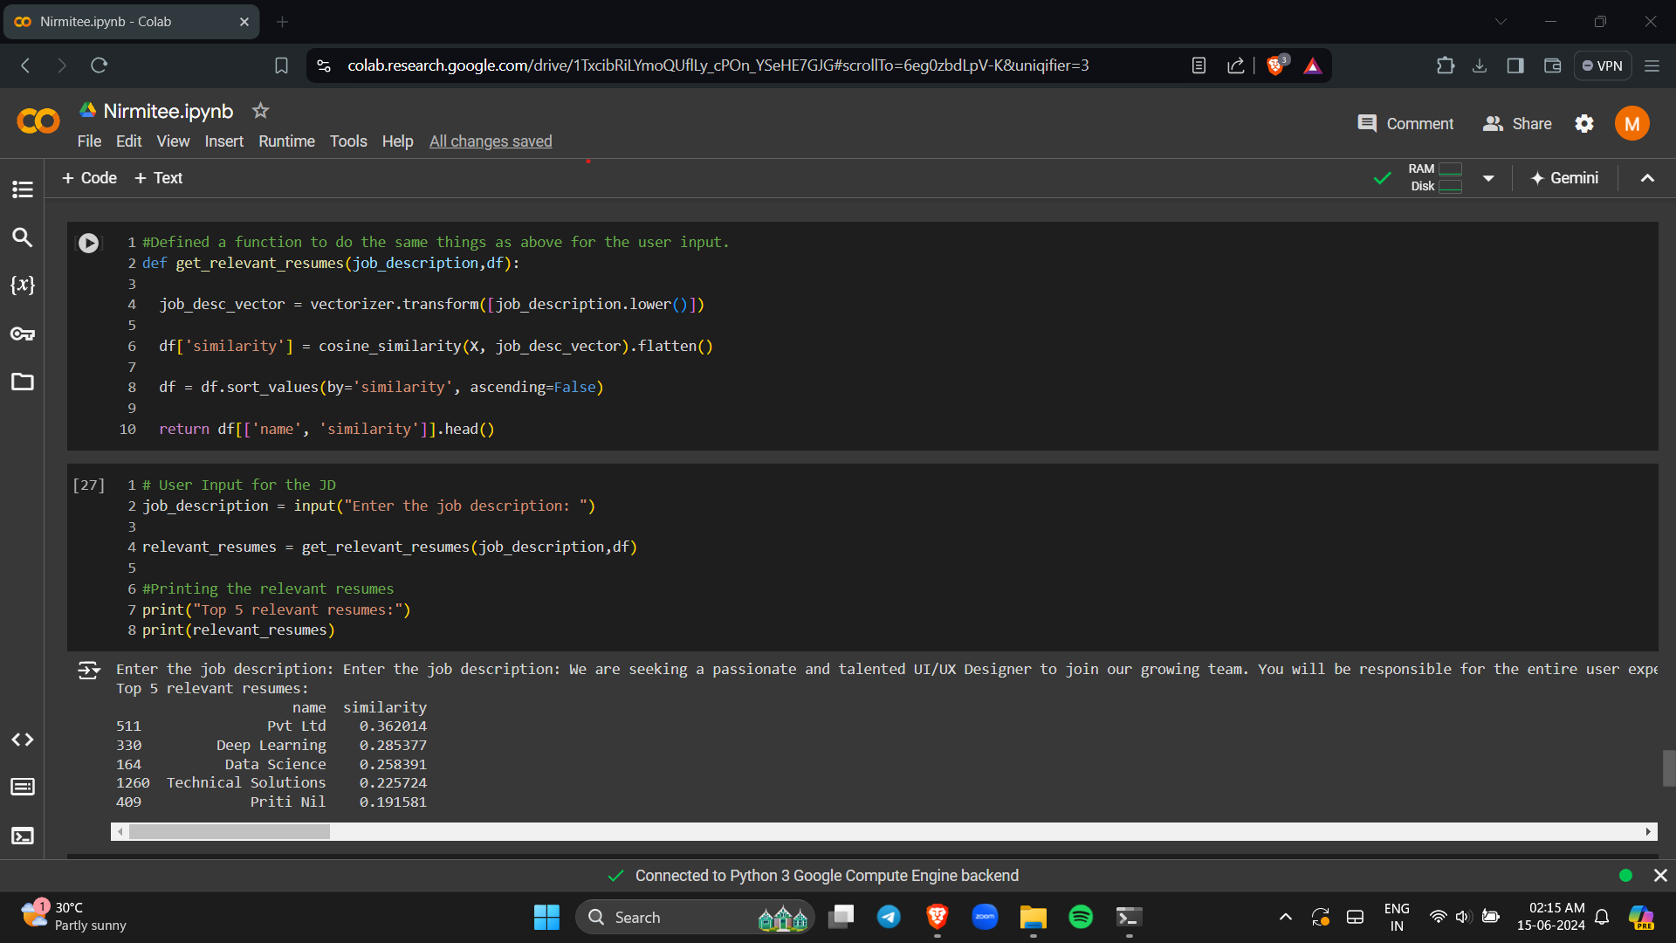
  A user input function was created to easily input a new job description and obtain the top 5 resumes based on the similarity.

Slide 8
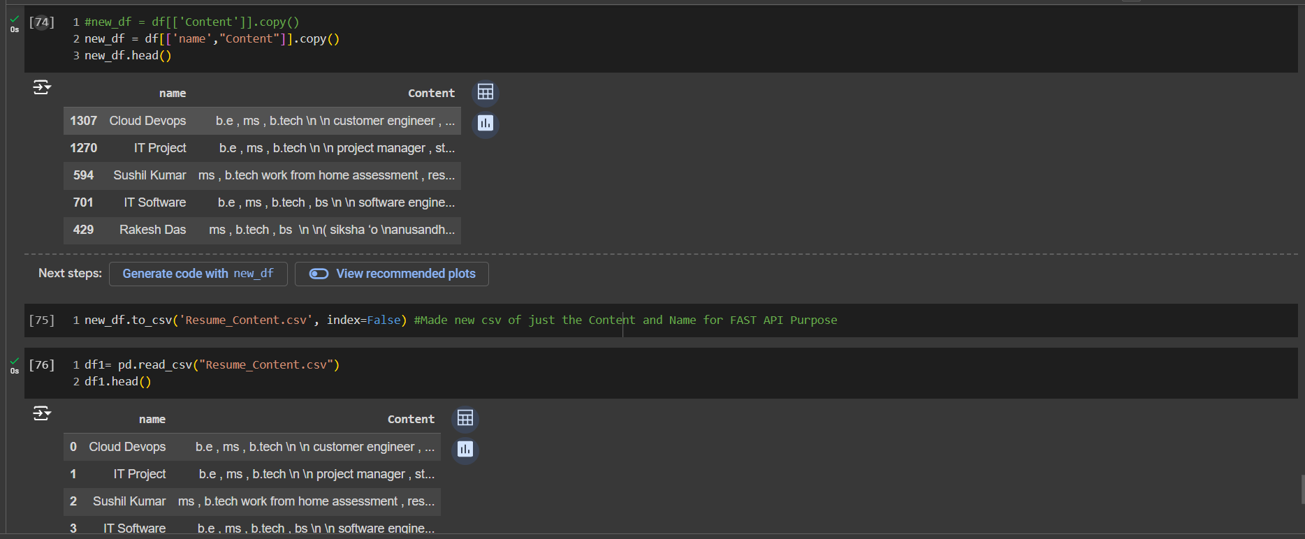
  A new CSV file was created, consisting of names and cleaned resume content, for use with FastAPI.

Slide 9
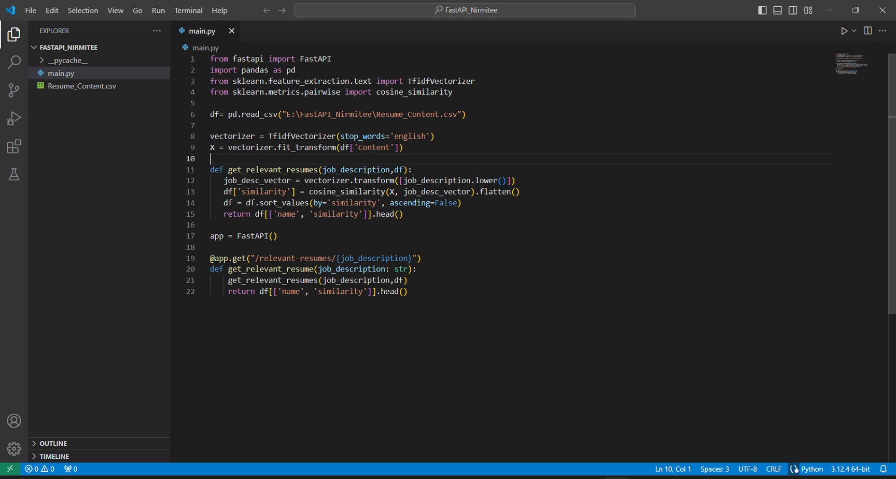
  The main Python file was created to define the FastAPI application.

Slide 10
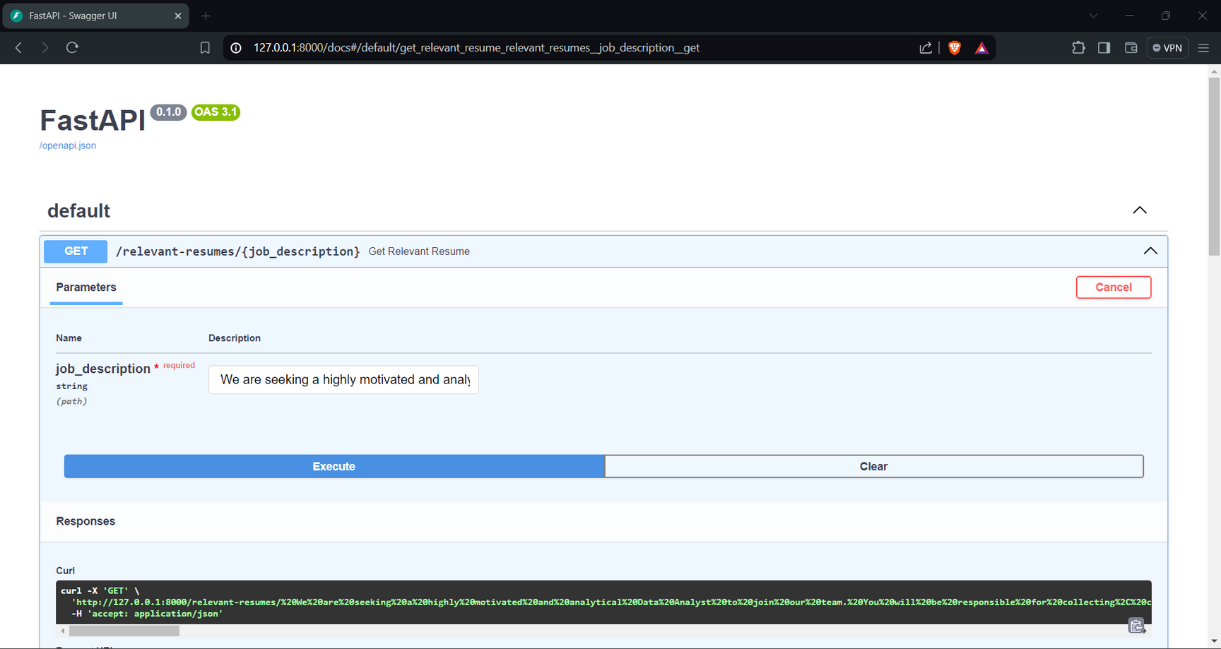
  Accessed the built-in Swagger UI for FastAPI using the `/docs` endpoint.

Slide 11
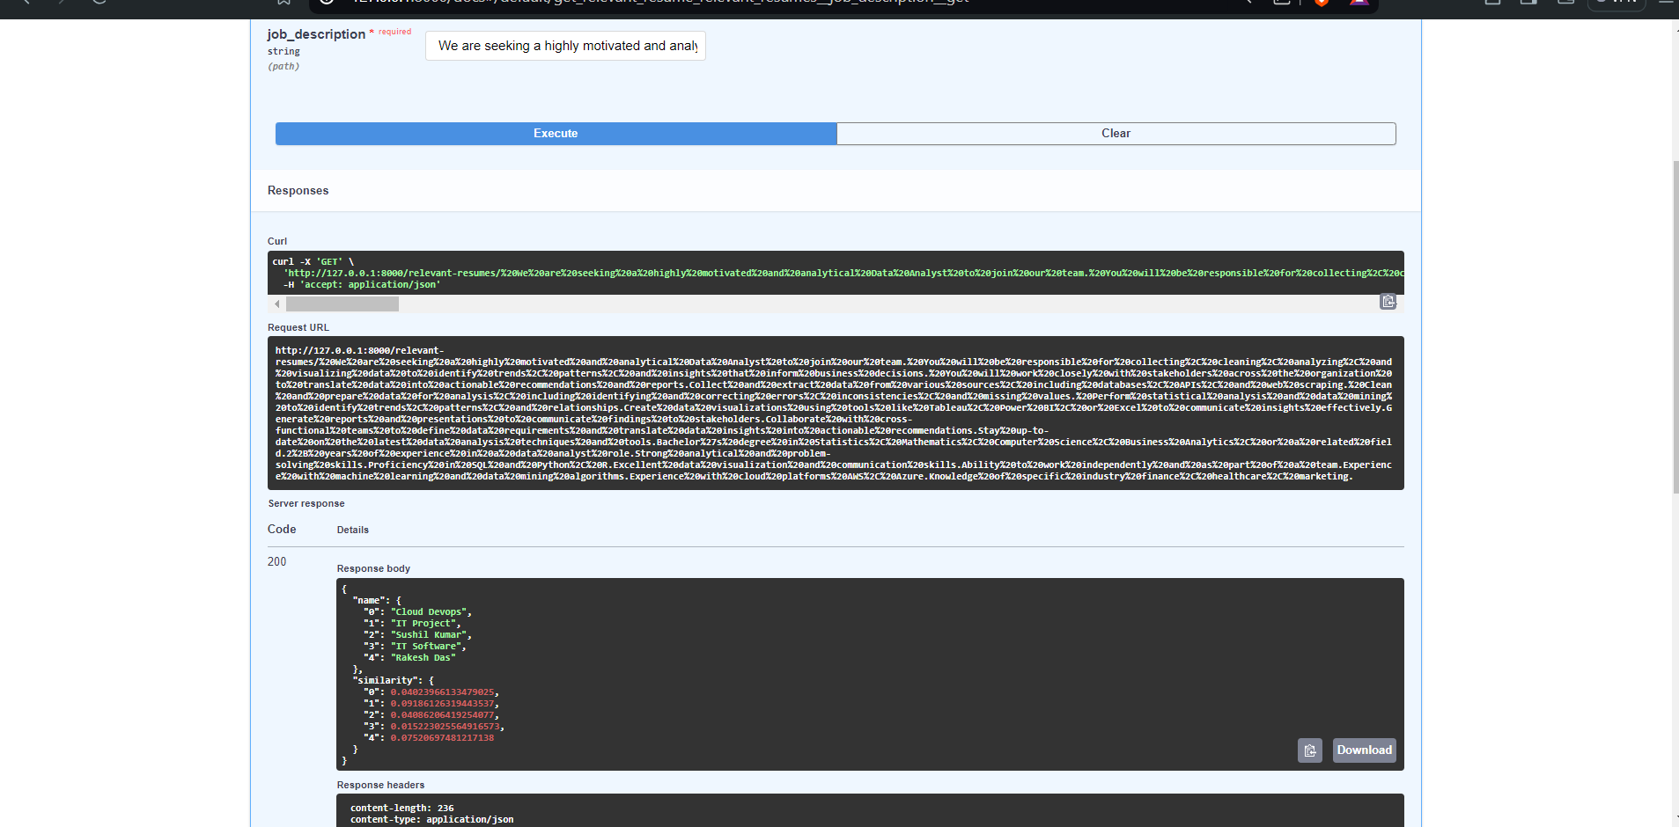
  Additionally, I verified the functionality of the application by testing it with various data inputs.

Slide 12

THANK YOU
It was an enjoyable experience, and I look forward to hearing your feedback.

