Slide 1
College admission agent
CAPSTONE PROJECT
Presented By:
Student name :Malhar Nikam
College Name & Department : A c patil coe , Kharghar

Slide 2
OUTLINE
Problem Statement
Technology used
Wow factor
End users
Result
Conclusion
Git-hub Link
Future scope
IBM Certifications

Slide 3
Problem Statement
Prospective college students and their parents often face a stressful and confusing admission process. They struggle to find clear, consolidated information about admission policies, eligibility criteria, course details, fee structures, and important deadlines, which are often scattered across various university websites and documents. This information overload leads to repetitive manual inquiries, frustration, and the risk of missing critical application steps.
Proposed Solution: AI College Admission Agent that uses Natural Language Processing (NLP) and Retrieval-Augmented Generation (RAG) to streamline the student admission process. The agent will serve as a centralized, 24/7 virtual assistant, providing prospective students with instant and accurate answers to their questions, drawn directly from the institution's trusted data sources.

Slide 4
Technology used
IBM cloud lite services
Natural Language Processing (NLP)
Retrieval Augmented Generation (RAG)
IBM Granite model

Slide 5
IBM cloud services used
IBM Cloud Watsonx AI Studio
IBM Cloud Watsonx AI runtime
IBM Cloud Agent Lab
IBM Granite foundation model

Slide 6
Wow factors
This agent will significantly enhance the applicant experience by providing immediate, personalized guidance, reducing anxiety and uncertainty. It will also boost the efficiency of the admissions office by automating responses to common questions, allowing staff to focus on more complex issues.
Unique features:
Instant Policy Summarizer: Provides concise summaries of complex admission policies and eligibility criteria
Deadline and Fee Inquiry: Instantly retrieves and displays important deadlines and detailed fee structures for different courses.
Personalized Course Recommender: Suggests suitable courses based on a student's interests and academic background.

Slide 7
End users
Prospective Students
Parents and Guardians
College Admission Staff
High School Counselors

Slide 8
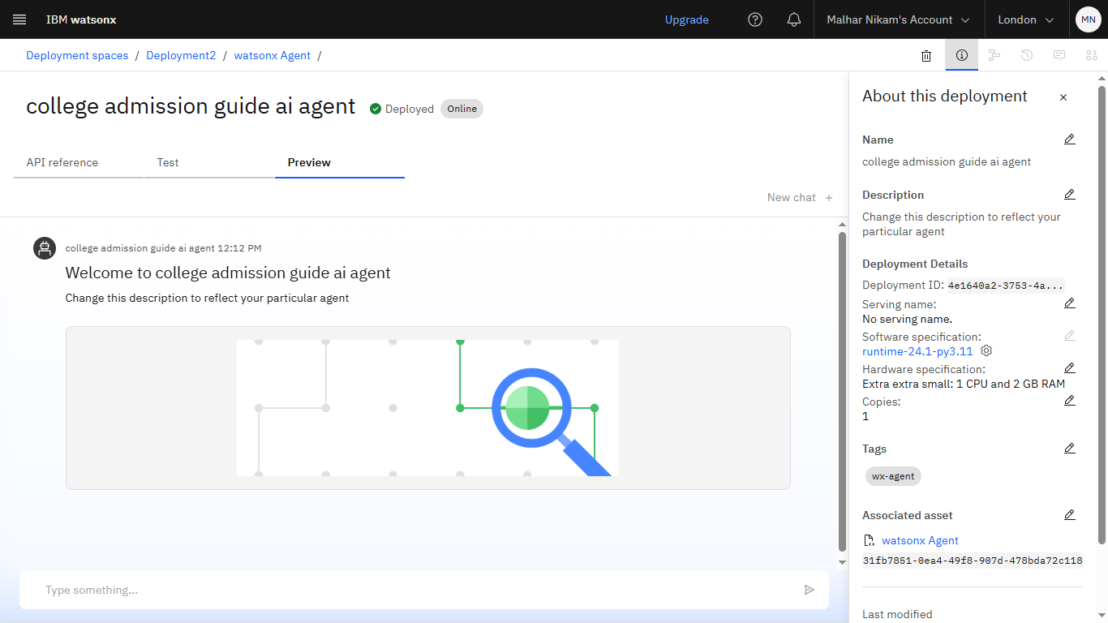
Results

Slide 9
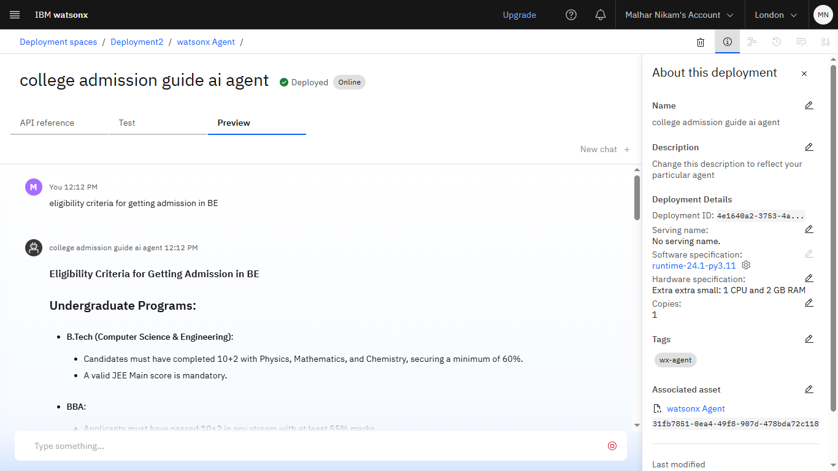
Results

Slide 10
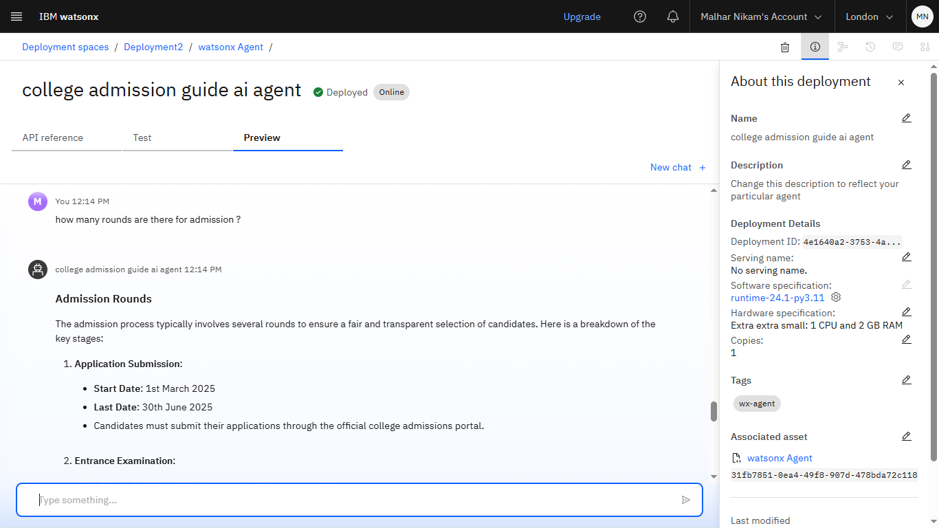
Results

Slide 11
Results
Deployed AI Agent

Slide 12
Conclusion
The College Admission Guide AI Agent transforms the admissions journey from a stressful ordeal into a smooth and transparent process.
By automating inquiries and providing instant, reliable information, it boosts applicant confidence and improves administrative efficiency, making college admissions more accessible for everyone.
It saves time by automating repetitive tasks like citation management and data extraction.

Slide 13
Future scope
Multilingual Research Support
Application Form Assistance
Integration with Virtual Campus Tours
Scholarship and Financial Aid Information

Slide 14
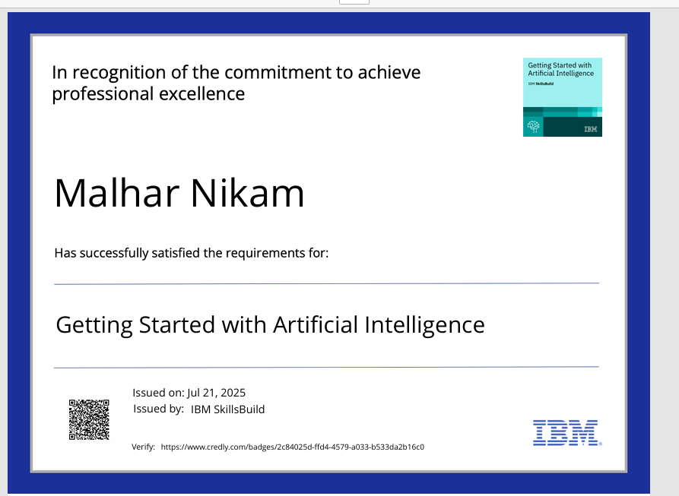
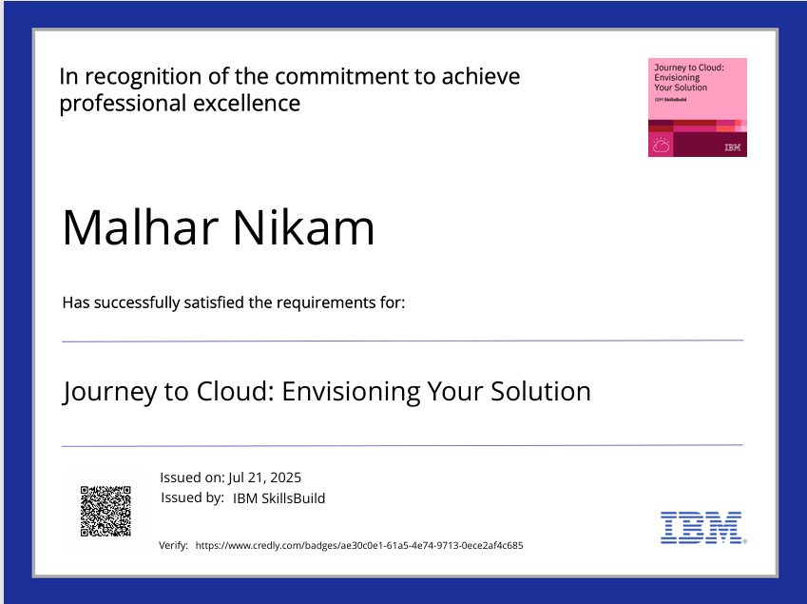
IBM Certifications

Slide 15
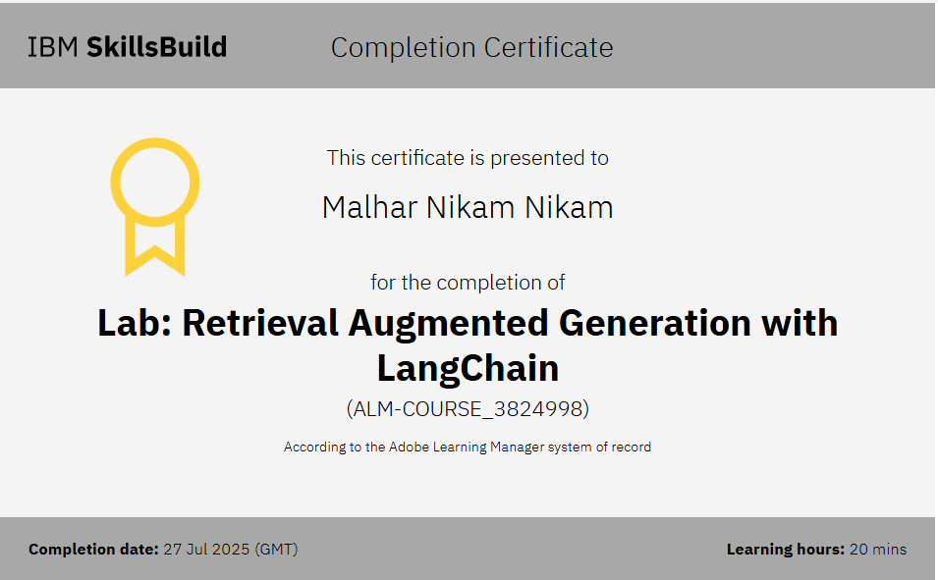

Slide 16
Git hub lik : https://github.com/MalharNikam/IBM-internship

Slide 17
GitHub Link
Make sure that there should be readme file

Slide 18
THANK YOU

