Slide 1

DEPARTMENT OF ELECTRICAL AND ELETRONICS
ENGINNERING
RAHUL TELI 01FE21BEE008
MALHAR KULKARNI 01FE21BEE016
CHANDRU T 01FE21BEE022
CHANDRASHEKHAR R ANGADI 01FE21BEE031
GUIDE: Ms ANUPAMA R ITAGI

Slide 2


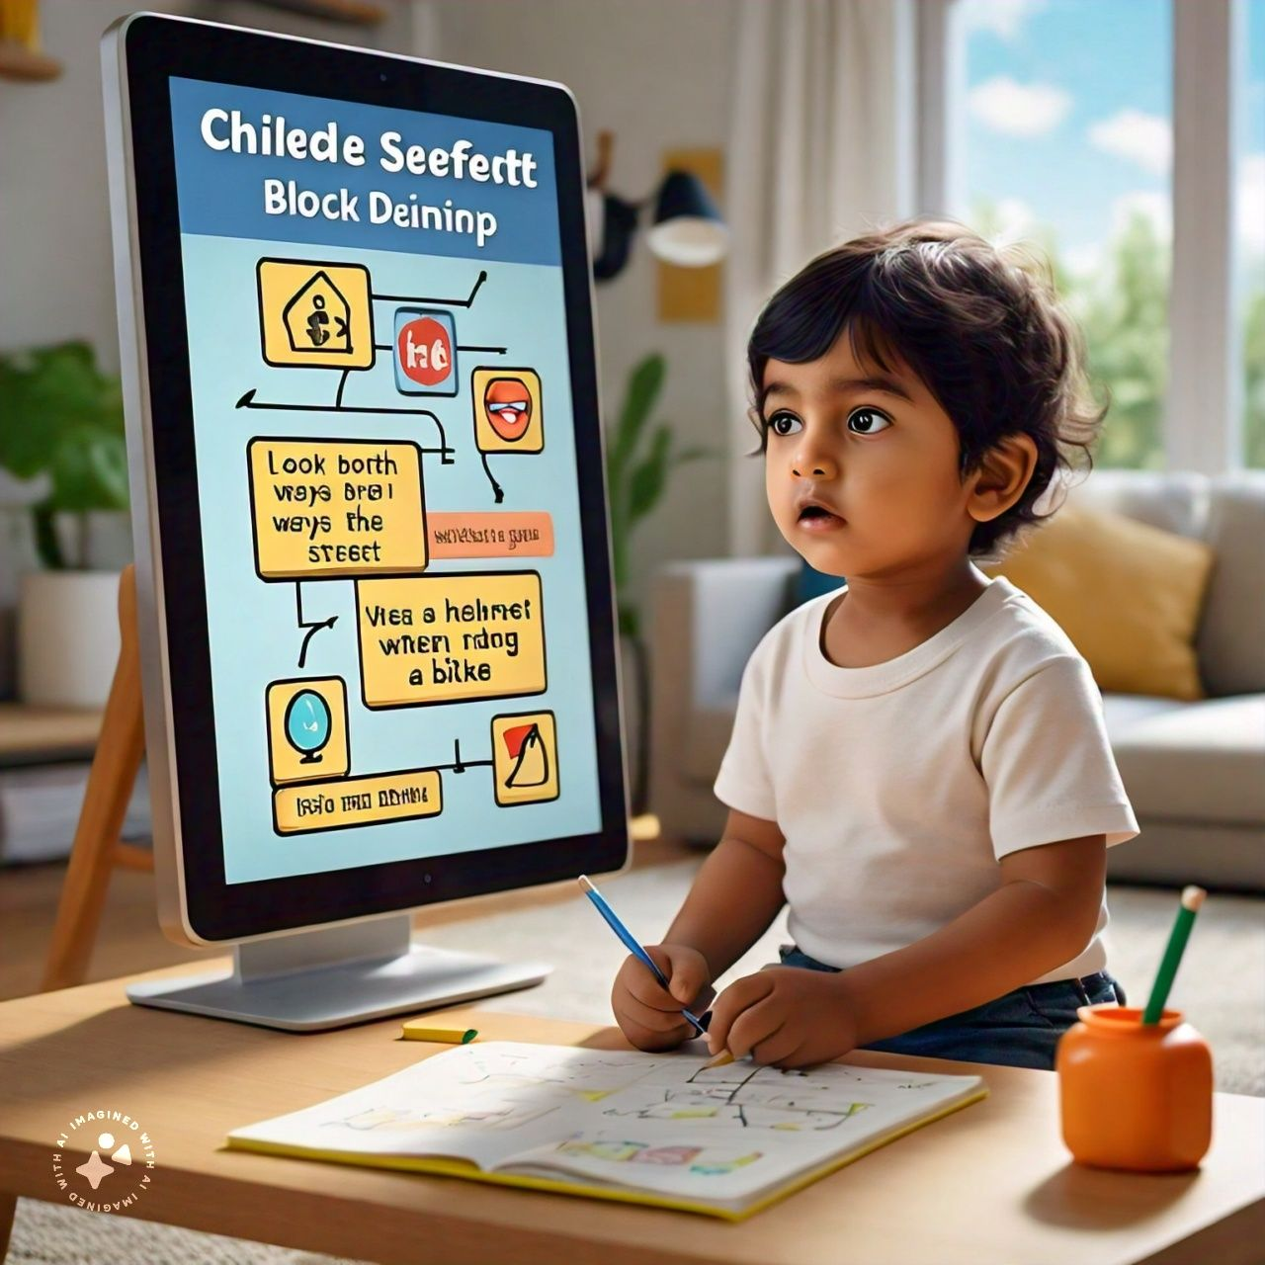

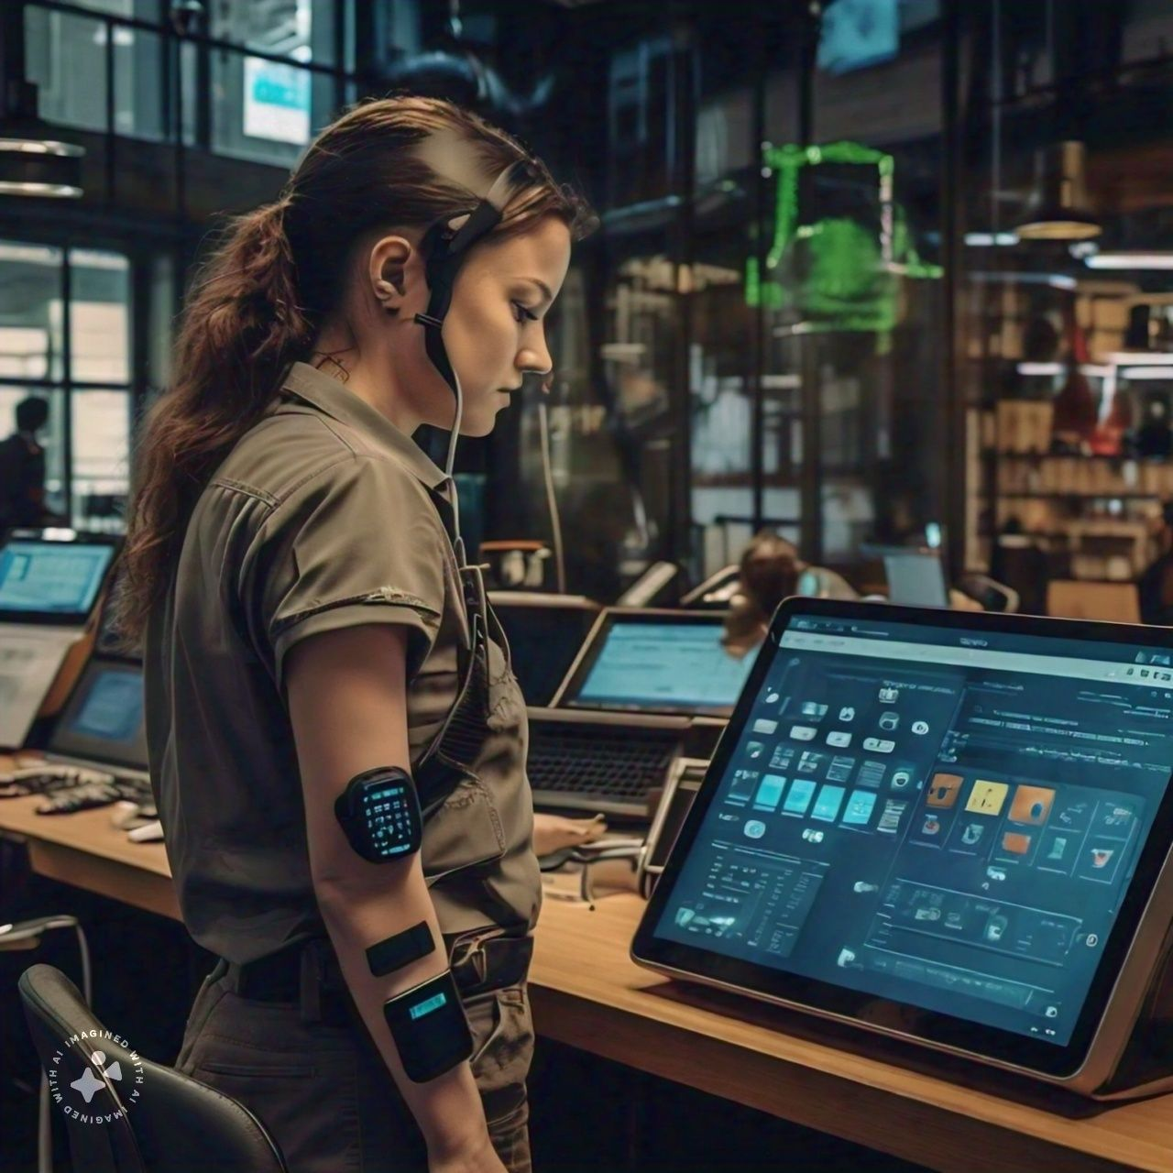

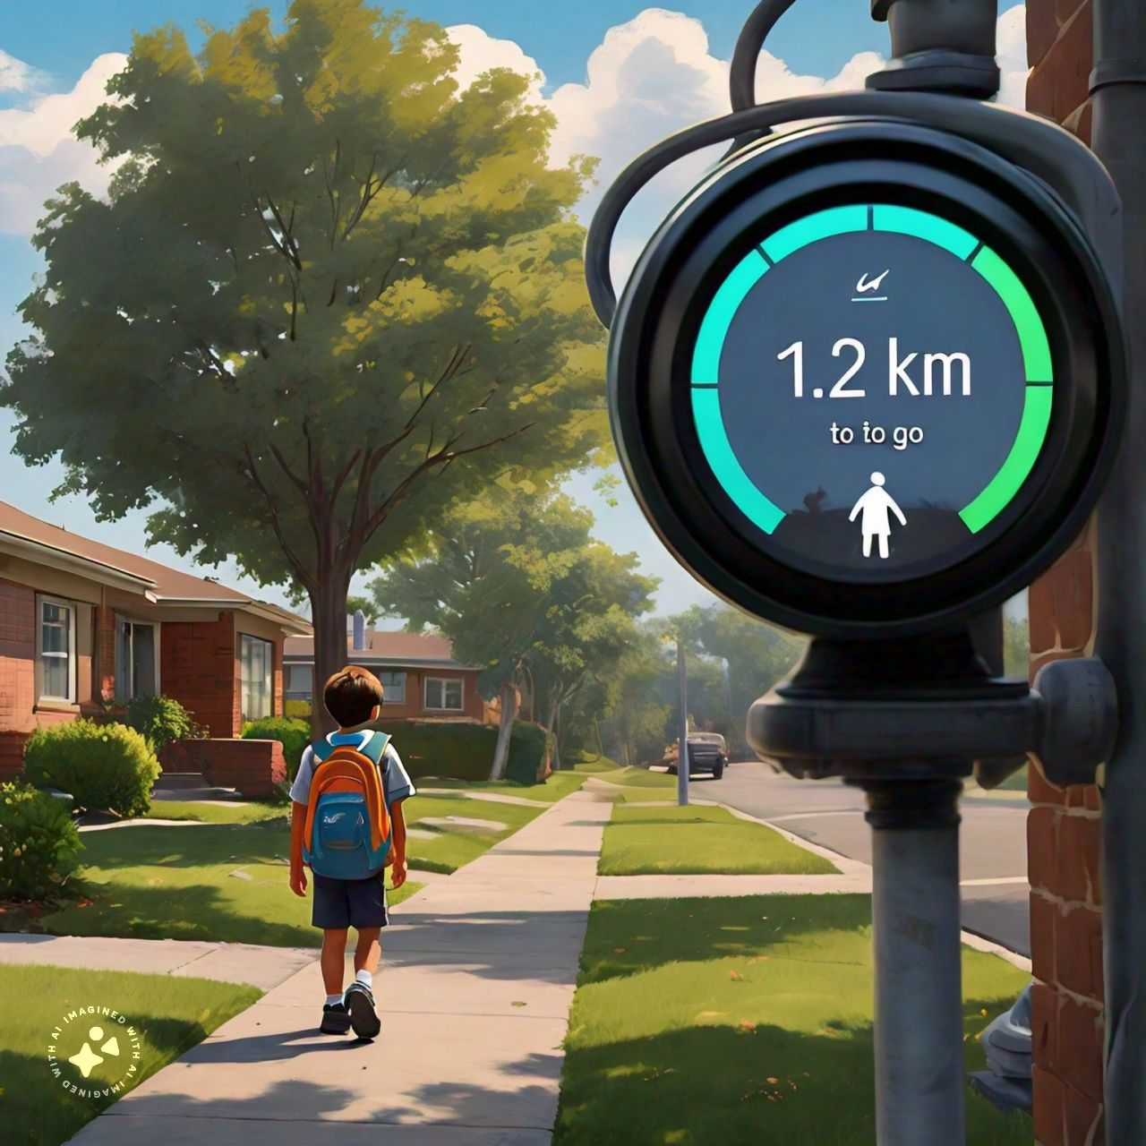
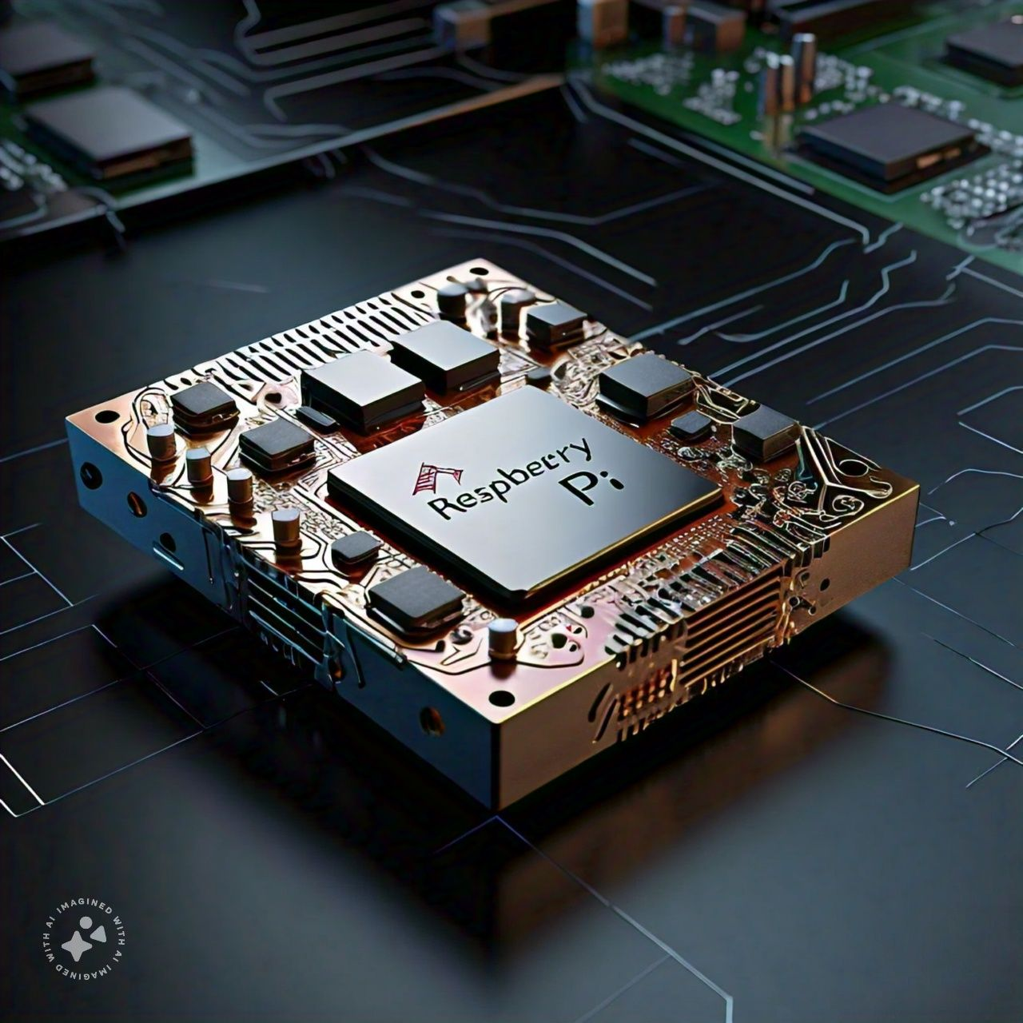
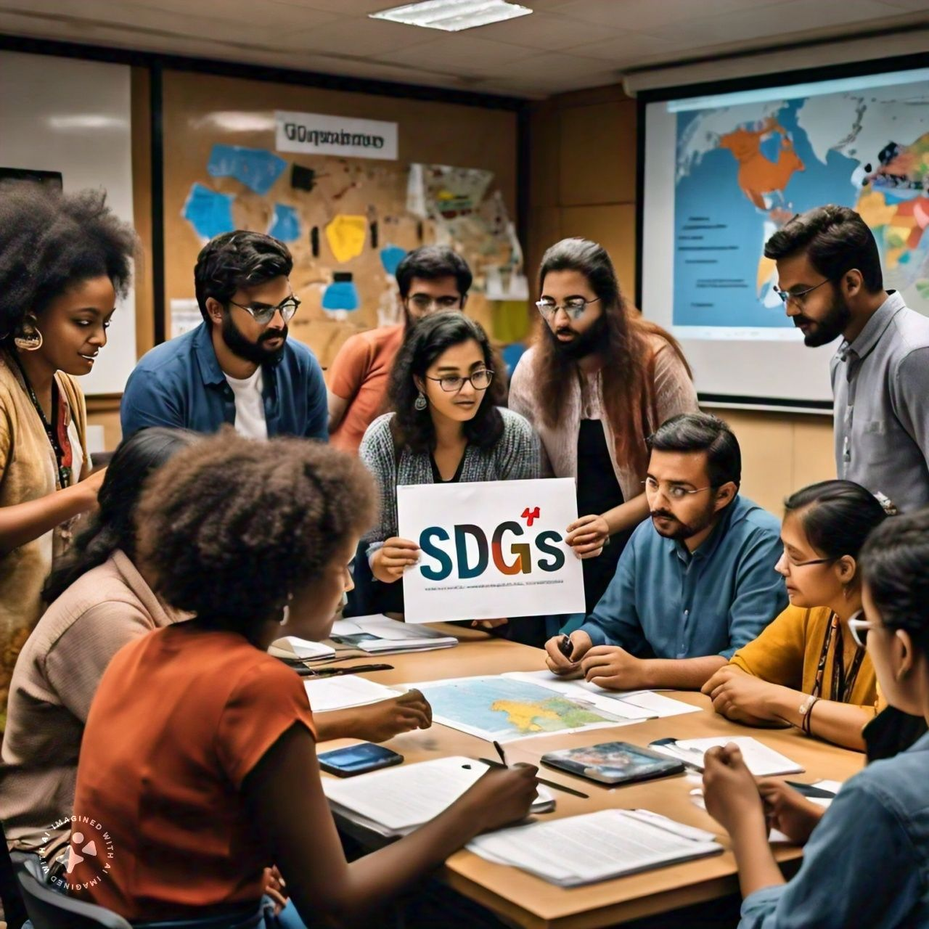
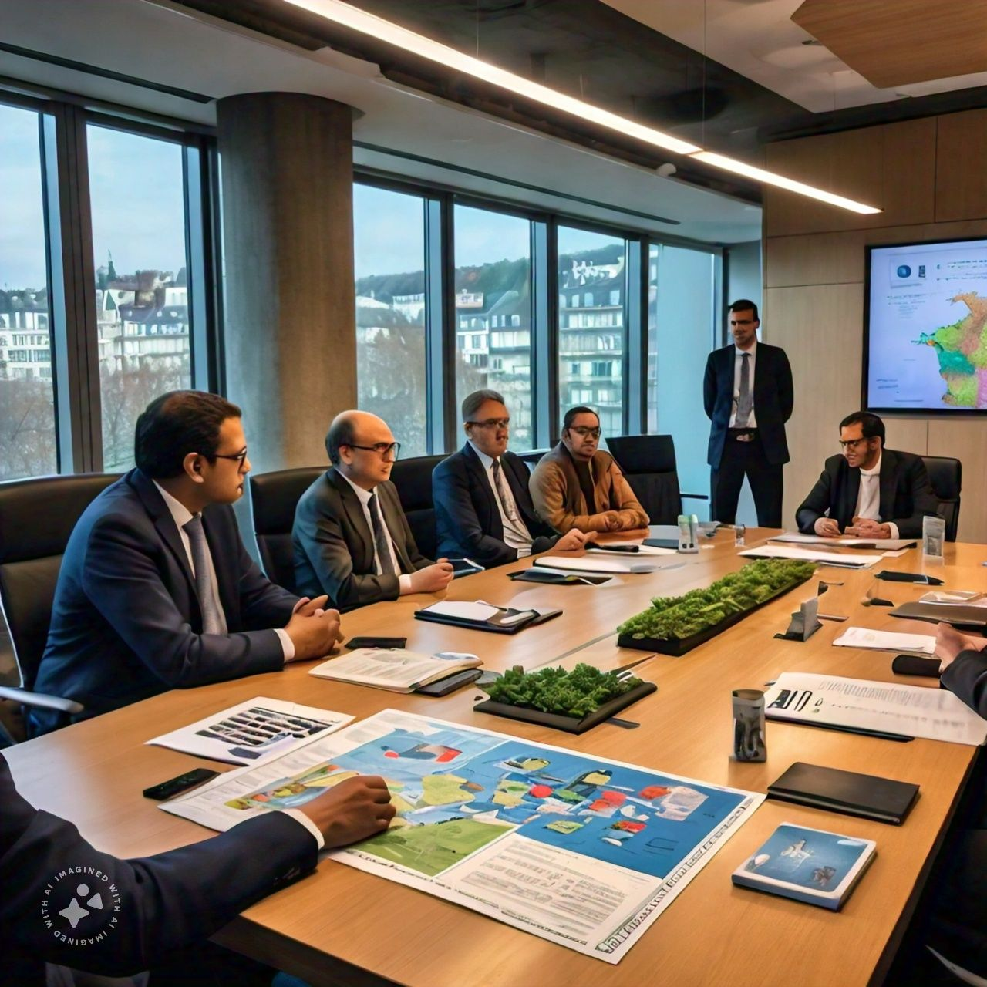

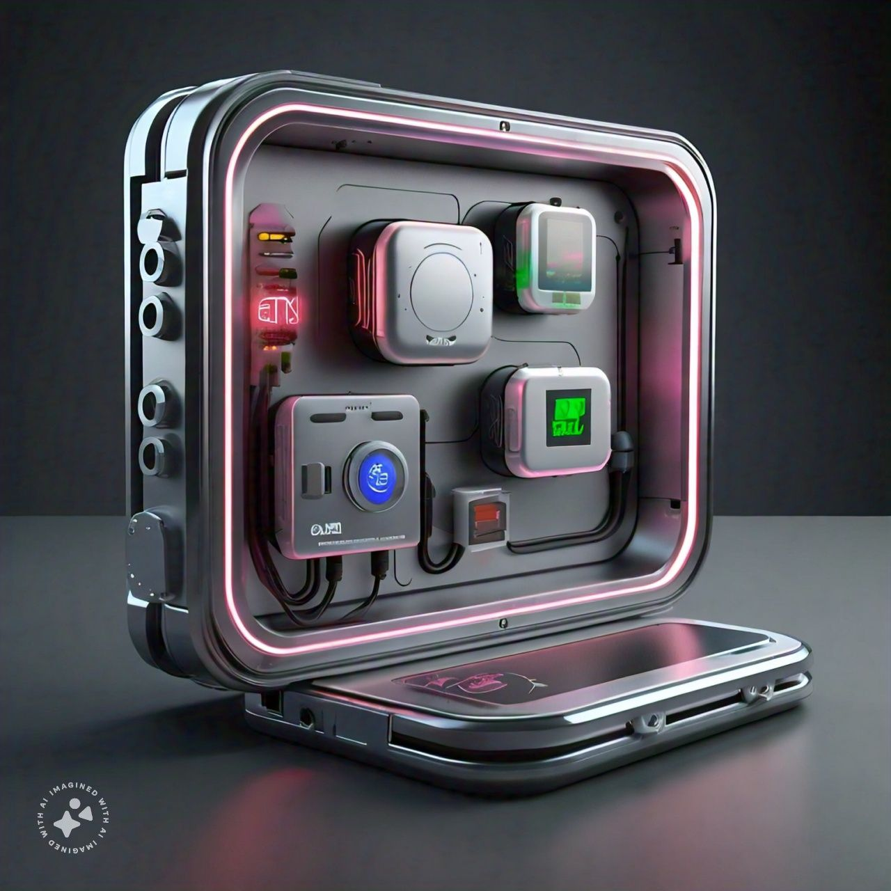
Project Title:
Development and Testing of an Advanced Individual Safety Alert System

Slide 3
Introduction:
This project develops an advanced individual safety alert system using a Raspberry Pi 3b, integrating GPS for location tracking, RFID for identification, and environmental sensors (temperature and gas) for comprehensive monitoring.
The system enables real-time tracking, geofencing, and environmental hazard detection, providing a holistic approach to personal safety in various scenarios.
The Raspberry Pi 3b serves as the central processing unit, collecting and processing data from all components and communicating with a cloud server for remote access and storage.
This versatile setup offers a robust, real-time safety solution for applications like lone worker protection, elderly care, outdoor adventures, and industrial monitoring, with immediate alert capabilities.

Slide 4
Sustainable Development Goals:
Good Health and Well-being (SDG 3):Our system enhances personal safety and enables quick emergency responses, directly contributing to improved health outcomes and overall well-being.
Quality Education (SDG 4):The RFID-based attendance tracking feature supports educational institutions in monitoring student engagement, potentially improving educational outcomes..
Industry, Innovation, and Infrastructure (SDG 9):By developing an innovative IoT-based safety solution, your project advances technological capabilities and strengthens personal safety infrastructure..
Sustainable Cities and Communities (SDG 11):The system contributes to urban safety, particularly for vulnerable individuals, fostering the development of more inclusive and secure communities..

Slide 5
Sustainable Development Goals:
Peace, Justice, and Strong Institutions (SDG 16): By facilitating communication with authorities during emergencies, your system strengthens public safety institutions and promotes a sense of security.
Partnerships for the Goals (SDG 17): Our project has the potential to faster collaborations between technology developers, local authorities, and communities to implement and improve safety solutions.
Reduced Inequalities (SDG 10): The system's affordability and user-friendly design can help democratize access to personal safety technology across different socio-economic groups.

Slide 6
Objectives:
To develop a robust GPS tracking system capable of real-time location monitoring.
To implement alerts triggered by temperature and gas sensor readings for immediate notifications in case of anomalies.
To Create a cloud-based system that provides users with secure and intuitive access to view and manage their personal information.
To enable seamless communication channels between users and nearby authorities during emergencies.

Slide 7
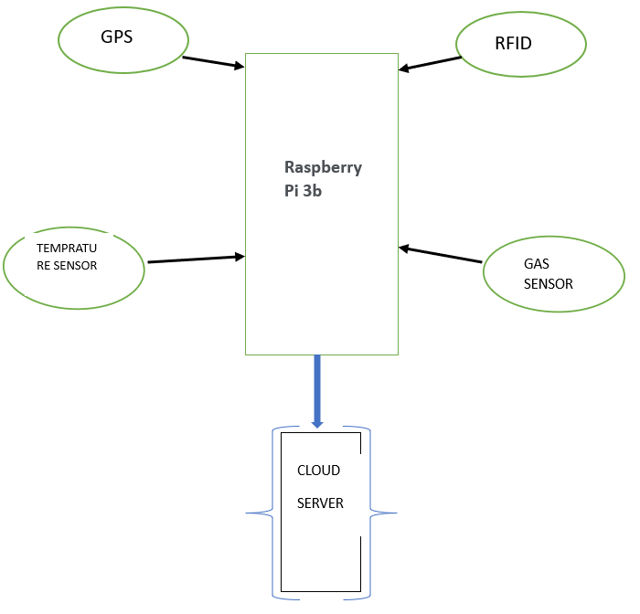
BLOCK DIAGRAM:

Slide 8
Methodology :
System Architecture and Hardware Setup: Design the architecture around Raspberry Pi 3b, integrating GPS, dual RFID readers, temperature and gas sensors, ensuring proper connections and power management
Software Development and Data Processing: Develop Python scripts for data collection, processing, and asynchronous communication, implementing GPS integration for real-time location .
Environmental and Activity Monitoring: Set up temperature and gas sensors with anomaly detection, and configure RFID readers for entry/exit monitoring, ensuring robust logic for attendance and safety checks.
Cloud Integration, Alerts, and User Interface: Establish secure communication with the cloud server for data storage and processing; develop a Telegram bot alert system and create intuitive web portals for real-time data access and management, followed by comprehensive testing and optimization.

Slide 9
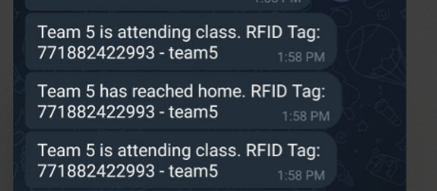
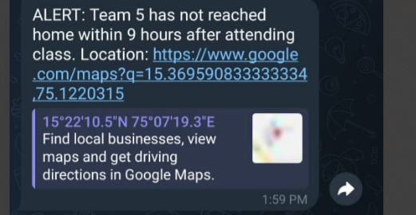
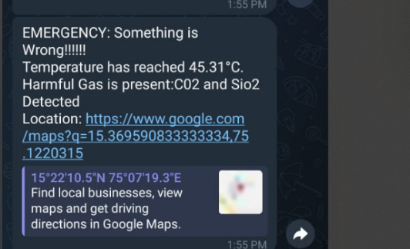
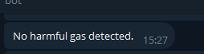
Results & Discussion:
Fig 2. Normal information message
Fig 3. .Emergency
Fig 3. Normal information message
Fig 4. Normal information message
An information message will be sent to the guardians, when he/she reaches a designated place (School/College/Office) (Shown in Fig2) and scans RFID tag. Emergency alert message will be sent via Telegram Bot if he/she fails to reach home before specified time (Shown in Fig3).
In case of detection of any harmful gas in his/her surroundings, emergency message will be sent to the guardian via Telegram Bot(Shown in Fig4).

Slide 10
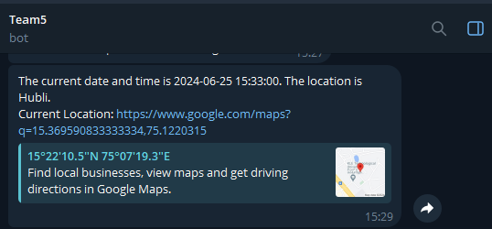
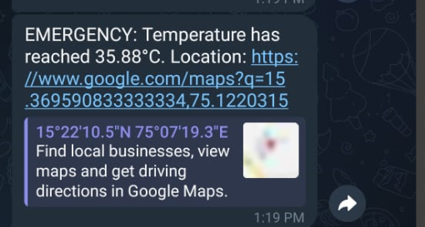
Results & Discussion:
Fig 5. Normal temperature message
Fig 6 .Emergency temperature message
Fig 7. Normal information message
Live location of he/she can be accessed by the guardians in case of a need(shown in Fig 7). In case of an emergency his/her live location will be sent to guardian via Telegram Bot
Body temperature can be accessed by the guardians in case of a need (Shown in Fig 5). Emergency message will be sent via Telegram Bot if the body temperature goes above or below the normal body temperature (Shown in Fig 6)

Slide 11
Results & Discussion:
The system incorporates GPS for real-time location tracking, temperature and gas sensors for environmental monitoring, and RFID readers for activity tracking, all managed by a Raspberry Pi 3b.
Asynchronous Python scripts ensure efficient and responsive data collection and processing, handling multiple sensors and tasks simultaneously.
Telegram bots send immediate notifications for anomalies such as high temperatures or gas detection, providing timely alerts to users during emergencies.
To effectively incorporate your test cases into your PowerPoint presentation, you can create a dedicated slide or section titled "System Testing and Validation." Here's a suggested approach to present these test cases:
RFID Alert Notification
Live GPS Tracking
Body Temperature Monitoring
Hazardous Gas Detection
Alert System Integration

Slide 12
Refference:
[1] Chen, Manting, et al. "A systematic review of wearable sensor-based technologies for fall risk assessment in older adults." Sensors 22.18 (2022): 6752.
[2] Lee, Boon-Giin, and Wan-Young Chung. "A smartphone-based driver safety monitoring system using data fusion." Sensors 12.12 (2012): 17536-17552.
[3] Shahbazian, Reza, and Irina Trubitsyna. "Human sensing by using radio frequency signals: A survey on occupancy and activity detection." IEEE Access (2023).
[4] Kwee-Meier, Sonja Th, Jennifer E. Bützler, and Christopher Schlick. "Development and validation of a technology acceptance model for safety-enhancing, wearable locating systems." Behaviour & Information Technology 35.5 (2016): 394-409.
[5] Hamidi, Hodjat. "An approach to develop the smart health using Internet of Things and authentication based on biometric technology." Future generation computer systems 91 (2019): 434-449.

Slide 13
Thank You…./

