Slide 1

RISC V Based SoC Design-SPI
Team Details
Team Number:01(EEE)
Sl.No | Student Name | USN | Roll No. | Division
1 | Rahul G Teli | 01FE21BEE008 | 6 | A
2 | Malhar Kulkarni | 01FE21BEE016 | 7 | A
3 | Chandru Thomare | 01FE21BEE022 | 12 | A
4 | CHANDRASHEKHAR R ANGADI | 01FE21BEE031 | 23 | A

Slide 2
Outline of Presentation
RISC V Based SoC Design-SPI
Problem statement.
Introduction.
Register Descriptions.
SPI Diagram with Explanation.
Signal Descriptions.
6. Conclusion.

Slide 3
Problem Statement:
RISC V Based SoC Design-SPI
RISC V Based SoC Design-SPI

Slide 4
RISC V Based SoC Design-SPI
Introduction:
The SPI is a synchronous serial interface in which data is a 32-bit byte can be shifted in and/or out 8 bit at a time.
USES: It can be used to communicate with a serial peripheral device or with another microcontroller.
Table 1: SPI Signals
SL.NO | SPI Signal | Name
1 | MISO | Master-In-Slave-Out
2 | MOSI | Master-Out-Slave-In
3 | SCLK | Serial Clock
4 | SS | Slave Select

Slide 5
RISC V Based SoC Design-SPI
A) Master In Slave Out (MISO):
Input of master and output of slave was configured as MISO line. It transfers serial data in only one direction, wherein MSB is sent first.
(B) Master Out Slave In (MOSI):
Input to slave and output to master is done by MOSI line. Data is transmitted in single direction serially, with the MSB.
(C) Slave Select (SS Bar):
The device of slave is selected using the select input line of slave, which is active low during data transfer and must stay low throughout the data transfer.
(D) Serial Clock (SCLK):
The synchronization of data to and from the device is done using the serial clock, through MOSI & MISO signals. The duration of eight clock cycles, slave and master device are capable in exchanging the data a byte.
SPI with Single Master& Single Slave

Slide 6
RISC V Based SoC Design-SPI
SPI Data Transfer
Master/Slave Transfer Block Diagram
Synchronous Serial Data Transfer
Master SPI device
Slave SPI device

Slide 7
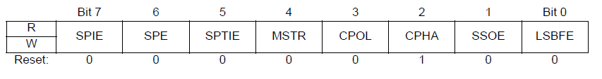
RISC V Based SoC Design-SPI
Register Descriptions
SPI Control Register 1 [8 bit] [Read/Write]:
SPIE — SPI Interrupt Enable Bit : This bit enables SPI interrupt requests, if SPIF or MODF status flag is set.
1 = SPI interrupts enabled. 0 = SPI interrupts disabled.
SPE — SPI System Enable Bit: This bit enables the SPI system and dedicates the SPI port pins to SPI system functions.
1 = SPI enable, port pins are dedicated to SPI functions. 0 = SPI disabled (lower power consumption).
Mode Of Operation

Slide 8
RISC V Based SoC Design-SPI
SPTIE — SPI Transmit Interrupt Enable
This bit enables SPI interrupt requests, if SPTEF flag is set.
1 = SPTEF interrupt enabled. 0 = SPTEF interrupt disabled.
MSTR — SPI Master/Slave Mode Select Bit
This bit selects, if the SPI operates in master or slave mode. Switching the SPI from master to slave or vice versa forces the SPI system into idle state.
1 = SPI is in Master mode. 0 = SPI is in Slave mode.
CPOL — SPI Clock Polarity Bit
This bit selects an inverted or non-inverted SPI clock. To transmit data between SPI modules, the SPI modules must have identical CPOL values.
1 = Active-low clocks selected. In idle state SCK is high. 0 = Active-high clocks selected. In idle state SCK is low.
CPHA — SPI Clock Phase Bit
This bit is used to select the SPI clock format. In master mode, a change of this bit will abort a transmission in progress and force the SPI system into idle state.
1 = Sampling of data occurs at even edges (2,4,6,...16) of the SCK clock
0 = Sampling of data occurs at odd edges (1,3,5,...,15) of the SCK clock

Slide 9
RISC V Based SoC Design-SPI
LSBFE — LSB-First Enable : This bit does not affect the position of the MSB and LSB in the data register. Reads and writes of the data register always have the MSB in bit 7.
1 = Data is transferred least significant bit first.
0 = Data is transferred most significant bit first.
SSOE — Slave Select Output Enable
The SS output feature is enabled only in master mode, if MODFEN is set, by asserting the SSOE as shown in Table 3.
Table 3: SS Input / Output Selection
MOD FEN | SSOE | Master Mode | Slave Mode
0 | 0 | SS not used by SPI | SS input
0 | 1 | SS not used by SPI | SS input
1 | 0 | SS input with MODF feature | SS input
1 | 1 | SS is slave select output | SS input

Slide 10
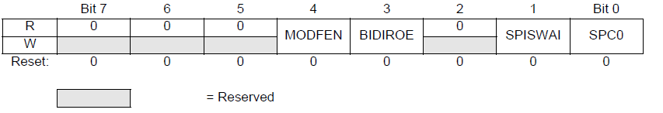
2. SPI Control Register 2 [8 bit] [Read/Write]:
RISC V Based SoC Design-SPI
MODFEN — Mode Fault Enable Bit
This bit allows the MODF failure being detected. If the SPI is in Master mode and MODFEN is cleared, then the SS port pin is not used by the SPI. In Slave mode, the SS is available only as an input regardless of the value of MODFEN.
1 = SS port pin with MODF feature
0 = SS port pin is not used by the SPI
BIDIROE — Output enabled in the Bidirectional mode of operation
This bit controls the MOSI and MISO output buffer of the SPI, when in bidirectional mode of operation (SPC0 is set). In master mode this bit controls the output buffer of the MOSI port, in slave mode it controls the output buffer of the MISO port.
1 = Output buffer enabled
0 = Output buffer disabled

Slide 11
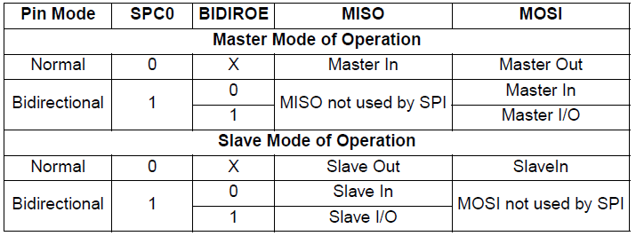
RISC V Based SoC Design-SPI
SPISWAI — SPI Stop in Wait Mode Bit: This bit is used for power conservation while in wait mode.
1 = Stop SPI clock generation when in wait mode. 0 = SPI clock operates normally in wait mode.
SPC0 — Serial Pin Control Bit 0:This bit enables bidirectional pin configurations as shown in Table 4.
Table 4 Bidirectional Pin Configurations

Slide 12
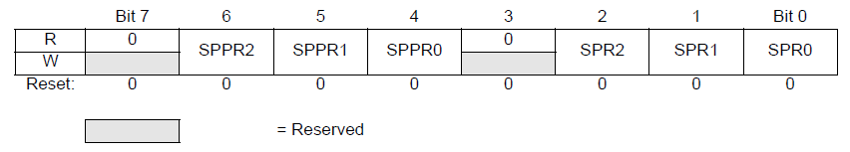
3) SPI Baud Rate Register [8 bit]:
RISC V Based SoC Design-SPI
SPPR2–SPPR0 — SPI Baud Rate Preselection Bits
SPR2–SPR0 — SPI Baud Rate Selection Bits
These bits specify the SPI baud rates as shown in the table below. In master mode, a change of these bits will abort a transmission in progress and force the SPI system into idle state.

Slide 13
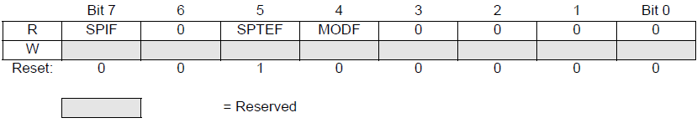
4. SPI Status Register [8 bit] [Only Read & Not Write]:
RISC V Based SoC Design-SPI
SPIF — SPIF Interrupt Flag: This bit is set after a received data byte has been transferred into the SPI Data Register. This bit is cleared by reading the SPISR register (with SPIF set) followed by a read access to the SPI Data Register.
1 = New data copied to SPIDR. 0 = Transfer not yet complete
SPTEF — SPI Transmit Empty Interrupt Flag: If set, this bit indicates that the transmit data register is empty. To clear this bit and place data into the transmit data register, SPISR has to be read with SPTEF=1, followed by a write to SPIDR.
1 = SPI Data register empty. 0 = SPI Data register not empty.
MODF — Mode Fault Flag: This bit is set if the SS input becomes low while the SPI is configured as a master and mode fault detection is enabled, MODFEN bit of SPICR2 register is set. The flag is cleared automatically by a read of the SPI Status Register (with MODF set) followed by a write to the SPI Control Register 1.
1 = Mode fault has occurred. 0 = Mode fault has not occurred.

Slide 14
RISC V Based SoC Design-SPI
Functional Block Diagram of SPI
SPI Modes based on CPOL and CPHA
Block Diagram of SPI

Slide 15
Block diagram Explanation
RISC V Based SoC Design-SPI
Controller Block
It is a configurable SPI controller that allows setting parameters like data width, address width, clock polarity/phase, baud rate etc. through register writes.
The SPICR_1, SPICR_2 and SPIBDR registers allow configuring the SPI mode parameters. Writing to these registers saves the configuration.
The MWDATA register is used to write the data to be transmitted. Reading the MRDATA gives the received SPI data.
It generates the SPI clock using a clock divider circuit. The baud rate is configurable by writing to the SPIBDR register.
The SPI state machine, transmission and reception logic is not shown here. Only the configuration registers, clock generation and interface to access the registers is defined.
It provides interfaces like chip select signals, interrupts etc. along with the SPI lines SCK, MOSI, MISO.
this is a configurable SPI controller design that allows setting various SPI communication parameters through register access. The module provides the necessary interfaces and a programmable clock divider to generate the SCK. The state machine and data transfer logic for SPI transmission/reception is likely implemented separately.
Master Block
It is a configurable SPI master that allows setting parameters like data width, clock polarity/phase, LSB/MSB first etc. through the SPICR registers.
The core logic involves SPI data transmission in 4 8-bit chunks. Transmit and receive shift registers (SPIDR_W, SPIDR_R) are used to shift out TX data and capture RX data.
The state machine has 4 states - idle, setup, write, read. Setup state configures the transmission, write state handles MOSI data shifting out, while read state shifts in MISO data.
The sclk generation logic creates the serial clock based on configurable parameters like polarity, phase. The baud rate can also be configured.
Interface signals include ss, sclk, mosi, miso along with registers like SPICR, SPISR for control and status.
this is a parameterized and configurable SPI master with support for varied data widths. It can handle both transmission and reception through inbuilt shift register based logic. The state machine orchestrates the SPI operations based on parameters set in configuration registers. Overall, this allows customizing SPI communication for different external slave devices.

Slide 16
Block diagram Explanation
RISC V Based SoC Design-SPI
SPI Top Block
It instantiates an SPI controller module (spi_controller) and an SPI master module (spi_master).
The controller module handles the register interface, clock generation and overall SPI parameters configuration.
The master module has the actual SPI data transmission and reception logic.
Configuration registers like SPICR_1, SPICR_2 are used to set SPI modes and are common for both modules.
The controller sets these registers and passes to the master module. It also handles the clock generation for SPI communication.
Master module uses these configurations to control the SPI transfer. It also has access to data registers for transmission and reception.
The MISI, MOSI, SS, SCLK signals are driven from the master module based on data transfers controlled by the state machine.
this creates a configurable SPI system with flexible interfaces. The controller and master separation allows reusing modules and customizing setups. The registers form the backbone to configure operational modes. Overall, this implements an SPI architecture following standard building blocks.
SPI Testbench
It instantiates the SPI top module (spi_top) and drives stimulus to it.
Stimulus includes the control signals like clock, reset, register writes to configure SPI. Also data to transmit and simulate MISO input.
It first writes the configuration registers SPICR_1, SPICR_2 to set parameters like clock polarity, phase etc.
It writes data to the transmit register, then toggles clock to complete an SPI transfer.
To simulate reception, it is driving MISO signal with dummy data, which gets captured.
Finally it reads the received data and control registers to check proper functioning.
this testbench automates the process of configuring the SPI module, conducting full data transfers by toggling clocks and finally reading back status registers and data. It verifies transmission and reception through interacting with interface signals. The spi_top interfaces are appropriately stimulated here.

Slide 17
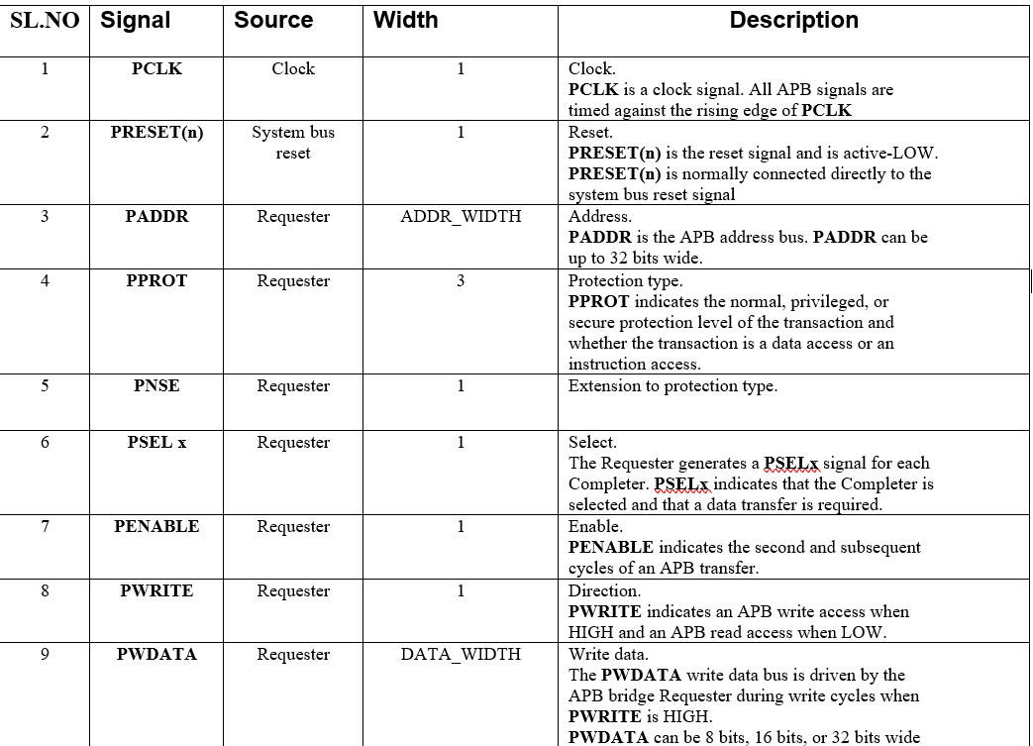
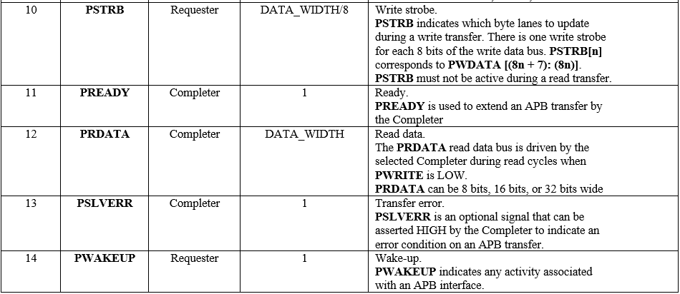
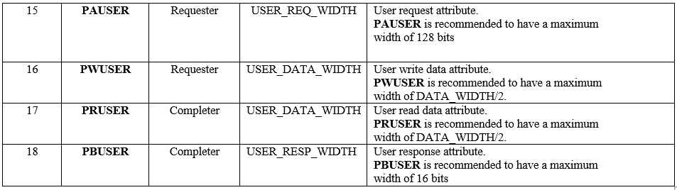
RISC V Based SoC Design-SPI
Signals Description

Slide 18
Conclusion
RISC V Based SoC Design-SPI
The series of SPI controller, SPI master and SPI testbench modules implemented demonstrate a fully functional SPI communication system in Verilog. The controller configures the SPI modes and parameters through register settings. The master module handles the actual data transfers, transmission and reception via shift register based logic controlled by a state machine. The interfaces conform to standard SPI protocols.
The testbench module provides stimulus to validate transmission and reception of multiple data packets. It shows the complete working of the configurable SPI modules for different bit orders, clock polarity/phases etc. Thus this reusable and flexible SPI architecture with parametrized data widths fulfills common communication
The configurable SPI controller and SPI master modules developed here showcase common building blocks required for implementing SPI communication protocols. The register interfaces allow easy integration with processors for configuration and data transfer. Modularizing the control and data path allows mixing different SPI modes easily based on application requirements.
Overall, these set of modules can enable rapid prototyping of SPI based systems. For example, the SPI master can interface with external SPI flash memory or ADCs/DACs to quickly build a sensor monitoring solution. The flexibility in data width parameter allows interfacing with peripherals of different resolutions easily. The testbench module provides a starting point for comprehensive verification through simulation tests. Both master and slave configurations are possible for end applications by tweaking the control registers.
In conclusion, by following standard SPI interfaces and a modular design approach, this reference implementation covers the key functionality needed in typical embedded applications. Built over this framework, custom SPI centric solutions for sensors, touchscreen, audio, and IoT systems can be rapidly realized. The parameterized structure makes the modules portable across different FPGAs as well. The modular architecture is amenable for future enhancements also discussed in the prior section.

