Slide 1

SoC Estimation of Li-ion Battery using deep
learning frame work for EV Applications
Research Experience for Undergraduates
Presented by: Malhar Kulkarni
USN: 01FE21BEE016
Under the Guidance of
Dr. Uday Wali
Prof. Leah S Joshi

Slide 2

OVERVIEW
01
Introduction
02
Objectives & Literature Review
SOC
03
Data Description
04
Methodology
05
Results and Analysis

Slide 3
INTRODUCTION
Importance of SOC Estimation for Evs
State of Charge (SOC) is a critical metric for monitoring the health and performance of lithium-ion batteries in electric vehicles (EVs).
Accurate SOC estimation ensures efficient battery utilization, prolongs battery lifespan, and enhances vehicle safety by avoiding overcharging or deep discharging.
SOC estimation is particularly challenging in dynamic operating conditions, where temperature significantly influences battery performance.
SOC
Challenges of Temperature Variations
Temperature fluctuations (from 0°C to 40°C) directly affect:
Battery capacity and internal resistance.
Chemical reactions, leading to changes in voltage and current.
SOC estimation accuracy, as models must adapt to these non-linear variations.
Low temperatures (e.g., 0°C) reduce battery efficiency, while higher temperatures can accelerate degradation, making robust estimation models essential.

Slide 4


Objectives
To predict the accurate soc of lithium-ion battery at varying temperatures using deep learning models i.e. LSTM, Bi-LSTM,TCN and Hybrid models.
Evaluate the deep learning Models using Adam and SGD Optimizers.
Compare model performance using RMSE to identify the most effective approach for temperature-dependent SOC estimation.

Slide 5
Literature Review
A Bayesian Optimized Deep Learning Approach for Accurate State of Charge Estimation of Lithium-Ion Batteries Used for Electric Vehicle Application
Summary: The paper proposes a Bayesian Optimized Deep Learning (DL) approach to estimate the State of Charge (SoC) of lithium-ion batteries used in electric vehicles (EVs). It highlights the limitations of traditional methods and introduces Bayesian optimization for hyperparameter tuning in deep learning models to improve prediction accuracy. The study evaluates different Recurrent Neural Network (RNN) architectures, including Long Short-Term Memory (LSTM), Gated Recurrent Unit (GRU), and Bidirectional LSTM (Bi-LSTM) for SoC estimation across different temperature conditions.
2. Battery Management Solutions for Li-ion Batteries Based on Artificial Intelligence
Summary: The paper explores how Artificial Intelligence (AI) techniques can improve Battery Management Systems (BMS) for lithium-ion (Li-ion) batteries. It discusses how AI-based approaches enhance battery State of Charge (SoC) estimation, State of Health (SOH) monitoring, and fault diagnosis, making Li-ion batteries safer and more efficient for electric vehicles (EVs) and energy storage applications.
SOC

Slide 6
Overview of Modeling Approaches
LSTM (Long Short-Term Memory):
Designed to handle sequential data with long-term dependencies.
Ideal for capturing the complex temporal relationships in battery voltage, current, and temperature data.
Features a memory cell to retain information over long periods, mitigating vanishing gradient issues seen in traditional RNNs.
TCN (Temporal Convolutional Network):
Uses dilated convolutions to model sequence data, ensuring predictions depend only on past inputs.
Handles long-range dependencies efficiently through dilated convolutions.
Robust to time-series variations, making it suitable for data with varying time scales (e.g., SOC at different temperatures).
Bi-LSTM (Bidirectional LSTM):
Extends LSTM by processing the sequence in both forward and backward directions.
Captures contextual information from both past and future inputs.
Useful for applications requiring a deeper understanding of dependencies in the data, such as SOC
influenced by sudden load or temperature changes.

Slide 7

Data Description PART 1
Dataset Overview
Source: The dataset is recorded from LG 18650HG2 Li-ion Battery dataset under controlled laboratory conditions,
simulating real-world EV operations. It includes diverse operational scenarios such as varying discharge rates, load conditions, and
environmental temperatures.
Features:
Voltage (V): Represents the electrical potential difference across the battery terminals.
Current (I): Measures the flow of electric charge.
Temperature (T): Monitors the operating temperature, critical due to its impact on battery behavior.
SOC: The percentage of the battery’s capacity remaining, the target variable for prediction.
Target Variable:
State-of-Charge (SOC): Represents the battery's energy status, calculated using a combination of
Coulomb counting and voltage-based methods.
Data Collection Conditions:
Battery cycling data was collected at 0°C, 10°C, 25°C, and 40°C to evaluate temperature-induced variations
in performance.
Controlled experiments ensure consistency and reliability of the data.

Slide 8
Data Collection
Data Description PART 2
Temperature Conditions
Recorded at: 0°C, 10°C, 25°C, and 40°C.
Relevance:
Low temperatures (e.g., 0°C) increase internal resistance, reducing capacity.
High temperatures (e.g., 40°C) accelerate chemical reactions, causing degradation.
In the Program: Data is segmented by temperature to evaluate SOC estimation performance under varying conditions.
Operational Conditions
Charge/Discharge Cycles: Simulate realistic EV usage patterns.
Relevance:
EV batteries operate dynamically; accurate SOC estimation is essential for all scenarios.
In the Program: Models are trained on varied cycles, enhancing robustness for real-world applications.
Measured Parameters (Input Features)
Inputs: Voltage (V), Current (I), Temperature (T).
Relevance: These parameters influence SOC and are key for modeling battery behavior.
In the Program: Features are normalized and fed into sequential models (LSTM, TCN) for training.
Data Sampling and Recording
Relevance: Regular sampling ensures uniformity and captures temporal patterns.
In the Program: Sequential data is processed using the sliding window method to create time-series inputs.

Slide 9

Model Architectures
LSTM (Long Short-Term Memory):
Bi-LSTM (Bidirectional LSTM):
Methodology - Model

Slide 10

Methodology - Training Setup
Training Parameters
Hyperparameters:
Batch Size: Affects training stability and speed. Smaller sizes (32) are used for TCN to match its lightweight architecture, while LSTM/Bi-LSTM uses 64 for better gradient updates.
Optimizers:
Adam: Adaptive optimizer suitable for complex models like LSTM and Bi-LSTM, ensuring faster convergence.
SGD: Simpler optimizer effective for TCN and smaller datasets but may require more epochs to converge.
Learning Rate: A fixed starting value of 0.001 with decay schedules for fine-tuning as training progresses.
Epochs: Set to 200 to ensure sufficient training cycles for convergence.
Loss Function: Mean Squared Error (MSE) minimizes the difference between predicted and actual SOC values.
Validation Strategy:
K-Fold Cross-Validation: Splits the dataset into 5 parts, using 4 for training and 1 for testing iteratively. This ensures robust evaluation by averaging performance across folds.
Comparison Strategy:
Models are trained for each temperature condition (0°C, 10°C, 25°C, 40°C) to evaluate how well they perform under varying conditions.
RMSE (Root Mean Square Error): Chosen as the evaluation metric to measure prediction accuracy, with lower RMSE indicating better performance.

Slide 11
Model Comparison LSTM
Strengths
Weaknesses
Observations
Excellent at capturing long-term dependencies in sequential data, which is critical for SOC estimation.
Sequential processing makes training slower compared to parallel models like TCN
Performs reliably under normal conditions but struggles to maintain accuracy in extreme temperature ranges.

Slide 12
Model Comparison Bi-LSTM
Strengths
Weaknesses
Observations
Processes input in both forward and backward directions, enhancing accuracy by capturing bidirectional temporal dependencies.
Higher computational cost due to processing the sequence twice (forward and backward).
Outperforms LSTM in dynamic conditions but lacks the speed advantage of convolutional models.

Slide 13
Model Comparison TCN
Strengths
Weaknesses
Observations
Fast training with parallel processing and effective handling of long-range dependencies using dilated convolutions.
Lacks the bidirectional capabilities of Bi-LSTM, limiting contextual understanding in certain conditions.
Performs well across all temperatures but slightly trails Bi-LSTM in extreme conditions.

Slide 14

Results and Analysis
Deep Learning Insights
LSTM:
Handles temporal sequences well.
Performance declines in extreme temperatures due to limited bidirectional learning.
RMSE: ~2.2% at 0°C.
Bi-LSTM:
Processes forward and backward temporal dependencies, improving accuracy.
Performs better in dynamic conditions compared to LSTM.
RMSE: ~1.91% at 0°C.
TCN:
Parallel processing with dilated convolutions enhances training speed and long-term dependency handling.
Best standalone performance across all temperatures.
RMSE: ~1.83% at 0°C.
TCN-BiLSTM:
Combines strengths of TCN and Bi-LSTM.
Superior SOC estimation accuracy under challenging conditions.
RMSE: ~1.70% at 0°C.

Slide 15

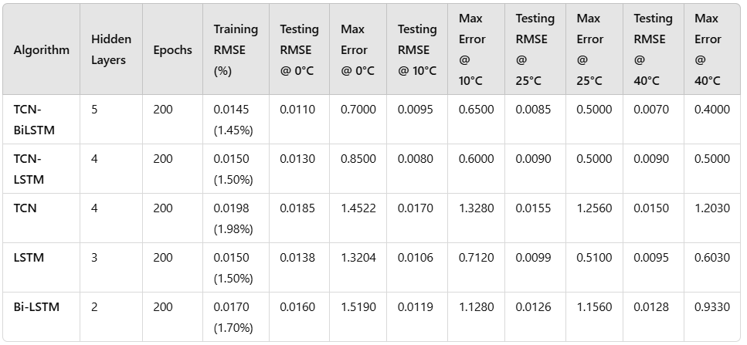
Results and Analysis -Contd
Key Observations:
TCN and its hybrid models outperformed LSTM and Bi-LSTM, particularly at extreme temperatures (0°C and 40°C).
TCN-Bi-LSTM demonstrated the best overall performance due to its ability to capture long-term dependencies and bidirectional relationships.
Training Efficiency:
TCN was faster than LSTM and Bi-LSTM, reducing training time by approximately 30%.
Table 1. Performance Comparison of Deep Learning Models for SoC Estimation of Li-Ion Batteries Across Varying Temperature Conditions

Slide 16
Conclusion
Best Model: TCN-Bi-LSTM delivers the most accurate and robust SOC estimations by combining TCN’s speed and Bi-LSTM’s bidirectional temporal learning.
Key Insights:
Hybrid models outperform standalone models, ensuring reliable performance across temperatures.
Accurate SOC estimation improves EV performance, safety, and battery lifespan.
Conclusion and Future Work
Future Work
Real-World Deployment: Optimize models for real-time onboard EV systems considering computational constraints.
Dataset & Testing: Expand datasets to include diverse scenarios like aging effects and dynamic load conditions.
Energy Efficiency: Develop lightweight versions of hybrid models for embedded systems.
System Integration: Combine SOC estimation with SOH prediction and thermal management for comprehensive EV solutions.

Slide 17


Slide 18
Thank You

