Slide 1


ADV Namma Yatri: Business Insights Deck

Slide 2
Business Objective
Reduce
Reduce cancellations
Improve
Improve ride completion rate
Align
Align drivers to high-demand zones & time blocks

Slide 3
Key Demand Trends
Most ride searches between 6–11 AM and 5–9 PM
Demand spikes at 1 AM and 7 AM (possibly airport/intercity)
Use cases: Work commute, evening return, late-night travel

Slide 4

Revenue Insights
Bangalore South, Yeshwantpur, and Hebbal generate the most revenue
Premium hours: 1 AM, 8 PM, 12 PM
Target pricing & driver supply in these zones/times

Slide 5
Ride Completion Challenges
Only 45.5% of quotes lead to completed rides
47.25% of rides cancelled by drivers
10.79% by customers

Slide 6
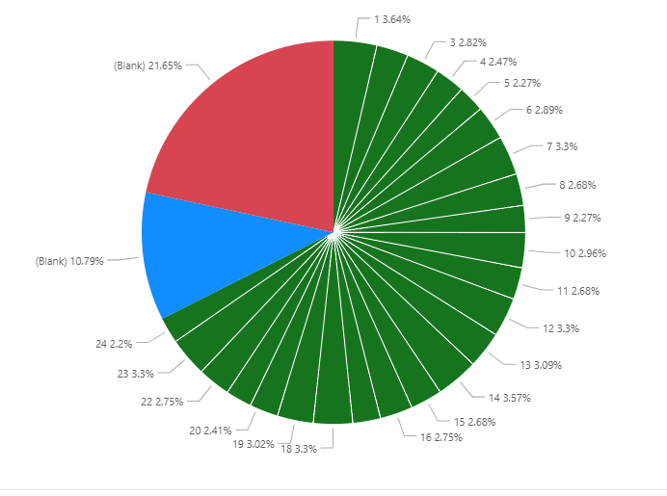
Conversion Funnel Breakdown
Visual: Pie chart by Hour_of_Trip and Ride_Status
Blank hour = 32% of total rides (cancelled without trip record)
Funnel leakage pre-trip creation

Slide 7
Recommendation #1: Fix the Quote-to-Completion Funnel
Capture
Capture time at quote/search stage
Add
Add quick-confirm buttons or timers
Offer
Offer fallback (auto-requote or retry with another driver)

Slide 8
Recommendation #2: Align Supply to Premium Trips
Use MinFare parameter analysis
High-fare rides cluster around 1 AM, 8–10 PM
Focus driver supply and pricing tools during these blocks

Slide 9
Recommendation #3: Zone-Based Incentives
Deploy incentive coupons for Mahadevapura and Dasarahalli, with High search, low completion
Promote successful zones (e.g., Hebbal, Bangalore South)

Slide 10
Recommendation #4: Reduce Driver Cancellations
Add
Add penalties or incentives for consistent drivers
Show
Show more ride info before accepting
Promote
Promote driver reliability in rider messaging

Slide 11
Recommendation #5: Campaign Around Digital Payment Growth
76%+ of rides paid via UPI/card
Introduce UPI cashback, loyalty points
Target digital-only promotions

Slide 12
Next Steps & Wrap-Up
Enable tracking at earlier funnel stages
Use these insights for pilot in top 3 revenue zones
Build weekly ops dashboard for zone/time monitoring

Slide 13
Thank You / Q&A
Presented By:
Umang Malhotra
Vikash Kumar Tripathi
Suchindran Varadaraj

