Slide 1


ADV Namma Yatri: Technical Insights Deck

Slide 2
Objective
Understand
Understand ride demand patterns across time and zones
Identify
Identify revenue trends, cancellations, and user drop-offs
Use
Use Power BI to enable data-driven operational decisions

Slide 3
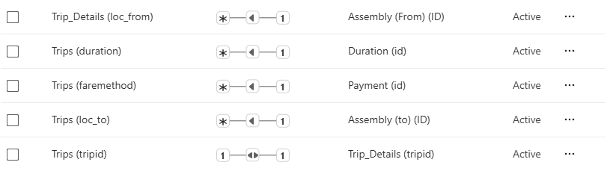
Data Model Overview
Tables used: Trips, Trip_Details, Duration, Payment, Assembly
Key joins:
Note: `Trip_Details` lacks duration/hour data for cancelled rides

Slide 4
Data Cleaning and Preparation
Removed nulls and duplicates
Created calculated fields:
Ride_Status (Completed / Driver Cancelled / Customer Cancelled)
Completed_After_Quote
IsValidTrip to filter only valid trips (fare > 0, distance > 0, end_ride = 1)
Hour_of_Trip was created in the Duration table to convert hour ranges to the higher hour for trending purpose

Slide 5
Key DAX Measures
Total Revenue = SUM(Trips[fare])
Completed Trips = COUNTROWS(FILTER('Trip_Details', end_ride = 1))
Completed_After_Quote = IF(searches_got_quotes = 1 && end_ride = 1, 1, 0)
MinFare What-If Parameter and filtered measure using FILTER()

Slide 6
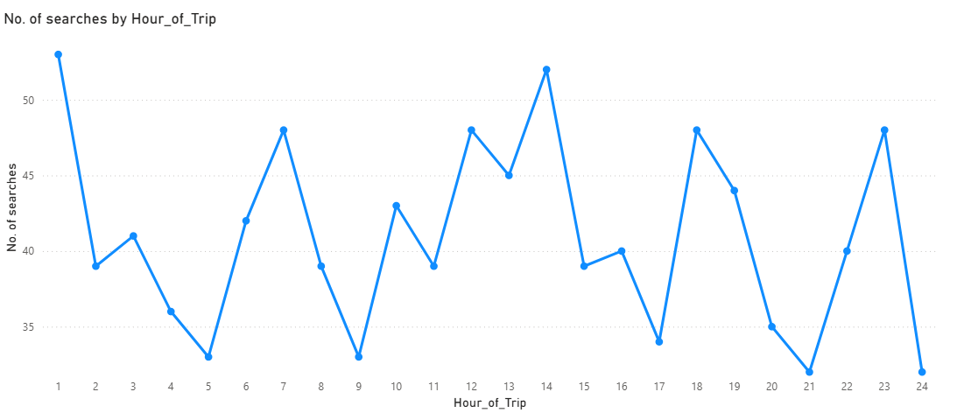
Ride Demand by Hour
Line chart showing total demand by Hour_of_Trip
Observation: Peaks at 1 AM, 7 AM, 12 PM, 8 PM
Used for driver allocation planning

Slide 7
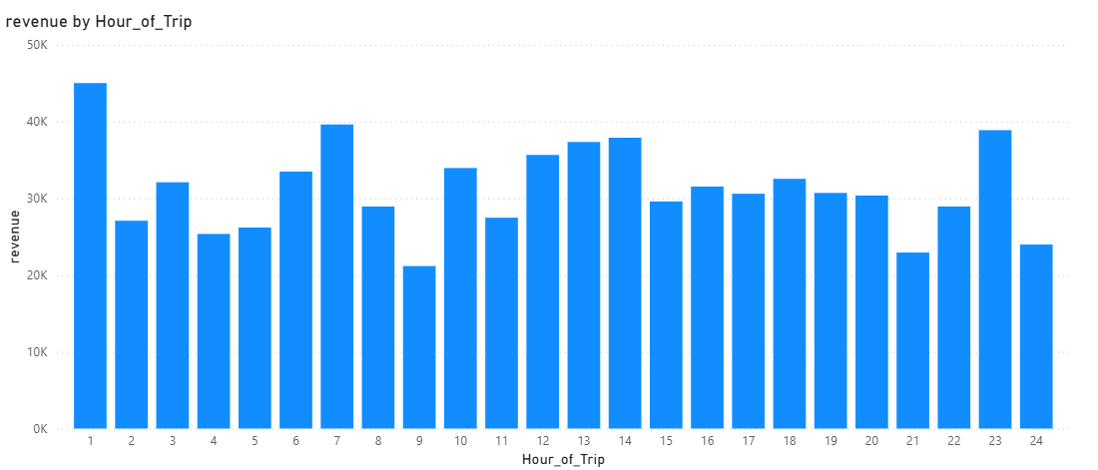
Revenue Contribution by Hour
Column chart showing Total Revenue by Hour_of_Trip
Highest revenue between 1–2 AM, and 6–8 PM
Validates alignment between demand and revenue

Slide 8
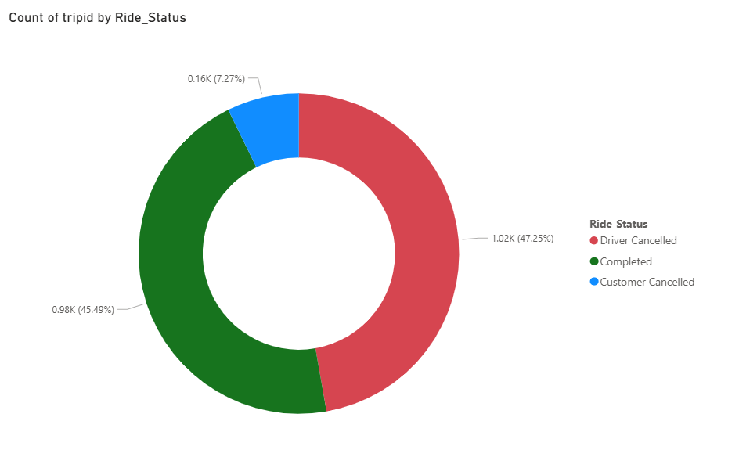
Completion Status Breakdown
Donut chart with Completed, Driver Cancelled, Customer Cancelled
Insight: 47.25% driver cancellations; only 45.5% completed

Slide 9
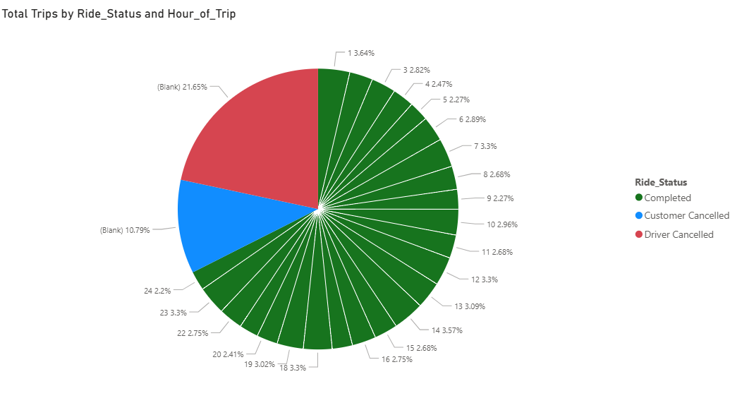
Quote to Completion Funnel
Pie chart showing Completed_After_Quote vs other statuses
32.4% of trips with quotes never completed
Blank Hour_of_Trip confirms drop-offs occur pre-trip creation

Slide 10
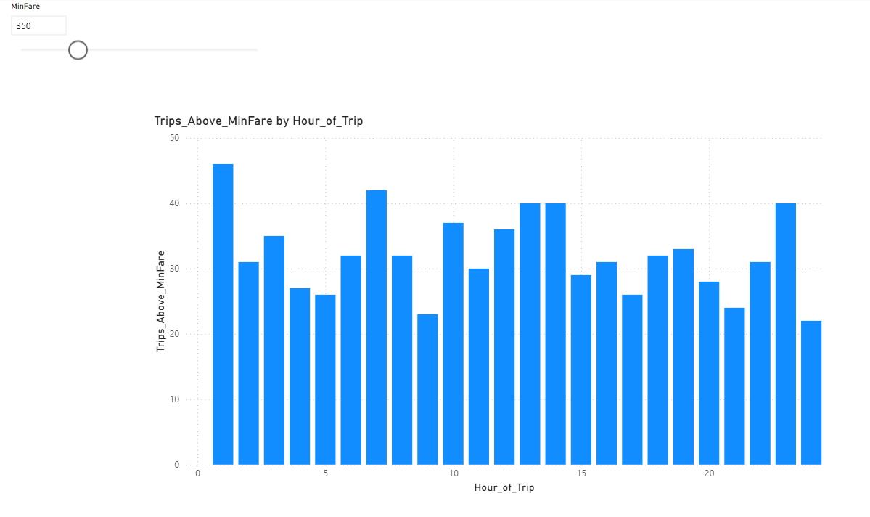
Parameterized Insights – MinFare Filter
MinFare slicer (0–1500), used in dynamic fare filtering
Trips_Above_MinFare = CALCULATE(COUNT(...), FILTER(...))
Chart updates by hour to show premium trip windows

Slide 11
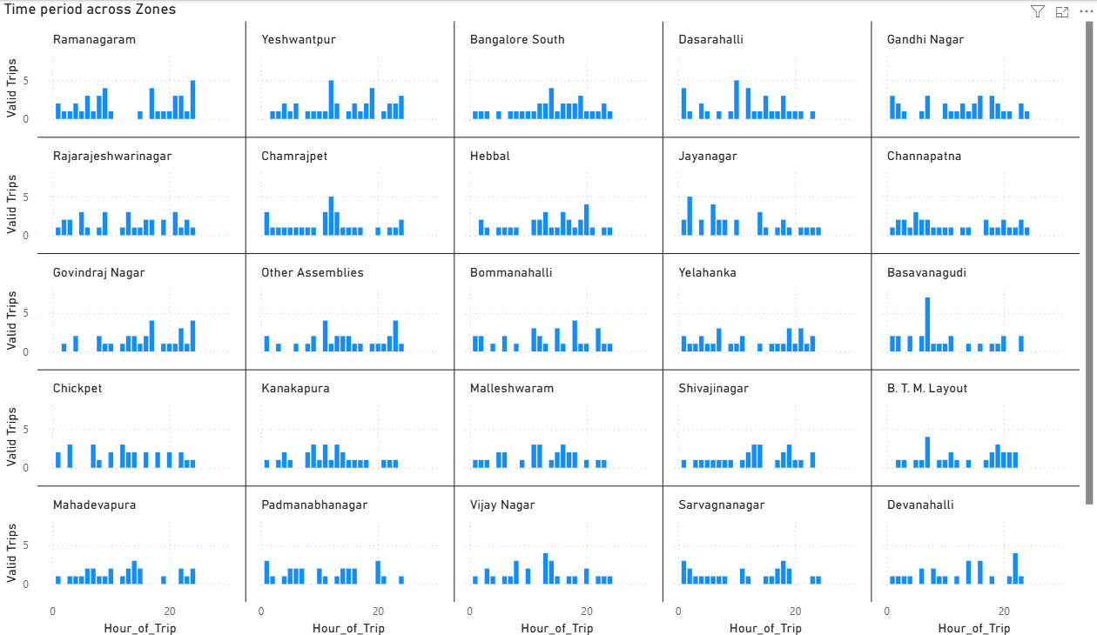
Time Period vs Zone Matrix
Small multiples or heatmap visual by Hour_of_Trip and Assembly
Useful for zone-hour level supply planning

Slide 12
Key Technical Recommendations
Use
Use Ride_Status for funnel tracking
Fix
Fix missing timestamps for non-completed rides
Enable
Enable early event capture (quote/search time)
Leverage
Leverage parameters for scenario analysis

Slide 13
Thank You / Q&A
Presented By:
Umang Malhotra
Vikash Kumar Tripathi
Suchindran Varadaraj

