Slide 1
OList retail analytics
Umang Malhotra
Ravi
Manjusha Bhamare

Slide 2
OList, an e-commerce company has faced some losses recently and they want to reduce any unnecessary inventory costs. To manage the inventory cost OList would like to: 1. Identify top products contributing to the revenue. 2. Identify items that are more likely to be purchased individually or in combination with some other products. 3. Identify the items in various product categories which they can get rid of without significantly impacting business.
Problem statement

Slide 3
Reading the dataset: - Filtered for only ‘delivered’ orders. - Discarded order status column. - Treated null values, to hold maximum records. - Created ‘Unknown’ for product category feature. Merging all the tables: - Created ‘revenue’ feature from price and shipping charges. - Kept relevant columns: IDs, price, revenue, product category etc. - Dropped duplicate records. EDA Analysis: - 80-20 Pareto Analysis - Category Depth - Market Basket Analysis - Inventory Optimization Export Cleaned dataset for Tableau Visualizations - Also, exported Rules information from Market Basket Analysis.
Data preprocessing

Slide 4
1. 80-20 Pareto Analysis: Top 20% categories driving ~80% revenue. 2. Category Depth: Unique SKUs (stock keeping units) per category. 3. Market Basket Analysis: Products sold more than others and Associations of products frequently bought together. 4. Inventory Optimization: categories with low revenue contribution but high SKU variety (inventory inefficiency).
Approach & key aspects

Slide 5
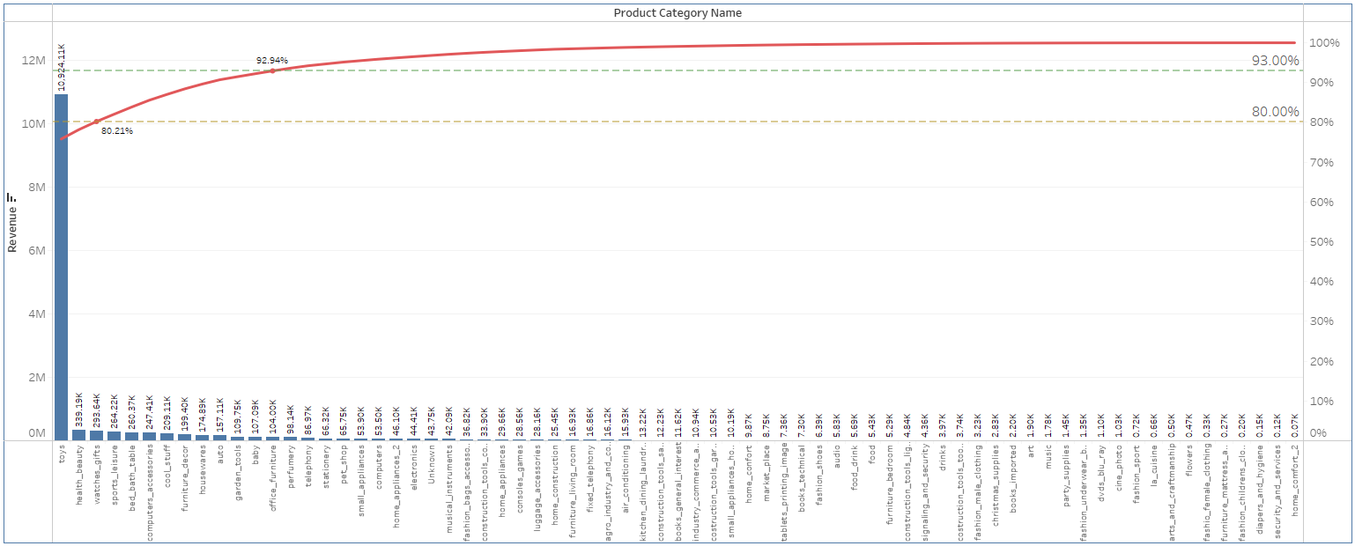
80-20 Pareto analysis
Highlights:
1. Top 13 Product Categories contribute to the cumulative revenue by nearly 93%.
2. Top 3 Product Categories contribute to the cumulative revenue by a little above 80%.

Slide 6
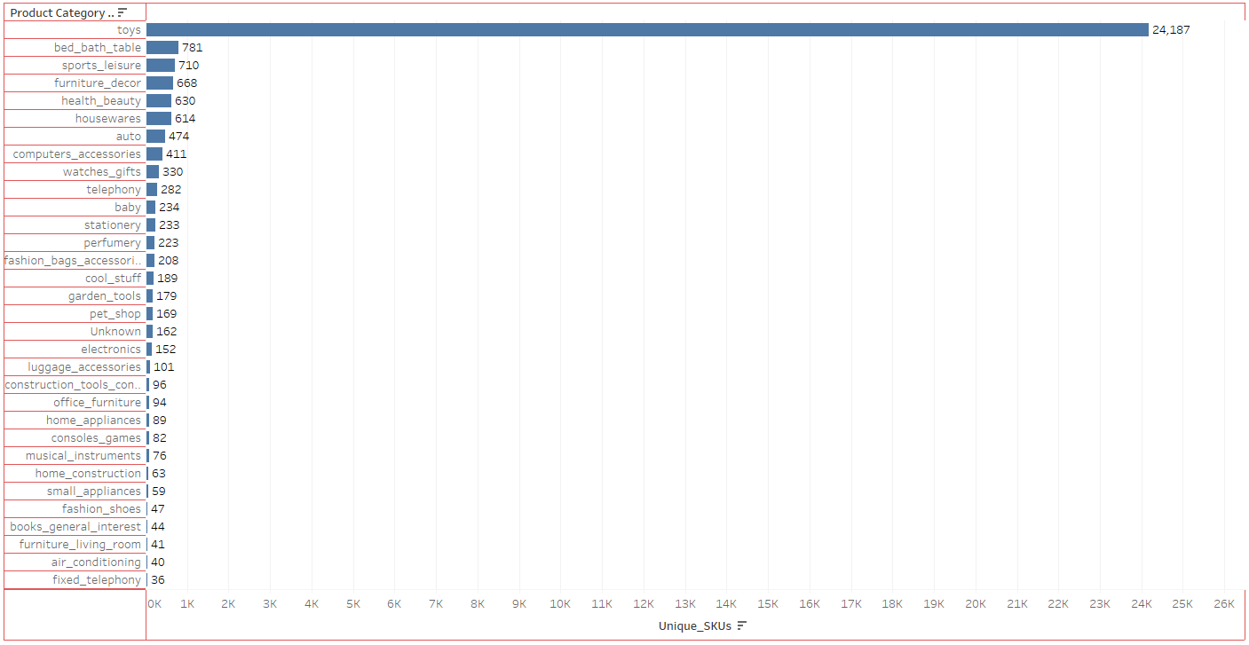
Category depth
Highlights:
1. Top 20 Product Categories in terms of SKUs have minimum 100 SKUs.
2. The highest SKUs, as high as 24,187, are in Product Category 'toys’.
3. The top 20 Product Categories except 'toys' have SKUs between 100 to 800.

Slide 7
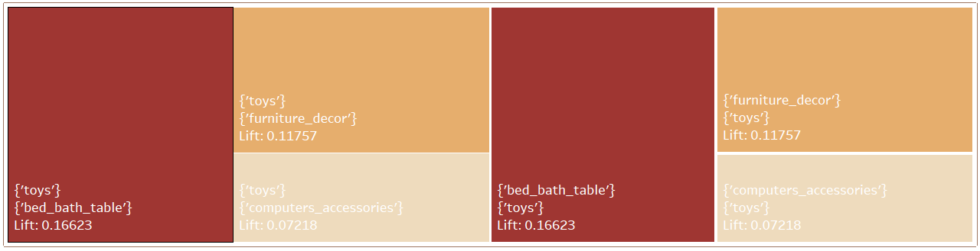
Market basket analysis
Highlights:
1. With a support threshold as 0.01, there are 10 frequently ordered itemsets with 1 item each with no associations among items.
2. With a support threshold 0.0009, there are 34 frequently ordered itemsets, with 2 itemsets having 2 items each and a few associations.
3. Highest support, confidence and lift 0.003, 0.004 and 0.166 respectively.

Slide 8
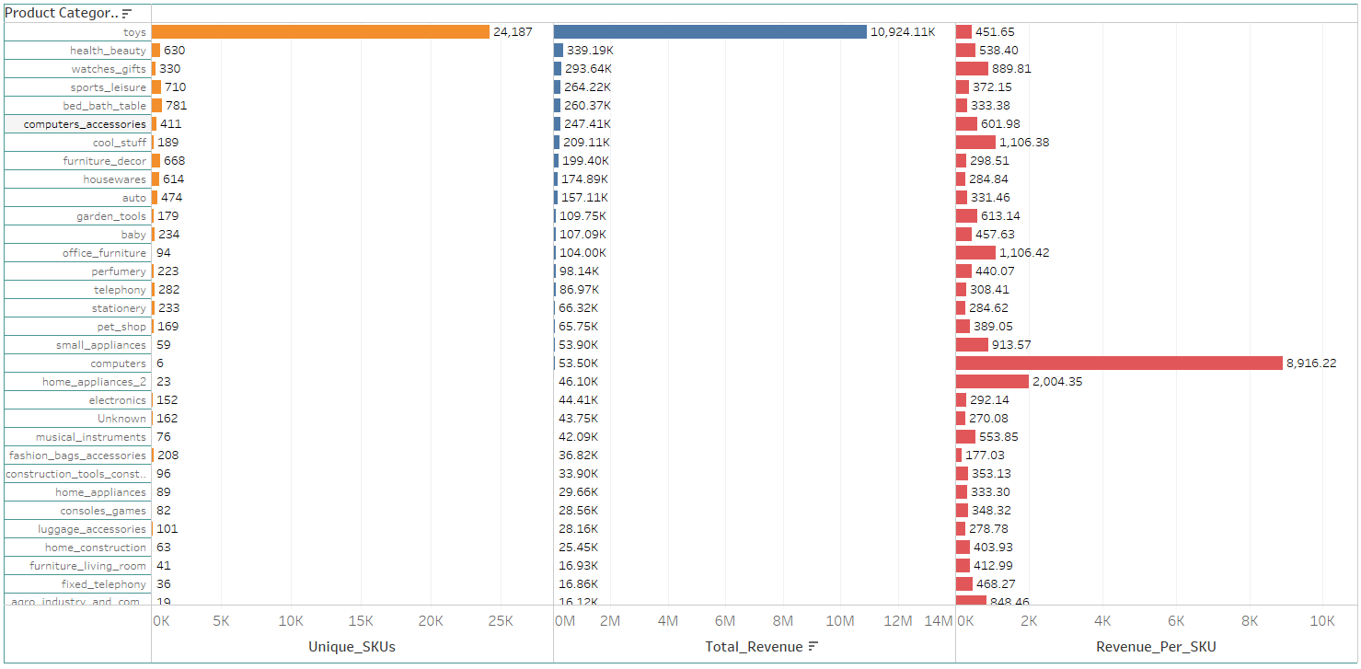
Inventory: SKUs & Revenue
Highlights:
1. SKUs with Total Revenue under 100K can be considered for Inventory Reduction, with Revenue/SKU not so high either.
2. These include perfumery, telephony, stationary, pet shop, electronics, fashion bag accessories, luggage accessories and more.

Slide 9
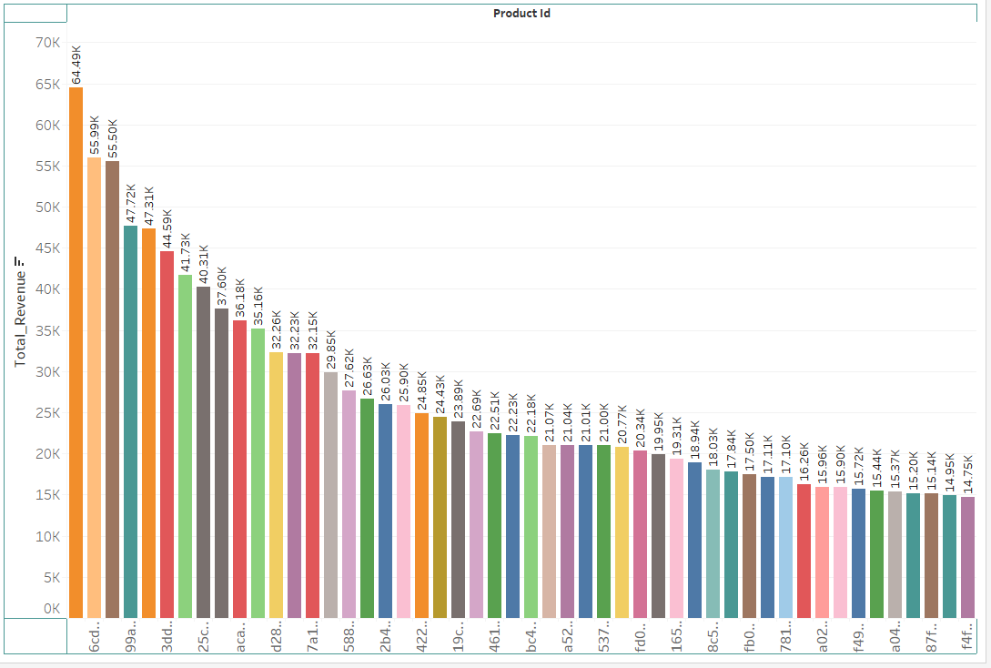
Inventory: top selling toys
Highlights:
1. Top selling SKUs in product category ‘toys’ can be kept.
2. SKUs in product category ‘toys’ with revenue less than threshold (e.g. 20K) can be discarded.

Slide 10
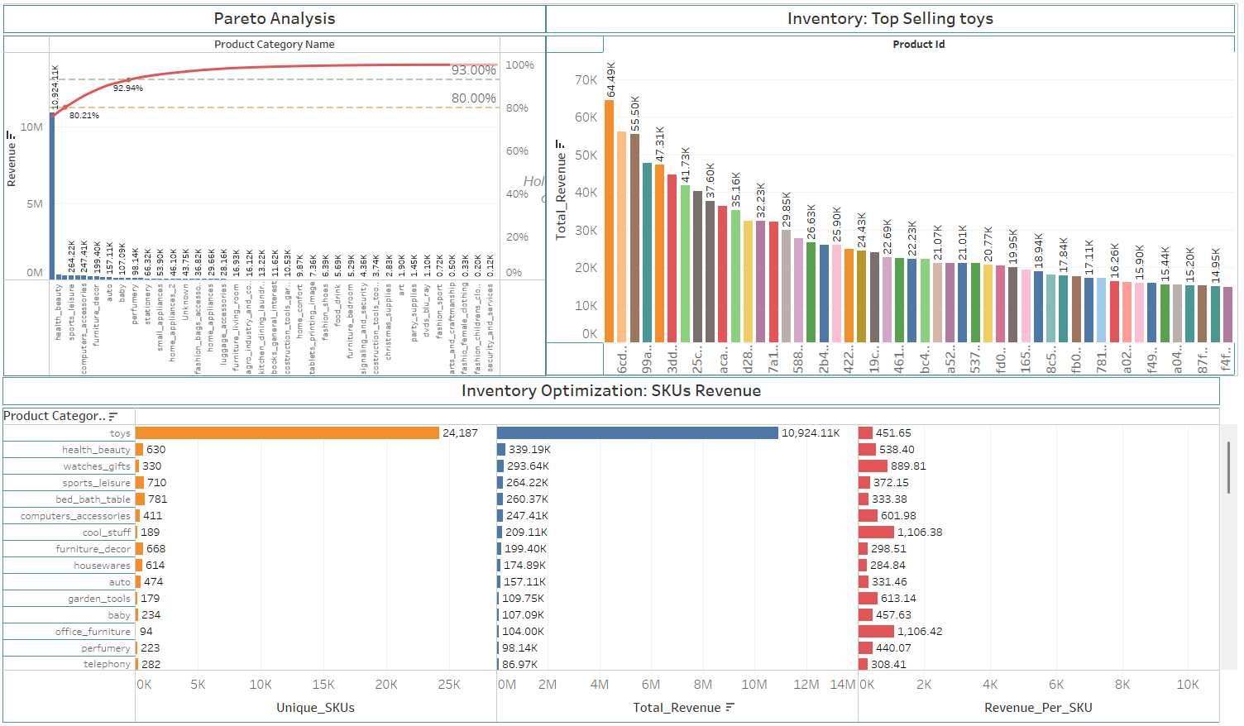
Tableau Dashboard: #1

Slide 11
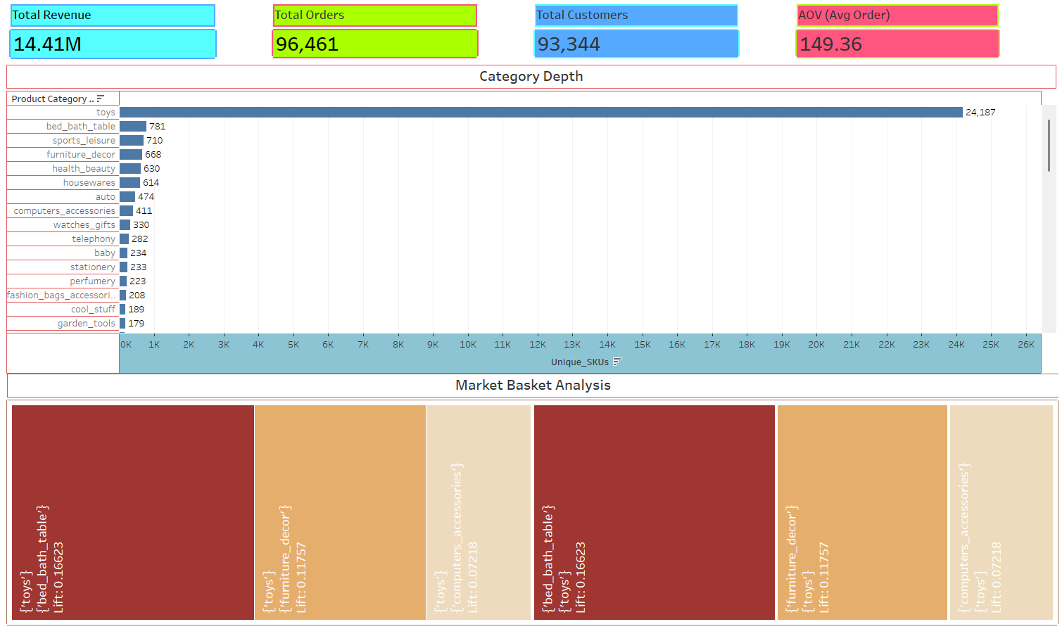
Tableau Dashboard: #2

Slide 12
Top 3 categories contribute >80% of total revenue, and top 13 categories account for ~93%. → Prioritize stock availability and supply chain for 3-5 High-Value categories. The ‘toys’ category has 24,187 SKUs, (next top 20 categories have under 800). → Keep top selling SKUs in toys and optimize shelf space. This will reduce storage cost without much impact on sales. Market basket analysis shows weak associations (max lift = 0.166). → Create product bundles (e.g. Toys + accessories, electronics + peripherals) to boost cross-sell. Categories such as perfumery, telephony, stationery, pet shop, accessories generate <100K revenue and low revenue/SKU as well. → Reduce inventory for these low-value categories.
Insights & recommendations

Slide 13
https://drive.google.com/drive/u/4/folders/1694yDfZO7pRGVSQ_KvnXp-UfP57cJTcV
Video Link

Slide 14
Thank you

