Slide 1
Database Management and Database Design Lab 4 10/21/2016

Slide 2
Transaction Stored Procedures Views

Slide 3
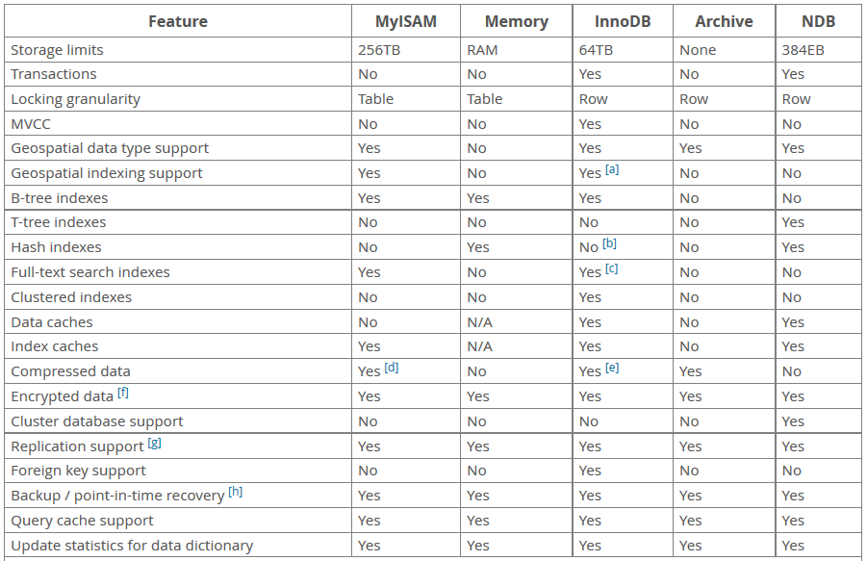

Slide 4
To support the creation of a transaction, MySQLprovides the
START TRANSACTION,
COMMIT, and
ROLLBACK statements.

Slide 5
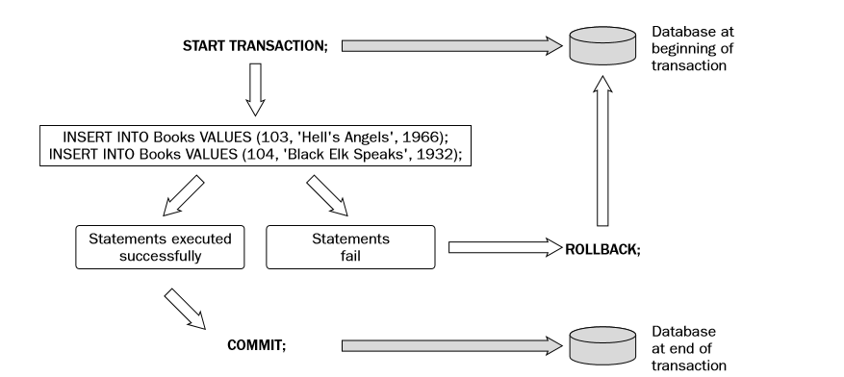

Slide 6
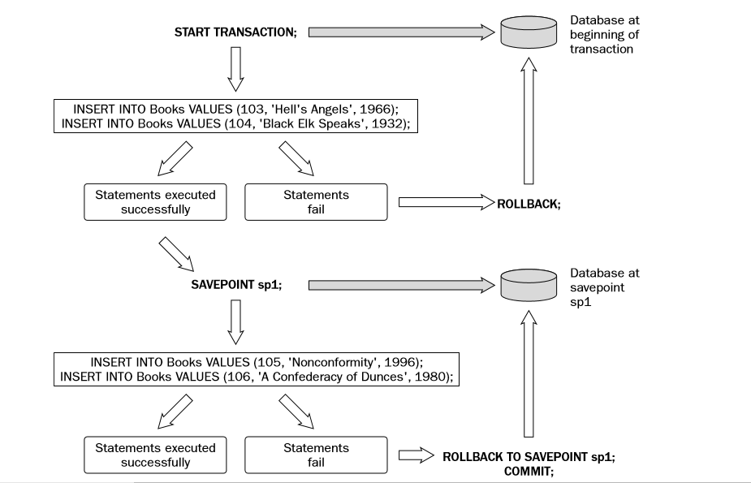

Slide 7
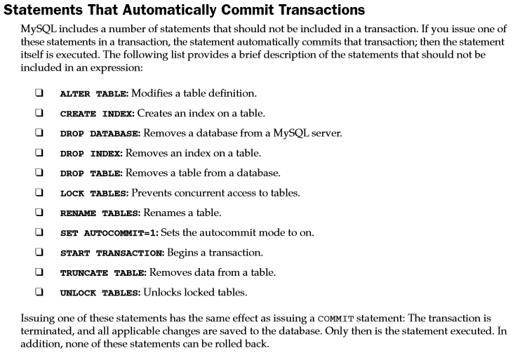

Slide 8
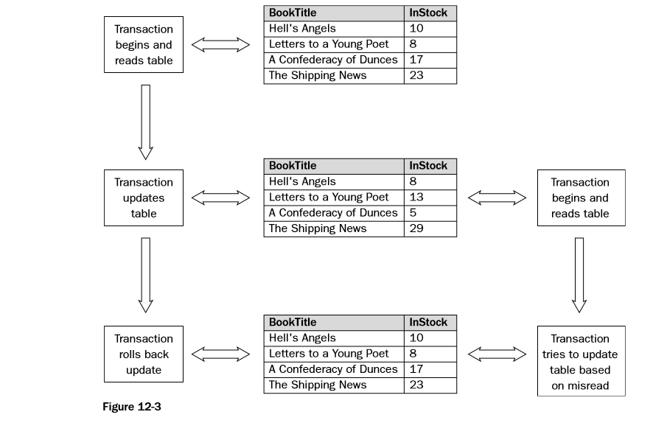
Dirty Reads

Slide 9
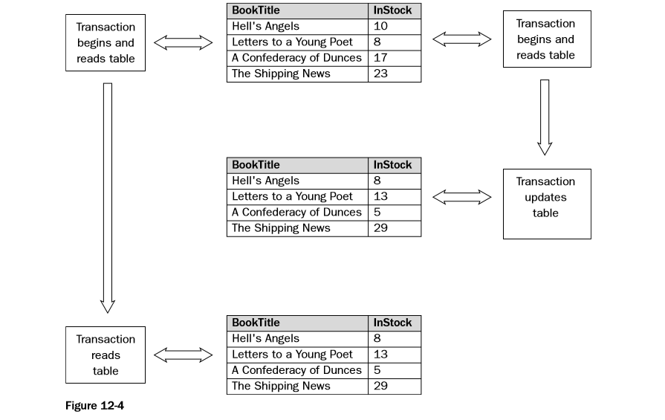
Nonrepeatable Reads

Slide 10
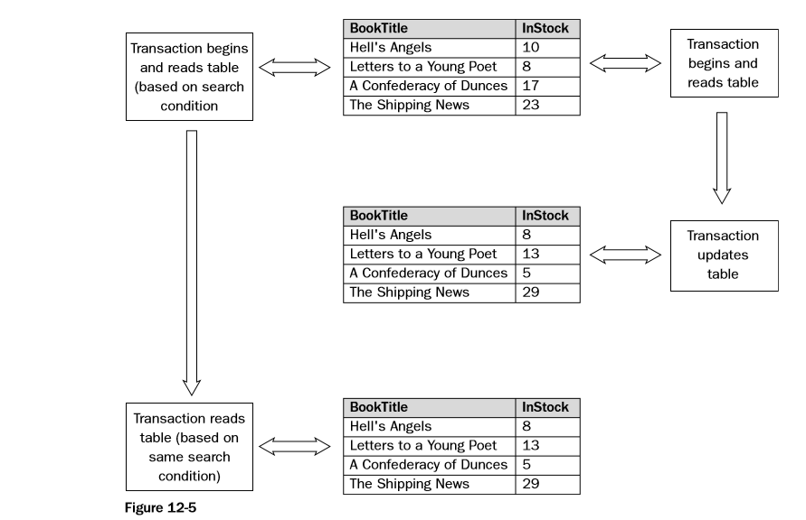
Phantom Reads

Slide 11
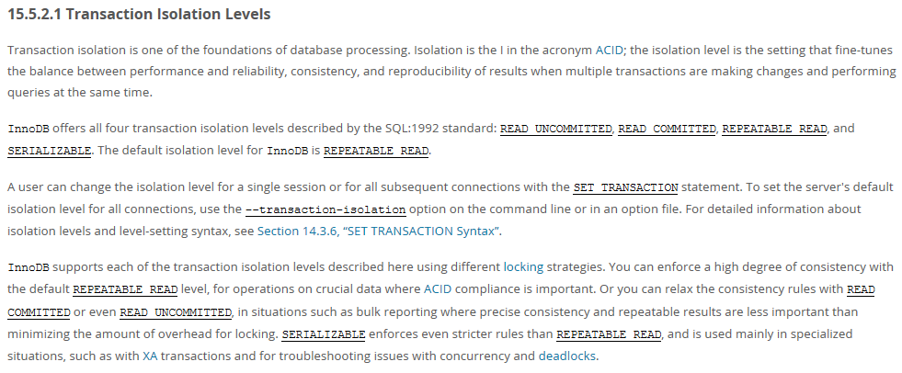

Slide 12
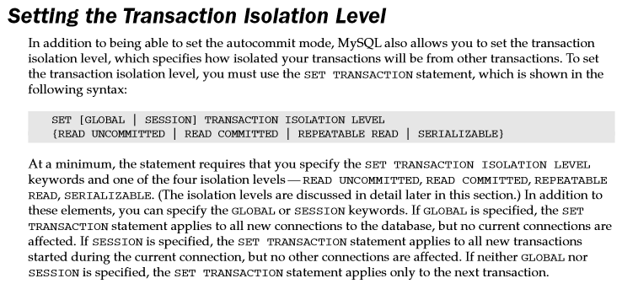

Slide 13
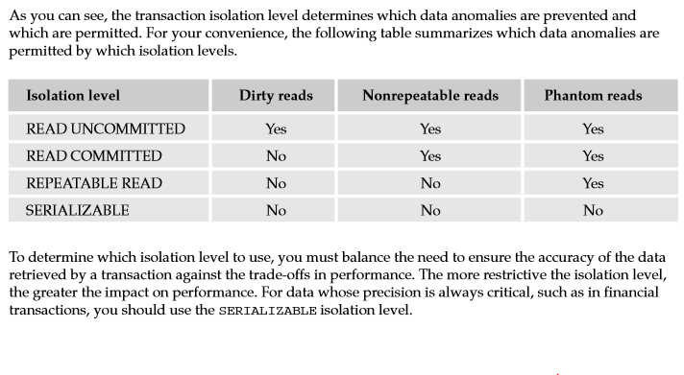

Slide 14
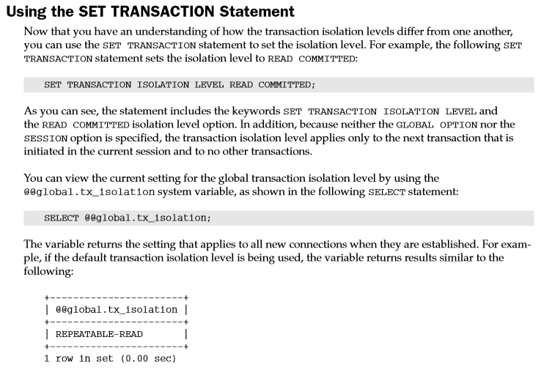

Slide 15
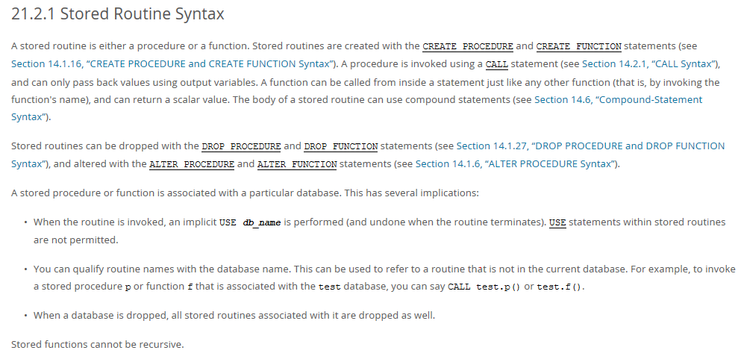

Slide 16
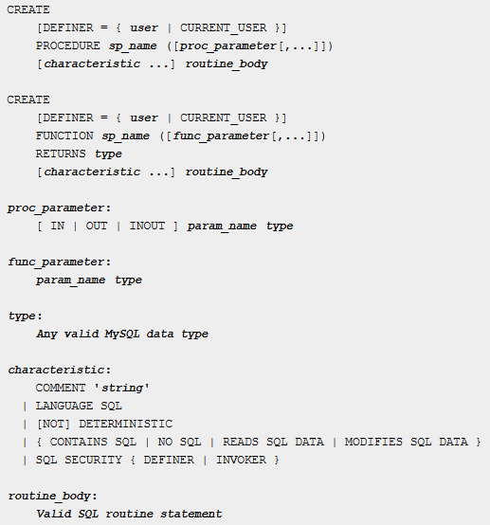

Slide 17


Slide 18


Slide 19
