Slide 1

Data warehousing – Business Intelligence
Final Project on Retail Business
Malick fairoz

Slide 2
OverView
This project involves a retail company that sells a variety of products to people and to businesses across a variety of sales channels.
The Retail Company would like to:
Create a data warehouse (DW) from its various systems of record (SORs)
Create BI applications that enable analysis of business performance
The DW will store (facts) in the following subject areas:
Sales
Inventory
Sales Quotas
Strategy Plans

Slide 3
The company details
The company has 4 sales channels:
Retail
Stores
Catalog
Online
Three top-level geographic regions:
North America
Europe
Asia
Customers who purchased products are tracked in:
Catalog
Online

Slide 4
Retail Company - SOR
Database | Business Area | dbms
Retail_SOR_NA | North America | Microsoft SQL Server
Retail_SOR_EU | Europe | MySQL
Retail_SOR_AS | Asia | PostgreSQL
Retail_SOR_CAT | Catalog | Oracle
Flat Files | Cross-unit reference data | csv, text delimited
Continent oriented SORs contain:
Sales – Store, Reseller & Online Channels data
The Catalog SOR contain:
Sales – Catalog Channel data from all three continents
All SORs contain:
Inventory
Sales Quotas
Strategy Plans
Supporting dimensions

Slide 5
Work flow process
Procuring the missing data from the Business people
Visualizing the data based on the business requirements
Understanding the Source & Destination Data Structure
Data Integration using Talend
Gathering the business requirements
Optimizing the integration to increase the performance

Slide 6
Understanding the data structure
Check the data warehouse structure and category it into Dependent and Independent tables.
Understand the data from all the source and gather only the information needed for the DW tables.
First load the tables which are completely independent in the database and finally to the fact tables.
While loading confirm the datatypes are matching on both source and destination, if not the required conversion are done in Tmap component.
The truncate the option for the destination tables are used only if it is needed.

Slide 7
Gathering Data
Not the complete data are provided in the beginning of the data integration, so while understanding the destination tables, there are few columns which has no source data, also no source data for a couple of tables.
So once it is available the data integration will be processed.
These data are gathered in flat file format as a cross reference tables to the DW.

Slide 8
Data Integration
Talend open studio is used for the data integration because of the following
Joining tables are simplified
Running parallel jobs
More features for optimizing the performance
JDBC connection for all data source
The DB and flat file connections are established and retrieved the data schema
Implemented CNTL job to generate the Job Id and date for the changes on the table, which will be used for Auditing
Implemented SCD types to track changes on the data.

Slide 9
Problems rectified
Datatype mismatch error on columns are converted
Date format and datatype conversion
Trimming data from flat file source to avoid space
Currency conversion are done with math calculation
Considered null values in the conversion code on the calculated field
Null values are replaced with hierarchy values and others
Bridge tables are used to populate data on recursion tables
Staging database are used to gather and convert data based on the destination DW

Slide 10
Optimization
Increasing the JVM ram speed specification to higher limit
Created a super job to run the certain tables in parallel and certain table in serial
Increased the number of row commit to high so that the job runs continuously
Increased the batch parallelism X4 to run the data parallelly on a single table itself
Selected only the required column from the source table
Stream and Cursor option are used in the advanced settings of the coponents
Indexes are created on the required source data columns, which can improve the select query performance

Slide 11
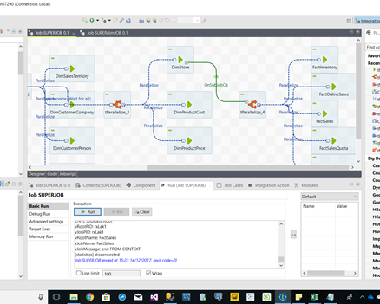
Talend JOB performance
The entire data integration process for the data warehouse took only 20 minutes to complete for 48 million records
Starting job SUPERJOB at 15:03 14/12/2017.
Job SUPERJOB ended at 15:23 14/12/2017. [exit code=0]

Slide 12
Visualization
Understanding the business requirements to generate the meaning information from the data warehouse
The loaded Data warehouse can be visualized to answer the business questions
It is done using the PowerBI, Tableau, QlikSence
The major analyzation are
Business Analysis
Reject Analysis
Talend Statistics Performance Analysis
Based on the requirements the story boards are build as delivery

Slide 13
Thank you

